Slide 1
State of Washington
Gambling Commission
Human Resource
Management Report
Plan & Align Workforce
Hire Workforce
Deploy Workforce
Reinforce Performance
Develop Workforce
[
October 2007

Slide 2
Managers’ Logic Model for Workforce Management
Outputs
Initial Outcomes
Intermediate Outcomes
Plan & Align Workforce
Articulation of managers HRM accountabilities. HR policies. Workforce planning. Job classes & salaries assigned.
Managers understand HRM accountabilities. Jobs, staffing levels, & competencies aligned with agency priorities.
Foundation is in place to build and sustain a productive, high performing workforce.
Hire
Workforce
Qualified candidate pools, interviews & reference checks. Job offers. Appts & per-
formance monitoring.
Best candidate hired & reviewed during appointment period. Successful performers retained.
The right people are in the right job at the right time.
Ultimate Outcomes
Employees are committed to the work they do & the goals of the organization
Productive, successful employees are retained
State has workforce depth & breadth needed for present and future success
Deploy
Workforce
Work assignments& requirements defined. Positive workplace environment created. Coaching, feedback, corrections.
Workplace is safe, gives capacity to perform, & fosters productive relations. Staff know job rqmts, how they’re doing, & are supported.
Time & talent is used effectively. Employees are motivated & productive.
Develop Workforce
Individual development plans. Time/ resources for training. Continuous learning environment created.
Learning environment created. Employees are engaged in develop-
ment opportunities & seek to learn.
Employees have competencies for present job & career advancement
Agencies are better enabled to successfully carry out their mission. The citizens receive efficient government services.
Reinforce Performance
Clear performance expectations linked to orgn’al goals & measures. Regular performance appraisals. Recognition. Discipline.
Employees know how performance contributes to success of orgn. Strong performance rewarded; poor performance eliminated
Successful perf is differentiated & strengthened. Employees are held accountable.

Slide 3
Standard Performance Measures
Plan & Align Workforce
Percent supervisors with current performance expectations for workforce management
Management profile
Workforce planning measure (TBD)
Percent employees with current position/competencies descriptions
Time-to-fill funded vacancies
Candidate quality
Hiring Balance (Proportion of appointment types)
Separation during review period
Percent employees with current performance expectations
Employee survey ratings on “productive workplace” questions
Overtime usage
Sick leave usage
Non-disciplinary grievances/appeals filed and disposition (outcomes)
Worker safety
Percent employees with current individual development plans
Employee survey ratings on “learning & development” questions
Competency gap analysis (TBD)
Percent employees with current performance evaluations
Employee survey ratings on “performance & accountability” questions
Disciplinary actions and reasons, disciplinary grievances/appeals filed and disposition (outcomes)
Reward and recognition practices (TBD)
Ultimate Outcomes
Hire
Workforce
Employee survey ratings on “commitment” questions
Turnover rates and types
Turnover rate: key occupational categories
Workforce diversity profile
Retention measure (TBD)
Deploy
Workforce
Develop Workforce
Reinforce Performance

Slide 4
Plan & Align Workforce
Outcomes:
Managers understand workforce management accountabilities. Jobs and competencies are defined and aligned with business priorities. Overall foundation is in place to build & sustain a high performing workforce.
Performance Measures:
Percent supervisors with current performance expectations for workforce management
Management profile
Workforce Planning measure (TBD)
Percent employees with current position/ competency descriptions
Workforce Management Expectations
Percent supervisors with current performance expectations for workforce management = 100%
Analysis:
This number represents agency employees who are in manager and supervisor positions, both exempt and classified. The count does not include the Deputy, Assistant Directors and Administrators however it is important to note they also have 100% participation in this measure. This is a clear expression of the value we place on communicating the essential framework of expectations that help individuals to succeed and to move our agency forward.
Action Steps:
Continue with current action plan of administering reasonable, meaningful and clear expectations that link with the agency mission and goals.
Total # of supervisors with current performance expectations for workforce management = 19
Total # of supervisors = 19
Management 6
Consultant 4
Policy 5
Not Assigned 0
Data as of 7/01/07]
Source: HR Data system

Slide 5
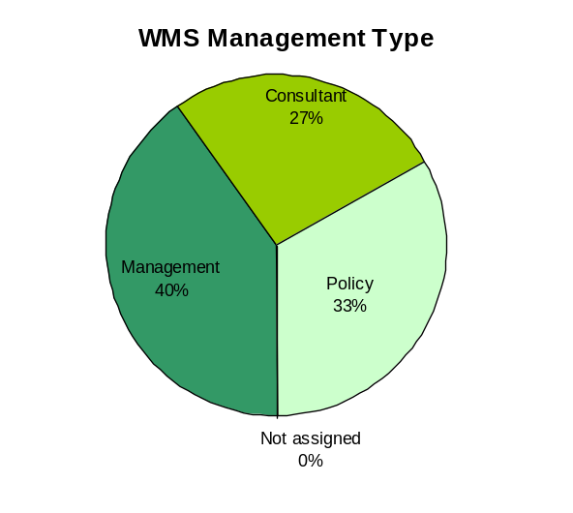
Plan & Align Workforce
Outcomes:
Managers understand workforce management accountabilities. Jobs and competencies are defined and aligned with business priorities. Overall foundation is in place to build & sustain a high performing workforce.
Performance Measures:
Percent supervisors with current performance expectations for workforce management
Management profile
Workforce Planning measure (TBD)
Percent employees with current position/ competency descriptions
Management Profile
WMS Employees Headcount = 15
Percent of agency workforce that is WMS = 8.6%
Managers* Headcount = 13
Percent of agency workforce that is Managers* = 7.4%
* In positions coded as “Manager” (includes EMS, WMS, and GS)
Analysis:
Of the 15 WMS employees, 6 are coded as manager positions, 4 are coded as consultants, and 5 are coded Policy.
Outside of WMS, there are 7 EMS managers, 3 of which are in the Special Agent class of Program Manager. The remaining 4 are Assistant Directors and Deputy Director.
The WMS profile reflects the baseline of allowable WMS staff set by DOP on 7/1/01 using a staff base of 175.
This data also enables monitoring the alignment of managers (7.4%) to staff.
Action Steps:
All WMS positions are well within the scope and definition of the Washington Management Services. There are no planned adjustments at this time.
Management 6
Consultant 4
Policy 5
Not Assigned 0
Data as of 7/01/07
Source: HR Data Systems

Slide 6
Plan & Align Workforce
Outcomes:
Managers understand workforce management accountabilities. Jobs and competencies are defined and aligned with business priorities. Overall foundation is in place to build & sustain a high performing workforce.
Performance Measures:
Percent supervisors with current performance expectations for workforce management
Management profile
Workforce Planning measure (TBD)
Percent employees with current position/ competency descriptions
Management Profile
Number of WMS employees = 15
Percent of agency workforce that is WMS = 8.6%
Number of all Managers* = 13
Percent of agency workforce that is Managers* = 7.4%
* In positions coded as “Manager” (includes EMS, WMS, and GS)
Analysis:
Analysis:
Of the 15 WMS employees, 6 are coded as manager positions. Outside of WMS, there are 7 EMS managers, 3 of which are in the Special Agent class of Program Manager. The remaining 4 are Assistant Directors and Deputy Director.
The WMS profile reflects the baseline of allowable WMS staff set by DOP on 7/1/01 using a staff base of 175.
This data also enables monitoring the alignment of managers (7.4%) to staff.
Action Steps:
All WMS positions are well within the scope and definition of the Washington Management Services. There are no planned adjustments at this time.
Manager 16
Consultant 0
Policy 0
Not Assigned 0
Data as of 9/2007
Source: HRMS Business Warehouse

Slide 7
Plan & Align Workforce
Outcomes:
Managers understand workforce management accountabilities. Jobs and competencies are defined and aligned with business priorities. Overall foundation is in place to build & sustain a high performing workforce.
Performance Measures:
Percent supervisors with current performance expectations for workforce management
Management profile
Workforce Planning measure (TBD)
Percent employees with current position/ competency descriptions
Current Position/Competency Descriptions
Percent employees with current position/competency descriptions = 93%
Analysis:
Current position/competency descriptions are an essential component in ensuring that jobs and workforce skills are properly aligned with the goals and priorities of the agency.
WSGC is close to reaching our goal to complete and or update position descriptions for all permanent positions.
Action Steps:
Increase efforts include communicating with managers/supervisors our priority on position descriptions in order to meet our goal of 100% by end of the next reporting period.
Total # of employees with current position/competency descriptions* = 65
Total # of employees* = 70
*Applies to employees in permanent positions, both WMS & GS
The agency exempt positions which include Gambling Special Agents are not counted in the above data.
Data as of 07-01-07]
Source: HRT Tracking System

Slide 8
Hire Workforce
Outcomes:
Best candidates are hired and reviewed during appointment period. The right people are in the right job at the right time.
Performance Measures
Time-to-fill vacancies
Candidate quality
Hiring Balance (proportion of appointment types)
Separation during review period
Time-to-fill / Candidate Quality
Time-to-fill Funded Vacancies
Average number of days to fill*: 59
Number of vacancies filled: 15
*Equals # of days from creation of the requisition to job offer acceptance
*Numbers represent recruitment for permanent WGS:WMS positions only.
Time Period: 7/01/06 – 6/30/07
Analysis:
Hiring data was tracked internally as the e-recruiting system was not operational in our agency. During this time period, HR was transitioning to the new rules and procedures of decentralized recruitment.
Average days to fill has decreased from 83 days the first 6 months of this period.
The average for the 12 months meets our previous goal of 60%.
Hiring managers were involved in the entire process and very satisfied with the candidate pool and ability to hire the best person for the job.
Action Steps:
We will continue monitoring the new recruitment/testing process to address problem areas and to streamline steps in our hiring procedure as needed.
Our base line is established, and a new goal is set for 45 days.
Candidate Quality
Of the candidates interviewed for vacancies, how many had the competencies (knowledge, skills & abilities) needed to perform the job?
  Number = 55 Percentage = 100%
Of the candidates interviewed, were hiring managers able to hire the best candidate for the job? Hiring managers indicating “yes”:
  Number = 15 Percentage = 100%
Time Period: 7/01/06 – 6/30/07
Data as of 7/01/07
Source: HR Data Systems

Slide 9
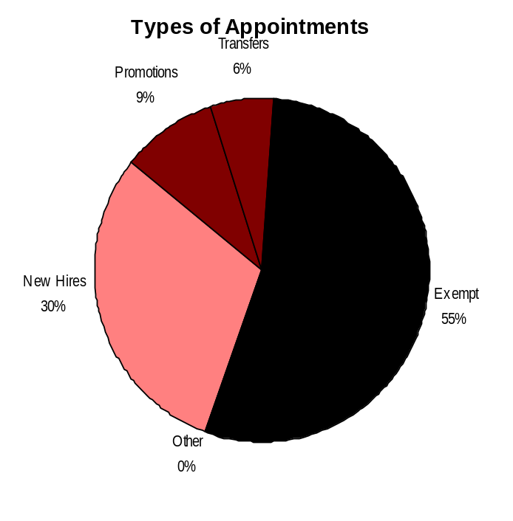
Hire Workforce
Outcomes:
Best candidates are hired and reviewed during appointment period. The right people are in the right job at the right time.
Performance Measures
Time-to-fill vacancies
Candidate quality
Hiring Balance (proportion of appointment types)
Separation during review period
Hiring Balance / Separations During Review Period
Analysis:
The pie chart reflects the total hiring balance during a 12-month period ending 6-30-07. It shows permanent appointments made to vacant permanent and exempt positions in the categories listed
The agency made 10 probationary appointments, 3 promotions and 2 transfer appointments to either GS or WMS positions.
Exempt appointments include 6 new hires, 4 internal promotions and 8 transfers.
There were no separations during trial, probationary or review periods. This is a positive reflection of successful hiring and testing practices.
Action Steps:
Continue partnering with hiring supervisors/ managers on competency based hiring and testing, selection.
Continue emphasis on training and coaching employees during probationary periods.
Continue with exit interviews for assessment.
Total number of appointments = 33*
Time period = 7/2006 through 6/2007
Includes appointments to permanent vacant positions only; excludes reassignments
“Other” = Demotions, re-employment, reversion & RIF appointments
Separation During Review Period
Probationary separations - Voluntary 0
Probationary separations - Involuntary 0
  Total Probationary Separations 0
Trial Service separations - Voluntary 0
Trial Service separations - Involuntary 0
  Total Trial Service Separations 0
Total Separations During Review Period 0
Time period = 7/2006 through 6/2007
Data as of 7/01/07
Source: HR Data Systems

Slide 10
Deploy Workforce
Outcomes:
Staff know job expectations, how they’re doing, & are supported. Workplace is safe, gives capacity to perform, & fosters productive relations. Employee time and talent is used effectively. Employees are motivated.
Performance Measures
Percent employees with current performance expectations
Employee survey ratings on “productive workplace” questions
Overtime usage
Sick leave usage
Non-disciplinary grievances/appeals filed and disposition (outcomes)
Worker safety
Current Performance Expectations
Percent employees with current performance expectations = 93%*
Analysis:
This measure is determined by whether Part 1 of the employee’s PDP is current. This means documented performance expectations that are measurable and clearly linked to the goals of the agency.
Our high completion rate reflects on our agency emphasis in this area that aligns with competency identification.
Action Steps:
The higher percentage reflects completion only. A complete review of each PDP will tell us if expectations set forth in the performance plan are in measurable terms or generally stated.
Continue to train where needed and support agency priorities in all areas of position descriptions through evaluations.
Continue with goal of 100% completion.
*Based on 65 of 70 reported employee count.
Applies to employees in permanent positions, both WMS & GS
Data as of 7/01/07
Source: HR Data Systems

Slide 11
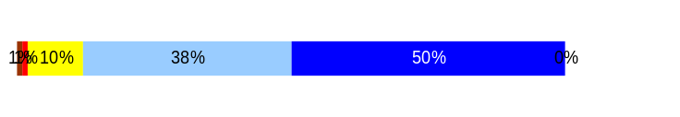
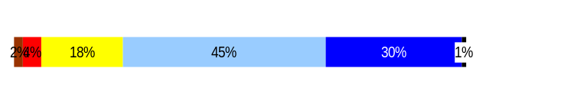
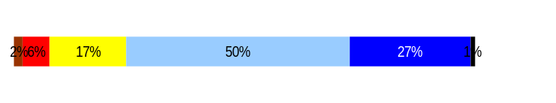
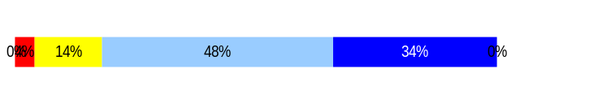
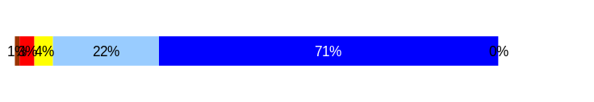
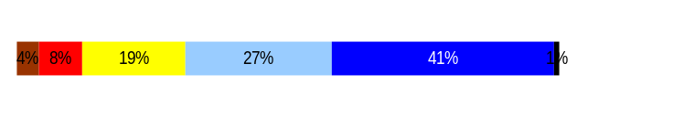
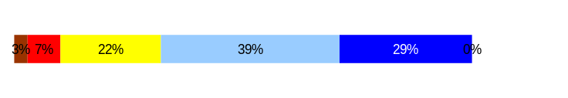
Deploy Workforce
Outcomes:
Staff know job expectations, how they’re doing, & are supported. Workplace is safe, gives capacity to perform, & fosters productive relations. Employee time and talent is used effectively. Employees are motivated.
Performance Measures
Percent employees with current performance expectations
Employee survey ratings on “productive workplace” questions
Overtime usage
Sick leave usage
Non-disciplinary grievances/appeals filed and disposition (outcomes)
Worker safety
Deploy Workforce
Outcomes:
Staff know job expectations, how they’re doing, & are supported. Workplace is safe, gives capacity to perform, & fosters productive relations. Employee time and talent is used effectively. Employees are motivated.
Performance Measures
Percent employees with current performance expectations
Employee survey ratings on “productive workplace” questions
Overtime usage
Sick leave usage
Non-disciplinary grievances/appeals filed and disposition (outcomes)
Safety and Workers Compensation (TBD)
Employee Survey “Productive Workplace” Ratings
Avg
Analysis:
The highest scoring question #7, reflects our agency values and creates an environment of respect, productivity and a safe workplace.
Q2. Expectations are generally clear but it is unknown how that is conveyed and in what form.
Q6. With the agency supporting training, proper equipment and information sharing, the numbers are relatively high but should be even higher.
Q8. Feedback is often solicited but may not be used a manner consistent with this question – “does it help to improve performance”?
Q.9 Recognition for a job well done is 68% overall satisfactory which could be better.
Our agency was among the top scoring agencies which met to provide best practices to the Governor.
Action Steps:
Clarity on competencies and agreed to performance measures and evaluations should improve lower productivity ratings.
Continued use of our new performance tools and training where needed will show improvement.
Performance management confirmation will help address job performance recognition.
4.3
Q4. I know what is expected of me at work.
Q1. I have opportunity to give input on decisions affecting my work.
Q2. I receive the information I need to do my job effectively.
Q6. I have the tools and resources I need to do my job effectively.
Q7. My supervisor treats me with dignity and respect.
Q8. My supervisor gives me ongoing feedback that helps me
improve my performance.
Q9. I receive recognition for a job well done.
4.0
4.0
4.1
4.6
3.9
3.9
Never
Seldom
Occasionally
Usually
Always
[
Overall average score for Productive Workplace Ratings: 4.1%
]
Data as of 7/01/07
Source: DOP Employee Survey

Slide 12
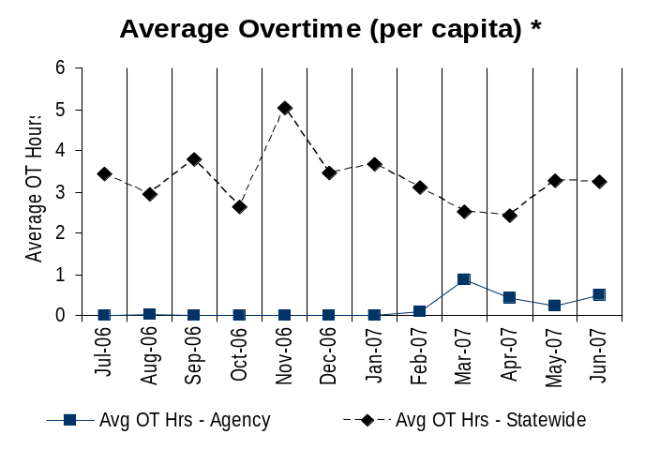
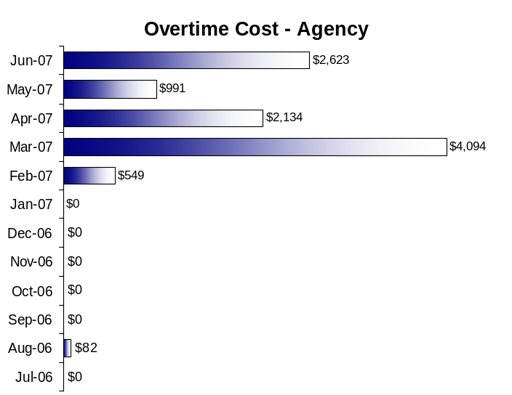
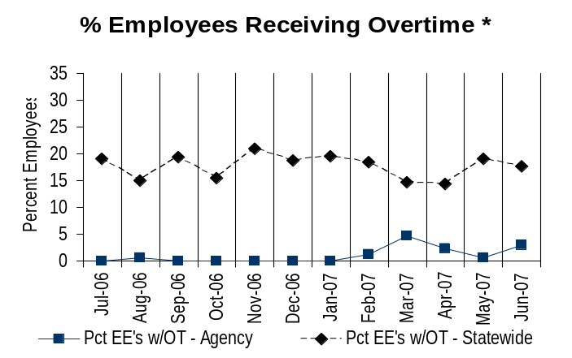
Deploy Workforce
Outcomes:
Staff know job expectations, how they’re doing, & are supported. Workplace is safe, gives capacity to perform, & fosters productive relations. Employee time and talent is used effectively. Employees are motivated.
Performance Measures
Percent employees with current performance expectations
Employee survey ratings on “productive workplace” questions
Overtime usage
Sick leave usage
Non-disciplinary grievances/appeals filed and disposition (outcomes)
Worker safety
Overtime Usage
Overall agency avg overtime usage – per capita, per month: .18**
*Statewide overtime values do not include DNR
**Overall agency avg overtime usage – per capita, per month = sum of monthly OT averages divided by number of months
Analysis:
Total overtime for this 12 month period was $10,473.
There was a noticeable increase from Feb through Jun 07. The majority of this overtime was authorized for licensing staff to complete backlog on specific files with a workload peak in March 07.
All overtime was project directed and short term.
Our agency is well below the statewide average.
Action Steps:
Continue to track overtime costs, while closely monitoring usage.
Overall agency avg employees receiving overtime per month: 1.02%**
*Statewide overtime values do not include DNR
**Overall agency avg employees receiving overtime per month = sum of monthly OT percentages divided by number of months
Data as of 7/01/07
Source: Business Warehouse

Slide 13
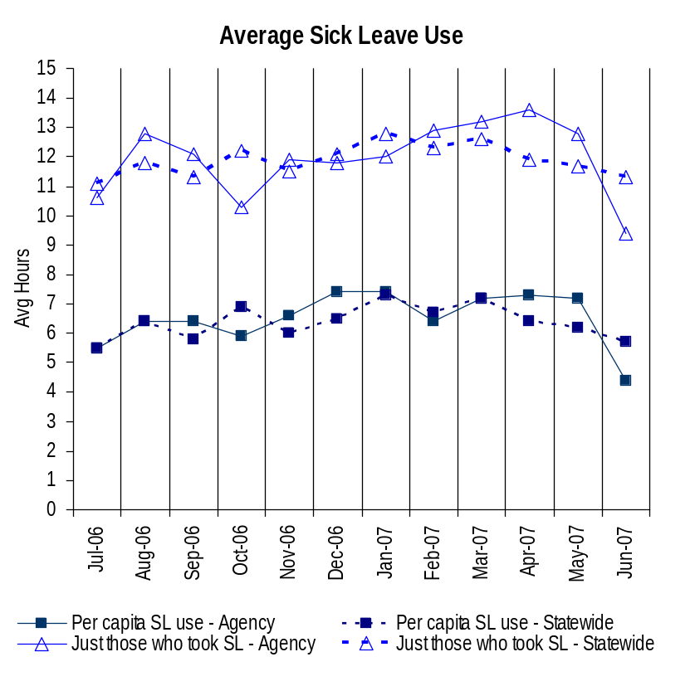
Deploy Workforce
Outcomes:
Staff know job expectations, how they’re doing, & are supported. Workplace is safe, gives capacity to perform, & fosters productive relations. Employee time and talent is used effectively. Employees are motivated.
Performance Measures
Percent employees with current performance expectations
Employee survey ratings on “productive workplace” questions
Overtime usage
Sick leave usage
Non-disciplinary grievances/appeals filed and disposition (outcomes)
Worker safety
Sick Leave Usage
Analysis:
The graph shows that our agency has been consistent in our average use of sick leave and comparable to statewide statistics of 11.9 hrs.
The graph provides only raw data and does not show the reasons for sick leave use.
Action Steps:
Monitor in house FMLA use and the impact it has on sick leave use.
Promote wellness programs and positive support in the workplace
Take corrective steps when abusive is suspected.
Sick Leave Hrs Used / Earned (per capita)
Avg Hrs SL Used (per capita) - Agency | % of SL Hrs Earned (per capita) - Agency
6.5 Hrs | 84.2%
Avg Hrs SL Used (per capita) – Statewide* | % of SL Hrs Earned (per capita) – Statewide*
6.4 Hrs | 82.5%
Sick Leave Hrs Used / Earned (those who took SL)
Avg Hrs SL Used (those who took SL) - Agency | % SL Hrs Earned (those who took SL) - Agency
11.9 Hrs | 149.2%
Avg Hrs SL Used (those who took SL) – Statewide* | % SL Hrs Earned (those who took SL) – Statewide*
11.9 Hrs | 148.4%
Sick Leave time period = 7/2007 through 6/2007
* Statewide data does not include DOL, DOR, L&I, and LCB
Source: Business Warehouse

Slide 14
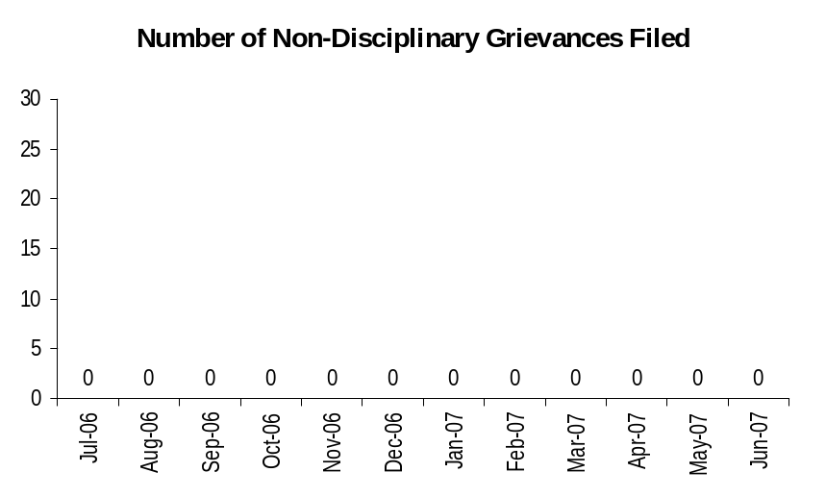
Deploy Workforce
Outcomes:
Staff know job expectations, how they’re doing, & are supported. Workplace is safe, gives capacity to perform, & fosters productive relations. Employee time and talent is used effectively. Employees are motivated.
Performance Measures
Percent employees with current performance expectations
Employee survey ratings on “productive workplace” questions
Overtime usage
Sick leave usage
Non-disciplinary grievances/appeals filed and disposition (outcomes)
Worker safety
Non-Disciplinary Grievances (represented employees)
The Washington State Gambling is a non-represented agency and does not have a grievance procedure.
Non-Disciplinary Grievances
None
* There may not be a one-to-one correlation between the number of grievances filed (shown top of page) and the outcomes determined during this time period. The time lag between filing date and when a decision is rendered can cross the time periods indicated.
Data as of 7/01/07
Source: DOP

Slide 15
Deploy Workforce
Outcomes:
Staff know job expectations, how they’re doing, & are supported. Workplace is safe, gives capacity to perform, & fosters productive relations. Employee time and talent is used effectively. Employees are motivated.
Performance Measures
Percent employees with current performance expectations
Employee survey ratings on “productive workplace” questions
Overtime usage
Sick leave usage
Non-disciplinary grievances/appeals filed and disposition (outcomes)
Worker safety
Non-Disciplinary Appeals (mostly non-represented employees)
Filings for DOP Director’s Review
Time Period = 7/2006 through 6/2007
0 Job classification
0 Rule violation
0 Name removal from register
0 Rejection of job application
0 Remedial action
0 Total filings
Filings with Personnel Resources Board
Time Period = 7/2006 through 6/2007
0 Job classification
0 Other exceptions to Director Review
0 Layoff
0 Disability separation
0 Non-disciplinary separation
0 Total filings
Non-Disciplinary appeals only are shown above.
There is no one-to-one correlation between the filings shown above and the outcomes displayed in the charts below. The time lag between filing date and when a decision is rendered can cross the time periods indicated.
Total outcomes = 0
Time Period = 7/2006 through 6/2007
Total outcomes = 0
Time Period = 7/2006 through 6/2007
Source: Dept of Personnel

Slide 16
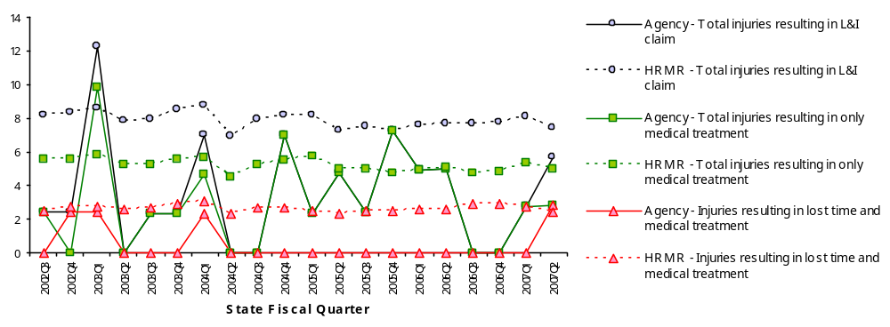
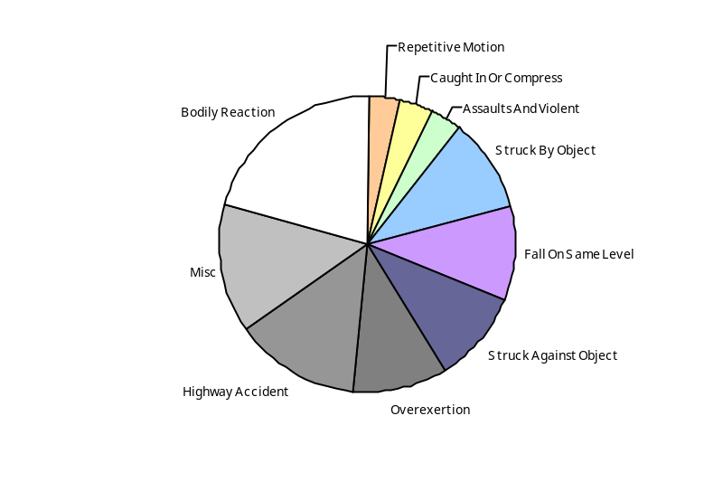
Deploy Workforce
Outcomes:
Staff know job expectations, how they’re doing, & are supported. Workplace is safe, gives capacity to perform, & fosters productive relations. Employee time and talent is used effectively. Employees are motivated.
Performance Measures
Percent employees with current performance expectations
Employee survey ratings on “productive workplace” questions
Overtime usage
Sick leave usage
Non-disciplinary grievances/appeals filed and disposition (outcomes)
Worker safety
Deploy Workforce
Outcomes
Staff know job expectations, how they’re doing, & are supported. Workplace is safe, gives capacity to perform, & fosters productive relations. Employee time and talent is used effectively. Employees are motivated.
Performance Measures
Percent employees with current performance expectations
Employee survey ratings on 'productive workplace' questions
Overtime usage
Sick leave usage
Non-disciplinary grievances/appeals filed and disposition outcomes
Worker Safety
Worker Safety: Gambling Commission, Washington State
Analysis:
In 2007, the rate of injuries resulting in an L&I claim was 5.65 FTEs in Quarter 2, up from 2.79 in Quarter 1, and 0 during 2006 Quarters 3 & 4.
Injuries resulting in only medical treatment also increased slightly from 2.79 FTEs in Quarter 1 to 2.82 .
The rate of injuries resulting in lost time and medical treatment was 2.82 FTEs. This is an increase over the rate of 0 during the preceding 12 quarters.
Action Plan:
Conduct further analysis to determine the root cause of injuries, particularly in the categories: 14% miscellaneous, 14% highway accident, and 21% bodily reaction.
Analysis will assist with injury prevention through targeted efforts such as education and awareness.
Allowed Annual
Claims Rate*^:
Agency vs. All HR
Management Report
(HRMR) agencies
*Annual claims rate
is # claims / 100 FTE
1 FTE = 2000 hours
^Due to natural lag
in claim filing, rates
are expected to
increase significantly
over time
Injuries by Occupational
Injury and Illness
Classification (OIICS)
event:
For fiscal period 2002Q3
through 2007Q2
(categories under 3% or not
adequately coded are grouped
into 'misc.')
Oiics Code | Oiics Description | Percent | Number
61 | Assaults And Violent | 3% | 1
21 | Bodily Reaction | 21% | 6
03 | Caught In Or Compress | 3% | 1
13 | Fall On Same Level | 10% | 3
41 | Highway Accident | 14% | 4
- | Misc | 14% | 4
22 | Overexertion | 10% | 3
23 | Repetitive Motion | 3% | 1
01 | Struck Against Object | 10% | 3
02 | Struck By Object | 10% | 3
Source: Labor & Industries, Research and Data Services (data as of 09/03/2007 )

Slide 17
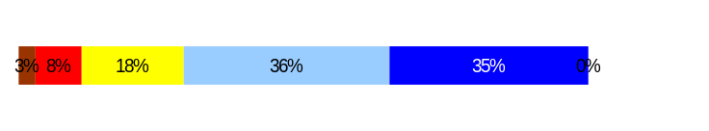
Develop Workforce
Outcomes:
A learning environment is created. Employees are engaged in professional development and seek to learn. Employees have competencies needed for present job and future advancement.
Performance Measures
Percent employees with current individual development plans
Employee survey ratings on “learning & development” questions
Competency gap analysis (TBD)
Develop Workforce
Outcomes:
A learning environment is created. Employees are engaged in professional development and seek to learn. Employees have competencies needed for present job and future advancement.
Performance Measures
Percent employees with current individual development plans
Employee survey ratings on “learning & development” questions
Competency gap analysis (TBD)
Individual Development Plans
Percent employees with current individual development plans = 79%*
Analysis:
The number of IDPs has increased during the last 6 months and are seen as a critical step in full performance management. One can see the correlation between percentage of IDPs and the survey questions on this topic. However, what we don’t know from this data is what other areas of influence might add or detract from the survey findings. For instance on Q.5, are promotional, transfer and rotational opportunities or desired training considered in responses.
Action Steps:
IDPs have been in use for a short time and believing that their impact is significant in training and development planning, the new survey ratings should reflect their use during the next cycle.
Improvement is also expected with continued performance coaching to enhance performance feedback between the employee and supervisor.
Total # of employees with current IDPs* = 65
Total # of employees* = 70
*Applies to employees in permanent positions, both WMS & GS
Employee Survey “Learning & Development” Ratings
Employee Survey “Learning & Development” Ratings
Q5. I have opportunities at work to learn and grow.
Q8. My supervisor gives me ongoing feedback that helps me
improve my performance.
Avg
3.9
3.9
Overall avg score for Learning & Development Ratings: [XX]
Overall average score for Learning & Development Ratings: 3.9%
Data as of 7/01/07
Source: HR Data Systems & DOP Employee Survey

Slide 18
Reinforce Performance
Outcomes:
Employees know how their performance contributes to the goals of the organization. Strong performance is rewarded; poor performance is eliminated. Successful performance is differentiated and strengthened. Employees are held accountable.
Performance Measures
Percent employees with current performance evaluations
Employee survey ratings on “performance and accountability” questions
Disciplinary actions and reasons, disciplinary grievances/appeals filed and disposition (outcomes)
Reward and recognition practices (TBD)
Current Performance Evaluations
Percent employees with current performance evaluations = 79%*
Analysis:
Our agency-wide performance evaluation completion rate is slightly higher than the previous period. This count is for WMS and GS staff only.
Managers are reminded of their workforce management responsibilities and are held accountable for fulfilling those responsibilities. This is fundamental to human resource management.
Action Steps:
Continue with our current transition plan moving to annual evaluations due by 12/31/07.
Expectations of 100% completion will be communicated to supervisors/managers during the annual evaluation period.
Total # of employees with current performance evaluations* = 55
Total # of employees* = 70
*Applies to employees in permanent positions, both WMS & GS
The agency exempts including Gambling Special Agents are not counted in the above data.
Data as of 7/01/07
Source: HR Tracking Systems

Slide 19
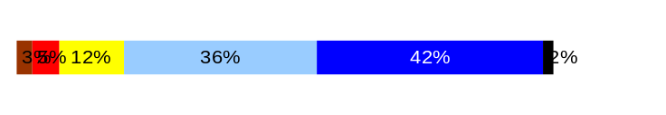
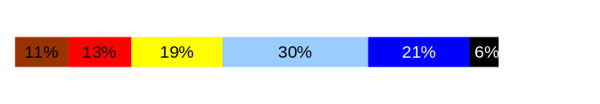
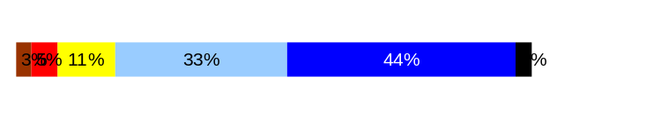
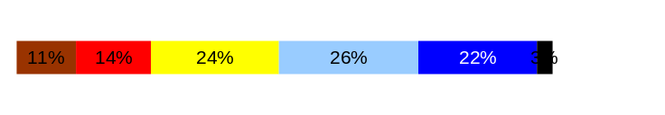
Reinforce Performance
Outcomes:
Employees know how their performance contributes to the goals of the organization. Strong performance is rewarded; poor performance is eliminated. Successful performance is differentiated and strengthened. Employees are held accountable.
Performance Measures
Percent employees with current performance evaluations
Employee survey ratings on “performance and accountability” questions
Disciplinary actions and reasons, disciplinary grievances/appeals filed and disposition (outcomes)
Reward and recognition practices (TBD)
Reinforce Performance
Outcomes:
Employees know how their performance contributes to the goals of the organization. Strong performance is rewarded; poor performance is eliminated. Successful performance is differentiated and strengthened. Employees are held accountable.
Performance Measures
Percent employees with current performance evaluations
Employee survey ratings on “performance and accountability” questions
Disciplinary actions and reasons, disciplinary grievances/appeals filed and disposition (outcomes)
Reward and recognition practices (TBD)
Employee Survey “Performance & Accountability” Ratings
Avg
Analysis:
The highest average is found in Q3 and Q11. Combined data shows confidence and accountability of employees’ work efforts towards meeting agency goals.
Q 9 and Q10 relates to the significance of knowing performance results and whether staff are acknowledged and rewarded for good performance. The implied link of awards to performance could be the reason this average is lower than the typically higher satisfaction rate in awards and recognition in general. The responses in Q9.may have been due in part because there is no monetary or award for a high performer immediately at evaluation time. Despite this, our agency was among the highest in the state on these two questions.
Action Steps:
Performance expectation and evaluation refresher training will be developed and conducted for the agency. This should increase the levels of understanding and increase completion rates.
Our agency is working toward performance confirmation which, if received, will allow a new practice of establishing a pay for performance program.
Q3. I know how my work contributes to the goals of my agency.
Q10. My performance evaluation provides me with meaningful information about my performance.
Q11. My supervisor holds me and my co-workers accountable for performance.
Q9. I receive recognition for a job well done.
4.1
3.4
4.1
3.3
Never
Seldom
Occasionally
Usually
Always
Overall average score for “Performance & Accountability” ratings: 3.7
Data as of 7/01/07
Source: HR Data Systems

Slide 20
Reinforce Performance
Outcomes:
Employees know how their performance contributes to the goals of the organization. Strong performance is rewarded; poor performance is eliminated. Successful performance is differentiated and strengthened. Employees are held accountable.
Performance Measures
Percent employees with current performance evaluations
Employee survey ratings on “performance and accountability” questions
Disciplinary actions and reasons, disciplinary grievances/appeals filed and disposition (outcomes)
Reward and recognition practices (TBD)
Formal Disciplinary Actions
Disciplinary Action Taken
Time period = [mm/yy] through [mm/yy]
Dismissals | 0
Demotions | 0
Suspensions | 1
Reduction in Pay* | 0
Total Disciplinary Actions* | 1
Analysis:
The agency had one formal disciplinary action during this period.
Action Steps:
Hold employees accountable by administering fair and equitable corrective and disciplinary actions.
Continuing to address employee performance difficulties by early correction whenever possible.
Take definitive disciplinary action when circumstances warrant.
* Reduction in Pay is not currently available in HRMS/BW.
Data as of 7/01/07
Source: HR Data Systems

Slide 21
Reinforce Performance
Outcomes:
Employees know how their performance contributes to the goals of the organization. Strong performance is rewarded; poor performance is eliminated. Successful performance is differentiated and strengthened. Employees are held accountable.
Performance Measures
Percent employees with current performance evaluations
Employee survey ratings on “performance and accountability” questions
Disciplinary actions and reasons, disciplinary grievances/appeals filed and disposition (outcomes)
Reward and recognition practices (TBD)
Disciplinary Grievances and Appeals
Disciplinary Grievances
(Represented Employees)
Disciplinary Appeals
(Non-Represented Employees
filed with Personnel Resources Board)
Time Period = 07/06 through 06/07
0 Dismissal
0 Demotion
0 Suspension
0 Reduction in salary
0 Total Disciplinary Appeals Filed with PRB
Total # Disciplinary Grievances Filed: 0
There is no one-to-one correlation between the filings shown above and the outcomes displayed in the charts below. The time lag between filing date and when a decision is rendered can cross the time periods indicated.
Disposition (Outcomes) of Disciplinary Grievances
Time period = 7/06 through 6/07
Time period = NA
Disposition (Outcomes) of Disciplinary Appeals*
Time period = 7/06 through 6/07
The Gambling Commission had no appeals during this period.
*Outcomes issued by Personnel Resources Board
Data as of 7/01/07
Source: HR Data Systems

Slide 22

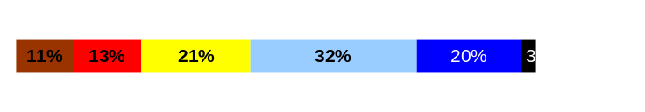
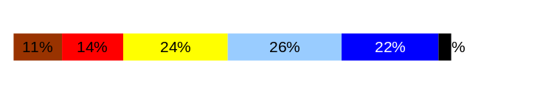
ULTIMATE OUTCOMES
Employees are committed to the work they do and the goals of the organization
Successful, productive employees are retained
The state has the workforce breadth and depth needed for present and future success
Performance Measures
Employee survey ratings on “commitment” questions
Turnover rates and types
Turnover rate: key occupational categories
Workforce diversity profile
Retention measure (TBD)
Employee Survey “Employee Commitment” Ratings
Avg
Analysis:
Q3. Our agency strategic plan is clear about our goals and the projects assigned to complete these goals. Cross-agency teams help to develop a sense of ownership and relationship to our work.
Q12. The lower scores on how we measure our agency success seem to be a result of our performance measures being less visible and understood.
Q9. One way that recognition is linked to our job performance is through teams. Yet, individual recognition may not be meaningful, timely or relevant.
Action Steps:
Q3. Competency training will serve to create a more solid link between our mission and goals to job duties and performance.
Q12.Performance measures are being revised to ensure clear and consistent communication which will increase knowledge agency wide.
Q9. A survey tool or manager analysis will be developed to formulate the best recognition selections/options for staff.
Q3. I know how my work contributes to the goals of my agency.
Q12. I know how my agency measures its success.
Q9. I receive recognition for a job well done.
4.1
3.4
3.3
Never
Seldom
Occasionally
Usually
Always
Overall average score for Employee Commitment ratings: 3.6%
Data as of 7/01/07
Source: DOP Employee Survey

Slide 23
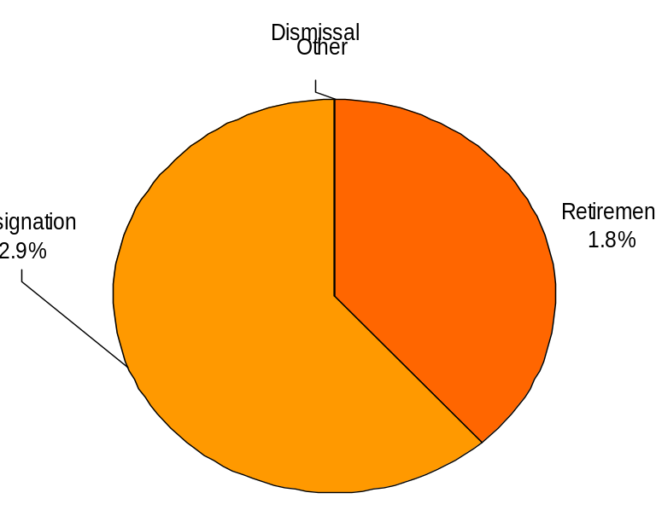
ULTIMATE OUTCOMES
Employees are committed to the work they do and the goals of the organization
Successful, productive employees are retained
The state has the workforce breadth and depth needed for present and future success
Performance Measures
Employee survey ratings on “commitment” questions
Turnover rates and types
Turnover rate: key occupational categories
Workforce diversity profile
Retention measure (TBD)
Turnover Rates
Total % Turnover (leaving state)
Time Period: 07/01/06 through 07/01/07
Analysis:
8 staff left state service during FY07: 5 resignations & 3 retirements.
Of the 5 resignations (62.5%), 1 promoted to other employment outside the agency. Four (%) staff left employment for other reasons.
The 3 retirements (37.5%) were part of our succession planning.
This 4.7% 12- month turnover rate is unchanged for the same period in 2005 and 6.4% less than the state rate of 11.1% within the same timeframe.
Action Steps:
Turnover is at a reasonable rate – no corrective action is required.
Exit interviews will continue to be used as an evaluation tool with appropriate follow-up as needed.
Total Turnover Actions: 8
Total % Turnover: 4.7%
Note: Movement to another agency is currently not available in HRMS/BW
Data as of 7/01/07
Source: HR Data Systems

Slide 24
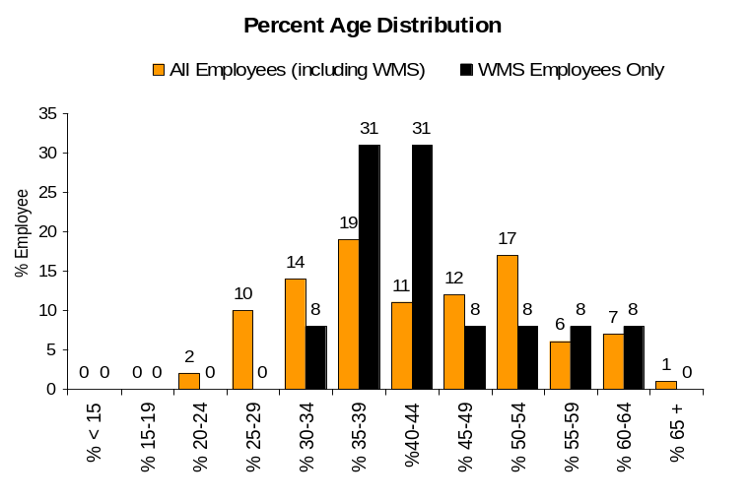
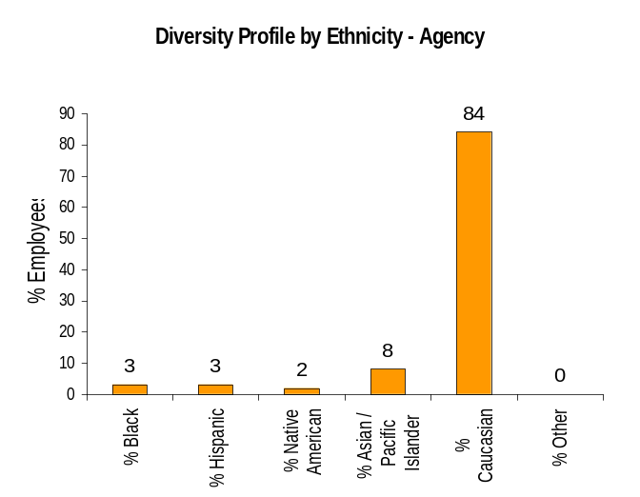
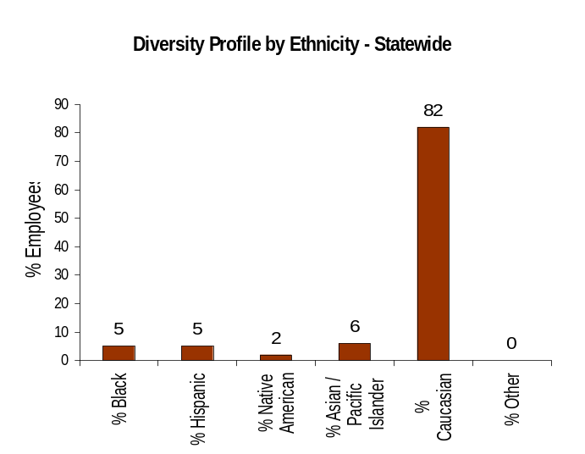
ULTIMATE OUTCOMES
Employees are committed to the work they do and the goals of the organization
Successful, productive employees are retained
The state has the workforce breadth and depth needed for present and future success
Performance Measures
Employee survey ratings on “commitment” questions
Turnover rates and types
Turnover rate: key occupational categories
Workforce diversity profile
Retention measure (TBD)
Workforce Diversity Profile
Agency State
Female 49% 53%
Disabled 2% 5%
Vietnam Vet 7% 7%
Disabled Vet 2% 2%
People of color 16% 18%
Persons over 40 54% 75%
Analysis:
During FY07, we appointed 15 new staff into the agency. The diversity profile for the 15 includes: 10 Female, 1 Native American; 3 Asian/Pacific Islander; and 8 +40. During the 1st quarter, of FY 08, we hired 2 additional staff not yet reflected in this data. The diversity profile for the 2 includes: 1 Female; 1 Native American and 1 Black.
During FY07, a total of 8 staff left the agency/state. The diversity profile for these individuals included: 6 Female; 1 Asian/Pacific Islander and 3 +40.
Action Steps:
Continue to do outreach and diversity career fairs that enrich our candidate pool of qualified, diverse employees.
Data as of 7/01/07
Source: HRMS BW

