Slide 1
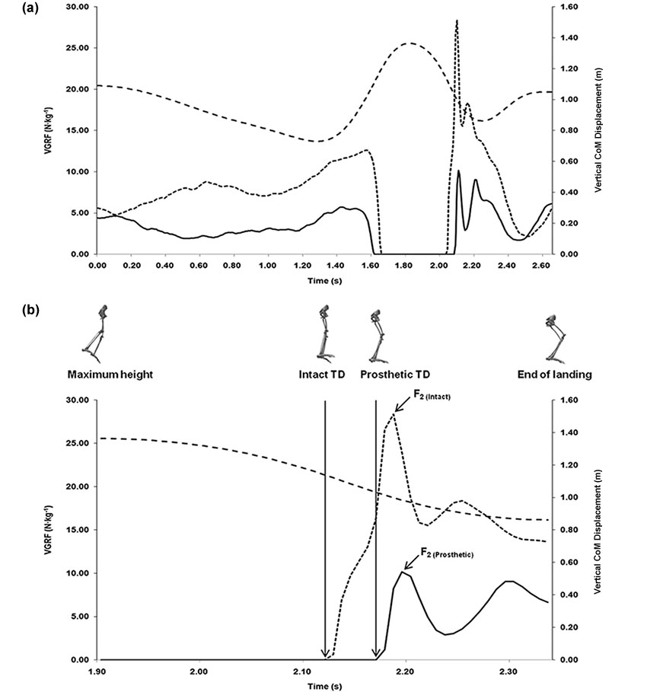

Figure 1. Illustration of vertical ground reaction force (VGRF) and center of mass (CoM) during (a) whole countermovement jump and (b) zoomed into landing phase for TTA₃. Reported maximum peaks (F₂) are shown by downward arrows. Figure demonstrates largest delay in touchdown (TD) and asymmetrical loading between intact and prosthetic side for illustrative purposes. TTA = participant with transtibial amputation.
Schoeman M, Diss CE, Strike SC. Asymmetrical loading demands associated with vertical jump landings in people with unilateral transtibial amputation. J Rehabil Res Dev. 2013;50(10):1435–48.
http://dx.doi.org/10.1682/JRRD.2012.10.0199
ResearcherID/ORCID: Marlene Schoeman, PhD: G-4112-2011
Notes:
Figure 1. Illustration of vertical ground reaction force (VGRF) and center of mass (CoM) during (a) whole countermovement jump and (b) zoomed into landing phase for TTA3. Reported maximum peaks (F2) are shown by downward arrows. Figure demonstrates largest delay in touchdown (TD) and asymmetrical loading between intact and prosthetic side for illustrative purposes. TTA = participant with transtibial amputation.

