Slide 1

Credit coring
A Help to Low Income Customers
Presented by
Larry Nowicki
Manager, Regulatory Compliance
Thursday, June 16, 2005

Slide 2
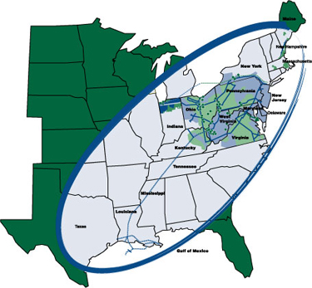
ABOUT NISOURCE
Fortune 500 holding company headquartered in Merrillville, Indiana.
15 subsidiary companies engage in natural gas transmission, storage & distribution as well as electric generation, transmission & distribution.
Deliver energy to more than 3.7 million customers in high energy corridor stretching from the Gulf Coast through the Midwest to New England.
Over 16,000 miles of interstate transmission pipeline; 55,000 miles of distribution pipeline.
Over 9,000 employees.
Income from continuing operations of $430 million in 2004.
Notes:
Mike

Slide 3
ABOUT NISOURCE

