Slide 1

Certification
Christina Linder
Director of Certification
CPLinder@sde.idaho.gov

Slide 2
HQT Statistics
 | 2005-6 | 2006-7 | 2007-8
% of HQT Teachers Reported | 99.33% | 70.30% | 93.06%

Slide 3
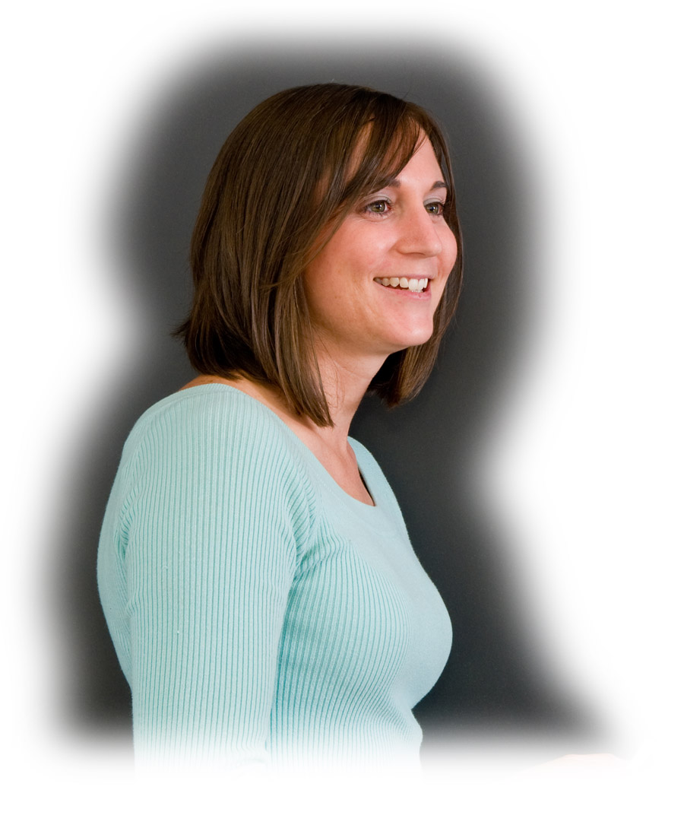
HQT Paths
HQT is established by:
Verifiable major (minimum 30 credits) in content area
Masters in content area
NBPTS Certification in content area
Praxis II Content Test successfully passed
Verifiable HOUSSE rubric completed prior to June 30, 2008
  As of June 30, 2008, HOUSSE was no longer available EXCEPT in certain cases pertaining to Special Ed or
  Rural Districts

Slide 4
100% HQT, or …
2008-2009 - Focus on using Title IIA funds for assisting teachers to this end. Possible loss of state funding.
2009-2010 - Loss of funding: Complete alignment between state funding and federal HQT guidelines established
(No HQT = No $$$)

Slide 5
How we can help…
Better tools to match teachers and assignments
Early and ongoing assistance with alternate routes
Full-time Coordinator to provide technical assistance in professional development planning and identification of resources
Proposed alternate route to endorsement

Slide 6
Proposed Alternate Route to Endorsement
Teachers who will be/are teaching in a content area for which they do not currently hold an endorsement may be eligible
Endorsements added via:
  National Board Certification; or
  Praxis II + supervised teaching; or
  Praxis II + pedagogical performance evaluation + supervised teaching

Slide 7
Adopted Change in Code/Rule
Professional Development – Final language approved by Board for approval in 2009 Legislative session
Fingerprinting/Background Check – Final language from negotiated rulemaking set for August Board approval and approval in 2009 Legislative session

Slide 8
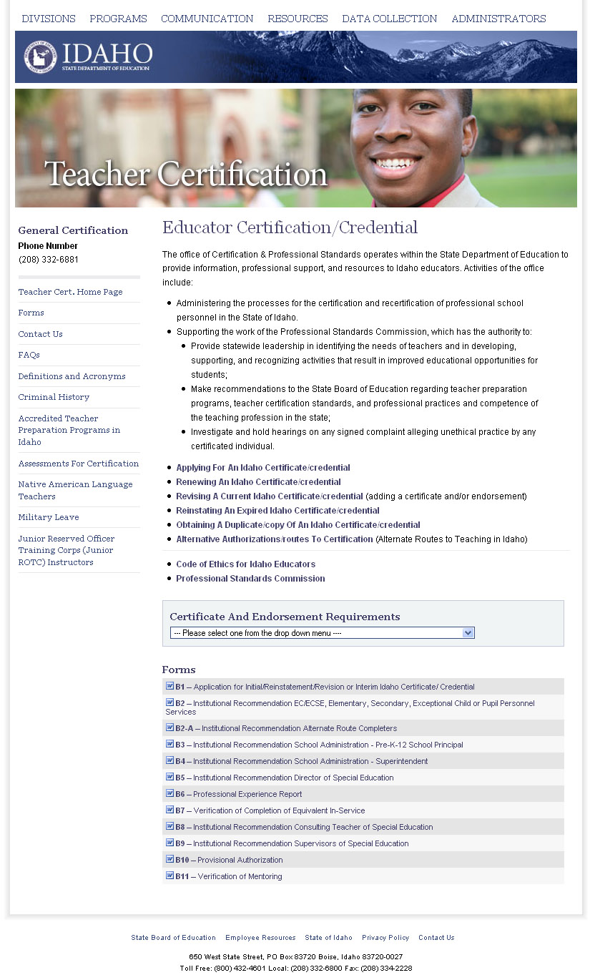
Updated Certification Information

