Slide 1

Washington State
Board of Industrial Insurance Appeals
Human Resource Management Report
2006 Annual Report
October 2006

Slide 2
Human Resource Management Report - Reporting Process
GMAP
Managers’ evaluations includes HR Management Report results
Agency internal GMAP sessions include HR Management Report presentation
Agency director communicates workforce management and HR Management Report expectations & measures to managers
Managers collect and report data for HR Management Report performance measures
Agency Director has agency-wide data analysis and reports prepared
Agency Director presents selected portions of HR Management Report at agency’s assigned Governor’s GMAP forums
Agency HR Office assists managers in data collection, analysis, report preparation
Quarterly reporting to DOP of agency-tracked standard measures
Copy to DOP of agency-internal GMAP reports on HR management as they are done
DOP presents enterprise-wide HR Management Report at Governor’s GMAP forums on Government Efficiency
Base set of data
Quarterly statewide updates
Special request data
DOP collects statewide data and conducts overall analysis
DOP provides agency with centrally available data analysis queries & consultation
DOP submits annual comprehensive statewide status report to Governor & Directors

Slide 3
Human Resource Management Report - Reporting Timeline
Government Efficiency GMAP on enterprise HR Management Report
Government Efficiency GMAP on enterprise HR Management Report
Government Efficiency GMAP on enterprise HR Management Report
Government Efficiency GMAP on enterprise HR Management Report
DOP provides with base set of centrally available data & queries for standard performance measures
DOP sends statewide data update to agencies
DOP sends statewide data update to agencies
DOP sends statewide data update to agencies
DOP sends statewide data update to agencies
Dec 05 | Jan 06 | Feb 06 | Mar 06 | Apr 06 | May 06 | June 06 | July 06 | Aug 06 | Sept 06 | Oct 06 | Nov 06 | Dec 06
Agencies report selected “agency-tracked” HR Mgmt Report standard measures to DOP*
Agencies report selected “agency-tracked” HR Mgmt Report standard measures to DOP*
Agencies report selected “agency-tracked” HR Mgmt Report standard measures to DOP*
Agency Directors communicate “workforce management” performance expectations, measures, and reporting process requirements to their managers
DOP delivers comprehensive first annual report statewide human management status to Governor
Agency-internal GMAP sessions on HR Management Report
* “Agency-tracked” means certain HR Management Report data that must be tracked by each agency because it is not available in the central system.
** In addition, agencies send copies of their internal GMAP reports on HR Management Report to DOP as they are completed.

Slide 4
Priorities of Government
Plan the Organization
Managers’ Accountability for Strategic Workforce Management
Strategic Plan
Mobilize Resources
Deliver Services
Manage Financial Resources
Manage Human Resources
Manage Business Processes
Manage Relation-
ships
Achieve Public Value & Benefit
Managers have five primary workforce management functions:
Manage Human Resources
Plan & Align Workforce
Hire Workforce
Deploy Workforce
Reinforce Performance
Develop Workforce

Slide 5
Agency Managers’ Logic Model for Workforce Management
Key Outputs
Initial Outcomes
Intermediate Outcomes
Articulation of managers HR performance accountabilities. HR policies. Job & competency analyses. Workforce plan. Positions classified, salaries assigned.
Workforce levels, competencies, & strategies are aligned with agency priorities
Managers’ accountabilities are communicated & understood
Foundation in place to build and sustain a productive, high performing workforce
Plan & Align Workforce
Hire Workforce
Qualified candidate pools, interviews & backgrounding. Job offers. Appointments and initial performance monitoring.
Best qualified hired & reviewed during appointment period
The right people are in the right job at the right time
Work assignments& requirements defined. Positive workplace environment & relations created. Coaching, feedback, corrections.
Workplace is safe, gives capacity to perform, fosters productive relations
Employees know job requirements, how they’re doing, & are supported
Time & talent is used effectively. Employees are motivated & productive.
Deploy Workforce
Develop Workforce
Individual development plans. Time/ resources for training. Continuous learning environment created.
Learning environment created. Employees are engaged in develop-
ment opportunities & seek to learn.
Employees have competencies for present job & career advancement
Clear performance expectations linked to organizational goals & measures. Regular performance appraisals. Recognition. Discipline.
Employees know how their performance contributes to success of organization. Strong performance rewarded; poor performance eliminated
Successful performance is differentiated & strengthened. Employees are held accountable.
Reinforce Performance
Ultimate Outcomes
Agencies have workforce depth & breadth needed for present and future success
Employees are committed to the work they do & the goals of the organization
Productive, successful employees are retained
Agency is enabled to successfully carry out its mission. The citizens receive efficient, cost-effective government services.
Notes:
Notes:
This is an abbreviated version of the logic model for agency managers’ HRM accountabilities. NOTE - these are the outcomes for agency managers, not the HR office. The role of the HR office is to guide and support managers in achieving these outcomes.

Slide 6
Human Resource Management Report
Standard Performance Measures
Plan & Align Workforce
Percent current position/competencies descriptions [agency tracking system]
Percent supervisors with current performance expectations for workforce management [agency tracking system]
Time-to-fill funded vacancies [agency tracking system]
Percent satisfaction with candidate quality [agency tracking system]
New Hire-to-Promotional ratio [DOP Data/Business Warehouse]
Percent turnover during review period [DOP Data/Business Warehouse]
Percent employees with current performance expectations [agency tracking system]
Employee survey ratings on “productive workplace” questions [DOP standard survey]
Leave usage (sick, LWOP, unscheduled leave) [DOP Data/Business Warehouse]
Overtime usage [DOP Data/Business Warehouse]
Number & type of non-disciplinary grievances [agency tracking system]
Percent employees with current annual individual development plans [agency tracking system]
Employee survey ratings on “learning/development” questions [DOP standard survey]
Percent current performance evaluations [agency tracking system]
Employee survey ratings on “performance accountability” questions [DOP standard survey]
Number/type of disciplinary issues, actions, appeals disposition [agency tracking system]
Turnover rates and types (e.g., retirement, resignation, etc.) [DOP Data/Business Warehouse]
Turnover rate of key occupational categories and of workforce diversity [DOP Data/Business Warehouse]
Employee survey ratings on “commitment” questions [DOP standard survey]
Hire Workforce
Measures to add in the future:
Current workforce plans that align staff with business priorities
Safety and Workers Compensation measures
Competency gap analysis measure
Recognition/reward measure
Others to be determined
Deploy Workforce
Develop Workforce
Reinforce Performance
Ultimate Outcomes

Slide 7
Overall foundation & management accountability system to build & sustain high performing workforce
Plan & Align Workforce |
HR Management Report category:
Plan & Align - Slide 1 of 1
HR Management Report
(preliminary standard measures)
Percent current position/competency descriptions
Percent supervisors with current performance expectations for workforce management
Percent positions with current job and competency descriptions
  92% of our 154 employees have current job descriptions
Percent supervisors with current performance expectations for workforce management
100% of BIIA supervisors have performance expectations for workforce management outlined in their current Performance Development Plans.
Notes:
Notes:
Plan & Align Workforce is the foundation for the remaining four key HRM functions.
Ideally, each agency should have a comprehensive workforce plan that aligns staffing levels and competencies with business priorities, and identifies strategies to close workforce gaps. Most agencies do not have a workforce plan (a key reason WA did not get an A on Grading of the States). A future action step is to institute workforce planning in the state.
Right now, as a starting point, managers need to know what their HRM responsibilities and performance expectations are. This includes an understanding of the master agreement provisions and new HR policies. Of the XX agencies with represented employees that responded to our inquiry, XX had trained the majority of their managers on those provisions.
Next, a management accountability system needs to be in place. At this point, our best measure is whether managers are receiving performance evaluations. However, what needs to happen is implementation of the Managers HRM Report Card, so that those meaasures are incorporated in the evaluations.

Slide 8
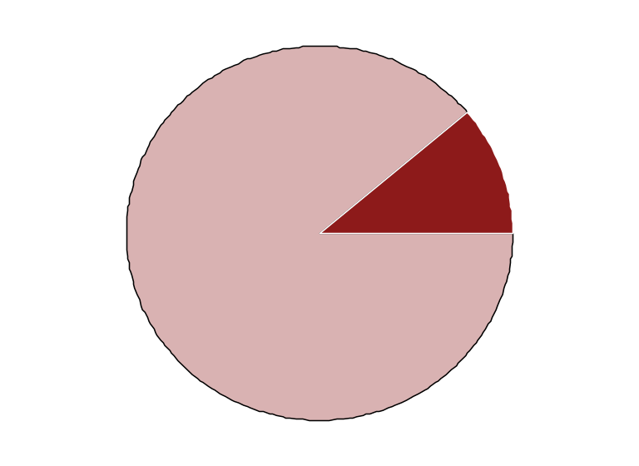
Hire Workforce |
HR Management Report category:
Right People in the Right Job at the Right Time
HR Management Report
(standard measures)
Days to fill vacancies (from requisition to appointment)
% satisfaction with candidate quality
% new hires; % promotional hires
Retention/dismissal rate during review period
Hire Workforce - Slide 1 of 1
Board of Industrial Insurance Appeals
Hiring Balance - FY 2006 (9 Total Hires)
Candidate Quality
(managers’ satisfaction rating)
This information will be gathered through the new E-Recruiting System and will be reported after the new system is put in place.
Inter-agency Promotions (1)
New Hires (8)
Days to Fill Vacancies
This information will be gathered through the new E-Recruiting System and will be reported after the new system is put in place.
Separation during Review Period
There was one employee that failed to complete the probationary period. The separation occurred during FY 2006
*
Notes:
Notes:

Slide 9
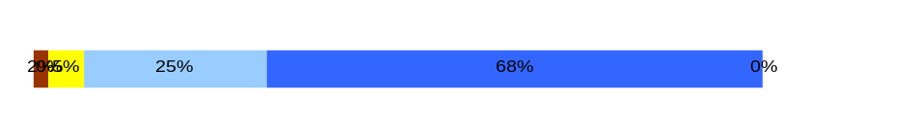
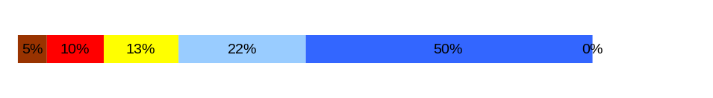
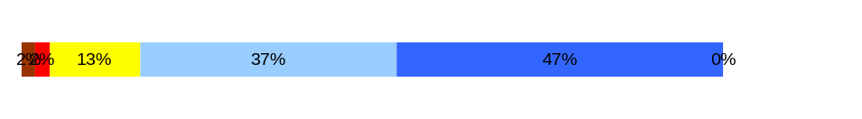
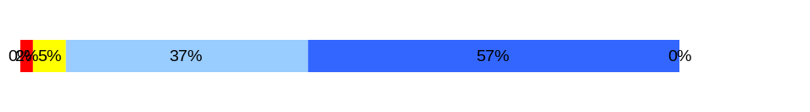
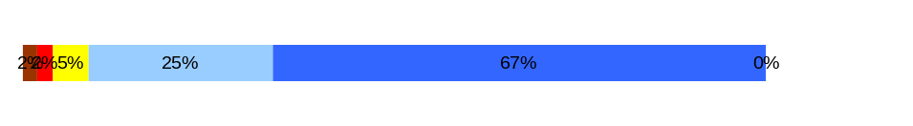
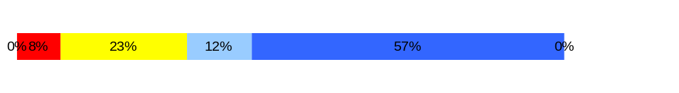
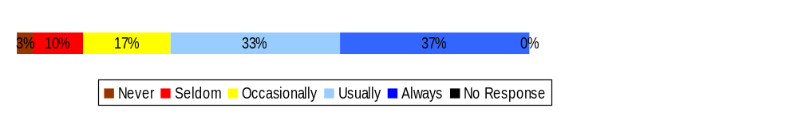
Deploy Workforce |
HR Management Report category:
Employee time and talent is used effectively. Employees motivated.
HR Management Report
(standard measures)
Percent employees with current performance expectations
Employee survey ratings on “productive workplace” questions
Overtime usage
Sick leave usage (and “unscheduled” leave if available)
Number & type of non-disciplinary grievances and disposition
Deploy Workforce - Slide 1 of 4
Percent employees with current performance expectations
  93% of all BIIA employees have current performance expectations.
Q4. I know what is expected of me at work. (4.6)
Q1. I have opportunity to give input on decisions affecting my work. (4.0)
Q2. I receive the information I need to do my job effectively. (4.3)
Q6. I have the tools and resources I need to do my job effectively. (4.5)
Q7. My supervisor treats me with dignity and respect. (4.5)
Q8. My supervisor gives me ongoing feedback that helps me improve
my performance. (4.2)
Q9. I receive recognition for a job well done. (3.9)
Do employees have day-to-day support to enable successful job performance?
Survey conducted Spring 2006. Board of Industrial Insurance Appeals number of responses = 60 (39%)
The BIIA scored in the top five agencies with the highest responses to the employee survey and was the highest scoring for agencies with 100 or more FTEs
Overall average score for “productive workplace” questions is 4.3

Slide 10
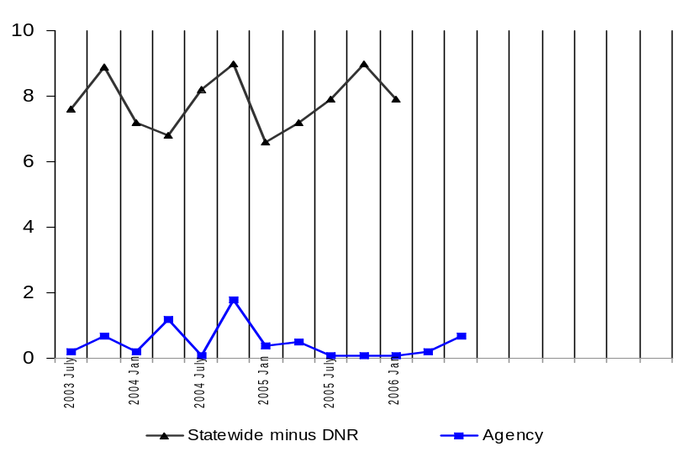
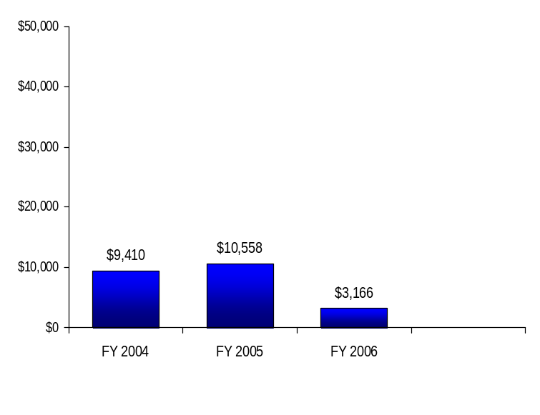
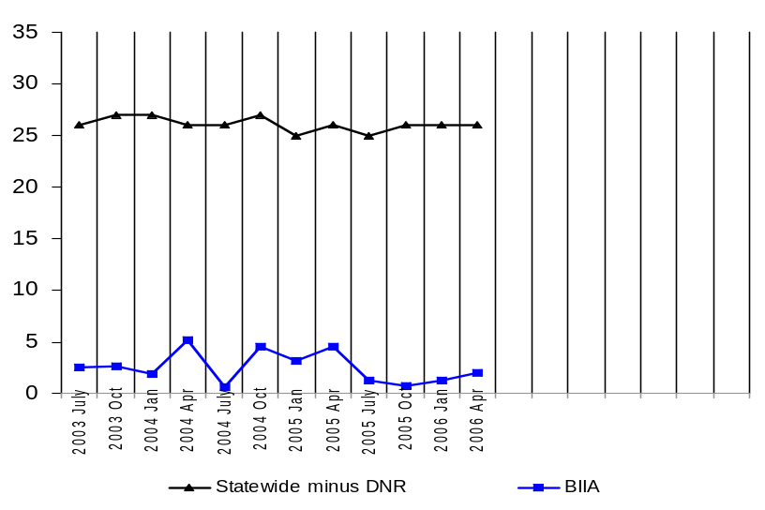
Deploy Workforce |
HR Report Card category:
Employee time and talent is used effectively. Employees motivated.
Overtime: Is employee time well managed?
Deploy Workforce - Slide 2 of 4
Average Overtime Hours per Employee per Quarter*
Board of Industrial Insurance Appeals
Overtime Costs
Quarter
Average Percent Employees Receiving Overtime
Statewide Overtime Costs
(In $Millions. All agencies, except DNR)
FY 2003 = $45.2 million
FY 2004 = $46.9 million
FY 2005 = $48.9 million
FY 2006 = $39.8 million
Percent Employees
Quarter
* Per capita

Slide 11
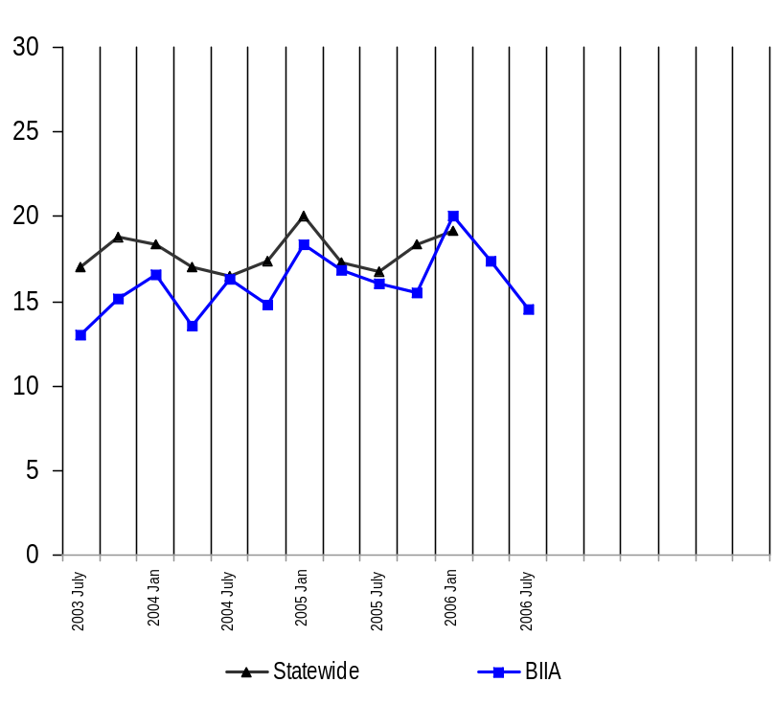
Deploy Workforce |
HR Report Card category:
Employee time and talent is used effectively. Employees motivated.
Leave: Do employees come to work as scheduled?
Deploy Workforce - Slide 3 of 4
Average Sick Leave Hours per Employee per Quarter
Notes:
It is unknown whether the sick leave usage shown was planned or unplanned.
Only actual leave time gone from work is shown. Leave hours donated and most cashed out leave hours have been removed from this display.
Quarter
Per Capita Sick Leave Use
Just Those Who Took Sick Leave
*Statewide Average since 10/01
*BIIA Average since 07/03
Ave. Sick Leave Hours Used per Qtr*
% of Earned Sick Leave
Ave. Sick Leave Hours Used per Qtr*
% of Earned Sick Leave
Statewide
17.8
hours
74%
22.8
hours
95%
BIIA
16.2
hours
68%
22.4
hours
93%

Slide 12
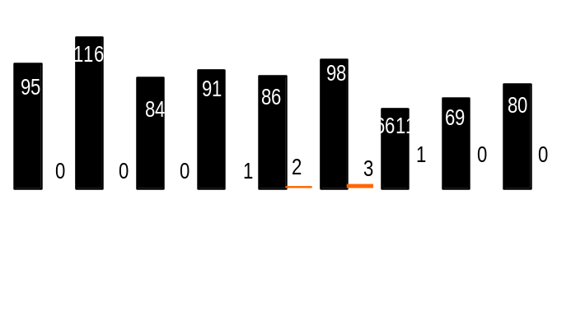
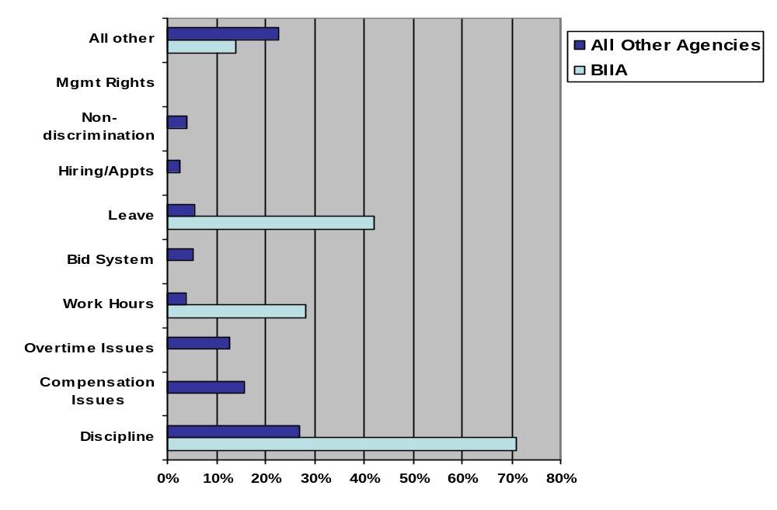
Deploy Workforce |
HR Management Report category:
Employee time and talent is used effectively. Employees motivated.
Employee relations: Are contracts/policies applied appropriately?
Deploy Workforce - Slide 4 of 4
Number of Grievances Filed Since 7-1-05
All Agencies
BIIA
Notes:
The data shown in these charts is for “represented” employees as reported monthly by agencies to the State Labor Relations Office (LRO).
Five of the seven BIIA grievances cited multiple issues/articles grieved (i.e., work hours and leave). This information is reflected in the percentage chart.
Since 7-1-05, one employee in BIIA filed a job classification appeal with the Department of Personnel. The BIIA decision was upheld
7/05 8/05 9/05 10/05 11/05 12/05 1/06 2/06 3/06
116
95
80
Type of Grievances (July 05 – May 06)
Source: State Labor Relations Office

Slide 13
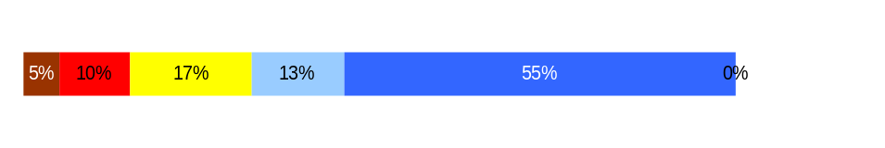
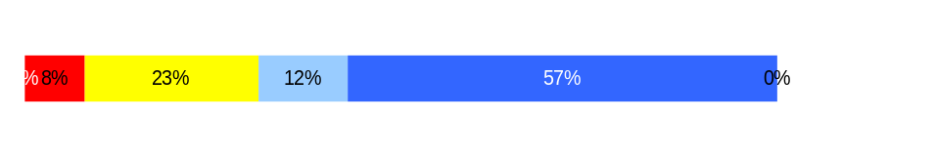
Employees have competencies for present job and future advancement
Develop Workforce |
HR Management Report category:
Develop Workforce - Slide 1 of 1
HR Management Report
(standard measures)
Percent employees with current annual individual development plans
Employee survey ratings on “learning & development” questions
Percent employees with current annual individual development plans
  93% of all BIIA employees have current individual development plans.
Employee perceptions on learning and development:
Survey conducted Spring 2006. Board of Industrial Insurance Appeals number of responses = 60 (39%)
The BIIA scored in the top five agencies with the highest responses to the employee survey and was the highest scoring for agencies with 100 or more FTEs
Overall average score for “Learning & Development” questions is 4.1
Employee perceptions on
learning and development
Q5. I have opportunities at work to learn and grow. (4.0)
Q8. My supervisor gives me ongoing feedback that helps me improve
my performance. (4.2)
Never
Seldom
Occasionally
Usually
Always
Notes:
Notes:

Slide 14
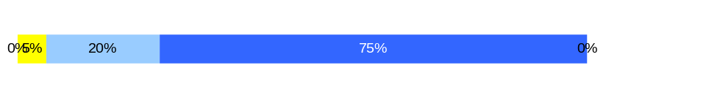
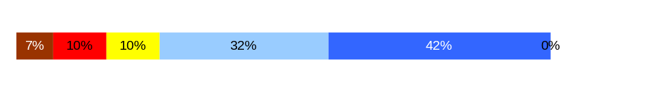
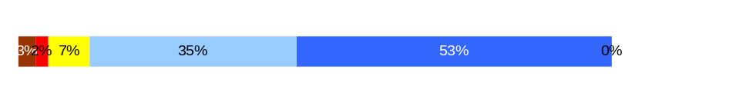
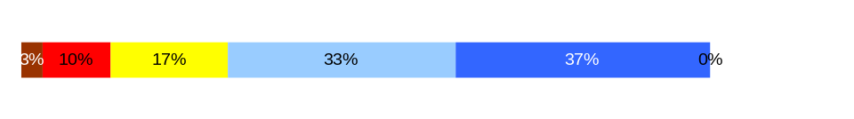
Successful performance is differentiated & strengthened. Employees are held accountable.
Reinforce Performance |
HR Management Report category:
Reinforce Performance - Slide 1 of 2
HR Management Report
(standard measures)
Percent employees and managers with current annual performance evaluations
Employee survey ratings on “performance and accountability” questions
Number and type of disciplinary issues, actions, appeals disposition
Percent employees and managers with current annual performance evaluations
93% of BIIA employees have current Performance Development Plans.
Do employees see a meaningful linkage between their performance and the success of the organization?
Do employees see a meaningful linkage between their performance and the success of the organization?
Survey conducted Spring 2006. Board of Industrial Insurance Appeals number of responses = 60 (39%)
The BIIA scored in the top five agencies with the highest responses to the employee survey and was the highest scoring for agencies with 100 or more FTEs
Overall average score for “performance & accountability” questions is 4.2
Q3. I know how my work contributes to the goals of my agency. (4.7)
Q10. My performance evaluation provides me with meaningful information about my performance. (3.9)
Q11. My supervisor holds me and my co-workers accountable for performance. (4.3)
Q9. I receive recognition for a job well done (3.9)
Never
Seldom
Occasionally
Usually
Always
Notes:
Notes:
Training on the new performance evaluation system has been very popular. In FY 05 = 1,200 trained. In FY 06 to date = 225 and 875 more anticipated for remainder of fiscal year. Over 97% of these participants are managers and supervisors.

Slide 15
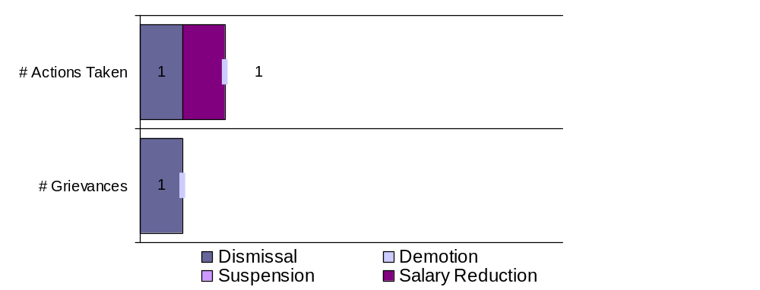
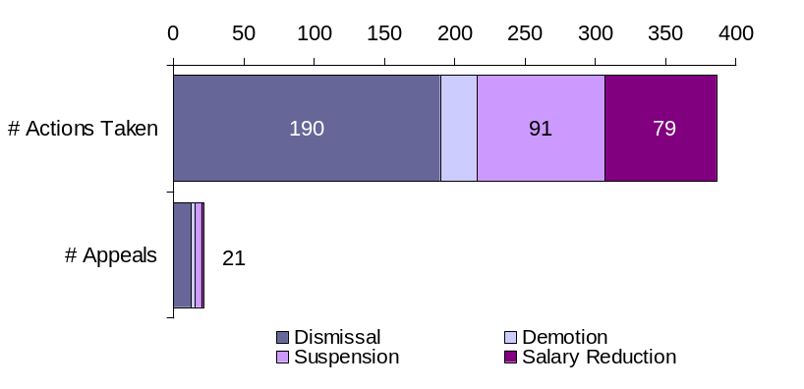
Reinforce Performance |
HR Management Report category:
Successful performance is differentiated & strengthened. Employees are held accountable.
Disciplinary action: Is poor performance dealt with?
Reinforce Performance - Slide 2 of 2
Formal Disciplinary Actions and Appeals
FY 2006 to date (July 1, 2005- June 30, 2006)
Statewide Comparison
Disciplinary Actions and Appeals Filed Since July 1, 2005
Issues Leading to Disciplinary Action and Disciplinary Grievances
Misuse of State Resources
Disposition of Disciplinary-related Grievances and Appeals
The BIIA has one disciplinary-related grievance scheduled for arbitration.

Slide 16
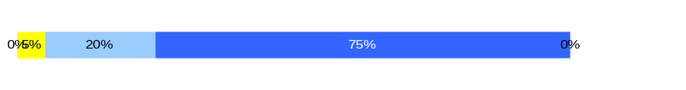
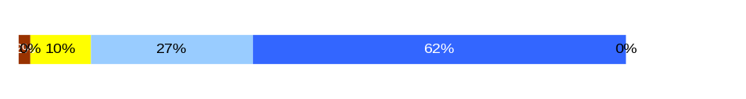
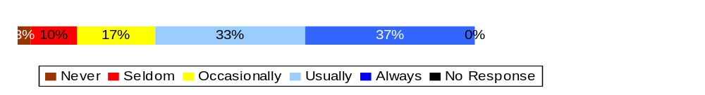
Ultimate Outcomes |
HR Management Report category:
State has workforce breadth & depth for present & future success.
Employees are committed to the work they do and the goals of the organization.
Successful, productive employees are retained.
HR Management Report
(standard measures)
Employee survey ratings on “commitment” questions
Turnover rates and types (e.g., retirement, resignation, etc.)
Turnover rate of key occupational categories and of workforce diversity
Ultimate Outcomes - Slide 1 of 3
Indicators of Employee Commitment
Survey conducted Spring 2006. Board of Industrial Insurance Appeals number of responses = 60 (39%)
The BIIA scored in the top five agencies with the highest responses to the employee survey and was the highest scoring for agencies with 100 or more FTEs
Overall average score for “performance & accountability” questions is 4.4
Indicators of Employee Commitment
Q3. I know how my job contributes to the goals of my agency. (4.7)
Q12. I know how my agency measures its success. (4.5)
Q9. I receive recognition for a job well done (3.9)
Notes:
Notes:

Slide 17
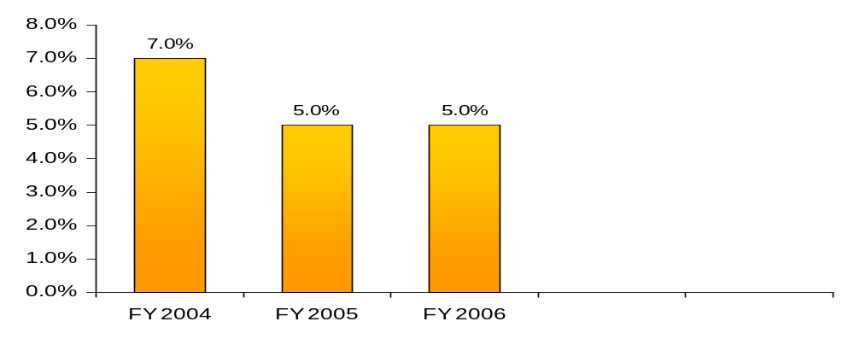
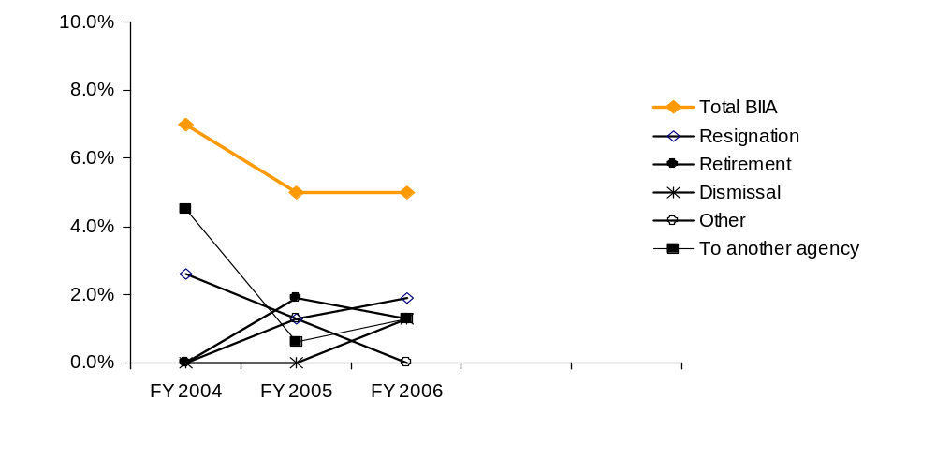
Ultimate Outcomes | continued
HR Management Report category:
Ultimate Outcomes - Slide 2 of 3
BIIA Turnover (Leaving the agency)
BIIA Workforce Turnover Breakdown
Notes:
Notes:

Slide 18
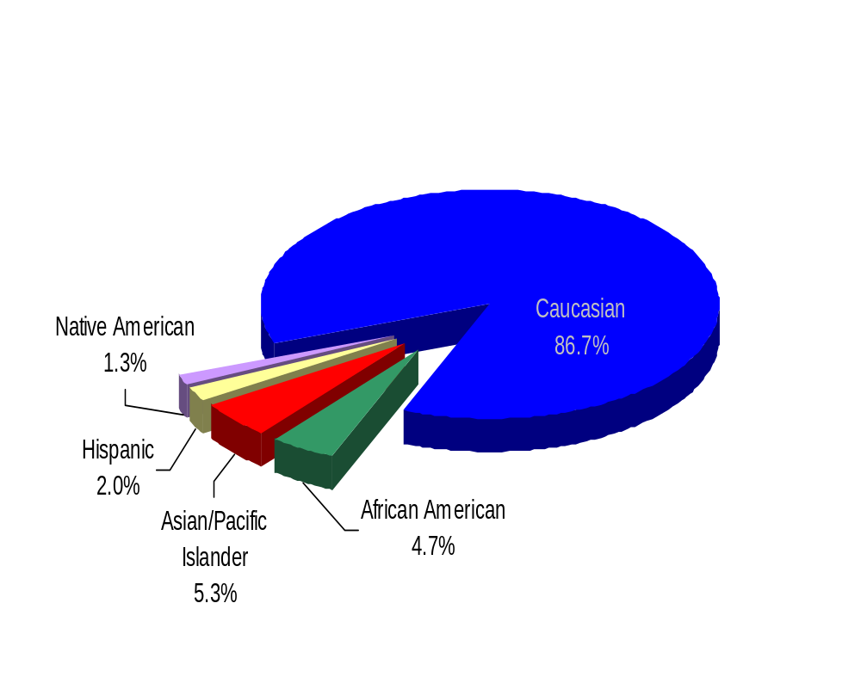
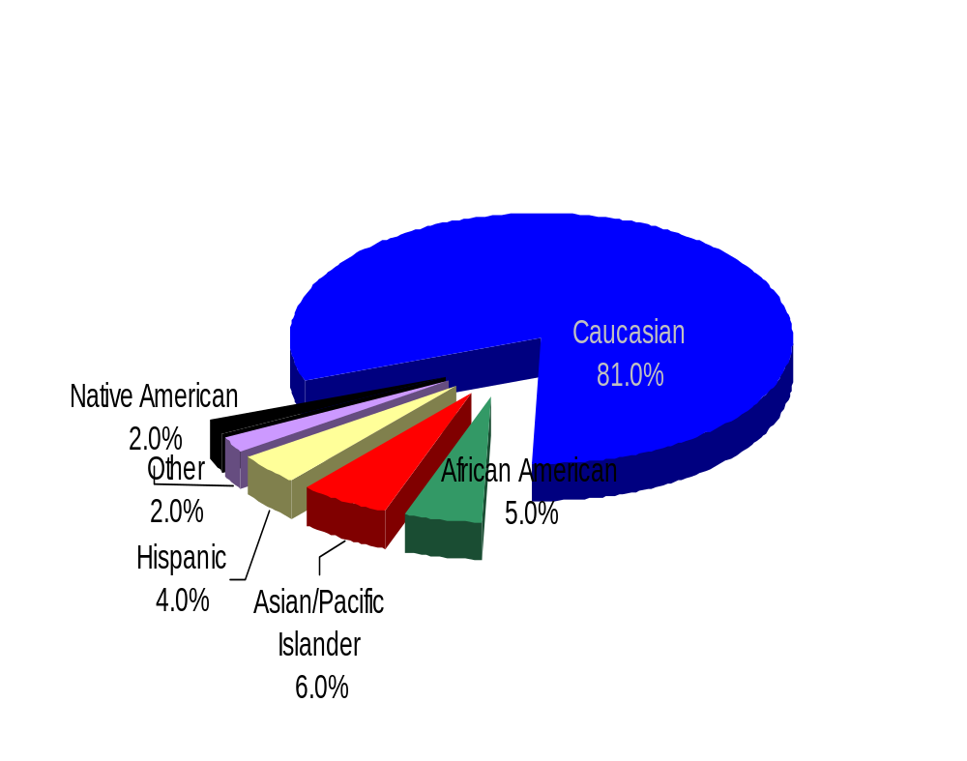
Ultimate Outcomes | continued
HR Management Report category:
Ultimate Outcomes - Slide 3 of 3
Board of Industrial Insurance Appeals - Workforce Diversity
Diversity Profile State BIIA
Women 52.0% 62.0%
Persons with disabilities 5.0% 4.7%
Vietnam Veterans 7.0% 4.0%
Disabled Veteran 2.0% 2.0%
Persons over 40 76.0% 84.7%
People of color 17.5% 13.3%
BIIA
WA STATE

