Slide 1
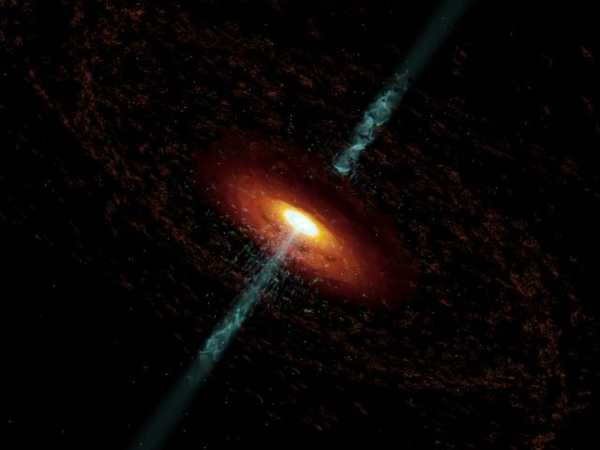


GLAST & Multiwaveband Monitoring as Probes of Bright Blazars
Alan Marscher
Boston University
Research Web Page: www.bu.edu/blazars

Slide 2
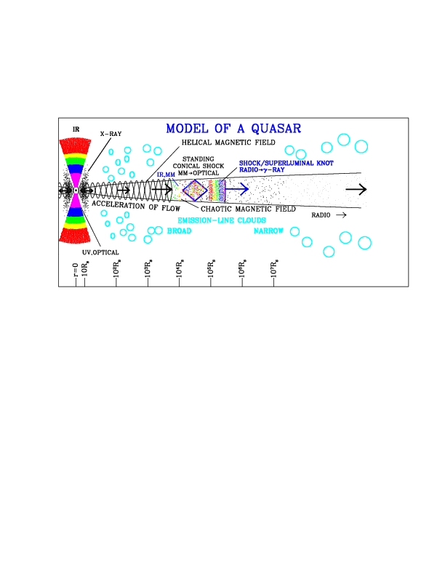
Sketch of Physical Structure of Jet, AGN
Based on Current Observations & Theory
Goals: 1. Determine where & how gamma-ray emission originates
2. Use multiwaveband light curves + VLBI images to probe compact jet

Slide 3
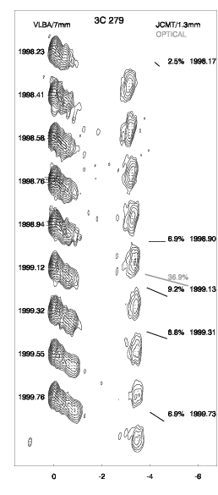
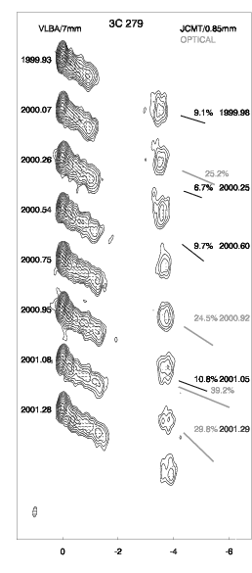
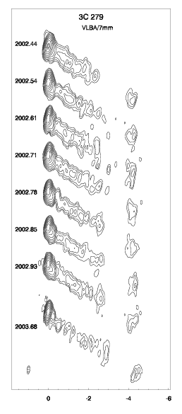
Jets of EGRET Blazars: Very Fast
Superluminal motion as high as almost 50c
Bulk Lorentz factor up to 50
→ Doppler factor can approach 100
3C 279: apparent speeds range from ~ 5c to >20c

Slide 4
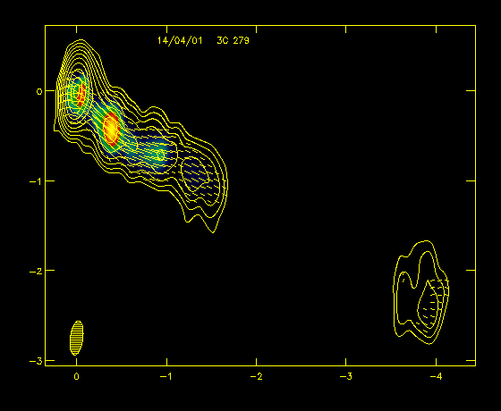
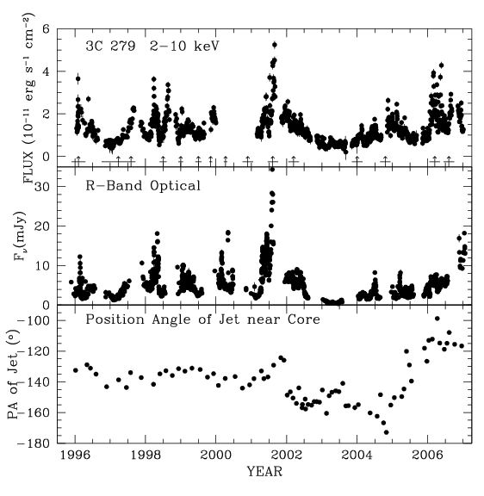
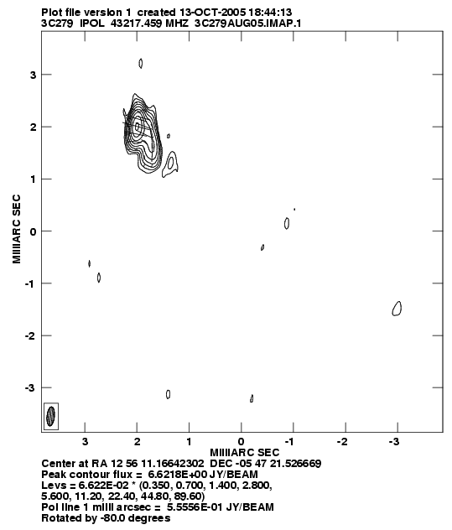
Changes in Direction
Change in apparent speed possible from change in direction even if Γ constant
Nonthermal luminosity seems to be related to direction of jet
Changes amplified greatly by projection effects
Velocity seems ballistic in some jets but seems to follow twisting jet in many others
Changes in direction tend can be abrupt, unlike precession (more like an unstable firehose)

Slide 5
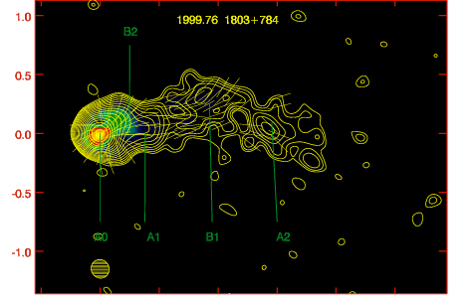
The Core of Blazar Jets
a. Frequencies below ~ 40 GHz: τ ~ 1 surface (deeper at higher frequencies)
b. At higher frequencies, perhaps some lower frequencies:
Conical standing shock (Daly & Marscher 1988)
Reproduces polarization pattern if randomly oriented B field is compressed by conical shock (Cawthorne 2006; e.g.; non-EGRET BL Lac object 1803+784 shown below)
c. Even higher frequencies (~300 GHz): End of zone of flow acceleration
- Where Doppler factor reaches asymptotic value
1803+784

Slide 6
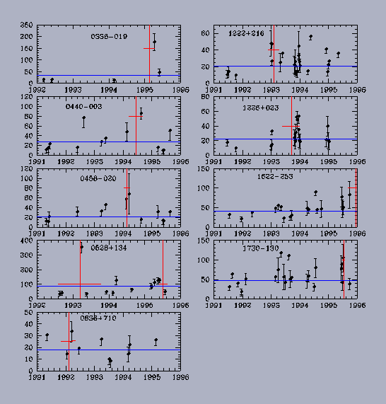
Connection between γ-ray Flares and Superluminal Ejections
Jorstad et al. (2001): In 10 out of 23 cases the ejection of a superluminal component coincided to within 1σ with time of high state of the γ-ray flux. Flare in 15 GHz polarized flux occurs prior to time of high γ-ray flux
Lähteenmäki & Valtaoja (2003): high γ-ray flux occurs during rising phase of 37 GHz outbursts
Conclusion: mm-wave outburst + superluminal knot ejection occur before peak in γ-ray flux
γ-rays are produced in the knots, well beyond broad emission-line region
Need to test with better timing data: GLAST + well-sampled VLBI data

Slide 7
EGRET/VLBI: Likely Site(s) of Gamma-ray Emission
Moving shock waves = superluminal knots
Signature: outburst lasting weeks/months with persistent polarization direction
Standing (oblique/conical) shocks = core & other stationary features
Signature: steady but typically low polarization, usually parallel to jet axis
3. Combination of the two (as in M87; Cheung et al. 2007, ApJL, submitted)
- Method for testing: (1) Well-sampled (monthly) time sequences of 43 GHz VLBI images, both total & polarized intensity; (2) polarization light curves from radio to optical; (3) total flux light curves from radio to gamma-ray

Slide 8
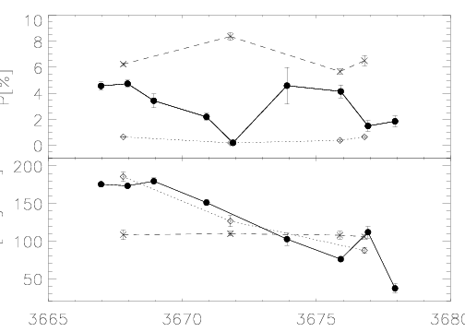
Variations from Turbulence (Not all flares are new shocks!)
Shock waves moving through turbulent jet plasma
Signature: flux & polarization % and χ fluctuate about values that change more smoothly over weeks-months
Turbulence passing through standing conical shock system (e.g., core of 0420-014; D'Arcangelo et al. 2007, ApJL)
Signature: polarization % and χ fluctuate about low base polarization
- Method for observing: (1) 10-20 day campaigns of daily polarization monitoring in optical & as frequently as possible (at least 3 times per week) with VLBA at 43 GHz; (2) polarization monitoring at intermediate frequencies if possible
%
Dark: optical
Light diamonds: core at 43 GHz
Light crosses: knot in jet for comparison
χ
MJD

Slide 9
Cryptic Guide to VLBI Observations
Frequencies lower than ~ 15 GHz:
- Sensitive but relatively coarse resolution (>0.5 mas), inner jet opaque
Good for surveys but need to wait to see moving knots
- Images of > 100 sources at 15 GHz available at MOJAVE website (~100 sources): www.physics.purdue.edu/astro/MOJAVE and ~1000 sources at 5 GHz from VIPS (G. Taylor, UNM) in the future
43 & 22 GHz (VLBA, add Effelsberg et al. for better resolution):
+ Fine resolution (0.1-0.2 mas), can see deeper into jet
→ see knots shortly after ejection, get apparent speeds & dates of ejection after several months
− Sensitive enough only for > 1 Jy blazars, 0.1 Jy with phase referencing
+ Need to observe at least once per month to follow knots
- Images of 29 blazars will be available at www.bu.edu
86 GHz (Global Mm-VLBI Array):
+ Highest non-experimental frequency + Finest resolution (40 μas)
− Lowest sensitivity → probes core region, not much else
− Poor time coverage - twice per year (unless core brighter than a few Jy so possible with stand-alone VLBA)

Slide 10
Number of Objects in a VLBA Session
Basic principles:
Don't usually care about faint outer structure → can observe a given object for only 5-10 min per hour, cycle through 5-10 sources + calibrators
24 hours: can observe ~25 sources with flux > 1 Jy with dynamic range better than 100:1 (usually adequate to follow knots) even at 43 GHz
Observe at as high a frequency as possible given brightness of source & dynamic range needs
Surveys of basic properties (as opposed to monitoring changes): can observe >100 objects at lower frequencies in a single 24-hour session
Difficult objects (e.g., TeV BL Lacs with weak knots): Observe more frequently during session to get better image fidelity
Weak objects: sandwich program sources between scans of phase calibrator

Slide 11
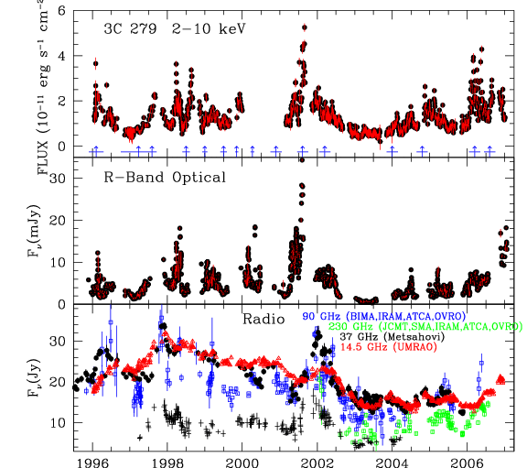
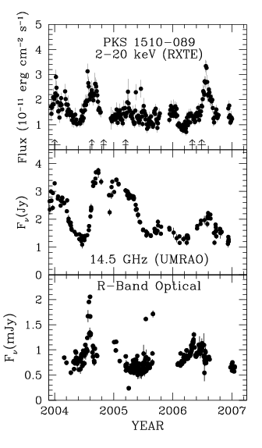
The Desired Observational Result
Densely sampled light curves from radio to gamma-ray for correlation analysis
Times of superluminal ejections and flux history of core & knots
ID of features on VLBI images responsible for higher-frequency outbursts
Cross-correlate light curves at different λ → connections & time lags

Slide 12
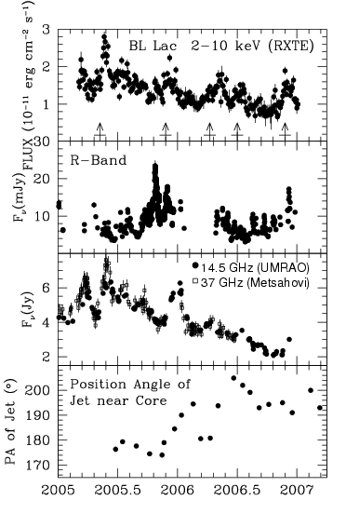
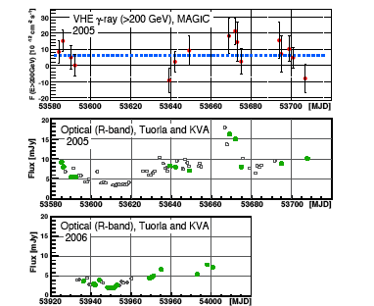
A Taste of the Gamma-Ray/Lower Frequency Connection: BLLac
0.2-1 TeV detection most significant during late 2005 X-ray/optical/radio outburst associated with the ejection of a bright superluminal radio knot

Slide 13
Recipe for Definitive Results: Don't Cheat on the Ingredients (Time & Frequency Coverage, Images)
Need both long-term monitoring to observe major outbursts/gradual trends + campaigns to sample short-term fluctuations
Gaps in coverage leave doubt about correlations & non-correlations
Polarization can be useful for identifying turbulence & connecting features on VLBI images to variable optical component
Comprehensive multiwaveband observations in concert with GLAST and the VLBA can locate where high-E emission occurs in jet
VLBA images available on web if groups are adequately supported
GRAB A TELESCOPE (OR 10) & JOIN THE FUN!
SAVE THE VLBA & ITS USERS!!!
Tell the NSF and the NRAO director how crucial the VLBA is!
& Support the theorists - we need more sophisticated models!

