Slide 1
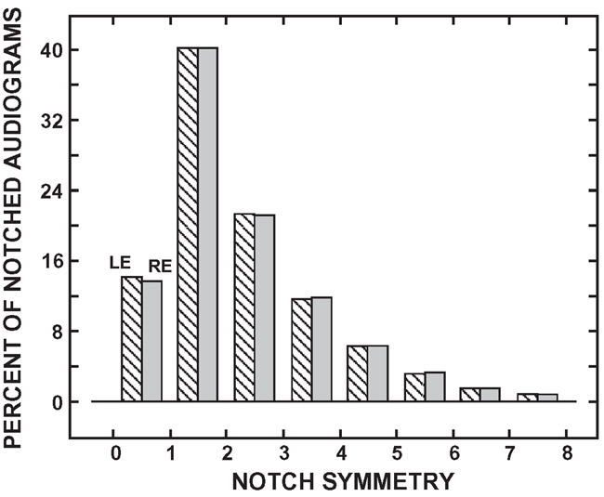

Figure 4. Histograms of percentage of left ear (LE) (striped) and right ear (RE) (shaded) 4,000 Hz notched audiograms for eight notch symmetries. LE n = 113,818; RE n = 108,616.
Wilson RH, McArdle R. Characteristics of the audiometric 4,000 Hz notch (744,553 veterans) and the 3,000, 4,000, and 6,000 Hz notches (539,932 veterans). J Rehabil Res Dev. 2013;50(1):111–32.
http://dx.doi.org/10.1682/JRRD.2011.11.0225
Notes:
Figure 4. Histograms of percentage of left ear (LE) (striped) and right ear (RE) (shaded) 4,000 Hz notched audiograms for eight notch symmetries. LE n = 113,818; RE n = 108,616.

