Slide 1
Harvard Medical School Meeting on Personally Controlled
Health Record Infrastructure
(PCHRI 2006)
Report to the AHIC Consumer Empowerment Workgroup
William Crawford
CMS
Kenneth D. Mandl, MD, MPH
Harvard Medical School

Slide 2
About the Meeting
October 10th and 11th, 2006 at the HMS Countway Library of Medicine, hosted by the Center for Biomedical Informatics
100 Leaders from Government, Academia and Industry discussing an ongoing infrastructure for Personally Controlled Health Records
More information at http://www.pchri2006.org/

Slide 3














Selected Participants
CMS
CDC
NIH
NLM
Social Security
ONC
Plus Harvard University, HMS Center for Biomedical Informatics, MIT, The Center for Biomedical Innovation, Oregon Health Sciences University, Markle, Robert Wood Johnson, Stanford Medical School, Mass eHealth Collaborative, Reigenstrief, CareGroup, Mass Medical, AAFP…..

Slide 4
Agenda: Cross-Cutting Issues
Personal Control
Disruptive Technologies
Business Models
Data Liqudity
PHRs and HIEs
Technology: Friend or Foe?

Slide 5
1. The “PCHR”
Personally Controlled Health Record
  Control is about more than just access
  Not welded to a single infrastructure
A PCHR includes a irrevocable copy of all healthcare data
  Subsequent release of this copy is under patient control
  Same applies to all data contributed directly by patient
  Technology enables the “rules of engagement”

Slide 6
Top level goals for PCHRs
Enable a single point of access for patients to their PCHR, creating a “virtual medical home”
Allow patients to control data flows through a health information exchange
Establish a line of communication with patients
Accommodate unanticipated uses

Slide 7
2. Business Models
Consensus on a straightforward point: to encourage PHR adoption, consumers MUST HAVE A COMPELLING INTEREST
  High order needs:
    Take care of my wife’s health
  Economic interests:
    I want to profit from my own data
Workflow for EHRs, “Life Flow” for P(C)HRs?

Slide 8
3. Disruptive Technologies
From the keynote by Mitch Kapor:
  Closed -> Open
  Hierarchical, Centralized -> Decentralized, Coordinated
  Islands -> Interoperability
“If Open Systems are Nurtured, they dominate closed systems.”
“Build it and they will come – there will be unexpected entrepreneurial opportunities.”

Slide 9
4. “Liquid Data” Builds Businesses
The value of PHR data will grow exponentially along with its potential uses
  The fundamental issue is not how to get consumers to demand information and buy “records,” but rather to facilitate “liquidity” of the data
  Consumers already perceive that their medical information exists in a “liquid form” and is freely exchanged between providers
Risk/benefit trade-offs to medical data liquidity
  People seem willing – at least in focus groups – to accept the reduction in privacy to save their lives or improve health

Slide 10
Underpinnings of Data Liquidity
“Control”
  Separate control from ownership & focus on uses and rights
  Dynamic, easy to use opt-in/opt-out (with intelligent defaults)
  Fine grained options for sharing
Authentication (of data)
  The value of information is based on its reliability
Accessibility & Richness
  We need a “download” button—for patients—on all sources of medical data
Trust is a central component
  Transparent rules, harmonizing privacy with other interests
  Education component for physicians and patients
  Ongoing process for focusing on ELSI (Ethical, Legal and Social Issues)
    Legislation
    Regulation
    Seals of approval
    Recognized oversight authority

Slide 11
5. PHRs and HIEs
A PHR that isn’t “welded” will contain pointers to multiple data sources.
Is a PCHR the core of the health information exchange, or an element within it?

Slide 12
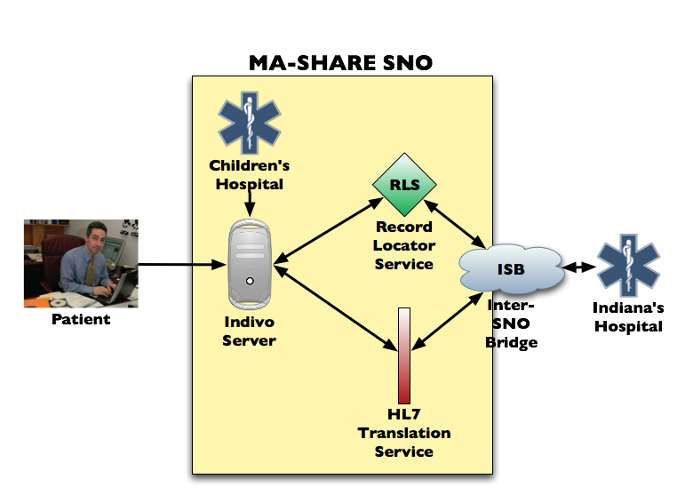


Slide 13
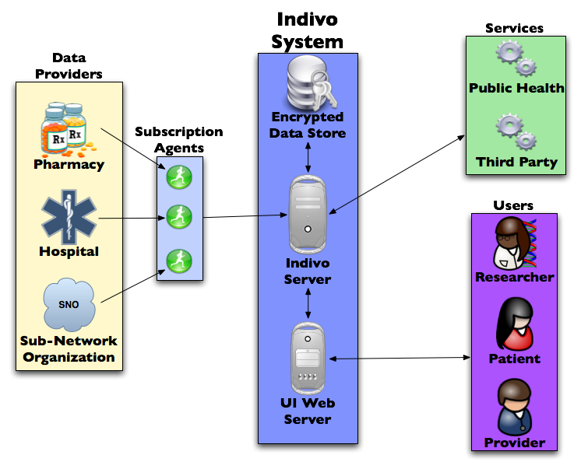
Interoperable Core

Slide 14
6. Technology is not the Problem
Access control in online photo sharing works just fine!
Other industries do a lot of R&D – don’t reinvent the wheel
For example, the “Semantic Web” technologies for knowledge management

Slide 15
Further (Technical) Consensus
Audit trails should be simple and focused
  Not sure about interoperability
Data in transit should be encrypted
  Encrypted stored data is a “safe” practice
Define use cases for public health and research

Slide 16
Recommendations
Promote openness in PHR platforms
Prevent fragmentation through openness
Don’t crowd out innovation
  Embrace policies that create and support platforms
Rely on individual rights
  Confront privacy head on by exercising individual rights to information
  The patient is the integrator of his/her own medical record
  Allow fine-grained opt in/opt out

Slide 17
Thank You!
www.pchri2006.org
william.crawford @ cms.hhs.gov
kenneth_mandl @ harvard.edu

