Slide 1

State of Washington
GMAP Government Efficiency
Human Resource Management
May 21, 2008
Hire Workforce
Plan & Align Workforce
Deploy Workforce
Reinforce Performance
Develop Workforce
Logic model for statewide workforce management
Dashboard: Government Efficiency – Human Resource Management
HR Management Report – April 2008 Roll-up Report Summary
Agency Priorities for Improving Workforce Management
State Employee Survey – Summary of agencies’ analyses
Presented by:
Eva Santos, Director
Department of Personnel
May 21, 2008

Slide 2
April 2008 HR Management Report Roll-up
Logic Model:
Workforce Management Linked to Agency Strategy
so that
Agencies can achieve goals & priorities; and fulfill its mission
Agencies have depth & breadth of needed talent
Successful, productive employees are retained
Employees are committed to job & agency goals
so that
Reinforce Performance
Employees receive formal feedback on performance
Poor performance is eliminated
Successful performance is rewarded & strengthened
Reinforce Performance
Performance Measures
Plan & Align Workforce
% supervisors with current performance expectations for workforce management
Management profile
Workforce planning measure (TBD)
% employees with current position descriptions
Hire Workforce
Time-to-fill vacancies
Candidate quality
Hiring Balance (Proportion of appointment types)
Separation during review period
Deploy Workforce
% employees with current performance expectations
Employee survey ratings on “productive workplace” questions
Overtime usage
Sick leave usage
Non-disciplinary grievances/appeals filed
Worker safety – injury claims
Develop Workforce
% employees with individual development plans
Employee survey ratings on “learning & development” questions
Reinforce Performance
% employees with current performance evaluations
Employee survey ratings on “performance & accountability” questions
Disciplinary actions and reasons, disciplinary grievances/appeals filed
Reward and recognition practices (TBD)
Ultimate Outcomes
Employee survey ratings on “commitment” questions
Turnover rates and types
Workforce diversity profile
Retention measure (TBD)
so that
Deploy Workforce
Employees know what’s expected of them, and how they’re doing
Employees are well-managed on a day-to-day basis
Employees do their job & contribute to agency goals
Deploy Workforce
Develop Workforce
Skill & knowledge development strategies are implemented
Workforce gets learning needed to perform job well
Develop Workforce
so that
Hire Workforce
Hire Workforce
Recruitment strategies are developed & implemented
Well-qualified candidates are hired in a timely manner
Plan & Align Workforce
Roles & jobs aligned to support agency goals
Staffing/skill needs to achieve goals are identified
Strategies to close gaps are determined
Plan & Align Workforce
so that
Agency Missions, Strategic Plans, Priorities, and Performance Measures
Department of Personnel March 2008

Slide 3
April 2008 HR Management Report Roll-up
Dashboard – Government Efficiency - Statewide Human Resource Management
Measure | Agency | Baseline | Target | Actual (4/08) | Status | Notes
State Employee Survey – agencies with rating of 4.00 or higher | 41 agencies | 11 (2006) | No statewide target set | 18 (2007) |  | The 18 agencies with rating >4.00 in 2007 represent 17% of the workforce. Data is based only on the 41 agencies that had 50 or more respondents to the survey.
Statewide turnover rate | Agys with >100 emps | 8.3% (FY 07) | No statewide target set | 4.5% (1st half FY 08) |  | Turnover data represents “leaving state service”.
Number of agencies with key workforce planning components | Agys with >100 emps | TBD | TBD |  |  | New measure. Initial data source will be agencies’ Strategic Plans as submitted to OFM in June 08.
Candidate quality rating | Agys with >100 emps | Insufficient data | No statewide target set | 74% |  | Preliminary results based on 25 of 36 agencies reporting (un-weighted average).
Average time-to-hire (days) * | Agys with >100 emps | Insufficient data | No statewide target set |  |  | Statewide roll-up data not yet available, due to different definitions used across agencies.
Percent workforce with current performance evaluations | Agys with >100 emps | 63% | 100% | 90.3% |  | Data reflects 27% increase since October 2006.
Meets/exceeds target
Within 10% of target
OR
Area of concern
More than 10% below target
OR
Area of great concern
Data not available
* Alternative language under consideration: “Percent agencies meeting or exceeding their Time-to-Hire target”
Source: State of Washington Department of Personnel

Slide 4
April 2008 HR Management Report Roll-up
Human Resource Management Report – April 2008 Statewide Summary
Performance Measure | Statewide Status | Comments
PLAN & ALIGN WORKFORCE
% supervisors who have performance expectations for WF mgmt | 98.3% | As of 12/31/07
Management profile: | 9.0 % = “Managers”; 7.6% = WMS only | As of 12/31/07; WMS control point = 7.6%
% employees with current position/competency descriptions | 93.1% | As of 12/31/07
HIRE WORKFORCE
Average days to hire for job vacancies | Statewide value pending use of uniform definition | 36 of 36 agencies now reporting
Candidate quality ratings: | 74% candidates interviewed had competencies needed for job 93% managers indicate they were able to hire the best candidate | Average of satisfaction rates reported by 25 of 36 agencies (preliminary, un-weighted)
Hiring balance (% types of appointments): | 37% promo; 39% new hires; 14% transfers; 8% exempts; 2% other | For 7/1/07 through 12/31/07
Number of separations during post-hire review period | 366 | For 7/1/07 through 12/31/07
DEPLOY WORKFORCE
Percent employees with current performance expectations | 87.4% | As of 12/31/07
Employee survey “productive workforce” ratings | 3.83 (1-5 scale) | As of 11/07. Up +.02 from 4/06 survey
Overtime usage: (monthly average) | 3.5 hours (per capita); 18.3% of employees receiving OT | OT cost = $37.7M. Data as of July-Dec 07
Sick leave usage: (monthly average) | 6.0 hours (per capita); 11.5 hours (just those who used S/L) | For 7/1/07 through 12/31/07
# of non-disciplinary grievances, appeals, & Dir’s Reviews filed | 285 grievances, 7 appeals, 61 Director’s Reviews | For 7/1-12/31/07; Dir Rev up 93% due to class consolidations effective 7/1/07.
Projected annual number of accepted claims per 100 FTE | 6.98 | As of 6/30/07
DEVELOP WORKFORCE
Percent employees with current individual training plans | 87.3% | As of 12/31/07
Employee survey “training & development” ratings | 3.71 (1-5 scale) | As of 11/07. Up +.05 from 4/06 survey
REINFORCE PERFORMANCE
Percent employees with current performance evaluations | 90.3% | As of 12/31/07
Employee survey “performance & accountability” ratings | 3.78 (1-5 scale) | As of 11/07. Up +.03 from 4/06 survey
Number of formal disciplinary actions taken | 78 | For 7/1/07 through 12/31/07
Number of disciplinary grievances and appeals filed | 105 grievances; 6 appeals | For 7/1/07 through 12/31/07
ULTIMATE OUTCOMES
Employee survey “Employee Commitment” ratings | 3.67 (1-5 scale) | As of 11/07. Up +.05 from 4/06 survey.
Turnover percentages (leaving state service) | 4.6% (1st half of FY 08) | For 7/1/07 through 12/31/07
Employee survey rating on “Support for a diverse workforce” | 3.83 | As of 11/07 survey
Diversity Profile | 53% female; 18% people of color; 75% >40 | As of 12/31/07
Source: State of Washington Department of Personnel

Slide 5
April 2008 HR Management Report Roll-up
Agencies’ Priorities for Improving Workforce Management
In their April 2008 HR Management “Interim” Reports, agencies were asked to indicate which performance measurement areas were High, Medium, and Low priorities for improvement. Agencies were also asked to provide a summary analysis of their recent State Employee Survey results.
A roll-up of agencies’ responses indicates that the following subject areas are most in need of further action:
Top Three Priorities for Improvement
Performance management
  See slides 7 & 8
Hiring: Time-to-Hire and Candidate Quality
  See slides 9-12
Turnover
  See slides 13 & 14
Top Employee Survey Issues
Getting meaningful performance evaluations and feedback
  See slides 7 & 8; slide 18
Receiving recognition
  See slides 17-18
Knowing how one’s agency measures its success
  See slides 17-18
Source: State of Washington Department of Personnel

Slide 6
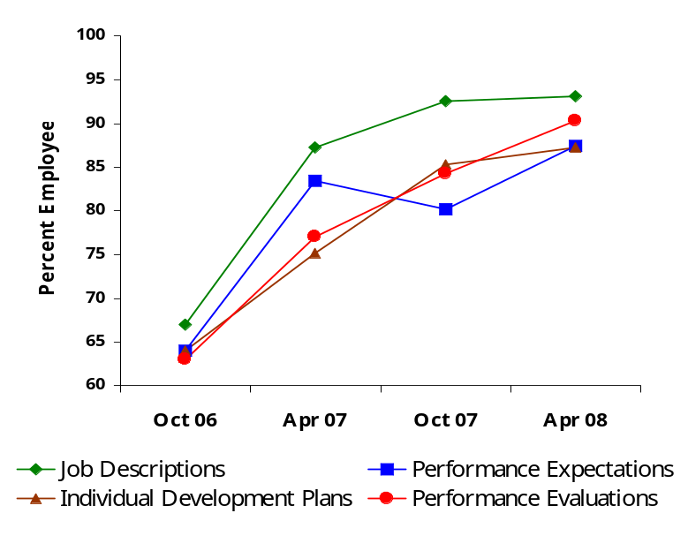
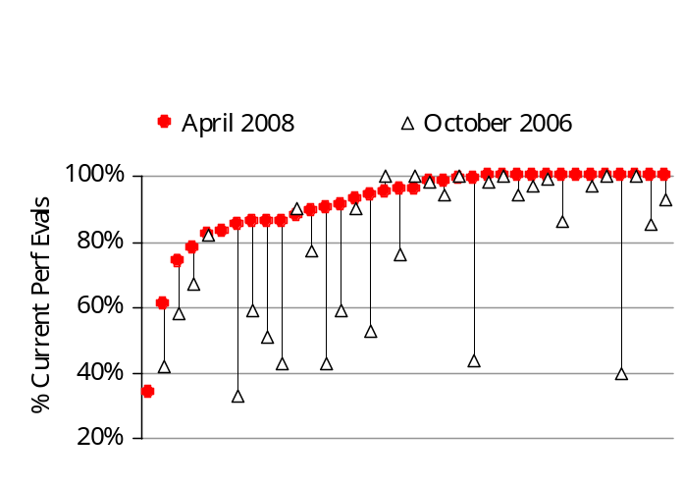
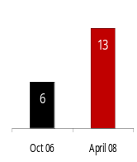
April 2008 HR Management Report Roll-up
Priority 1
Employee Performance Management
Accountability
Recognition
Current job description
Performance expectations linked to agency goals
Individual development plan
Statewide Performance Management Progress
~36 agencies with >100 employees reporting
Performance Management
Performance evaluation
Ongoing feedback and learning
Employee Survey Results relating to Performance Management
Respondents indicating “Usually/Always”
Apr 06 Nov 07
I know what is expected of me at work. | 84% | 85%
I know how my job contributes to the goals of my agency. | 78% | 80%
I have opportunities to learn and grow. | 57% | 60%
My supervisor gives me ongoing feedback that helps me improve. | 62% | 64%
My performance evaluation provides me meaningful information. | 51% | 53%
My supervisor holds me & my co-workers accountable. | 77% | 78%
I receive recognition for a job well done. | 48% | 51%
Per Agency Progress on Current Performance Evaluations
Most agencies’ performance management practices have improved dramatically over the past 1½-2 years. ~90% of the state workforce has current performance expectations and evaluations. This is up from 63% in Oct 2006 – a 27% increase.
Agency-specific improvement with performance evaluations:
>40% increase: Agric, DOT, Mil, OAH, Parks, WSP
30-40% increase: L&I, DSHS
20-30% increase: DOC, F&W
The target for current performance evaluations = 100%
  Agencies at 100%: BIIA, ECY, PRT, CTED, DFI, DOL, DOP, HCA, AGO UTC, WSP, LOTT, SchBlind
  Agencies at 95-99%: F&W, DIS, DOR, DVA, ESD, OFM, SchDeaf
  Agencies at 90-95: DSHS, DOT, GAMB
Target = 100%
# Agencies with 100%
Current Perf Evals
Each mark represents an agency
Source: State of Washington Department of Personnel

Slide 7
April 2008 HR Management Report Roll-up
Priority 1
Employee Performance Management (cont.)
Key Issues
Though they have made significant progress, 70% of agencies continue to view performance management as a high/medium priority for improvement.
Many are still working to get at the 100% target. Others are working to sustain improvements made and targets reached.
Agencies indicate that the key to improvement in
performance management is top executive
commitment/directive and holding managers accountable.
Supervisory turnover and workload are sometimes cited as challenges.
Agencies that are transitioning to an all-agency annual performance evaluation cycle experience a timing lag before getting to 100%.
Although Employee Survey ratings related to performance management have increased some since 4/06, it will take more time for the recent improvements in performance management practices to settle in and result in more substantial increases.
Employees want to know two basic things:
(1) What do you want me to do? (2) How am I doing?
The Employee Survey results indicate that employees have a fairly good feel on the first question, but not the second.
Now that most performance expectations and evaluations are getting completed, the focus is shifting to improving the quality:
  Are performance expectations clear and linked to agency goals?
  Is the evaluation of performance clear, candid, and meaningful?
Feedback and recognition should not be viewed as a once-a-year proposition. It must be ongoing and just-in-time.
Action Plans
Agency-specific (examples from Agencies’ HR Mgmt Reports)
Executive commitment and management accountability through internal GMAP forums, management reviews, etc.
Continued performance management training for supervisors (and employees)
Monitoring quality and content
Clarifying linkage of individual job to agency goals
Informing supervisors of best practice techniques
Establishing policy to cover for supervisory turnover
Emphasizing actions for ongoing feedback (e.g., staff meetings, 1x1s, get out of office initiatives, drop-in time, interim reviews)
Working toward achieving performance culture and Performance Management Confirmation
NOTE: The subject of “recognition” is addressed in slide #18
Enterprise / DOP:
Executive expectations and monitoring through Governor’s GMAP forums and HR Management Report [now and ongoing]
Continue offering training on performance management [DOP - ongoing]
Coordinate “best practice” information sharing forums {DOP – now]
Consultation on performance management and Performance Management Confirmation [DOP – ongoing]
Source: State of Washington Department of Personnel

Slide 8
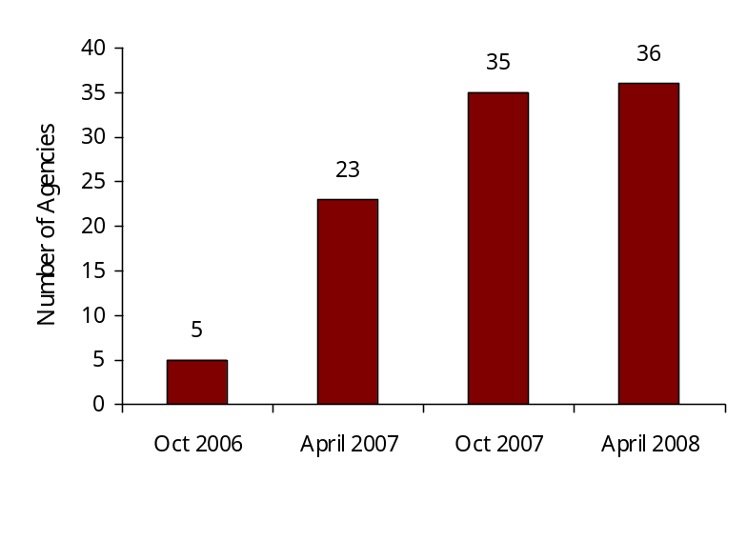
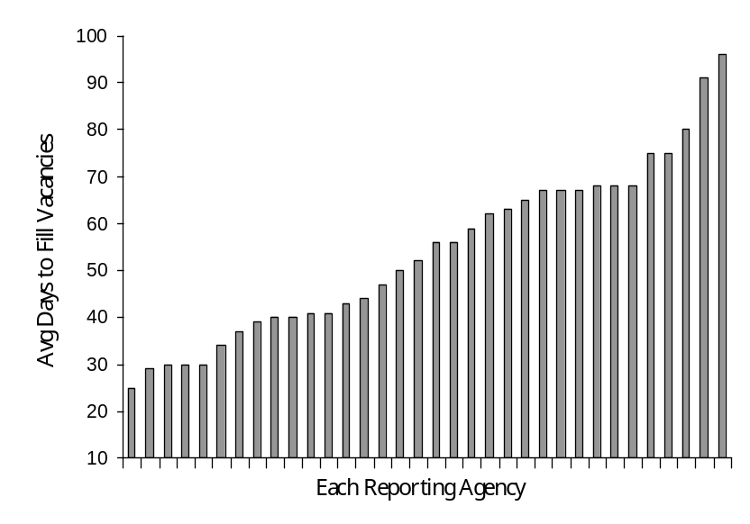
April 2008 HR Management Report Roll-up
Priority 2
Hiring: Time-to-Hire and Candidate Quality
All agencies are now reporting Time-to-Hire
Out of ~36 agencies with >100 employees
Analysis – Time-to-Hire:
As of April 2008, 36 of 36 reporting agencies are monitoring the number of days to fill vacancies. This is a 7-fold increase since October 2006.
Most agencies have developed their own method for tracking this data. Six agencies used e-recruit system.
Average days to hire ranges from a low of 19 in one agency to a high of 92 in another.
HOWEVER – because agencies have used different definitions for Time-to-Hire, comparisons across agencies cannot be made. Therefore, a valid statewide average cannot be determined.
After collaborating with agencies, DOP reiterated in 2/08 that the parameters for Time-to-Hire are:
  Start date = day the hiring supervisor asks the agency HR Office to begin process to fill the vacancy
  End date = day the job offer is accepted
Agencies’ should now be using these parameters so that uniform data can be reported in their October 2008 HR Management Reports.
Please note that Time-to-Hire is not the same as vacancy rate. There are a number of reasons why an agency may choose to not fill a vacancy right away. The present Time-to-Hire measure only captures the time from when the hiring process starts.
Please see the following slide #10 for further analysis and action steps.
Average Time-to-Hire per Agency
Valid data not available until October 2008
Source: State of Washington Department of Personnel

Slide 9
April 2008 HR Management Report Roll-up
Priority 2
Hiring: Time-to-Hire and Candidate Quality (cont.)
Key Issues – Time-to-Hire
70% of agencies indicated in their April 2008 HR Mgmt Report that Time-to-Hire was a high/medium priority for improvement.
It is recognized that the longer the job is vacant, productivity is lost. However, caution must be taken when setting targets for time-to-hire. Less is not necessarily better.
Considerations include:
  Balance length of time with candidate quality. If you hire too fast, you may not have found the best candidate. If you take too much time, you will lose good candidates to other employers.
  Some jobs take longer than others due to the availability of qualified candidates. Finding good managers, medical professionals, IT, and other high skilled professionals takes longer.
  Although comparison with a statewide average is of interest, agencies should use a more precise benchmark (e.g., similar occupations, business lines, etc.).
Other issues mentioned by agencies included:
  Influx of new positions. For example, DOC this has been particularly challenging, especially when combined with turnover problems in the same kinds of jobs.
  Time required to do background checks for sensitive jobs.
  Inadequate workforce planning and other preparatory work by the hiring managers.
  Internal inefficiencies with recruitment and selection processes.
  During any one reporting period, a few “hard-to-fill” vacancies can significantly skew agency’s average.
  Some hard-to-fill jobs require expanded regional and nationwide searches due to lack of source of skills/education in state of WA.
  Internal administrative issues with timely data input and tracking.
Action Plans – Time-to-Hire
Agencies cite a number of process improvements activities to help reduce time-to-hire. Examples include:
Better workforce planning. Anticipate skill and staffing needs ahead of time (e.g., 3-6-9-12 months out).
Keep job/competency descriptions current. Don’t wait until vacancy occurs to update this basic information.
Evaluate HR processes to streamline or eliminate unnecessary steps. Create process improvement team that includes hiring managers and HR staff to address all aspects of hiring process
Devote appropriate HR staff resources to the recruitment function. Have adequate back-up as well.
Track the full cycle of recruitment and hiring activities. Ensure that staff are trained to properly and timely input tracking data.
Require hiring managers to prepare a full recruitment plan for each hiring to include: complete information on specific competencies needed, recruiting sources, and candidate assessment strategies.
Prepare candidate screening and interview tools in advance of recruitment.
Survey new employees and to learn what works well – where and how to target recruitment efforts.
Have a fresh candidate pool steadily available for high volume jobs.
Use a variety of recruitment strategies for hard-to-fill jobs, not just one or two methods.
Seek out best practices and lessons learned
Report out and hold accountable. Review status and progress at internal GMAP sessions.
Be careful not to sacrifice candidate quality when reducing time-to-hire.
The Statewide Recruitment Strategy Team, co-chaired by Eva Santos (DOP) and Karen Lee (ESD), has been carefully reviewing hiring issues. Final recommendations will be presented to the Cabinet in June 2008.
Source: State of Washington Department of Personnel

Slide 10
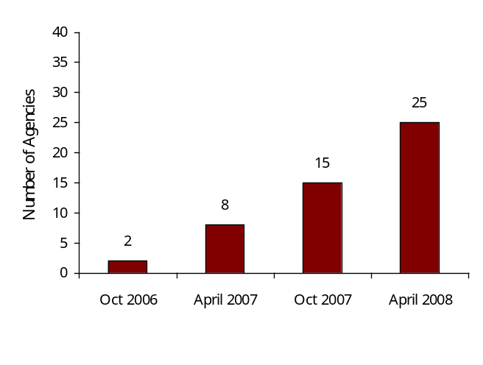
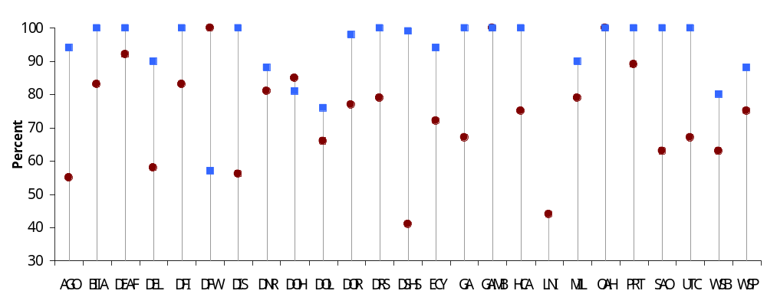
April 2008 HR Management Report Roll-up
Priority 2
Hiring: Time-to-Hire and Candidate Quality (cont.)
Increased reporting of Candidate Quality data
Analysis – Candidate Quality:
This is a key measure of whether agencies’ hiring strategies are working, and one that all agencies should be tracking. As of April 2008, 25 of the 36 HR Mgmt Report agencies are monitoring and reporting candidate quality data – a significant increase from previous reports.
Most agencies have developed their own method for tracking this data. Four agencies are using E-recruit to track this information.
The candidate quality data is based on a brief survey of the hiring managers.
The data depicted in the chart below represents only 22% or 1,226 out of a total of 5,592 appointments made from 7/07 through 12/07. Agencies are still in process of fully implementing their tracking systems.
Averaging across agencies, 74% of candidates interviewed had competencies needed for the job.
Overall, 93% of supervisors said they were able to hire the best candidate of those interviewed for the job. (Not necessarily the ideal candidate, just the best of the candidate pool)
Out of ~36 agencies with >100 employees
Candidate Quality (7/07 – 12/07)
= % of candidates interviewed for the vacancy who actually had the competencies need to perform the job
= % supervisors indicating they were able to hire the best candidate, of those interviewed for the job
Ideally, the red dot and blue dot would be equal, indicating that all candidates had needed competencies AND best candidate accepted the job. This was the case for only 2 agencies.
The worst scenario is where all candidates interviewed had competencies, but agency is repeatedly unable to hire the best candidate.
It is of concern that a significant percentage of the candidates who make it to the interview are not deemed to have the knowledge and skills to succeed in the job.
Source: State of Washington Department of Personnel

Slide 11
April 2008 HR Management Report Roll-up
Priority 2
Hiring: Time-to-Hire and Candidate Quality (cont.)
Key Issues – Candidate Quality
Many agencies have only recently begun to track data on candidate quality. Therefore, data is preliminary at this point.
Some agencies rated this a high priority because they have no tracking system and want to start one to enable data-based analysis.
Supervisors need to work more with HR staff and thoroughly evaluate the position prior to recruitment and be clear on what qualifications are needed for the job.
What candidates say on their application does not always jive with information that comes out during the interview. Not all applicants are representing their qualifications at the level the agency requires for the position.
Anticipate hiring/skill needs, better workforce planning
Applicant screening tools/processes used to qualify for interview need improvement.
Managers and the agency HR Office need to work collaboratively to help ensure a successful recruitment and selection process.
In some cases, existing employees have not accessed Employee Self Service to update their contact information, thus interfering with careers.wa.gov correspondence to them.
Need to be active and creative with recruitment outreach/sourcing. Can’t just rely on passively posting a job announcement to attract good candidates.
Action Plans – Candidate Quality
Agency-specific (examples from Agencies’ HR Mgmt Reports)
Install a system to collect candidate quality data. Or, fully implement newly established tracking system.
Stress importance of and hold managers accountable to report candidate quality information. Regularly monitor and review candidate quality data and progress at internal-GMAP sessions.
Improve workforce planning. Anticipate and articulate skill and education needs.
Streamline application process and improve screening tools to better qualify candidates allowed into the interview.
Identify best practices and lessons learned
Obtain candidate feedback in order to improve hiring processes
Collaborate with other agencies to build qualified candidate pools.
Conduct 3-month-after survey of managers to determine if new appointee is indeed a well-qualified hire; improve processes accordingly.
Bring group of managers together to identify barriers to candidate quality and strategies/implementation plans to overcome.
Managers required to prepare full recruitment plan for each hire, including complete information on job competencies and sourcing strategies.
Address salary disparities for certain job classes that appear to impact ability to hire best candidates.
Use internal job seeker labs to help employees apply for promotional opportunities.
Use a variety of sourcing techniques: DOP search services, recruitment firms, on-line search services, job fairs, college campuses, and others.
Correlate candidate quality with separation during post-hire review period.
Enterprise / DOP:
The Statewide Recruitment Strategy Team, co-chaired by Eva Santos (DOP) and Karen Lee (ESD), has been carefully reviewing hiring issues. Final recommendations will be presented to the Cabinet in June 2008.
Source: State of Washington Department of Personnel

Slide 12
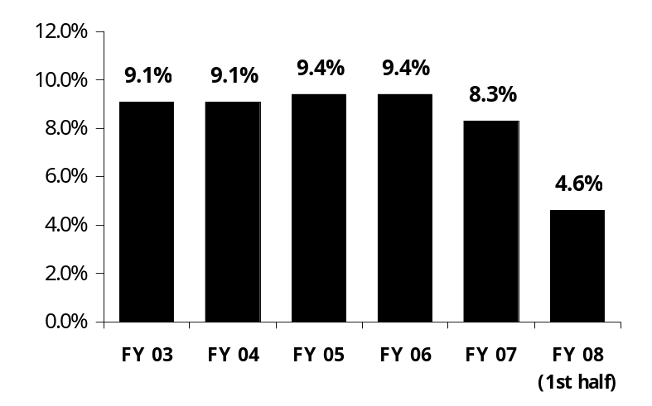
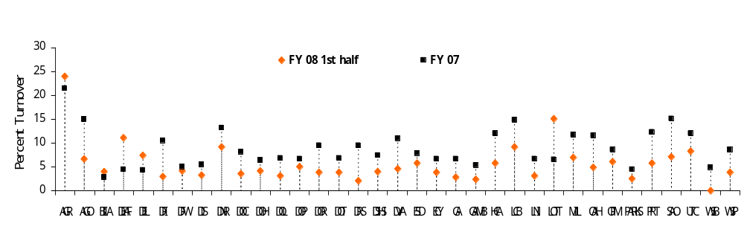
April 2008 HR Management Report Roll-up
Priority 3
Turnover
Statewide Turnover - Overall
(leaving state service)
Statewide Turnover – By Type
(leaving state service)
 | FY 03 | FY 04 | FY05 | FY 06 | FY07 | FY08 (1st half)
Resignation | 4.5% | 4.5% | 4.9% | 5.6% | 5.0% | 2.9%
Retirement | 1.9% | 1.9% | 1.9% | 1.7% | 1.7% | 1.0%
Dismissal | 0.4% | 0.4% | 0.4% | 0.4% | 0.4% | 0.1%
RIF/Other | 2.4% | 2.3% | 2.2% | 1.8% | 1.2% | 0.6%
5,238
5,242
5,498
5,428
4,454
2,530
Note: Turnover due to movement to another agency averages 1.9%
The difference between FY 2006 and 2007 is due data query revisions after conversion to HRMS. Prior to FY 07, some non-permanent employees were included in the turnover data.
1st half FY08 statewide turnover (4.6%) is slightly above the 1st half FY07 (4.4%) due to increased resignations of .2%.
Turnover – By Agency
(leaving state service)
For the 1st half of FY08, 44% (16/36) of agencies are at or below the halfway projection of the FY07 total turnover.
Source: State of Washington Department of Personnel – Business Warehouse standard query

Slide 13
April 2008 HR Management Report Roll-up
Priority 2
Turnover (cont.)
Key Issues – Turnover
21 of 36 agencies indicated Turnover is a high/medium priority for their agency
1st half FY08 statewide turnover is up .2% from 1st half FY07. Increase is in Resignations.
While various issues are cited by agencies concerning Turnover (see below), the recurring issue seems to be non-competitive wages.
Some key issues presented by agencies include:
  Exit interview data indicates a concern for cost of living vs compensation.
  Ability to report Turnover at the agency level, rather than just “Leaving State Service”.
  NOTE: DOP is currently working toward a solution of including “churnover” data, rather than just those leaving state service.
  Ongoing challenges losing employees to private sector for higher salaries.
  Concerns over cost, time and resources used for training new hires who soon leave agency for other positions
Action Plans – Turnover
Agency-specific (examples from Agencies’ HR Mgmt Reports)
Submitting classification and pay proposals to reflect more competitive salaries
Using exit interview data to develop turnover reduction strategies
Implementing recruitment and retention strategies and teams
Providing opportunities within the agency to promote vertically or horizontally
Directing resources to high turnover areas
Developing succession planning strategies
Providing clear expectations of duties during recruitment process
Adding recognition component to look at ways to promote recognition of staff within agency
Enterprise
The Statewide Recruitment Strategy Team, co-chaired by Eva Santos (DOP) and Karen Lee (ESD), has reviewed retention and workforce planning issues. Final recommendations will be presented to the Cabinet in June 2008.
DOP is working on a solution to include “churnover” tracking in HRMS. Progress report due mid-summer 2008.
DOP will conduct drill down analysis on some specific jobs and compare to salary survey recommendations (summer 2008).
Source: State of Washington Department of Personnel

Slide 14
2007 State Employee Survey – Analysis Summary
April 2008 HR Management Report Roll-up
Overall Results
The State Employee Survey was administered on a statewide basis in April 2006, and again in November 2007.
72 agencies, boards, and commissions participated in the survey. 35,838 employees took the survey, for a response rate of 58%.
A rating scale of 1 (lowest) to 5 (highest) was used.
The overall average score for 2007 was 3.80, compared to 3.78 in 2006. This is a statistically significant improvement.*
 |  | Average Rating
# | Survey Questions | Apr 2006 | Nov 2007 | + / - Change
1 | I have the opportunity to give input on decisions affecting my work. | 3.50 | 3.56 | + .06
2 | I receive the information I need to do my job effectively. | 3.80 | 3.77 | - .03
3 | I know how my work contributes to the goals of my agency. | 4.12 | 4.14 | + .02
4 | I know what is expected of me at work. | 4.28 | 4.25 | - .03
5 | I have opportunities at work to learn and grow. | 3.59 | 3.66 | + .07
6 | I have the tools and resources I need to do my job effectively. | 3.76 | 3.75 | - .01
7 | My supervisor treats me with dignity and respect. | 4.29 | 4.29 | 0
8 | My supervisor gives me ongoing feedback that helps me improve my performance. | 3.72 | 3.76 | + .04
9 | I receive recognition for a job well done. | 3.34 | 3.43 | + .09
10 | My performance evaluation provides me with meaningful information about my performance. | 3.39 | 3.45 | + .06
11 | My supervisor holds me and my co-workers accountable for performance. | 4.14 | 4.11 | - .03
12 | I know how my agency measures its success. | 3.39 | 3.43 | + .04
13 | My agency consistently demonstrates support for a diverse workforce. | n/a | 3.83 | n/a
 | OVERALL | 3.78 | 3.80 | + .02
* = statistically significant difference at 95% confidence level.
Note: Key factors for statistical significance: size of change; number of respondents; degree of variability among responses.
Source: State of Washington Department of Personnel

Slide 15
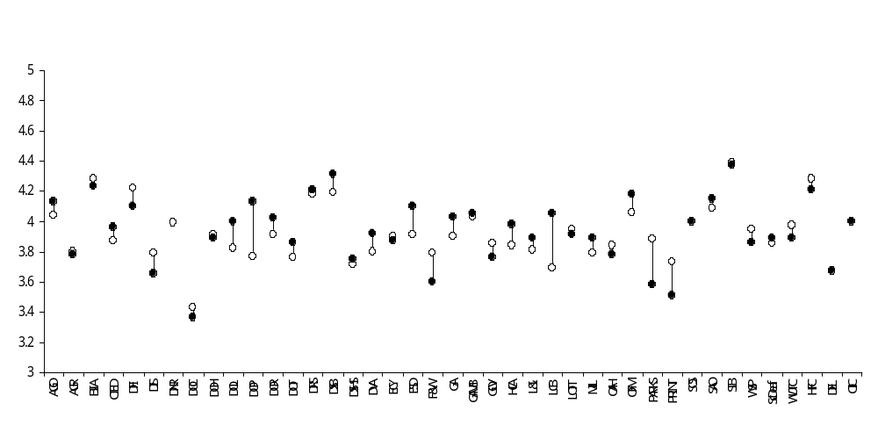
2007 State Employee Survey – Analysis Summary (cont)
April 2008 HR Management Report Roll-up
Average Scores per Agency
April 2006
November 2007
Target = 4.00 or better
2007 Ave = 3.80
2006 Ave = 3.78
Most Improved Agencies | Avg 2006 | Avg 2007 | Increase
Dept of Personnel | 3.77 | 4.13 | + .36
Liquor Control Board | 3.69 | 4.05 | + .36
Employment Security | 3.91 | 4.10 | + .19
Department of Licensing | 3.82 | 4.00 | + .18
General Administration | 3.90 | 4.03 | + .13
Office of Financial Mgmt | 4.06 | 4.18 | + .12
Veterans Affairs | 3.80 | 3.92 | + .12
Dept of Revenue | 3.91 | 4.02 | + .11
Dept of Transportation | 3.76 | 3.86 | + .10
Attorney General Office | 4.04 | 4.13 | + .09
Labor & Industries | 3.81 | 3.89 | + .08
Social & Health Services | 3.71 | 3.75 | + .04
18 agencies have an overall survey rating of 4.00 or higher:*
Attorney General’s Office
Board of Industrial Insurance Appeals
Department of Financial Institutions
Department of Licensing
Department of Personnel
Department of Revenue
Department of Retirement Systems
Department of Services for the Blind
Employment Security Department
General Administration
Gambling Commission
Housing Finance Commission
Liquor Control Board
Office of Financial Management
Office of Insurance Commissioner
Secretary of State
State Auditor’s Office
State Investment Board
* Of agencies with >50 respondents to the survey
Source: State of Washington Department of Personnel

Slide 16
April 2008 HR Management Report Roll-up
2007 State Employee Survey – Analysis Summary (cont)
Notable Highlights:
In the statewide roll-up results, the lowest scoring questions in the 2006 survey pertained to recognition (Q #9), performance evaluation (Q #10), and knowing how agency success is measured (Q #12). In the recent 2007 survey, these continue to be the lowest scoring questions. However, the scores for each of these questions improved significantly as highlighted below:
Receiving recognition:
Statewide, the most improved score was for Question #9 “I receive recognition for a job well done”, which increased +.09 points in 2007. Still, this question remains tied with Q#12 as the lowest scoring question.
Getting meaningful performance evaluations and feedback:
The statewide score for Question #10 on receiving meaningful performance evaluations improved significantly with an increase of +.06 in 2007.
  It is noteworthy that the percent of completed performance evaluations jumped from 64% in 2006 to 84% in 2007, and is now at 90% statewide. This likely correlates to the improvement on Q# 10, and possibly the improvement of +.04 on Q #8 about receiving helpful ongoing feedback.
Knowing how one’s agency measures its success:
The statewide score for Question #12 “I know how my agency measures its success” significantly improved by +.04. It remains tied as the lowest scoring question in the survey, but this 2007 improvement is significant.
  Clearly articulated agency success measures that employees know and understand are central to a strong performance-based culture. Agencies that do well on this question, tend to do well on almost every other question on the survey and have higher overall scores.
2006
3.34
2007
3.43
2006
3.39
2007
3.45
2006
3.39
2007
3.43
Never
Seldom
Occasionally
Usually
Always
No Response

Slide 17
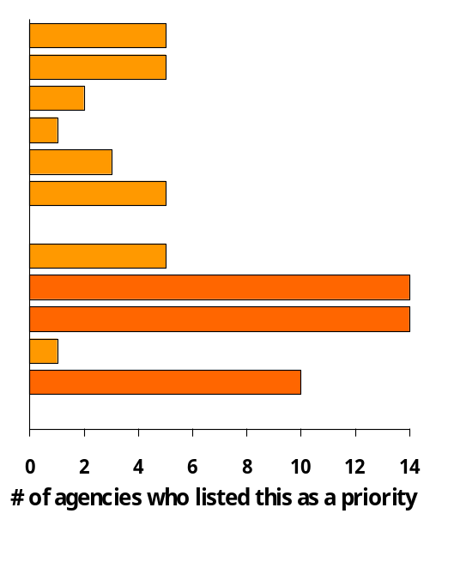
April 2008 HR Management Report Roll-up
2007 State Employee Survey – Analysis Summary (cont)
Approaches agencies took to generate focused survey data and action plans:
  Most agencies conducted drill-down analysis, action planning, and communication at all levels of their organization. Examples include:
    Added customized questions to the standard survey for further insight on employee climate
    Analysis by administration, division, and unit level
    Senior management implemented a thorough and timely process for communicating results to employees
    Management held conversations with staff to identify suggestions, priorities, and planned actions
    Action plans based on staff feedback
    Link created between the action plans and strategic planning process
    Thank staff for participating in the survey
Recognition, Performance Evaluation, and Measuring Success are the three most frequent agency survey priorities.
Q1 – Staff input in decision making
Q2 – Information to do job effectively
Q3 – Knowledge of contribution to agency goals
Q4 – Knowledge of work expectations
Q5 – Opportunity to learn and grow
Q6 – Tools & resources to do job effectively
Q7 – Treated with dignity and respect
Q8 – Feedback
Q9 – Recognition
Q10 – Performance evaluation
Q11 – Accountability
Q12 – Measuring success
Q13 – Support for a diverse workforce
As part of their April 2008 HR Management Report, agencies were asked to attach a high level summary of their employee survey analysis.
The three areas that most agencies listed as their key focus for improvement happen to be the same areas that had the lowest statewide scores.
Issues and examples of agency action steps are listed on the following slide.
Agencies often noted multiple priorities in their survey analysis
Source: State of Washington Department of Personnel

Slide 18
2007 State Employee Survey – Analysis Summary (cont)
April 2008 HR Management Report Roll-up
Key Issues
Receiving recognition:
Although most improved, Q #9 “I receive recognition for a job well done” continues to be the lowest scoring question (tied with Q #12). 48% of respondents statewide indicate that they “never/seldom” or only “occasionally” receive recognition.
Over the past 1½ years, several agencies have indicated in their HR Management Reports that they were implementing employee recognition initiatives, sometimes as part of a larger performance management initiative.
High scoring agencies have noted that meaningful recognition must be regular and focused on performance that contributes to achievement of agency goals, rather than the occasional “cake & punch” ceremony.
Getting meaningful performance evaluations:
Over the past two years, many agencies have implemented action plans to improve performance management, including executive direction, supervisory training, placing an emphasis on completing performance evaluations, and holding managers accountable to do so.
These efforts are clearly starting to make a difference: the percent of completed performance evaluations jumped from 63% in 2006 to 90% statewide by the end of 2007.
Educating/coaching supervisors on giving meaningful evaluations and feedback is a next step indicated in many agencies’ HR Management Reports.
See also slides #6-7 of this report.
Knowing how one’s agency measures its success:
The statewide score for Q #12 “I know how my agency measures its success” improved by +.04, but remains tied as the lowest scoring question, with 45% of respondents replying “never/seldom” or only “occasionally.”
Clearly articulated agency success measures that employees know and understand are central to a strong performance-based culture.
Executive leadership, visibility and frequent communication about what success looks like, and how each employee’s job and performance contributes to that success, is key. It helps solidify a clear linkage of agency priorities with employee performance, feedback, and recognition.
Action Plans
(examples from Agencies’ HR Mgmt Reports)
Recognition:
Provide recognition that is Timely, Specific, Sincere, Individual, Personal, and Proportional
Ask employees and managers for meaningful recognition strategies
Stress the importance of ongoing, just-in-time recognition
Invite staff to Management Team meetings for recognition
Implement recognition initiatives as part of a comprehensive performance management program
Agencies listed a variety of specific recognition strategies
Performance evaluations:
Continued commitment from the leadership team and managers
Treat the evaluation process as an ongoing dialogue
Solicit input from staff early in the PDP process
Provide time and a structure to discuss and generate solutions for each employee’s work situation
Assess PDP quality on an on-going basis
Provide status reports through the internal GMAP process
Implement “just in time” training on PDP’s and performance management
Measuring success:
Use the logic model to help connect employee work and agency goals
Involve staff at all levels in aligning and creating strategic plan
Start staff meetings with a “How are we doing” measure report that links to strategic plans
Communicate how the agency is meeting its goals and objectives in relation to GMAP, the strategic plan, and other significant accomplishments
Involve line staff in the presentation of agency-internal GMAP sessions
Provide easy intranet access to performance measures and reports
Frequent communication: quarterly all-staff meetings, environmental scan sessions, messages from leadership
Source: State of Washington Department of Personnel

