Slide 1

Tipranavir
NDA 21-814
Antiviral Drugs Advisory Committee
May 19, 2005

Slide 2
HIV Drug Resistance
Different patient populations
  Naïve subjects harboring resistant virus
  Limited or Intermediate prior treatment with resistance
  Extensive prior treatment with resistance with limited treatment options

Slide 3
HIV Drug Resistance in the U.S.
Treatment-experienced subject cohort with VL > 500 copies/ml from HIV Cost and Service Utilization Study (Richman, et al, AIDS, 2004)
Overall resistance was 76%
2-class resistance = 48%
3-class resistance = 13%

Slide 4
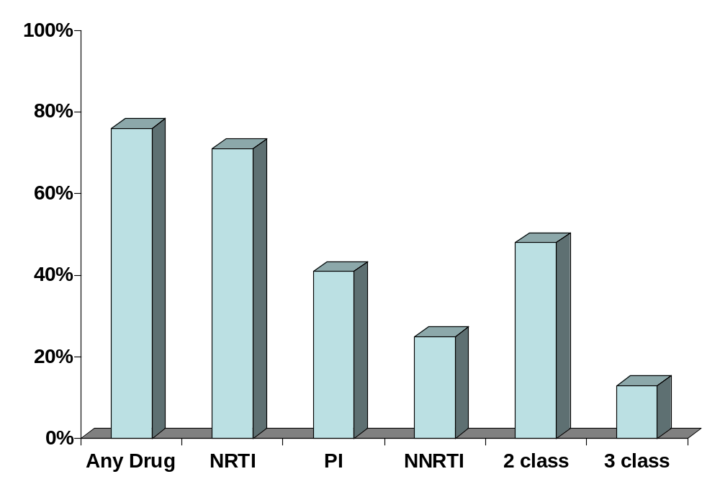
Prevalence of Estimated HIV Drug Resistance
76%
71%
48%
% of U.S. subjects with drug resistance
41%
25%
13%
Drug resistance detected
Richman, et el. AIDS. July 2004

Slide 5
Current State of Therapy for Patients with Limited Treatment Options
Enfuvirtide(T-20)
  Traditional approval 2004
Drugs in antiviral pipeline
Tipranavir
  2 key studies in a highly treatment experienced population

Slide 6
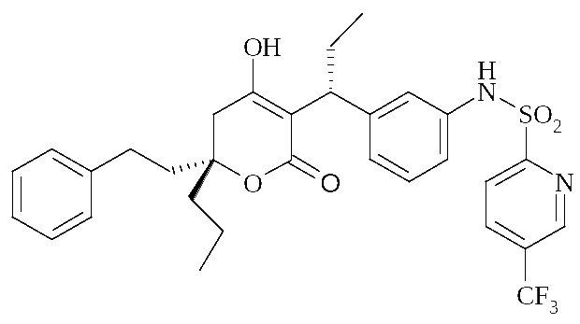
Tipranavir

Slide 7
Tipranavir/r: Trial Design
Resist 1 and Resist 2
  Open label
    TPV/r + OBR vs CPI/r + OBR
  Amended protocol allowed patients with PI resistant virus to receive a PI-based regimen
    Analyzed as superiority trials
  Escape clause @ week 8 to allow subjects with VF to receive TPV in 1182.17
    Loss of control arm @ week 8

Slide 8
Tipranavir/r: Patient Population
Highly treatment experienced
  3 class experienced
  Median number of 12 prior antiretroviral drugs
  Prior T-20 use in 12%
  Baseline resistance
    97% of isolates resistant to at least 1 PI
    95% of isolates resistant to at least 1 NRTI
    75% of isolates resistant to at least 1 NNRTI

Slide 9
Tipranavir/r: FDA Presentation
Efficacy evaluation
Resistance evaluation
Exposure-response data
Drug-drug interactions
  CYP 3A inhibitor
  PgP inducer
Safety profile
  Hepatoxicity
  Rash
  Hyperlipidemia
Summary

Slide 10
NDA 21-814 Review Team
Clinical Statistical
  Jeff Murray Greg Soon
  Rosemary Johann-Liang Rafia Bhore
  Andrea James Susan Zhou
  Melisse Baylor
  Neville Gibbs
  Virology Toxicology
  Jules O’Rear James Farrelly
  Lisa Naeger Anita Bigger
  Kim Struble
  Chemistry Clin. Pharmacology
  Stephen Miller Kellie Reynolds
  Ko Yu-lo Derek Zhang
  Jenny J. Zheng
  Joga Gobburu
  Project Management
  Tanima Sinha

