Slide 1

Washington State
Department of General Administration
Human Resource Management Report
Linda Villegas Bremer, Director
Department of General Administration
September 2006

Slide 2
Logic Model
Managers Accountability for Workforce Management
Plan & Align Workforce
Hire
Workforce
Deploy
Workforce
Develop Workforce
Reinforce Performance
Articulation of managers HRM accountabilities. HR policies. Workforce planning. Job classes & salaries assigned.
Qualified candidate pools, interviews & reference checks. Job offers. Appts & per-
formance monitoring.
Work assignments& requirements defined. Positive workplace environment created. Coaching, feedback, corrections.
Individual development plans. Time/ resources for training. Continuous learning environment created.
Clear performance expectations linked to orgn’al goals & measures. Regular performance appraisals. Recognition. Discipline.
Staffing levels & competencies aligned with agency priorities. Mgr’s HRM accountabilities are understood.
Best candidate hired & reviewed during appointment period. Successful performers retained.
Workplace is safe, gives capacity to perform, & fosters productive relations. Staff know job rqmts, how they’re doing, & are supported.
Learning environment created. Employees are engaged in develop-
ment opportunities & seek to learn.
Employees know how performance contributes to success of orgn. Strong performance rewarded; poor performance eliminated
Foundation is in place to build and sustain a productive, high performing workforce.
The right people are in the right job at the right time.
Time & talent is used effectively. Employees are motivated & productive.
Employees have competencies for present job & career advancement
Successful performance is differentiated & strengthened. Employees are held accountable.
State government has workforce depth & breadth needed for present and future success
Employees are committed to the work they do & the goals of the organization
Productive, successful employees are retained
Agencies are better enabled to successfully carry out their mission. The citizens receive efficient government services.

Slide 3
Human Resource Management Report
Standard Performance Measures
Plan & Align Workforce
Percent current position/competencies descriptions
Percent supervisors with current performance expectations for workforce management
Time-to-fill funded vacancies
Percent satisfaction with candidate quality New Hire-to-Promotional ratio
Percent turnover during review period
Percent employees with current performance expectations
Employee survey ratings on “productive workplace” questions
Leave usage (sick, LWOP, unscheduled leave)
Overtime usage
Number & type of non-disciplinary grievances
Percent employees with current annual individual development plans
Employee survey ratings on “learning/development” questions
Percent current performance evaluations
Employee survey ratings on “performance accountability” questions
Number/type of disciplinary issues, actions, appeals disposition
Turnover rates and types (e.g., retirement, resignation, etc.)
Turnover rate of key occupational categories and of workforce diversity
Employee survey ratings on “commitment” questions
Hire Workforce
Measures to add in the future:
Current workforce plans that align staff with business priorities
Safety and Workers Compensation measures
Competency gap analysis measure
Recognition/reward measure
Others to be determined
Deploy Workforce
Develop Workforce
Reinforce Performance
Ultimate Outcomes

Slide 4
Overall foundation & management accountability system to build & sustain high performing workforce
Plan & Align Workforce |
HR Management Report category:
Plan & Align - Slide 1 of 1
HR Management Report
(preliminary standard measures)
Percent current position/competency descriptions
Percent supervisors with current performance expectations for workforce management
Percent positions with current job and competency descriptions
  Position Descriptions Forms/ Competencies – 70.5% complete as of June 30, 2006.
Percent supervisors with current performance expectations for workforce management
  Expectations were sent to all supervisors/managers and will be attached to PDP’s.
  Status: 100% complete
Notes:
Notes:

Slide 5
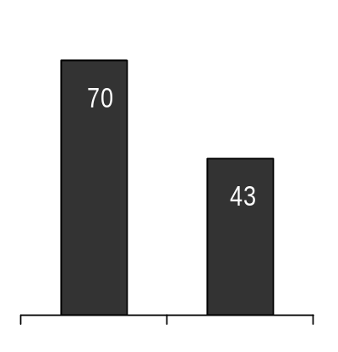
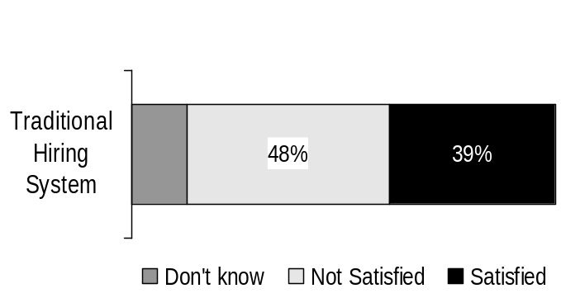
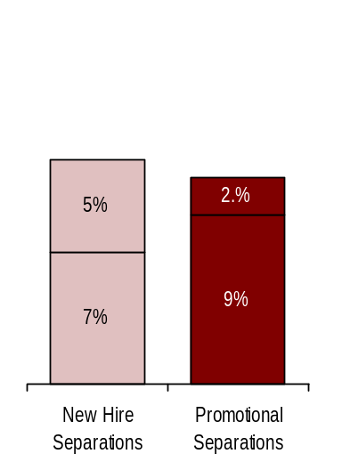
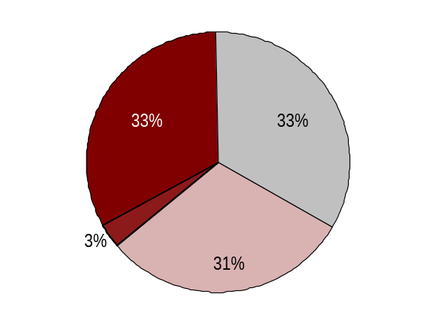
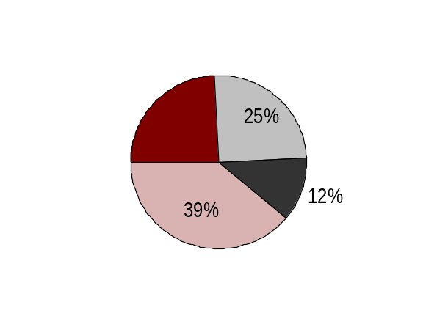
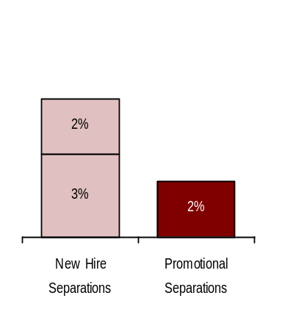
Hire Workforce |
HR Management Report category:
Right People in the Right Job at the Right Time
Hire Workforce - Slide 1 of 1
HR Management Report
(standard measures)
Days to fill vacancies (from requisition to job offer)
% satisfaction with candidate quality
% new hires; % promotional hires
Retention/dismissal rate during appointment period
Estimated days to fill vacancies
Candidate Quality
(managers’ satisfaction rating)
14-70 range
Implement when rating available from DOP, date TBD
Implement when rating available from DOP, date TBD
State Agencies
Industry Benchmark
Source: 2003 Mercer Benchmark Study
Source: 2001 DOP random survey of managers
GA Hiring Balance
2003-05 Biennium
Separation during Review Period
GA Hiring Balance
FY 06 TD 4th Qtr
Separation during Review Period
(274 total appointments)
(94 total appointments)
* Released
** Voluntary
* Released
** Voluntary
Promotions
(intra-agency)
Other Internal
Other
*
*
Promotions
(intra-agency)
24%
**
In-Training
*
**
**
New Hires
*
Promotions
(inter-agency)
New Hires
Source: DOP Data Warehouse: Last available data June 30. 2006
Notes:
Notes:

Slide 6
Deploy Workforce |
HR Management Report category:
Employee time and talent is used effectively. Employees motivated.
HR Management Report
(standard measures)
Percent employees with current performance expectations
Employee survey ratings on “productive workplace” questions
Overtime usage
Sick leave usage (and “unscheduled” leave if available)
Number & type of non-disciplinary grievances and disposition
Deploy Workforce - Slide 1 of 5
Percent employees with current performance expectations
  Preliminary review indicates 46% of GA employees have current PDP’s as of June 30, 2006.
  Plan for 90% completion by Oct. 1, 2006.
Do employees have day-to-day support to enable successful job performance?
"Deploy Workforce" Overall Average GA 4.0 STATE 3.8
GA STATE
Q 1) I have the opportunity to give input on decisions affecting my work. 3.8 3.5
Q 2) I receive the information I need to do my job effectively. 4.0 3.8
Q 4) I know what is expected of me at work. 4.4 4.3
Q 6) I have the tools and resources I need to do my job effectively. 4.1 3.8
Q 7) My supervisor treats me with dignity and respect. 4.4 4.3
Q 8) My supervisor gives me ongoing feedback that helps me improve my performance. 3.9 3.7
Q 9) I receive recognition for a job well done. 3.5 3.3
Survey conducted Spring 2006. GA had 396 responses or six out of ten GA employees participated – slightly more than the statewide average.

Slide 7
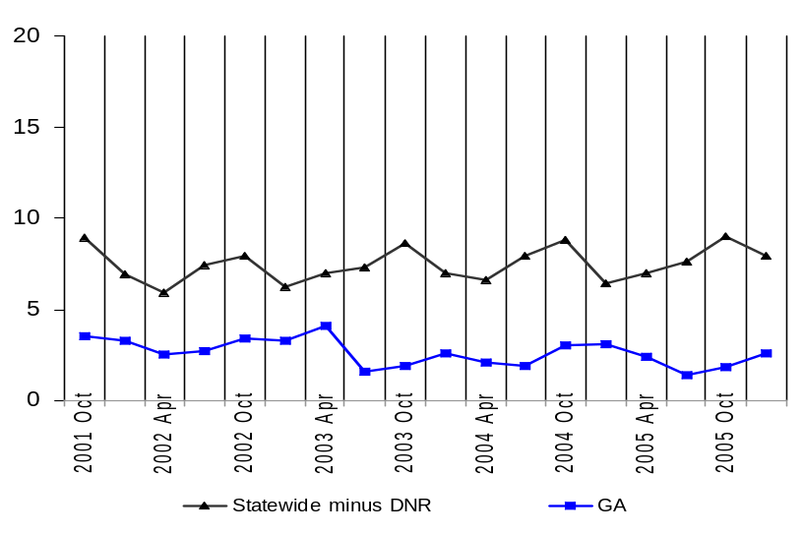
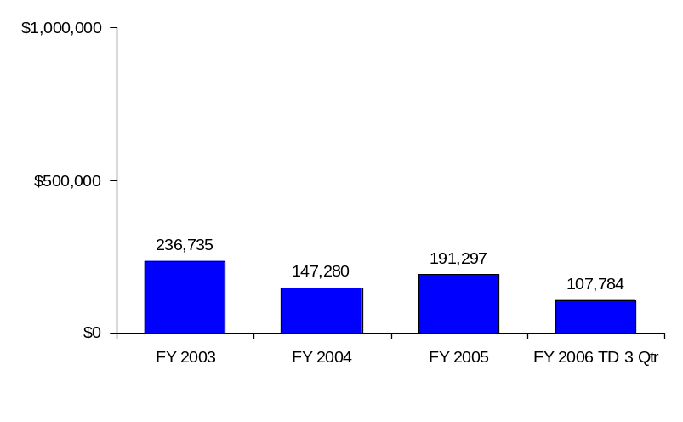
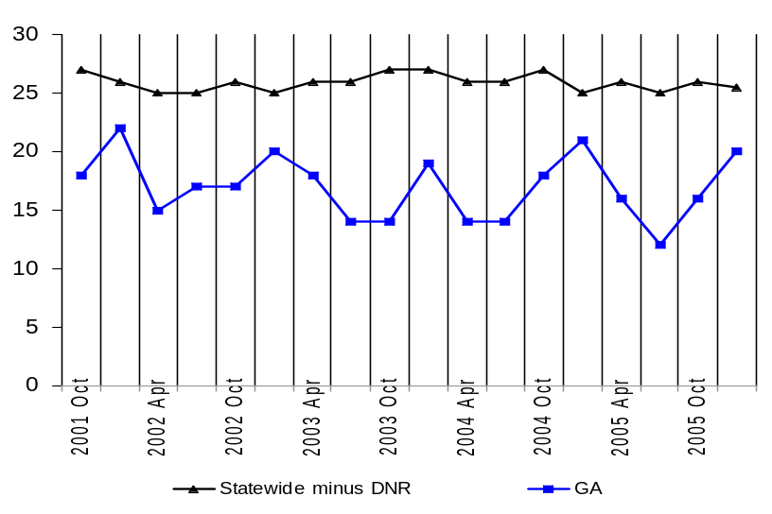
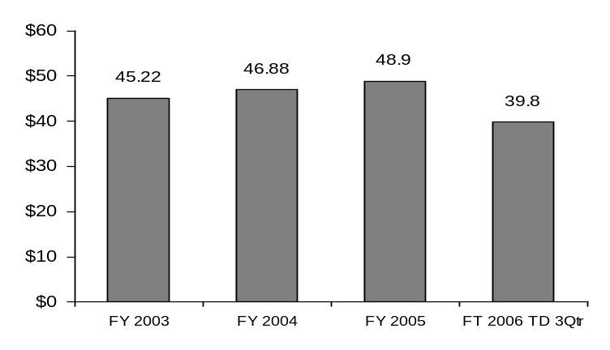
Deploy Workforce |
HR Management Report category:
Employee time and talent is used effectively. Employees motivated.
Overtime: Is employee time well managed?
Deploy Workforce - Slide 2 of 5
Average Overtime Hours per Employee per Quarter*
GA Overtime Costs
Quarter
Average Percent Employees Receiving Overtime
Statewide Overtime Costs
(In $Millions. Excludes DNR)
Percent Employees
Quarter
Source: DOP Data Warehouse: Last available data March 30. 2006

Slide 8
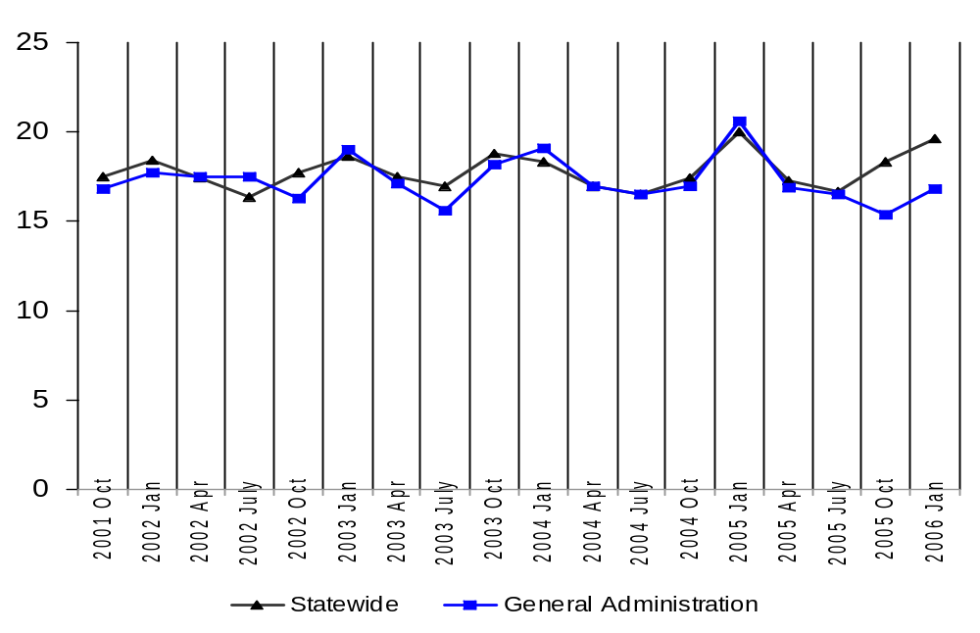
Deploy Workforce |
HR Report Card category:
Employee time and talent is used effectively. Employees motivated.
Leave: Do employees come to work as scheduled?
Deploy Workforce - Slide 3 of 5
Average Sick Leave Hours per Employee per Quarter
Notes:
It is unknown whether the sick leave usage shown was planned or unplanned.
Quarter
Per Capita Sick Leave Use
Just Those Who Took Sick Leave
Ave. Sick Leave Hours Used per Qtr*
% of Earned Sick Leave
Ave. Sick Leave Hours Used per Qtr*
% of Earned Sick Leave
Statewide
17.8
hours
74%
22.8
hours
95%
General Administration
16.2
hours
60%
20.8
hours
87%
*Average since Oct. 2001
Source: DOP Data Warehouse: Last available data March 30. 2006

Slide 9
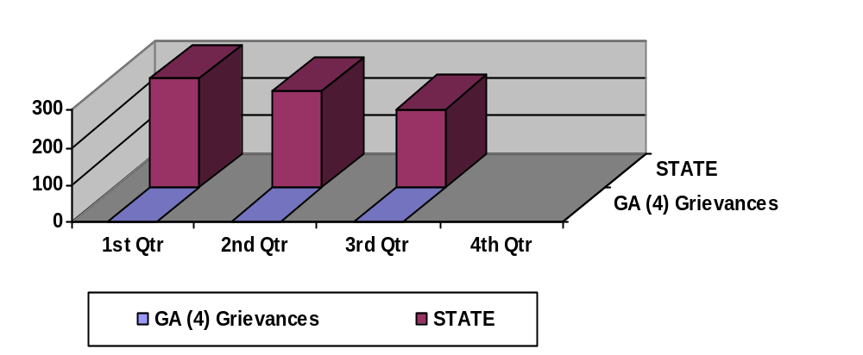
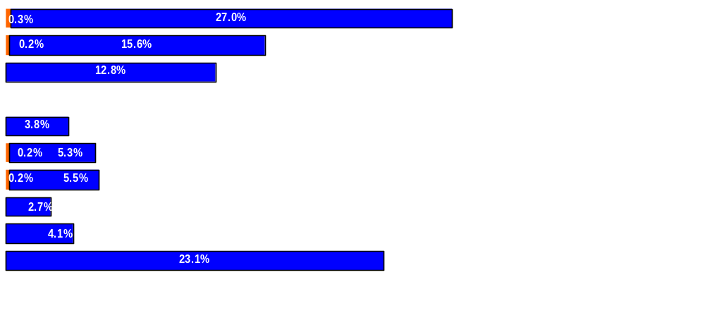
Deploy Workforce |
HR Management Report category:
Employee time and talent is used effectively. Employees motivated.
Employee relations: Are contracts/policies applied appropriately?
Deploy Workforce - Slide 4 of 5
Notes:
Grievance filing information is reported monthly by the agency to the State Labor Relations Office (LRO). LRO then maintains statewide data.
LRO tracks which grievances move on to pre-arbitration reviews and arbitrations. They also track outcomes and trends statewide and by agency.
116
95
80
Discipline
Compensation
Overtime
Work Hours
Bid System
Leave
Hiring/Appts
Non-discrimination
Management Rights
All other
All Other Agencies
GA Only
Source: State Labor Relations Office :Last available data March 30. 2006

Slide 10
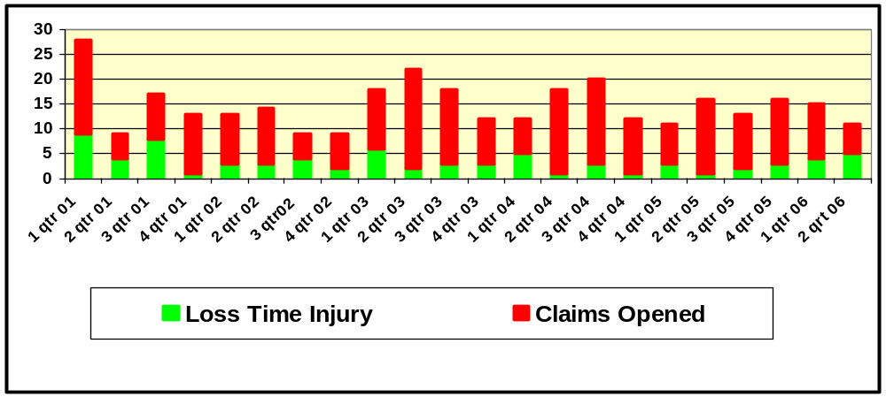
Deploy Workforce |
HR Management Report category:
Employee time and talent is used effectively. Employees motivated.
Safety and Worker Compensation Measures
Deploy Workforce - Slide 5 of 5
116
95
80
Analysis:
Track and monitor Time Loss Claims to ensure the injured employee is returned to work as soon as the employee is able.
Current information as of June 30, 2006 - 15 Time Loss and 55 injury claims. All injured workers have returned to work.
Current injury experience rating is .83 - 1.00 is average
GA injury experience rating currently ranks 63 best out of 156 agencies, colleges and universities
Source: GA internal log and OFM Risk Management

Slide 11
Employees have competencies for present job and future advancement
Develop Workforce |
HR Management Report category:
Develop Workforce - Slide 1 of 1
HR Management Report
(standard measures)
Percent employees with current annual individual development plans
Employee survey ratings on “learning & development” questions
Percent employees with current annual individual development plans
  Review indicates 46% of GA employees have current IDP’s as of June 30, 2006.
Employee perceptions on learning and development:
"Develop Workforce" Overall Average GA 3.8 STATE 3.65
GA STATE
Q 5) I have opportunities at work to learn and grow. 3.7 3.6
Q 8) My supervisor gives me ongoing feedback that helps me improve my performance. 3.9 3.7
Survey conducted Spring 2006. GA had 396 responses or six out of ten GA employees participated – slightly more than the statewide average
Notes:
Notes:

Slide 12
Successful performance is differentiated & strengthened. Employees are held accountable.
Reinforce Performance |
HR Management Report category:
Reinforce Performance - Slide 1 of 2
HR Management Report
(standard measures)
Percent employees and managers with current annual performance evaluations
Employee survey ratings on “performance and accountability” questions
Number and type of disciplinary issues, actions, appeals disposition
Percent employees and managers with current annual performance evaluations
  Present data indicates 76.5% General Service, 100% Management Service employees have current annual performance evaluations, as of June 30, 2006
Do employees see a meaningful linkage between their performance and the success of the organization?
“Reinforce Performance" Overall Average GA 3.95 STATE 3.8
GA STATE
Q 3) I know how my work contributes to the goals of my agency. 4.2 4.1
Q 8) My performance evaluation provides me with meaningful information about my performance. 3.9 3.7
Q 9) I receive recognition for a job well done. 3.5 3.3
Q 11) My supervisor holds me and my co-workers accountable for performance. 4.2 4.1
Survey conducted Spring 2006. GA had 396 responses or six out of ten GA employees participated – slightly more than the statewide average
Notes:
Notes:
Training on the new performance evaluation system has been very popular. In FY 05 = 1,200 trained. In FY 06 to date = 225 and 875 more anticipated for remainder of fiscal year. Over 97% of these participants are managers and supervisors.

Slide 13
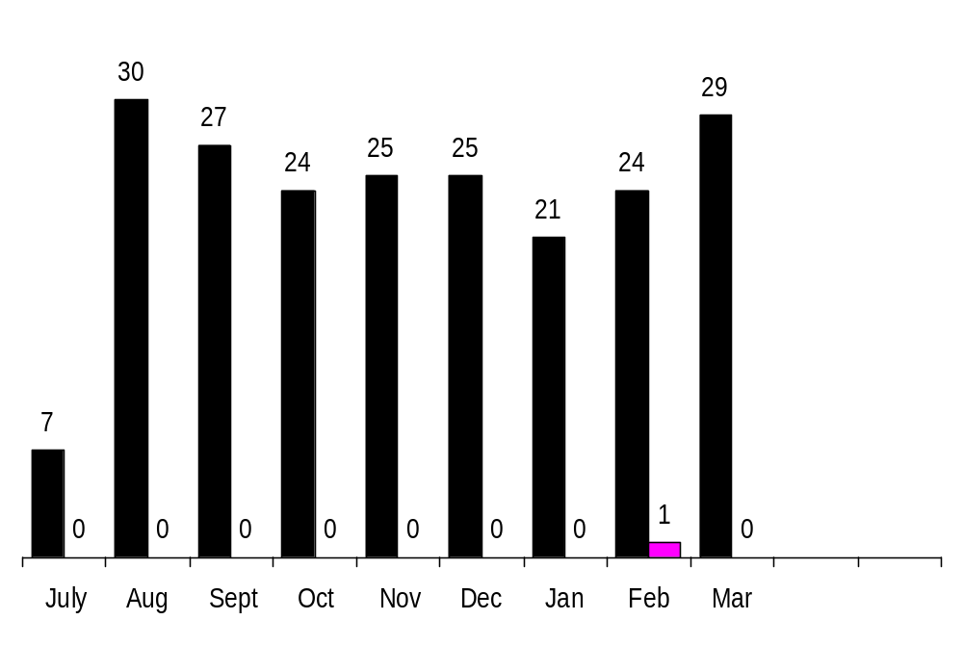
Reinforce Performance |
HR Management Report category:
Successful performance is differentiated & strengthened. Employees are held accountable.
Disciplinary action: Is poor performance dealt with?
Reinforce Performance - Slide 2 of 2
Disciplinary Grievances Filed Since July 1, 2005
Issues Leading to Disciplinary Action and Disciplinary Grievances
All agencies (including GA)
GA Only – One to date
Placeholder. DOP is presently working with LRO and AGO to track types of issues that lead to disciplinary action and related grievances.
Source: DOP Data Warehouse: Last available data March 30. 2006

Slide 14
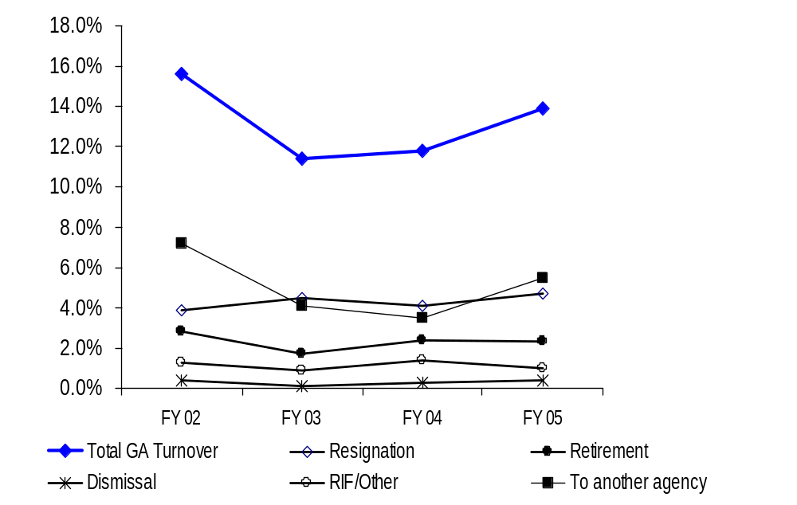
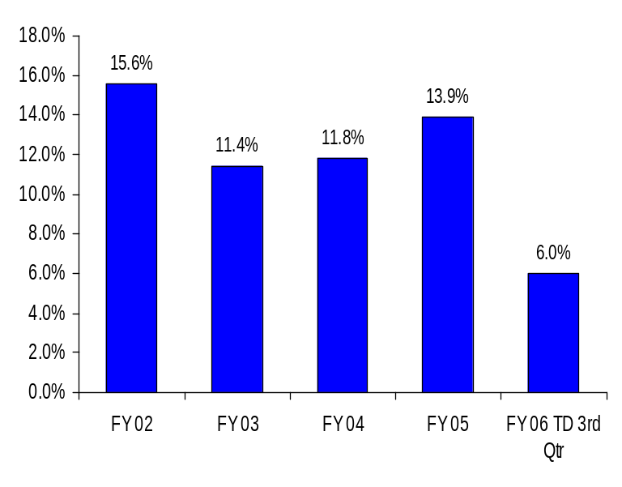
Ultimate Outcomes |
HR Management Report category:
Ultimate Outcomes - Slide 1 of 2
Turnover – General Administration
(Leaving the agency)
Workforce Turnover Breakdown
Source: DOP Data Warehouse: Last available data March 30. 2006
Notes:
Notes:

Slide 15
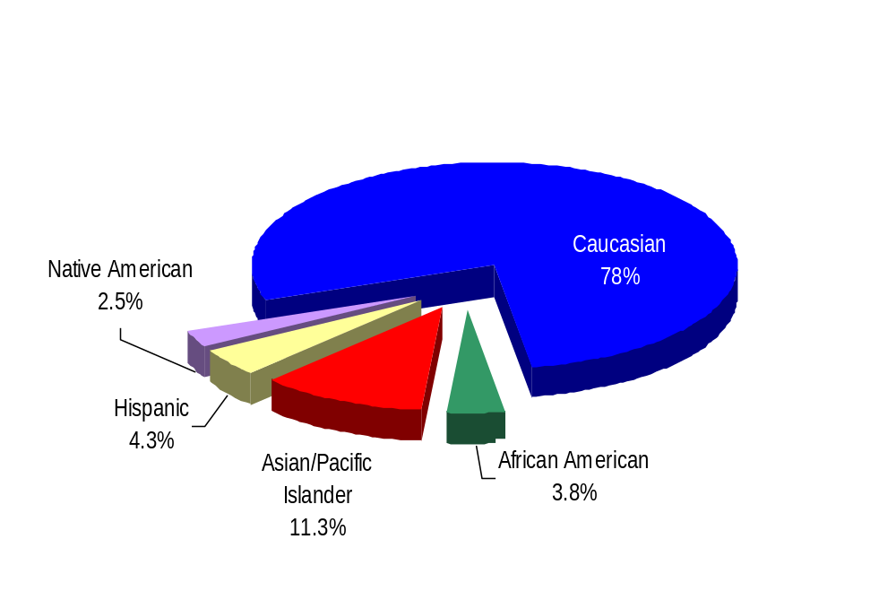
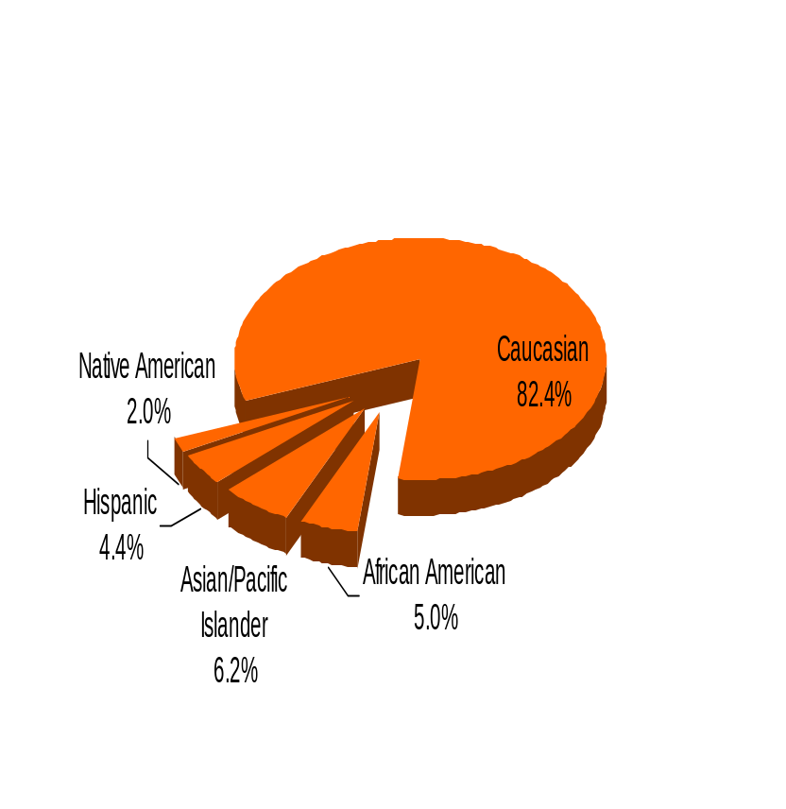
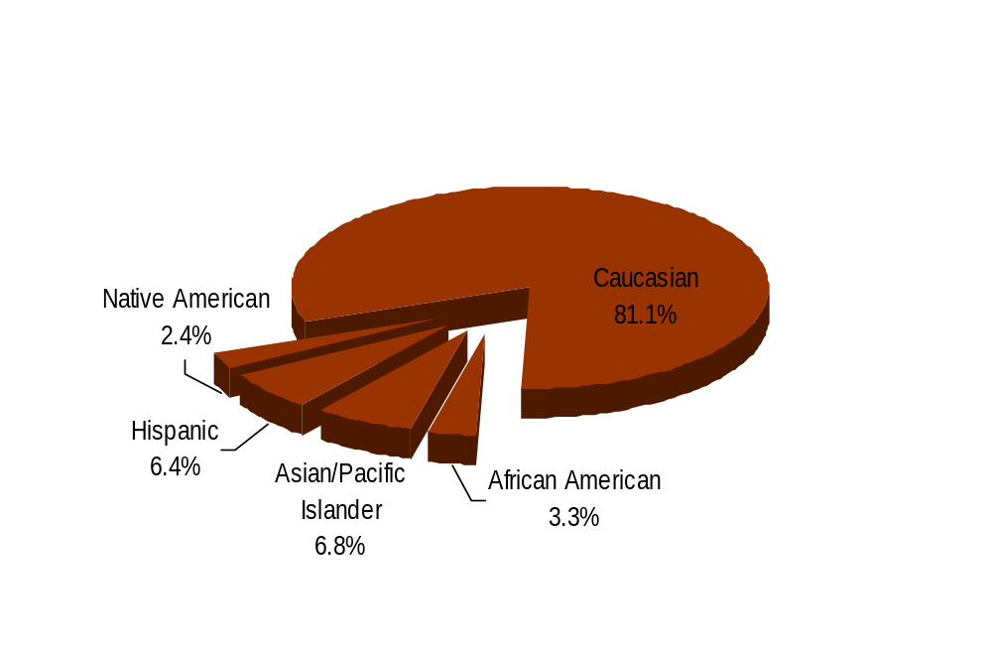
Ultimate Outcomes | continued
HR Management Report category:
Ultimate Outcomes - Slide 2 of 2
Workforce Diversity
Department of
General Administration
Diversity Profile GA State
Women 34.9% 52.0%
Persons with disabilities 6.0% 5.2%
Vietnam Veterans 10.1% 7.3%
Disabled Veterans 0.8% 1.3%
Persons over 40 83.0% 73.1%
People of color 22.0% 17.6%
WA State Government
WA Labor Force
Source: DOP Data Warehouse as of June 30, 2006

