Slide 1
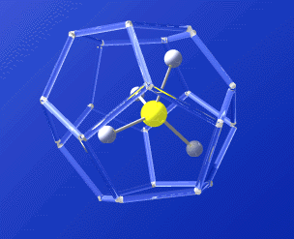
Gas Hydrate: Ice-like structure that traps gases
Methane, Carbon Dioxide, Ethane,
Butane, Propane, Hydrogen Sulfide
Source: U.S. Geological Survey
Notes:
Gas hydrates are a crystalline or ice-like structure that forms a cage around a molecule of gas, as you can see here. The water molecules are bonded to form the structure and, in this case, a methane molecule is trapped inside. The gas that is trapped can be methane, carbon dioxide, hydrogen sulfide and some smaller hydrocarbon molecules like ethane, butane, and propane.

Slide 2


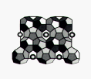
Hydrate Structures
Type I
Type II
Type H
Concentrates gas with a ratio of ~ 1:160
One cubic foot of gas hydrate contains
160 cubic feet of gas at standard
temperature and pressure
Sources: U.S. Geological Survey and Texas A&M University
Notes:
The cage can take several forms as seen here. All three have been observed in nature, but they can also be synthesized in the laboratory. The interest in methane hydrates as a potential resource results from the trapping capability of the hydrate structure. Essentially, hydrates concentrate gas by a ratio of 1:160. What this means, is that in one cubic foot of hydrate, about 160 cubic feet of gas is trapped. This would be 160 cubic feet at standard temperature and pressure.

Slide 3
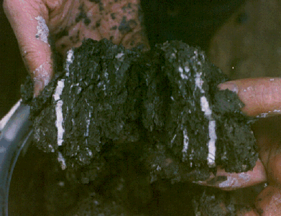
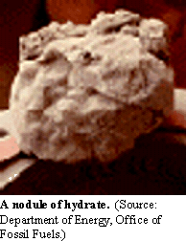
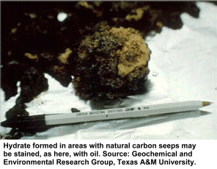
Notes:
These are some examples of hydrates that have been recovered. In the top picture, you can see the white banding, which is the hydrate. The lower left picture is a nodule of hydrate and on the right is a hydrate recovered from the Gulf of Mexico, which is coated with oil. As you can see, hydrates from within the sediments and you would not expect to find huge blocks of hydrate in the sediments, there isn’t room for them to form. You do see outcrops in the Gulf, and I will discuss this further later in the presentation.

Slide 4
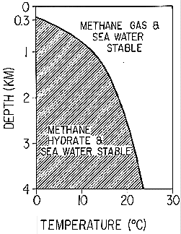
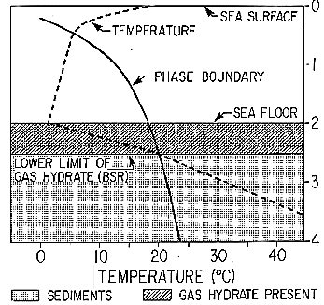
Notes:
As I said, you need the right pressure and temperature conditions for hydrates to form. On the left is a plot of temperature vs. depth, which can be treated as pressure. That is to say that increasing depth also means increasing pressure. If the depth and temperature of a location plot in the shaded area, then the conditions are right for hydrates to form. If the temperature and pressure plot in the white area, then methane gas is stable. Also, if you increase the pressure, then you increase the temperature at which hydrates can form. The upper depth is about 300m, meaning you would not expect to find hydrates in areas that are shallower than about 300 m. Again, this is the reason for the increased interest in hydrates as oil and gas activities move into deeper water.
The plot on the right basically shows the same thing with temperature plotted against depth. The main point here is that as you go deeper below the seafloor, the temperature increases due to the heat from deep within the earth. At some point the temperature is too high for hydrates, and the cage breaks down leaving free gas. The result is that below the seafloor, there is a zone or band where the conditions are right for hydrate formation.

Slide 5
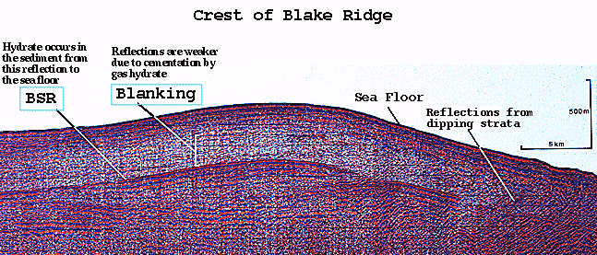
Notes:
The lower boundary where hydrates can form also shows up in seismic data as you can see here. The boundary where hydrates cannot form and there is actually gas in the sediments creates a demarkation called a bottom simulating reflector. As you can clearly see here, there is al ine that follows the bottom but is at some depth below the bottom. This line also cuts across the geological layers, indicating that is not due to a change in geology. The BSR is attributed to the change from the ice-like solid to gas in water.

Slide 6
Why the interest in Gas Hydrates?
Safety:
Hydrates plug flowlines
Hydrates can be geohazards
Resource:
Methane Hydrates are a source of natural gas
Environmental:
Sensitive Communities use hydrates as food
Methane Hydrates can contribute to global warming
Notes:
There are several reasons for the interest in gas hydrates and I will be explaining each in greater detail. The safety issues include plugging of flowlines and geohazards. Methane hydrate is considered a potentials reasource. And of environmental concern, sensitive biological communities exist on outcrops. Hydrates may also contribute to global warming.

Slide 7
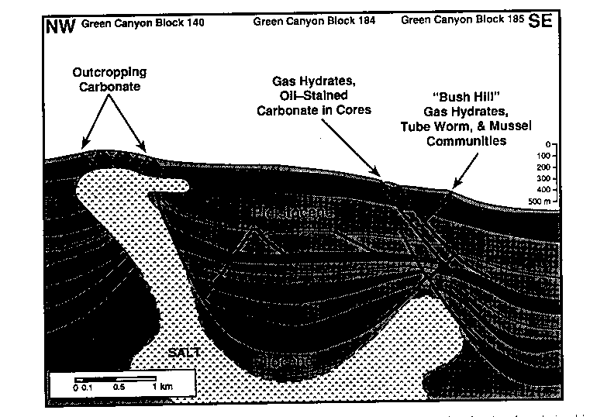
Seafloor gas hydrates exist near upward migration paths
Notes:
One scenario for the outcrops in the Gulf of Mexico is believed to be a result of the dynamic geology in the Gulf. Essentially, the migrating salt causes faults fissures in the overlying sediments. The resultant structure also enables the trapping of hydrocarbons at depth. The lighter hydrocarbons migrate up the fissures to the surface and form hydrate outcrops at the surface. We now have a proposal from Dr. Harry Roberts to test this hypothesis in the Gulf using data from MMS about the surface signature and the underlying geology. This information will be used by the Leasing and Environment section to better interpret surface seismic data submitted with applications and used to apply mitigations requiring avoidance of the surface outcrops and associated sensitive communities.

Slide 8
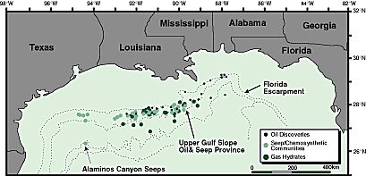
Notes:
This map shows locations of known or suspected gas hydrate outcrops on the slope in the Gulf of Mexico. Oil discoveries and seep communities are also included.

Slide 9
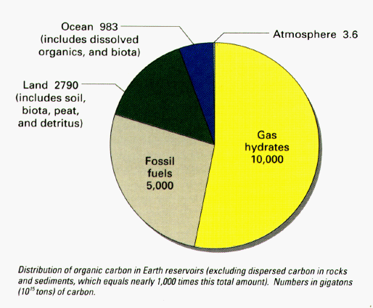
Resource
Notes:
Moving on to methane hydrates as a resource. This diagram was prepared by the USGS and represents the estimated reservoirs of carbon on the earth’s surface excluding dispersed carbon in rocks and sediments. The large yellow section is the estimates of carbon locked up in hydrates which is double the amount of carbon in fossil fuels. The other compartments include the land, the ocean, and the atmosphere.

Slide 10
Environmental
Chemosynthetic Communities:
Sensitive Biological Communities
Associated with Methane Hydrates
Found in Deepwater throughout Gulf of Mexico
Notes:
I’ve already discussed a little bit about the outcrops of gas hydrates in the Gulf of Mexico and the association of chemosynthetic communities with these outcrops.

Slide 11
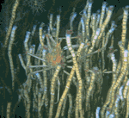
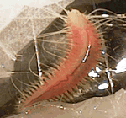
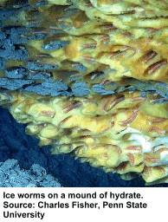
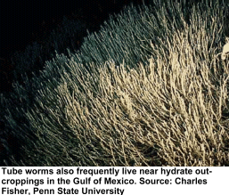
Notes:
Here are some examples of the life that is associated with the hydrates. MMS has funded two large projects to study these unique communities. On the left are ice worms colonizing a methane hydrate outcrop. The worm is about 2” long and are affectionately known as ice worms. On the right are tube worms that are also associated with hydrates. They form large bushes with some of the worms estimated to be 100-200 years old. In addition, other creatures such as the spider crab reside in the bush.

Slide 12
Currently at MMS
CMRET Study at one location in Gulf
Joint DOE/Industry study coring in Gulf
Applied Gas Hydrate Research Program
Resource Evaluation

Slide 13
Proposed Study
Comparison of Remote Technologies to Better Assess the Location of Gas Hydrates

