Slide 1
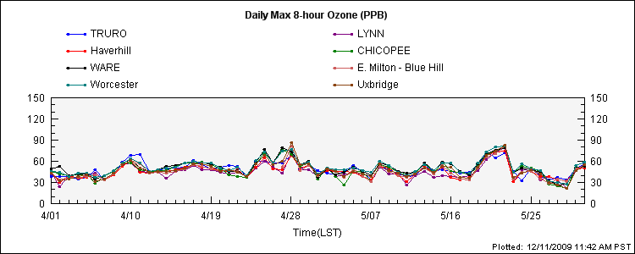
April and May 2009 Peak Ozone
NAAQS

Slide 2
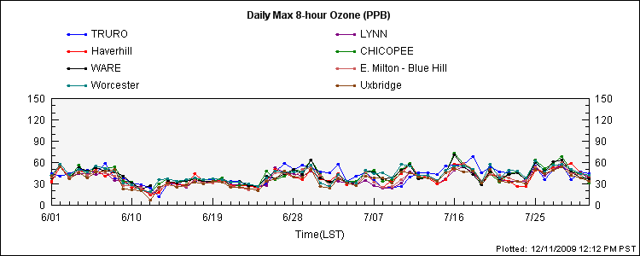
June and July 2009 Peak 8-hr Ozone
NAAQS

Slide 3
Ozone season highlights
No ozone exceedances from May 23 through Aug 17
Only 8 exceedance days (unofficial)
April - 3
May - 2
June - 0
July - 0
Aug - 3
Sept - 0

Slide 4
DESIGN VALUES
MONITOR | 2006-2008 | 2007-2009
Truro | 79 | 76
Martha’s Vineyard | 83 | 77
Lynn | 81 | 79
Chicopee | 88 | 84
Quabbin | 84 | 80
Blue Hill | 82 | 78
Worcester | 82 | 82

