Slide 1

D0 Taking Stock
11/2004 - 06/2005
Calibration Database Servers

Slide 2
Overview
Successfully running during the last calendar year
No major problems have arisen
Mature product with low maintenance requirements
10 different types of Calibration dbservers currently running
  Muon servers, farms and users, are available but are still not being used
  Can d0reco be changed so these servers be can shut down?

Slide 3
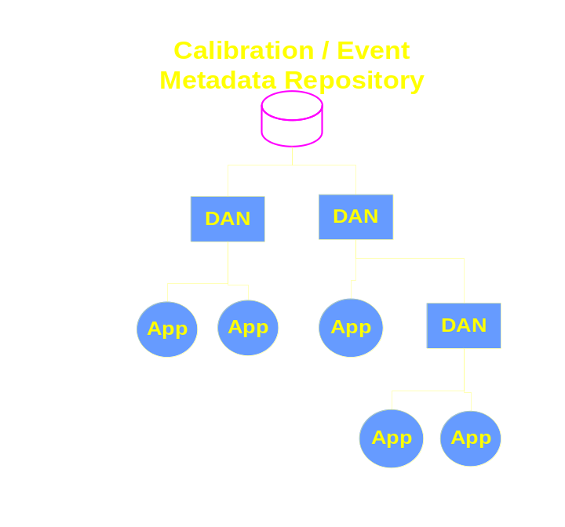
Deployment
Remote Servers now exist at:
  Karlsluhe, IN2P3, Imperal College, WestGrid, SAR
Remote sites beginning to run within the next few weeks:
  OSCER (this is mostly Univ. of Oklahoma)
  Prague
  Manchester
  Wisconsin
  CMS (at fnal)
  Lancaster (it may take bit for Lancaster to get going due to manpower limits)
  RAL (same comment as for Lancaster)
Possible new remote sites:
  Michigan State, Brookhaven, SLAC
Remote Servers are processing data with p17.03.03 of d0reco.

Slide 4
Hardware
Production nodes
  Two nodes, with servers divided for farms/users
  Dual 1.5 GHZ AMD Athlon w/2 GB Memory
Failover nodes
  Two nodes, one serving each production node
  1, Dual 1.5 GHZ AMD Athlon w/2 GB Memory (farms)
  1, Dual 1.0 GHZ Pentium III w/1 GB Memory (users)
Hardware is supporting current loads and is expected to support load increase.
  Contingency plan is to add new nodes and servers.

Slide 5
Concerns & Plans
Increasing Farms Load
  160 Additional dual processor, and faster, CPUs being added
  Db servers are expected to be able to handle the expected load increase.
  Contingency plan:
    Added a new node with additional servers, split the farm requests across servers, develop a load manager.

Slide 6
Concerns & Plans
Multi-Run Data Sets
  For each distinct run the client will request an entire calibration set.
  Db servers may face difficulties trying to handle diverse multi-run sets of events from multiple users.
  Possible solutions:
    Double the size of the cache from ~20 runs to ~40runs
      May require additional Linux boxes.
    Add additional Linux boxes with large cache servers. Develop a load manager for distribution of requests.
Maintenance & Support
    Upgrade is underway to version 4.x of omniORBpy.
      Some minor bugs will be addressed during the upgrade.
    Continue providing support for remote sites.

