Slide 1
State of Washington
Department of Corrections
Human Resource Management Report
Note: This is the recommended standard format provided by DOP as of 8-8-06. Agencies may supplement this format to meet unique needs, as long as the minimum information shown in this format is included. For the report due in October 2006, agencies may use previous versions of the reporting format, if desired.
October 2006

Slide 2
Logic Model
Managers Accountability for Workforce Management
Plan & Align Workforce
Hire
Workforce
Deploy
Workforce
Develop Workforce
Reinforce Performance
Articulation of managers HRM accountabilities. HR policies. Workforce planning. Job classes & salaries assigned.
Qualified candidate pools, interviews & reference checks. Job offers. Appts & per-
formance monitoring.
Work assignments& requirements defined. Positive workplace environment created. Coaching, feedback, corrections.
Individual development plans. Time/ resources for training. Continuous learning environment created.
Clear performance expectations linked to orgn’al goals & measures. Regular performance appraisals. Recognition. Discipline.
Staffing levels & competencies aligned with agency priorities. Mgr’s HRM accountabilities are understood.
Best candidate hired & reviewed during appointment period. Successful performers retained.
Workplace is safe, gives capacity to perform, & fosters productive relations. Staff know job rqmts, how they’re doing, & are supported.
Learning environment created. Employees are engaged in develop-
ment opportunities & seek to learn.
Employees know how performance contributes to success of orgn. Strong performance rewarded; poor performance eliminated
Foundation is in place to build and sustain a productive, high performing workforce.
The right people are in the right job at the right time.
Time & talent is used effectively. Employees are motivated & productive.
Employees have competencies for present job & career advancement
Successful performance is differentiated & strengthened. Employees are held accountable.
State government has workforce depth & breadth needed for present and future success
Employees are committed to the work they do & the goals of the organization
Productive, successful employees are retained
Agencies are better enabled to successfully carry out their mission. The citizens receive efficient government services.

Slide 3
Human Resource Management Report
Standard Performance Measures
Plan & Align Workforce
Percent current position/competencies descriptions
Percent supervisors with current performance expectations for workforce management
Time-to-fill funded vacancies
Percent satisfaction with candidate quality New Hire-to-Promotional ratio
Percent turnover during review period
Percent employees with current performance expectations
Employee survey ratings on “productive workplace” questions
Leave usage (sick, LWOP, unscheduled leave)
Overtime usage
Number & type of non-disciplinary grievances
Percent employees with current annual individual development plans
Employee survey ratings on “learning/development” questions
Percent current performance evaluations
Employee survey ratings on “performance accountability” questions
Number/type of disciplinary issues, actions, appeals disposition
Turnover rates and types (e.g., retirement, resignation, etc.)
Turnover rate of key occupational categories and of workforce diversity
Employee survey ratings on “commitment” questions
Hire Workforce
Measures to add in the future:
Current workforce plans that align staff with business priorities
Safety and Workers Compensation measures
Competency gap analysis measure
Recognition/reward measure
Others to be determined
Deploy Workforce
Develop Workforce
Reinforce Performance
Ultimate Outcomes

Slide 4
Overall foundation & management accountability system to build & sustain a high performing workforce
Plan & Align Workforce |
HR Management Report category:
Performance Measures (1)
Percent current position/competency descriptions
Percent supervisors with current performance expectations for workforce management
Agency-wide Percent Current Position & Competency Descriptions
14%
Analysis:
Secretary Clarke announced Core Competencies on June 28, 2006 for the classes below, with an expected completion date of December 31, 2006 for all position descriptions:
  Correctional Officer 1, 2 & 3
  Community Corrections Officer 2 & 3
  Classification/Correctional Counselor 2 & 3
  Correctional Records Specialist & Manager
  Cook AC
  RN2
Generic position descriptions and blank forms for the above classes were distributed to HR Staff and the Extended Leadership Team on June 30, 2006, and posted to DOCNET in early July 2006.
Action Steps:
Send out a reminder to all DOC Supervisors prior to November 01, 2006 to reinforce that the December 31, 2006 position description due date is a firm expectation.
HR will provide the necessary assistance to supervisors and employees on completing position descriptions.
Notes:
Notes:
Plan & Align Workforce is the foundation for the remaining four key HRM functions.
Ideally, each agency should have a comprehensive workforce plan that aligns staffing levels and competencies with business priorities, and identifies strategies to close workforce gaps. Most agencies do not have a workforce plan (a key reason WA did not get an A on Grading of the States). A future action step is to institute workforce planning in the state.
Right now, as a starting point, managers need to know what their HRM responsibilities and performance expectations are. This includes an understanding of the master agreement provisions and new HR policies. Of the XX agencies with represented employees that responded to our inquiry, XX had trained the majority of their managers on those provisions.
Next, a management accountability system needs to be in place. At this point, our best measure is whether managers are receiving performance evaluations. However, what needs to happen is implementation of the Managers HRM Report Card, so that those meaasures are incorporated in the evaluations.

Slide 5
Overall foundation & management accountability system to build & sustain a high performing workforce
Plan & Align Workforce |
HR Management Report category:
Performance Measures (3)
Percent current position/competency descriptions
Percent supervisors with current performance expectations for workforce management
Percent supervisors with current performance expectations for workforce management
100%
DOC completed this goal by developing the Core Competencies for all employees, with specific competencies identified for supervisors and managers, which included People Management and Managing for Results.
Expectations were provided to all DOC appointing authorities and supervisors by Secretary Clarke on June 28, 2006.
Notes:
Notes:
Plan & Align Workforce is the foundation for the remaining four key HRM functions.
Ideally, each agency should have a comprehensive workforce plan that aligns staffing levels and competencies with business priorities, and identifies strategies to close workforce gaps. Most agencies do not have a workforce plan (a key reason WA did not get an A on Grading of the States). A future action step is to institute workforce planning in the state.
Right now, as a starting point, managers need to know what their HRM responsibilities and performance expectations are. This includes an understanding of the master agreement provisions and new HR policies. Of the XX agencies with represented employees that responded to our inquiry, XX had trained the majority of their managers on those provisions.
Next, a management accountability system needs to be in place. At this point, our best measure is whether managers are receiving performance evaluations. However, what needs to happen is implementation of the Managers HRM Report Card, so that those measures are incorporated in the evaluations.

Slide 6
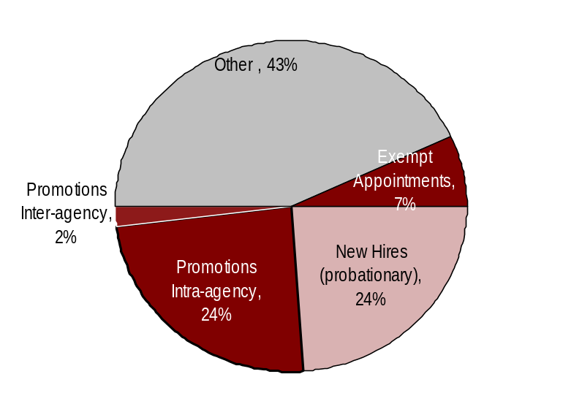
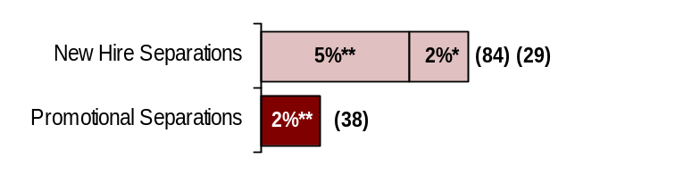
Hire Workforce |
HR Management Report category:
Right People in the Right Job at the Right Time
Performance Measures (6)
Days to fill vacancies
% satisfaction with candidate quality
% new hires; % promotional hires
% separation during review period
Analysis:
Out of the 5% of new hires who separated voluntarily, 62 were custody separations (74%).
Out of the 2% of new hires that were involuntarily separated, seven were Correctional Officers.
The 24% intra-agency promotions demonstrates that DOC is committed to developing and promoting from within.
43% in the “other” category refers to the number of appointments such as transfers, demotions, and/or movement in lieu of layoff, etc. 1,787 reassignments were excluded as it would of account for more than 50% of the total appointments. Reassignments are almost exclusively used when awarding bids in institutions.
Hiring Balance - FY 2006
Total of 1595 appointments
Days to Fill Vacancies
This data will be reported by agencies to DOP in April 2007
Other (3,926)
Action Steps:
HR staff are personally contacting departing Correctional Officers to seek additional information through June 30, 2007.
The Department is hiring Correctional Officers above the minimum Step A statewide, on a regular basis beginning November 01, 2006.
A Recruitment Plan has been developed that specifically targets expansion efforts at WSP and CRCC, and also MCC, which has the highest turnover rate in the state. The state also negotiated an additional 5% geographic pay for these areas effective July 01, 2007.
The Recruitment Plan anticipates a regional focus for critical, high volume classifications, to facilitate healthy competition among institutions, especially those that are located within a 60-mile radius of each other.
The assessment process for COs is also being examined, along with other classifications that used INET as a part of the implementation of E-Recruiting.
Candidate Quality
(managers’ satisfaction rating)
This data will be reported by agencies to DOP in April 2007
Separations During Review Period
*
**
* Involuntary
** Voluntary
*
Other = transfers, demotions, reassignments, movement in lieu of RIF, etc.
Notes:
Notes:

Slide 7
Deploy Workforce |
HR Management Report category:
Employee time and talent is used effectively. Employees motivated.
Performance Measures (8)
Percent employees with current performance expectations
Employee survey ratings on “productive workplace” questions
Overtime usage
Sick leave usage Number & type of non-disciplinary grievances and disposition
Percent employees with current performance expectations
59%
Analysis:
Performance expectations for all employees were provided by Secretary Clarke in October 2006.
DOC implemented the new Performance Development Plan (PDP) approximately one year ago. The DOC Human Resources (HR) provided training to all managers/supervisors so they could be prepared to initiate the new PDP process. The PDP process currently requires that supervisors maintain the original PDP in an employee’s supervisory file and the original be forwarded to HR once the PDP has been completed.
DOC’s former tracking system was fed by Data Warehouse, which with the implementation of HRMS is no longer available. DOC does not have a current electronic tracking tool to determine when current individual development plans have been initiated. However, we assume that because 59% of evaluations were completed, that Part 1 of the evaluation process was completed.
Action Steps:
DOC is working with an independent developer to create a tracking tool for evaluations (ATLAS). It is expected to be completed within the next six months. In the interim, each appointing authority is responsible for developing a system to monitor the completion of parts 1 and 2 of the PDP. A full report is expected by April 2007.
Notes:
Notes:

Slide 8
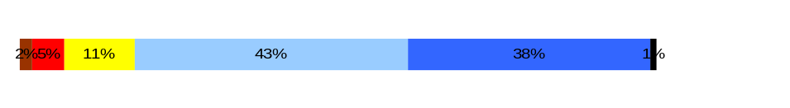
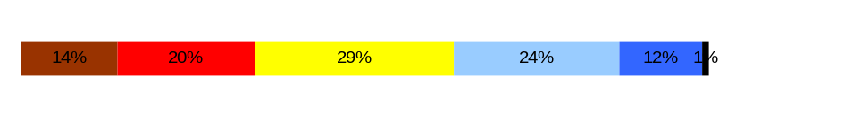
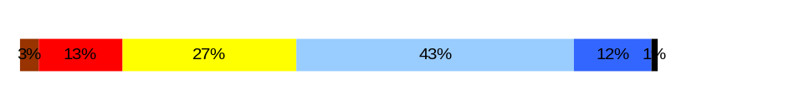
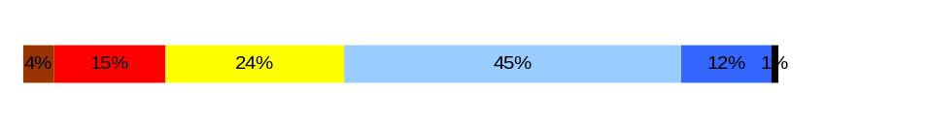
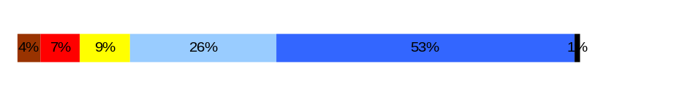
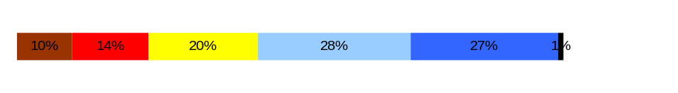
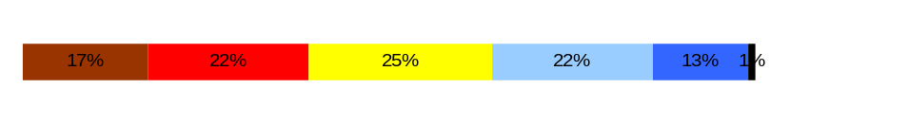
Deploy Workforce |
HR Management Report category:
Employee time and talent is used effectively. Employees motivated.
Performance Measures (9)
Percent employees with current performance expectations
Employee survey ratings on “productive workplace” questions
Overtime usage
Sick leave usage Number & type of non-disciplinary grievances and disposition
Do employees have the day-to-day support
needed to enable successful job performance?
Analysis:
Staff continue to voice they have excessive workload and inadequate resources to complete timely work.
Staff performance evaluations are not completed timely, due to high levels of workload.
With the completion of evaluations and position descriptions, ratings should increase.
Lack of a formal internal process for communicating suggestions likely contributed to Q1.
Effective January 2006, the Department has taken steps to improve efficiencies in the workload for Community Correction Officers and Facility Counselors by streamlining the data and information needed in the Offender Accountability Plan.
Q4. I know what is expected of me at work. (4.1)
Q1. I have opportunity to give input on decisions affecting my work. (3.0)
Q2. I receive the information I need to do my job effectively. (3.5)
Q6. I have the tools and resources I need to do my job effectively. (3.4)
Q7. My supervisor treats me with dignity and respect. (4.2)
Q8. My supervisor gives me ongoing feedback that helps me improve
my performance. (3.5)
Q9. I receive recognition for a job well done. (2.9)
Overall average score for “productive workplace” questions is 3.5
Never
Seldom
Occasionally
Usually
Always
Action Steps:
The Department’s process improvement policy is currently being revised, which will be completed by November 30, 2006.
The Department is partnering with the Washington State Institute of Public Policy to replace the Level of Service Inventory-Revised (LSI-R) and the Risk Management Identification (RMI) tools with a research-based Offenders Risk and Needs Assessment tool. This tool streamlines the data and information needed, and will be completed by June 2007.
The Department has requested funding in the 2007-2009 biennial budget to develop and implement the personalized plan for offenders. This electronic plan will contain a comprehensive assessment information that will assist prison and community corrections staff in coordinating the service delivery and guide Department interventions for offenders while they are under our jurisdiction.

Slide 9
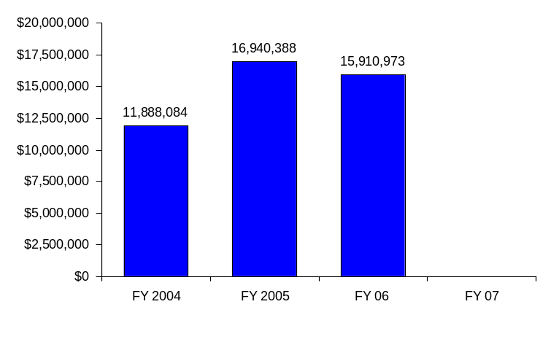
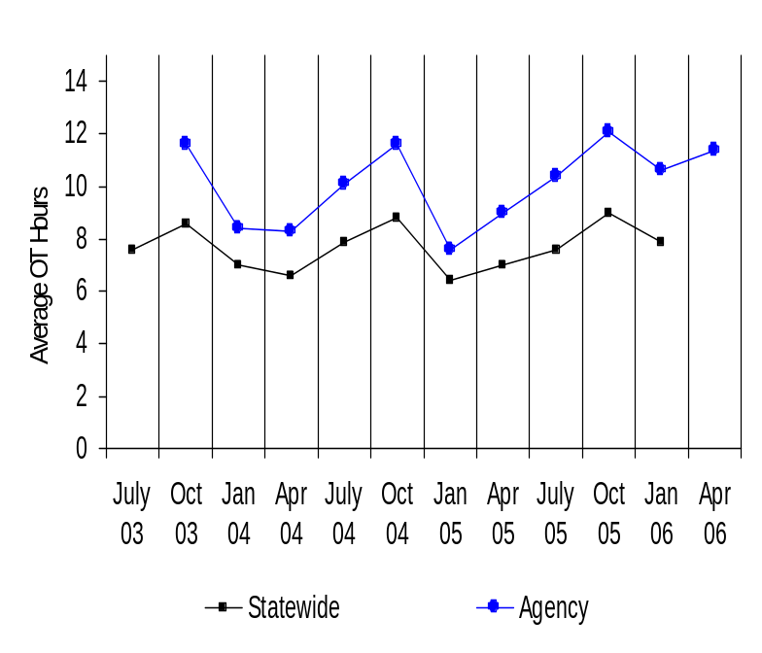
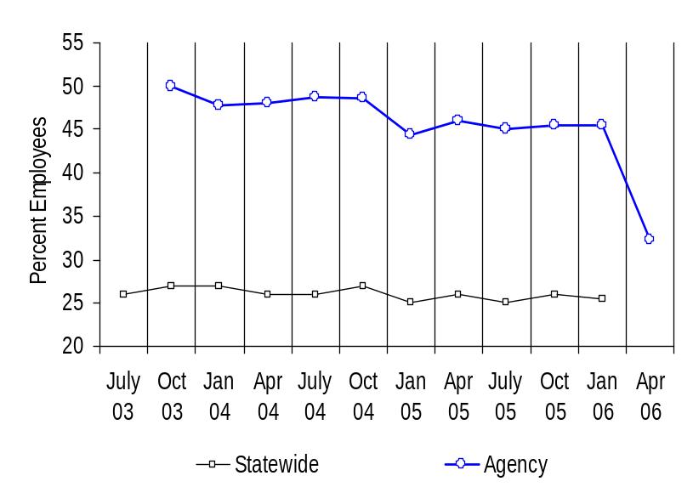
Deploy Workforce |
HR Management Report category:
Employee time and talent is used effectively. Employees motivated.
Performance Measures (11)
Percent employees with current performance expectations
Employee survey ratings on “productive workplace” questions
Overtime usage
Sick leave usage
Number & type of non-disciplinary grievances and disposition
Agency Overtime Costs
Analysis/Action Steps:
OT is an issue at the major institutions; the top three are MCC, WSP, and WCC.
Primary reason for OT use is vacancy issues.
OT increases as SL increases due to 24 hour operations of facilities.
The Department has initiated a recruitment initiative, which includes partnering with Employment Security Department-Work Source and reaching out to communities to expand correctional staff candidate pool.
Average Overtime Hours (per capita)
Percent Employees Getting Overtime
Notes:
Notes:

Slide 10
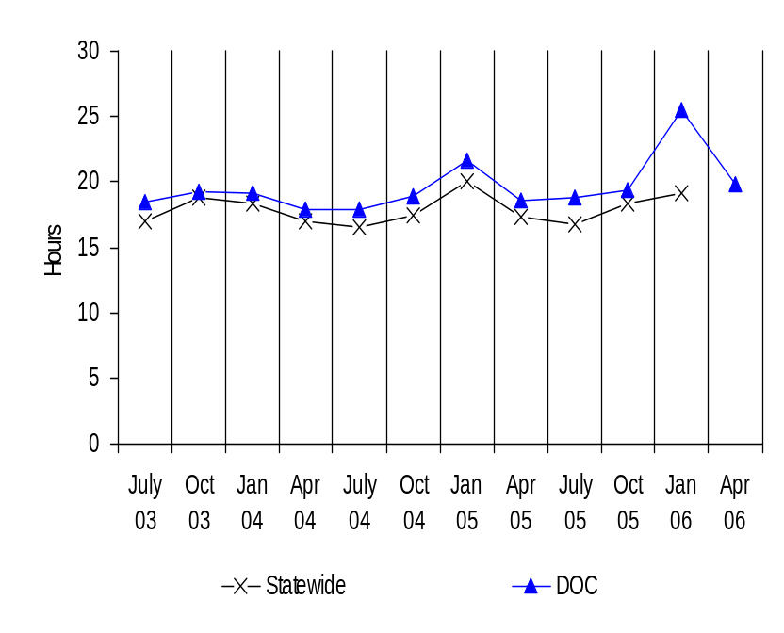
Deploy Workforce |
HR Management Report category:
Employee time and talent is used effectively. Employees motivated.
Performance Measures (10)
Percent employees with current performance expectations
Employee survey ratings on “productive workplace” questions
Overtime usage
Sick leave usage
Number & type of non-disciplinary grievances and disposition
Average Sick Leave Use
(per capita)
Analysis/Action Steps:
Close to state average; except 1/06 spike.
It is anticipated that implementation of a recruitment plan will contribute to decreasing sick leave use, as vacancy rates will be reduced.
Per Capita Sick Leave Use
Just Those Who Took Sick Leave
Ave. Sick Leave Hours Used per Qtr*
% of Earned Sick Leave
Ave. Sick Leave Hours Used per Qtr*
% of Earned Sick Leave
Statewide
17.8
hours
74%
22.9
hours
95%
Dept. of Corrections
19.0
hours
79%
24.4
hours
102%**
* Average since July 03
**Includes Leave W/O Pay
Notes:
Notes:

Slide 11
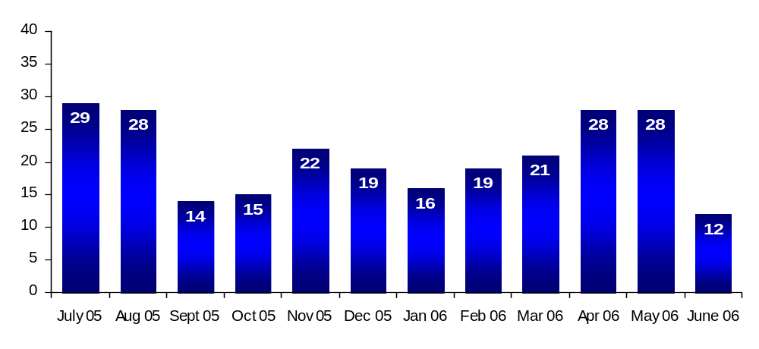
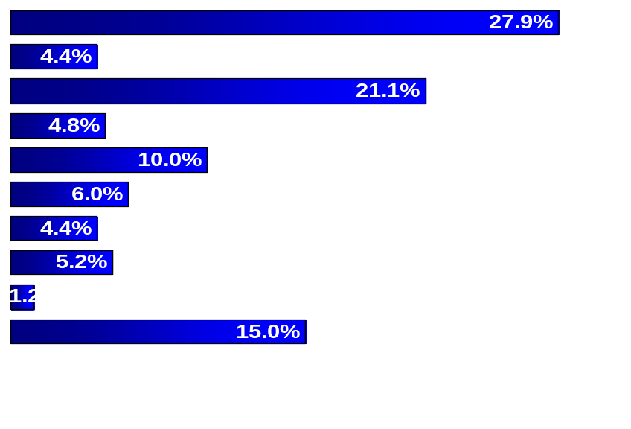
Deploy Workforce |
HR Management Report category:
Employee time and talent is used effectively. Employees motivated.
Performance Measures (12)
Percent employees with current performance expectations
Employee survey ratings on “productive workplace” questions
Overtime usage
Sick leave usage
Number & type of non-disciplinary grievances and disposition
Number of Grievances
Type of Grievances (July 05 – May 06)
Grievance Disposition
DOC had 181 grievances in FY06, with spikes in July and August 2005, and April and May 2006. There is no data that suggests a reason for this spike, except that a new contract was effective July 1, 2005.
Disposition: 11 (6% ) were filed on Hours of Work. Some institutions implemented 4/10s, which was inconsistent with the terms of the CBA. These grievances were resolved by reverting back to a 5/8 schedule.
Further analysis will be completed for the next reporting cycle.
Discipline
Compensation
Overtime
Work Hours
Bid System
Leave
Hiring/Appts
Non-discrimination
Management Rights
All other
Notes:
Notes:

Slide 12
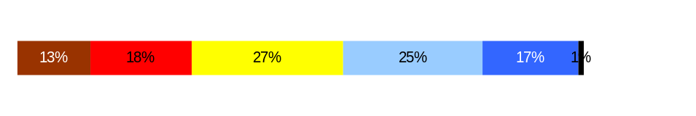
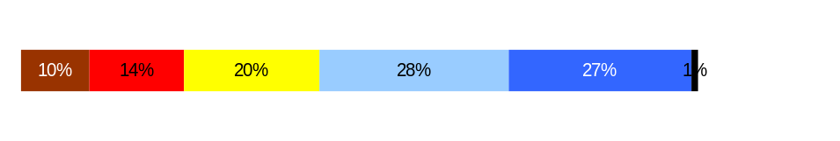
Employees have competencies for present job and future advancement
Develop Workforce |
HR Management Report category:
Performance Measures (14/16)
Percent employees with current annual individual development plans
Employee survey ratings on “learning & development” questions
Percent employees with current Individual Development Plans
59%
Analysis:
DOC does not have a mechanism to track when individual development plans have been initiated.
We assume that the completion of a greater number of evaluations and position descriptions will result in score improvements on Q5 & Q8.
Overall average score for “Learning & Development” questions is 3.3
Employee perceptions on
learning and development
Q5. I have opportunities at work to learn and grow. (3.1)
Q8. My supervisor gives me ongoing feedback that helps me improve
my performance. (3.5)
Never
Seldom
Occasionally
Usually
Always
Action Steps:
DOC is working with an independent developer to create a tracking tool for evaluations (ATLAS). It is expected to be completed by April 30, 2007.
In the interim, each appointing authority is responsible for developing a system to monitor the completion of parts 1 and 2 of the PDP. A full report is expected by April 30, 2007.
94%
Notes:
Notes:

Slide 13
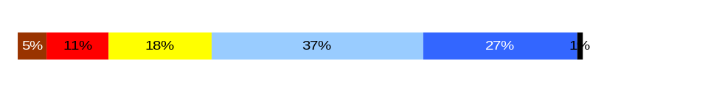

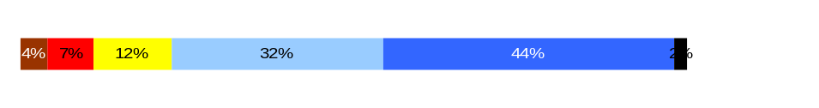
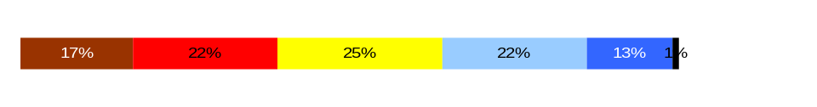
Successful performance is differentiated & strengthened. Employees are held accountable.
Reinforce Performance |
HR Management Report category:
Performance Measures (17/19)
Percent employees and managers with current annual performance evaluations
Employee survey ratings on “performance and accountability” questions
Number and type of disciplinary issues, actions, appeals disposition
Percent employees with current performance evaluations
59%
Analysis:
59% of DOC employees have a current performance evaluation.
DOC has an employee recognition program including:
  Annual Agency Awards
  Employee of the Quarter/Year
  Team of the Quarter/Year
  Volunteer of the Year
A greater percentage of evaluations should positively impact Q3, Q10 and Q11.
Do employees see a meaningful linkage between their performance and the success of the organization?
Q3. I know how my work contributes to the goals of my agency. (3.7)
Q10. My performance evaluation provides me with meaningful information about my performance. (3.1)
Q11. My supervisor holds me and my co-workers accountable for performance. (4.1)
Q9. I receive recognition for a job well done (2.9)
Overall average score for “performance & accountability” questions is 3.5
Never
Seldom
Occasionally
Usually
Always
Action Steps:
A workgroup developed additional recommendations for increased and targeted staff recognition. Management is currently implementing those recommendations.
Additional information is being collected through staff meetings and forums statewide in October/November 2006 on how the agency can do a better job on staff recognition.
Notes:
Notes:

Slide 14
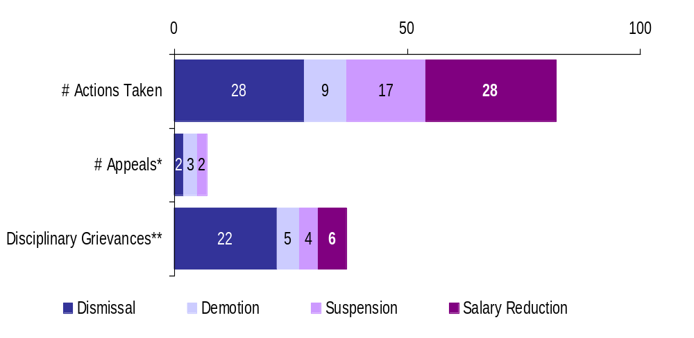
Successful performance is differentiated & strengthened. Employees are held accountable.
Reinforce Performance |
HR Management Report category:
Performance Measures (18)
Percent employees and managers with current annual performance evaluations
Employee survey ratings on “performance and accountability” questions
Number and type of disciplinary issues, actions, appeals disposition
Formal Disciplinary Actions, Appeals, Grievances
FY 2006 to date (July 1, 2005- June, 30, 2006)
Analysis:
39% of disciplinary grievances filed have been settled.
DOC believes this is because the union is not aggressively pursuing arbitration due to the lack of data, or relative to private arbitrators’ rulings on just cause standards.
Action Steps:
Better data collection and database improvements will increase the accuracy of future reporting.
22% of the disciplinary actions were for inappropriate offender contact. Due to the nature of the work, the Department has low tolerance for unprofessional behavior with offenders.
Data will be reviewed by location by January 2007 for further analysis and to help determine whether prevailing trends exist.
*Non-represented employees
** Represented employees (in addition, 33 grievances were filed on LOR’s)
Most Frequent Disciplinary Actions
Abuse of Position
Misuse of State Resources
Falsifying Documents
Impaired on Duty
Inappropriate Offender Contact
Inappropriate Comments/Behavior Insubordination
Loss of keys
No-call, No-show Sexual Harassment
Sleeping on Duty
Disposition of Disciplinary-related Grievances or Appeals
Dismissed 1
Overturned 2
Pending Arbitration 16
Pending Grievance Hearing 2
Pending PARM 6
Remedy Granted 1
Settled 29
Upheld 5
Withdrawn 16
Notes:
Disciplinary Grievance Analysis
Of 70 disciplinary grievances filed, 33 were due to Letters of Reprimand (LORs) – which is equivalent to 47%.
Of the 33 LOR grievances, 20 were within the Teamsters Bargaining Units and 13 within the Federation Bargaining Units
Of the 20 Teamsters LOR grievances filed, all were resolved – DOC believes it is because the Teamsters cannot move LOR grievances past Step 2 of the grievance process in accordance with the CBA.
Of the 13 WFSE LOR grievances, 9 were resolved, 1 is pending arbitration, and 3 are pending pre-Arbitration (PARM) – WFSEs CBA allows moving LORs to arbitration.
Of the 70 disciplinary grievances filed, 22 were due to termination from employment, which amounts to 31%.
20 of the termination grievances were filed by the Teamsters
Of the 20, 10 were resolved = 50%
2 of the termination grievances were filed by WFSE
Both were withdrawn

Slide 15
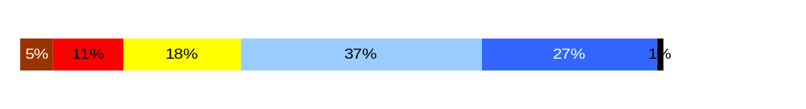


Ultimate Outcomes
HR Management Report category:
State has workforce breadth & depth for present & future success.
Employees are committed to the work they do and the goals of the organization.
Successful, productive employees are retained.
Performance Measures (24)
Employee survey ratings on “commitment” questions
Turnover rates and types (e.g., retirement, resignation, etc.)
Turnover rate of key occupational categories - TBD
Diversity profile [& turnover TBD]
Analysis:
Employees generally understand how their jobs contribute to DOC goals.
Additional work needs to be done in the areas of recognition and measuring success.
Indicators of Employee Commitment
Q3. I know how my job contributes to the goals of my agency. (3.7)
Q12. I know how my agency measures its success. (2.5)
Q9. I receive recognition for a job well done (2.9)
Overall average score for “performance & accountability” questions is 3.1
Action Steps:
Secretary Clarke addressed all DOC staff in a letter dated October 11, 2006 which discussed the Department’s accomplishments over the past year, identification of five strategic plan goals, and development of a new mission statement.
Employees were informed that agency leadership would be meeting with staff to talk about the strategic plan and to discuss employee survey results.
Appointing Authorities will survey staff by January 2007 on how they would like to be recognized.
Never
Seldom
Occasionally
Usually
Always
Notes:
Notes:

Slide 16
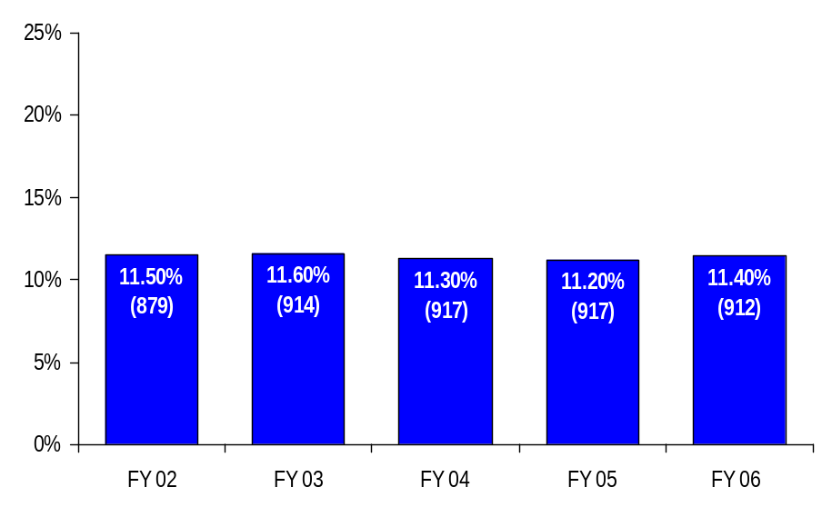
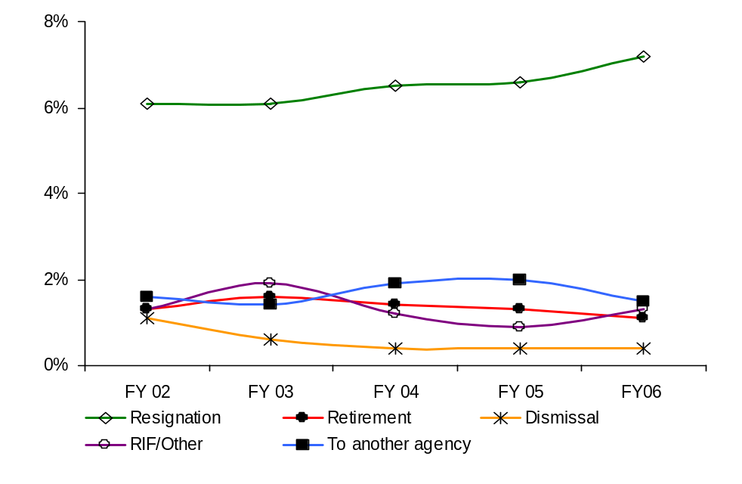
Ultimate Outcomes | continued
HR Management Report category:
Performance Measures (21)
Employee survey ratings on “commitment” questions
Turnover rates and types (e.g., retirement, resignation, etc.)
Turnover rate of key occupational categories - TBD
Diversity profile [& turnover TBD]
Analysis:
DOC consistently maintains an agency-wide turnover rate of approximately 11.4%.
Resignations account for a significant portion of turnover (6.5% annually) for the last five years. DOC believes there is a link between this data and the turnover rate for Correctional Officers.
Correctional Officer and Medical classes represent the most critical turnover.
DOC plans to hire new staff to meet prison expansion plans:
  FY07 363.0 FTEs
  FY08 14.5 FTEs
  FY09 455.4 FTEs
Agency-wide Turnover
[leaving agency]
Agency Workforce Turnover Breakdown
Action Steps:
Implementing concerted exit interview efforts for Correctional Officers may help DOC analyze the issues around custody turnover.
Enhanced recruitment activities should produce an improvement in vacancy rates and overall turnover.
Notes:
Marcos
Notes:
Trend Factors:
HRISD – Project ending – if current trend continues = 8% by end of FY06
DIR – Change in leadership – if current trend continues = 7% by end of FY06
CERS & PSD - Reorganized – if current trend continues = 4% by end of FY06
ASD Stable and low rate – if current trend continues = .33% by end of FY06
OEDS – Stable and low rate – if current trend continues = 1.5% by end of FY06

Slide 17
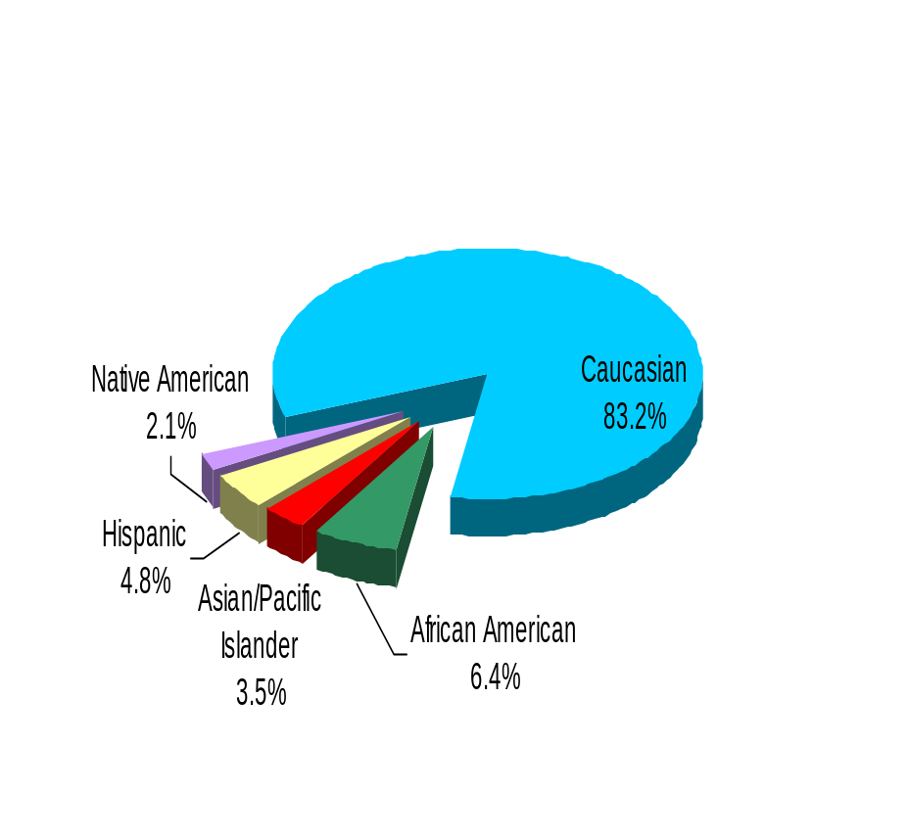
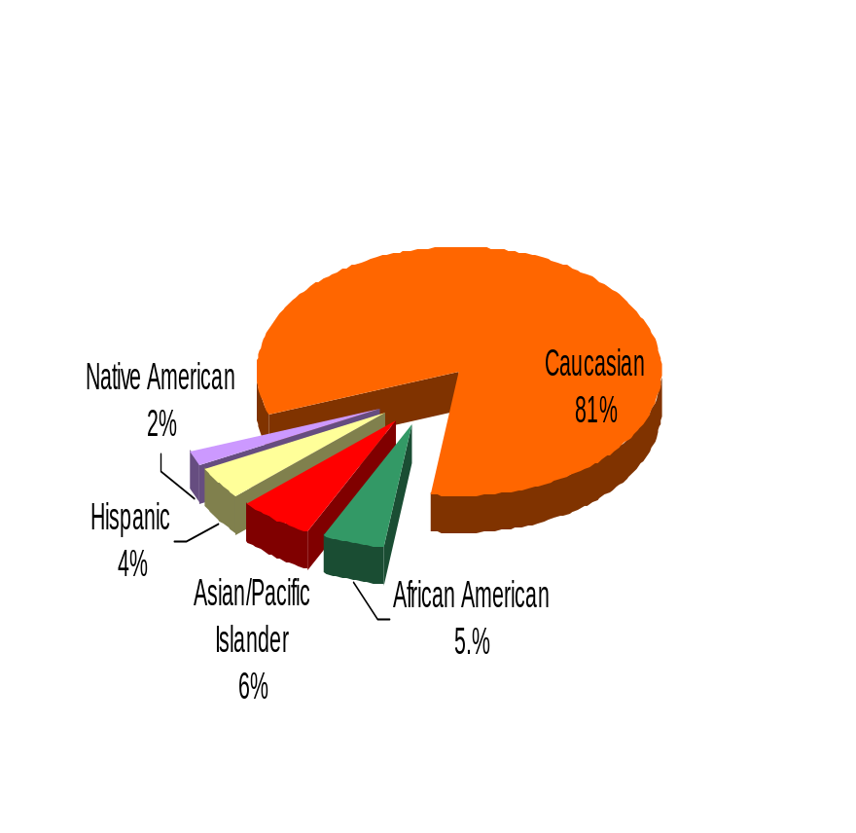
Ultimate Outcomes | continued
HR Management Report category:
Performance Measures (24)
Employee survey ratings on “commitment” questions
Turnover rates and types (e.g., retirement, resignation, etc.)
Turnover rate of key occupational categories - TBD
Diversity profile [& turnover TBD]
Department of Corrections
Diversity Profile DOC State
Women 36.0% 52%
Persons with disabilities 3.4% 5%
Vietnam Veterans 9.5% 7%
Disabled Veterans 7.0% 2%
Persons over 40 51.0% 76%
People of color 17.0% 17.5%
WA State Government
People of color reflect statewide demographics.
DOC is below the statewide profile for women and persons with disabilities, but employs a greater number of disabled veterans than the rest of the state.
At the executive level (Assistant Deputies and above), the percentage of people of color is 36% and women comprise 47%.
The Governor’s Affirmative Action Policy Committee recently approved DOC’s Affirmation Action Plan. The Affirmative Action Administrator will deploy this plan statewide over the next 90 days to each appointing authority.
Notes:
Marcos
Notes:
Trend Factors:
HRISD – Project ending – if current trend continues = 8% by end of FY06
DIR – Change in leadership – if current trend continues = 7% by end of FY06
CERS & PSD - Reorganized – if current trend continues = 4% by end of FY06
ASD Stable and low rate – if current trend continues = .33% by end of FY06
OEDS – Stable and low rate – if current trend continues = 1.5% by end of FY06

