Slide 1
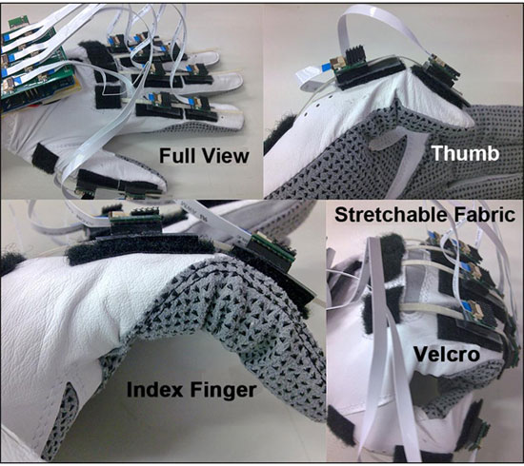

Figure 11. SmartGlove prototype.
Li K, Chen IM, Yeo SH, Lim CK.
Development of finger-motion capturing device based on optical linear encoder.
J Rehabil Res Dev. 2011;48(1):69-82.
DOI:10.1682/JRRD.2010.02.0013
Notes:
Figure 11. SmartGlove prototype.

