Slide 1


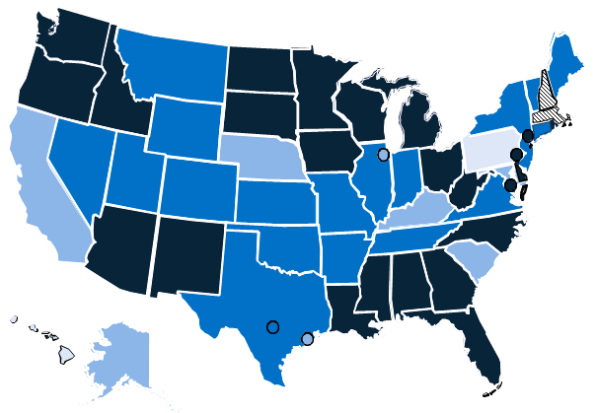
Percentage of children aged < 6 years participating in an immunization information system -- United States, five cities§, DC, and eight Territories†, 2010
no IIS/no report
0% - 33%
34% - 66%
67% - 94%
95%+
† American Samoa (no report);
Marshall Islands (75%);
Federated States of Micronesia (105%);
Guam (52%);
N. Mariana Islands (113%);
Palau (no report);
Puerto Rico (93%);
Virgin Islands (No IIS).
§ Chicago, IL (47%);
District of Columbia (120%);
Houston, TX (62%);
New York City, NY (121%);
Philadelphia, PA (115%);
San Antonio, TX (88%).
National Coverage: 82% (excluding Territories)
Source: CY2010 IISAR

