Slide 1
Archived File
The file below has been archived for historical reference purposes only. The content and links are no longer maintained and may be outdated. See the OER Public Archive Home Page for more details about archived files.

Slide 2



NIDCD Small Grant (R03)
Program
Craig A. Jordan, Ph.D.
Director, DEA, NIDCD
Notes:
Efforts by NIDCD staff and Council members

Slide 3
NIDCD Small Grant (R03) Program
ORIGINAL EMPHASIS: ……… supports basic and clinical scientists with no prior NIH or federal research support
CURRENT EMPHASIS: ……… supports basic and clinical research of scientists with no NIH or federal research support who are in the early stages of establishing an independent research career, and supports individuals transitioning from postdoctoral status to their first independent research/academic position.

Slide 4
NIDCD R03 Program
Nov. 1990 – solely for New Investigator
  – $25,000 (DC); 2 years
  – Goal is to reach R01/R29 support
Oct. 1995 – ↑ to $35,000
Nov. 1996 – ↑ to 3 years
June 1999 – ↑ to $50,000; modular budget
June 2000 – add concurrent or pre-K award
  Add individual transitioning from postdoc
2007 (planned) – ↑ to $100,000; tighten eligibility

Slide 5
NIDCD R03: Details
$50,000/yr. for 3 years; modular budget; research plan totals 10 pages
Review is conducted by Scientific Review Branch, NIDCD
Ineligible if a previous/current R03, R15, R29 or R01 grantee
Eligible if a prior NRSA fellow or mentored K-grantee
Directed towards the New Investigator: Advanced postdoctoral fellow, research associate or new faculty member; Aids the transition to independence
May use mentor’s resources and space but requires an original research project
Transferable

Slide 6
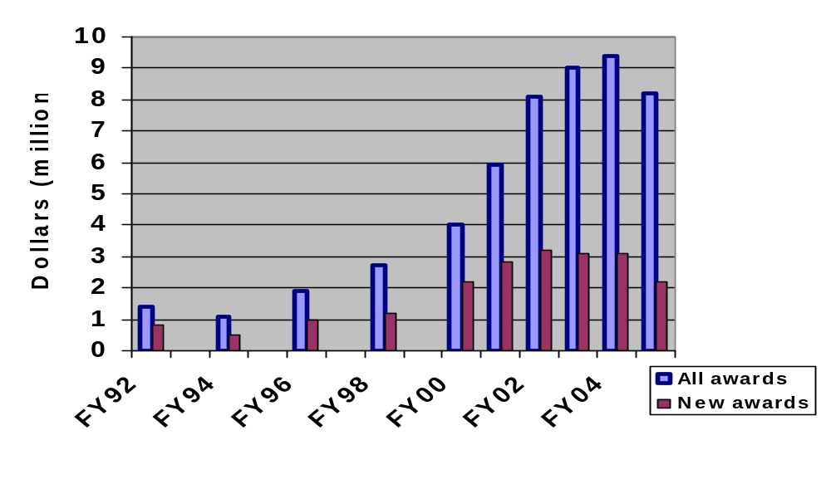
R03s: annual expenditures

$8.1M/ 108 awards

$1.4M/ 41 awards
Source: NIDCD Budget Office

Slide 7
The NIDCD R03 Small Grant Program
Awards
 | FY00 | FY01 | FY02 | FY03 | FY04 | FY05
Applications (N) | 90 | 122 | 158 | 135 | 137 | 120
Awards | 31 | 40 | 42 | 42 | 40 | 26
Percent Funded | 34% | 33% | 27% | 31% | 29% | 21%
NIH new R03 Success Rate | 30% | 33% | 33% | 29% | 24% | 22%
Source: QVR

Slide 8
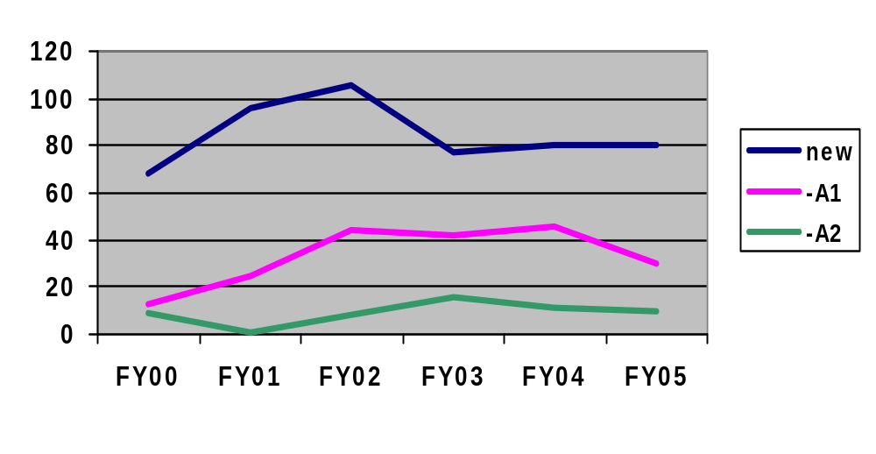
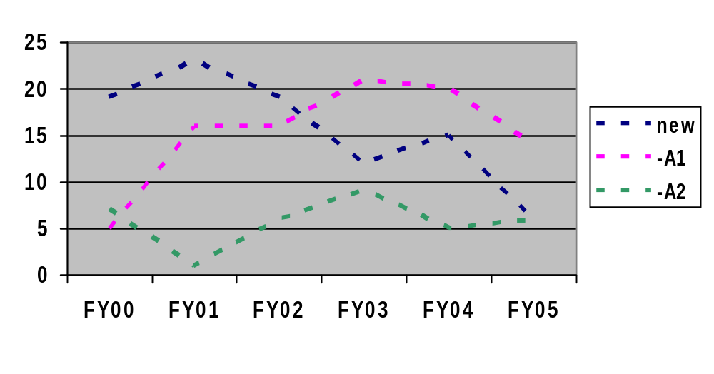
R03s: amendment profile
applications
Cumulative
% funded
New 19%
A1 46%
A2 62%
All 29%
awards
Source: QVR

Slide 9
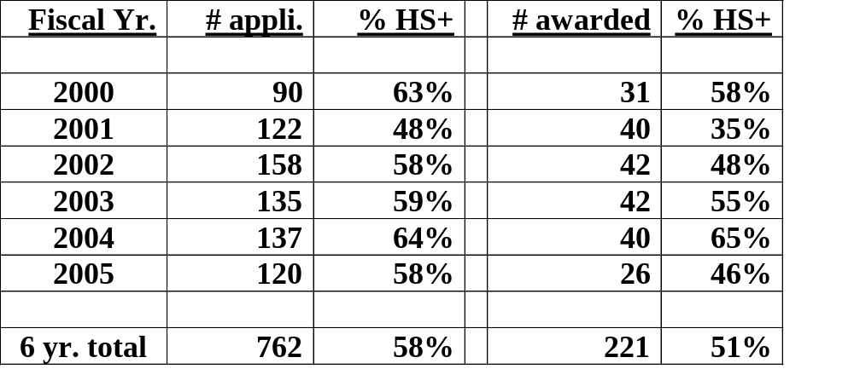
How do Human Subject R03s Fare?
Source: QVR

Slide 10
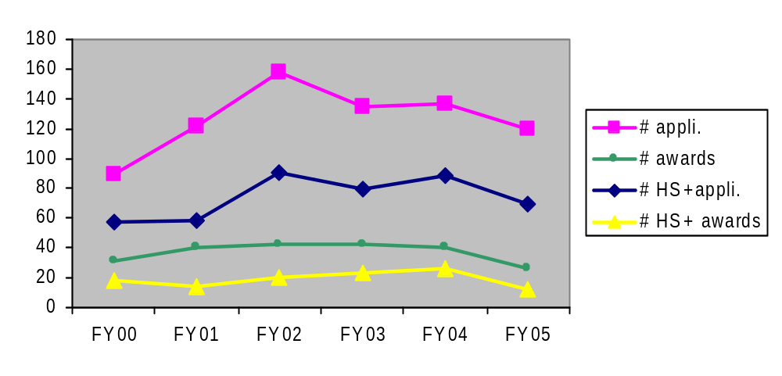
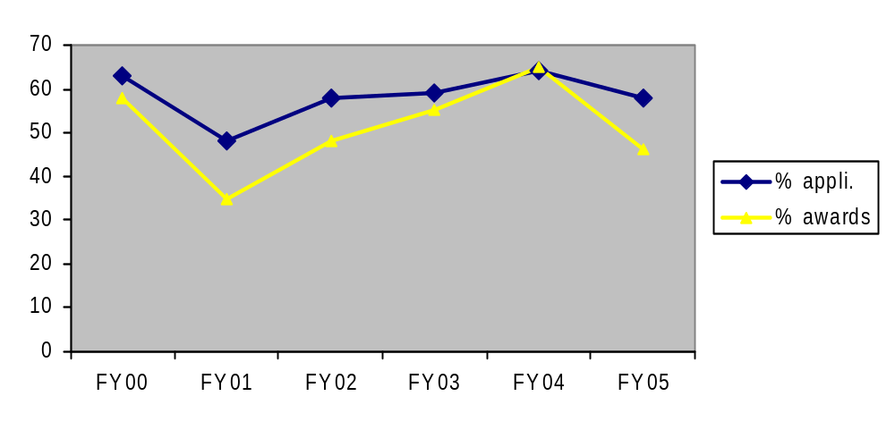
R03s: Human Subjects (HS+) profile
Actual numbers
Cumulative
% funded
HS+ 26%
All 29%
HS+ percent of total
Source: QVR

Slide 11
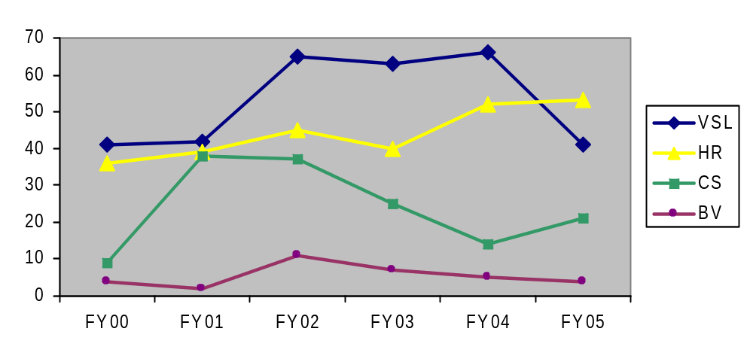
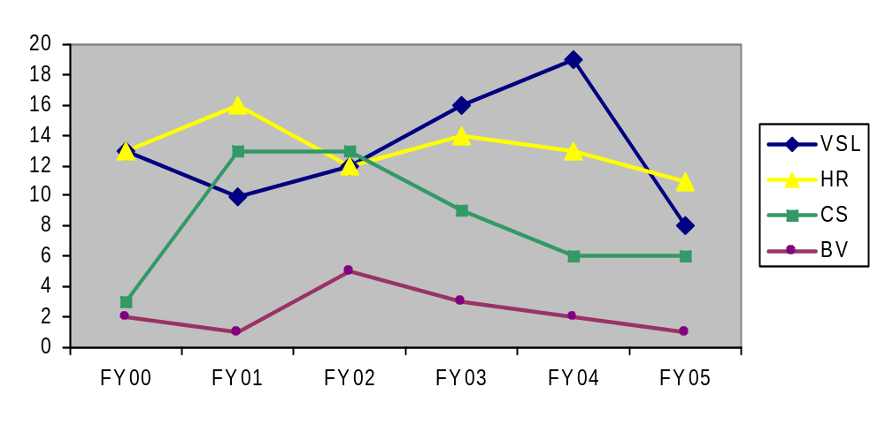
R03s: programmatic profile
applications
awards
Source: QVR

Slide 12
NIDCD New Investigators: NIH Funding History
 | FY00 | FY01 | FY02
N: | 19/65 | 32/72 | 30/75
R01: % Success *: | 29.2% | 44.4% | 40.0%
NIH Funding History:
K-award | 5% | 3% | 20%
F32 | 16% | 9% | 27%
R03 | 21% | 31% | 13%
Straight to R01 | 58% | 59% | 30%
*Numbers of new investigators funded / Numbers of new investigator applications reviewed
Source: NIDCD STARS
12/2002 Analysis

Slide 13
NIDCD R03 Small Grant Program
Subsequent Successful R01/R29 Funding
Year of R03 Award
 | FY93 | FY94 | FY95 | FY96 | FY97 | FY98 | FY99 | FY00 | FY01 | FY02
Awards | 5/16 | 8/15 | 11/23 | 15/31 | 18/35 | 11/24 | 10/22 | 7/32 | 4/36 | 1/44
Success (%) | 31.2 | 53.3 | 47.8 | 48.4 | 51.4 | 45.8 | 45.4 | 21.8 | 11.1 | 2.3
Year of R01/R29 Award | ’95 -‘97 | ’95 -‘00 | ’96 -‘02 | ’96 -‘02 | ’98 -‘02 | ’99 -‘02 | ’01 -‘02 | ’00 -‘02 | ’01 -‘02 | ‘02
Source: NIDCD STARS
12/2002 Analysis

Slide 14
Conclusions from FY2002 Evaluation of NIDCD’s R03 Program
R03 funding comes at a critical career point at the end of the postdoctoral experience or beginning faculty appointment, and helps establish a research direction. -often provides essential pilot data for an R01.
The R03 serves as an important bridge to R01 support for some, but not all beginning investigators require small grant support.
40-50% of all R03 recipients subsequently obtain R01/R29 support.
Most R03 awardees who are successful in obtaining an R01 experience a lapse in support between the two.

Slide 15
NIDCD R03: review
Single dedicated Special Emphasis Panel
  Hand-picked reviewers
  Common orientation, goals, and application of review criteria
Continuity of Reviewers
  For individual application
  For meeting-to-meeting
Issue: great breadth of science
  Moving to multiple SEPs for smaller, more scientifically focused panels

