Slide 1
Architectural
Barriers Act
Accessibility Standard
(ABAAS)
For Leased Facilities

Slide 2
When Does ABAAS apply?
New Construction Solicited
ABAAS applies
Offers for existing or new lease construction considered/Award new construction as best value
ABAAS F202.6 applies
Lease Extensions over 12 months
ABAAS F202.6 applies*
Lease Alterations
ABAAS F202.3 applies to altered elements if building complies with previous standard and to elements not addressed by the previous standard*
New or Succeeding Leases in Existing Buildings
ABAAS F202.6 applies*
Leases servicing disasters (ie. FEMA), temp leases
ABAAS does not apply
*Exceptions: historic structures (see F202.5) OR technically infeasible (structural impediment
OR physical OR site constraints)

Slide 3
Existing and New Solicited Results in New Construction
ABAAS Section F202.6 will apply if:
  GSA funds are not used for construction
  GSA does not control design/construction criteria
  Items listed in Section F202.6 must meet the ABAAS standard when those items are provided
  F202.6 lists:
  joint use areas accessible routes
  toilet and bathing facilities parking
  drinking fountains fire alarms
  public telephones dining & work surfaces
  assembly areas sales and service counters
  depositories, vending machines,
  change machines, and mail boxes
  residential facilities

Slide 4
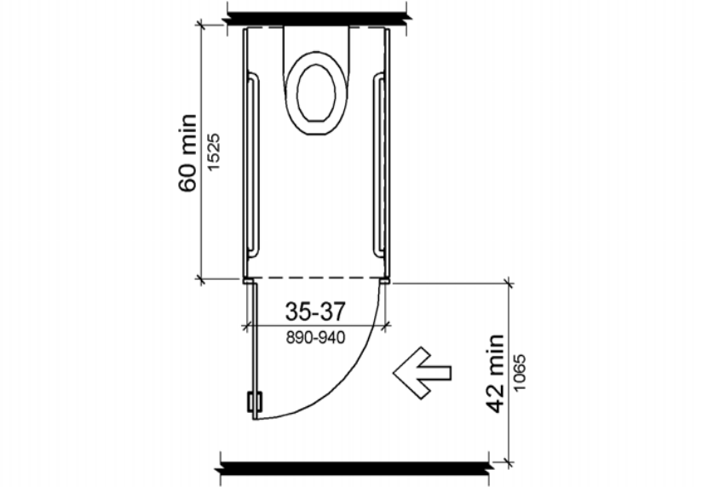
Existing Building
IF COMPLIANT WITH A PREVIOUS STANDARD:
Alterations to any existing element covered by F202.6 must meet ABAAS (Section F203.2 Elements in compliance with an earlier standard shall not be required to comply with new ABAAS requirements unless altered)
If UFAS/ADA did not require a specific
element and ABAAS does you must meet
ABAAS requirement
  Van parking (F208.2.4)
  TYY public telephones (F217 and 704.3) with
    wheelchair accessible reach ranges
  Assembly Areas (F221) companion seat requirement
  and moveable arm rest on aisle seat
  Sections F213.3.1 and 604.8.2
  Ambulatory Accessible Toilet Compartment

Slide 5
Exceptions for Existing Buildings
Section F202.5 Qualified Historic Facilities: if SHPO determines compliance with accessible routes, entrances or toilet facilities threatens or destroys the historic significance those elements do not need altering
Section F203.2 Technically infeasible to alter a specific element (structural impediment or physical/site constraints), comply to maximum extent feasible
Leased buildings used by officials servicing disasters on a temporary, emergency basis
Buildings leased for 12 months or less (provided that the lease may not be extended or renewed)

Slide 6
Technical Highlights for Leased Facilities
Parking and Van Spaces (Sections F208 and 502)
Circulation Paths / Accessible Routes (Section F206 and Chapter 4)
Toilet Rooms and Water Closets (Section F213 and Chapter 6)
Fire Alarm Systems (Sections F215 and 702)
Sales and Service Counters (Sections F227 and 904)

Slide 7
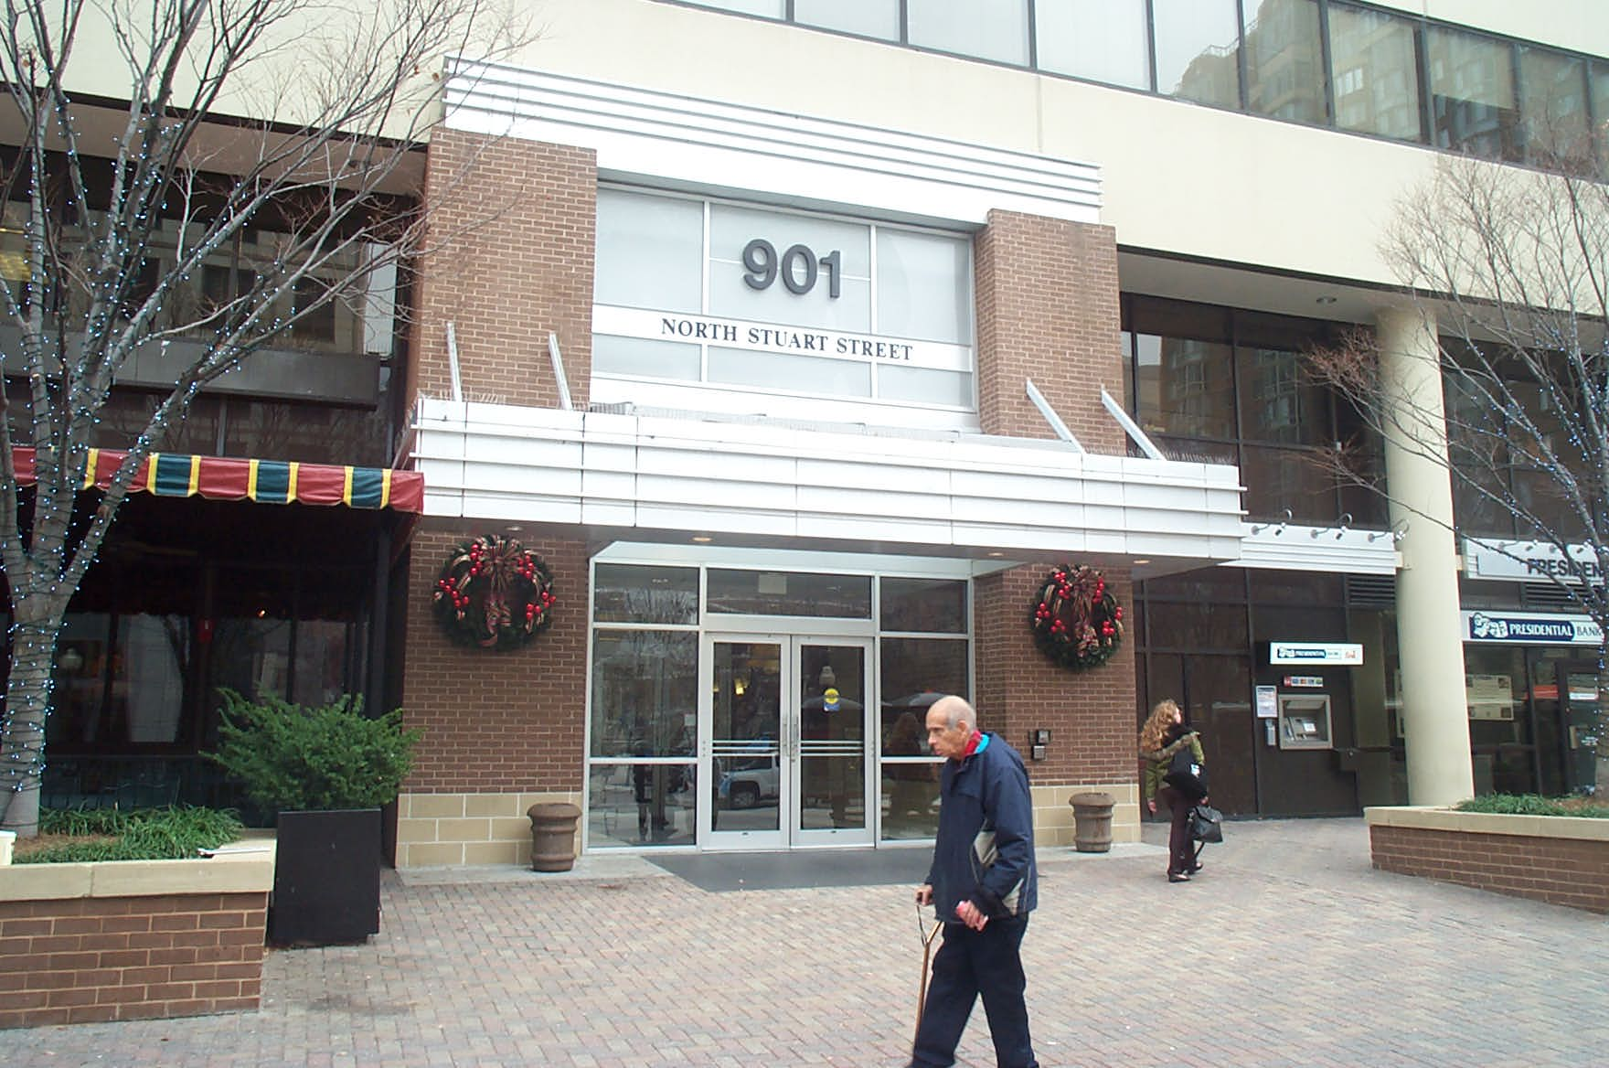
Entrances (Section F206.4)
Different from UFAS
60% of public entrances must be accessible (F206.4.1)
At least 1 restricted or secured entrance must be accessible (F206.4.7)
Each direct access from parking structures (F206.4.2) and each direct access from a tunnel or elevated walkway (F206.4.3) to a building entrance must be accessible

Slide 8
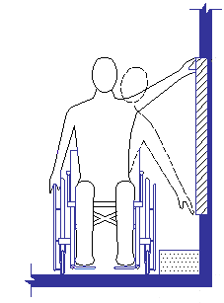
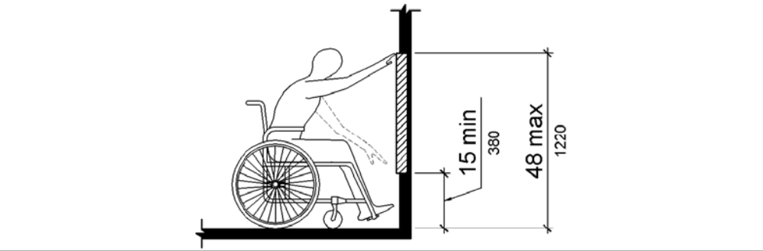
Unobstructed Reach Ranges (308)
Maximum above floor – 48”
Lowered from 54”
Minimum above floor – 15”
Raised from 9”
Forward & side reach

Slide 9
Parking (F208)
Van Spaces - 1 of every 6 accessible spaces
(instead of 1 of 8) must accommodate a van
Exception - spaces used exclusively for:
  bus, trucks, and other delivery vehicles
  law enforcement vehicles
  vehicular impound
These lots must have compliant passenger loading zone where public access is provided

Slide 10
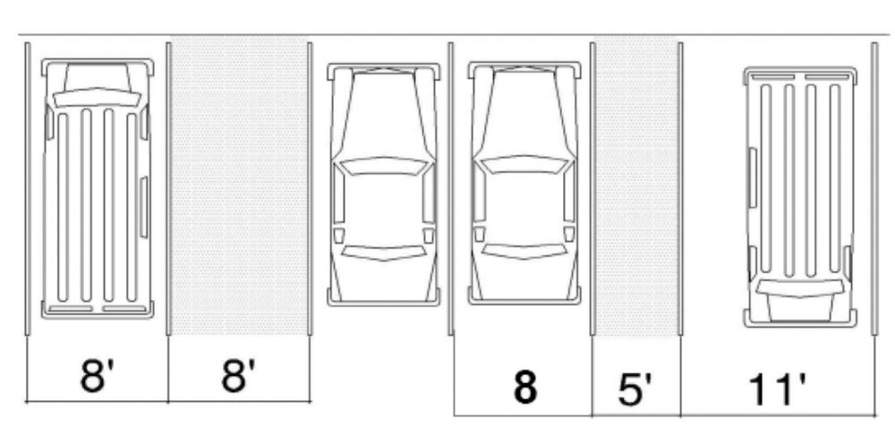
Van Spaces (Section 502)
’
Car space
Van space

Slide 11
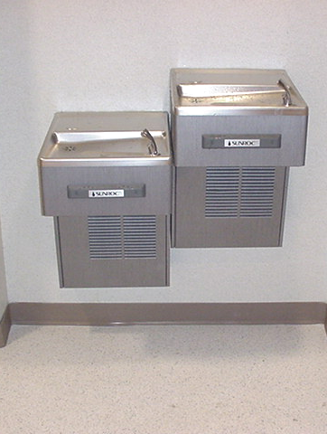
Drinking Fountains (F211)
2 required: wheelchair accessible and standing access
Acceptable alternative: single unit with dual access (e.g., “hi-lo” units)
Forward approach required with appropriate knee and toe clearances

Slide 12
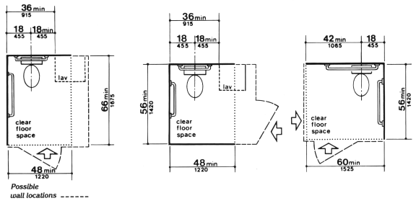
Toilet & Bathing Rooms (603)
Required clearances ensure space for side transfer

Slide 13
GSA Points of Contact
National Office: Thomas Williams (202) 501-3280
New England Region: Lori Anderson, 617-565-5980
Northeast and Caribbean Region: Tony DaCruz, 212-264-6414
Mid-Atlantic Region: Douglas McCone, 215-446-4513
Southeast Sunbelt Region: Doug Anderson, 404-331-0871
Great Lakes Region: Tony Szafran, 312-886-1189
Heartland Region: Ruth Ann Shane, 816-926-1103
Greater Southwest Region: Charles Lawrence, 817-978-4158
Rocky Mountain Region: Greg Sebesta, 303-236-8000, ext 5272
Pacific Rim Region: Bob Levenson, 415-522-3190
Northwest and Arctic Region: Ron Smith, 253-931-7696
National Capital Region: Vincent Tana, 202-708-7473

Slide 14
U.S. Access Board Contact Information
Access Board
(800) 872-2253 (voice)
(800) 993-2822 TTY
E-mail ta@access-board.gov
www.access-board.gov/ada-aba/final.htm

