Slide 1
Ion Source Test Stand Vacuum Control System
Johnny Tang

Slide 2
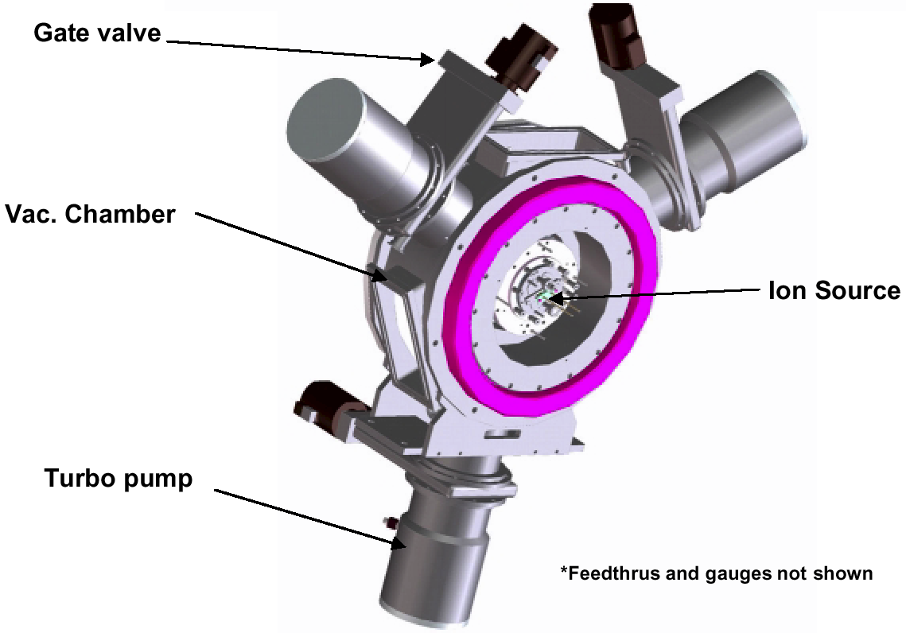
Hot Spare Stand Vacuum Requirements
(Purpose) To maintain a suitable pressure in the LEBT for conditioning and measuring the performance of the hot-spare ion source
(Vacuum Requirements) Hydrogen gas load is 0.1-0.4 Torr l/s
(Vacuum Requirements) To limit the charge-exchange to 10%, required 3 pump speed 1500 l/s in LEBT (not least)
(Vacuum Requirements) LEBT vacuum pressure 10-6 Torr with no Gas and 10-4 Torr with H2 Gas
Estimated pump down time : < 20 Minutes
(Control System Requirements)
  Keep the Same Functionality as in Front End
  Upgrade PLC5 to ControlLogix
  Upgrade RIO to EtherNet/IP
  Use R3.14 EPICS Base Release

Slide 3
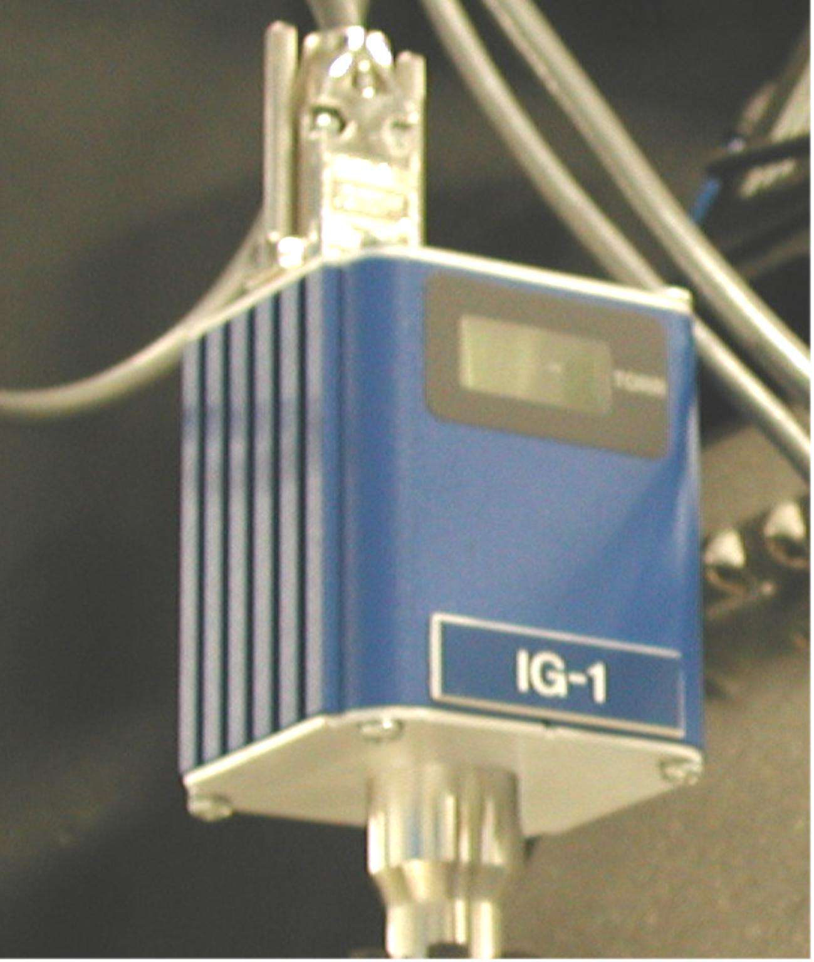
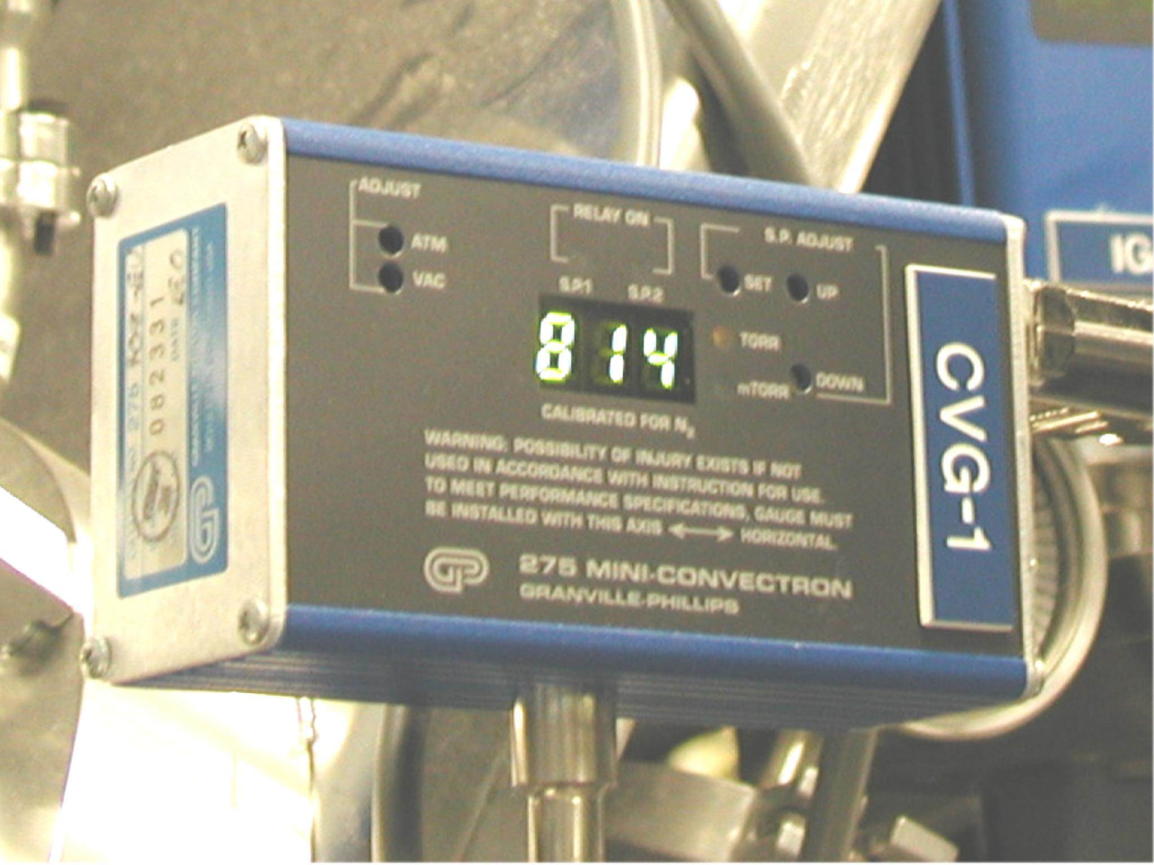
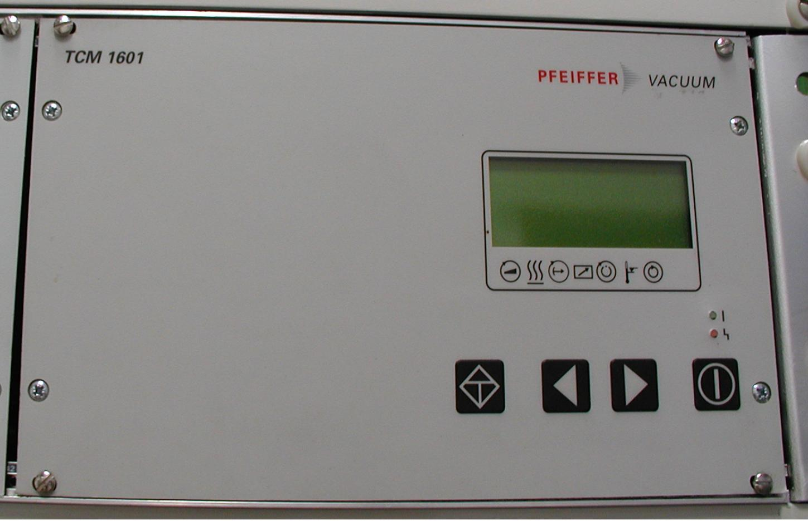
Controlled and Controlling Device List
5 Convectron Gauges (CG)
4 Ion Gauges (IG)
3 Turbo Pumps (TMP)
4 Rough Pumps (RP)
3 Gate Valves (GV)
4 Rough Valves (RV)
1 Vent Valve (VV)
2 AB-Flex IO Boxes (FEE20 & FER08-26)
1 ControlLogix PLC
1 EtherNet/IP Module
1 VME IOC
FEE20: 2 IE8, 2 IB16, 1 IV16, 1 OB16 and 2 OW8 modules (76 IOs)
FER08-26: 1 IE8, 1 IB16, 1 OE4 and 3 OW8 modules (36 IOs)

Slide 4
Control Signal Name
Device Type | Signals | Details | Signal Type
CVG | :Cmd | On/Off | bo
 | :Sts | On/Off | bi
 | :P | T | ai
 | :Raw | mV | ai
IG | :Cmd | On/Off | bo
 | :Sts | On/Off | bi
 | :P | T | ai
 | :Raw | V | ai
 | :DG_Cmd | DGas/Off | bo
 | :DG_Sts | DGas/Off | bi
 | :EM_Cmd | HI/LO | bo
 | :EM_Sts | HI/LO | bi

Slide 5
Control Signal Name
Device Type | Signals | Details | Signal Type
TMP | :Cmd | Run/Stop | bo
 | :Sts | On/Off | bi
 | :Cmd_Stby | Run/Stby | bo
 | :Spd | Hz | ai
 | :Fault | Ok/Fault | bi
 | :Lcl | LCL/REM | bo
 | :Cmd_AC | On/Off | bo
 | :Enable | ENA/DIS | bo
 | :Spd_Set | Hz | ao
 | :Reset | NORM/RST | bo
 | :Vent_Rls | CLS/RLS | bo
 | :H2O_flw | Ok/Low | bi
 | :Other | Ok/Fault | bi

Slide 6
Control Signal Name
Device Type | Signals | Details | Signal Type
VV,RV,GV | :Cmd | OPN/CLS | bo
 | :Opn | OPEN | bi
 | :Cls | Closed | bi
 | :Rdy | RDY/ILK | bi
RP | :Cmd | Run/Stop | bo
 | :Sts | Run/Stop | bi
CVG | 5*4 = 20
IG | 4*8 = 32
TMP | 3*13 = 39
RP | 4*2 = 8
VV,RV,GV | 8*4 = 32
Total PVs | 131 + VxStat and PLCStat

Slide 7
Documentation List
Doc Name | Description | Contact
Pfeiffer TCM 1601 | The instruction manual for the Magnetic Bearing Controller TCM 1601 that serves to drive and monitor Pfeiffer turbomolecular pumps | www.pfeiffer-vacuum.de 1800-248-8254

