Slide 1
State of Washington
Department of Printing
Human Resource
Management Report
Plan & Align Workforce
Hire Workforce
Deploy Workforce
Reinforce Performance
Develop Workforce
October 2007

Slide 2
Managers’ Logic Model for Workforce Management
Outputs
Initial Outcomes
Intermediate Outcomes
Plan & Align Workforce
Articulation of managers HRM accountabilities. HR policies. Workforce planning. Job classes & salaries assigned.
Managers understand HRM accountabilities. Jobs, staffing levels, & competencies aligned with agency priorities.
Foundation is in place to build and sustain a productive, high performing workforce.
Hire
Workforce
Qualified candidate pools, interviews & reference checks. Job offers. Appts & per-
formance monitoring.
Best candidate hired & reviewed during appointment period. Successful performers retained.
The right people are in the right job at the right time.
Ultimate Outcomes
Employees are committed to the work they do & the goals of the organization
Productive, successful employees are retained
State has workforce depth & breadth needed for present and future success
Deploy
Workforce
Work assignments& requirements defined. Positive workplace environment created. Coaching, feedback, corrections.
Workplace is safe, gives capacity to perform, & fosters productive relations. Staff know job rqmts, how they’re doing, & are supported.
Time & talent is used effectively. Employees are motivated & productive.
Develop Workforce
Individual development plans. Time/ resources for training. Continuous learning environment created.
Learning environment created. Employees are engaged in develop-
ment opportunities & seek to learn.
Employees have competencies for present job & career advancement
Agencies are better enabled to successfully carry out their mission. The citizens receive efficient government services.
Reinforce Performance
Clear performance expectations linked to orgn’al goals & measures. Regular performance appraisals. Recognition. Discipline.
Employees know how performance contributes to success of orgn. Strong performance rewarded; poor performance eliminated
Successful perf is differentiated & strengthened. Employees are held accountable.

Slide 3
Standard Performance Measures
Plan & Align Workforce
Percent supervisors with current performance expectations for workforce management
Management profile
Workforce planning measure (TBD)
Percent employees with current position/competencies descriptions
Time-to-fill funded vacancies
Candidate quality
Hiring Balance (Proportion of appointment types)
Separation during review period
Percent employees with current performance expectations
Employee survey ratings on “productive workplace” questions
Overtime usage
Sick leave usage
Non-disciplinary grievances/appeals filed and disposition (outcomes)
Worker safety
Percent employees with current individual development plans
Employee survey ratings on “learning & development” questions
Competency gap analysis (TBD)
Percent employees with current performance evaluations
Employee survey ratings on “performance & accountability” questions
Disciplinary actions and reasons, disciplinary grievances/appeals filed and disposition (outcomes)
Reward and recognition practices (TBD)
Ultimate Outcomes
Hire
Workforce
Employee survey ratings on “commitment” questions
Turnover rates and types
Turnover rate: key occupational categories
Workforce diversity profile
Retention measure (TBD)
Deploy
Workforce
Develop Workforce
Reinforce Performance

Slide 4
Plan & Align Workforce
Outcomes:
Managers understand workforce management accountabilities. Jobs and competencies are defined and aligned with business priorities. Overall foundation is in place to build & sustain a high performing workforce.
Performance Measures:
Percent supervisors with current performance expectations for workforce management
Management profile
Workforce Planning measure (TBD)
Percent employees with current position/ competency descriptions
Workforce Management Expectations
Percent supervisors with current performance expectations for workforce management = 60]%*
Analysis:
Percent of supervisors with current performance expectations is below the 95% goal.
Slight decrease during last half of year – down from 67%.
Action Steps:
Currently creating an action plan to increase percentage monthly until 95% is reached.
Will regularly meet with leadership team to discuss agency progress in this area.
*Based on 9 of 15 reported number of supervisors
Data as of July 1, 2007
Source: Agency Tracking

Slide 5
Plan & Align Workforce
Outcomes:
Managers understand workforce management accountabilities. Jobs and competencies are defined and aligned with business priorities. Overall foundation is in place to build & sustain a high performing workforce.
Performance Measures:
Percent supervisors with current performance expectations for workforce management
Management profile
Workforce Planning measure (TBD)
Percent employees with current position/ competency descriptions
Management Profile
WMS Employees Headcount = 0
Percent of agency workforce that is WMS = 0%
Managers* Headcount = 12
Percent of agency workforce that is Managers* = 9.8%
* In positions coded as “Manager” (includes EMS, WMS, and GS)
Analysis:
The Department of Printing does not have any WMS Employees.
Data as of July 1, 2007
Source: DOP Business Warehouse

Slide 6
Plan & Align Workforce
Outcomes:
Managers understand workforce management accountabilities. Jobs and competencies are defined and aligned with business priorities. Overall foundation is in place to build & sustain a high performing workforce.
Performance Measures:
Percent supervisors with current performance expectations for workforce management
Management profile
Workforce Planning measure (TBD)
Percent employees with current position/ competency descriptions
Current Position/Competency Descriptions
Percent employees with current position/competency descriptions = 97%*
Analysis:
This is a slight increase over the first half of the year.
Action Steps:
As we fill new positions, we will continue to review and update position descriptions as needed.
Will work with management to complete all changes to those position descriptions that are not current.
*Based on 118 of 122 reported employee count
Applies to employees in permanent positions, both WMS & GS
Data as of July 1, 2007
Source: Agency Tracking

Slide 7
Hire Workforce
Outcomes:
Best candidates are hired and reviewed during appointment period. The right people are in the right job at the right time.
Performance Measures
Time-to-fill vacancies
Candidate quality
Hiring Balance (proportion of appointment types)
Separation during review period
Time-to-fill / Candidate Quality
Time-to-fill Funded Vacancies
Average number of days to fill*: 44
Number of vacancies filled: 20
*Equals # of days from creation of the requisition to job offer acceptance
Time Period: 07/01/06 – 06/30/07
Analysis:
The average number of days is affected greatly by 3 hires in particular that went over 100 days as the necessity of the necessity of the positions was reviewed.
The average number of days to fill has decreased in the last half of the year.
Action Steps:
The agency will continue to look at ways of streamlining the process while maintaining the integrity of the process.
Candidate Quality
Of the candidates interviewed for vacancies, how many had the competencies (knowledge, skills & abilities) needed to perform the job?
  Number = [XXX] Percentage = [XXX]
Of the candidates interviewed, were hiring managers able to hire the best candidate for the job?
  Hiring managers indicating “yes”:
  Number = [XXX] Percentage = [XXX]
  Hiring managers indicating “no”:
  Number = [XXX] Percentage = [XXX]
Time Period: [mm/dd/yyyy – mm/dd/yyyy]
The Department of Printing has not measured Candidate Quality to date. Implementation of a survey to be done by the end of the year.
Data as of October 2007
Source: Agency Tracking

Slide 8
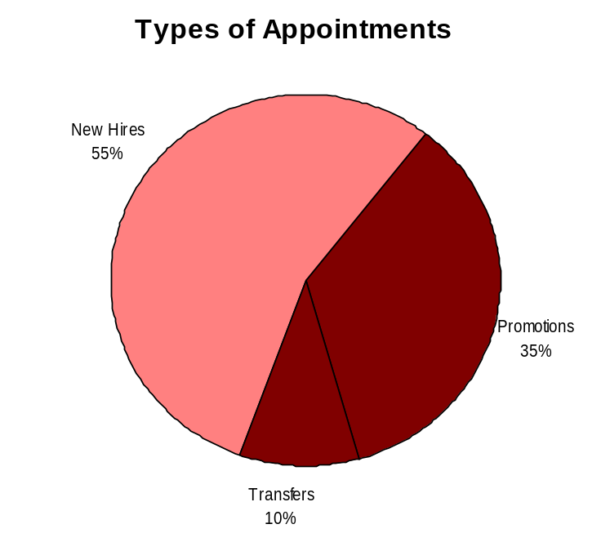
Hire Workforce
Outcomes:
Best candidates are hired and reviewed during appointment period. The right people are in the right job at the right time.
Performance Measures
Time-to-fill vacancies
Candidate quality
Hiring Balance (proportion of appointment types)
Separation during review period
Hiring Balance / Separations During Review Period
Analysis:
Through December 2006, 23% of appointments were promotions. By year end, promotions constituted 35% of the appointments.
Through December 2006, 62% of appointments were new hires. By year end, new hires constituted 55% of the appointments.
Action Steps:
The agency will continue to look at developing our employees to compete for promotional opportunities.
Total number of appointments = 20*
Time period = July 2007 through June 2007
Includes appointments to permanent vacant positions only; excludes reassignments
“Other” = Demotions, re-employment, reversion & RIF appointments
Separation During Review Period
Probationary separations - Voluntary 0
Probationary separations - Involuntary 0
  Total Probationary Separations 0
Trial Service separations - Voluntary 0
Trial Service separations - Involuntary 0
  Total Trial Service Separations 0
Total Separations During Review Period 0
Time period = July 2006 through June 2007
Data as of October 2007
Source: Agency Tracking

Slide 9
Deploy Workforce
Outcomes:
Staff know job expectations, how they’re doing, & are supported. Workplace is safe, gives capacity to perform, & fosters productive relations. Employee time and talent is used effectively. Employees are motivated.
Performance Measures
Percent employees with current performance expectations
Employee survey ratings on “productive workplace” questions
Overtime usage
Sick leave usage
Non-disciplinary grievances/appeals filed and disposition (outcomes)
Worker safety
Current Performance Expectations
Percent employees with current performance expectations = 60.1%*
Analysis:
The agency goal for current performance expectations is 95%.
Action Steps:
The agency has drafted a new performance development plan form that will include a new performance expectations section that will meet the needs of a production environment and will support the development of our staff. It is currently being used and appears to be helpful in moving towards our goal.
Currently creating an action plan to increase percentage monthly until 95% is reached.
Will regularly meet with leadership team to discuss agency progress in this area.
*Based on 74 of 123 reported employee count
Applies to employees in permanent positions, both WMS & GS
Data as of July 1, 2007
Source: Agency Tracking

Slide 10
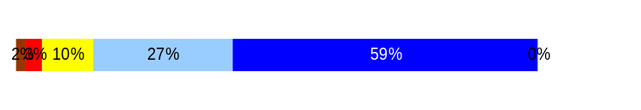
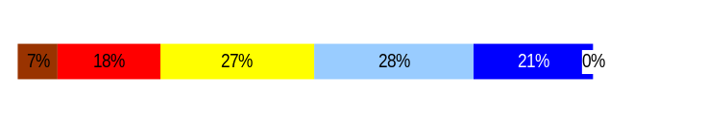
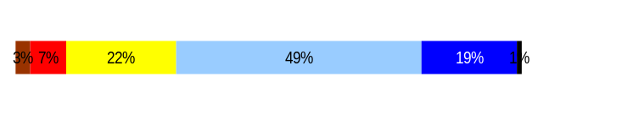
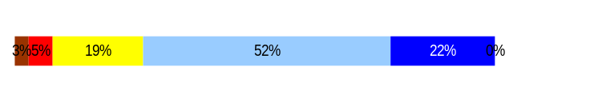
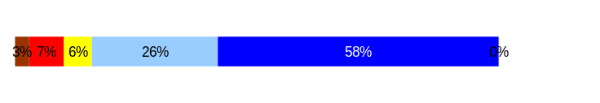
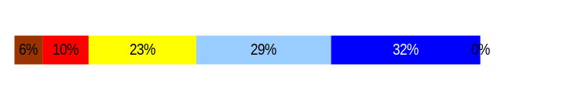
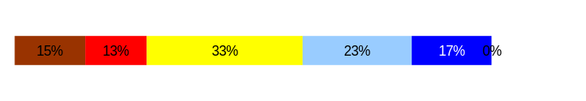
Deploy Workforce
Outcomes:
Staff know job expectations, how they’re doing, & are supported. Workplace is safe, gives capacity to perform, & fosters productive relations. Employee time and talent is used effectively. Employees are motivated.
Performance Measures
Percent employees with current performance expectations
Employee survey ratings on “productive workplace” questions
Overtime usage
Sick leave usage
Non-disciplinary grievances/appeals filed and disposition (outcomes)
Worker safety
Employee Survey “Productive Workplace” Ratings
Avg
Q4. I know what is expected of me at work.
Q1. I have opportunity to give input on decisions affecting my work.
Q2. I receive the information I need to do my job effectively.
Q6. I have the tools and resources I need to do my job effectively.
Q7. My supervisor treats me with dignity and respect.
Q8. My supervisor gives me ongoing feedback that helps me
improve my performance.
Q9. I receive recognition for a job well done.
Analysis:
More than a quarter of our employees feel that they seldom or never receive recognition for a job well done. Agency average is below state average.
Action Steps:
Our agency regularly posts letters of thanks from co-workers and external customers. We are developing a recognition program that will incorporate individual thanks. The program is to be in place by the end of November.
4.4
3.4
3.8
3.9
4.3
3.7
3.1
Never
Seldom
Occasionally
Usually
Always
Overall average score for Productive Workplace Ratings: 3.8
Data as of October 2007
Source: 2006 DOP Employee Survey

Slide 11
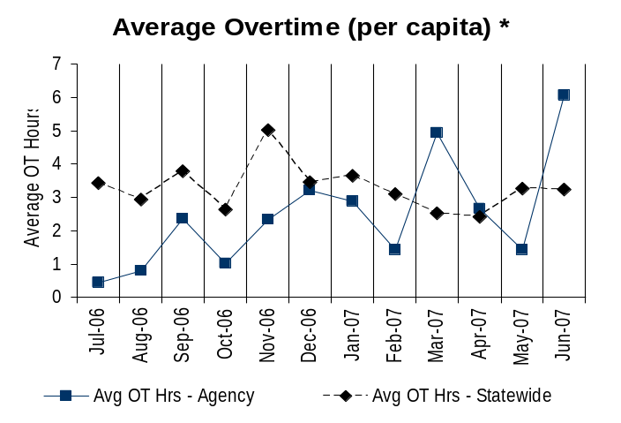
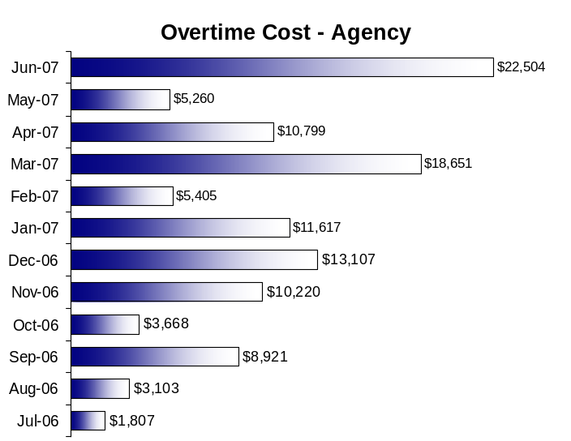
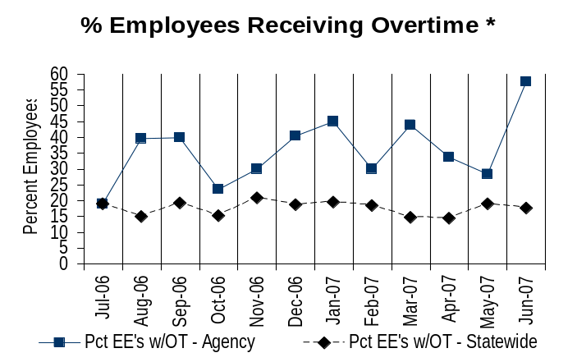
Deploy Workforce
Outcomes:
Staff know job expectations, how they’re doing, & are supported. Workplace is safe, gives capacity to perform, & fosters productive relations. Employee time and talent is used effectively. Employees are motivated.
Performance Measures
Percent employees with current performance expectations
Employee survey ratings on “productive workplace” questions
Overtime usage
Sick leave usage
Non-disciplinary grievances/appeals filed and disposition (outcomes)
Worker safety
Overtime Usage
Overall agency avg overtime usage – per capita, per month: 2.47**
*Statewide overtime values do not include DNR
**Overall agency avg overtime usage – per capita, per month = sum of monthly OT averages divided by number of months
Analysis:
Average Overtime per capita is generally less than the state. There will be peaks that do not match the state based on being a production facility. The majority of overtime is earned by our production employees. Our production employees represent over 50% of our staff. This also accounts for the % of employees receiving overtime.
The Overtime Cost for the agency will fluctuate based on business needs. One such pattern of high overtime is during the end of the fiscal year as a high volume of jobs are ordered by our customers.
Action Steps:
We regularly monitor overtime and the ability to meet the needs of our customers.
Overall agency avg employees receiving overtime per month: 35.95%**
*Statewide overtime values do not include DNR
**Overall agency avg employees receiving overtime per month = sum of monthly OT percentages divided by number of months
Data as of October 2007
Source: DOP Business Warehouse

Slide 12
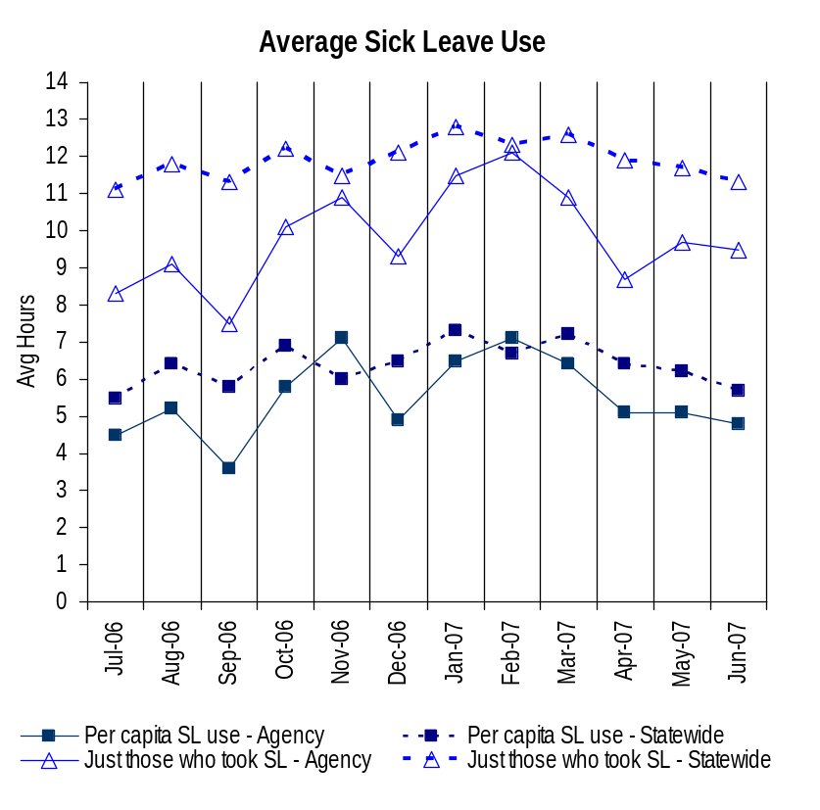
Deploy Workforce
Outcomes:
Staff know job expectations, how they’re doing, & are supported. Workplace is safe, gives capacity to perform, & fosters productive relations. Employee time and talent is used effectively. Employees are motivated.
Performance Measures
Percent employees with current performance expectations
Employee survey ratings on “productive workplace” questions
Overtime usage
Sick leave usage
Non-disciplinary grievances/appeals filed and disposition (outcomes)
Worker safety
Sick Leave Usage
Analysis:
Sick Leave Hours Used/Earned and Sick Leave Hours Used/Earned (those that took sick leave) are both below state figures.
Average Sick Leave Use Per Capita mirrors the state average except the spike in November and February.
Action Steps:
As an agency, we will continue to work with our management team to monitor leave patterns and, if necessary, start the corrective action process.
When we monitor average sick leave, we are careful to take into consideration the size of our agency as any extended absence can dramatically affect the average short term.
Sick Leave Hrs Used / Earned (per capita)
Avg Hrs SL Used (per capita) - Agency | % of SL Hrs Earned (per capita) - Agency
5.5 Hrs | 70.1%
Avg Hrs SL Used (per capita) – Statewide* | % of SL Hrs Earned (per capita) – Statewide*
6.4 Hrs | 82.5%
Sick Leave Hrs Used / Earned (those who took SL)
Avg Hrs SL Used (those who took SL) - Agency | % SL Hrs Earned (those who took SL) - Agency
9.8 Hrs | 122.4%
Avg Hrs SL Used (those who took SL) – Statewide* | % SL Hrs Earned (those who took SL) – Statewide*
11.9 Hrs | 148.4%
Sick Leave time period = July 2006 through June 2007
* Statewide data does not include DOL, DOR, L&I, and LCB
Source: DOP MI HRM Performance And Accountability

Slide 13
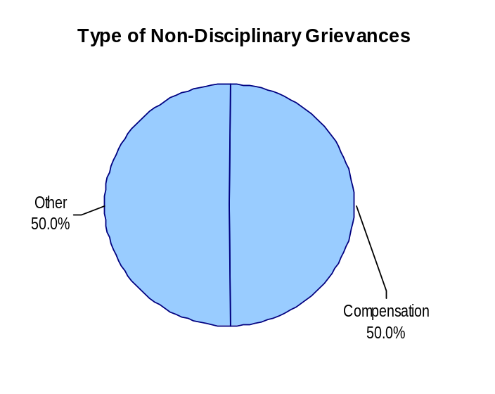
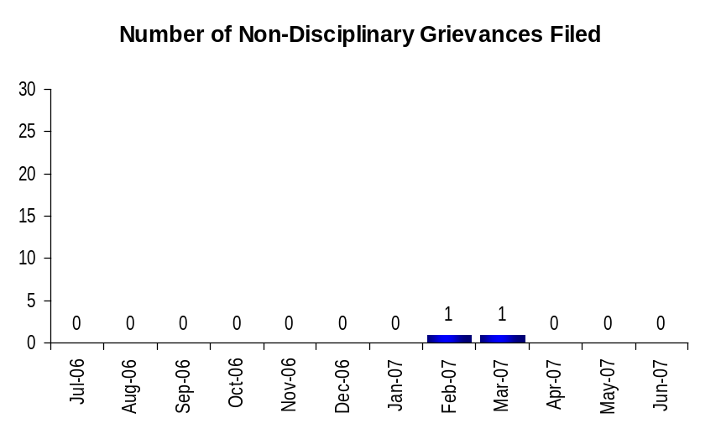
Deploy Workforce
Outcomes:
Staff know job expectations, how they’re doing, & are supported. Workplace is safe, gives capacity to perform, & fosters productive relations. Employee time and talent is used effectively. Employees are motivated.
Performance Measures
Percent employees with current performance expectations
Employee survey ratings on “productive workplace” questions
Overtime usage
Sick leave usage
Non-disciplinary grievances/appeals filed and disposition (outcomes)
Worker safety
Non-Disciplinary Grievances (represented employees)
Total Non-Disciplinary Grievances = 2
Non-Disciplinary Grievance Disposition*
(Outcomes determined during 07/06 through 06/07)
Agreement made with union concerning the compensation of an employee filling in for a lead. Clarification in the CBA wording.
Arbitration scheduled but avoided by a settlement with the employee and agreement with union concerning represented employees moving into non-represented positions.
Analysis:
Open communication between Management and the Unions representing the production employees of the Department of Printing reduces the need for grievances.
Action Steps:
The Department of Printing Management will continue to foster a positive relationship with the Unions.
* There may not be a one-to-one correlation between the number of grievances filed (shown top of page) and the outcomes determined during this time period. The time lag between filing date and when a decision is rendered can cross the time periods indicated.
Data as of October 2007
Source: Agency Tracking

Slide 14
Deploy Workforce
Outcomes:
Staff know job expectations, how they’re doing, & are supported. Workplace is safe, gives capacity to perform, & fosters productive relations. Employee time and talent is used effectively. Employees are motivated.
Performance Measures
Percent employees with current performance expectations
Employee survey ratings on “productive workplace” questions
Overtime usage
Sick leave usage
Non-disciplinary grievances/appeals filed and disposition (outcomes)
Worker safety
Non-Disciplinary Appeals (mostly non-represented employees)
Filings for DOP Director’s Review
Time Period = 07/06 through 06/07
0 Job classification
0 Rule violation
0 Name removal from register
0 Rejection of job application
0 Remedial action
0 Total filings
Filings with Personnel Resources Board
Time Period = 07/06 through 06/07
0 Job classification
0 Other exceptions to Director Review
0 Layoff
0 Disability separation
0 Non-disciplinary separation
0 Total filings
Non-Disciplinary appeals only are shown above.
Source: Dept of Personnel

Slide 15
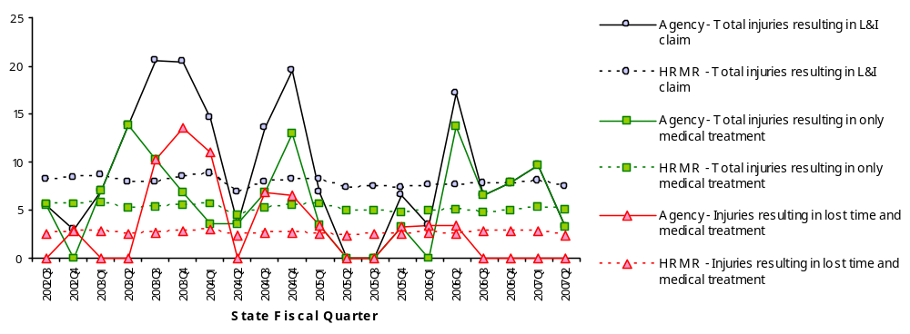
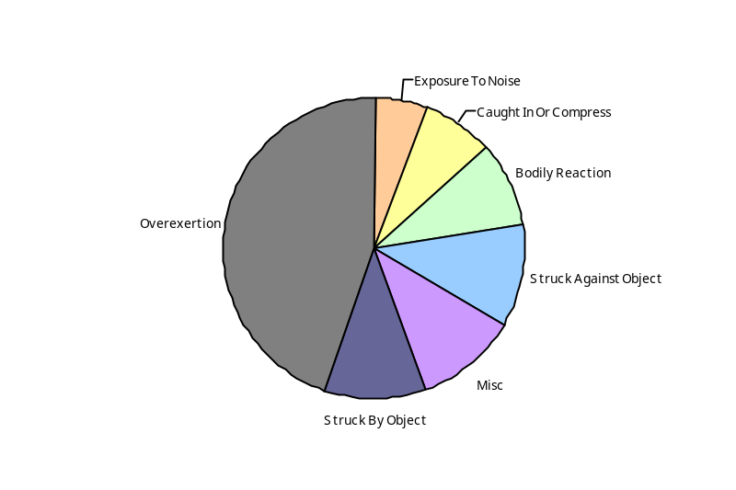
Deploy Workforce
Outcomes
Staff know job expectations, how they’re doing, & are supported. Workplace is safe, gives capacity to perform, & fosters productive relations. Employee time and talent is used effectively. Employees are motivated.
Performance Measures
Percent employees with current performance expectations
Employee survey ratings on 'productive workplace' questions
Overtime usage
Sick leave usage
Non-disciplinary grievances/appeals filed and disposition outcomes
Worker Safety
Worker Safety: Printing, Department of
Analysis:
During the last four quarters, no time loss incidents.
The highest level of incidents is in the classification of overexertion.
Action Plan:
The agency will continue to focus on reducing the overall number of injuries through safety awareness, initial safety training for new hires, and continued training for existing employees.
Utilize safety committee communication to increase overall awareness.
Allowed Annual
Claims Rate*^:
Agency vs. All HR
Management Report
(HRMR) agencies
*Annual claims rate
is # claims / 100 FTE
1 FTE = 2000 hours
^Due to natural lag
in claim filing, rates
are expected to
increase significantly
over time
Injuries by Occupational
Injury and Illness
Classification (OIICS)
event:
For fiscal period 2002Q3
through 2007Q2
(categories under 3% or not
adequately coded are grouped
into 'misc.')
Oiics Code | Oiics Description | Percent | Number
21 | Bodily Reaction | 9% | 5
03 | Caught In Or Compress | 7% | 4
35 | Exposure To Noise | 6% | 3
- | Misc | 11% | 6
22 | Overexertion | 44% | 24
01 | Struck Against Object | 11% | 6
02 | Struck By Object | 11% | 6
Source: Labor & Industries, Research and Data Services (data as of 09/03/2007 )
Notes:
HRMR Safety Report Overview
The HRMR Safety Reports are:
- PowerPoint slides created by the Department of Labor and Industries
- Created for each state agency that is reporting their employee safety program results bi-
annually as part of their Human Resources Management Report (HRMR).
- Snapshots of five years of worker’s compensation claim data specific to that agency, as
well as a comparison to the combined data for agencies completing HRMR reports.
- There is a two quarter lag at the end of the five years.
This allows each agency’s payroll data to be entered into L&I’s computer system. This
payroll data is used to compute the number of workers per agency and quarter.
Definitions
Claim – When a covered worker sustains an occupational injury or illness, that worker files a
'claim’ for benefits. A 'claim number' is assigned, and all wage replacement payments, medical
provider bills, etc, for that worker and injury, are associated with that claim number.
Report Detail
'Allowed Annual Claim Rate'
This chart shows your agency's rate of injuries resulting in allowed
claims, by injury quarter, for on-the-job injuries and occupational illnesses. The rate for all
reporting agencies is shown for comparison.
- The rate is the number accepted claims per 200,000 annual worker hours (100 workers)
Three rates are included in this chart:
A)The total rate for all injuries resulting in a claim; the two groups listed below are
exclusive of each other.
B)The rate of injuries which required medical care, but no compensation for lost
time.
C)The rate of injuries which resulted in compensation for lost time in addition to
medical care.
'Injuries by Occupational Injury and Illness Classification (OIICS) Event’
This section contains a pie chart which shows your agency's injuries by type* and a table which
shows the percent and number of accepted claims by OIICS Event description and code.
This information is useful in identifying what causes injuries so prevention can occur. Prevention
might include root cause analysis, education, and hazard mitigation.
* Injury Type is based on the 2 digit Major Group code of the Event or Exposure section of the Occupational
Injury and Illness Classification System (OIICS). Groups with less than 3% of the
total injuries are combined into the 'Misc' category.
How to get this report for your agency:
All worker compensation reports will be available on the L&I website by the 20th of September or
the 20th of March of each year. The data will be provided in a PowerPoint slide to which you will
add your own analyses and action plans.

Slide 16
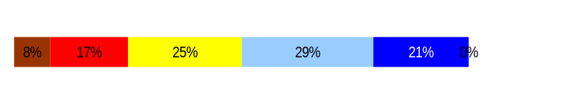
Develop Workforce
Outcomes:
A learning environment is created. Employees are engaged in professional development and seek to learn. Employees have competencies needed for present job and future advancement.
Performance Measures
Percent employees with current individual development plans
Employee survey ratings on “learning & development” questions
Competency gap analysis (TBD)
Individual Development Plans
Percent employees with current individual development plans = 60.1%*
Analysis:
The agency goal for current individual development plans is 95%.
Action Steps:
Currently creating an action plan to increase percentage monthly until 95% is reached.
Will regularly meet with leadership team to discuss agency progress in this area.
The agency uses the performance development plan sections 2 and 3 as an individual development plan.
The agency has drafted a new performance development plan form that includes an entire section for individual development. The form meets the needs of a production environment and has just gone into use. It should help in reaching our goal.
*Based on 74 of 123 reported employee count
Applies to employees in permanent positions, both WMS & GS
Employee Survey “Learning & Development” Ratings
Q5. I have opportunities at work to learn and grow.
Q8. My supervisor gives me ongoing feedback that helps me
improve my performance.
Avg
3.4
3.7
Overall avg score for Learning & Development Ratings: 3.5
Data as of July 1, 2007
Source: Agency Tracking

Slide 17
Reinforce Performance
Outcomes:
Employees know how their performance contributes to the goals of the organization. Strong performance is rewarded; poor performance is eliminated. Successful performance is differentiated and strengthened. Employees are held accountable.
Performance Measures
Percent employees with current performance evaluations
Employee survey ratings on “performance and accountability” questions
Disciplinary actions and reasons, disciplinary grievances/appeals filed and disposition (outcomes)
Reward and recognition practices (TBD)
Current Performance Evaluations
Percent employees with current performance evaluations = 60.1%*
Analysis:
The agency goal for current performance evaluations is 95%.
Action Steps:
Currently creating an action plan to increase percentage monthly until 95% is reached.
Will regularly meet with leadership team to discuss agency progress in this area.
The agency has drafted a new performance evaluation form. The form meets the needs of a production environment and has just gone into use. It should help in reaching our goal.
*Based on 74 of 123 reported employee count
Applies to employees in permanent positions, both WMS & GS
Data as of July 1, 2007
Source: Agency Tracking

Slide 18
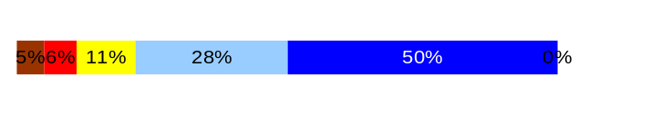
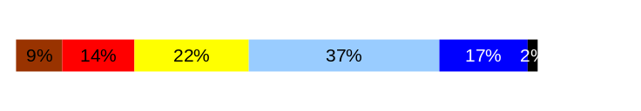
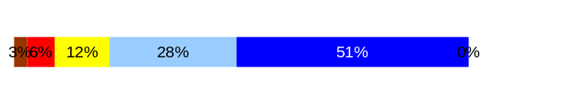
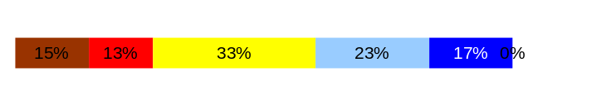
Reinforce Performance
Outcomes:
Employees know how their performance contributes to the goals of the organization. Strong performance is rewarded; poor performance is eliminated. Successful performance is differentiated and strengthened. Employees are held accountable.
Performance Measures
Percent employees with current performance evaluations
Employee survey ratings on “performance and accountability” questions
Disciplinary actions and reasons, disciplinary grievances/appeals filed and disposition (outcomes)
Reward and recognition practices (TBD)
Employee Survey “Performance & Accountability” Ratings
Avg
Q3. I know how my work contributes to the goals of my agency.
Q10. My performance evaluation provides me with meaningful information about my performance.
Q11. My supervisor holds me and my co-workers accountable for performance.
Q9. I receive recognition for a job well done.
Analysis:
Agency averages for questions 3, 10, and 11 are above the state average.
Agency average for question 9 is slightly below the state average of 3.4. More than a quarter of our employees feel that they seldom or never receive recognition for a job well done.
Action Steps:
Our agency is developing a recognition program that will incorporate individual thanks as well as traditional forms of recognition. The program is to be in place by the end of November.
4.1
3.4
4.2
3.1
Never
Seldom
Occasionally
Usually
Always
[DOUBLE CLICK ON THE BAR CHARTS TO ENTER YOUR AGENCY’S DATA]
Overall average score for “Performance & Accountability” ratings: 3.7
Data as of October 2007
Source: 2006 DOP Employee Survey

Slide 19
Reinforce Performance
Outcomes:
Employees know how their performance contributes to the goals of the organization. Strong performance is rewarded; poor performance is eliminated. Successful performance is differentiated and strengthened. Employees are held accountable.
Performance Measures
Percent employees with current performance evaluations
Employee survey ratings on “performance and accountability” questions
Disciplinary actions and reasons, disciplinary grievances/appeals filed and disposition (outcomes)
Reward and recognition practices (TBD)
Formal Disciplinary Actions
Disciplinary Action Taken
Time period = 07/06 through 06/07
Analysis:
Historically, the agency has a low number of disciplinary actions.
Action Steps:
The agency will continue to work with managers to address performance issues and educate employees prior to the need for disciplinary actions.
Dismissals | 2
Demotions | 0
Suspensions | 1
Reduction in Pay* | 0
Total Disciplinary Actions* | 3
* Reduction in Pay is not currently available in HRMS/BW.
Issues Leading to Disciplinary Action
Job abandonment.
Poor work performance.
Data as of October 2007
Source: Agency Tracking

Slide 20
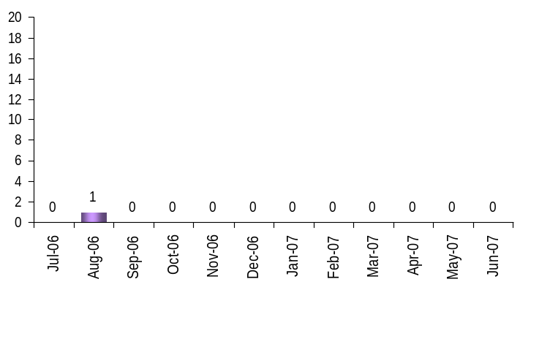
Reinforce Performance
Outcomes:
Employees know how their performance contributes to the goals of the organization. Strong performance is rewarded; poor performance is eliminated. Successful performance is differentiated and strengthened. Employees are held accountable.
Performance Measures
Percent employees with current performance evaluations
Employee survey ratings on “performance and accountability” questions
Disciplinary actions and reasons, disciplinary grievances/appeals filed and disposition (outcomes)
Reward and recognition practices (TBD)
Disciplinary Grievances and Appeals
Disciplinary Grievances
(Represented Employees)
Disciplinary Appeals
(Non-Represented Employees
filed with Personnel Resources Board)
Time Period = 07/06 through 06/07
0 Dismissal
0 Demotion
0 Suspension
0 Reduction in salary
0 Total Disciplinary Appeals Filed with PRB
Total # Disciplinary Grievances Filed: 1
There is no one-to-one correlation between the filings shown above and the outcomes displayed in the charts below. The time lag between filing date and when a decision is rendered can cross the time periods indicated.
Disposition (Outcomes) of Disciplinary Grievances
Time period = 07/06 through 06/07
August 2006 grievance dismissed August 2006
Disposition (Outcomes) of Disciplinary Appeals*
Time period = 07/06 through 06/07
No Disciplinary Appeals
*Outcomes issued by Personnel Resources Board
Data as of October 2007
Source: Agency Tracking

Slide 21
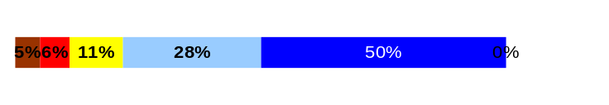
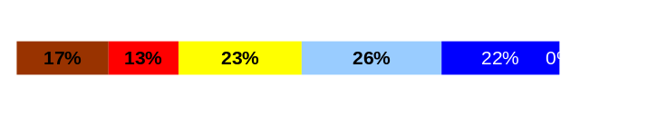
ULTIMATE OUTCOMES
Employees are committed to the work they do and the goals of the organization
Successful, productive employees are retained
The state has the workforce breadth and depth needed for present and future success
Performance Measures
Employee survey ratings on “commitment” questions
Turnover rates and types
Turnover rate: key occupational categories
Workforce diversity profile
Retention measure (TBD)
Employee Survey “Employee Commitment” Ratings
Avg
Analysis:
Agency averages for questions 9 and 12 are slightly below the state averages. Agency average for question 3 is equal to the state average.
Agency average for question 9 is slightly below the state average of 3.4. More than a quarter of our employees feel that they seldom or never receive recognition for a job well done.
Action Steps:
The agency has focused on open communication of its goals, its successes, areas needing improvement, and the direction the agency is going. This information is shared to all employees via all staff meetings and department meetings.
Our agency is developing a recognition program that will incorporate individual thanks as well as traditional forms of recognition. The program is to be in place by the end of November.
Q3. I know how my work contributes to the goals of my agency.
Q12. I know how my agency measures its success.
Q9. I receive recognition for a job well done.
4.1
3.2
3.1
Never
Seldom
Occasionally
Usually
Always
Overall average score for Employee Commitment ratings: 3.5
Data as of October 2007
Source: 2006 DOP Employee Survey

Slide 22
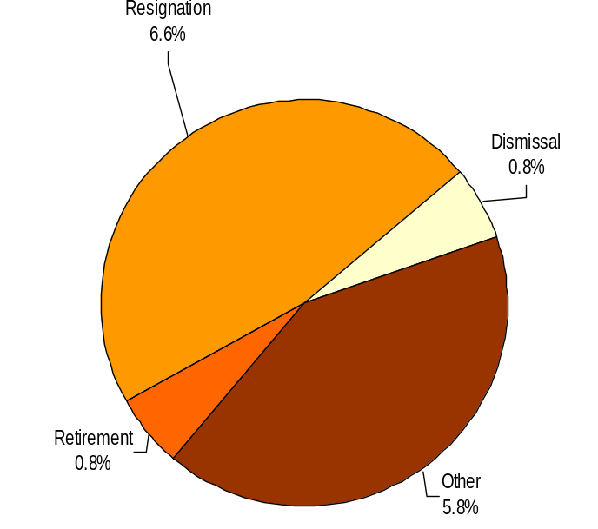
ULTIMATE OUTCOMES
Employees are committed to the work they do and the goals of the organization
Successful, productive employees are retained
The state has the workforce breadth and depth needed for present and future success
Performance Measures
Employee survey ratings on “commitment” questions
Turnover rates and types
Turnover rate: key occupational categories
Workforce diversity profile
Retention measure (TBD)
Turnover Rates
Total % Turnover (leaving state)
Time Period: 07/06 through 06/07
Analysis:
There was a slight decrease in turnover during the second half or the fiscal year.
The majority of our resignations come from our entry level production employees.
Action Steps:
The agency has addressed one cause of the entry level production resignations by reviewing and changing the wage structure for those positions. The positions are physically demanding so some turnover is to be expected.
In addition, the agency is developing a recognition program that will incorporate individual thanks as well as traditional forms of recognition.
Total Turnover Actions: 17
Total % Turnover: 14.0%
Note: Movement to another agency is currently not available in HRMS/BW
Data as of October 2007
Source: DOP Business Warehouse

Slide 23
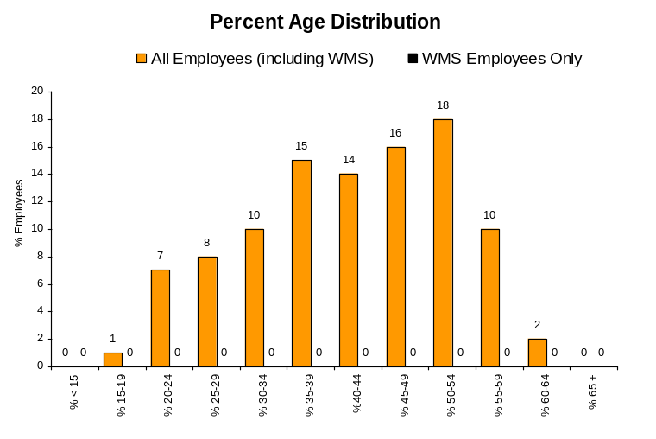
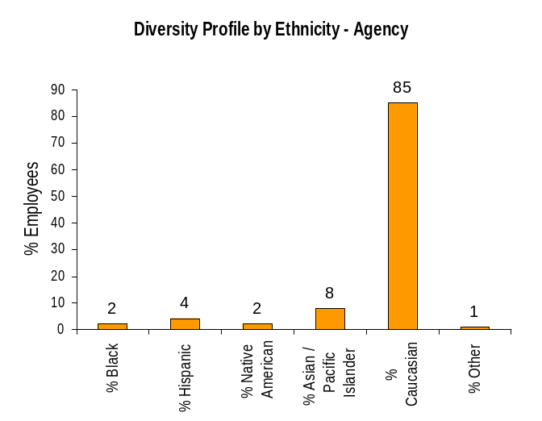
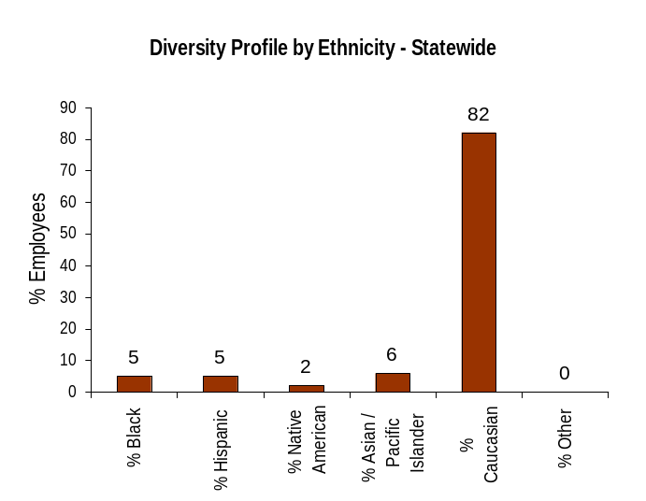
ULTIMATE OUTCOMES
Employees are committed to the work they do and the goals of the organization
Successful, productive employees are retained
The state has the workforce breadth and depth needed for present and future success
Performance Measures
Employee survey ratings on “commitment” questions
Turnover rates and types
Turnover rate: key occupational categories
Workforce diversity profile
Retention measure (TBD)
Workforce Diversity Profile
Agency State
Female 41% 53%
Disabled 2% 5%
Vietnam Vet 1% 7%
Disabled Vet 2% 2%
People of color 16% 18%
Persons over 40 59% 75%
Analysis:
According to the May 2006 Affirmative Action Plan for the agency, compared to similar production facilities, we are underrepresented in the Native American group.
Action Steps:
The agency will continue to monitor the hiring process to determine if our recruitment or hiring practices need to be revised.
The agency will continue to utilize various diversity listings to attract qualified candidates.
Data as of July 1, 2007
Source: DOP Business Warehouse

