Slide 1


Campylobacter
County of San Diego
Department of Environmental Health

Slide 2

Overview
What is Campylobacter?
Transmission
Symptoms
Complications
Prevention

Slide 3

Campylobacter
Leading cause of bacterial diarrheal illness in US
Estimated 2.4 million cases each year in the US
In CA, there were 5,736 cases reported in 2001
Occurs as isolated, sporadic events, not as a part of large outbreaks.
Children under five years and young adults (15-29) are more frequently affected.
Notes:
2.4 million number comes from CDC EID

Slide 4
Transmission
Contaminated food (particularly poultry)
Un-treated water
Unpasteurized milk
Contact with infected animals (particularly cats and puppies).
Can be spread from person to person by the fecal-oral route.

Slide 5
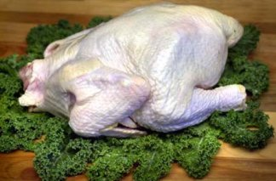
Poultry and Campylobacter
80% of poultry for human consumption is contaminated with Campylobacter.

Slide 6
Symptoms
Symptoms of campylobacteriosis usually occur within 2 to 10 days
Diarrhea (may contain blood or mucus)
Fever
Nausea
Vomiting
Abdominal Pain

Slide 7
Treatment
Most infected persons with Campylobacter will recover without any specific treatment.
In severe cases, antibiotics can be used.

Slide 8
Complications
Meningitis
Urinary tract infections
Septicemia
Reactive arthritis (rare and almost always short-term)
Guillain-Barre syndrome, an unusual type of paralysis (rare).

Slide 9
Prevention
CLEAN
Wash hands before preparing or serving foods.
Teach children to wash their hands after toileting and before eating.
Wash all contact surfaces (e.g. cutting boards)
Animal stools should also be considered to be contaminated. Wash after handling or close contact. (e.g. cleaning litter box).
Wash hands after contact with animals in petting zoos.

Slide 10
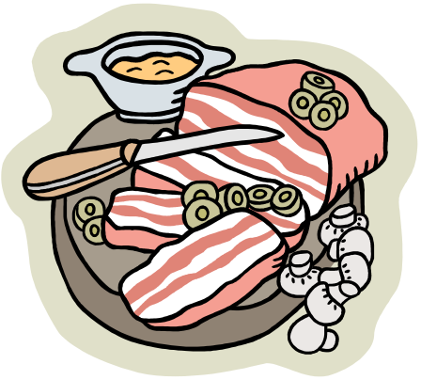
Prevention
SEPARATE
Do not contaminate cooked foods with uncooked foods.
Do not place cooked poultry/meat on cutting board which was used to prepare raw poultry/meat.
How old is your cutting board?

Slide 11
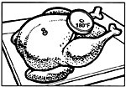

Prevention
COOK
Be sure that meats and poultry are fully cooked using a meat thermometer
Cook poultry to an internal temperature of 165ºF
Cook pork to an internal temperature of 145ºF
Where is your meat thermometer?

Slide 12

Prevention
CHILL
Refrigerate poultry and meats immediately.
Keep poultry and other meats in refrigerator at 41ºF or less.
When was the last time you checked the temperature in your refrigerator?

Slide 13
Prevention
To protect the public, anyone who is infected with Campylobacter should not work as a food handler, patient care provider, dairy processor or child care provider until there is no longer a risk of infecting others.

Slide 14
Sites for further information
www.cdc.gov
www.fda.gov

Slide 15
Contact Information
Reportable Illness
Health and Human Services Agency
(619) 515-6620
Suspect Food borne Illness
Dept of Environmental Health
(619) 338-2356 or fhdutyeh@sdcounty.ca.gov
Presentation prepared by Student Beck Goldberg,MPH
Graduate School of Public Health
April 2003

