Slide 1

NAEP
National Assessment of Educational Progress
South Dakota Results 2005 Math
Gary Skoglund, NAEP Director
South Dakota Department of Education

Slide 2
Student, School/District Characteristics for South Dakota Public Schools
Student Characteristics Number enrolled: 125,537 Percent in Title I schools: 42.9% With Individualized Education Programs (IEP): 13.6% Percent in limited-English proficiency programs: 3.6% Percent eligible for free/reduced lunch: 31.4% Racial/Ethnic Background White: 84.9%¹ Black: 1.5%¹ Hispanic: 1.8%¹ Asian/Pacific Islander: 1.0% American Indian/Alaskan Native: 10.7%¹ | School/District Characteristics Number of school districts: 172* Number of schools: 741 Number of charter schools: N/A Per-pupil expenditures: $6,675¹ Pupil/teacher ratio: 13.6 Number of FTE teachers: 9,245

Slide 3
CAUTION INTERPRETING RESULTS
The averages and percentages in this report are estimates based on samples of students rather than on entire populations. Moreover, the collection of questions used at each grade level is only a sample of the many questions that could have been asked to assess the skills and abilities described in the NAEP framework. Therefore, the results are subject to a measure of uncertainty, reflected in the standard error of the estimates—a range of up to a few points above or below the score or percentage—which takes into account potential score fluctuation due to sampling error and measurement error. Statistical tests that factor in these standard errors are used to determine whether the differences between average scores or percentages are significant. All differences were tested for statistical significance at the .05 level.

Slide 4
Defining the content domain to be assessed
State Curriculum Framework and Standards
State Assessment, Framework, and Specifications
State Assessment
NAEP Assessment Framework and Specifications
Subject Area Domain
Notes:
Talking points:
During this presentation you need to be thinking about how the NAEP framework interacts and overlaps with the frameworks and assessments from your state.

Slide 5
NAEP Math Test
A combination of multiple-choice and constructed-response questions was used to assess students' mathematics performance. Short constructed-response questions ask students to provide the answer for a numerical problem or to briefly describe the solution to a problem. Longer constructed-response questions require students to produce both a solution and a justification, explanation, or interpretation for the solution.
Released test questions, along with student performance data by state, are available on the NAEP website (http://nces.ed.gov/nationsreportcard/itmrls/

Slide 6
The framework incorporates the use of calculators (four-function at grade 4 and scientific at grade 8), rulers, protractors (grade 8), and manipulatives such as spinners and geometric shapes. The use of these ancillary materials and the use of calculators were incorporated into some parts of the assessment, but not all. Calculator use was permitted on approximately one-third of the test questions.

Slide 7
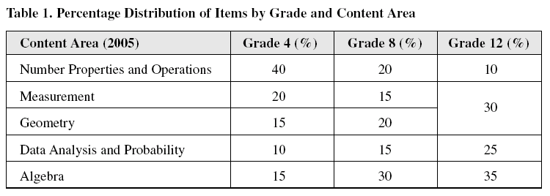
Distribution of Items by Content Area

Slide 8
Overall Math Results for Grade 4
In 2005, the average scale score for fourth-grade students in South
Dakota was 242. This was higher¹ than their average score in 2003
(237).
South Dakota's average score (242) in 2005 was higher than that
of the Nation's public schools (237).
Of the 52 states and other jurisdictions² that participated in the
2005 fourth-grade assessment, students' average scale scores in
South Dakota were higher than those in 29 jurisdictions, not
significantly different from those in 17 jurisdictions, and lower than
those in 5 jurisdictions.
The percentage of students in South Dakota who performed at or
above the NAEP Proficient level was 41 percent in 2005. This
percentage was greater than that in 2003 (34 percent)
The percentage of students in South Dakota who performed at or
above the NAEP Basic level was 86 percent in 2005. This
percentage was greater than that in 2003 (82 percent).

Slide 9
Performance of NAEP Reporting Groups in South Dakota Grade 4 Math
Group 2003 2005 Dif
Males 239 243 +4
Females 235 240 +5
White 241 245 +4
Native American 217 221 +4
Eligible for free/reduced lunch 227 232 +5
Not eligible for free/reduced lunch 244 249 +5
Students classified as having a disability 219 225 +6

Slide 10
Math Grade 4 Comparison—Highest and Bordering States
2003-2005
Jurisdiction 2003 2005
Massachusetts 242 247
Minnesota 242 246
Wyoming 241 243
North Dakota 238 243
South Dakota 237 242
Iowa 238 240
Nebraska 236 238

Slide 11
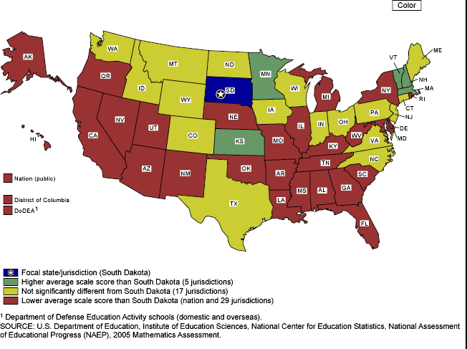
South Dakota's average mathematics scale score compared with scores for the nation and other participating jurisdictions, grade 4 public schools: 2005

Slide 12
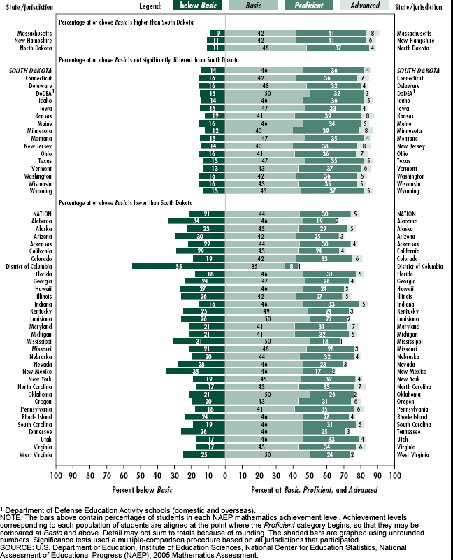
Percentage of students within each mathematics achievement level, and South Dakota's percentage at or above Basic compared with the nation and other participating jurisdictions, grade 4 public schools: By state, 2005

Slide 13
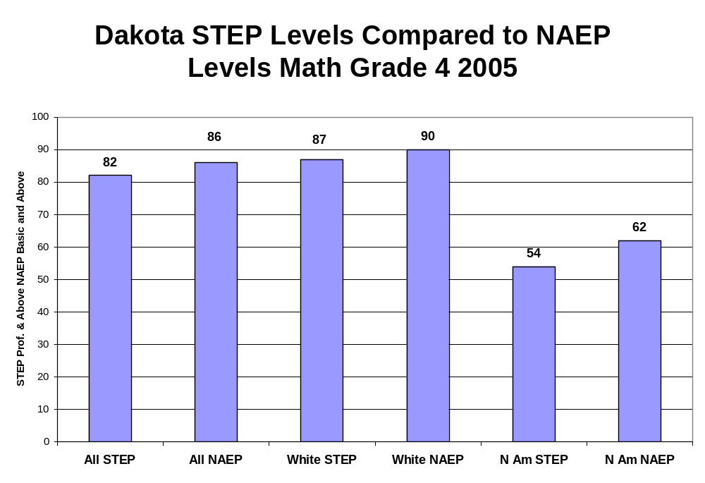

Slide 14
Overall Math Results for Grade 8
In 2005, the average scale score for eighth-grade students in
South Dakota was 287. This was higher¹ than their average score
in 2003 (285).
South Dakota's average score (287) in 2005 was higher than that
of the Nation's public schools (278).
Of the 52 states and other jurisdictions² that participated in the
2005 eighth-grade assessment, students' average scale scores in
South Dakota were higher than those in 44 jurisdictions, not
significantly different from those in 6 jurisdictions, and lower than
those in 1 jurisdiction.
The percentage of students in South Dakota who performed at or
above the NAEP Proficient level was 36 percent in 2005. This
percentage was not significantly different from that in 2003 (35
percent)
The percentage of students in South Dakota who performed at or
above the NAEP Basic level was 80 percent in 2005. This
percentage was not significantly different from that in 2003 (78
percent).

Slide 15
Performance of NAEP Reporting Groups in South Dakota Grade 8 Math
Group 2003 2005 Dif
Males 286 287 +1
Females 284 287 +3
White 288 291 +3
Native American 255 260 +5
Eligible for free/reduced lunch 272 276 +4
Not eligible for free/reduced lunch 291 294 +3
Students classified as having a disability 246 250 +4

Slide 16
Math Grade 8 Comparison—Highest and Bordering States
2003-2005
Jurisdiction 2003 2005
Massachusetts 287 292
Minnesota 291 290
South Dakota 285 287
North Dakota 287 287
Nebraska 282 284
Iowa 284 284
Wyoming 284 282

Slide 17
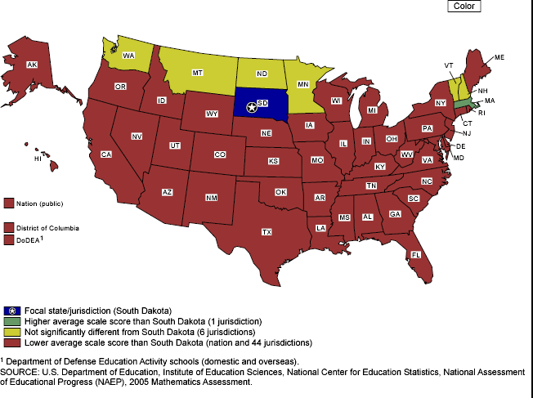
South Dakota's average mathematics scale score compared with scores for the nation and other participating jurisdictions, grade 8 public schools: 2005

Slide 18
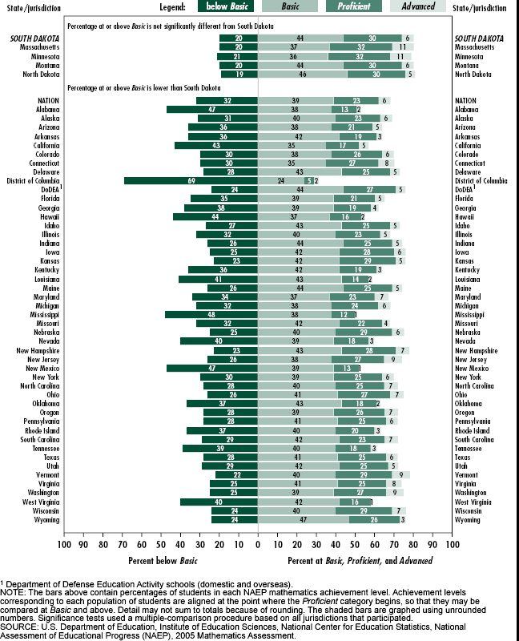
Percentage of students within each mathematics achievement level, and South Dakota's percentage at or above Basic compared with the nation and other participating jurisdictions, grade 8 public schools: By state, 2005

Slide 19
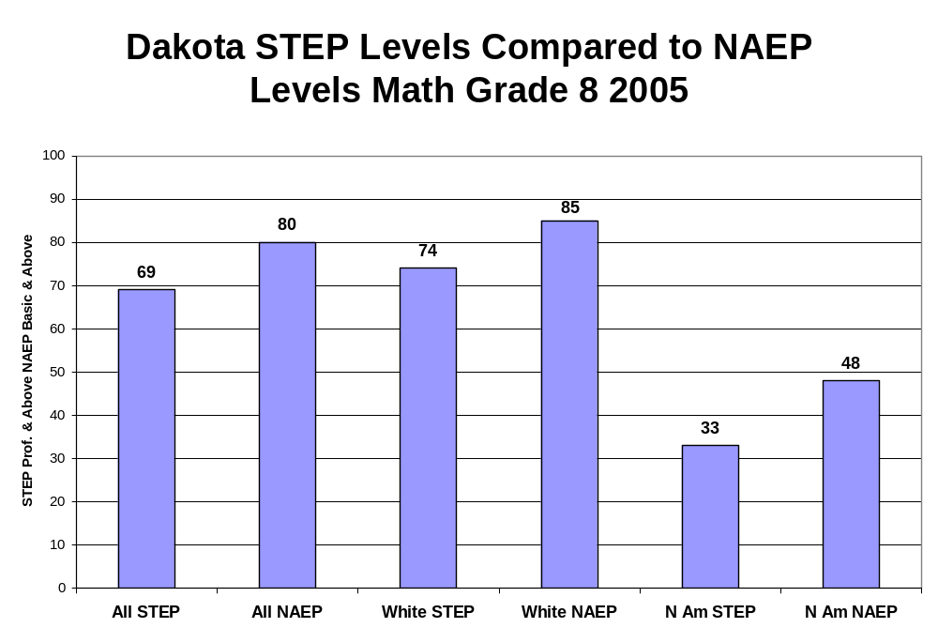

Slide 20
http://nces.ed.gov/nationsreportcard/

