Slide 1
USA Staffing/USA Jobs Training For Supervisors
Office of the Adjutant General Human Resources Office
Department of the Army and the Air Force
Human Resources-Recruitment and Placement
Presenter: Ms. Nora Yu

Slide 2
Agenda
Office of the Adjutant General Human Resources Office
Purpose of USA Staffing
Vacancy Request
User Name/ Password
Certificate of Eligibles
Supervisors Responsibilities
Department of the Army and the Air Force

Slide 3
Purpose of USA Staffing
USA Staffing allows the California National Guard (CNG) to:
  Post vacancy announcements on USA Jobs
  Accept applications via the internet or fax
  Analyze applicant competencies and qualifications electronically
  Timely turnaround on rating applications and publishing certificate of eligible applicants
Notes:
Wider applicant pool
Snail-mail lag time eliminated

Slide 4
Vacancy Request
Vacancy Announcement Request
-Newly Created Request Form, CNG Form 690-1
-SF 52s will no longer be accepted
-Review request for accuracy
-Vacancy announcement draft will be emailed prior to posting on USAJOBS
-Amendments will no longer be accepted
-Must be submitted to Unit HR Assistants/Remote Designee to be forwarded to HRO
Area of Consideration Requirements:
-Current CNG Members/Technicians (formerly Statewide) 14 days
-All Sources (formerly Nationwide) 21 days
Area of Consideration for “Unit Only” has been eliminated due to system requirements
Notes:
After June 15th, no more SF-52’s for vacancy announcements
Draft vacancy announcement will be emailed to the selecting supervisor prior to posting
No more amendments. Any changes needed after posting will result in the vacancy announcement being pulled off USAJobs and the entire VA request process being repeated.
Supervisors ~ ensure that you spread the message to your employees when you have an open vacancy announcement

Slide 5
Certificate of Eligibles
Certificate of Eligibles notification will be received via email.
-The email will include a secure link and instructions on how to retrieve the list of eligible job applicants
Agency Document Viewer (ADV) - allows you to view and print the certificate of eligibles.
Notes:
After the vacancy announcement closes, the cert will be securely emailed to the selecting supervisor

Slide 6
Email
From: USAStaffingOffice@opm.gov [mailto:USAStaffingOffice@opm.gov]
Sent: Wednesday, March 01, 2006 1:43 PM
To:
Subject: Request Number 06-150A for Vacancy ID 100647 is available for viewing
Welcome to the USA Staffing Agency Document Viewer (ADV)!
This email provides a link to the requested list of eligible job applicants. The USA Staffing document viewer will allow you to view or print the list of eligible job applicants and applicants' documents, and to annotate the action taken for each of the certified applicants.
Click on the link below or copy and paste the URL into the "Address" field of your Web browser to retrieve the list of eligible job applicants.
http://USAStaffing.opm.gov/trainusastaffingadv/Staffing/Referral/Certificate.aspx?ChangeContext=Y&ContextType=Vacancy&ContextID=100647&ID=29032&CRITERIAID=29437&CERTIFICATEID=31955
If you are unfamiliar with the Agency Document Viewer, please click on this link for detailed instructions. If you need additional information concerning the list of eligible job applicants or the Agency Document Viewer, contact the HR specialist responsible for this job announcement.
Note: this is an automated email message. Please do not reply directly to this message.
------------------------------
USA Staffing System
-------------------------------
-- Even though this E-Mail has been scanned and found clean of
-- known viruses, OPM can not guarantee this message is virus free.
-------------------------------
-- This message was automatically generated.
-------------------------------ro
Notes:
Example of the email

Slide 7
User Name/ Password
User Names will be issued by HRO
User Name will be First Initial, Middle Initial, Last Name. Example: JLSMITH
Initial password will be Last Name. Example: Smith
Once logged on to the USA Staffing website, you will be prompted to change your password.

Slide 8
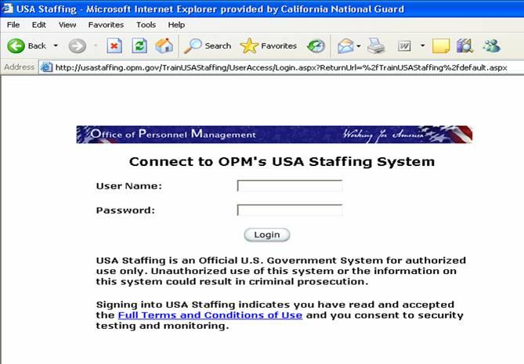
Notes:
Secure website log in

Slide 9
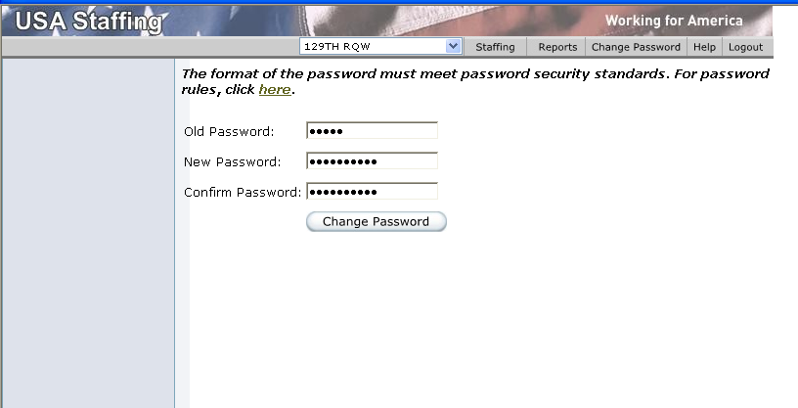
Notes:
Prompt to change password

Slide 10
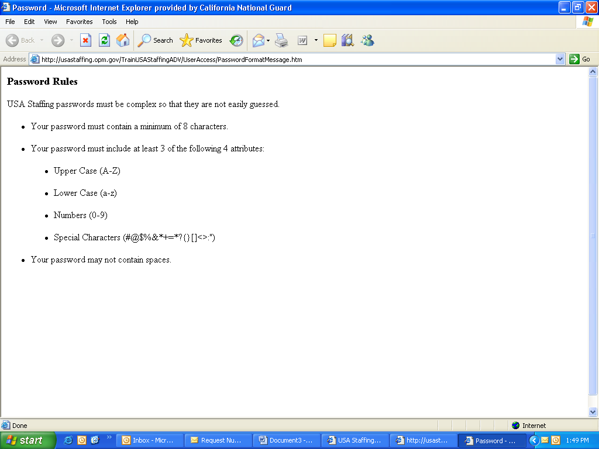
Notes:
Rules for password change

Slide 11
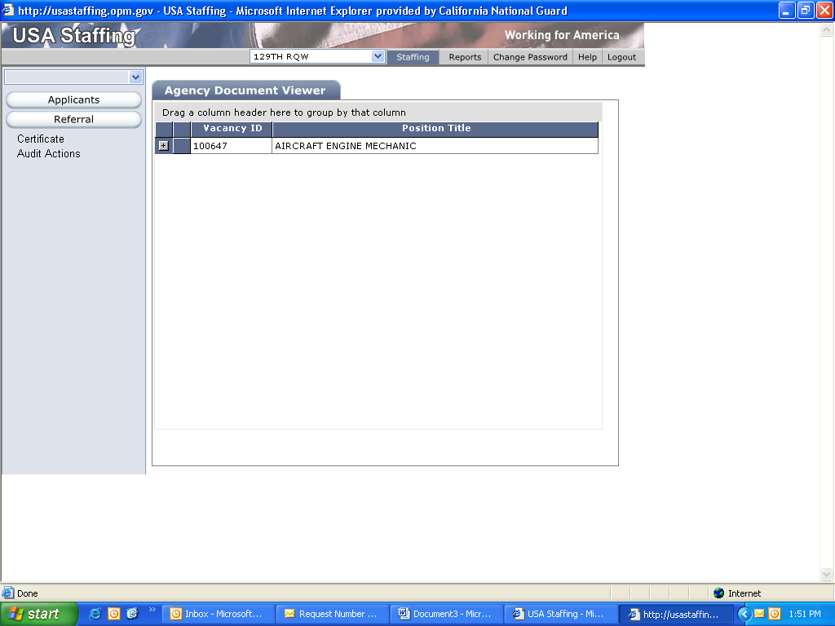
Notes:
This is what the certificate of eligibles will look like
Click the “+” button to open

Slide 12
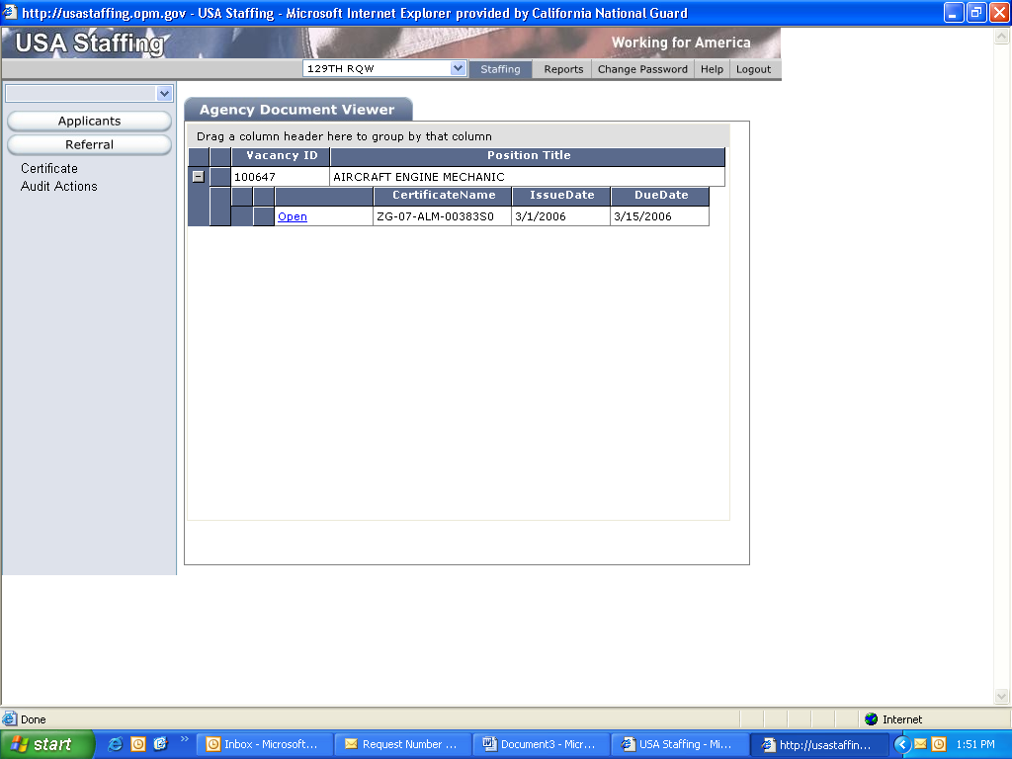
Notes:
Each cert (one for each grade) will be posted
Click “open” to see applicants

Slide 13
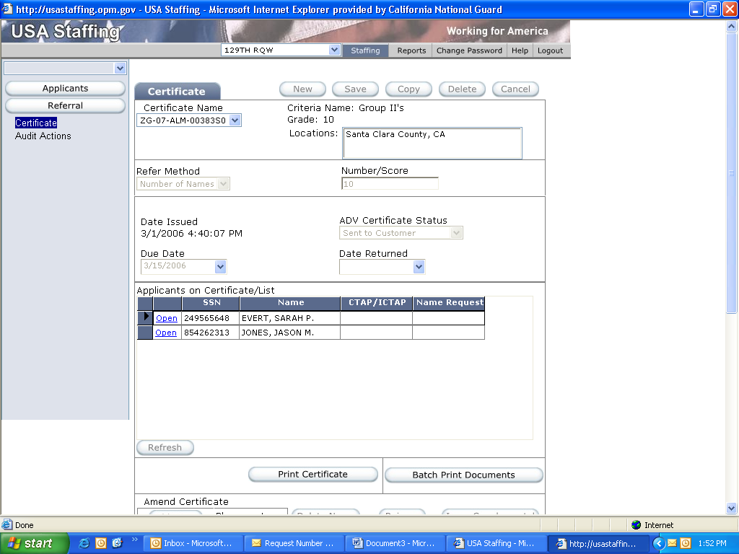
Notes:
You can print out all documents if desired

Slide 14
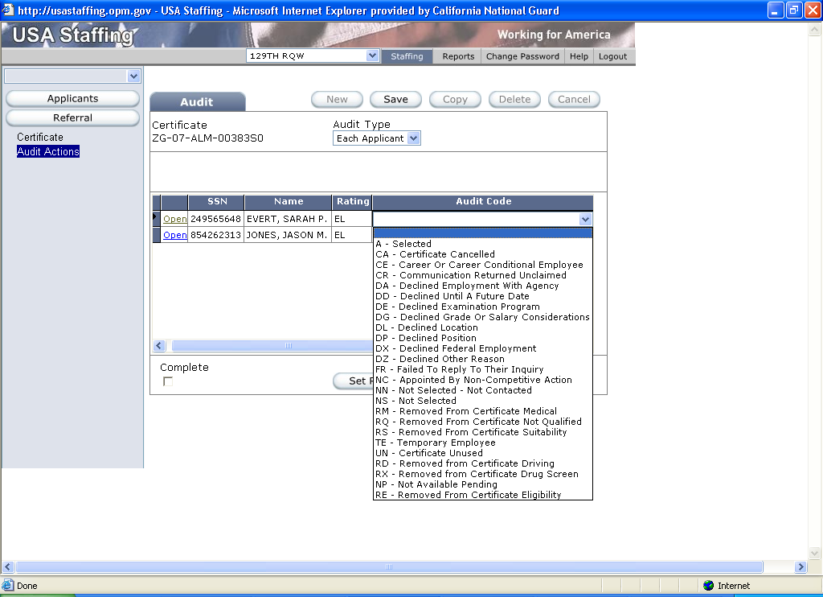
Notes:
After reviewing, rating and ranking applicants using Merit Placement Principles and Agency plan
Code applicants

Slide 15
Supervisory Responsibilities
Certificate of Eligibles
  View certificates on USA Staffing
  - Separate certificates will be issued for multiple grades
  Rate and rank applicants IAW Merit Placement Principles & Agency Plan
  Input audit codes for the action taken for each applicant
  Print and sign completed Certificate of Eligibles
  Return Certificate (KSA Worksheet and Candidate Worksheet, if applicable) to HRO via email, fax, or US Mail
Notes:
Print and sign completed certificate
Return certificate (KSA worksheet and candidate worksheet if applicable) via email, fax or US Mail

Slide 16
Questions ?
Office of the Adjutant General Human Resources Office
Department of the Army and the Air Force
If one does not ask, one will never know

