Slide 1
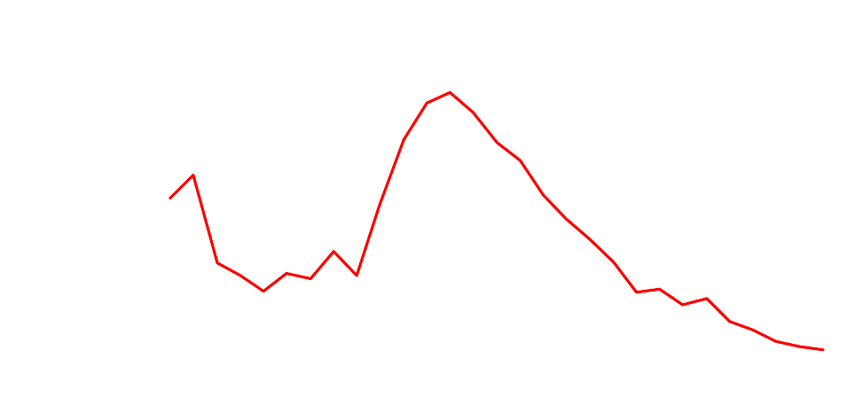
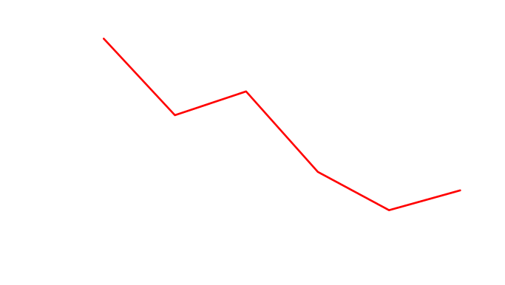
Figure 1. Number of Tuberculosis Cases: California, 1930-2008
Number of Tuberculosis Cases
1980
1982
1984
1986
1988
1990
1992
1994
1996
1998
2000
2002
2004
2006
2008

Slide 2
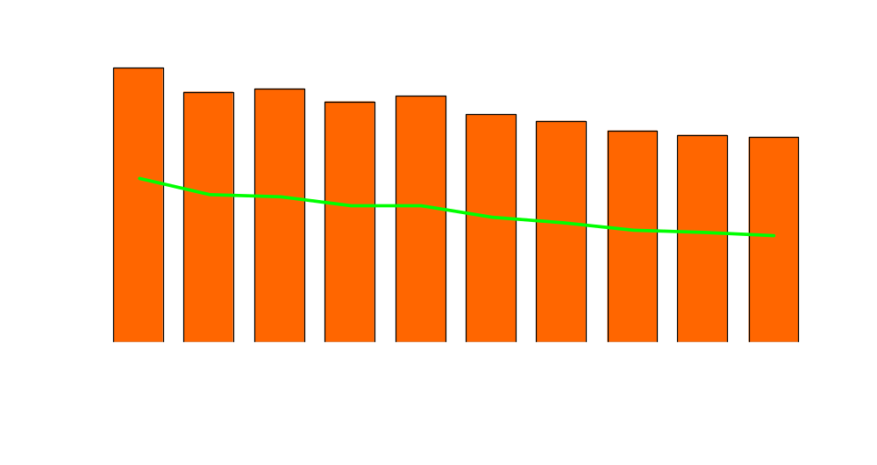
Figure 2. Number of Tuberculosis Cases and Case Rates: California, 1999-2008
Number of Cases
Case Rate per 100,000
Number of Cases
Case Rate per 100,000 Population

Slide 3
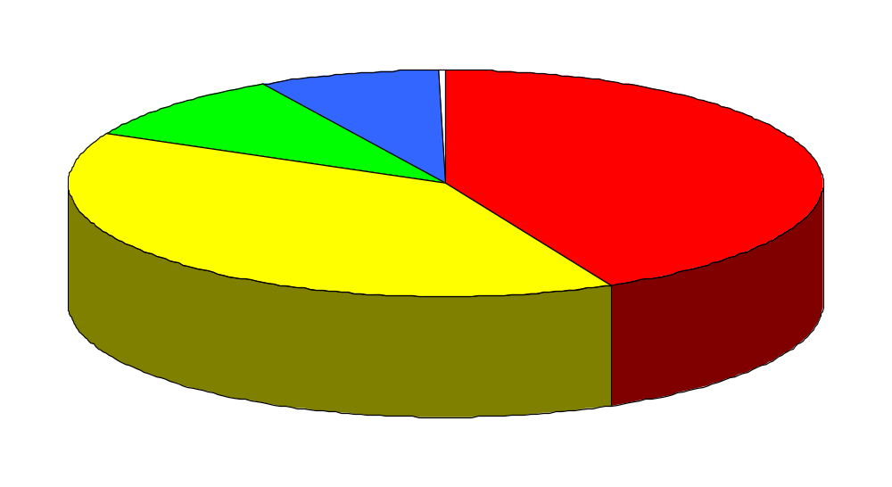
Figure 3. Tuberculosis Cases by Race/Ethnicity: California, 2008
American Indian/
Alaska Native
9 (0.3%)
Black
210 (7.8%)
Unknown
1 (<0.1%)
White
261 (9.7%)
Asian/Pacific Islander
1,156 (42.9%)
Hispanic
1.058 (39.3%)

Slide 4
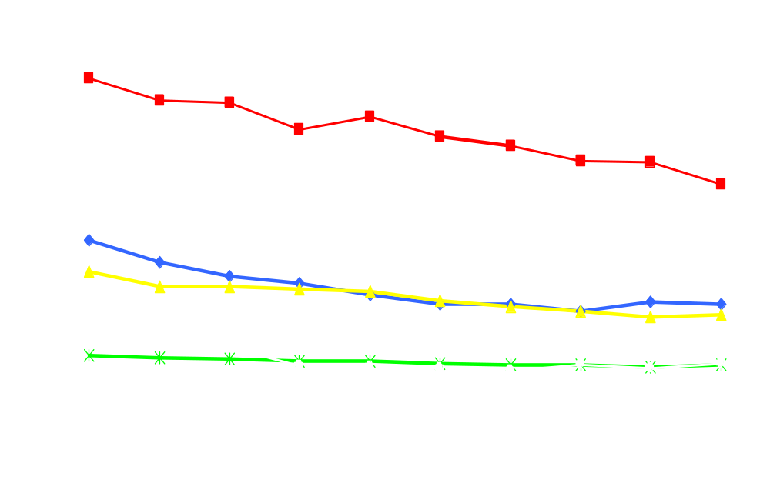
Figure 4. Tuberculosis Case Rates by Race/Ethnicity: California, 1999-2008
Asian/Pacific Islander
Cases per 100,000
Black
Hispanic
American Indian/Alaska Native
White

Slide 5
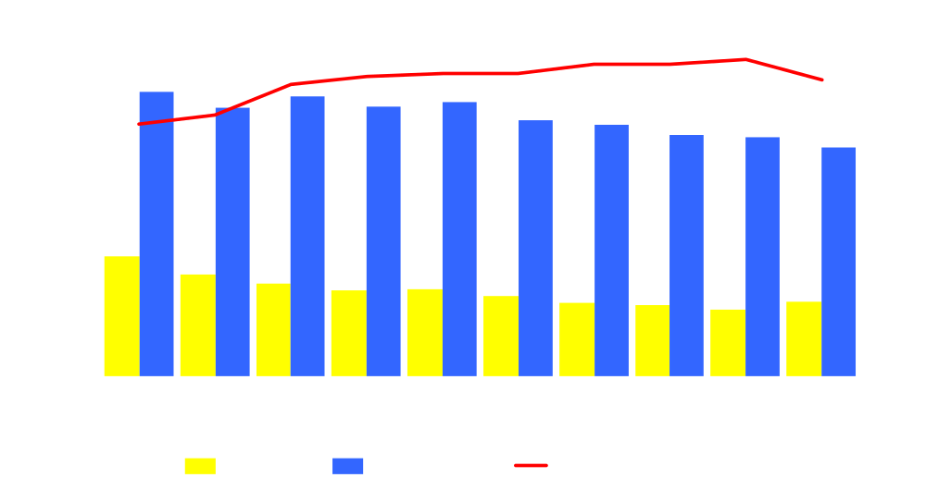
Figure 5. Tuberculosis Cases in Foreign-born and U.S.-born Persons: California, 1999-2008
Number of Cases
Percent of Cases

Slide 6
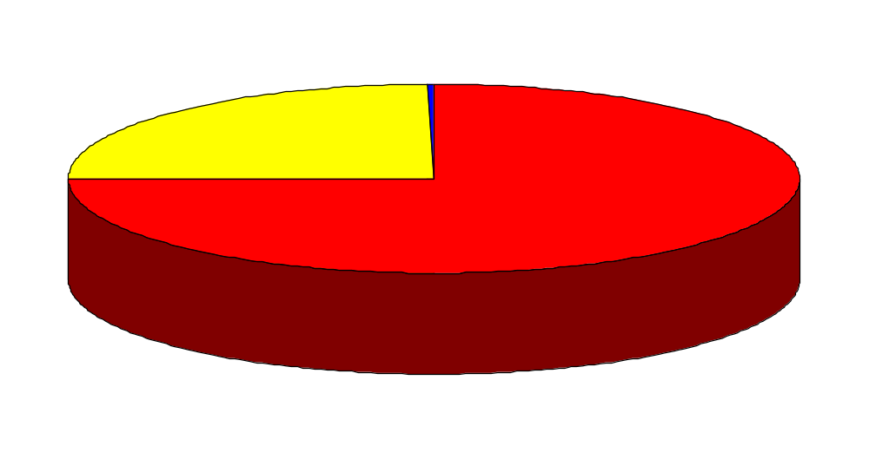
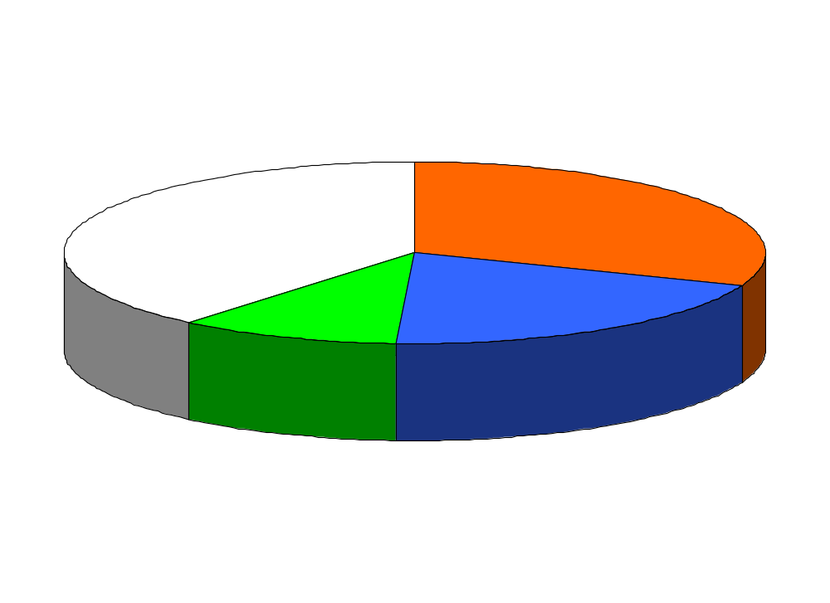
Figure 6. Tuberculosis Cases by Country of Origin: California, 2008
U.S.-born
661 (24.5%)
Unknown
11 (0.4%)
Foreign-born
2,023 (75.1%)
All Others
776 (38.8%)
Mexico
623 (30.8%)
Vietnam
211 (10.4%)
Philippines
404 (20.0%)

Slide 7
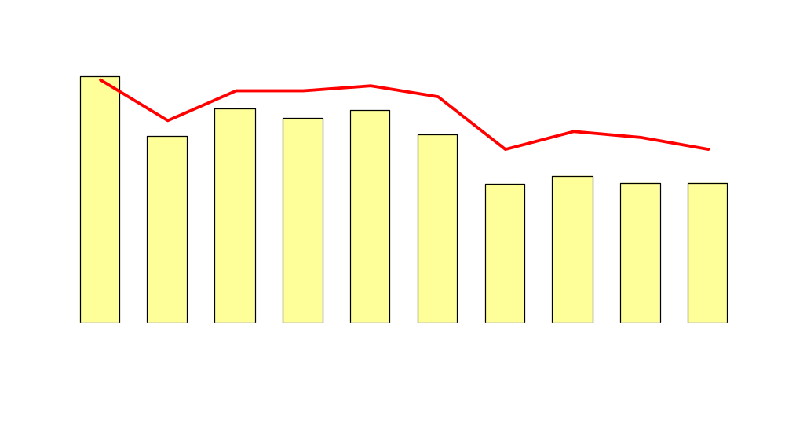
Figure 7. Tuberculosis Cases in Persons 0-4 Years of Age: California, 1999-2008
Number of Cases
Percent of Cases
Number of Cases
Percent of Cases

Slide 8
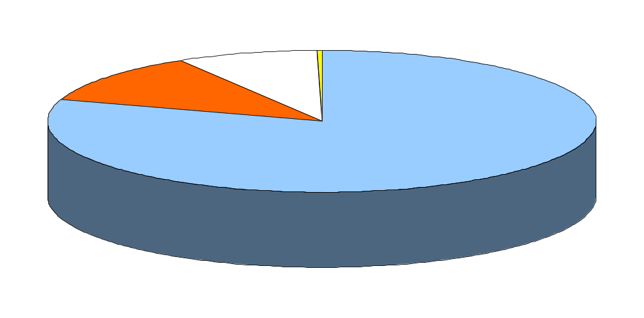
Figure 8. Tuberculosis Cases by Verification Criteria: California, 2008
Provider Diagnosis
220 (8.2%)
Clinical Case
310 (11.5%)
Positive Smear
7 (0.3%)
Positive Culture
2,158 (80.1%)

Slide 9
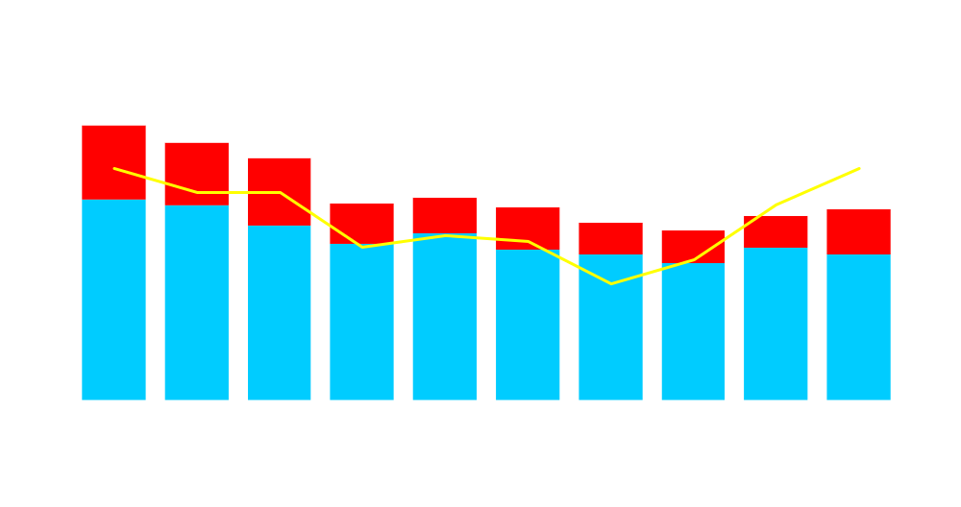
Figure 9. Deaths in Persons with Tuberculosis: California, 1997-2006
Number of Deaths
Percent of Cases
Died During Treatment
Died Before Starting Treatment
Dead at Diagnosis
Percent Dying with Tuberculosis

Slide 10
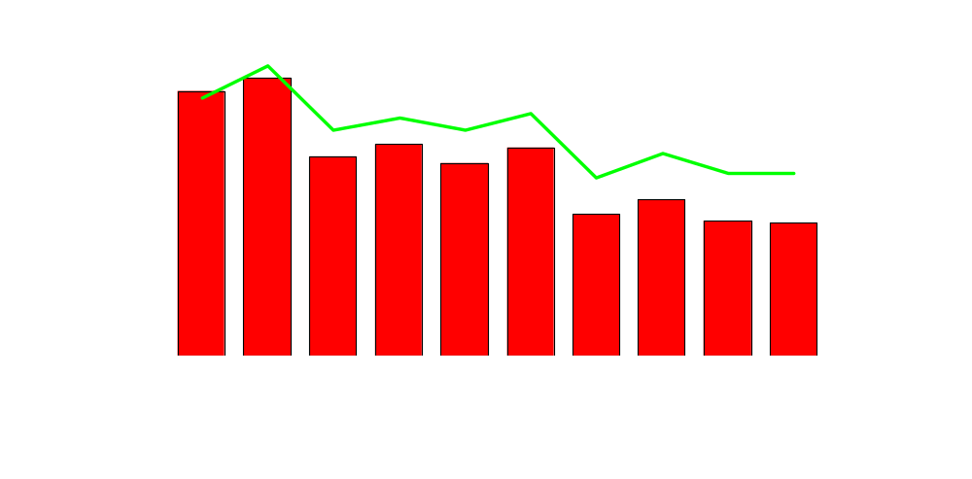
Figure 10. Tuberculosis Cases by AIDS Diagnosis*: California, 1998-2007
Number of Tuberculosis Cases with AIDS
Percent of Tuberculosis Cases with AIDS
Number of Cases with AIDS
71
Percent of Cases with AIDS
* Match found in AIDS Case Registry, California Office of AIDS.

Slide 11
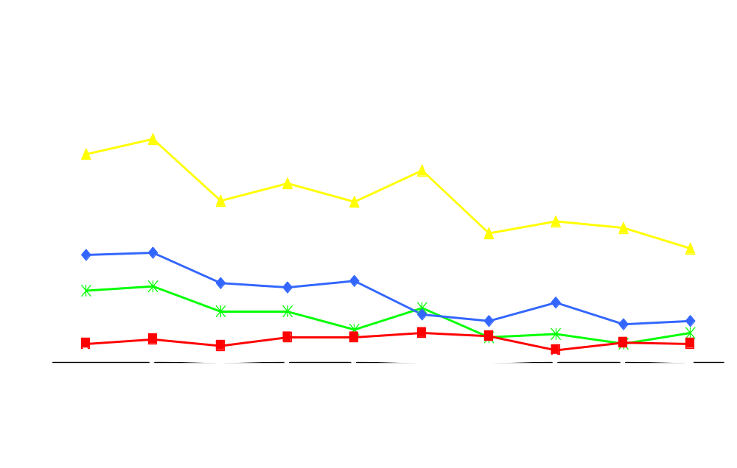
Figure 11. AIDS-associated Tuberculosis* by Race/Ethnicity: California, 1998-2007
Hispanic
Number of Tuberculosis Cases with AIDS
Black
White
Asian/Pacific Islander
American Indian/Alaska Native
* Match found in AIDS Case Registry, California Office of AIDS.

Slide 12
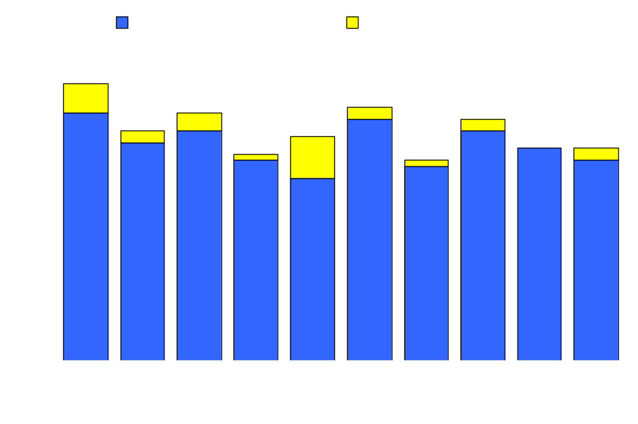
Figure 12. Tuberculosis Cases with Multidrug Resistance (MDR) on Initial or Final Drug Susceptibility Testing*: California, 1997-2006
47
42
43
41
39
38
35
34
36
36
Number of MDR Tuberculosis Cases
1997
1998
1999
2000
2001
2002
2003
2004
2005
2006
*Cases with resistance to at least isoniazid, and either rifampin or rifabutin reported on the Initial Drug Susceptibility Report (Follow-up 1) or on the Case Completion Report (Follow-up 2).

Slide 13
Figure 13. Tuberculosis Cases with Initial Multidrug Resistance (MDR)*: California, 2004-2008
Initial MDR Cases:
2004-2008
≥ 25 Cases
15-24 Cases
5-14 Cases
1-4 Cases
None
Berkeley
San Francisco
Pasadena
Long Beach
*Cases with initial drug resistance to at least isoniazid, and either rifampin or rifabutin.

Slide 14
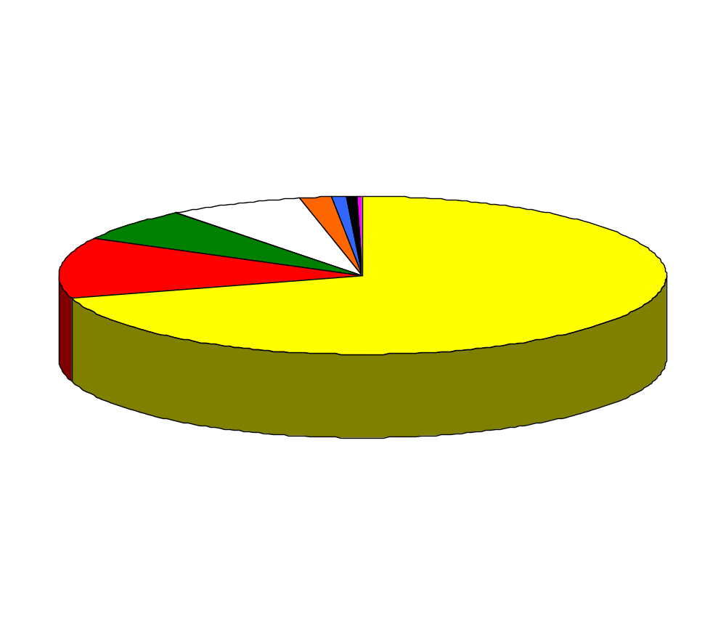
Figure 14. Tuberculosis Cases¹ by Outcome of Therapy: California, 2006
Lost³
43 (1.6%)
No Info
25 (0.9%)
Other
8 (0.3%)
Died
191 (7.1%)
Refused
15 (0.6%)
Moved²
182 (6.8%)
Completed Therapy >12 Months
330 (12.3%)
Completed Therapy ≤ 12 Months
1,881 (70.3%)
¹ Patient alive at diagnosis and started on an initial drug regimen of one or more drugs.
² Patient moved to another jurisdiction with a known forwarding address before treatment was completed.
³ Patient could not be located prior to the completion of treatment.

Slide 15
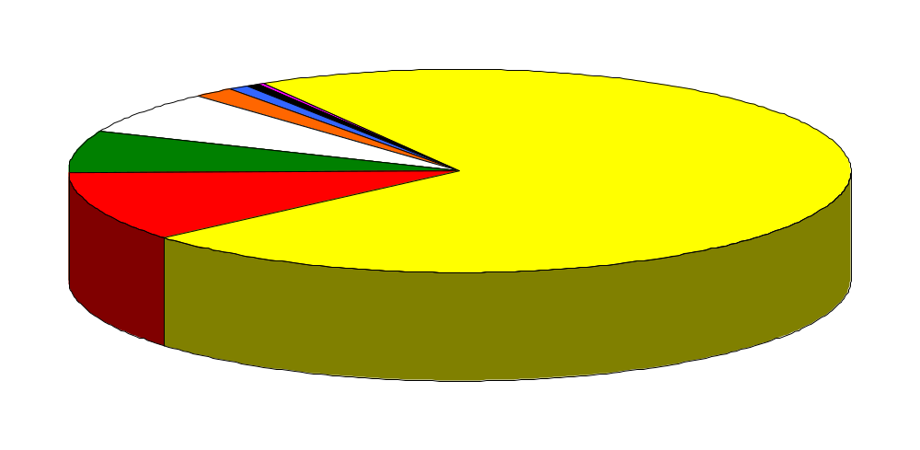
Figure 15. Outcome in Tuberculosis Cases for Whom One Year or Less of Treatment was Indicated¹: California, 2006
No
Information
18 (0.7%)
Refused
15 (0.6%)
Other
8 (0.3%)
Lost³
43 (1.7)
Died
180 (7.0%)
Moved²
175 (6.8%)
Completed Therapy >12 Months
285 (11.0%)
Completed Therapy ≤ 12 Months
1,861 (72.0%)
¹ Excludes cases with rifampin resistant disease, cases with meningeal disease, and cases less than
15 years of age with disseminated tuberculosis disease.
² Moved to another jurisdiction with a known forwarding address before treatment was completed.
³ Patient could not be located prior to the completion of treatment.

Slide 16
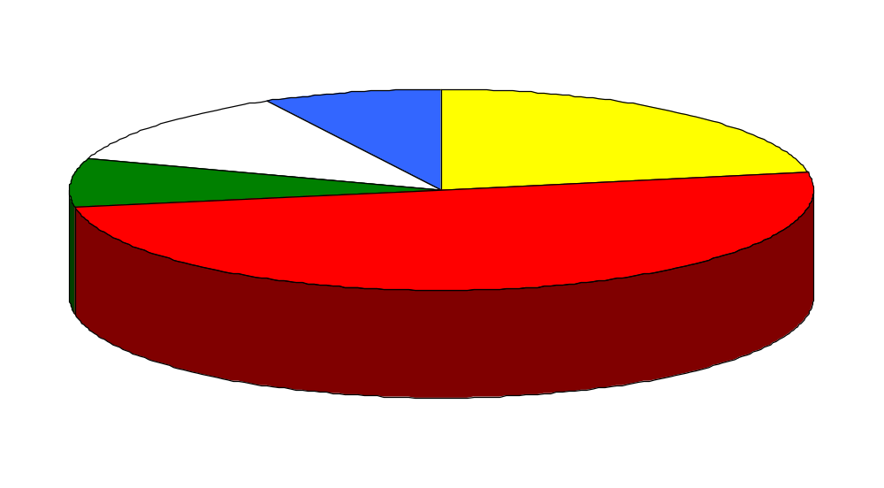
Figure 16. Outcome in Tuberculosis Cases for Whom Greater than One Year of Treatment was Indicated¹: California, 2006
No
Information
7 (7.8%)
Died
11 (12.2%)
Completed Therapy £ 12 Months
20 (22.2%)
Moved²
7 (7.8%)
Completed Therapy >12 Months
45 (50.0%)
¹Includes cases with rifampin resistant disease, cases with meningeal disease, and cases less than 15 years of age with disseminated tuberculosis disease.
² Patient moved to another jurisdiction with a known forwarding address before treatment was completed.
³ Patient could not be located prior to the completion of treatment.

Slide 17
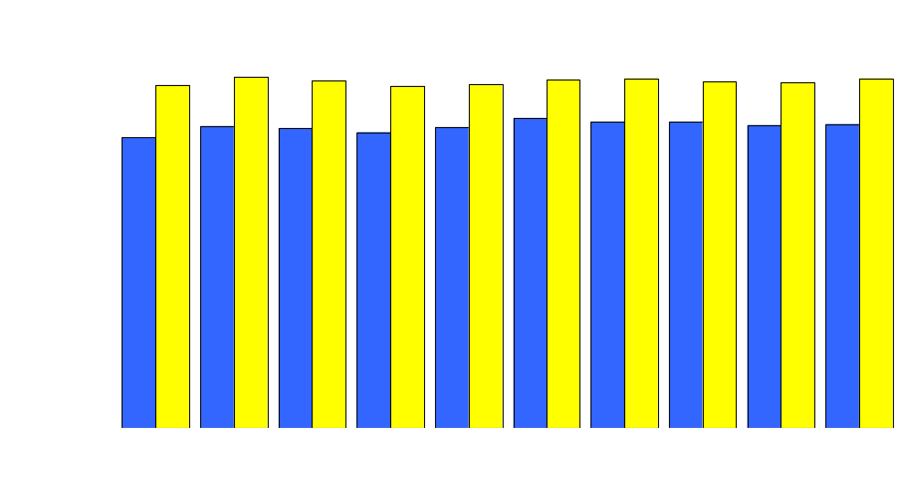
Figure 17. Completion of Tuberculosis Therapy: California,1997-2006
Completed in 1 year or less
Completed
Note: Excludes cases with rifampin resistant disease, cases with meningeal disease, cases less than 15 years of age with disseminated tuberculosis disease, and those that died during treatment.

Slide 18
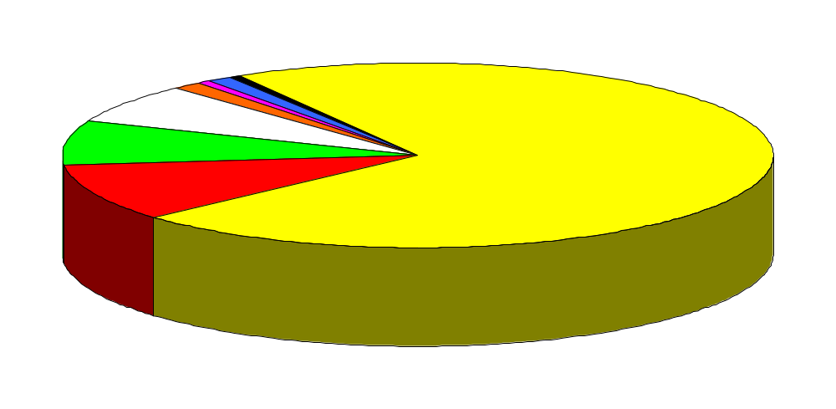
Figure 15. Outcome in Tuberculosis Cases for Whom One Year or Less of Treatment was Indicated¹: California, 2005
No
Information
34 (1.2%)
Other
15 (0.5%)
Refused
15 (0.5%)
Lost³
37 (1.4%)
Died
191 (7.0%)
Moved²
207 (7.6%)
Completed Therapy >12 Months
274 (10.0%)
Completed Therapy ≤ 12 Months
1,964 (71.8%)
¹ Excludes cases with rifampin resistant disease, cases with meningeal disease, and cases less than
15 years of age with disseminated tuberculosis disease.
² Moved to another jurisdiction with a known forwarding address before treatment was completed.
³ Patient could not be located prior to the completion of treatment.

Slide 19
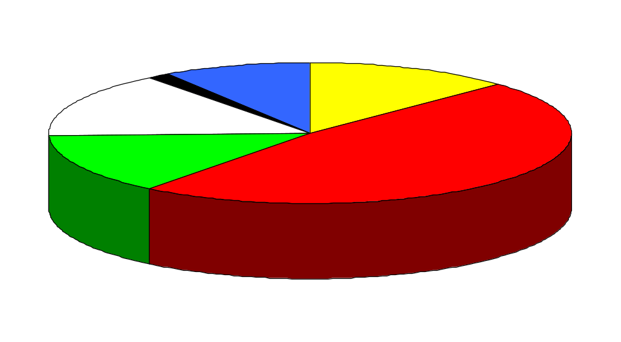
Figure 16. Outcome in Tuberculosis Cases for Whom Greater than One Year of Treatment was Indicated¹: California, 2005
No
Information
8 (9.3%)
Refused
1 (1.2%)
Completed Therapy ≤ 12 Months
11 (12.8%)
Died
13 (15.1%)
Moved²
12 (14.0%)
Completed Therapy >12 Months
41 (47.7%)
¹Includes cases with rifampin resistant disease, cases with meningeal disease, and cases less than 15 years of age with disseminated tuberculosis disease.
² Patient moved to another jurisdiction with a known forwarding address before treatment was completed.
³ Patient could not be located prior to the completion of treatment.

Slide 20
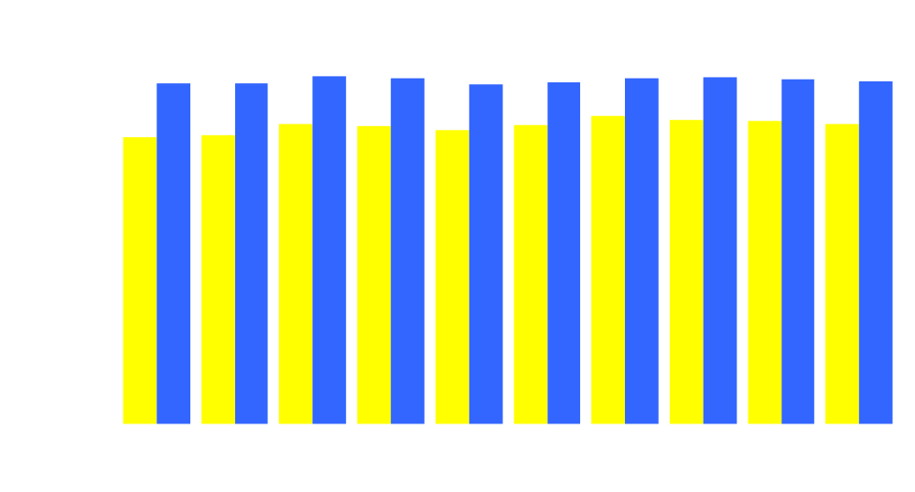
Figure 17. Completion of Tuberculosis Therapy: California,1996-2005
Completed in 1 year or less
Completed
Note: Excludes cases with rifampin resistant disease, cases with meningeal disease, cases less than 15 years of age with disseminated tuberculosis disease, and those that died during treatment.

