Slide 1
Due to the sign confusion of the skew quad. In MAD, we have two versions of transport matrix (TM).
Why ? We all agreed that the skew quads should have “north pole” at the top. Though Steve thought he had “north pole” at the top in his MAD model, Phil has shown/convinced Steve that he didn’t have the “north pole” at the top for the skew in his TM of June-10-2011. That’s why Steve made the change and produced TM of July-28-2011, which has larger cross-terms. This is understood for the blue as the optimal (minimum cross-term) setting was not achieved /used (as it’s small at 6 o’clock and much larger at other places of the RHIC ring).
TM June-10-2011 : Smallest cross-terms (a₁₄ etc.)
TM July-28-2011 : larger cross-terms (a₁₄ etc.)
  But Phil believes that the yellow should have the minimal cross-term as the setting seems to be the same as the optimal design. Phil checks and now thinks the signs of the small tilt for the Q1/Q2/Q3 are wrong. Waiting for Vadim …
Kin Yip Aug. 3, 2011

Slide 2
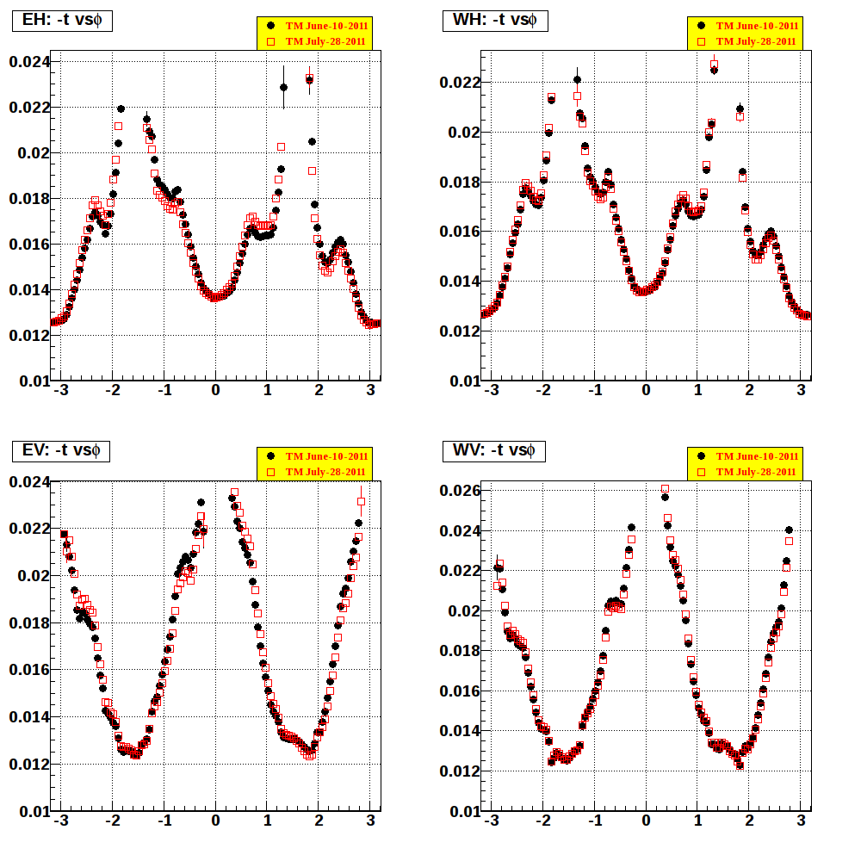
With fiducial/hotspot cuts :

Slide 3
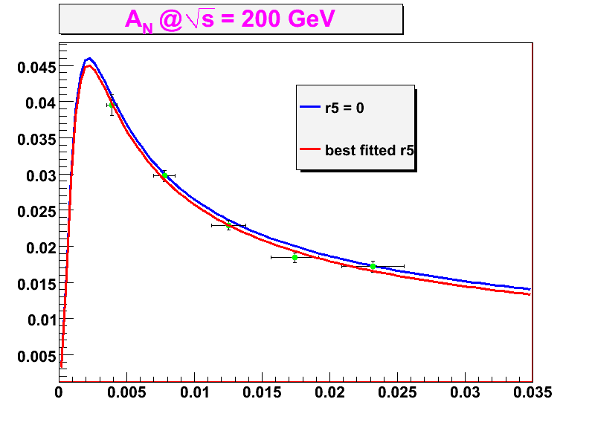
Transport of June 10 (Steve)
With fiducial/hotspot cuts :
Δt/t ~ 10%.

Slide 4
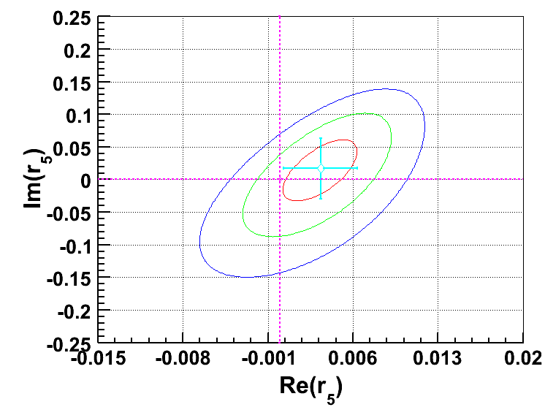
Transport of June 10 (Steve)
With fiducial/hotspot cuts :

Slide 5
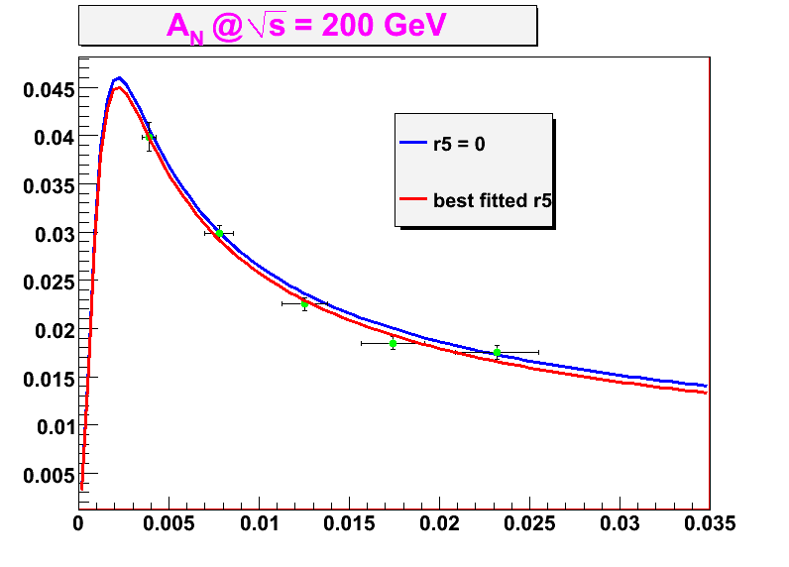
Transport of July 28 (Steve)
With fiducial/hotspot cuts :
Δt/t ~ 10%.

Slide 6
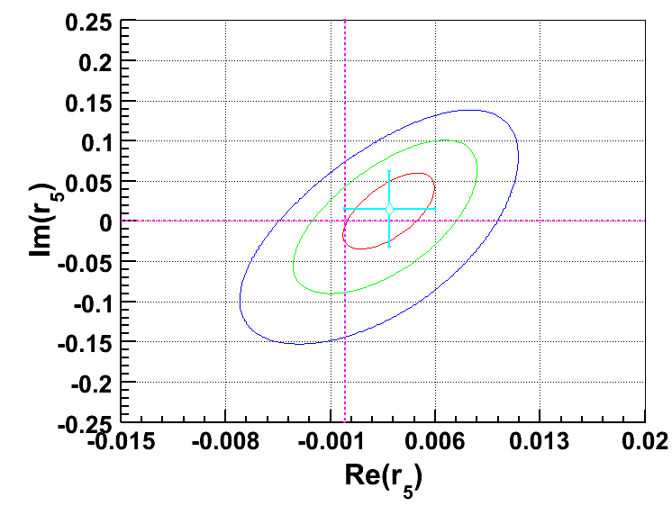
Transport of July 28 (Steve)
With fiducial/hotspot cuts :

Slide 7
 | All | 11020 | 11026 | 11030 | 11032
P_{B}+P_{Y} |  | 1.2445 | 1.1377 | 1.2637 | 1.2364
A_{N} | 0.02277 | 0.02246 | 0.02413 | 0.02272 | 0.02134
δ(A_{N}) | 0.00034 | 0.00064 | 0.00065 | 0.00066 | 0.00077
TM of June 10, 2011:
With fiducial/hotspot cuts and all –t:
Slightly better than when hotspot/fiducial cuts were not made but the situations are ~similar
 | All | 11020 | 11026 | 11030 | 11032
A_{N} | 0.02280 | 0.02245 | 0.02422 | 0.02271 | 0.02142
δ(A_{N}) | 0.00034 | 0.00064 | 0.00065 | 0.00066 | 0.00077
TM of July 28, 2011:

Slide 8
Transport of June 10 (Steve)
With fiducial/hotspot cuts:
 | -t < 0.005 | 0.005 ≤ -t < 0.01 | 0.01 ≤ -t < 0.015 | 0.015 ≤ -t < 0.02 | -t ≥0.02
<-t> | 0.003908 | 0.007775 | 0.01253 | 0.01742 | 0.02318
A_{N} | 0.03952 | 0.02972 | 0.02289 | 0.01844 | 0.01717
δ(A_{N}) | 0.00149 | 0.00076 | 0.00066 | 0.00067 | 0.00074
Transport of July 28 (Steve)
 | -t < 0.005 | 0.005 ≤ -t < 0.01 | 0.01 ≤ -t < 0.015 | 0.015 ≤ -t < 0.02 | -t ≥0.02
<-t> | 0.003905 | 0.007778 | 0.01253 | 0.01742 | 0.02318
A_{N} | 0.03985 | 0.02988 | 0.02253 | 0.01846 | 0.01753
δ(A_{N}) | 0.00149 | 0.00076 | 0.00066 | 0.00067 | 0.00076

Slide 9
Backup

Slide 10
 | All | 11020 | 11026 | 11030 | 11032
P_{B}+P_{Y} |  | 1.2445 | 1.1377 | 1.2637 | 1.2364
A_{N} | 0.02277 | 0.02246 | 0.02413 | 0.02272 | 0.02134
δ(A_{N}) | 0.00034 | 0.00064 | 0.00065 | 0.00066 | 0.00077
With fiducial/hotspot cuts and all –t:
TM of June 10, 2011:
 | All | 11020 | 11026 | 11030 | 11032
A_{N} | 0.02273 | 0.02261 | 0.02418 | 0.02265 | 0.02101
δ(A_{N}) | 0.00034 | 0.00064 | 0.00064 | 0.00066 | 0.00077
without fiducial/hotspot cuts and all –t :

