Slide 1
Drug Courts and Successful Outcomes for Children and Families:
Key Components
Jane E. Pfeifer
Justice Development & Training
February 11, 2009

Slide 2
Overview of Family Dependency Treatment Courts
What are they?
Why do we need them?
What are the unique characteristics?

Slide 3
What is Family Dependency Treatment Court
Definition:
A court that deals with cases involving children who have been abused or neglected by a parent or caregiver as a result of substance abuse and who are the subject of court proceedings that oversee social service efforts to rehabilitate families or to provide alternate permanent plans for children.

Slide 4
What is Family Dependency Treatment Court
Mission Statement:
To protect children from abuse and neglect — precipitated by the substance abuse of a parent or caregiver — by addressing the comprehensive issues of both parents and their children through an integrated, court-based collaboration among service providers who work as a team to achieve timely decisions, coordinated treatment and ancillary services, judicial oversight, and safe and permanent placements.
Notes:
Ask the participant to adopt this Mission Statement for the purpose of the session
Identify that each team will have an opportunity to complete a Mission Statement for their jurisdiction during the Skills Program

Slide 5
Why create a FDTC?
Findings of No Safe Haven: Children of Substance-Abusing Parents
  January 1999 report by The National Center on Addiction and Substance Abuse at Columbia University
Substance abuse and addiction severely compromise or destroy the ability of parents to provide a safe and nurturing home for the child
Timely and comprehensive treatment can work and such treatment is cost-effective
Only dramatic changes in child welfare practice can make real progress against this problem
Notes:
4
This report sets the stage for the need to develop a FDTC. We know that substance abuse impairs parenting– we know that treatment works -And a system overhaul will allow the systems within a jurisdiction to address how to ensure safety, permanency and well-being for children.
Refer to stats heard in evolution presentation regarding the problems of the child welfare system, treatment system and court system in addressing substance abuse of parents in cases of the abuse and neglect of children.
Very young children are most effected- four clocks early intervention- birth to three is a high risk group- show connection- make reference to tx works.
Evolution- - problems in child welfare system. Over last several years more research has been done to identify

Slide 6
Systems’ Disconnect
TREATMENT / CHILD WELFARE / COURT
    Who is the client?
    Values & Philosophies
    Training & Education
    Defining Success
    Confidentiality
    Resources
Notes:
3
There is an apparent disconnect between treatment, child welfare and the court in various ways including the following:
Who is the client?
CPS identifies the client as the child
Treatment identifies the client as the parent /adult involved in treatment
Court identifies the client as the family
2. Values & Philosophies
3. Training & Education CPS and Treatment Providers Training
4. Defining Success: CPS and the court are talking about safety, well-being and permanency; treatment identifies the reduction in problems associated with use
5. Confidentiality: Barriers among different systems requirements
6. Resources: Addressing the presenting problems of families and availability of existing resources in community to address the presenting problems
Refer to the Blending Perspective report to congress

Slide 7
The Four Competing Clocks
ASFA Clock
  12mos to permanency decision; possible 6mos extension; 15 of last 22mos in FC- move to TPR
Child’s Clock
  Developmental needs
TANF Clock
  2-5 years of $ and services
Recovery Clock
  “Life Long Process”
  9-12mos and long term continued care
Notes:
Trainer Notes: -refresh group memory on key provisions of TANF & ASFA…
-Discuss this slide as the overall context in which FDTC Team members AND all other service providers who interact with drug-affected families in the child welfare system must work since the passage of Welfare Reform and ASFA. The top row describes policy in the form of 2 pieces of legislation that dis-proportionately affect parents in the child welfare system & have “clocks ticking”; bottom row summarizes “biologic” reality, with inflexible timelines…
-Discuss fact that some states have tighter implementation of ASFA (less time to move to TPR if child is younger than 3 etc. ) Sometimes it’s “policy by press release”; as well as recognition of increased vulnerability as well as greater adoptability of younger children: all of which is borne out in literature on this. )
-Drug Recovery in private population settings (w/ insurance, etc.) claims sobriety and graduations at 4-6 months; because clients frequently seen in the public services system have so many issues associated with their SA, 9-12 mo is much more usual timeframe required to establish sobriety & a pattern of functioning, followed by LongTerm Aftercare
-Child Development is the big variable around which the ASFA timeline was established: 2 months is a long time in the life of a 2 y/o to have dirty diapers, not be fed, be neglected, etc. 6 months in the life of a 5 y/o is a long time to watch Mom being beaten up, shooting up, eating cheetos as meal; Conversely a long time to attach in foster home, etc. Discuss permanency & child development timelines.
FIRST YEARS IN CHILD’S LIFE ARE CRITICAL FOR HEALTHY DEVELOPMENT. EARLY CHILDHOOD EXPERIENCES INFLUENCE HOW THE BRAIN DEVELOPS & HOW CHILD WILL INTERACT W/THEIR ENVIRONMENT. CHILDREN NEED STIMULATION & NURTURANCE FOR HEALTHY DEVELOPMENT. NEGLECT DURING EARLY CHILDHOOD CAN HAVE NEGATIVE CONSEQUENCES LATER IN LIFE. MALNUTRITION, STRESS, EXPOSURE TO VIOLENCE, LACK OF STIMULATION & DISRUPTED ATTACH PROCESSES WILL IMPACT PHYSICAL & EMOTIONAL GROWTH OF CHILD. WE KNOW THAT SUBSTANCE ABUSE COMPROMISES PARENT’S ABILITY TO MEET CHILD’S NEEDS. CHILD’S DEVELOPMENTAL NEEDS CREATE A SENSE OF URGENCY BOTH IN TERMS OF SERVICES FOR CHILDREN & PROVIDING STABLE HOMES.
Competing Time Lines
child welfare mandates decisions regarding permanent placement in 12 months
substance abuse treatment may take multiple treatment attempts and relapse is common but not necessary
a child cannot be put on hold without serious developmental consequences
Mission of the dependency court is to provide children with safe, permanent homes in a timely manner.
More than 70%of the cases are substance-abuse related.
Permanency delayed may be permanency denied. A downward spiral of escalating problems can leave children in legal limbo for prolonged periods of time.
Older children with social, emotional, and academic problems may be left to grow up in foster care. Time in the life of a child –The children that we are talking about a re you and the amount of development that goes on is critical. Set the stage for early intervention Skills and Operations – Intergenerational and Healthy Child Development- Kids raised by the system vs children raised by the parents.
Recovery is not linear and recovery does not necessarily happen in this neat orderly fashion

Slide 8
What are the key questions?
Can parents possibly recover from serious drug involvement in one year’s time?
Can children be assured safety, well-being and permanency within the ASFA mandates?
  If treatment
    begins at once
    is appropriate for the degree of substance use
    is coordinated with other necessary services
  The family’s progress is closely monitored by the court to ensure provision of necessary services & to facilitate informed, timely decision making.
Notes:
Review questions at face value.

Slide 9
Considerations for FDTC Implementation
Systems Change
  Therapeutic Jurisprudence: “The use of social science to study the extent to which a legal rule or practice promotes the psychological and physical well-being of the people it affects”[1] Therapeutic Jurisprudence further “Suggests mental and physical health aspects of law should be examined …in achieving proposed goals”[2]
  Strengths-Based Focus: Identification of the positive characteristics of a child, parent and family in the assessment and development of a case plan and further participation in the family drug court.
  Family Broadly Defined: Recognizing the structure of family unit as the child and parent view this system to include the non-traditional family relationships. In addition, an approach to provide services for the entire family and identifying the family as the client.
  Comprehensive & Integrated Case Management: Recognition that the child, parent and family are most often involved in various systems; attempting to manage multiple case plans. Family Dependency Treatment Court is an opportunity for agencies to work together , to maximize resources and to create better outcomes for children and families.
[1] Slobogin, Christopher. Therapeutic Jurisprudence: Five Dilemmas to Ponder; Psychology, Public Policy and Law 193, 196 (1995).
[2] Schma, William. Judging for the New Millennium. Court Review, Spring 2000.
Notes:
These are concepts that the participants will continue to see throughout the training program and must take into consideration in the design of each component part of the FDTC.
Review list broadly…..

Slide 10
FDTC Characteristics
Focus on the permanency, safety and welfare of abused and neglected children as well as the needs of the parents.
A Family Dependency Treatment Court addresses the needs of both children and parents, encompassing the entire family as the client.
Early intervention, assessment and facilitated access to services for parents and children in a holistic approach to strengthen family function.
Notes:
This is a preview of what is to come: All FDTC Characteristics will be explored more extensively throughout the training program in the design and development of the FDTC.
1. Family is the client
Multiple client system
Permanency does not just mean re-unification- Tie in problem statement where children awaiting adoption and the numbers of children in foster care are overwhelming
2. Front loading services- This is a piece that CPS does not do well-tie in with the problems- systems does not have ability, competing timelines, main characteristic of this model---examples- Linda Ray Center Early Intervention, Suffolk early intervention without money-- existing resources, public health nurse and developmental assessment of children- resource mapping will occur in Skills Based Program of the training series
Strength based assessments- family group conferencing is used in various dependency court processes and drug court model- move away from a deficit focused systems- use of genograms and ecomaps in assessment process- Operation Programs

Slide 11
FDTC Characteristics
Develop comprehensive service plans that address the needs of the entire family system.
Comprehensive assessment of both children and parents to determine their treatment, developmental, mental and physical health needs.
Provide enhanced case management services to monitor progress & facilitate access to services.
Notes:
3. Working with systems together to develop a plan for the family in the provision of services
4. Application of this characteristic within various jurisdiction….based on needs of jurisdiction…identification of problems associated with monitoring…TASC….CPS workers….treatment systems… integrated service provider/case manager through the court/ or other agency….. The team needs to determine how to enhance the systems that currently exist- and we recognize that this is a daunting task-…however, it also makes the systems stronger

Slide 12
FDTC Characteristics
Regularly scheduled staffings facilitate the exchange of information & coordinate services for the family.
Review parent’s progress in treatment and other services and services to children. Update family service plans as needed.
Increased judicial supervision of children and families.
Review progress toward permanency, ensure provision of services and timely decision making for children and families.
Notes:
5. This occurs in a number of different ways- inclusion of judges…not including judges…fragmentation of services…coordinate and communicate information…conferencing
These staffings take different forms however, the bottom line is that communication and coordination of services is integral to the success of the FDTC process.
6. Ensuring timely and informed decision making
Where does this fit within the dependency court process…..will you hear and make decisions on the dependency court case issues regarding the official change in status of the child (ie changes in the following visitation, services, reunification)…….ensure the best interest of the child but also promote the continued support and recovery of the parent….and creating the opportunity to fast track the dependency court issues to make timely and appropriate decisions. (Don’t wait until the scheduled 3 or six month review to make these critical decisions) Ensure that individuals from the treatment team (CPS or TX) are present at the dependency hearing.

Slide 13
FDTC Characteristics
Individual & systems accountability.
FDTCs hold parents accountable through a graduated system of incentives & sanctions. Judicial monitoring ensures that services necessary to preserve or reunify families are provided.
Ensuring legal rights, advocacy and confidentiality for parents and children
Ensure that advocacy, confidentiality, and due process are maintained by advising the parent and children (and their representatives) of the guidelines for participating in the drug court
Notes:
7. Individual in terms of Incentives and Sanctions- refer to Managing Participant Behavior Session
Systems Accountability- Judicial Monitoring- ensuring appropriate services are provided. MOU’s
8. Identify the statutory obligations and limitations and of all team members.

Slide 14
FDTC Characteristics
Operate within the Federal mandates of the Adoption and Safe Families Act and Indian Child Welfare Act
The ASFA guidelines reduce the deadline for permanency placement hearings for children in foster care from 18 months to 12 months.
Judicial leadership for both the planning and implementation of the court
The judge plays a key leadership role in the planning and implementation of an FDTC providing vision and encouraging collaboration.
Notes:
9. Refer to earlier presentation
10. Community and Day to Day Judicial Leadership. Refer to presentation the following day

Slide 15
FDTC Characteristics
Commitment to measuring outcomes of the FDTC program and plan for program sustainability
Develop a common definition of success and, with this as a base, identify the variables to be studied and establish the procedures to ensure the efficient and timely gathering of data.
Working as a collaborative, non-adversarial team supported by cross-training
Communicate to parents with one voice, eliminating the confusion of contradictory messages, strengthening the relationship between the court and the family, and fostering the parent’s motivation to change.
Notes:
11. Making sure that everyone is on the same page in defining success…as a group we need to identify measures of success and what data will they need to gather….fold this into the day to day operation
12. Systems cross training…non-adversarial team does not mean that the give up zealous representation or due process, but it starting from a common ground.

Slide 16
Best Practices in Dependency Court

Slide 17


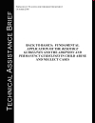
1. Resource Guidelines (1995)
2. Adoption and Permanency Guidelines (2000)
3. Back to Basics: Fundamental Application of the RESOURCE GUIDELINES and the ADOPTION AND PERMANENCY GUIDELINES in Child Abuse and Neglect Cases (2006)

Slide 18
What the Research Tells Us
National Cross-Site Study
Worcel, S. D., Green, B. L., Furrer, C. J., Burrus, S. W. M., Finigan, M. W. (March 2007). Family Treatment Drug Court Evaluation: Final Report. NPC Research: Portland, OR.

Slide 19
Focus of Study
Parent Treatment Outcome Questions
Child Welfare & Court System Outcome Questions

Slide 20
Treatment Outcome Questions
Compared to Control Parents, Did Parents in FTDC:
  Enter treatment at a higher rate?
  Enter treatment more quickly following their child welfare petition?
  Spend more time in treatment?
  Complete treatment at a higher rate?

Slide 21
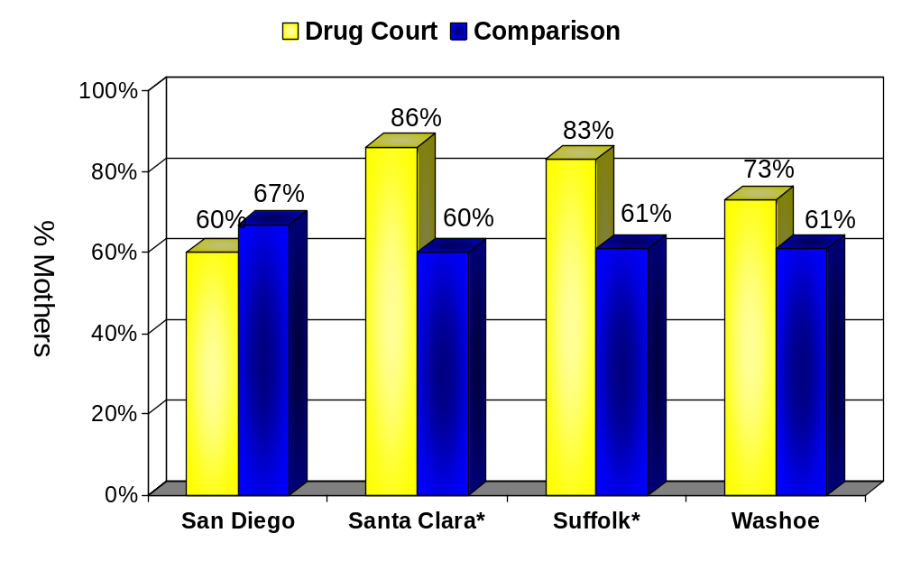
Likelihood of Treatment Entry
* Statistically significant at p<.001.

Slide 22
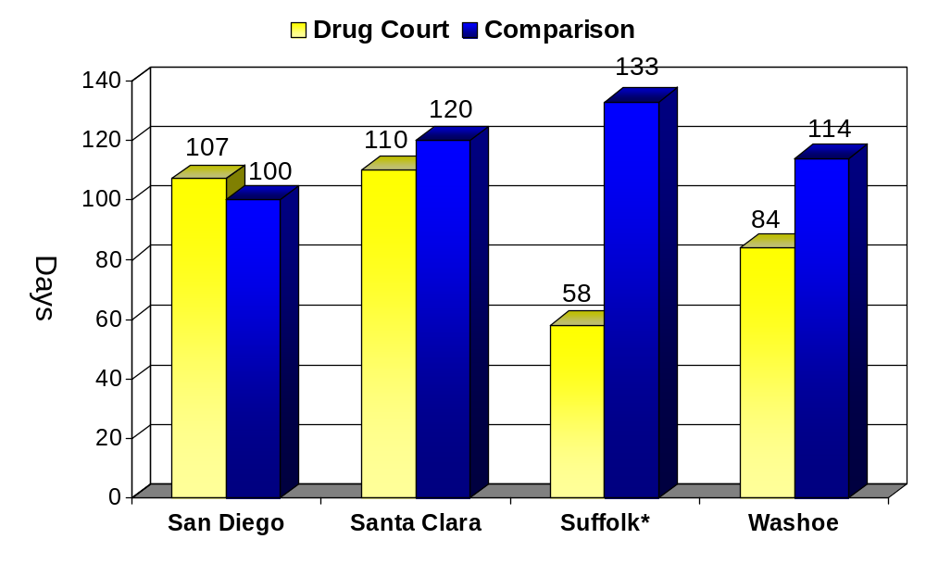
Days to Treatment Entry
* Statistically significant at p<.001.

Slide 23
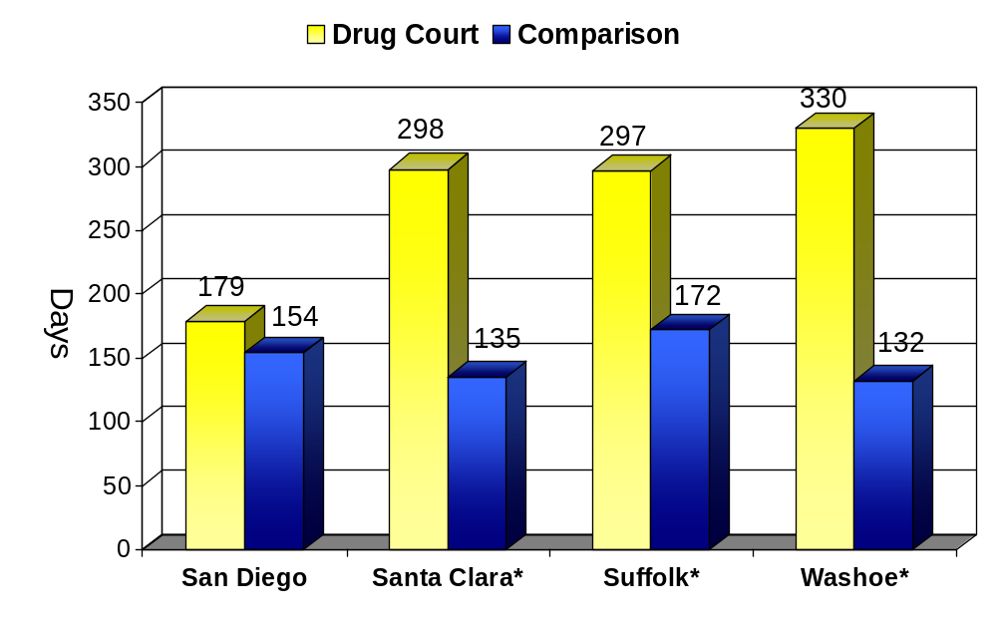
Days Spent in Treatment
* Statistically significant at p<.001.

Slide 24
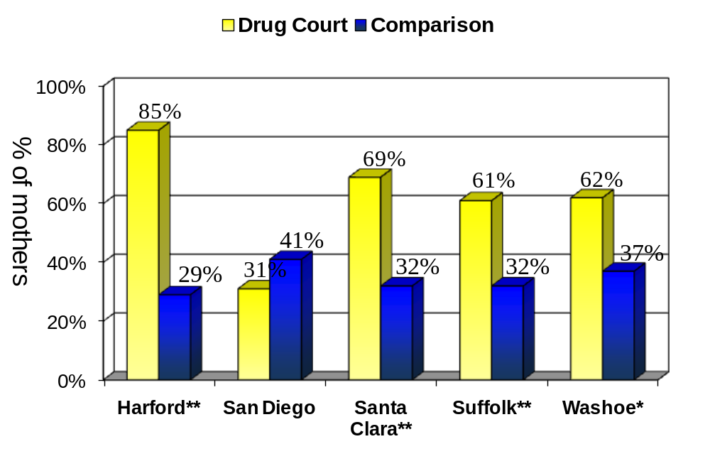
Percent Completing at Least One Treatment
**Statistically significant at p<.001. *Statistically significant at p<.01.

Slide 25
Child Welfare & Court System
Outcome Questions
Did children of FTDC parents spend less time in out-of-home care?
Did FTDC cases reach permanency faster?
Were children of FTDC parents reunified at a higher rate?

Slide 26
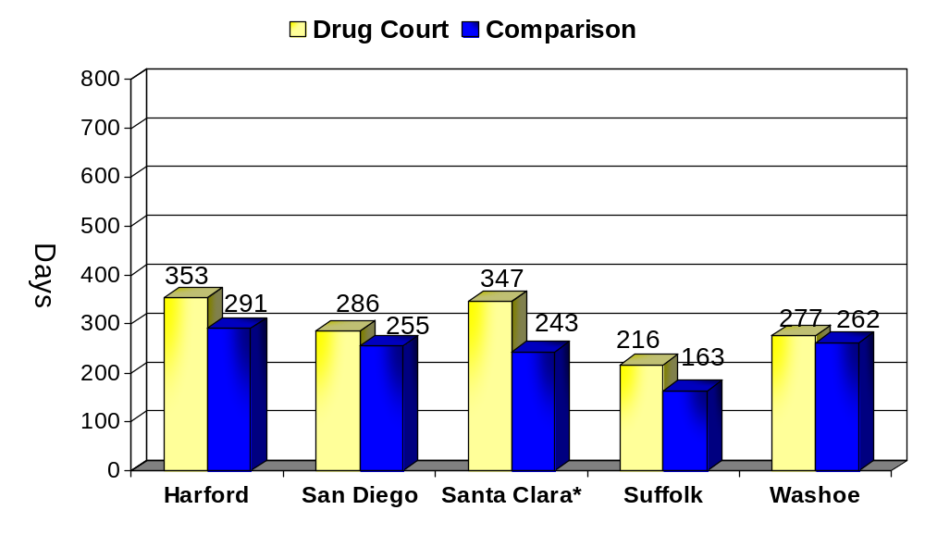
Days to Permanent Placement
* Statistically significant at p<.05.

Slide 27
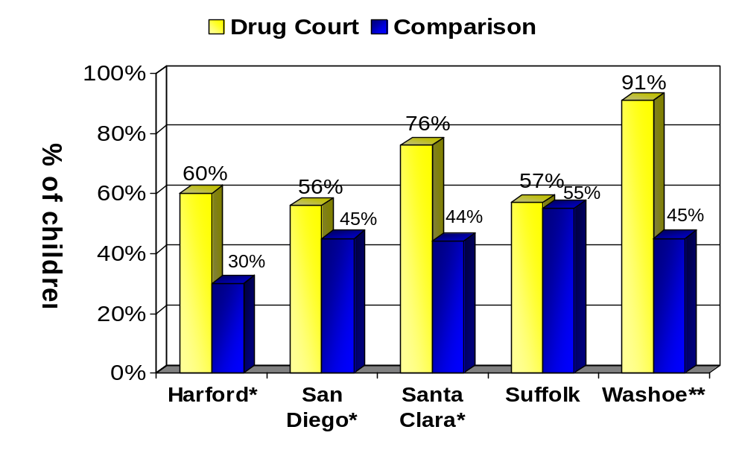
Percent Reunified
* Statistically significant at p<.05. ** Statistically significant at p<.001.

Slide 28
Summary: Outcomes for FTDCs
Strong treatment outcomes: FTDC parents more likely to enter treatment, spend more time in treatment, and complete treatment
Longer time to permanent placement for FTDC parents could be explained by the longer treatment stays
Less time in Out of Home Placements: FTDC children spent more of this time with their parents
More likely to be reunified: FTDC children were more likely to be reunified with their parents at the end of the case

Slide 29
Transferable Practices
Strategies that can be used in non-FDTCs.
Practices that can be evaluated in dependency proceedings.

Slide 30
Collaborative Justice in Conventional Courts CCI, 2004
Judges identified the following collaborative justice principles and practices as the easiest or most appropriate to transfer:
• A proactive, problem-solving orientation of the judge
• Interaction with the defendant/litigant
• Ongoing judicial supervision
• Integration of social services
• A team-based, non-adversarial approach

Slide 31
FTDC Experiences and Substance Abuse Treatment Outcomes
Variable | Statistically Significant? | Nature of Relationship to Treatment Outcomes
Time to FTDC entry (petition to entry) | No | No relationship
Longer time spent in FTDC | Yes | Longer stays in tx More tx completion
More FTDC appearances | Yes | Longer stays in tx More tx completion
FTDC graduation | Yes | Longer stays in tx More tx completion

Slide 32
FTDC Experiences and Reunification
Variable | Statistically Significant? | Nature of Relationship to Reunification
Faster time to FTDC entry | No | No relationship
More time spent in FTDC | Yes | More reunification
More FTDC appearances | Yes | More reunification
FTDC graduation | Yes | More reunification

Slide 33
Treatment Experiences and
Treatment Completion
Variable | Statistically Significant? | Nature of Relationship to Treatment Outcomes
Faster time to treatment entry | Yes | Longer treatment stays Higher rates of treatment completion
Longer time in treatment | Yes | Higher rates of treatment completion

Slide 34
What do the parents say?

Slide 35
Emotional Support
Parents talked about how the drug court team, and in particular the judge and the drug court-dedicated case workers, provide a support system.
  “The drug court team and the drug court case worker have helped me a lot. My first case worker, that wasn’t the drug court one, didn’t spend much time with me, but my drug court case worker always knew what was going on with me, and helped me get what I needed to get my kids back.”

Slide 36
Accountability and Collaboration
Parents also explained how frequent hearings and attendance in drug court provided accountability for their behavior because:
  “the team knows what’s going on with you and you get immediate support for whatever is going on as soon as you need it.”
  “it’s helpful going every two weeks because things can come up during that time, and in drug court these problems are addressed quickly.”

Slide 37
Accountability and Collaboration, cont’d
Frequent court attendance means that the judge and others are well informed about the parents’ cases and able to provide appropriate support for recovery and other issues facing the parent.
“(attending drug court regularly) helps you feel less alone, that someone knows what’s going on in your life and the all the issues that you face, they know how to support you and what you need.”

Slide 38
Putting It All Together—
What Have We Learned?
FTDC’s work — Families have more positive treatment and child welfare outcomes
How FTDC’s work –
  Support for treatment entry, retention, and completion
  Combination of emotional support, accountability, and service coordination – but how these work is largely unknown
Retention of families in FTDC programs is important to success
FTDC influence on child welfare recidivism needs additional data and research

Slide 39
Resources
National Council for Juvenile and Family Court Judges http://www.ncjfcj.org/content/blogcategory/369/438/
http://www.npcresearch.com/Files/FTDC_Evaluation_Final_Report.pdf
http://www.ndci.org/publications/FDTC_Fact_Sheet.web.pdf
http://www.courtinfo.ca.gov/programs/collab/documents/TranferabilityStudyFullReport.pdf

Slide 40
Questions?
janepfeifer@msn.com

