Slide 1
Weekly Summary
Tevatron Department Meeting
Tevatron Coordinator
Dean Still
Friday, May 14, 2010

Slide 2
Store Summary
Store | Avg Init. Lumi (E30) | Avg Deliv’d Lumi (nb⁻¹) | Time (hr) | How did it end? | Comments
7798 | 371.5 | 8507 | 17.3 | Intentional | First store after 12 hour shutdown
7799 | 391.4 | 8685 | 16.4 | Intentional
7802 | 380.7 | 3751 | 4.3 | Quench | Quench D34L; Not fully understood
7804 | 319.7 | 7276 | 16.7 | Intentional
7805 | 376.2 | 7912 | 14.8 | Intentional | Moved to shooting from smaller stashes
7806 | 357.5 | 8016 | 16.4 | Intentional | Hi proton halo losses; D49V change; smooth
7807 | 335 | 7605 | 15.5 | Intentional | Hi p&pbar halo loss;pbar v emit blew in int collisions.
7808 | 360 | 5939 | 9.1 | Abort | Smoothed; lost due to lightning
7811 | 293 |  |  | On going | Smoothed made changes to tunes to stop scalloping; shot from small stash due to MI access
Tevatron Coordinator - FNAL

Slide 3
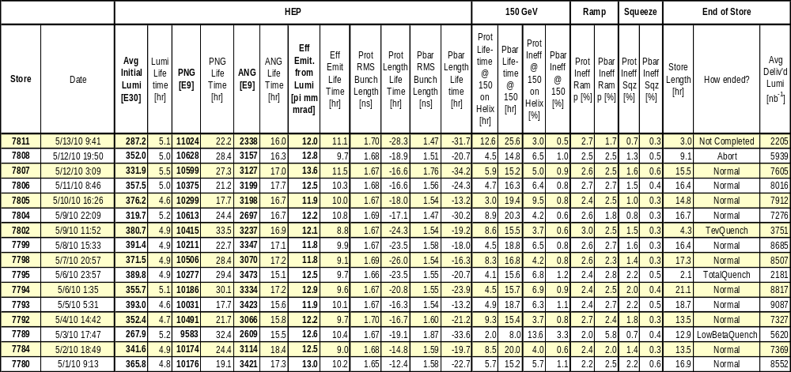
Store Numbers
Tevatron Coordinator - FNAL

Slide 4
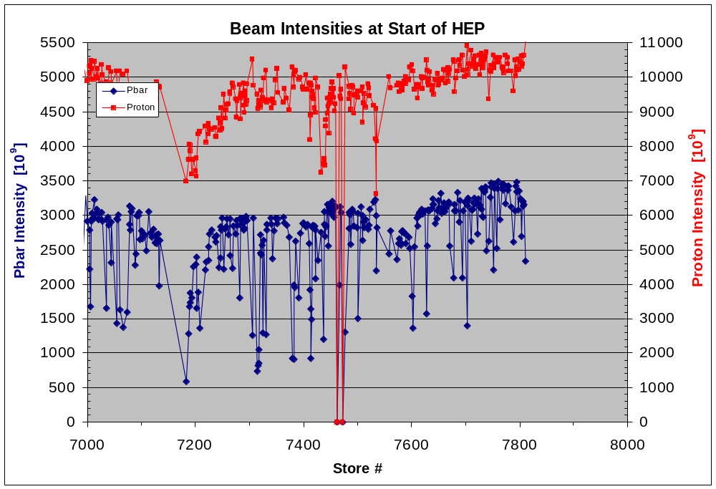
HEP Particle Intensities

Slide 5
HEP Effective Emittance

Slide 6
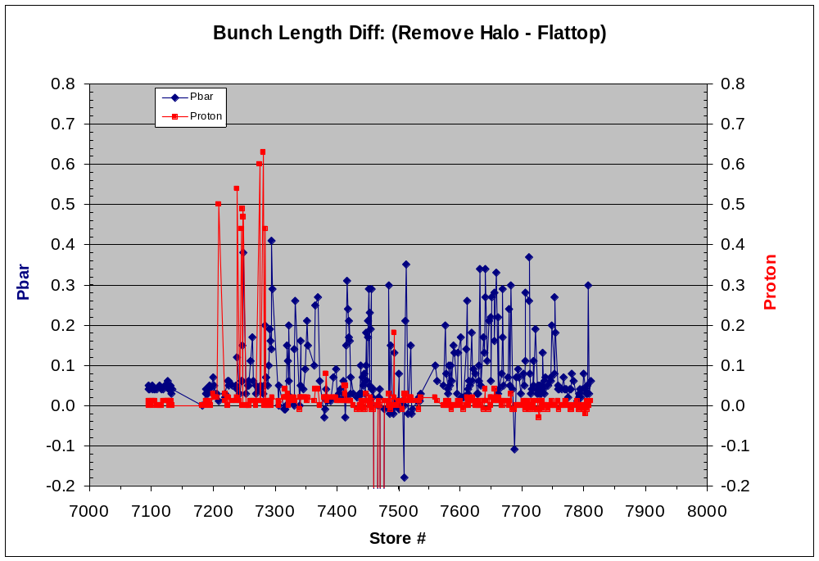
HEP Bunch Length

Slide 7
Problems
Still have both Pbar and Proton Longitudinal blow ups
Quench D34L ; No beam loss; Not fully understood. Low quench threshold magent.
High Proton halo losses at start of store.
Store loss due to lightning.
Pbar vert emit growth at int collision and scalloping.
Tevatron Coordinator - FNAL

Slide 8
Studies/Work Completed
Proton only store to smooth orbits.
Tevatron Coordinator - FNAL

Slide 9
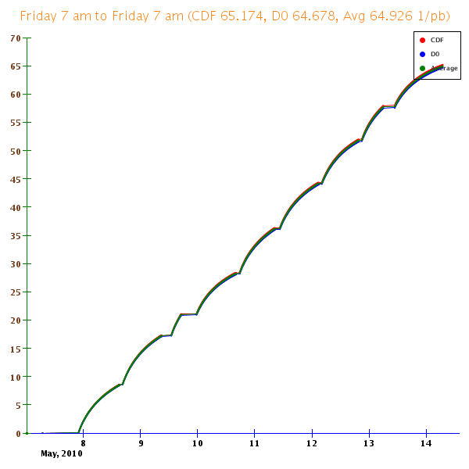
Luminosity Integral
Tevatron Coordinator - FNAL

Slide 10
Study requests
TEL-2 abort gap cleaning test (EOS 1 hour)
150gev Chrom Study (2 hours- dedicated at 150gev, Tan)
Aperture scans at B0 and D0
Ping beam at low field to measure coupling with protons on the pbar helix
Tune mults calibration.
Pbar only store once luminosity is better to document conditions.
Lattice measurements at Flattop and Sequence 14 and on pbar helix at Collisions
Tevatron Coordinator - FNAL

