Slide 1
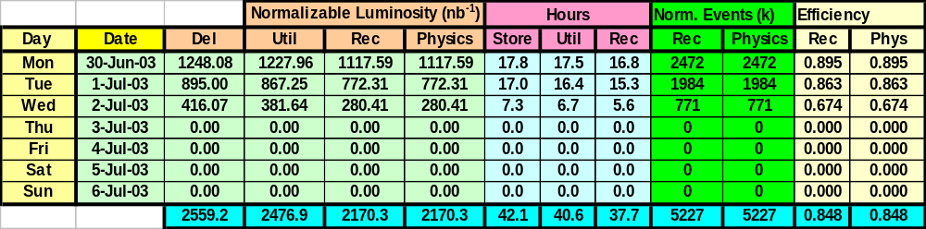
Data Taking Statistics
Week of 2003 Jun 30 - Jul 6
 | Recorded Physics Lumi | Efficiency | Physics Events (million)
This Week | 2.2 pb⁻¹ | 84.8% | 5.2
Last Week | 6.9 pb⁻¹ | 87.0% | 14.2
Best Week (2003 May 12-18) | 7.8 pb⁻¹ | 91.5% | 13.5
Bad News: Lowest operating efficiency in three months
Good News: Lowest operating efficiency in three months

Slide 2
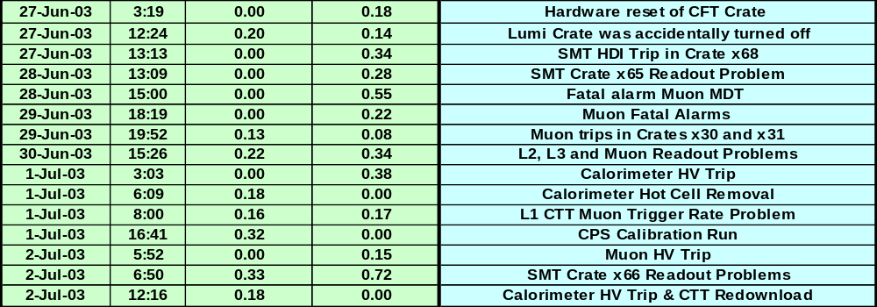
Delivered Luminosity Losses
We have seen most of these type of problems before, but…
  More human errors than usual
    Influx of newer, less experienced shifters
    Average response time was slower
  Many experts taking vacations
Today (July 7) - Resumed physics data taking within 3 minutes of Store 2768 declaration - stable running first hour plus and counting

Slide 3
Plans for Upcoming Week
Dmitri Denisov is away from the lab until July 14
  I will be Acting RC until next Monday (Pager: 218-8991)
Have few jobs that need ~1 hour of controlled access
  Muon Pixel & PDT electronics; CTT firmware upgrade
  Low priority - can wait for natural opportunity
Significant changes to our trigger list today
  First run (2-3 hrs) of this store - proof of principle test
  Will end our "Summer Conference" data set
  Performed extensive tests, and taken special runs
    New triggers, filters, tools, etc.
  Expect to be able to increase our L2 rates by ~100%
    L1/L2/L3 ~ 1500/800/50 Hz
Rest of week - Integrate Luminosity!

Slide 4
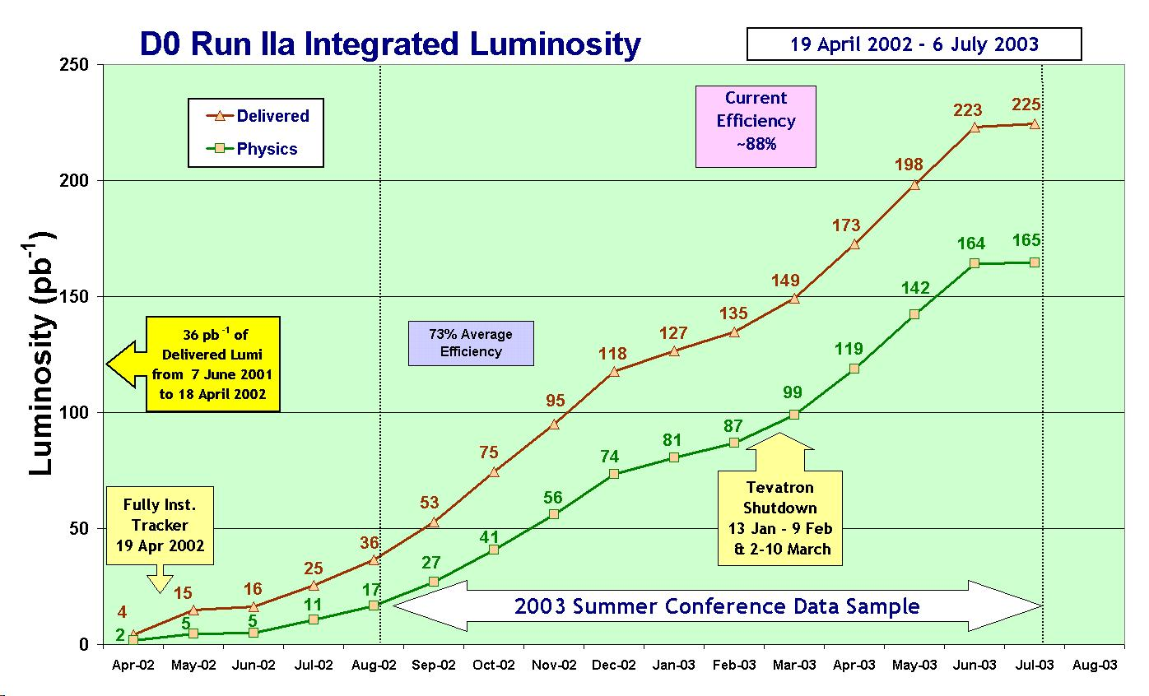
D0 Integrated Luminosity

