Slide 1

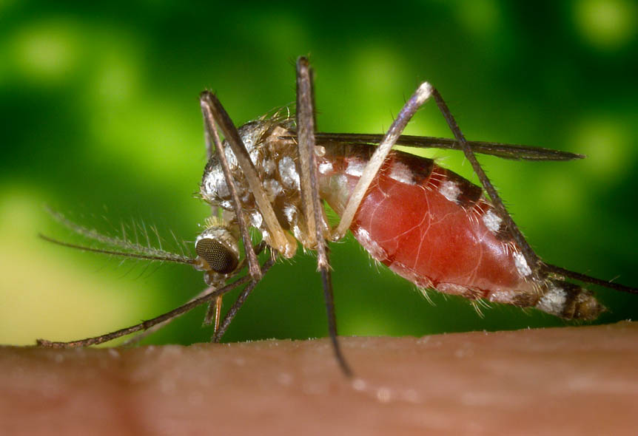
Emerging Clinical Syndromes of West Nile Virus Infection
James J. Sejvar, MD
Division of Viral and Rickettsial Diseases
National Center for Infectious Diseases
Centers for Disease Control and Prevention

Slide 2
West Nile Virus—Clinical Disease
Historically infrequent outbreaks of mild febrile illness
Since 1996:
  More frequent outbreaks
  More reports of severe CNS disease, fatalities
Understanding of clinical picture based mainly on recent outbreaks

Slide 3
WNV Human Infection “Iceberg”
1 CNS disease case
=
~150 total infections
<1%
CNS
disease
~10% fatal
(<0.1% of total infections)
Very crude estimates
~20%
“West Nile Fever”
~80%
Asymptomatic
Notes:
The crows remain an important part of the avian mortality surveillance

Slide 4
West Nile Virus—”Classical” Clinical Description
Incubation period of 2-15 days
Most illness: “West Nile fever”
  Self-limited dengue-like illness
  Fever, headache
  Rash, lymphadenopathy
  Nausea, vomiting
Rarely pancreatitis, hepatitis, myocarditis

Slide 5
West Nile Virus—”Classical” Clinical Description
Severe neurologic illness categories
  -- Meningitis
    Fever, nuchal rigidity, CSF pleocytosis
  -- Encephalitis
    Altered mental status
  -- “Meningoencephalitis”
  -- Acute flaccid paralysis

Slide 6
WNV—Clinical Questions
Limitations of previous analyses
  Retrospective chart reviews
  Multiple observers
  Incomplete and inconsistent studies
  Long-term outcome data virtually nonexistent
True spectrum of disease unclear
Notes:
However, most of what we know about the clinical manifestations of WNV in humans has been based on retrospective chart reviews and anecdotal reporting. There has been a great deal of contradiction in the literature regarding human clinical disease.
For instance, though it seems clear that recent outbreaks have been associated with more frequent and more severe neurologic involvement, the true incidence of such manifestations remains unclear. For instance, severe neurologic disease was felt to be relatively infreqent during the NYC outbreaks of 1999 and 2000, while outbreaks in Romania, Russia, and Israel have reported high rates of neurologic illness and death.
Case fatality rates have ranged anywhere from 4% in Romania in 1996 to 12% in NYC in 1999 to nearly 50% in Russia in 1999
In addition, the particular clinical features have never really been accurately described. Neurologic features have varied widely in published reports, due to the retrospective nature and multiple observers involved in previous assessments.
There are many unanswered questions regarding the progression of disease. For instance, it is largely unknown how often those presenting initially with febrile illness will go on to develop neurologic involvement.
And, although various predictors of poor outcome have been suggested, no single underlying condition has been significantly associated with neurologic illness or death.
Finally, data on long-term sequellae from WNV is essentially nonexistent

Slide 7
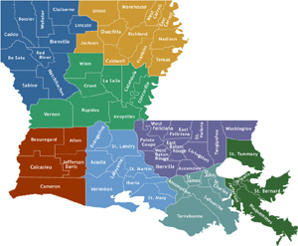

WNV Clinical Investigations--2002
Prospective clinical case series
  Detailed serial neurologic exams
  16 patients identified
WNV Fever Study
Detailed neurodiagnostic studies on large numbers of patients
House-to-house serosurvey

Slide 8
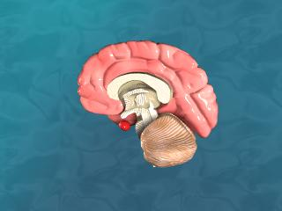
Clinical Syndromes—Understanding the Scope of Illness
West Nile fever
Emerging clinical syndromes
  Movement disorders
  Parkinsonism
  Flaccid paralysis
  Rhabdomyolysis
Outcomes / prognosis
Future directions

Slide 9
West Nile Fever
Felt to represent the majority of symptomatic infections
Determination of proportion with WNF in WNV outbreak setting
Subacute progression to severe CNS disease unlikely
Increased detection—fewer cases truly asymptomatic??

Slide 10
WNV and Movement Disorders
Tremor
  Sometimes associated with other viruses
  Documented in 15 (94%) of prospective series patients
  Static / kinetic; sometimes with movement
  Occasionally disabling

Slide 11


Slide 12
WNV and Movement Disorders
Myoclonus
  Observed in 10 (63%); described in 12 overall
  Upper extremity, facial involvement most frequent
  Nocturnal myoclonus
Both tremor and myoclonus—onset generally > 5 days following initial symptoms

Slide 13
WNV and Parkinsonism
Parkinsonism observed in 11 (68%)
  Cogwheel rigidity
  Bradykinesia
  Postural instability
Rest tremor not observed
Seen both in encephalitis and meningitis cases

Slide 14
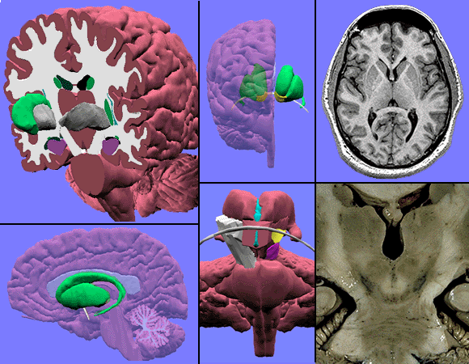
WNV and Movement Disorders
Neuroimaging: lesions in basal ganglia, thalamus, pons
Histopathology—virus detected in basal ganglia, thalamus, brainstem

Slide 15
WNV-Associated Flaccid Paralysis
Previously described; not “new” syndrome
Relatively young; lack of premorbid conditions
May have absence of fever, headache
Clinical hallmarks:
  Onset during acute infection
  Asymmetry of weakness
  Absence of sensory changes
  Elevation of CSF protein and WBC

Slide 16
WNV-Associated Flaccid Paralysis
Multiple alternative diagnoses (stroke, GBS, myopathy)—Rx with heparin, IVIG
Syndrome actually localized to spinal anterior horn cells*—resultant poliomyelitis
Recognition could limit unnecessary diagnostic procedures, treatment
Little or no improvement short-term
*Dr. A. Leis, Methodist Rehab. Center, Jackson, MS

Slide 17
WNV and Rhabdomyolysis
Rhabdomyolysis—acute destruction of skeletal muscle cells
Infrequent manifestation of viral infection
September 2002—rhabdomyolysis reported in Chicago WNV patients
14 total cases identified
Trauma, medication effect unlikely
Further studies to assess association

Slide 18
West Nile Virus--Other Clinical Syndromes (?)
Flaccid paralysis with sensory symptoms
  Neuropathic pain
  Causalgia
  Paresthesias
Peripheral neuropathy, polyradiculopathy
Optic neuritis
Acute demyelinating encephalomyelitis (ADEM)
Prenatal WNV infection with CNS developmental abnormalities
  WNV as a teratogen?

Slide 19
West Nile Virus—Clinical Outcomes Data
Current data limited
Fatality rates
  10% fatality rate in CNS disease
  Elderly, immunosuppressed
  Independent risk factors unknown
Long-term outcomes in NYC:
  >50% with continued impairment at 1 year
  Only 37% considered fully recovered

Slide 20
West Nile Virus—Clinical Outcomes Data
Short-term prospective data
  No deaths
  Most patients (14/16; 88%) eventually went home
Follow-up telephone query data
  Persistent / chronic headache
  Concentration, memory difficulties
  Overwhelming fatigue
  Persistence of tremor, parkinsonism
Paralysis—no short-term improvement

Slide 21
WNV Human Infection “Iceberg”
1 CNS disease case
=
~150 total infections
<1%
CNS
disease
~10% fatal
(<0.1% of total infections)
Very crude estimates
~20%
“West Nile Fever”
~80%
Asymptomatic
Notes:
The crows remain an important part of the avian mortality surveillance

Slide 22
WNV Human Infection “Iceberg” Revisited
1 CNS disease case
=
~?? total infections
<?%
CNS
disease
~10% fatal
(<0.1% of total infections)
~?%
“West Nile Fever”
Febrile illness alone less frequent?
~80%
Asymptomatic

Slide 23
WNV Clinical Syndromes—Future Directions
Surveillance for meningitis, encephalitis as distinct entities
Enhanced surveillance for flaccid paralysis; incidence rates
Population-based assessment of movement disorders, parkinsonism
Long-term follow up studies
  persistence of symptoms
  psychosocial outcomes
  development of sequelae

Slide 24
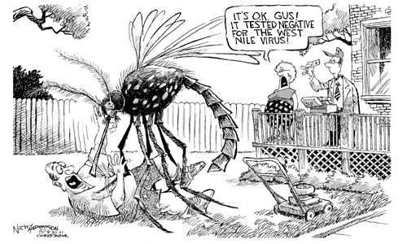

Slide 25
WNV--Outcomes
Short-term prospective data
  Of 8 encephalitis patients, 6 went home, 1 to SNF, 1 on chronic ventilation
  All meningitis patients discharged home
Follow-up call data
  Persistent / chronic headache
  Concentration, memory difficulties
  Overwhelming fatigue
  Persistence of tremor, parkinsonism
AFP—no short-term improvement

Slide 26
West Nile Fever (WNF)
Subacute progression to severe CNS disease unlikely
  Development of meningitis / encephalitis /paralysis within 24-48 hours of fever onset
  No subsequent hospitalization among fever outpatients

