Slide 1
Washington State
Department of Printing
Human Resource Management Report
Prepared for
Department of Personnel
October 16, 2006

Slide 2
Human Resource Management Report
Standard Performance Measures
Plan & Align Workforce
Percent current position/competencies descriptions [agency tracking system]
Percent supervisors with current performance expectations for workforce management [agency tracking system]
Time-to-fill funded vacancies [agency tracking system]
Percent satisfaction with candidate quality [agency tracking system to be developed]]
New Hire-to-Promotional ratio [DOP Data/Business Warehouse]
Percent turnover during review period [DOP Data/Business Warehouse]
Percent employees with current performance expectations [agency tracking system]
Employee survey ratings on “productive workplace” questions [DOP standard survey]
Leave usage (sick, LWOP, unscheduled leave) [DOP Data/Business Warehouse]
Overtime usage [DOP Data/Business Warehouse]
Number & type of non-disciplinary grievances [agency tracking system]
Percent employees with current annual individual development plans [agency tracking system]
Employee survey ratings on “learning/development” questions [DOP standard survey]
Percent current performance evaluations [agency tracking system]
Employee survey ratings on “performance accountability” questions [DOP standard survey]
Number/type of disciplinary issues [agency tracking system]
Turnover rates and types (e.g., retirement, resignation, etc.) [DOP Data/Business Warehouse]
Employee survey ratings on “commitment” questions [DOP standard survey]
Hire Workforce
Deploy Workforce
Develop Workforce
Reinforce Performance
Ultimate Outcomes

Slide 3
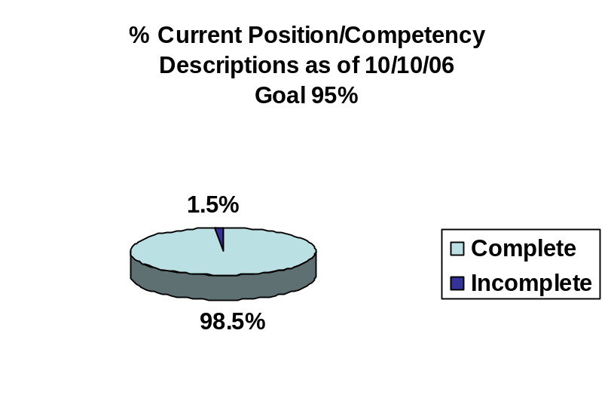
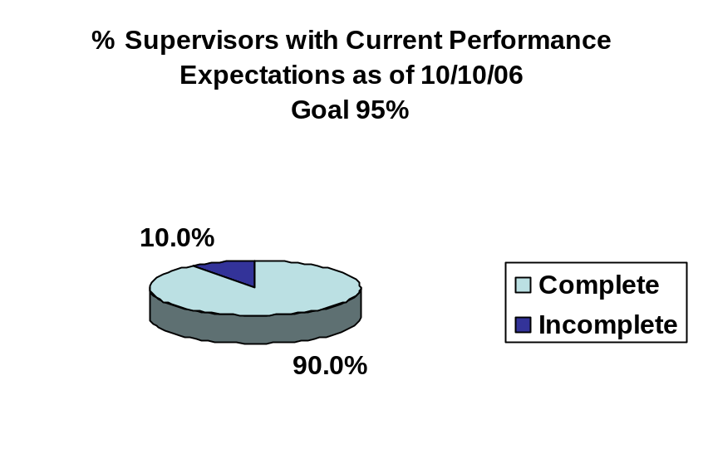
Overall foundation & management accountability system to build & sustain high performing workforce
Plan & Align Workforce |
HR Management Report category:
Plan & Align - Slide 1 of 1
HR Management Report
(Preliminary Measures)
Percent current position/competency descriptions
Percent supervisors with current performance expectations for workforce management
Source: PRT Internal Tracking

Slide 4
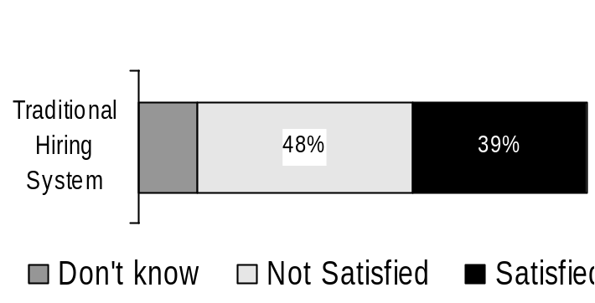
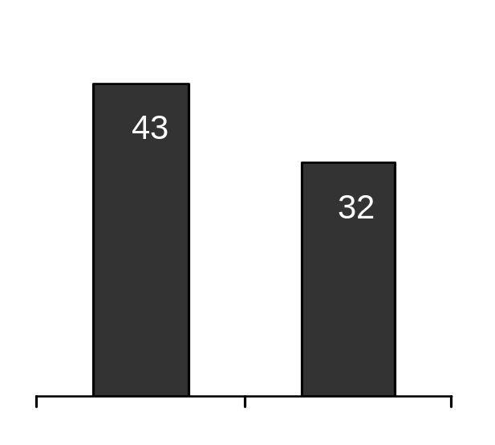
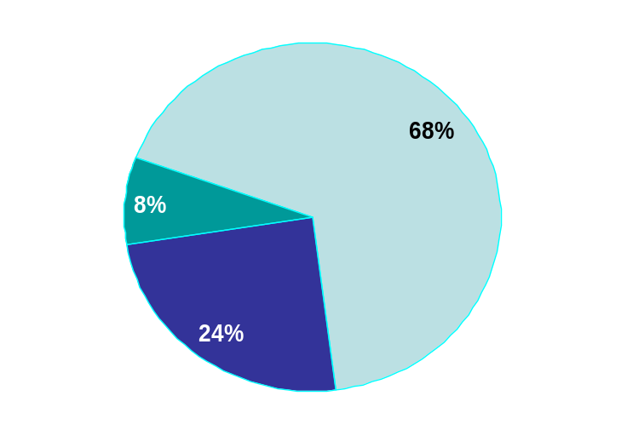
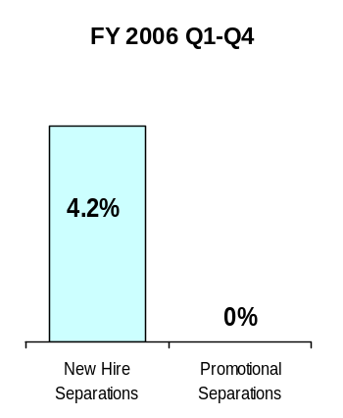
Hire Workforce |
HR Management Report category:
Right People in the Right Job at the Right Time
Hire Workforce - Slide 1 of 1
HR Management Report
(standard measures)
Days to fill vacancies (from requisition to job offer)
% satisfaction with candidate quality
% new hires; % promotional hires
Retention/dismissal rate during appointment period
Candidate Quality
(managers’ satisfaction rating)
Data is not currently being collected.
Estimated days to fill vacancies
Source: Agency Survey following Recruitment
Separation during Review Period
FY 2006
12/05-6/06
(37 total appointments)
New Hires
Transfers In
Industry Benchmark
Printing
Source: 2003 Mercer Benchmark Study
Promotions Within
Source: PRT Internal Tracking

Slide 5
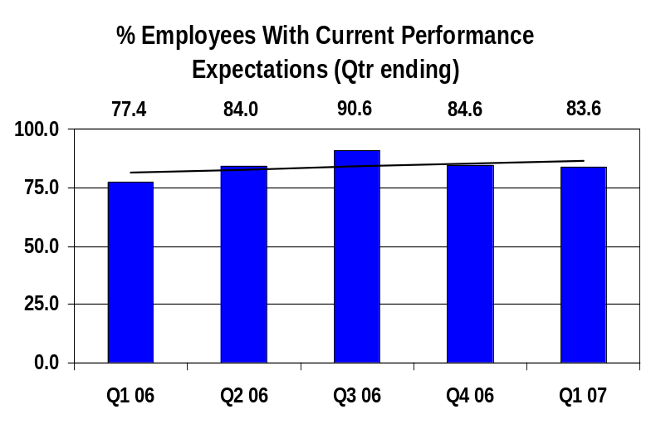
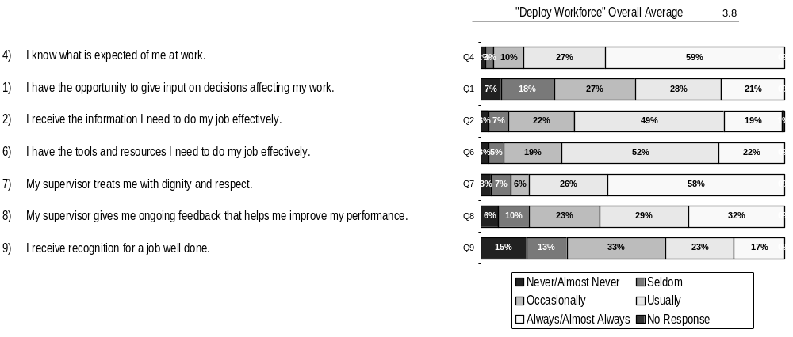
Deploy Workforce |
HR Management Report category:
Employee time and talent is used effectively. Employees motivated.
Deploy Workforce - Slide 1 of 4
HR Management Report
(standard measures)
Percent employees with current performance expectations
Employee survey ratings on “productive workplace” questions
Overtime usage
Sick leave usage (and “unscheduled” leave if available)
Number & type of non-disciplinary grievances and disposition
Do employees have day-to-day support to enable successful job performance?
Survey conducted Spring 2006. Dept. of Printing number of responses = 120
NOTE: State Overall Average: 3.8

Slide 6
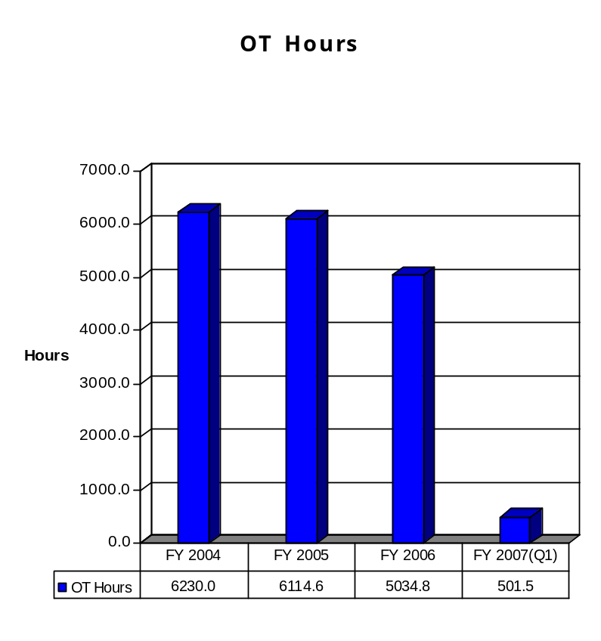
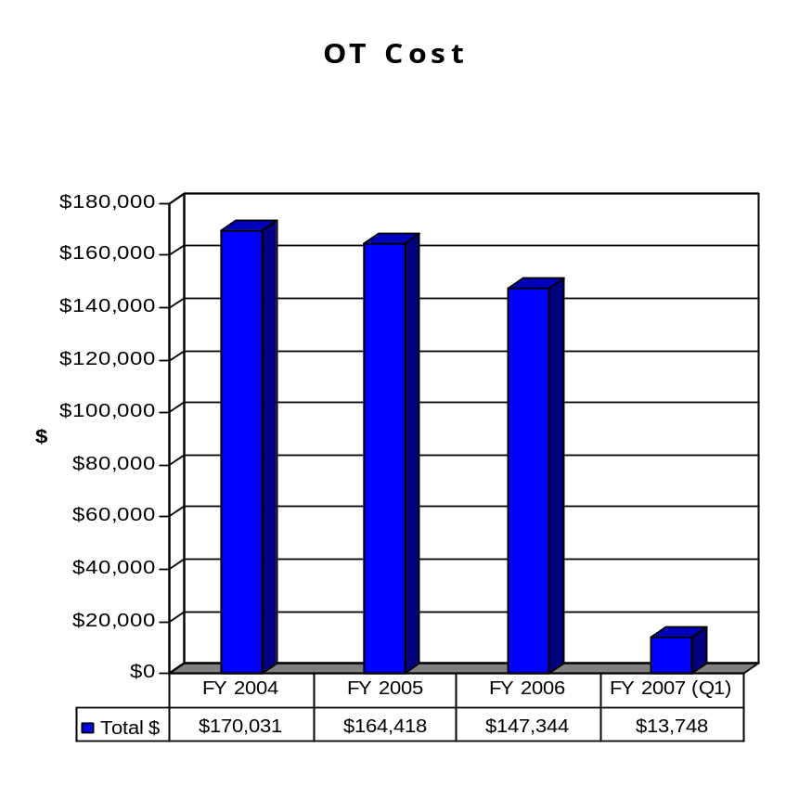
Deploy Workforce |
HR Management Report category:
Employee time and talent is used effectively. Employees motivated.
Deploy Workforce - Slide 2 of 4
AGENCY OVERTIME COST REPORT
Source: Monthly Position Cost Report and SAP

Slide 7
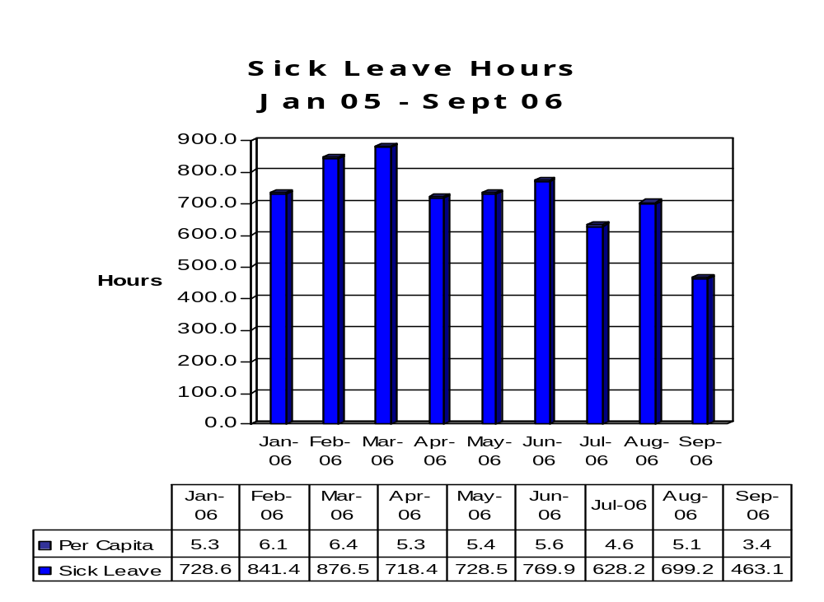
Deploy Workforce |
HR Management Report category:
Employee time and talent is used effectively. Employees motivated.
Deploy Workforce - Slide 3 of 4
AGENCY SICK LEAVE USEAGE
Source: Monthly Position Cost Report

Slide 8
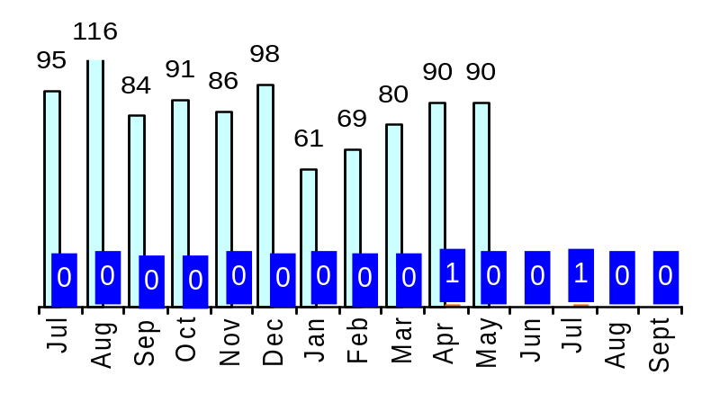
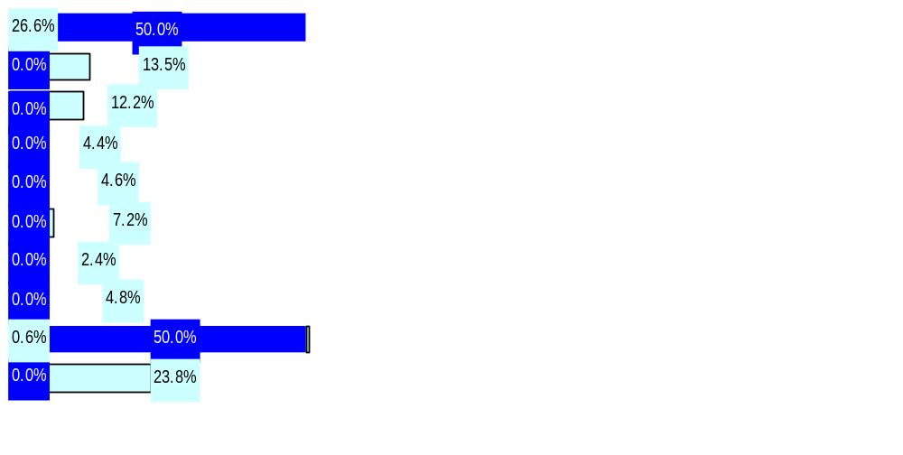
Deploy Workforce |
HR Management Report category:
Employee time and talent is used effectively. Employees motivated.
Employee relations: Are contracts/policies applied appropriately?
Deploy Workforce - Slide 4 of 4
Number of Grievances Filed (July 05 – May 06)
Notes:
The Department of Printing is represented by two international trade unions; Graphic Communications International Union and Communications Workers of America.
The Department of Printing represented staff are not a part of the state’s master contract. Contract renewals are negotiated between the union and the Agency.
All agencies
Printing Only
116
95
80
Type of Grievances (July 05 – May 06)
Discipline
Compensation
Overtime
Work Hours
Bid System
Leave
Hiring/Appts
Non-discrimination
Management Rights
All other
All Other Agencies
Printing Only
Source: State Labor Relations Office and Agency Tracking

Slide 9
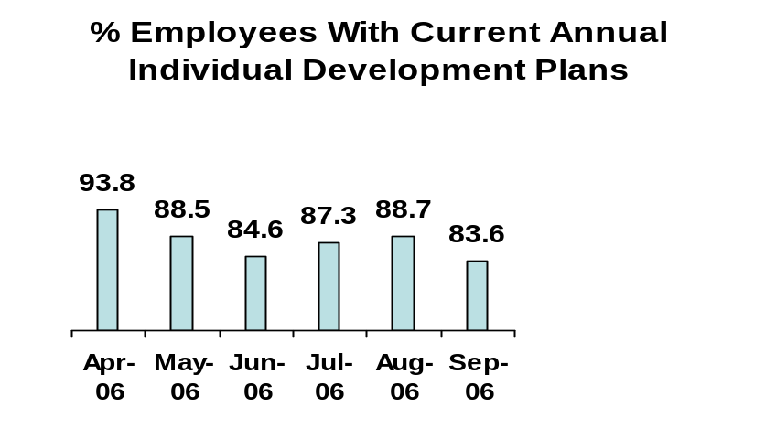
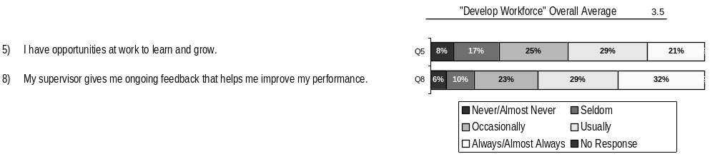
Employees have competencies for present job and future advancement
Develop Workforce |
HR Management Report category:
Develop Workforce - Slide 1 of 1
HR Management Report
(standard measures)
Percent employees with current annual individual development plans
Employee survey ratings on “learning & development” questions
*The Department of Printing uses the numbers that come from the PDP, Section 2 – Training and Development Needs/Opportunities.
Employee perceptions on learning and development:
Survey conducted Spring 2006. Dept. of Printing - number of responses = 120
NOTE: State Overall Average: 3.7

Slide 10
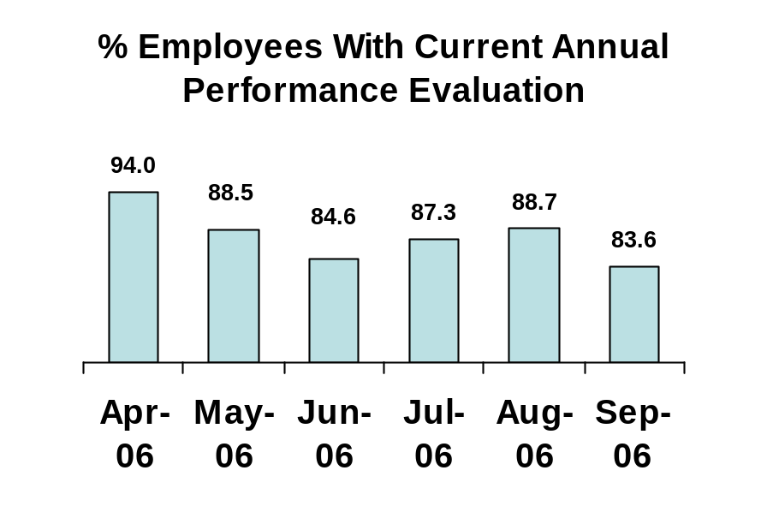
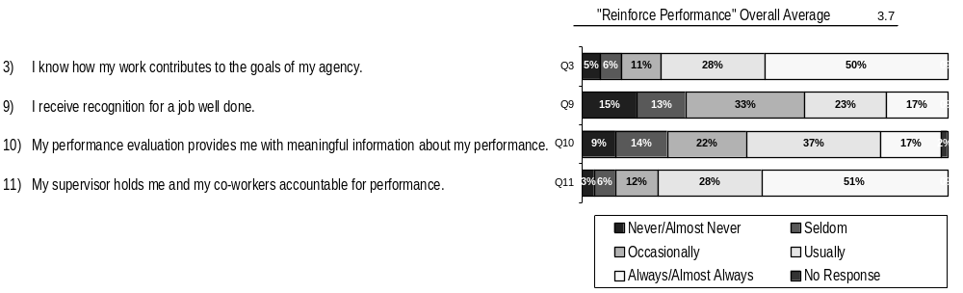
Successful performance is differentiated & strengthened. Employees are held accountable.
Reinforce Performance |
HR Management Report category:
Reinforce Performance - Slide 1 of 3
HR Management Report
(standard measures)
Percent employees and managers with current annual performance evaluations
Employee survey ratings on “performance and accountability” questions
Number and type of disciplinary issues, actions, appeals disposition
Do employees see a meaningful linkage between their performance and the success of the organization?
Survey conducted Spring 2006. Dept. of Printing - number of responses = 120
NOTE: State Overall Average: 3.7

Slide 11
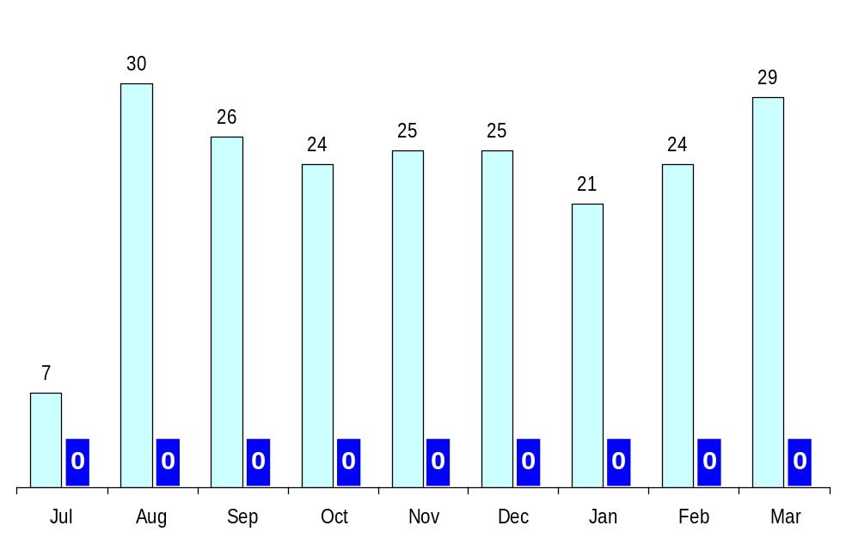
Reinforce Performance |
HR Management Report category:
Successful performance is differentiated & strengthened. Employees are held accountable.
Disciplinary action: Is poor performance dealt with?
Reinforce Performance - Slide 2 of 3
Disciplinary Grievances Filed Since July 1, 2005
The Department of Printing is represented by two International Trade Unions; Graphic Communications International Union (GCIU) and Communications Workers of America (CWA). Neither union is covered under the State of Washington Master Contract Agreement
All agencies
Printing Only
Source: PRT Internal Tracking

Slide 12
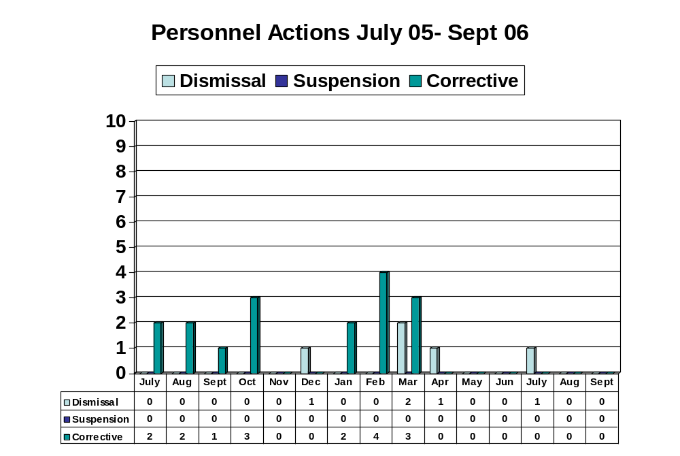
Reinforce Performance |
HR Management Report category:
Successful performance is differentiated & strengthened. Employees are held accountable.
Disciplinary action: Is poor performance dealt with?
Reinforce Performance - Slide 3 of 3
Source: Tracked at Agency Level

Slide 13
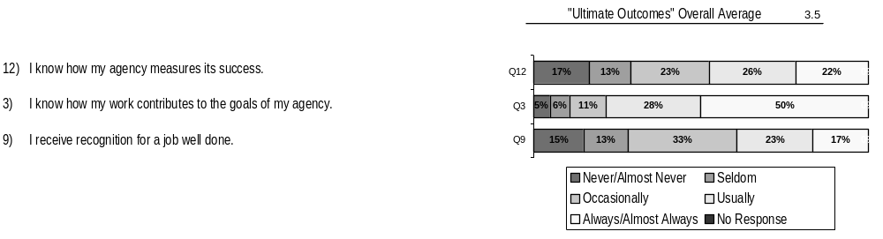
Ultimate Outcomes |
HR Management Report category:
State has workforce breadth & depth for present & future success.
Employees are committed to the work they do and the goals of the organization.
Successful, productive employees are retained.
HR Management Report
(standard measures)
Employee survey ratings on “commitment” questions
Turnover rates and types (e.g., retirement, resignation, etc.)
Turnover rate of key occupational categories and of workforce diversity
Ultimate Outcomes - Slide 1 of 3
Indicators of Employee Commitment
Survey conducted Spring 2006. Dept. of Printing - number of responses = 120
NOTE: State Overall Average: 3.6
Notes:
Notes:

Slide 14
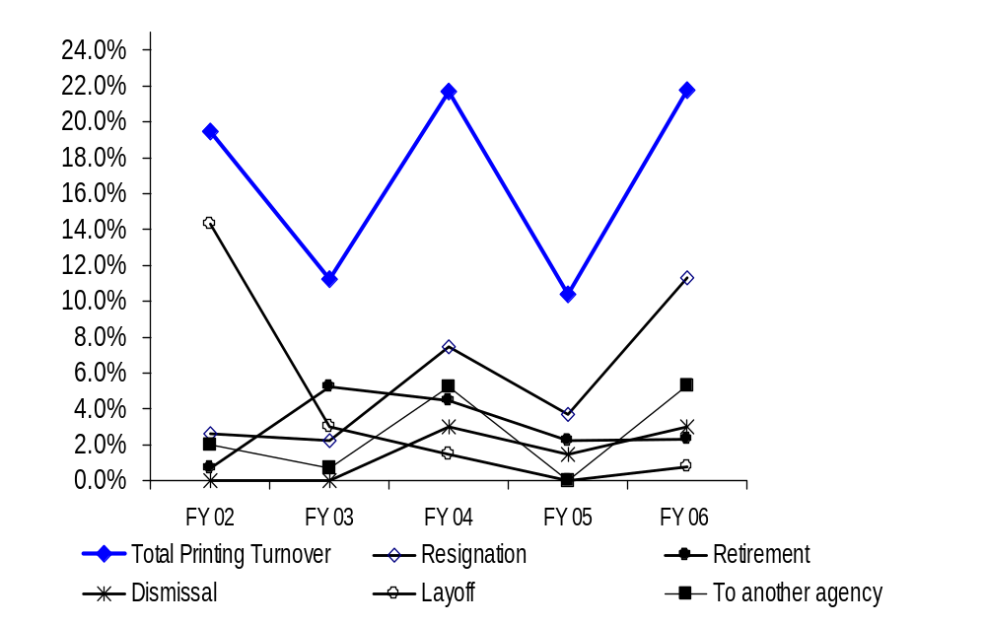
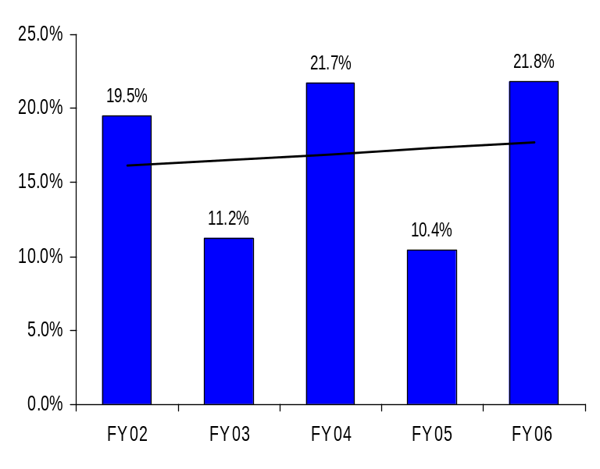
Ultimate Outcomes | continued
HR Management Report category:
Ultimate Outcomes - Slide 2 of 3
Workforce Turnover
Turnover – Department of Printing
(Leaving the agency)
Workforce Turnover Breakdown
Source: DOP Data Warehouse/Agency Internal Tracking
Notes:
Notes:

Slide 15
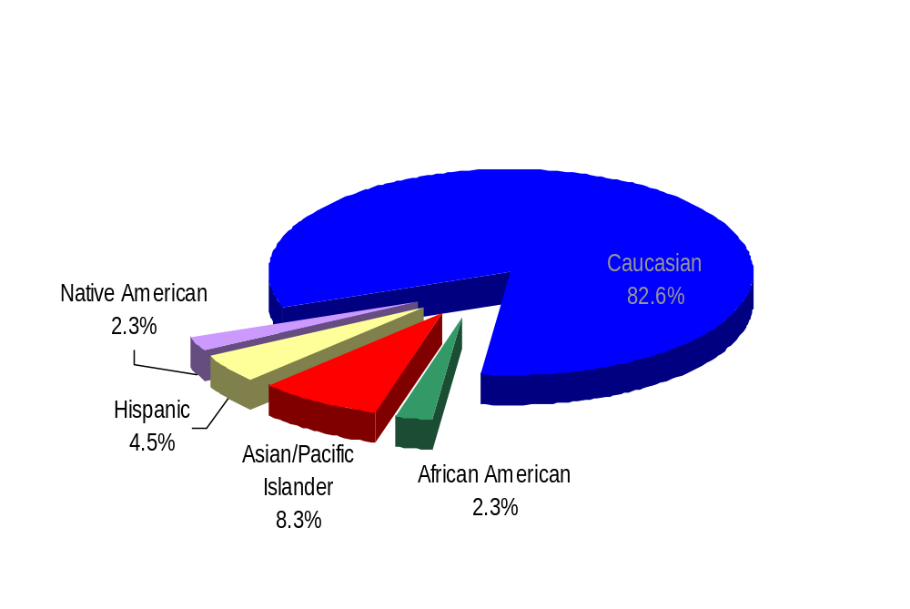
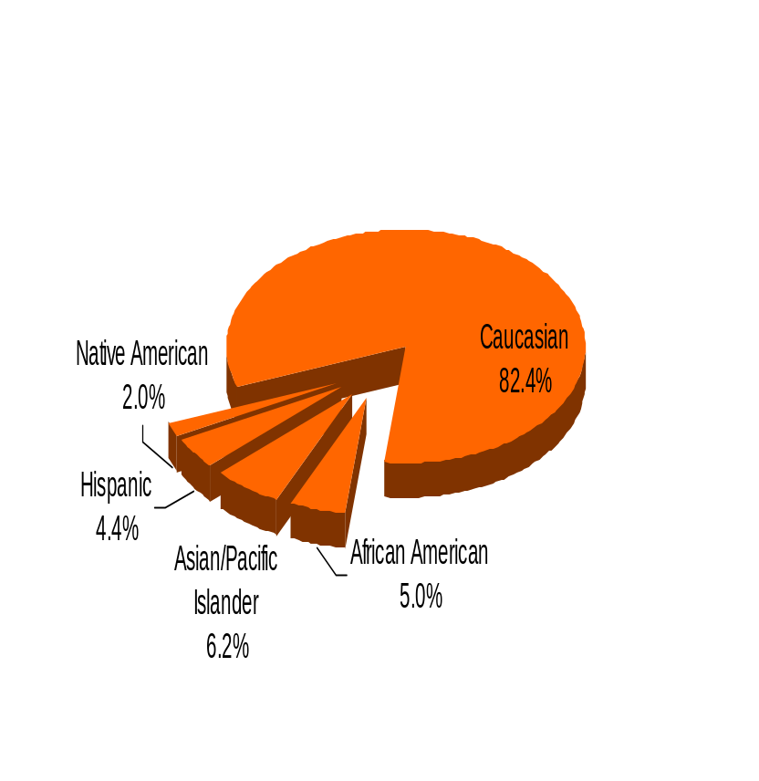
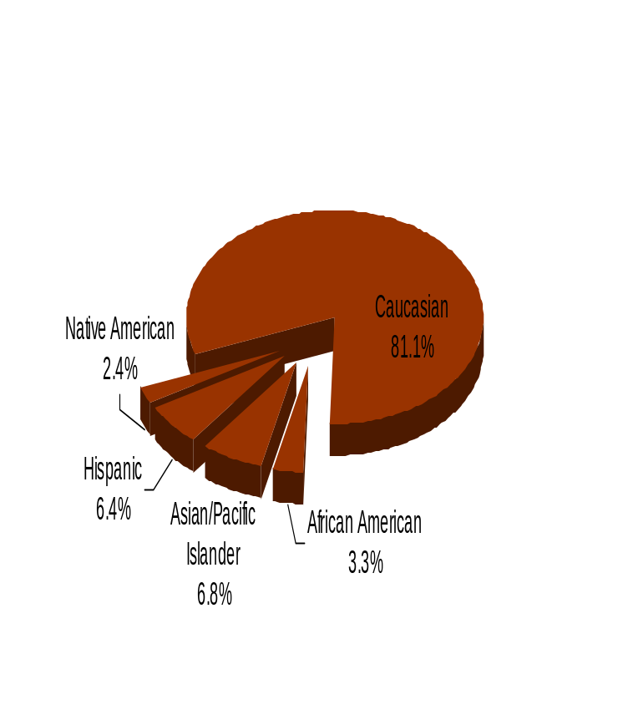
Ultimate Outcomes | continued
HR Management Report category:
Ultimate Outcomes - Slide 3 of 3
Workforce Diversity
Department of Printing
Diversity Profile Printing State
Women 41.7% 52%
Persons with disabilities 1.5% 5%
Vietnam Veterans 1.5% 7%
Disabled Veterans 0% 2%
Persons over 40 56.8% 76%
People of color 17.4% 17.5%
WA State Government
WA Labor Force
Source: DOP Data Warehouse

