Slide 1

Human Resource Management Report
[October 16, 2006]

Slide 2
Logic Model
Managers Accountability for Workforce Management
Plan & Align Workforce
Hire
Workforce
Deploy
Workforce
Develop Workforce
Reinforce Performance
Articulation of managers HRM accountabilities. HR policies. Workforce planning. Job classes & salaries assigned.
Qualified candidate pools, interviews & reference checks. Job offers. Appts & per-
formance monitoring.
Work assignments& requirements defined. Positive workplace environment created. Coaching, feedback, corrections.
Individual development plans. Time/ resources for training. Continuous learning environment created.
Clear performance expectations linked to orgn’al goals & measures. Regular performance appraisals. Recognition. Discipline.
Staffing levels & competencies aligned with agency priorities. Mgr’s HRM accountabilities are understood.
Best candidate hired & reviewed during appointment period. Successful performers retained.
Workplace is safe, gives capacity to perform, & fosters productive relations. Staff know job rqmts, how they’re doing, & are supported.
Learning environment created. Employees are engaged in develop-
ment opportunities & seek to learn.
Employees know how performance contributes to success of orgn. Strong performance rewarded; poor performance eliminated
Foundation is in place to build and sustain a productive, high performing workforce.
The right people are in the right job at the right time.
Time & talent is used effectively. Employees are motivated & productive.
Employees have competencies for present job & career advancement
Successful performance is differentiated & strengthened. Employees are held accountable.
State government has workforce depth & breadth needed for present and future success
Employees are committed to the work they do & the goals of the organization
Productive, successful employees are retained
Agencies are better enabled to successfully carry out their mission. The citizens receive efficient government services.

Slide 3
Human Resource Management Report
Standard Performance Measures
Plan & Align Workforce
Percent current position/competencies descriptions
Percent supervisors with current performance expectations for workforce management
Time-to-fill funded vacancies
Percent satisfaction with candidate quality New Hire-to-Promotional ratio
Percent turnover during review period
Percent employees with current performance expectations
Employee survey ratings on “productive workplace” questions
Leave usage (sick, LWOP, unscheduled leave)
Overtime usage
Number & type of non-disciplinary grievances
Percent employees with current annual individual development plans
Employee survey ratings on “learning/development” questions
Percent current performance evaluations
Employee survey ratings on “performance accountability” questions
Number/type of disciplinary issues, actions, appeals disposition
Turnover rates and types (e.g., retirement, resignation, etc.)
Turnover rate of key occupational categories and of workforce diversity
Employee survey ratings on “commitment” questions
Hire Workforce
Measures to add in the future:
Current workforce plans that align staff with business priorities
Safety and Workers Compensation measures
Competency gap analysis measure
Recognition/reward measure
Others to be determined
Deploy Workforce
Develop Workforce
Reinforce Performance
Ultimate Outcomes

Slide 4
Overall foundation & management accountability system to build & sustain a high performing workforce
Plan & Align Workforce |
HR Management Report category:
Performance Measures
Percent current position/competency descriptions
Percent supervisors with current performance expectations for workforce management
Agency-wide Percent Current Position & Competency Descriptions
31.9%
Analysis:
Agency Core Competencies are being incorporated into PDFs as they are updated.
Need to continue working with agency managers to ensure position descriptions are being reviewed and completed.
The relationship between employee duties and agency mission and goals are clearly outlined.
Action Steps:
Continue to require and utilize updated position description forms on all recruitments.
Competencies utilized in the PDP process to identify expectations.
Work with Agency Management to ensure all Positions descriptions are reviewed and updated.
Notes:
Notes:
Plan & Align Workforce is the foundation for the remaining four key HRM functions.
Ideally, each agency should have a comprehensive workforce plan that aligns staffing levels and competencies with business priorities, and identifies strategies to close workforce gaps. Most agencies do not have a workforce plan (a key reason WA did not get an A on Grading of the States). A future action step is to institute workforce planning in the state.
Right now, as a starting point, managers need to know what their HRM responsibilities and performance expectations are. This includes an understanding of the master agreement provisions and new HR policies. Of the XX agencies with represented employees that responded to our inquiry, XX had trained the majority of their managers on those provisions.
Next, a management accountability system needs to be in place. At this point, our best measure is whether managers are receiving performance evaluations. However, what needs to happen is implementation of the Managers HRM Report Card, so that those measures are incorporated in the evaluations.

Slide 5
Overall foundation & management accountability system to build & sustain a high performing workforce
Plan & Align Workforce |
HR Management Report category:
Performance Measures
Percent current position/competency descriptions
Percent supervisors with current performance expectations for workforce management
Percent supervisors with current performance expectations for workforce management
46.8%
Analysis:
Transitioning all agency employees from the EDPP to the new PDP
Need to continue working with agency managers to ensure performance development plans are completed timely.
Action Steps:
Agency requiring use of new PDP form.
Training on-going for all supervisory staff regarding new PDP process
Make training available and accessible to agency non-supervisor staff.
Make PDP guide accessible to all agency staff via the intra-net.
Notify at divisional levels of evaluation due dates.
Notes:
Notes:
Plan & Align Workforce is the foundation for the remaining four key HRM functions.
Ideally, each agency should have a comprehensive workforce plan that aligns staffing levels and competencies with business priorities, and identifies strategies to close workforce gaps. Most agencies do not have a workforce plan (a key reason WA did not get an A on Grading of the States). A future action step is to institute workforce planning in the state.
Right now, as a starting point, managers need to know what their HRM responsibilities and performance expectations are. This includes an understanding of the master agreement provisions and new HR policies. Of the XX agencies with represented employees that responded to our inquiry, XX had trained the majority of their managers on those provisions.
Next, a management accountability system needs to be in place. At this point, our best measure is whether managers are receiving performance evaluations. However, what needs to happen is implementation of the Managers HRM Report Card, so that those measures are incorporated in the evaluations.

Slide 6
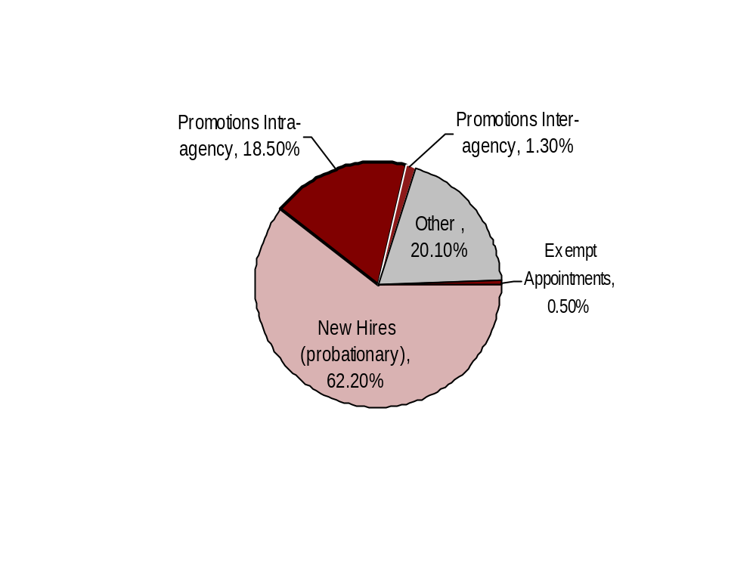

Hire Workforce |
HR Management Report category:
Right People in the Right Job at the Right Time
Performance Measures
Days to fill vacancies
% satisfaction with candidate quality
% new hires; % promotional hires
% separation during review period
Analysis:
Separations during review periods is 13% of total hiring.
The majority of the hiring was from OC candidates.
Hiring for FY06 was impacted by the transition of intermittent retail staff to permanent status per CBA.
Hiring Balance - FY 2006
Total of 384 appointments
Days to Fill Vacancies
This data will be reported by agencies to DOP in April 2007
Action Steps:
Continue to build capacity to reduce percentage of involuntary separations.
Continue to require reference checks and background checks on all potential hires permanent and/or non-permanent.
Candidate Quality
(managers’ satisfaction rating)
Separation during Review Period
This data will be reported by agencies to DOP in April 2007
*
0.0%*
* Released
** Voluntary
**
Other = transfers, demotions, reassignments, movement in lieu of RIF, etc.
Notes:
Notes:

Slide 7
Deploy Workforce |
HR Management Report category:
Employee time and talent is used effectively. Employees motivated.
Performance Measures
Percent employees with current performance expectations
Employee survey ratings on “productive workplace” questions
Overtime usage
Sick leave usage Number & type of non-disciplinary grievances and disposition
Percent employees with current performance expectations
58.1%
Analysis:
Transitioning all agency employees from the EDPP to the new PDP
Need to continue working with agency managers to ensure performance development plans are completed timely.
Action Steps:
Continue to work with agency management to ensure all Performance evaluations are up-to-date and include performance expectations.
Provide training profiles to assist in the development of training plans for employees.
Ensure development of notification and tracking system.

Slide 8
Deploy Workforce |
HR Management Report category:
Employee time and talent is used effectively. Employees motivated.
Do employees have the day-to-day support
needed to enable successful job performance?
Performance Measures
Percent employees with current performance expectations
Employee survey ratings on “productive workplace” questions
Overtime usage
Sick leave usage Number & type of non-disciplinary grievances and disposition
Q4. I know what is expected of me at work. (4.3)
Q1. I have opportunity to give input on decisions affecting my work. (3.4)
Q2. I receive the information I need to do my job effectively. (3.7)
Q6. I have the tools and resources I need to do my job effectively. (3.6)
Q7. My supervisor treats me with dignity and respect. (4.1)
Q8. My supervisor gives me ongoing feedback that helps me improve
my performance. (3.7)
Q9. I receive recognition for a job well done. (3.3)
Overall average score for “productive workplace” questions is 3.8
Never
Usually
Seldom
Always
Occasionally
Analysis:
Staff know what is expected from them.
The employees do not feel they have the opportunity to provide input on decisions impacting their work.
Most staff believe they have the tools to do their job.
Employees feel feedback is provided - They are treated with dignity and respect.
Recognition could be improved
Action Steps:
PDP should ensure employees know what is expected and can plan their training to ensure they have the skills and tools.
Agency recognition group to be developed.
Recognition policy put into effect.
Develop a communication plan to roll our survey results to all agency staff.

Slide 9
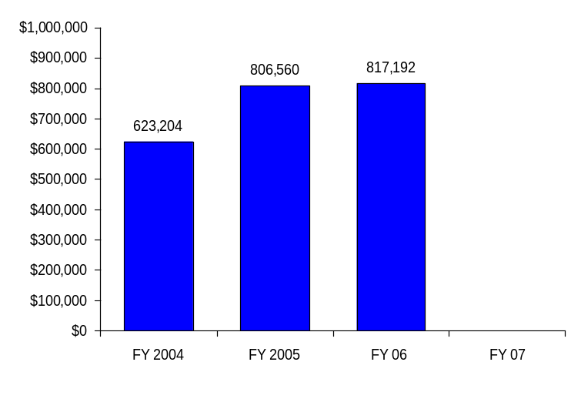
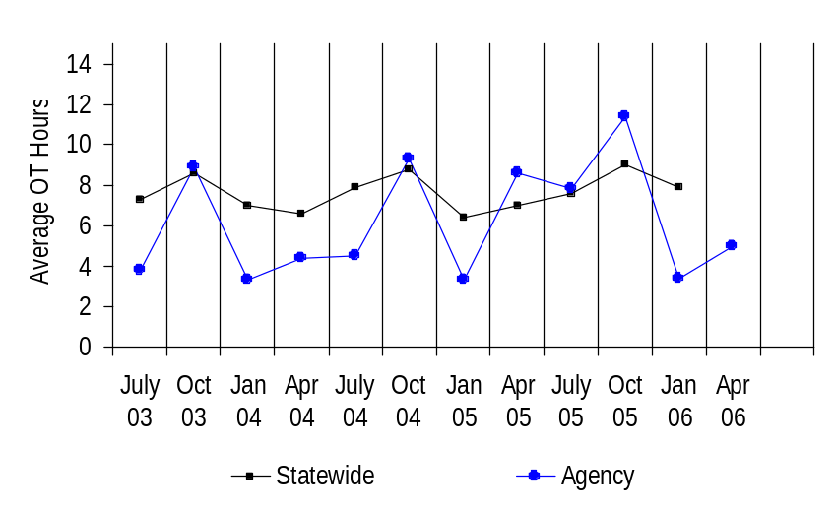
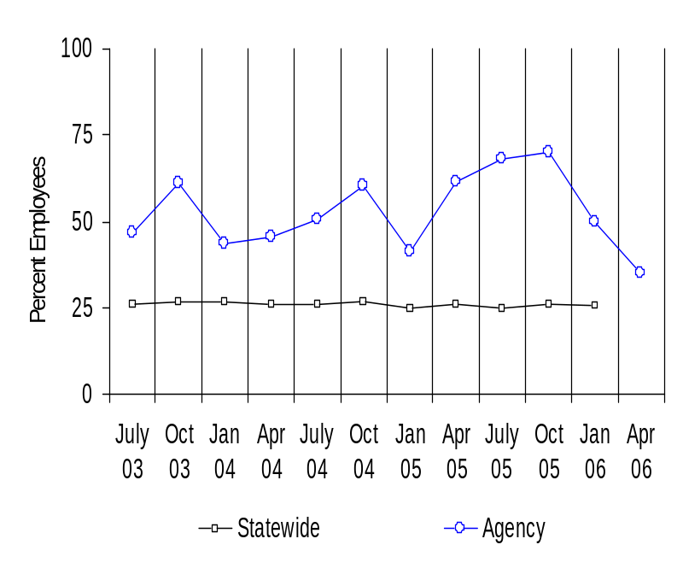
Deploy Workforce |
HR Management Report category:
Employee time and talent is used effectively. Employees motivated.
Performance Measures
Percent employees with current performance expectations
Employee survey ratings on “productive workplace” questions
Overtime usage
Sick leave usage
Number & type of non-disciplinary grievances and disposition
Agency Overtime Costs
Analysis/Action Steps:
Overtime peaks at the end of the 3rd quarter each year.
Percentage of LCB employees receiving OT is significantly higher than the state average.
Retail division and Distribution center impacts overtime during peak season (Oct-Dec).
Overtime costs were impacted by the transition of intermittent retail staff to permanent status per CBA in 2005.
Average Overtime Hours (per capita)
Percent Employees Getting Overtime

Slide 10
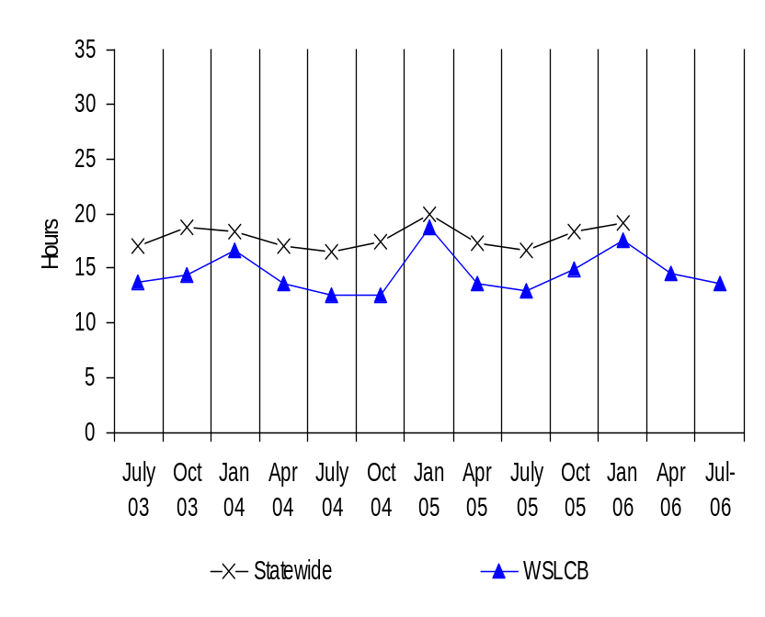
Deploy Workforce |
HR Management Report category:
Employee time and talent is used effectively. Employees motivated.
Performance Measures
Percent employees with current performance expectations
Employee survey ratings on “productive workplace” questions
Overtime usage
Sick leave usage
Number & type of non-disciplinary grievances and disposition
Average Sick Leave Use
(per capita)
Analysis, HR will:
Work with Divisions to assess need & frequency of providing sick leave usage data.
Review Leave usage to determine potential patterns of leave abuse.
Continue to collect and review on a monthly basis to determine if any trends or patterns appear.
Action Steps, HR will:
Provide case-by-case assistance to managers regarding leave abuse issues.
Per Capita Sick Leave Use
Just Those Who Took Sick Leave
Ave. Sick Leave Hours Used per Qtr*
% of Earned Sick Leave
Ave. Sick Leave Hours Used per Qtr*
% of Earned Sick Leave
Statewide
17.9
hours
74%
22.9
hours
95%
WSLCB
15.8
hours
77%**
23.3
hours
114%**
* Average since July 03 ** % of Earned Sick Leave Used is affected by ~50% part-time employees who earn less sick leave per mo.

Slide 11
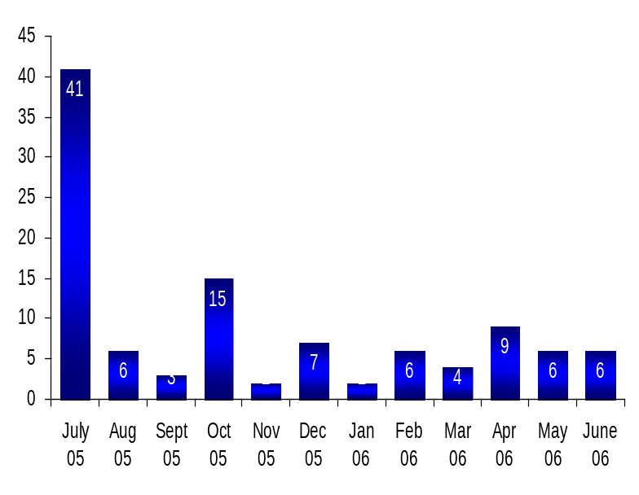
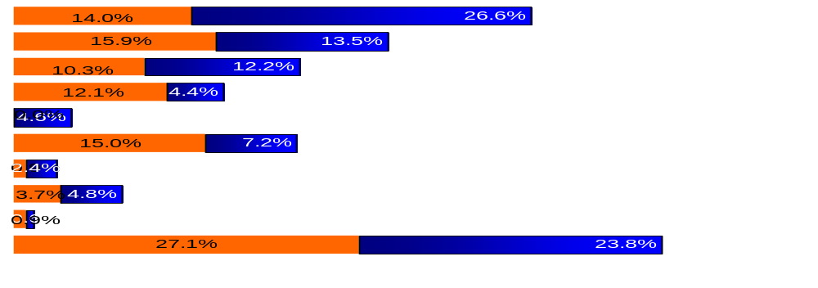
Deploy Workforce |
HR Management Report category:
Employee time and talent is used effectively. Employees motivated.
Performance Measures
Percent employees with current performance expectations
Employee survey ratings on “productive workplace” questions
Overtime usage
Sick leave usage
Number & type of non-disciplinary grievances and disposition
Number of Grievances
Grievance Disposition
Grievances:
Disciplinary 15 - Open 4 Closed 11 (1 in Arbitration)
Compensation 17 - Open 1 Closed 16 (1 in Arbitration)
Overtime 11 - Open 10Closed 1 (10 cases consolidated to 1 in Arbitration)
Work Hours 13 - Open 0 Closed 13
Leave 16 - Open 1 Closed 15 (1 in
Arbitration)
Hiring/Appts 1 - Open 0 Closed 1
Non-Discrimination 4 - Open 2 Closed 2
Management Rights 1 - Open 1 Closed 0
3
2
2
Type of Grievances (July 05 – May 06)
Discipline
Compensation
Overtime
Work Hours
Bid System
Leave
Hiring/Appts
Non-discrimination
Management Rights
All other
LCB
All Other Agencies

Slide 12
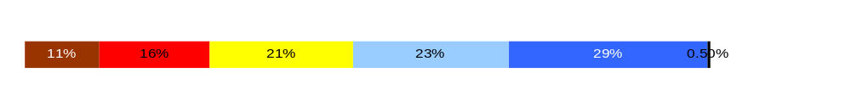
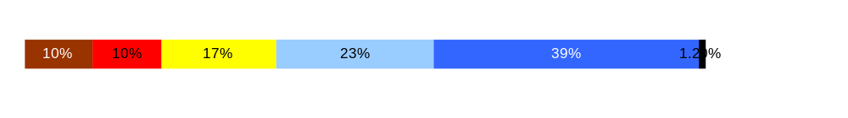
Employees have competencies for present job and future advancement
Develop Workforce |
HR Management Report category:
Performance Measures
Percent employees with current annual individual development plans
Employee survey ratings on “learning & development” questions
Percent employees with current Individual Development Plans
58.1%
Employee perceptions on
learning and development
Q5. I have opportunities at work to learn and grow. (3.4)
Q8. My supervisor gives me ongoing feedback that helps me improve
my performance. (3.7)
Overall average score for “Learning & Development” questions is 3.6.
Never
Seldom
Occasionally
Usually
Always
Analysis:
More training will continue to be provided
Regularly scheduled staff meetings.
Yearly Performance Development Plans should provide more detail.
Action Steps:
Annual performance development plans will address training needs and annual feedback.
94%
Notes:
Notes:

Slide 13
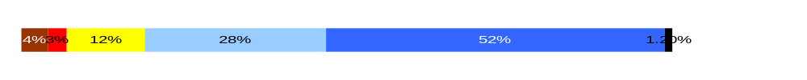
Successful performance is differentiated & strengthened. Employees are held accountable.
Reinforce Performance |
HR Management Report category:
Performance Measures
Percent employees and managers with current annual performance evaluations
Employee survey ratings on “performance and accountability” questions
Number and type of disciplinary issues, actions, appeals disposition
Percent employees with current performance evaluations 58.1%
Do employees see a meaningful linkage between their performance and the success of the organization?
Q3. I know how my work contributes to the goals of my agency. (4.0)
Q10. My performance evaluation provides me with meaningful information about my performance. (3.5)
Q11. My supervisor holds me and my co-workers accountable for performance. (4.2)
Q9. I receive recognition for a job well done (3.3)
Overall average score for “performance & accountability” questions is 3.8.
Never
Seldom
Occasionally
Usually
Always
Analysis:
More information needs to be shared on a regular basis.
Performance Development Plan should provide more meaningful information.
Accountability could be improved.
Recognition should be reviewed.
Action Steps:
Monthly LCB Updates
Open Forum with the Board.
Recognition team to be established.

Slide 14
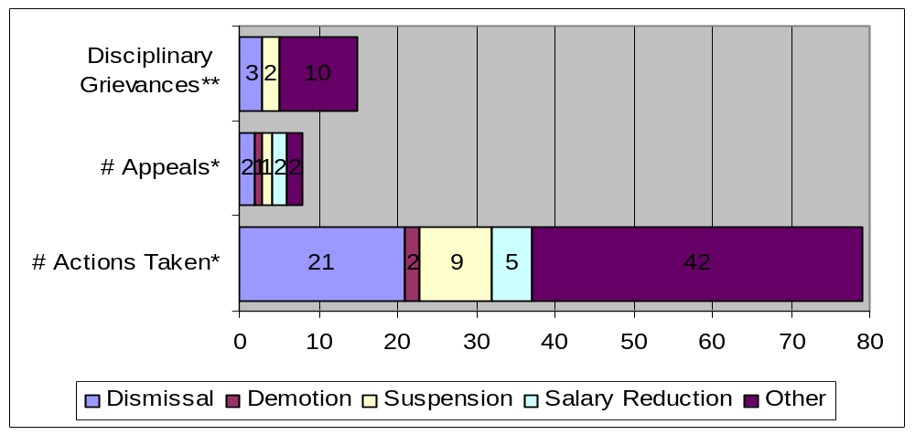
Successful performance is differentiated & strengthened. Employees are held accountable.
Reinforce Performance |
HR Management Report category:
Formal Disciplinary Actions, Appeals, Grievances FY 2006 (July 1, 2005- June 30, 2006)
Analysis:
Agency has a high workload of disciplinary cases.
Only 16% of Disciplinary actions taken have been grieved.
Performance Measures
Percent employees and managers with current annual performance evaluations
Employee survey ratings on “performance and accountability” questions
Number and type of disciplinary issues, actions, appeals disposition
Action Steps:
1. Completed and timely investigation and follow through.
2. Hire additional staff.
3. Leadership & Performance Management training such as Ethics, Sexual Harassment, Drug Free work place.
4. HR policy Development & Training on HR practices.
* Non-represented employees ** Represented employees
The above totals do not include 36 additional cases/investigations that did not result in “FORMAL” disciplinary action.
Issues Leading to Disciplinary Action
Misconduct
Theft (time, product, etc.,)
Misuse of state resources.
Impaired at work.
Sale to Minor.
Inappropriate comments.
Sexual Harassment
Absenteeism
Other
Disposition of Disciplinary-related Grievances or Appeals
Grievances:
Disciplinary 15 Open 4 Closed 11 (1 in Arbitration)
Compensation 17 Open 1 Closed 16 (1 in Arbitration)
Overtime 11 Open 10Closed 1 (10 cases consolidated to 1 in Arbitration)
Work Hours 13 Open 0 Closed 13
Leave 16 Open 1 Closed 15 (1 in Arbitration)
Hiring/Appts 1 Open 0 Closed 1
Non-Discrimination 4 Open 2 Closed 2
Management Rights 1 Open 1 Closed 0
Appeals:

Slide 15
Ultimate Outcomes
HR Management Report category:
State has workforce breadth & depth for present & future success.
Employees are committed to the work they do and the goals of the organization.
Successful, productive employees are retained.
Performance Measures
Employee survey ratings on “commitment” questions
Turnover rates and types (e.g., retirement, resignation, etc.)
Turnover rate of key occupational categories - TBD
Diversity profile [& turnover TBD]
Indicators of Employee Commitment
Q3. I know how my job contributes to the goals of my agency. (4.0)
Q12. I know how my agency measures its success. (3.1)
Q9. I receive recognition for a job well done (3.3)
Never
Seldom
Occasionally
Usually
Always
Overall average score for “performance & accountability” questions is 3.5.
Analysis:
Employees understand goals of the agency.
Information regarding agency success should be shared.
Recognition to be reviewed.
Action Steps:
Monthly Updates
Open Forum with the Board.
Recognition Committee to be established.
Focus on communicating to employees how agency measures success.
Notes:
Notes:

Slide 16
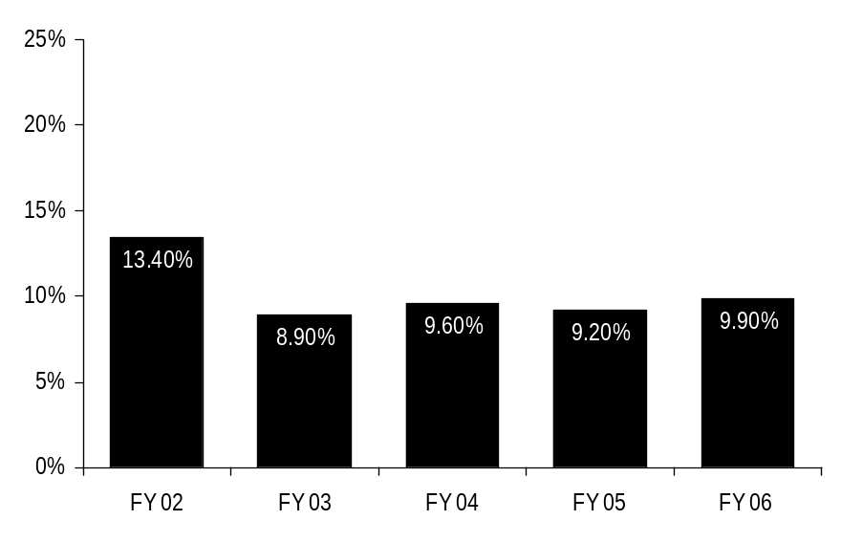
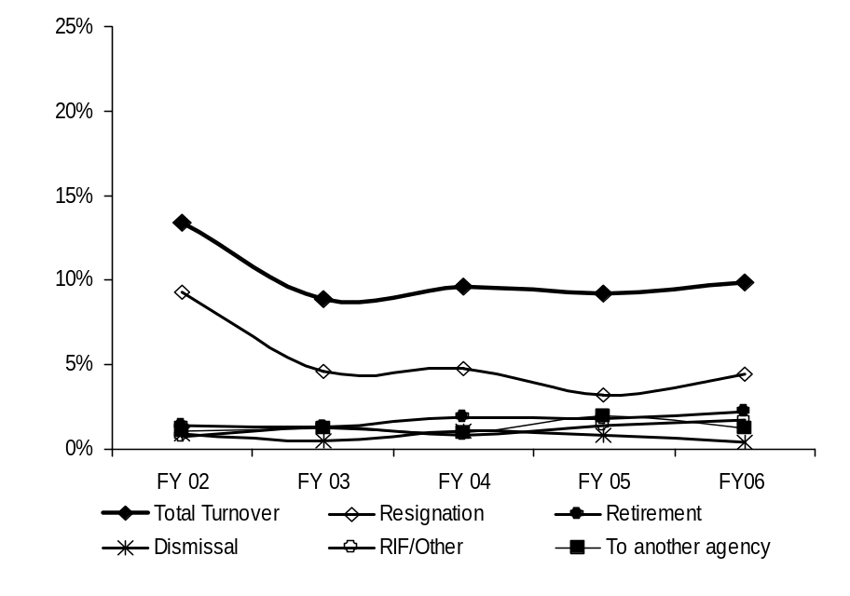
Ultimate Outcomes | continued
HR Management Report category:
Performance Measures
Employee survey ratings on “commitment” questions
Turnover rates and types (e.g., retirement, resignation, etc.)
Turnover rate of key occupational categories - TBD
Diversity profile [& turnover TBD]
Agency-wide Turnover
[leaving agency]
Analysis:
Agency turnover has remained relatively stable over the last 4 years.
Action Steps:
Currently developing agency workforce/succession plan to prepare for anticipated retirements.
Develop and utilize Exit Interviews to obtain feedback from employees regarding resignations
Assess turnover data to determine potential issues or areas of concern within agency.
Review data at division level to identify trends and develop action plans.
Agency Workforce Turnover Breakdown
Notes:
Notes:
Trend Factors:
HRISD – Project ending – if current trend continues = 8% by end of FY06
DIR – Change in leadership – if current trend continues = 7% by end of FY06
CERS & PSD - Reorganized – if current trend continues = 4% by end of FY06
ASD Stable and low rate – if current trend continues = .33% by end of FY06
OEDS – Stable and low rate – if current trend continues = 1.5% by end of FY06

Slide 17
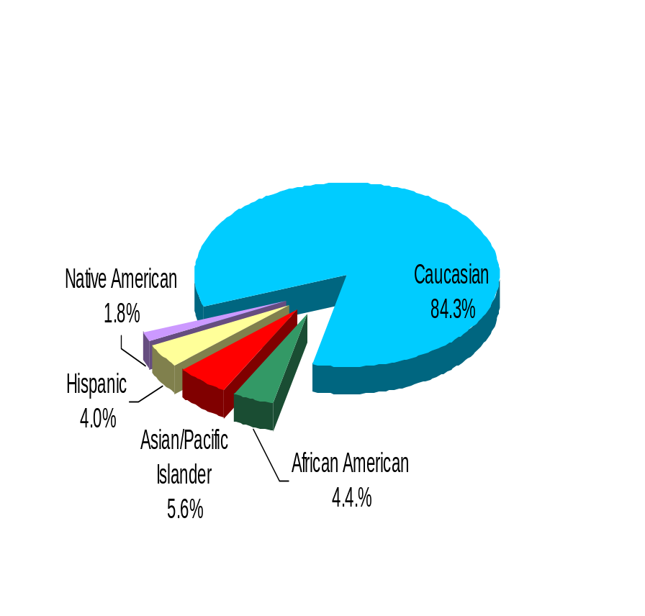
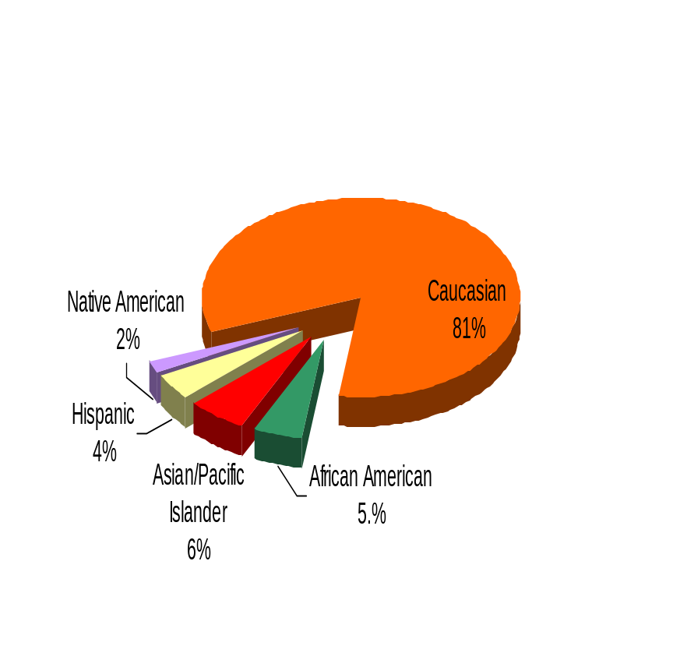
Ultimate Outcomes | continued
HR Management Report category:
Performance Measures
Employee survey ratings on “commitment” questions
Turnover rates and types (e.g., retirement, resignation, etc.)
Turnover rate of key occupational categories - TBD
Diversity profile [& turnover TBD]
Liquor Control Board
Diversity Profile [Agency] State
Women 54.0% 52.0%
Persons with disabilities 2.6% 5.0%
Vietnam Veterans 6.4% 7.0%
Disabled Veterans 3.2% 2.0%
Persons over 40 69.8% 76.0%
People of color 15.8% 17.5%
WA State Government
Notes:
The agency is lower than the state average in all areas except “women” and “Disabled Veterans”.
The LCB has taken steps to increase recruitment efforts and to ensure applicant pool is more diverse.
Category “Persons with Disabilities” has the greatest difference between the agency & statewide averages and will be an area of focus for the agency.
Notes:
Notes:
Trend Factors:
HRISD – Project ending – if current trend continues = 8% by end of FY06
DIR – Change in leadership – if current trend continues = 7% by end of FY06
CERS & PSD - Reorganized – if current trend continues = 4% by end of FY06
ASD Stable and low rate – if current trend continues = .33% by end of FY06
OEDS – Stable and low rate – if current trend continues = 1.5% by end of FY06

