Slide 1
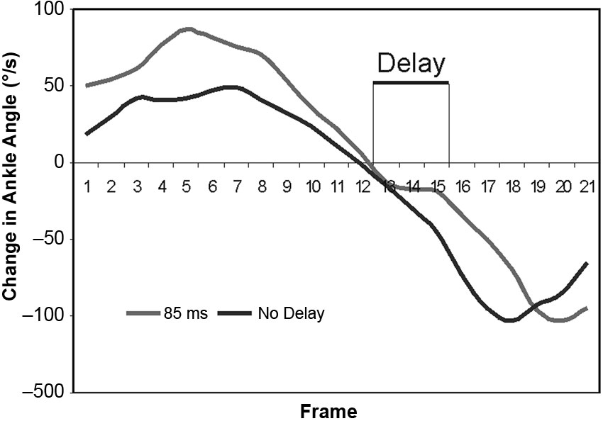

Figure 6. Plot of differential of ankle flexion with respect to frame number (hence time) for Subject 1. Shown is No Delay and 85 ms delay, with region of low change in flexion that reflects delay of release of ankle.
Mitchell M, Craig K, Kyberd P, Biden E, Bush G. Design and development of ankle-foot prosthesis with delayed release of plantarflexion. J Rehabil Res Dev. 2013;50(3): 409–22.
http://dx.doi.org/10.1682/JRRD.2011.06.0107
Notes:
Figure 6. Plot of differential of ankle flexion with respect to frame number (hence time) for Subject 1. Shown is No Delay and 85 ms delay, with region of low change in flexion that reflects delay of release of ankle.

