Slide 1
Madden/Julian Oscillation: Recent Evolution, Current Status and Forecasts
Update prepared by
Climate Prediction Center / NCEP
March 15, 2005

Slide 2
Outline
Overview
Recent Evolution and Current Conditions
Madden Julian Oscillation Forecast
Summary

Slide 3
Overview
MJO activity during June-October and December 2004-January 2005 resulted in significant variability in the atmosphere (wind, pressure) and Pacific Ocean (surface and subsurface temperature).
This activity was associated with periods of significant weakening of the low-level easterly winds over the equatorial Pacific and was related to the initiation of eastward-propagating oceanic Kelvin waves.
Westerlies associated with the quasi-stationary area of enhanced convection near the date line initiated a strong Kelvin wave during late January 2005. Warming of the eastern tropical Pacific waters is expected over the next several weeks.
Statistical model forecasts indicate that MJO activity will remain weak over the next 6-10 day period, however a more organized MJO pattern may be in it’s formative stages.

Slide 4
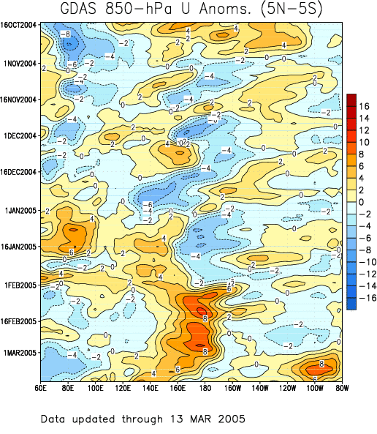
Low-level (850-hPa) Zonal (east-west) Wind Anomalies (m s⁻¹)
Weaker-than-average easterlies (orange/red shading).
Stronger-than-average easterlies (blue shading).
Westerly anomalies, which developed over the western equatorial Pacific in early January, expanded eastward through the end of the month and persisted through February. During the last two weeks, the westerly anomalies have weakened in the vicinity of the Date Line.
The westerly anomalies which have developed over the eastern equatorial Pacific during the first week of March are already weakening.
Time
Longitude

Slide 5
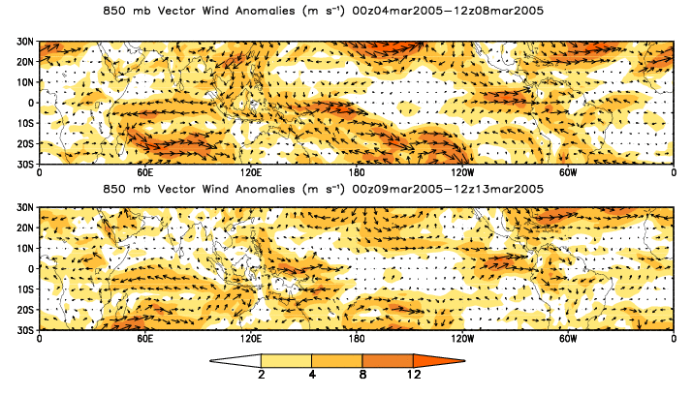
850-hPa Vector Wind Anomalies (m s⁻¹)
Note that shading denotes the magnitude of the anomalous wind vectors.
The westerly anomalies in the vicinity of the date line are weakening.

Slide 6
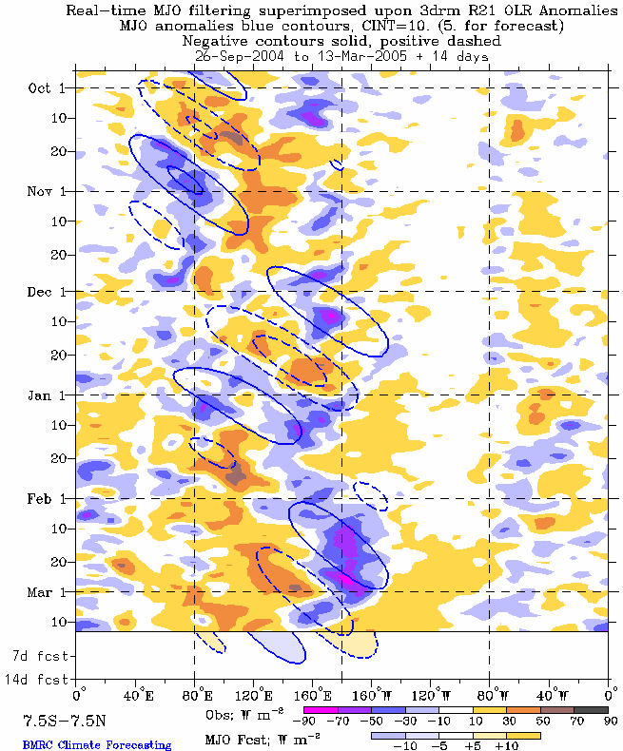
Outgoing Longwave Radiation (OLR) Anomalies (7.5°S-7.5°N)
Drier-than-average conditions (orange/red shading)
Wetter-than-average conditions (blue shading)
Time
The eastward propagation of the positive/negative anomaly dipole over the Indian Ocean and Indonesia (late December 2004-early January 2005) was associated with the MJO.
Enhanced convection became persistent in the region of the anomalously warm water near the date line during February, but has weakened during early March.
Longitude

Slide 7
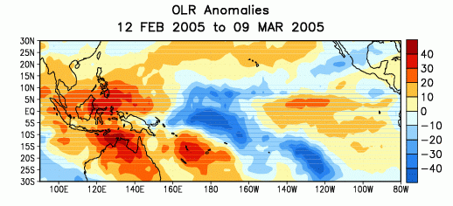
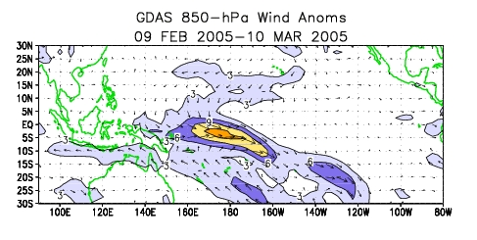
Anomalous OLR and 850-hPa Wind: last 30 days
Negative OLR anomalies (above-average rainfall) have persisted over the central equatorial Pacific and along the South Pacific Convergence Zone during the last 30 days. Positive OLR anomalies (below-average rainfall) persisted over Indonesia and Australia. These features are consistent with the positive SST departures in the central eq. Pacific, and have been weakening over the past few weeks.
Low-level (850-hPa) westerly wind anomalies have persisted over the central equatorial Pacific during the last 30 days. A series of tropical cyclones, which developed over low-latitudes in the Southern Hemisphere, affected some of the islands in the South Pacific

Slide 8
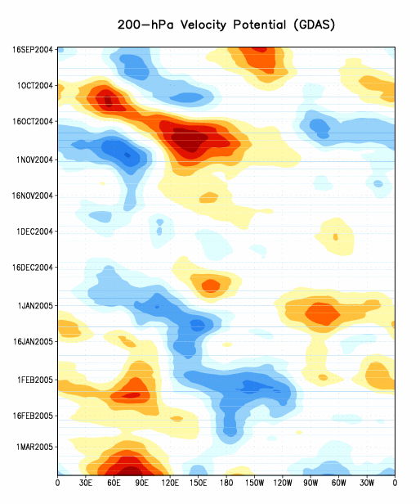
200-hPa Velocity Potential Anomalies
Positive anomalies (orange/red shading) indicate unfavorable conditions for precipitation.
Negative anomalies (blue shading) indicate favorable conditions for precipitation.
The eastward propagation of negative anomalies over the Indian ocean and positive anomalies over Indonesia and the Pacific during December/early January was associated with the MJO.
A more stationary pattern developed during February.
An area of positive anomalies has developed over East Africa and the Indian Ocean.
Time
Longitude

Slide 9
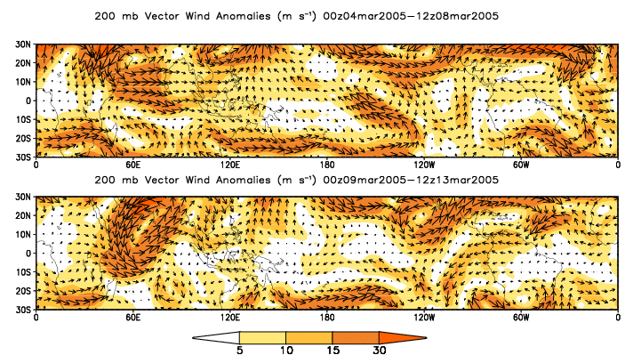
200-hPa Vector Winds and Anomalies (m s⁻¹)
Note that shading denotes the magnitude of the anomalous wind vectors.

Slide 10
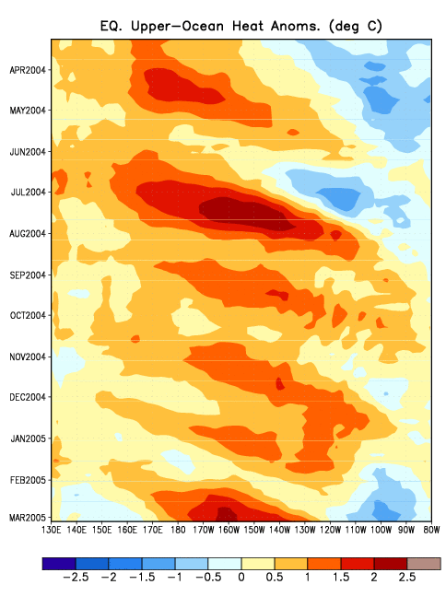
Heat Content Evolution in the Eq. Pacific
Through 2004 there were several cases of eastward-propagating oceanic Kelvin waves (indicated by dashed black lines in the figure).
Each Kelvin wave was initiated when the easterlies weakened over the equatorial Pacific in association with Madden-Julian Oscillation (MJO) activity.
Between August 2004 and January 2005 Kelvin wave activity weakened and the average heat content (0-300 m) decreased.
During February-early March 2005, a stronger Kelvin wave developed.
Time
Longitude

Slide 11
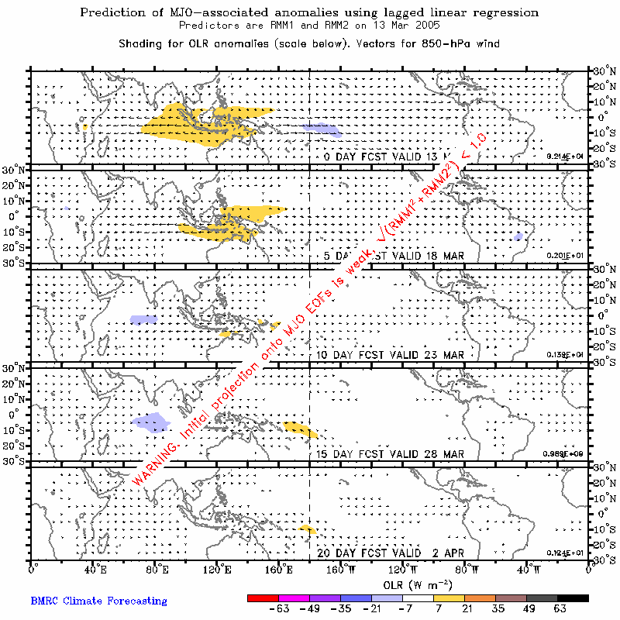
Empirical Forecast Based on the Real-time Multivariate MJO index
MJO activity is forecasted to be weak over the next 6-10 day period.

Slide 12
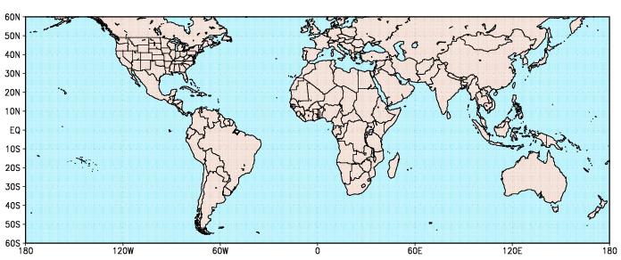
Potential Global Impacts
Heavy rains over portions of sub-Saharan Africa (3-10 days)
Enhanced risk of tropical cyclones during week 2

Slide 13
Summary
MJO activity during June-October and December 2004-January 2005 resulted in significant variability in the atmosphere (wind, pressure) and Pacific Ocean (surface and subsurface temperature).
This activity was associated with periods of significant weakening of the low-level easterly winds over the equatorial Pacific and was related to the initiation of eastward-propagating oceanic Kelvin waves.
Westerlies associated with the quasi-stationary area of enhanced convection near the date line initiated a strong Kelvin wave during late January 2005. Warming of the eastern tropical Pacific waters is expected over the next several weeks.
Statistical model forecasts indicate that MJO activity will remain weak over the next 6-10 day period, however a more organized MJO pattern may be in it’s formative stages.

