Slide 1

Early Event Detection
Issues and Requirements
John W. Loonsk, M.D.
May 24th, 2004

Slide 2
Early Event Detection
Issues and Requirements
Terminology and setting
Reporting Methodology Considerations
Data Considerations
Next steps

Slide 3
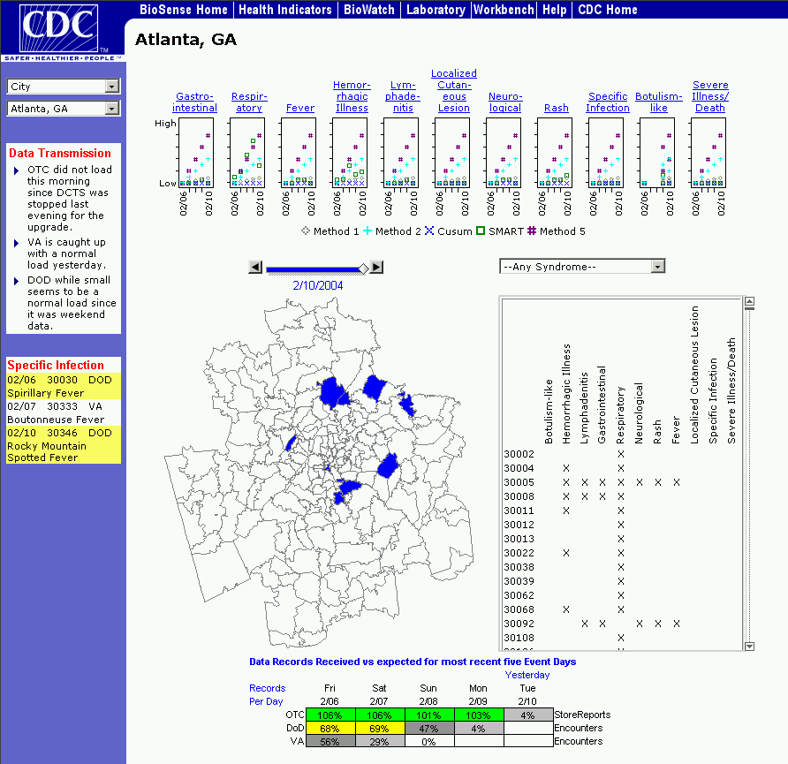
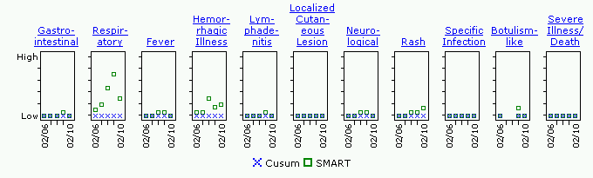
BioSense
BioSense is an initiative to enhance early detection, quantification and localization of possible bioterroism attacks and outbreaks.

Slide 4
BioSense - Setting
One of the new national bioterrorism initiatives:
  BioShield -rapid development of new vaccines and therapeutics
  BioWatch - deployment of environmental air samplers in key locations
  BioSense - early event detection through accessing and analyzing pre-existing diagnostic and pre-diagnostic health data
BioSense is a major part of the DHHS / DHS 2005 biosurveillance initiative. Integration point for human health “sector”
Bio-integration function – integration with intelligence data and other sectors (DHS)

Slide 5
“Early Event Detection”
Initial detection – find an event as early as possible
Quantification – how many people are ill?
Localization – where is it taking place?
Investigation – demographics, etiology, conveyance
Subsequent detection – identifying other possible cases, leading to…
Outbreak management – confirming true cases, tracking who was exposed
Countermeasure administration – prevention information, isolation, prophylaxis, vaccination
Target – minimizing morbidity and mortality of an event

Slide 6
All Hazards Detection and Response Data
BT
Attack
Hours
Days
Weeks
Early health seeking behaviors – OTC, absenteeism
Ambulatory care visits / Nurse call lines
Tertiary Care, morbidity and mortality (traditional)
Initial detection
Subsequent detection, quantification, localization
Outbreak management, contact tracing, case confirm
Countermeasure admin, isolation, prophylaxis, Rx

Slide 7
Public Health Information Network - Setting
Early Event Detection
BioSense
  Outbreak Management Outbreak Management System
  Connecting with Laboratory Systems
  lab result reporting
Surveillance
NEDSS
Communications & Alerting
Epi-X
Health Alerting
Analysis & Interpretation
BioIntelligence
analytic technology
Information Dissemination & Knowledge Management
CDC Website
Countermeasure & Response Administration isolation, vaccine, prophylaxis
Federal Health Architecture & Consolidated Health Informatics, NHII

Slide 8
Issues and Terminology
Reporting Methodology
  “Traditional” public health reporting
  Secondary use – “data mining”
Data Considerations
  “Electronic reporting” data
  “Syndromic” and early health seeking behavior data

Slide 9

Reporting Methodology:
“Traditional” Public Health
“Case Report”
Low capture rate
Not timely
Incomplete data about a report
If data available in “real time” – only at one level of public health
Can miss multi-jurisdictional issues
Difficult to make fully electronic
Case Report
Name: Jane
Age 46
Sex Female
Weight____
Height_____
Temp_____
Public Health Case
Reports

Slide 10
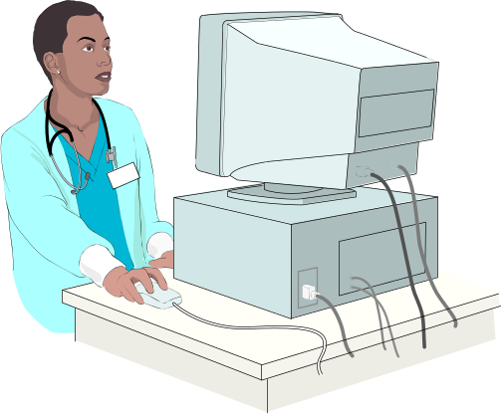
Reporting Methodology:
Secondary use data
No clinical reporting burden
Greatly increased percentage of “cases” reported
Data frequently available in multi-jurisdictional data stores
Algorithms for best identifying data anomalies still being refined
Needs for consistent infrastructure for authorized public health investigation
Diagnoses and Procedures from Clinical Care Sites

Slide 11
Secondary Use of Health Data
Use a bi-directional network for getting clinical data (rather than just data uploads)
Do not include patient names and medical record numbers in reported data. Enable appropriate public health investigation.
Reported data –
no names or
medical record numbers
Appropriate
Public Health
Investigation

Slide 12
Issues and Terminology
Data Considerations
  Electronic reporting data
    Public health case reports
    Clinical care diagnoses and lab results
  “Syndromic” and early health seeking behavior data
    Over the counter drug sales
    Chief complaints, clinical care procedures and lab requests
    Nurse call lines
    Absenteeism
    Etc.

Slide 13
“Electronic Reporting Data”
Many data are accumulated in multi-jurisdictional data stores
  difference in data flow
  for either data flow – difficulties in interfaces
Complement traditional reporting and physician as best bet “detector”
Data types are not as early as some of the “Syndromic” and early health seeking behavior data
Clearly useful for secondary detection, better reporting, quantification, localization, outbreak management

Slide 14
Other Data Sources
Consider procedures such as “lab requests” as “electronic reporting data”
  Lab requests connect to results
  Requests may have early indicator value
Free text chief complaints can be ICD coded
  Limited investment to implement
Rigorous evaluation of some “Syndromic” and early health seeking behavior data is needed

Slide 15

Reporting and Data Issues
Case Report
Name: Jane
Age 46
Sex Female
Weight____
Manually submitted
Notifiable disease case reports
Public Health Case
Reports
Clinical care diagnoses
Clinical laboratory test results
Diagnosis and Procedures from Clinical Care Sites
Over the counter drug sales
Nurse call line data
Other possible early event data
Pre-Diagnostic Data

Slide 16
Data Delivery – Draft
Initial metropolitan area will be constructed from involved zip codes regions
Process will be implemented for changing the metropolitan area delineation
Reported “health indicator” and environmental data for a metropolitan area will be delivered to each of the local jurisdictions involved in that metropolitan area
Some data, like lab results, may be addressed specifically to a local jurisdiction and may not go to other jurisdictions in that metropolitan area

Slide 17
Data Delivery - Draft
States will have simultaneous access to state “health indicator” data and environmental results
The CDC will have simultaneous access to national “health indicator” data and environmental results
A process will be established so that changes in data access can be requested and approved by the relevant jurisdiction
  Modification of metropolitan area delineation
  Inclusion of adjacent component metropolitan area data into a state’s data

Slide 18
Early Event Detection Considerations
Reported data should support more than initial detection over a common infrastructure
Use PHIN standards for integration / data exchange with outbreak management and countermeasure administration systems
Prioritize real-time delivery of health care data to public health (diagnostic and pre-diagnostic)
Many pre-diagnostic data sources still need to be rigorously evaluated

Slide 19
Early Event Detection Considerations
Consequence management is a major issue
Support comparative analysis and interpretation by public health professionals
Coordinate multiple data sources to facilitate signal evaluation, reduce false alarms and minimize end-user burden
Let public health professionals control alerting and notifications
Advance reporting but also query infrastructure for electronic investigation

Slide 20
Early Event Detection Considerations
Reported data will not include patient names or medical record numbers – but allow for appropriate follow-up with source provider
Data will be securely managed for public health use
Build on standards and investments
  Public Health Information Network (PHIN) and National Electronic Disease Surveillance System (NEDSS)
  Both are fully aligned with the standards identified by CHI and the NCVHS
  Will align with Federal Health Architecture as it develops

Slide 21
Plans for 2004 - 2005
Establish test bed(s) to fully evaluate “syndromic” and early health seeking behavior data sources
Use test beds for refining outbreak detection algorithms and visualization approaches
Further infrastructure for, and provisioning of, substantiated electronic reporting data
Implement standards for data exchange for all levels of public health
Advance consistent application of approaches that ensure confidentiality

