Slide 1
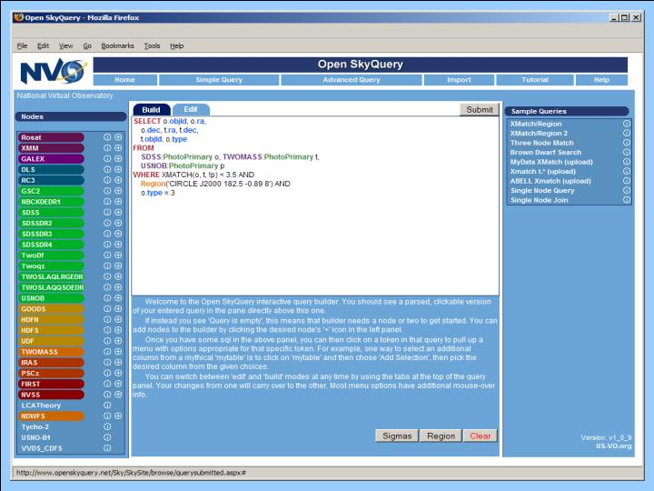
Large-Scale On Demand Cross-Match Engine
Project Summary
The NVO’s primary mission is to make distributed archives accessible and interoperable. This requires the ability to cross-match arbitrarily large areas from multiple archives on demand. We are leveraging the results from several previous AISRP projects (Open SkyQuery, CasJobs and zone-based data partitioning) to build a large scale (all-sky) cross-match engine. Key technologies will be parallel data access (partitioning), mega-streaming data transport, distributed VOSpaces and asynchronous workflow.
Ani Thakar, thakar@jhu.edu
Maria Nieto-Santisteban
Alex Szalay
The Johns Hopkins University
Robert Grossman,
David Hanley
National Center for Data Mining
University of Illinois, Chicago
Last Year’s Highlights
Zone-based data partitioning and cross-match benchmarks
Large Scale Cross-Match for LSST (talk at ADASS06)
Won Supercomputing 06 Bandwidth Challenge
Added Brown Dwarf EPO project
Plans for Next Year
Build CasJobs-based VOSpace with asynchronous workflow
Incorporate zone data partitioning and cross-match into Open SkyNodes
Test mega-streaming with UDT between SkyNodes
Impact on Science
Multi-wavelength science from multiple NASA and ground-based archives, e.g. NEO searches, searches for brown dwarfs and new classes of objects, statistical cosmology, starburst-AGN connection, AGN LF etc.
Develop large scale cross-matching technology critical for upcoming LSST and PAN-STARRS surveys.
Reduce time to publication of results from newly available digital archives.
Keywords: Virtual Observatory, Federated Query, Cross-Match
http://www.openskyquery.net/
NASA AISR 2006-09

