Slide 1
What Do Nurses Do When They Immunize Children?
Principal Investigator:
Thomas E. Stenvig, RN, MS, MPH, CNAA, Doctoral Candidate
Affiliation:
University of Wisconsin-Madison School of Nursing

Slide 2
Parents’ Vaccine Safety Concerns - A Continuum
Ordinary Unusual
Predictable Unpredictable
Momentary Intractable fear
Situational and distrust

Slide 3
The Questions:
List 3 things you do to reduce discomfort BEFORE immunizing a child
and
List 3 things you do to reduce discomfort AFTER immunizing a child
(Open-ended short answer format)

Slide 4
Previous studies:
French and colleagues (1994)
  Children taught to blow imaginary bubbles reported less pain and fewer pain behaviors than a control group
  Only 2% of parents have devised their own strategy to deal with pain from vaccinations
Source: French, G. M., Painter, E. C., & Coury, D. L. (1994). Blowing away shot pain: A technique for pain management during immunization. Pediatrics, 93, 384-388.

Slide 5
The Sample:
261 randomly selected nurses in South Dakota who immunize children
  LPNs, RNs, Advanced Practice Nurses
  Private and public sites including IHS, tribal

Slide 6
Results
Giving 4 or more shots on the same visit is distressful for kids, parents, and nurses
481 Before Interventions
555 After Interventions
5 categories of strategies
Similarities and differences

Slide 7
1. Pharmacological Agents:
Systemic oral acetaminophen or other NSAIDs;
Application of external numbing agents to the skin to reduce discomfort;

Slide 8
2. "TLC" (Tender Loving Care):
Physical contact and verbal communication to calm, emotionally support, comfort, or sooth the child;
Often included requests for parents or caregivers to hug or hold the child;

Slide 9
3. Distraction
Actions to divert attention away from the immediate experience of an injection;
Included singing, blowing bubbles, changing the interaction context, band-aids, giving food, stickers, toys, or other distracting objects to the child;

Slide 10
4. Specific Techniques:
Other specific non-pharmacologic strategies, such as:
- proper positioning, being prepared
- simultaneous administration of two vaccines by two nurses
- rubbing /not rubbing the injection site,
- application of warmth/ cold to reduce or minimize discomfort

Slide 11
5. Cognitive Strategies:
Verbal and non-verbal communication to prepare the parent or child mentally for the painful experience or elicit cooperation.
  Specific instructions about their participation
  Explanations about what to expect
  VIS, common side effects
  Minimization of the painful experience
  Information about home treatment
  Verbal praise and encouragement.

Slide 12
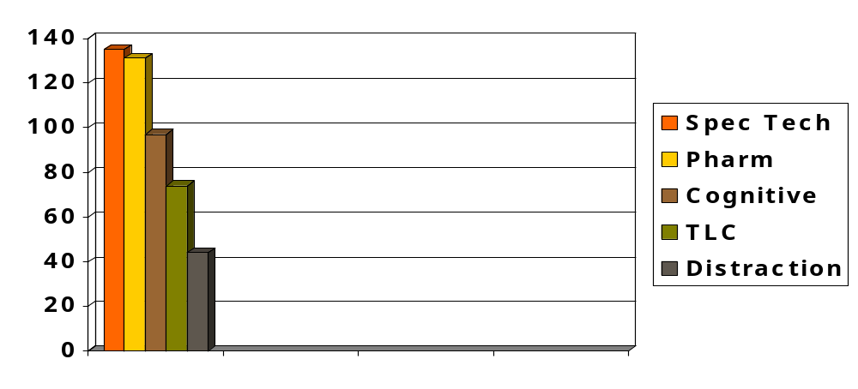
Frequency of 481 Interventions Before Vaccination

Slide 13
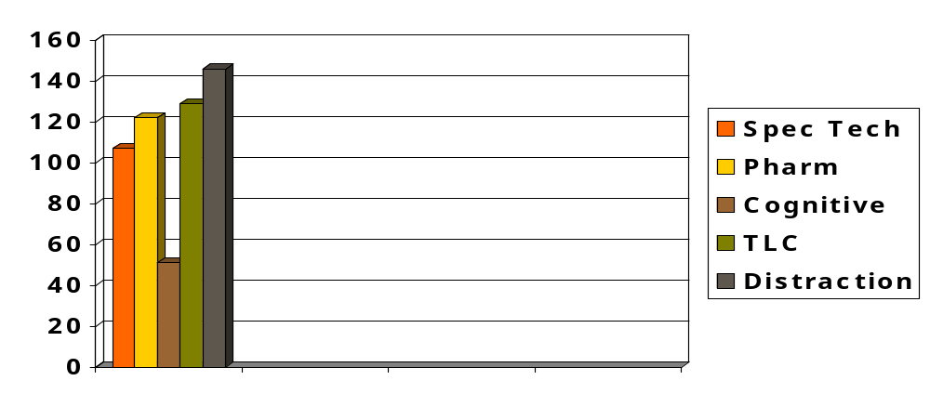
Frequency of 555 Interventions After Vaccination

Slide 14
Conclusions
Nurses use multiple strategies to relieve discomfort
Almost all nurses employ one or more strategies
One can assume behaving in a competent manner with regard to parents’ concerns may help alleviate their worries

Slide 15
Implications for Practice and Research
Both verbal and non-verbal communication and strategies are needed
Mismatch in parent’s/child’s needs and our communication mode problems
    Consider child’s age and parents’ needs
Can we be more “strategic” in communication strategies and appeals to cognition?
Research is needed on age-appropriate interventions that work

