Slide 1

NDA/PADAC Joint Meeting
April 22, 2002
Matthew R. Holman, Ph.D.
Interdisciplinary Scientist
FDA, CDER, Div. Of OTC Drug Products
1

Slide 2
OTC Issues: U.S. Regulations,
Foreign Marketing, and Label
Comprehension Study Results
2

Slide 3
Content
• U.S. regulations regarding OTC anti-histamines
• Foreign marketing of loratadine
• Summary of label comprehension study
3

Slide 4
OTC Drug Monograph Process
• Advance Notice of Proposed Rulemaking (ANPR)
Advisory Review Panel Report
• Tentative Final Monograph (TFM)
• Final Monograph (FM)
4

Slide 5
OTC Cold, Cough, Allergy, Bronchodilator, and Antiasthmatic Drug Products
ANPR (1976)
• Advisory Review Panel Report
– Does not mention CIU or hives
TFM for OTC Antihistamine Drug Products (1985)
• One comment requested hives indication
– No data submitted
– Panel did not review hives
5

Slide 6
Final Monograph for OTC Antihistamine Drug Products (1992)
• One comment recommended “symptomatic
treatment of allergic itching”
• One comment referenced data supporting relief of
itching skin caused by . . . hives
– Hives are component of anaphylactic reaction
– Average person cannot distinguish mild and
life-threatening condition with similar symptoms
– Cited reference states ideal urticaria treatment is removal of cause
6

Slide 7
Content
• U.S. regulations regarding OTC anti-histamines
• Foreign marketing of loratadine
• Summary of label comprehension study
7

Slide 8
Foreign Marketing of Loratadine
• Prescription required in 80 countries
• Prescription-free in 33 countries
– 29 countries allow hives indication
• 22 countries sell “behind-the-counter”
• 7 countries sell over-the-counter
Belgium, Canada, Germany, Ireland,
the Netherlands, Russia, and United Kingdom
8

Slide 9
Marketing of Loratadine
in Canada
• Marketed OTC since 1990
• OTC indications: allergic rhinitis and hives
9

Slide 10
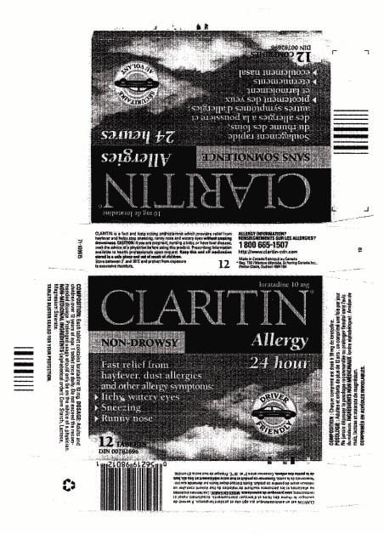
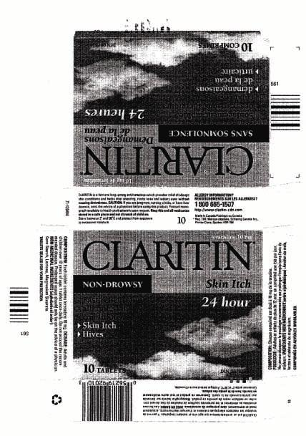
Sample Labels of Selected Loratadine Products in Canada
10

Slide 11
Marketing of Loratadine
in United Kingdom
• Marketed General Sales List (GSL) since December 2001;
previously Pharmacy (P) class
– GSL sales limited to 7 tablets
• OTC indications: allergic rhinitis and hives
• Cetirizine only other GSL oral antihistamine with hives
indication
11

Slide 12
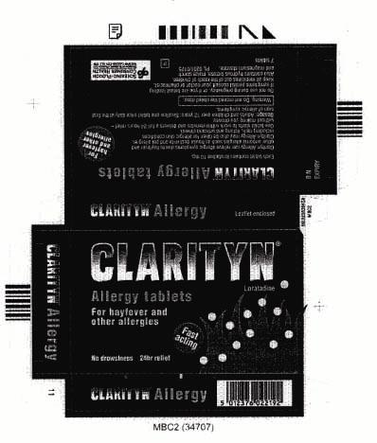
Sample Label of Selected Loratadine Product in United Kingdom
Clarityn Allergy may also be
taken for allergic skin
conditions including rash,
itching and urticaria (hives).
12

Slide 13
Summary of Sample Labeling Available from 19 Prescription-Free Countries
• chronic urticaria of unknown source: 1 country
• chronic urticaria and/or hives: 12 countries
• urticaria or hives: 3 countries
• allergic skin condition and urticaria: 3 countries
• “after being told by doctor”: 0 countries
50% of cartons do not list indication
13

Slide 14
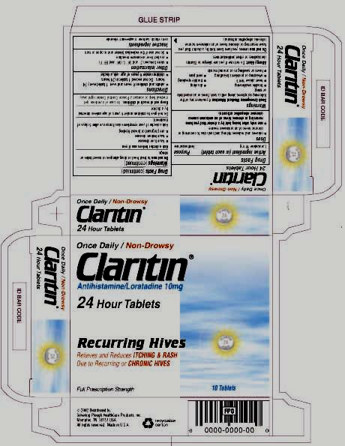
Loratadine Label (U.S.)
Proposed by Sponsor
Uses
• relieves and reduces itching and rash
due to recurring or chronic hives of
an unknown source.
• use only after being told by a doctor
that you have recurring or chronic
hives (chronic idiopathic urticaria).
14

Slide 15
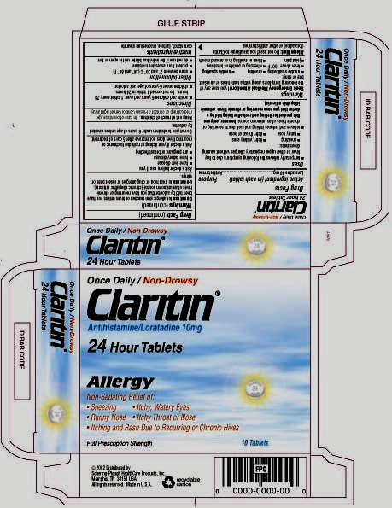
Loratadine Label (U.S.)
Proposed by Sponsor
Uses
• relieves and reduces itching and rash
due to recurring or chronic hives of an
unknown source; however, only use
this product for itching and rash
after being told by a doctor that you
have recurring or chronic hives
(chronic idiopathic urticaria).
15

Slide 16
Content
• U.S. regulations regarding OTC anti-histamines
• Foreign marketing of loratadine
• Summary of label comprehension study
16

Slide 17
CIU Self-Recognition and
Label Comprehension Study
565 subjects
• Cohort 1: self-recognized CIU sufferers (N=196)
• Cohort 2: general population (N=116)
• Cohort 3: low literacy (N=96)
• Cohort 4: pregnant/nursing, liver/kidney disease (N=114)
• Cohort 5: acute hives sufferers (N=102)
17

Slide 18
Label Comprehension Results
Based on the label, what is this product used for?
• 62% correct or acceptable response
– 79% incorrect responses mentioned hives
– Other incorrect responses: trouble
speaking/swallowing, drooling, food or
medication allergy, fever, breathing problems
18

Slide 19
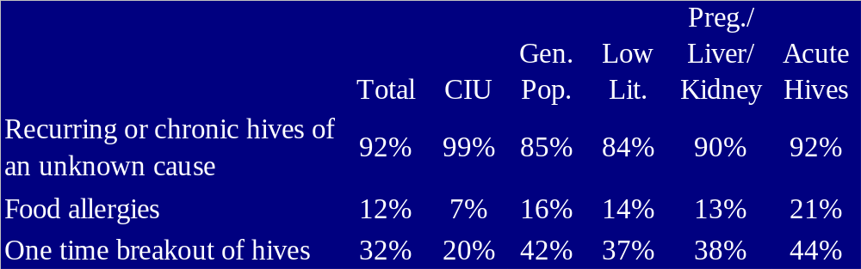
Label Comprehension Results
Is this product intended to be used for the
following conditions?
Recurring or chronic hives of
an unknown cause
92%
Food allergies
12%
21%
One time breakout of hives
32%
42%
37%
38%
42%
*Percentage represents those who believe product is used for listed indication.
19

Slide 20
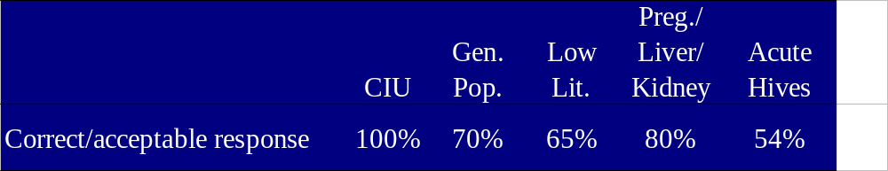
Self-Selection Results
Considering everything on the package label, is this product
intended for you, personally, to take home and start using?
20

Slide 21
Conclusion
• OTC oral antihistamines cannot be marketed
currently for hives or CIU under monograph system
• Foreign Market
– Chronic hives is the commonly labeled
indication
– Loratadine is typically marketed Rx or
“behind-the-counter”
• Consumers will use for all types of hives
21

