Slide 1

Beams Division Local Administrators Meeting
3/26/02
Brian Drendel

Slide 2
What will we talk about today?
Beams Division Updates - Brian Drendel
  Browse list
  Service Packs
  Win2k Migration
Guest Speaker – Al Lilianstrom

Slide 3
Browse List
WH12/13 computers and MW9 Computers were missing off of the browse list.
Problem: Management software requires that the computer be on the browse list.
Solution:
  Setup a master browser for 131.225.18.* and for 131.225.176.*
    HKLM\System\CurrentControlSet\Services\Browser\Parameters
      MaintainServerList = YES (Yes, No, or Auto)
      IsDomainMasterBrowser = TRUE (True or False)

Slide 4
Browse List: Desktops
Desktops:
  Each desktop should not be a master browser
    HKLM\System\CurrentControlSet\Services\Browser\Parameters
      MaintainServerList = No (Yes, No, or Auto)
      IsDomainMasterBrowser = TRUE (True or False) – usually ok
  Each desktop must
    HKLM\System\CurrentControlSet\Services\LanmanServer\Parameters\Hidden
      0 to unhide your workstation
      1 to hide your workstation
  Subnet masks must match that of the master browser to be on the browse list.

Slide 5
Browse List
Subnet | IP | WinNT/2K Mask | Default Gateway
General | 131.225.16.* | 255.255.0.0 | 131.225.16.200
General | 131.225.123.* | 255.255.0.0 | 131.225.123.200
General | 131.225.125.* | 255.255.0.0 | 131.225.125.200
General | 131.225.136.* | 255.255.0.0 | 131.225.136.200
NT | 131.225.122.* | 255.255.255.0 | 131.225.122.200
Win2k | 131.225.130.* | 255.255.255.0 | 131.225.130.200
Controls | 131.225.121.* | 255.255.0.0 | 131.225.121.100
Controls | 131.225.124.* | 255.255.0.0 | 131.225.124.200
Controls | 131.225.126.* | 255.255.0.0 | 131.225.126.200
Main Injector | 131.225.23.* | 255.255.255.224 | See the Network Group
Various | 131.225.134.* | 255.255.255.224 | See the Network Group
Various | 131.225.135.* | 255.255.255.240 | See the Network Group
MW9 | 131.225.176.* | 255.255.255.0 | 131.225.176.200
WH12/13 | 131.225.18.* | 255.255.255.0 | 131.225.18.200
Others | Datacomm | Datacomm | Datacomm

Slide 6
Are we more secure?
Quick Updates
  Browse list
  Service Packs
  Win2k Migration
Guest Speaker – Al Lilianstrom

Slide 7
Service Packs
Progress is being made in both monitoring and application of service packs
  Gravity Storm Service Pack Manager
  Also Testing HFNETCHKPRO

Slide 8
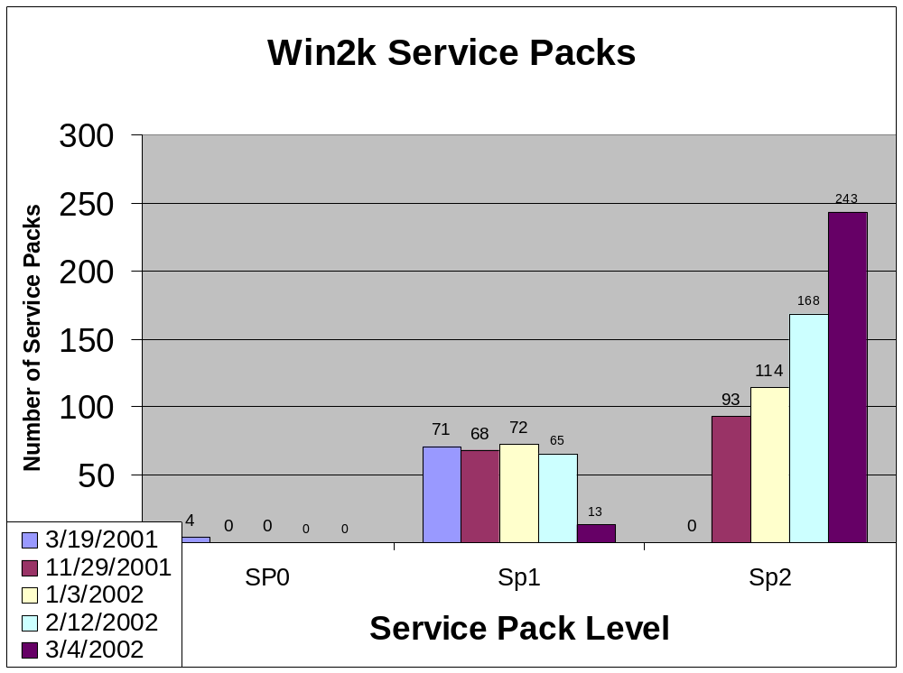

Slide 9
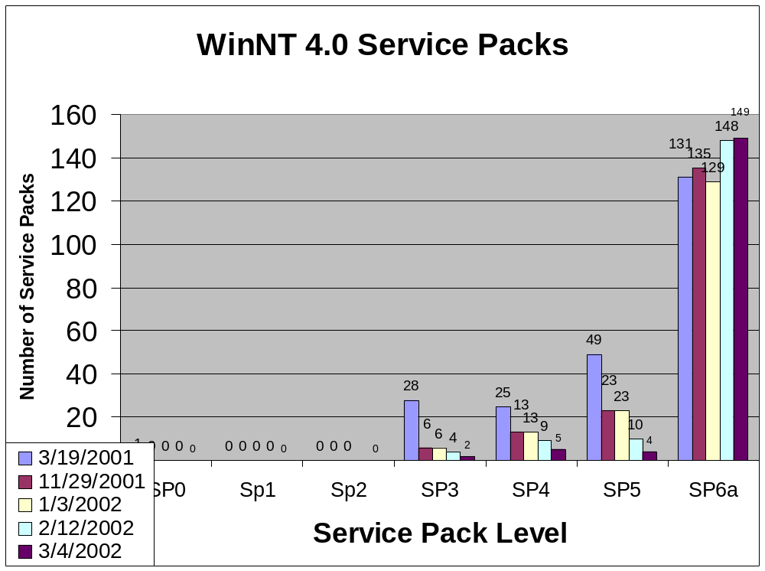

Slide 10
When can we get accounts in the Win2k Domain?
Quick Updates
  Browse list
  Service Packs
  Win2k Migration
Guest Speaker – Al Lilianstrom

Slide 11
Win2k Migration
Main topic of next month’s presentation is the status of the Win2k Migration.
Please review our last Win2k Migration talk at
http://www-bdnew.fnal.gov/network/Local%20Admin%20Talks/Local%20Admin%20Meeting%206-12-2001.htm
  Slides 19-64 deal with Win2k Migration

Slide 12
Win2k Migration
Quick Update:
  We now have seven Beams accounts copied over to the Win2k reference domain for testing.
  We have one desktop in the computer room (bd-w2k-test02) that is available for general logins.
  Testing results
    Working with CD on ways to administer Active Directory
    Login script works
    Beamssrv1 Y: and Z: drives are mounted
    Macintosh connectivity presently does not work using OS X SMB client, Dave or Sharity.
  Once we have the bugs worked out, we will move some accounts into the production domain.

Slide 13
Win2k Migration
We are accepting requests for Win2k test accounts:
  You need a kerberos principal.
    Memo from last month asked everyone to get a kerberos principal if they do not already have one.
    Request form is located at
    http://www.fnal.gov/cd/forms/strongauth.html
  Your WinNT Beams account will be “cloned” by computing division.
  You will be able to login to bd-w2k-test02 in the computer room.
  This will be covered in depth in next month’s meeting.

Slide 14
Questions?

