Slide 1

State of Washington
GMAP Government Efficiency
Human Resource Management
Written Report – August 13, 2008
Plan & Align Workforce
Hire Workforce
Deploy Workforce
Reinforce Performance
Develop Workforce
Turnover for Selected Job Classes - Follow-Up Report
At the June 3, 2008 Government Efficiency GMAP forum, the Governor asked whether the salary increases granted effective 7/1/07 had an impact on resolving turnover problems. This report serves as a follow-up response to that question.
The Department of Personnel selected certain job classes to research this issue. One or more of the following criteria were applied to select which jobs to look at:
  Job class is generally considered to have hiring or turnover challenges
  Job class is widely used and/or is of high demand
  Job class received special compensation adjustment on 7/1/07 to resolve documented recruitment and retention problems
  Job class received salary increase on 7/1/07 to bring it within market rates
The table shown on page 2 lists the job classes reviewed. The findings are displayed graphically and discussed in more detail in the subsequent pages of this report.
The turnover formula used in this analysis included resignations, dismissals, and miscellaneous separations. It did not include turnover due to retirement. Statewide, for all job classes, the average turnover rate (excluding retirements) was 4.7% in FY 08 (as of 5/23/08).
Most of the job classes selected for this review experienced reduced average turnover in FY 08. In some cases it may be too soon to tell whether the 7/1/07 salary increase made a difference. Also, other economic and management factors can affect turnover and hiring challenges.
Vacancy rate data was not available. However, headcount numbers give some indication of ability to successfully hire for these jobs.
Submitted by:
Eva Santos, Director
Department of Personnel
August 2008

Slide 2
Government Efficiency GMAP – Human Resource Management
Turnover for Selected Job Classes
Page | Job Class | Turnover * |  | Total Headcount
 |  | FY 07 | FY 08 | July 06 | May 08
3 | Community Corr. Officer 2 | 8.3% | 5.6% | 444 | 538
3 | Community Corr. Officer 3 | 3.4% | 3.8% | 264 | 268
4 | Correctional Officer 2 | 6.8% | 4.6% | 2,392 | 3,213
4 | Correctional Officer 3 | 2.3% | 1.7% | 388 | 432
5 | Excise Tax Examiner 2 | 16.1% | 3.3% | 41 | 73
5 | Excise Tax Examiner 3 | 2.3% | 3.1% | 44 | 66
6 | Information Tech Specialist 3 | 4.9% | 2.4% | 558 | 567
6 | Information Tech Specialist 4 | 3.5% | 2.5% | 760 | 874
6 | Information Tech Specialist 5 | 3.7% | 3.8% | 658 | 812
7 | Investigator 2 | 7.7% | 6.8% | 85 | 106
7 | Investigator 3 | 7.3% | 7.2% | 42 | 59
8 | Legal Secretary 1 | 14.3% | 10.3% | 80 | 83
8 | Legal Secretary 2 | 9.1% | 6.4% | 146 | 173
9 | Registered Nurse 2 | 9.6% | 8.1% | 462 | 541
9 | Registered Nurse 3 | 2.3% | 2.2% | 206 | 228
10 | Licensed Practical Nurse 1 | 9.0% | 19.1% | 59 | 14
10 | Licensed Practical Nurse 2 | 9.8% | 8.6% | 254 | 309
10 | Licensed Practical Nurse 4 | 1.9% | 2.4% | 156 | 170
11 | Safety & Health Specialist 2 | 5.3% | 0 | 57 | 47
11 | Safety & Health Specialist 3 | 6.4% | 0 | 44 | 61
11 | Safety & Health Specialist 4 | 6.0% | 2.0% | 52 | 52
12 | Transportation Engineer 1 | 17.4% | 18.7% | 101 | 108
12 | Transportation Engineer 2 | 3.3% | 2.8% | 618 | 648
12 | Transportation Engineer 3 | 3.2% | 4.3% | 426 | 451
12 | Transportation Engineer 4 | 2.8% | 4.0% | 150 | 154
* Note: FY 08 data is as of May 23, 2008
Source: Department of Personnel

Slide 3
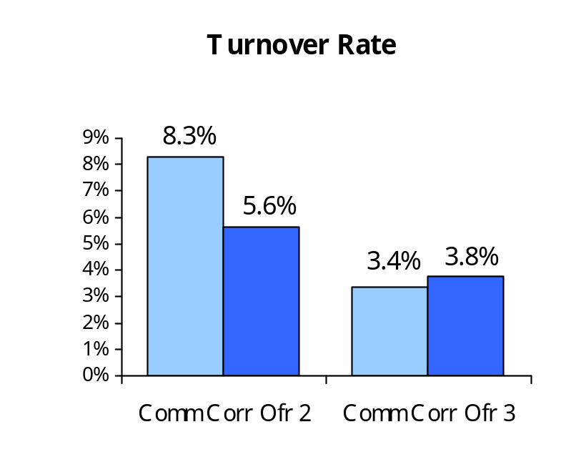
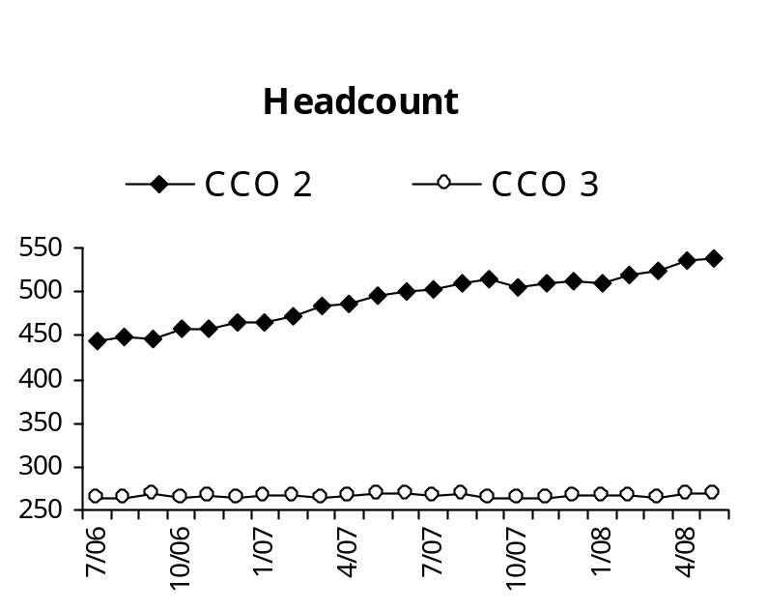
Community Corrections Officers (CCO)
Analysis
Both the 2 and 3 levels received a 5% salary increase. However, they continue to remain 20% behind market rate.
Although turnover rate for CCO 2 has dropped significantly, it is still above the 4.7% statewide average.
Headcount has continued to grow at the 2 level while remaining steady at the 3 level, indicating that recruitment efforts have been successful at maintaining adequate staffing.
Anecdotally, DOC believes that the salary increases in conjunction with new recruitment and retention strategies have been positive. However, it is still too early to assess the full impact.
FY 2007
FY 2008
Source: Department of Personnel

Slide 4
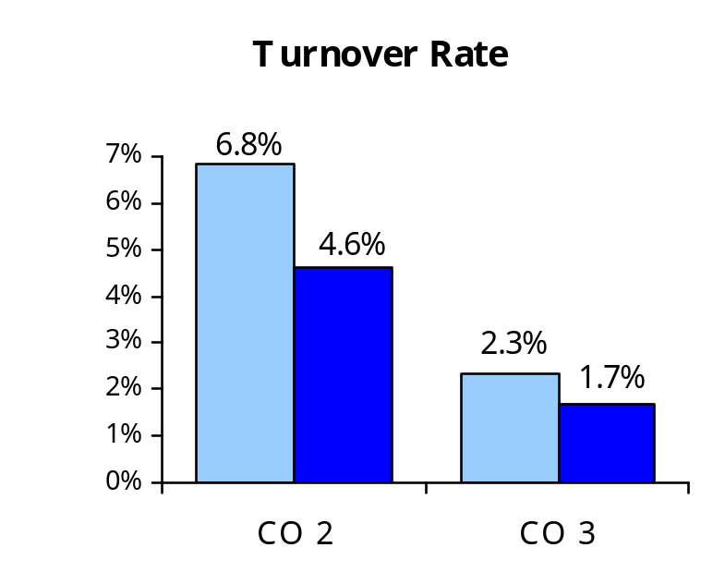
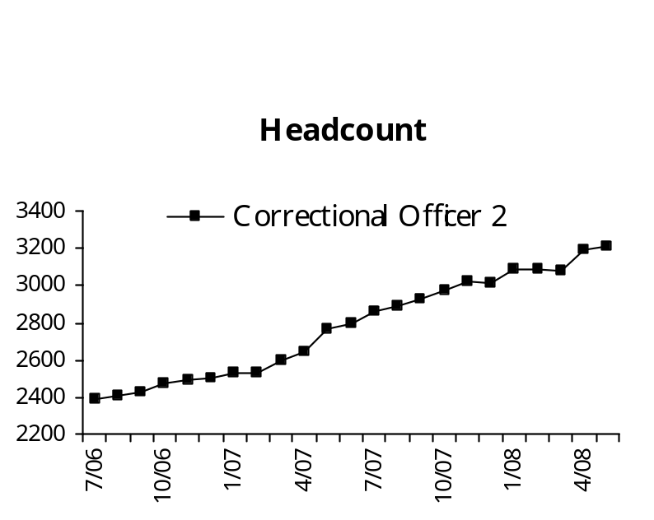
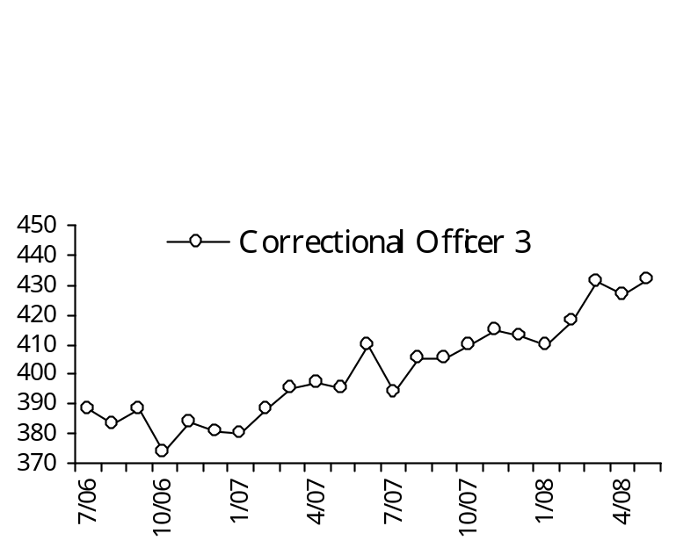
Correctional Officers (CO)
Analysis
Both the 2 and 3 levels received a 10% salary increase, along with $10/hour assignment pay when conducting tactics/firearms training. Additionally, a 5% geographic assignment pay was granted for positions at Monroe, the State Penitentiary, and Coyote Ridge facilities. Regardless, Correction and Custody Officers still remain 20% behind market rate.
Both the 2 and 3 level are now below the 4.7% statewide turnover average.
DOC reports that both the Monroe and Walla Walla institutions are fully staffed. Anecdotally, DOC believes that the salary increases in conjunction with new recruitment and retention strategies have been positive. However, it is still too early to assess the full impact.
FY 2007
FY 2008
Source: Department of Personnel

Slide 5
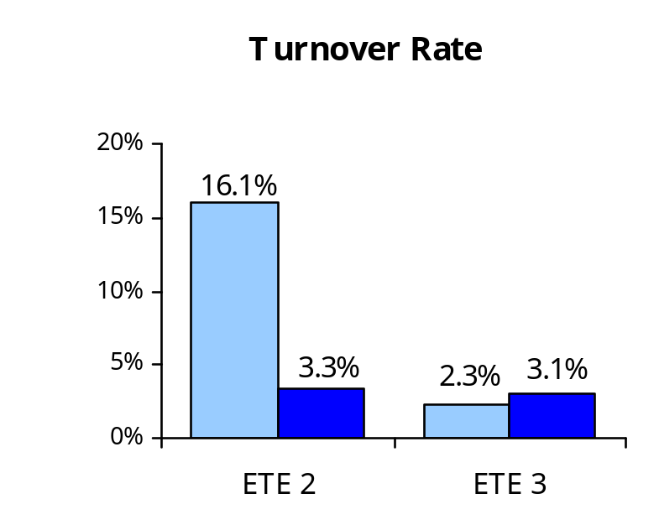
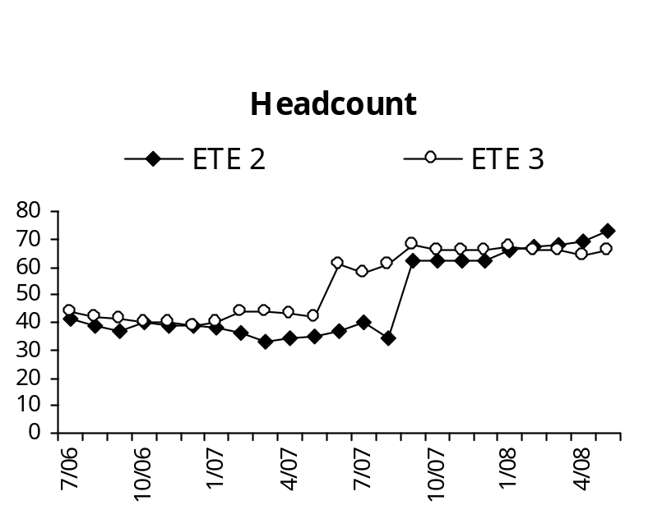
Excise Tax Examiners (ETE)
Analysis
Excise Tax Examiners are employed by two agencies: Department of Revenue and Department of Licensing.
Excise Tax Examiners received a 10% salary increase effective 7/1/2007. They are currently 7.5% behind market rate.
Both the 2 and 3 level are now substantially below the 4.7% statewide turnover average.
At Department of Revenue, The ETE 1 level has a one year in-training plan to the 2 level. Once they are trained and become 2’s, they become a highly sought after commodity.
About 25 Licensing Compliance Auditors were reallocated to Excise Tax Examiner series between 2007 and 2008 The historically low turnover in the Licensing Compliance Auditor series in combination with the increase in headcount (against which turnover is measured) largely accounts for the significant drop in turnover rate at the 2 level.
FY 2007
FY 2008
Source: Department of Personnel

Slide 6
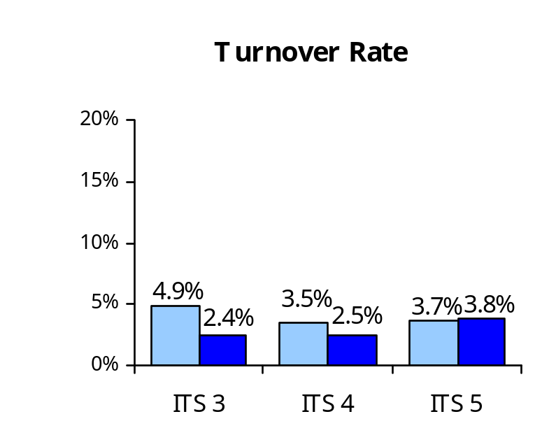
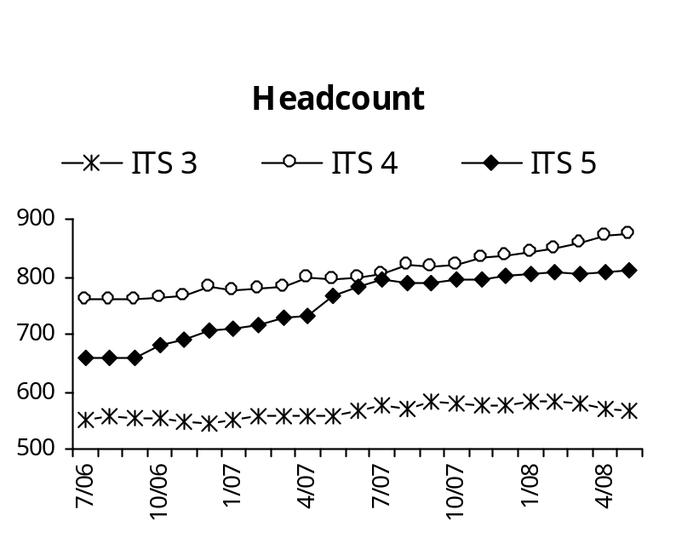
Information Technology Specialists (ITS)
Analysis
There are approximately 2,300 Information Technology Specialist positions broadly distributed throughout state government.
Information Technology Specialists at all levels received a 10% salary increase. However, they continue to remain 22.5% behind market rate.
The 3, 4, and 5 levels are all now substantially below the 4.7% statewide turnover average.
Anecdotally, DOP recruitment staff have not noticed a shift in supply of or demand for IT professionals throughout the state, nor have agency recruiters indicated that the salary change had a significant impact on recruitment and retention.
State agencies’ main recruitment strategy continues to be marketing state benefits and work/life balance.
FY 2007
FY 2008
Source: Department of Personnel

Slide 7
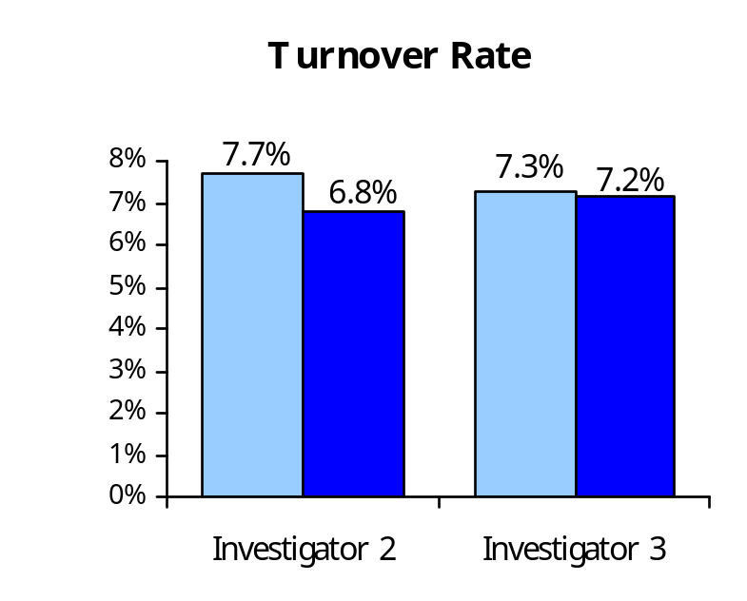
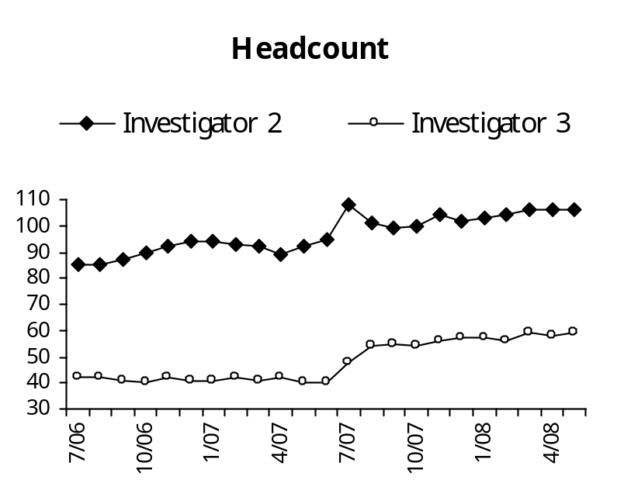
Investigators
Analysis
Investigators are employed by ten agencies including Agriculture, Financial Institutions, Labor and Industries, Retirement Systems, Licensing, DSHS, Human Rights Commission, OSPI, and the Horse Racing Commission.
Investigator 2’s received a 10% salary increase and Investigator 3’s received a 15% salary increase effective 7/1/2007. They are presently within 2.5% of market rate.
While turnover at both levels dropped marginally, they are still notably higher than the 4.7% statewide average.
Anecdotal feedback from Labor and Industries and the Department of Licensing indicates that recruitment challenges are easing somewhat, but that it is still too early to assess the full impact.
FY 2007
FY 2008
Source: Department of Personnel

Slide 8
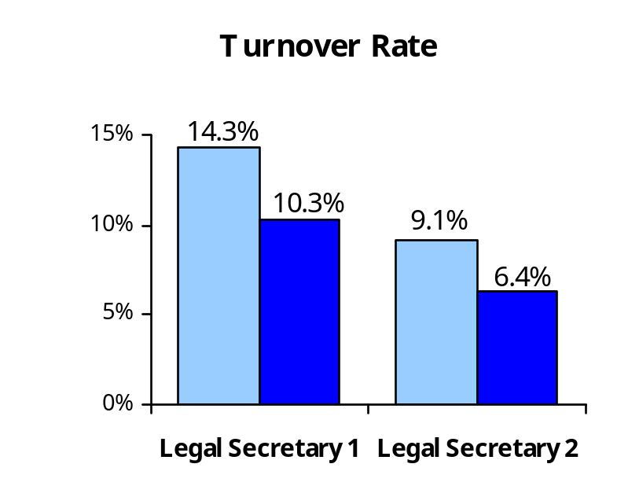
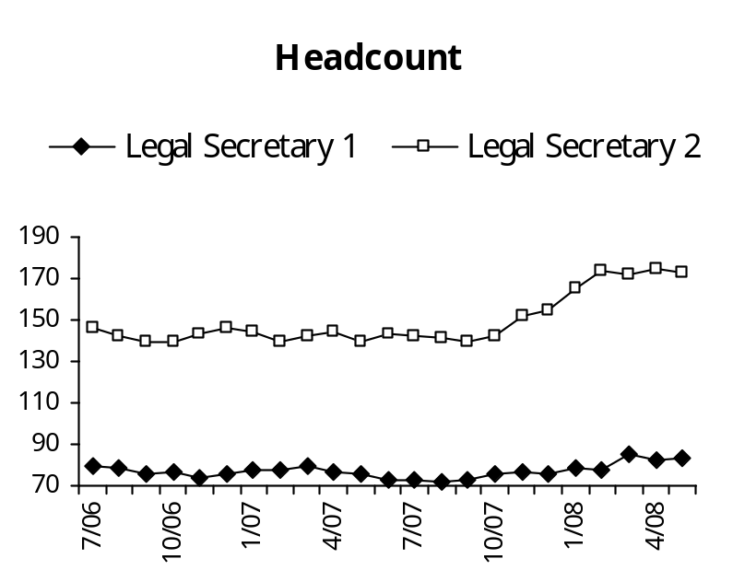
Legal Secretaries
Analysis
Legal Secretaries are employed by seven agencies, with the large majority located in the Attorney General’s Office.
The Legal Secretary 1 level received a 5% salary increase, and the 2 level received a 7.5% salary increase effective 7/1/2007. Positions in Seattle also were granted a 10% premium for geographic assignment pay. Legal Secretaries remain 22.5% behind market rate.
While turnover decreased substantially, both are still notably higher than the 4.7% statewide average.
Anecdotal feedback from the Attorney General’s Office indicates that recruitment challenges are easing somewhat, but that it is still too early to assess the full impact.
FY 2007
FY 2008
Source: Department of Personnel

Slide 9
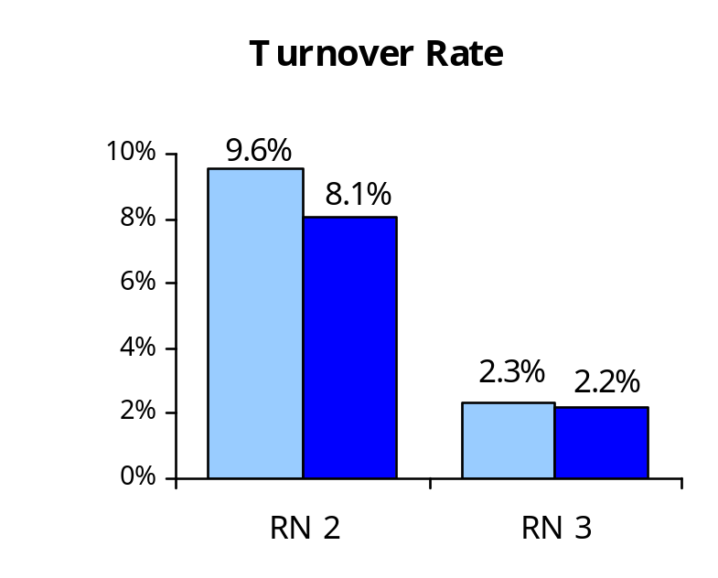
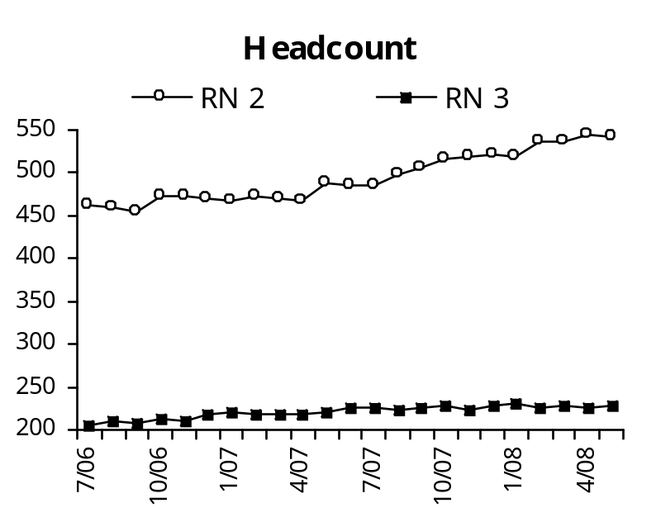
Registered Nurses
Analysis
Registered Nurses (RN’s) are employed by five agencies: DSHS, DOC, DVA, and the Schools for the Blind and Deaf.
RN’s received a 17.5% salary increase effective 7/1/2007. They are currently 2.5% behind market rate.
Turnover dropped marginally at both levels. While turnover for RN 2’s remains above the 4.7% statewide average, it is comparable to the 8.4% national average for nurses reported in a July 2007 Price Waterhouse Cooper report.
Headcount for both levels rose somewhat in 2008, indicating that agencies were able to successfully fill positions.
DOC reports that recent recruitment strategies have increased nursing appointments from 4/month to 10/month. Successful strategies have included setting managerial recruiting performance targets, hiring additional recruiting staff, creating an on-call pool, offering flex schedules, and offering in-training appointments.
DOC also reports a reduction in the need for contract Nurses to address vacant shifts and emergency on-call needs. Data reflect that 20 contractors have been hired into staff positions, while only two employees have left to work for nursing contractor firms.
FY 2007
FY 2008
Source: Department of Personnel

Slide 10
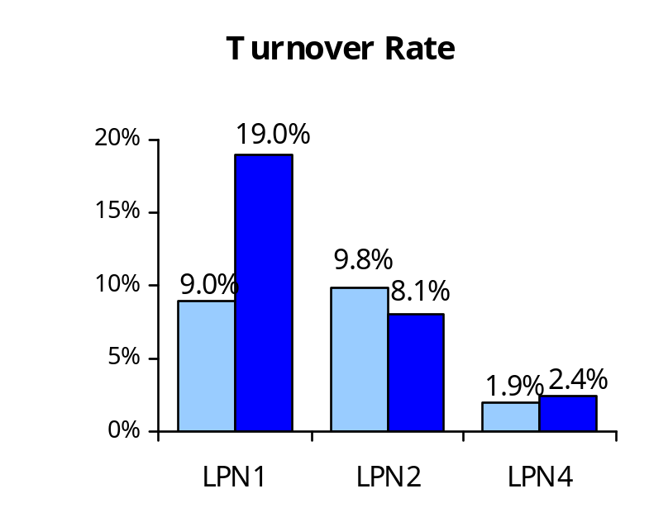
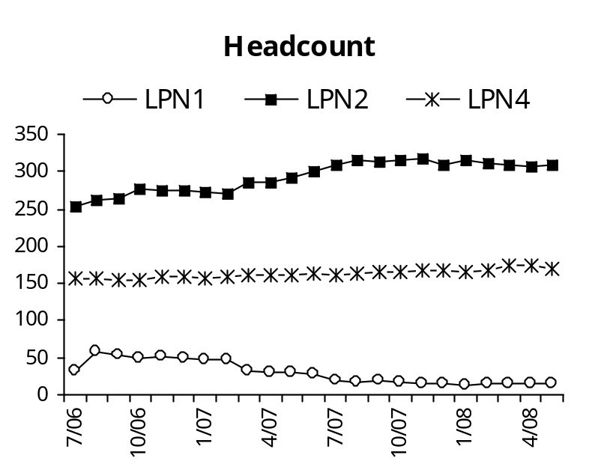
Licensed Practical Nurses
Analysis
LPN’s are employed by four agencies: DSHS, DOC, DVA, and DOH.
LPN’s did not receive a salary increase in 2007. They are currently 5% behind market rate.
The 2008 turnover rate for LPN 1’s looks deceptively high. However, total headcount dropped from 59 in 2007 to 14 in 2008, lowering the base and creating an “artificially” high percentage. It is noteworthy that many agencies transitioned from using LPN 1’s to LPN 2’s. due to Federal funding requirements
Turnover for LPN 2’s dropped somewhat between 2007 and 2008. While turnover at the 2 level is still higher than the 4.7% statewide average, it is still comparable to the 8.4% national average for nurses as reported in a July 2007 Price Waterhouse Cooper report.
Turnover rates for LPN 4 increased somewhat, but remain well below the 4.7% statewide average.
While DSHS has indicated difficulty finding LPN’s in the past, they presently report moderate recruiting success. They also report that they are holding several vacancies to provide layoff options to employees impacted by ward/unit closures.
FY 2007
FY 2008
Note: There is no LPN 3 level.
Source: Department of Personnel

Slide 11
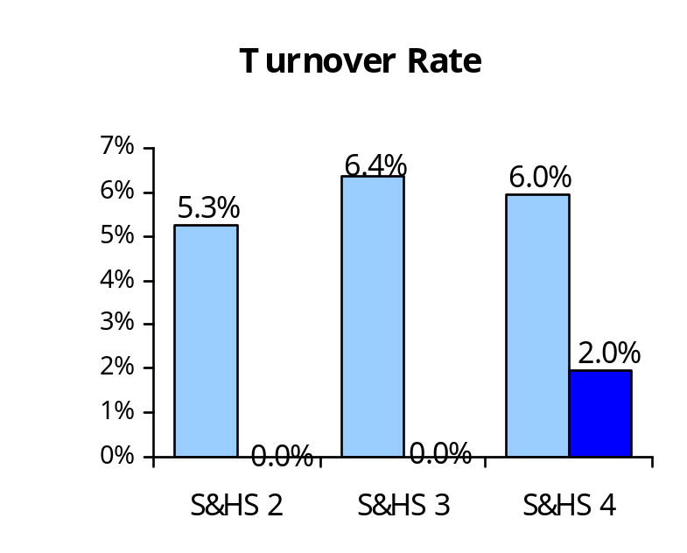
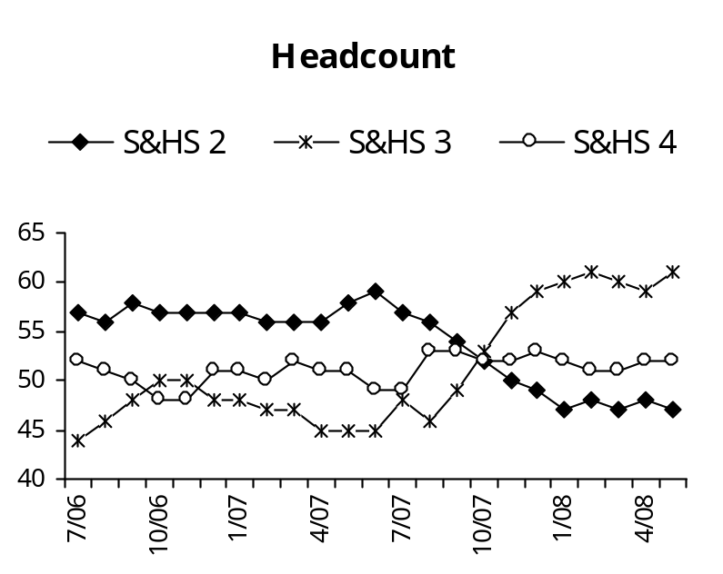
Safety & Health Specialists (S&HS)
Analysis
Safety & Health Specialists at all levels received a 7.5% salary increase. However, they continue to remain 20% behind market rate.
Turnover decreased dramatically for all three levels, which is well below the 4.7% statewide average.
As the headcount data indicates, many 2 level positions were reallocated to 3 level positions as part of a change in class definitions.
It is noteworthy that, in contrast to OSHA, L&I does not require professional certifications at the 2 and 3 level, which may positively impact recruitment and retention. In contrast, L&I does require certifications at the 4 level, making our employees targets of other employers.
FY 2007
FY 2008
Source: Department of Personnel

Slide 12
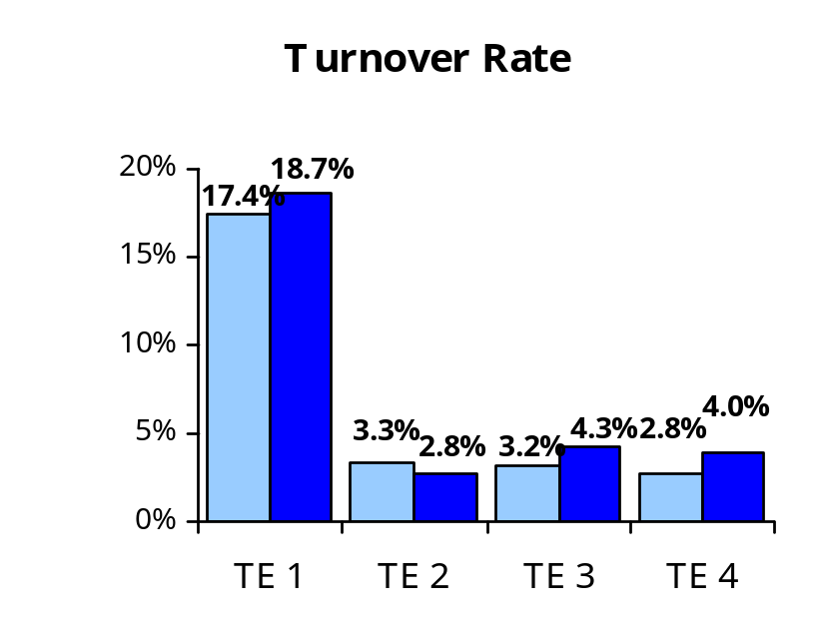
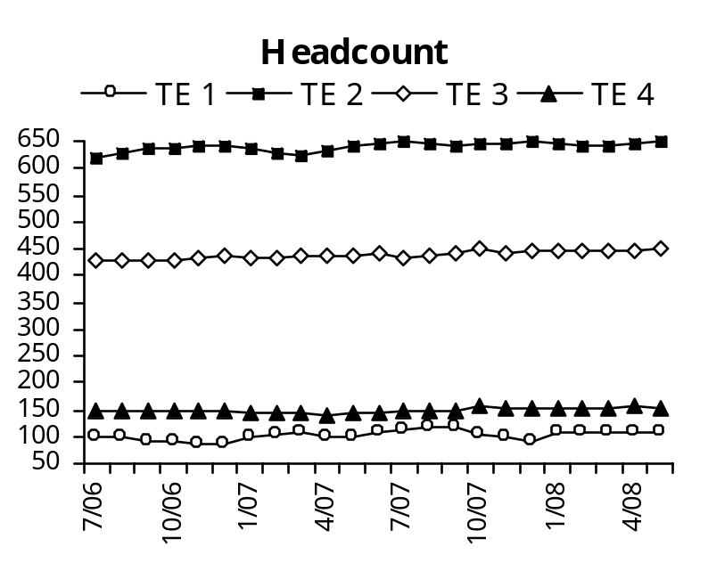
Transportation Engineers
Analysis
Transportation Engineers are employed exclusively by the Department of Transportation.
Transportation Engineers at all levels received a 5% salary increase. However, they continue to remain 17.5% behind market rate.
Turnover at the 1 level remains exceptionally high, actually rising in 2008. Turnover changed marginally at the other levels, but remained well within the 4.7% statewide average.
DOT’s own analysis indicates recent college graduates are leaving an average of two years following initial hire. Exit survey data and other analysis indicates that while the 1 level salary is competitive, the 2 level is less so and many new hires leave prior to progressing through the class series.
Specific strategies being implemented to address recruiting and retention challenges include marketing work-life balance benefits, developing supervisory skills, and developing recruiter and hiring manager marketing and selection skills.
FY 2007
FY 2008
Source: Department of Personnel

