Slide 1
PARiHS Framework
Promoting Action on Research
Implementation in Health Services
Philip M. Ullrich, Ph.D.
Spinal Cord Injury QUERI IRC
Philip M. Ullrich, Ph.D.
Spinal Cord Injury QUERI IRC
Philip M. Ullrich, Ph.D.
Spinal Cord Injury QUERI IRC
Notes:
Welcome, as introduced, I’ll be talking about the PARiHS framework, also know as the prmoting action on research implementation in health services framework.

Slide 2
PARiHS Framework:
History
Features
Proposed utility
Application Example
Philip M. Ullrich, Ph.D.
Spinal Cord Injury QUERI IRC
Philip M. Ullrich, Ph.D.
Spinal Cord Injury QUERI IRC
Notes:
I plan cover the origin and development of PARiHS briefly, then describe its features and proposed utility in real world implementation projects.
Leading up to an example from our work in SCI QUERI

Slide 3
PARiHS Origins
Royal College of Nursing Institute, UK
1990s
Contemporary models of the processes of implementing research into practice are inadequate.
  Unidimensional
  Non-interactive
Notes:
PARiHS was developed in the 1990s by a group at the RCN who were nursing researchers and implementation consultants
.
Premise: Contemporary models of the processes of implementing research into practice are inadequate,
Being too simplistic in terms of involving few factors described using non-interactive models.
There sense was that unidimensional, non-interactive models were inadequate, based on their understanding of the developing world of implementation research, and their experiences as implementation consultants.
RCN worked on the development of a conceptual framework which represents the interaction of numerous factors influencing the uptake of research evidence into practice.

Slide 4
PARiHS Framework developmental aims:
Accurately represent the complexities of implementation.
Useful for explaining variability in the
success of implementation projects.
Useful for guiding clinicians charged with implementing research into practice.
Notes:
RCN began developing the PARiHS framework to be
Representative of the complexities of factors influencing the uptake of research evidence into practice
used by researchers to explain variability in success of implementation projects
Help clinicians think about implementation strategies..

Slide 5
PARiHS Framework Elements
Evidence.
Context.
Facilitation.
Weak to strong support for implementation
Notes:
I first want to introduce the framework in terms of its primary factors or elements.
The PARiHS framework proposes that successful implementation of evidence into practice is a function of three broad interactive elements (evidence, context, and facilitation).
A basic premise is that each of these elements positions on a continuum from weak to strong with regard to support for the implementation project in question.
I will describe each element in turn, noting specific subelements that are part of the framework.

Slide 6
Evidence Sub-elements:
Research evidence.
  Weak: Anecdotal evidence, descriptive.
  Strong: RCTs, evidence-based guidelines.
Clinical experience.
  Weak: Expert opinion divided.
  Strong : Consensus.
Patient preferences and experiences.
  Weak: Patients not involved.
  Strong : Partnership with patients.
Local information.
Notes:
Research: Empirical research
Weak support for implementation would consist of anecdotes, lore, descriptive studies
Strong support RCTs, evidence-based guidelines
Clinical: Experiences reflected upon and tested by individuals and groups
Weak support for implementation would be conditions with absent or divide expert opinion.
Strong support would be consensus across experts.
Patient:
Weak support for implementation would be conditions in which patient input was not included or patients would be opposed to implementation of the practice
Strong support for implementation would be conditions where patient opinion is incorporated into the implementation or where patient preferences otherwise matched the practice to be implemented.
Local: audits, local research, pilot projects.
Weak support: no local experience or experiences are not consistent with the practice to be implemented
Strong support: Local information matches the practice to be implemented.

Slide 7
Context Sub-elements:
Culture.
  Weak: Task driven, low morale.
  Strong : Learning organization, patient-centered.
Leadership.
  Weak: Poor organization, diffuse roles.
  Strong : Clear roles, effective organization.
Evaluation.
  Weak: Absence of audit and feedback
  Strong : Routine audit and feedback.
Notes:
Culture: Attitudes and beliefs about health care, organizational morale.
Weak support for implementation are task driven settings with low moral
Strong support for implementation is learning, innovation, and patient-centered approaches are valued
Leadership
Weak support for implementation are those with poor organizational structure, unclear roles
Strong support for implementation possess effective organizational structure, clear roles
Evaluation
Strong support for implementation is found in settings with routine evaluation and feedback.

Slide 8
Facilitation Sub-elements:
Characteristics (of the facilitator).
  Weak: Low respect, credibility, empathy.
  Strong: High respect, credibility, empathy.
Role.
  Weak: Lack of role clarity.
  Strong: Clear roles.
Style.
  Weak: Inflexible, sporadic.
  Strong: Flexible, consistent.
Notes:
Facilitation refers to various strategies used to help change occur within an organization.
Broadly classed as practical, problem-solving interventions, and supportive activities aimed at enhancing individuals and teams motivation and ability to implement a practice. Can be many things, but PARiHS emphasizes facilitation as characteristics of a person in the specific role of the Facilitator.
Characteristics of facilitator
Strong support for implementation is found in a facilitator who elicits respect, is credible, and empathic
Role
Strong support for implementation occurs when the role of the facilitator is clear and adequate for the implementation project.
Style
Personal styles characterized by flexibility and consistency give strong support for implementation.

Slide 9
PARiHS Framework:
Elements and Subelements
Evidence.
  Research
  Clinical experience
  Patient experience
  Local knowledge
Context.
  Culture
  Leadership
  Evaluation
Facilitation.
  Characteristics
  Role
  Style
Notes:
So when the framework is viewed in its entire spectrum of elements and subelements, a greater appreciation for its complexity is gained.
Complex enough without speaking to the possible interactions imaginable.

Slide 10
PARiHS Framework
Successful implementation is most likely to occur when:
  Scientific evidence is viewed as sound and fitting with professional and patient beliefs.
  The healthcare context is receptive to implementation in terms of supportive leadership, culture, and evaluative systems.
  There are appropriate mechanisms in place to facilitate implementation.
Notes:
To keep my thinking about the PARiHS framework organized I like to think of the three elements in the following narrative format.
Summarizing the model with its three elements.

Slide 11
PARiHS Framework developmental history:
1998 - 2002. Development, conceptual analysis.
2001-2003. Empirical case studies.
2003 to present. Diagnostic/evaluative tool development.

Slide 12
PARiHS Framework current knowledge base:
Numerous case reports available, in support of face validity and practical appeal.
One published instrument related to PARiHS.
Theoretical positions of the framework are still in development.

Slide 13
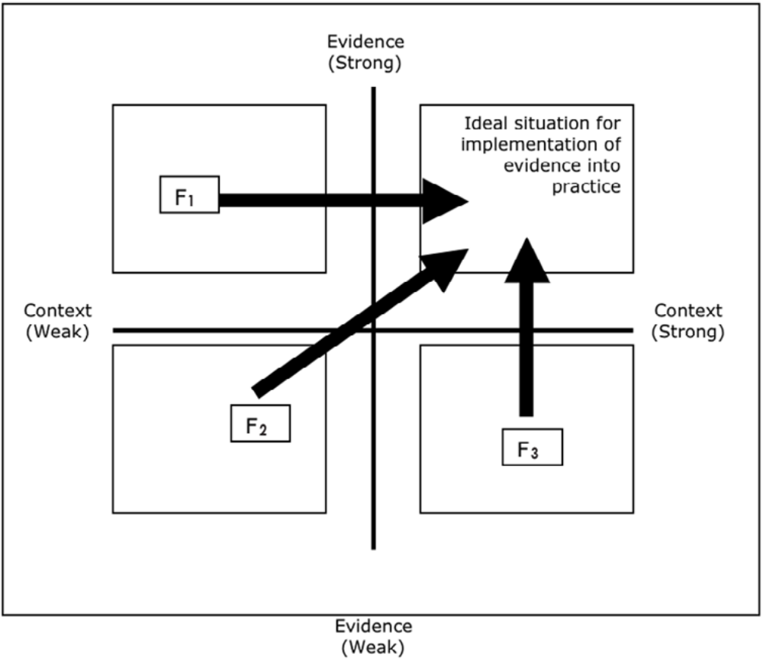
PARiHS Diagnostic and Evaluative utility?
PARiHS Diagnostic and Evaluative grid:
Kitson et al., 2008.
Notes:
Proposed evaluative approach based upon PARiHS framework.
In essence, the setting for a proposed implementation project can be evaluated in terms of the two broad elements of context and evidence, judged as falling somewhere on a weak to strong continuum according to degree of support for implementation.
In terms of the four cells you see depicted here, then, you might have a setting with
F1: context that is weak in support of implementation, but evidence is strong.
This might be a unit with that is not organized for training and learning and it may have low morale, but the practice to be implemented may have strong empirical support that matches clinical experience and patient preferences well.
F3: Setting for implementation in which Evidence is weak but Context is strong in support of implementation.
This might be a unit with high morale and energizing, enabling leadership, but the practice to be implemented has limited empirical literature support and among clinicians opinions are highly divided on its utility.
These two hypothetical scenarios would require different facilitation strategies
F1: Might require facilitation strategies aiming to move the weak context elements to strong, e.g., develop training programs and foster collaborative relationships among staff
F2: Might require facilitation strategies, such as interventions to develop professional consensus on best practices, or education on recommended best practices in other settings.

Slide 14
Summary:
Summary:
Summary:
Summary:
PARiHS framework has long been the subject of theoretical development.
Exploratory work in applying PARiHS to implementation interventions is encouraging.
Empirical foundations for the framework have not developed at pace with theory.

Slide 15
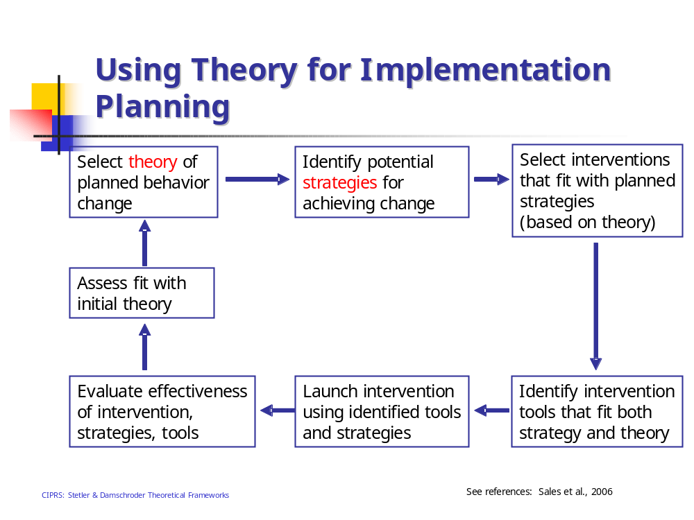

Slide 16
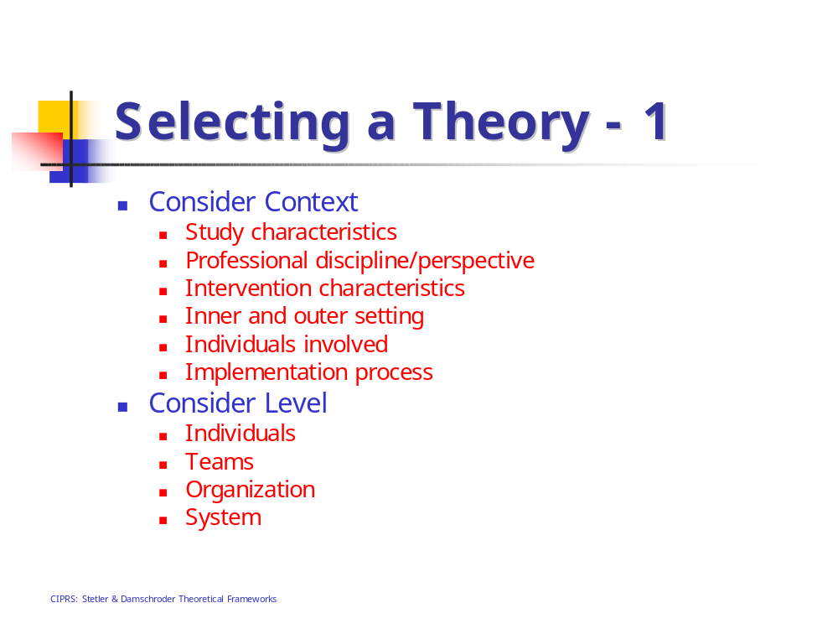

Slide 17
Why PARiHS Framework for Spinal Cord Injury
(SCI) QUERI?:
SCI system of care and targets for change
  Evidence
    Research
    Local
    Clinical
    Patient
  Context
Opportunities to work with other QUERI groups.
Notes:
Intrigued by the framework’s focus on the important of various forms of evidence towards the success of implementation.
There are few well designed studies to inform care, so we have been aware of the great importance of patient and provider opinions towards practices in our implementation projects.
The SCI system is governed with strong leadership at multiple levels, national, regional, facility, unit, heads of various disciplines, and interdisciplinary care is the standard. So, leadership and other aspects of context that relate to team functioning are thought by us to be important to the success of implementation projects.

Slide 18
Implementation Project Example 1
SCI Pressure Ulcer Management Tool (SCI PUMT)
  Implement a toolkit designed to standardize monitoring of pressure ulcer healing in the
  VA SCI system of care.
  PUMT:
    Training tools (education protocol, CD, models)
    Competency assessment
Notes:
Pressure ulcers are a common and serious problem after SCI. 14-30%
Long period of treatment and healing, Treatment is costly, no guarantees, recurrence
PrUs account for about 1/3 of all VA SCI admissions and over ½ of all hospital days for veterans with SCI
The Consortium for Spinal Cord Medicine[i] developed evidence-based clinical practice guidelines that addressed pressure ulcer risk, prevention, and management. At the core of the CSCM guidelines is the need for standardized assessment of pressure ulcer development and healing. For example, the CSCM guidelines stipulate that pressure ulcer healing should be monitored with a valid and reliable instrument and that the treatment plan should be modified if the pressure ulcer shows no evidence of healing within 2-4 weeks.
Audrey Nelson developed this tool. Studied barriers to implementation of guideline

Slide 19
SCI PUMT Implementation
12 SCI centers randomized to receive one of two implementation strategies:
Simple: Local “champion” receives toolkit materials.
Enhanced: PARIHS-informed external facilitation strategy.

Slide 20
SCI PUMT Enhanced facilitation
Kitson et al., 2008.
Notes:
an evaluation of stakeholder perceptions of evidence and the healthcare context enables the identification of facilitation interventions that would most effectively support successful implementation.

Slide 21
SCI PUMT Enhanced Facilitation
Diagnostic Assessment.
Measure factors important to implementation at all participating sites. Specifically, the diagnostic assessment will measure:
  EVIDENCE: Appraisals of 4 sources of evidence:
  (1) Published scientific evidence.
  (2) Clinical experience or professional knowledge.
  (3) Patient experiences and beliefs.
  (4) Evidence derived from local experiences.
  CONTEXT: Appraisals of 3 aspects of context
  (1) Organizational culture.
  (2) Leadership.
  (3) Evaluation.
Notes:
organizational culture or staff values, beliefs, and attitudes,
leadership, in terms of organizational structure, decision-making practices, and roles,
Evaluation, how the organization measures and provides feedback on performance
Also, resources, staff timeinformation systems in place

Slide 22
SCI PUMT
Enhanced Facilitation
Diagnostic Assessment.
Measures:
Organizational Readiness for Change Assessment (ORCA)
1) Questionnaire, 3 scales:
Evidence, Context, Facilitation.
Structured Interviews
Evidence, Context, Facilitation.

Slide 23
SCI PUMT
Enhanced Facilitation
Depends upon results of diagnostic.
AND Pre-diagnostic efforts
  Evidence:
      Presentations of empirical research by nursing leaders.
  Context
      Involving national and local SCI leadership.
  Facilitation
      Selecting and training nurse facilitators.
Notes:
So, following the diagnostic assessment, we should have ideas about what aspects of Context and what aspects of Evidence might be good targets for facilitation interventions.
Now, this may give the impression that the PUMT implementation project is largely a blank slate prior to the diagnostics.
However, of course we are also looking to PARiHS for guidance in developing the basics of the implementation plan.
For example, we aim to influence stakeholders appraisals of the evidence in favor of the PUMT with presentations of the empirical evidence for the PUMT given by respected nursing leaders.
MATCHING FACILITATION INTERVENTIONS TO DIAGNOSTIC
Problem identification and solving

Slide 24
SCI PUMT Results
Stay tuned!

