Slide 1
State of Washington
Department of Social and Health Services
Human Resource
Management Report
Plan & Align Workforce
Hire Workforce
Deploy Workforce
Reinforce Performance
Develop Workforce
October 2007

Slide 2
Managers’ Logic Model for Workforce Management
Department of Social and Health Services
Outputs
Initial Outcomes
Intermediate Outcomes
Plan & Align Workforce
Articulation of managers HRM accountabilities. HR policies. Workforce planning. Job classes & salaries assigned.
Managers understand HRM accountabilities. Jobs, staffing levels, & competencies aligned with agency priorities.
Foundation is in place to build and sustain a productive, high performing workforce.
Hire
Workforce
Qualified candidate pools, interviews & reference checks. Job offers. Appts & per-
formance monitoring.
Best candidate hired & reviewed during appointment period. Successful performers retained.
The right people are in the right job at the right time.
Ultimate Outcomes
Employees are committed to the work they do & the goals of the organization
Productive, successful employees are retained
State has workforce depth & breadth needed for present and future success
Deploy
Workforce
Work assignments& requirements defined. Positive workplace environment created. Coaching, feedback, corrections.
Workplace is safe, gives capacity to perform, & fosters productive relations. Staff know job rqmts, how they’re doing, & are supported.
Time & talent is used effectively. Employees are motivated & productive.
Develop Workforce
Individual development plans. Time/ resources for training. Continuous learning environment created.
Learning environment created. Employees are engaged in develop-
ment opportunities & seek to learn.
Employees have competencies for present job & career advancement
Agencies are better enabled to successfully carry out their mission. The citizens receive efficient government services.
Reinforce Performance
Clear performance expectations linked to orgn’al goals & measures. Regular performance appraisals. Recognition. Discipline.
Employees know how performance contributes to success of orgn. Strong performance rewarded; poor performance eliminated
Successful perf is differentiated & strengthened. Employees are held accountable.

Slide 3
Standard Performance Measures
Department of Social and Health Services
Plan & Align Workforce
Percent supervisors with current performance expectations for workforce management
Management profile
Workforce planning measure (TBD)
Percent employees with current position/competencies descriptions
Time-to-fill funded vacancies
Candidate quality
Hiring Balance (Proportion of appointment types)
Separation during review period
Percent employees with current performance expectations
Employee survey ratings on “productive workplace” questions
Overtime usage
Sick leave usage
Non-disciplinary grievances/appeals filed and disposition (outcomes)
Worker safety
Percent employees with current individual development plans
Employee survey ratings on “learning & development” questions
Competency gap analysis (TBD)
Percent employees with current performance evaluations
Employee survey ratings on “performance & accountability” questions
Disciplinary actions and reasons, disciplinary grievances/appeals filed and disposition (outcomes)
Reward and recognition practices (TBD)
Ultimate Outcomes
Hire
Workforce
Employee survey ratings on “commitment” questions
Turnover rates and types
Turnover rate: key occupational categories
Workforce diversity profile
Retention measure (TBD)
Deploy
Workforce
Develop Workforce
Reinforce Performance

Slide 4
Plan & Align Workforce
Outcomes:
Managers understand workforce management accountabilities. Jobs and competencies are defined and aligned with business priorities. Overall foundation is in place to build & sustain a high performing workforce.
Performance Measures:
Percent supervisors with current performance expectations for workforce management
Management profile
Workforce Planning measure (TBD)
Percent employees with current position/ competency descriptions
Department of Social and Health Services
Workforce Management Expectations
Percent supervisors with current performance expectations for workforce management = 100%*
Analysis:
The total number of supervisors includes first line supervisors through appointing authorities coded in HRMS as a supervisor.
Action Steps:
In March 2007, the Secretary sent the annual Workforce Management Performance Expectation memo to all DSHS supervisors.
In September 2007, the Secretary sent a memo to the Appointing Authorities requesting they include the March 2007 memo as part of their training curriculum.
DSHS updated the Employee’s Annual Review checklist to include the March 2007 memo.
DSHS posted the letter on the Human Resources Division (HRD) Office of Employee Development (OOED) web site and has incorporated the letter dated March 27, 2007 within the following classes:
Management Orientation on-line
Basics of Supervision
Harassment Prevention for Supervisors
New Employee Orientation Phase I & II
*Based on 2,293 of 2,293 reported number of supervisors
Data as of June 30, 2007
Source: Internal Procedures and Process

Slide 5
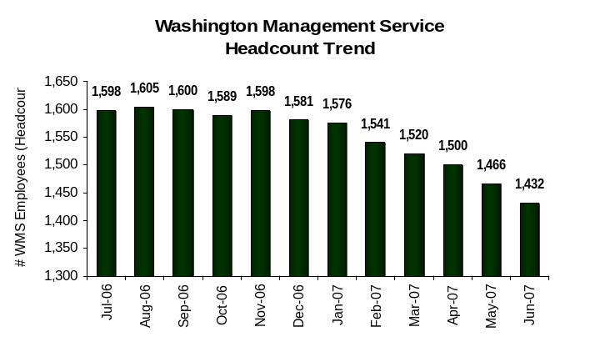
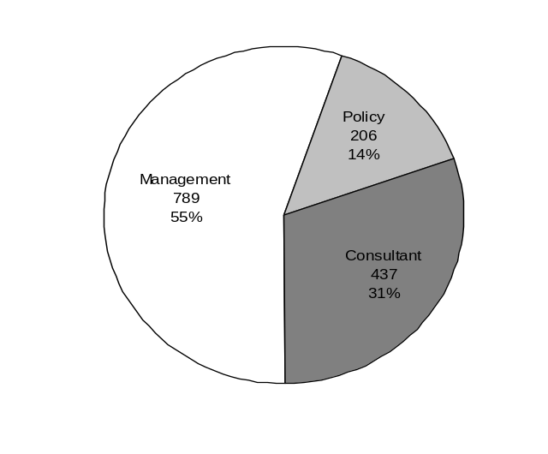
Plan & Align Workforce
Outcomes:
Managers understand workforce management accountabilities. Jobs and competencies are defined and aligned with business priorities. Overall foundation is in place to build & sustain a high performing workforce.
Performance Measures:
Percent supervisors with current performance expectations for workforce management
Management profile
Workforce Planning measure (TBD)
Percent employees with current position/ competency descriptions
Department of Social and Health Services
Management Profile
WMS Employees Headcount = 1,432
Percent of agency workforce that is WMS = 7.4%
Managers* Headcount = 1,662
Percent of agency workforce that is Managers* = 8.5%
Number of Employees = 19,428
* In positions coded as “Manager” (includes EMS, WMS, and WGS)
Analysis and Action Steps see next page
WMS Classification
Management 789
Consultant 437
Policy 206
TOTAL 1,432
All Classifications*
Management 1,662
Consultant 589
Policy 211
TOTAL 2,462
* All classifications (includes EMS, WMS, and WGS)
Data as of June 30, 2007
Source: HRMS Business Warehouse

Slide 6
Plan & Align Workforce
Outcomes:
Managers understand workforce management accountabilities. Jobs and competencies are defined and aligned with business priorities. Overall foundation is in place to build & sustain a high performing workforce.
Performance Measures:
Percent supervisors with current performance expectations for workforce management
Management profile
Workforce Planning measure (TBD)
Percent employees with current position/ competency descriptions
Department of Social and Health Services
Management Profile
Analysis:
The chart reflects the total mid-management reductions to date; however, it does not begin with July 2005 data when the reductions began. DSHS exceeded the target of 330 mid-management reductions by 62 additional reductions.
From July 2006 through June 2007, 139 WMS positions were transitioned from WMS to WGS and 113 WMS positions were abolished* bringing the total mid-management position reductions to 392 as of June 30, 2007.
DSHS has a total of 1,432 WMS employees which includes permanent and acting staff.
DSHS has a total of 1,662 managers which includes EMS, WMS and WGS.
The percentage of WMS Employees and Managers is based upon total DSHS employees (19,428).
The Headcount Trend Chart is based upon headcount, which includes multi-fills and acting employees and not positions.
Action Steps:
In April 2007, the DSHS Banding Committee began its review of all existing WMS positions to confirm each position’s qualification for WMS and the appropriateness of the position’s band. HRD anticipates submitting a final report to the Secretary by March 31, 2008.
HRD will continue to prepare and submit quarterly reports to the Secretary identifying newly established WMS positions, WMS positions abolished, and WMS positions transitioned to WGS classifications.
Effective July 1, 2007, DSHS initiated monthly coding of WMS management positions as: manager, consultant or policy for newly established and re-banded WMS positions.
On August 31, 2007, the DSHS Deputy Secretary established criterion for the inclusion of positions in WMS to ensure DSHS WMS staffing within its 7.7% baseline.
On August 31, 2007, the DSHS Deputy Secretary issued a memo requiring the elimination of permanent multi-filled positions by December 31, 2007.
The DSHS Banding Committee will continue to review all WMS establishment requests against the WMS criteria. Those position descriptions not clearly meeting the inclusion criteria for WMS will be returned to the respective Assistant Secretary for WGS consideration.
* The abolishment count includes multi-filled positions and funded but never created positions

Slide 7
Plan & Align Workforce
Outcomes:
Managers understand workforce management accountabilities. Jobs and competencies are defined and aligned with business priorities. Overall foundation is in place to build & sustain a high performing workforce.
Performance Measures:
Percent supervisors with current performance expectations for workforce management
Management profile
Workforce Planning measure (TBD)
Percent employees with current position/ competency descriptions
Department of Social and Health Services
Current Position/Competency Descriptions
Percent employees with current position/competency descriptions = 97.4%*
*Based on 16,102 of 16,527 reported employee count
Applies to employees in permanent positions, both WMS & WGS
Analysis:
There is no historical data for this measurement, because DSHS did not track prior to 2006.
As DSHS moved toward implementation of HRMS on July 1, 2005, HRD met with each administration and requested updated Position Description Forms (PDFs) as we moved toward position-based recruitment.
The GMAP report for January 2006 through June 2006 reflected an 84% completion rate for position/competency description forms referred to as PDF’s. This percentage was based upon the total number of permanent and temporary DSHS employees at that time. Since June 30, 2006, the DSHS completion rate has increased from 84% to 97.4% for an increase of 13.4%.
As of December 2006, DSHS had a 93% completion rate for PDF’s. Per DOP’s direction, this percentage is now based upon the number of permanent employees.
Action Steps:
DSHS has decided to utilize the HRMS system effective July 1, 2007 to track PDF completion data.
HRD staff will be trained to enter the PDF data into HRMS by October 15, 2007.
Quarterly tracking data will be shared with the Secretary and Administration management to achieve a 100% completion rate.
HRD will identify and distribute best practice techniques for completing PDF’s, train new supervisors on completing the PDF, and offer refresher training for existing supervisors on a quarterly basis beginning in September 2007.
Data as of June 30, 2007
Source: Internal Survey

Slide 8
Hire Workforce
Outcomes:
Best candidates are hired and reviewed during appointment period. The right people are in the right job at the right time.
Performance Measures
Time-to-fill vacancies
Candidate quality
Hiring Balance (proportion of appointment types)
Separation during review period
Department of Social and Health Services
Time-to-fill / Candidate Quality
Time-to-fill Funded Vacancies
Average number of days to fill*: 47
Number of vacancies filled: 789
*Equals # of days from creation of the requisition to job offer acceptance
Time Period: 07/01/2006 – 06/30/2007
This information was manually gathered from the administrations effective May 1, 2007.
COMPETENCIES: Total candidates interviewed based on supervisory report of 112 candidates.
HIRED BEST CANDIDATES: Total candidates interviewed based on supervisory report of 119 candidates.
Candidate Quality
Of the candidates interviewed for vacancies, how many had the competencies (knowledge, skills & abilities) needed to perform the job?
  Number = 99 Percentage = 88.4%
Of the candidates interviewed, were hiring managers able to hire the best candidate for the job?
  Hiring managers indicating “yes”:
  Number = 162 Percentage = 91.5%
  Hiring managers indicating “no”:
  Number = 15 Percentage = 8.5%
Time Period: 05/2007 – 06/2007
Data as of June 30, 2007
Source: Internal Process and DOP Provided Report

Slide 9
Hire Workforce
Outcomes:
Best candidates are hired and reviewed during appointment period. The right people are in the right job at the right time.
Performance Measures
Time-to-fill vacancies
Candidate quality
Hiring Balance (proportion of appointment types)
Separation during review period
Department of Social and Health Services
Time-to-fill / Candidate Quality
Analysis:
DSHS has 145 Recruiter Coordinators throughout all administrations. Training of the Recruiter Coordinators is on-going due to frequent turn-over.
Beginning January 1, 2007, DSHS used careers.wa.gov to fill permanent WGS, non-permanent WGS and WMS positions. Although Recruiters experienced steep learning curve and system issues, DSHS generated 1,621 requisitions resulting in 873 certified lists.
DOP reports 278 DSHS hires; however, there are additional hires that Recruiter Coordinators have not reported in the system due to a continued learning curve. Failure to report hires causes an inaccurate reflection of the number of days to fill a position.
Previous GMAP reported 17 days to complete hiring activity using INET. The referral was requested by the supervisor, all recruiting activity occurred within DOP usually accessing existing registers, and ended with a hire date. Under E-Recruiting, the count begins when the supervisor requests a certification, the Recruiter Coordinator creates a requisition, creates or uses existing questions/questionnaires as a screening tool, waits a minimum of 7 calendar days to create a certified list, reviews candidates qualifications and provides the certified list to the hiring supervisor. The count stops when the supervisor completes all interviews and offers employment to a certified candidate. The first 6 months of E-Recruiting presented a steep learning curve to Recruiter Coordinators, increasing time frames.
Hiring Managers surveys were sent to candidates rather than hiring supervisor, because the supervisors did not have a current e-mail address in the Employee Self Service (ESS).
DOP notified DSHS that approximately 12,000 DSHS employees have not accessed Employee Self Service to input valid e-mail address, interfering with careers.wa.gov correspondence to them.
Action Steps:
On June 25, 2007, DSHS met with WFSE to address concerns that employees could not successfully access careers.wa.gov and compete for positions. HRD created the DSHS Employment History Form, developed a process to assist all employees around state, and conducted training for recruiters on June 30, 2007. DSHS implemented this new process on July 9, 2007.
HRD chaired 11 Recruitment Committee meetings which included a representative from each DSHS administration and/or division. This committee will continue meeting twice monthly indefinitely. Based on the new recruiting focus, membership may change.
HRD sponsored 11 recruiter conference calls with approximately 50 recruiters participating in each call. These calls will continue as needed by recruiters. HRD also conducted 55 production labs, assisting administrations and recruiters creating requisitions and certified lists to fill vacancies and facilitated 4 E-Recruiting Workshops for approximately 65 recruiters and supervisors. Workshops will continue indefinitely.
HRD staff assisted DSHS employees to access careers.wa.gov by providing 26 job seeker labs to approximately 250 employees to assist employees to create and submit their profiles to requisitions; providing one-on-one assistance to 9 employees; and creating 15,434 new and temporary passwords allowing employees to access careers.wa.gov. These activities will continue indefinitely.
HRD created and/or released 1,621 requisitions. This activity will continue indefinitely as the primary recruitment methodology.
HRD posted or edited 1,397 job announcements to the DSHS employment web page beginning April 2007. This page will continue to be updated on a daily basis.
DSHS and DOP are working together to resolve the issue of missing e-mail addresses for employees and supervisors. The DSHS Recruitment Committee members will share the appropriate information and action steps with their administration.
Data as of June 30, 2007
Source: Internal Process and DOP Provided Report

Slide 10
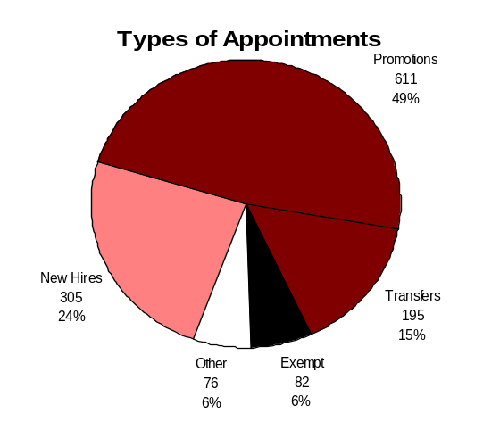
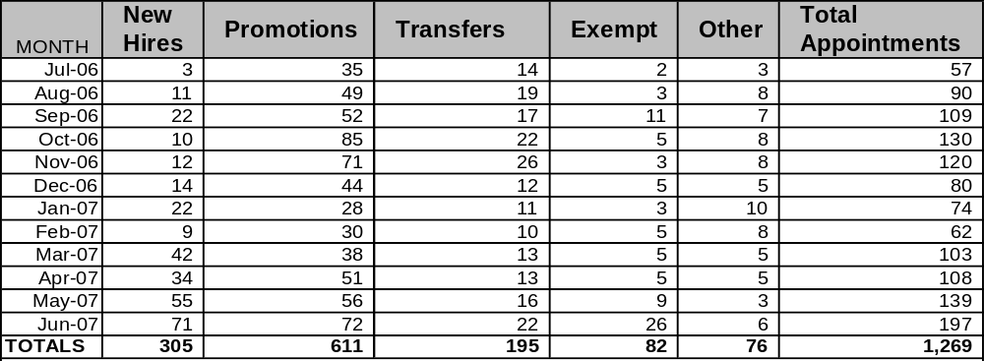
Hire Workforce
Outcomes:
Best candidates are hired and reviewed during appointment period. The right people are in the right job at the right time.
Performance Measures
Time-to-fill vacancies
Candidate quality
Hiring Balance (proportion of appointment types)
Separation during review period
Department of Social and Health Services
Hiring Balance / Separations During Review Period
Separation During Review Period
Probationary separations - Voluntary 62
Probationary separations - Involuntary 37
  Total Probationary Separations 99
Trial Service separations - Voluntary 40
Trial Service separations - Involuntary 6
  Total Trial Service Separations 46
Total Separations During Review Period 145
Time period = 07/2006 through 06/2007
Total number of appointments = 1,269
Time period = 07/2006 through 06/2007
Includes appointments to permanent vacant positions only; excludes reassignments
“Other” = Demotions, re-employment, reversion & layoff appointments
Analysis and Action Steps see next page
Data as of June 30, 2007
Source: HRMS Business Warehouse

Slide 11
Hire Workforce
Outcomes:
Best candidates are hired and reviewed during appointment period. The right people are in the right job at the right time.
Performance Measures
Time-to-fill vacancies
Candidate quality
Hiring Balance (proportion of appointment types)
Separation during review period
Department of Social and Health Services
Hiring Balance / Separations During Review Period
Analysis:
The chart shows 49% of appointments at DSHS were promotional. The HRMS data for the period of July 2006 through February 2007 includes probationary appointments within the agency as well as promotions. This accounts for the increased percentage of new hires over the percentage reported in May 2007 GMAP for July through December 2006. At the end of February 2007, HRMS was recoded to separately identify probationary appointments from promotions.
As of June 30, 2007, DSHS had created and/or released 1,621 requisitions and generated 873 certified lists.
The 2007 supplemental budget funds an additional 23.4 FTE’s and the 2007-2009 budget funds an additional 702.3 FTE’s which means there will be increased activity in recruitment and hiring.
15% of staff hired into probationary and trial service appointments separated prior to achieving permanent status. DSHS needs to identify the cause(s) of the separations to develop effective strategies to reduce this percentage.
The query provided does not include any WMS trial service appointments of new hires or probationary or trial service appointments made through the agency’s conversion process.
Action Steps:
DSHS will continue to focus on E-Recruiting efforts to increase our effectiveness in hiring and retaining employees. (See Slide 9 - Action Steps)
HRD will track and distribute monthly reports to the administrations identifying number of vacancies, number of certified registers, number of hires, and number of days to fill vacancies. Analysis and best practices will be shared via the department’s E-Recruiting website.
DSHS administrations developed recruitment plans identifying specific strategies for filling positions authorized for the 2007-2009 biennium. These recruitment plans are reviewed and monitored through the Recruitment Committee Meetings.
On September 14, 2007, at the DSHS Strategic Planning Roundtable meeting representatives from administrations agreed to incorporate the DSHS Recruitment Plans into the Agency’s Strategic Plan.
During August and September 2007, DSHS solicited input regarding the Employee Exit Questionnaire. The revised form has been finalized.
In October 2007, the Secretary will send a memo to reinforce the importance of the use of exit questionnaire for the collection of statistics that DSHS can use to identify the reasons why employees are leaving the agency.
Administrations will begin reporting exit data on a monthly basis beginning November 2007.
Data as of June 30, 2007
Source: HRMS Business Warehouse

Slide 12
Deploy Workforce
Outcomes:
Staff know job expectations, how they’re doing, & are supported. Workplace is safe, gives capacity to perform, & fosters productive relations. Employee time and talent is used effectively. Employees are motivated.
Performance Measures
Percent employees with current performance expectations
Employee survey ratings on “productive workplace” questions
Overtime usage
Sick leave usage
Non-disciplinary grievances/appeals filed and disposition (outcomes)
Worker safety
Department of Social and Health Services
Current Performance Expectations
Percent employees with current performance expectations = 71.1%*
Action Steps:
DSHS PDP training for managers and supervisors will include:
  The importance of identifying performance expectations for new and current employees
  The purpose of expectations and how to write and communicate them
  Setting and adjusting timeframes to meet leave, turnover, and internal staff movement
Effective July 1, 2007, DSHS started using the HRMS system to enter and track performance expectations, performance development plans and position description forms.
Administrations are expected to identify performance expectations for employees upon hire.
By October 31, 2007, HRD staff will be trained to input this data and generate reports.
*Based on 8,151 of 11,459 employees that were due evaluations.
Applies to employees in permanent positions, both WMS & WGS
Analysis:
This measure correlates to completion of part 1 of the Performance Development Plan (PDP).
From July 2006 thru December 30, 2006, the percentage of current performance expectations was an approximation based on total employee count; not the number of employees due evaluations.
From January 2007 thru June 2007 a manual count of evaluations due was used as the percentage base.
Data gathered from all administrations revealed the following trends interfere with completion of performance evaluations:
  Vacations, extended sick leave, resignations, transfers, promotions of staff and supervisors
  Staff movement within institutions
  Lack of training for supervisors
Data as of June 30, 2007
Source: Internal Process and Survey

Slide 13
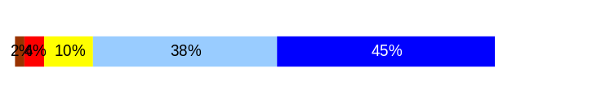
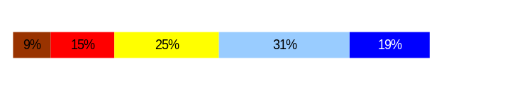
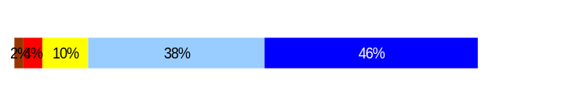
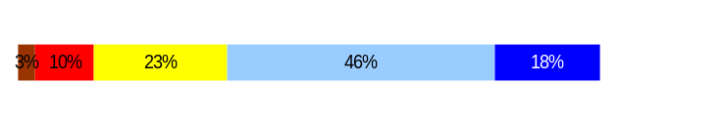
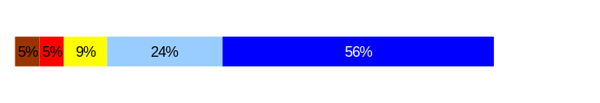
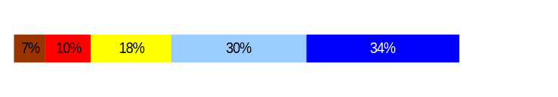
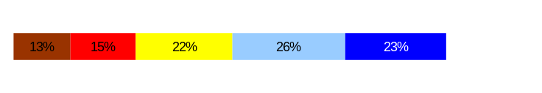
Deploy Workforce
Outcomes:
Staff know job expectations, how they’re doing, & are supported. Workplace is safe, gives capacity to perform, & fosters productive relations. Employee time and talent is used effectively. Employees are motivated.
Performance Measures
Percent employees with current performance expectations
Employee survey ratings on “productive workplace” questions
Overtime usage
Sick leave usage
Non-disciplinary grievances/appeals filed and disposition (outcomes)
Safety and Workers Compensation (TBD)
Department of Social and Health Services
[Enter Agency Name]
Employee Survey “Productive Workplace” Ratings
Avg
Q4. I know what is expected of me at work.
Q1. I have opportunity to give input on decisions affecting my work.
Q2. I receive the information I need to do my job effectively.
Q6. I have the tools and resources I need to do my job effectively.
Q7. My supervisor treats me with dignity and respect.
Q8. My supervisor gives me ongoing feedback that helps me
improve my performance.
Q9. I receive recognition for a job well done.
Analysis:
83% of all respondents indicate they know what is expected of them at work, but only 64% say they receive ongoing feedback.
84% feel they receive the information needed to do the job effectively, while only 50% have opportunity to give input on decisions.
80% say they were treated with dignity and respect, but only 49% feel they receive recognition for a job well done.
Action Steps:
Each January, the Secretary will send a memo to staff to encourage agency-wide participation in the annual employee recognition program.
The DSHS Statewide Employee Recognition Workgroup received ideas from a survey to improve the nomination form. These will be incorporated into the new form by November 2007.
In March 2007, the administrations sent their employee survey action plan progress report to the Secretary for review.
At the end of August 2007, each administration submitted their employee survey progress report to the Secretary.
4.2
3.4
3.7
3.6
4.2
3.7
3.3
Never
Seldom
Occasionally
Usually
Always
Overall average score for Productive Workplace Ratings: 3.7
Footnotes:
  DSHS Employee Survey: March – April 2006
  Number of Respondents: 13,311 – 77% Response Rate – based on FTEs
  All DSHS Employees – Unweighted
  In addition to multiple choice questions, DSHS also offered two open-ended questions for employees to answer. Some analyses were based on responses to these open-ended questions.
Data as of June 30, 2007
Source: DSHS Employee Survey: March – April 2006

Slide 14
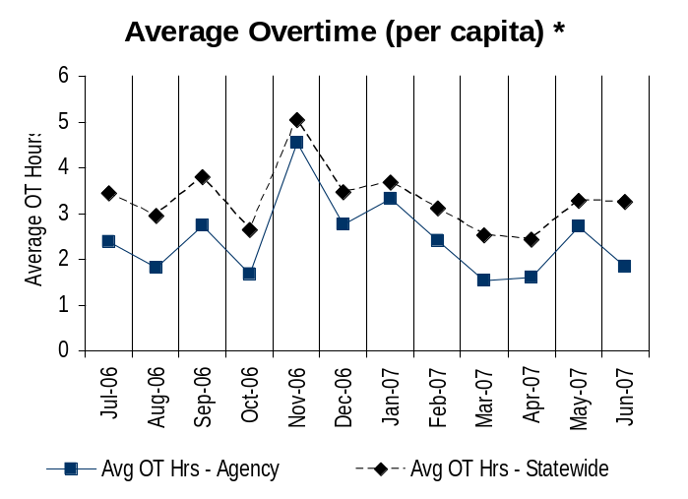
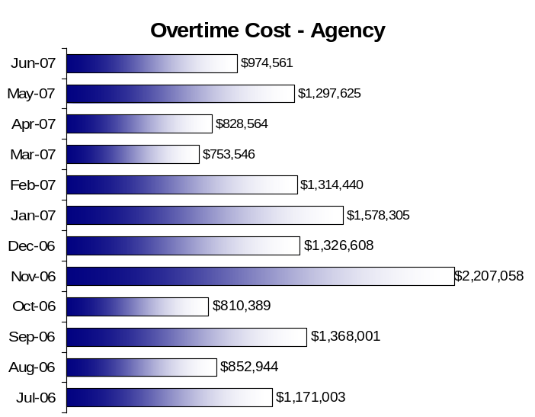
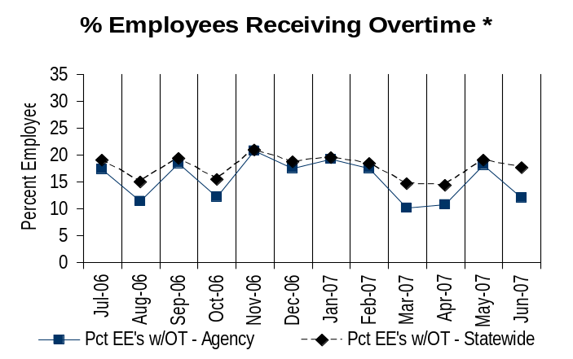
Deploy Workforce
Outcomes:
Staff know job expectations, how they’re doing, & are supported. Workplace is safe, gives capacity to perform, & fosters productive relations. Employee time and talent is used effectively. Employees are motivated.
Performance Measures
Percent employees with current performance expectations
Employee survey ratings on “productive workplace” questions
Overtime usage
Sick leave usage
Non-disciplinary grievances/appeals filed and disposition (outcomes)
Worker safety
Department of Social and Health Services
Overtime Usage
Overall agency avg overtime usage – per capita, per month: 2.5**
*Statewide overtime values do not include DNR
**Overall agency avg overtime usage – per capita, per month = sum of monthly OT averages divided by number of months
Analysis and Action Steps see next page
Overall agency avg employees receiving overtime per month: 15.5%**
*Statewide overtime values do not include DNR
**Overall agency avg employees receiving overtime per month = sum of monthly OT percentages divided by number of months
Data as of June 30, 2007
Source: HRMS Business Warehouse

Slide 15
Deploy Workforce
Outcomes:
Staff know job expectations, how they’re doing, & are supported. Workplace is safe, gives capacity to perform, & fosters productive relations. Employee time and talent is used effectively. Employees are motivated.
Performance Measures
Percent employees with current performance expectations
Employee survey ratings on “productive workplace” questions
Overtime usage
Sick leave usage
Non-disciplinary grievances/appeals filed and disposition (outcomes)
Worker safety
Department of Social and Health Services
Overtime Usage
Analysis:
The statistics are based upon 16,527 permanent staff.
Agency-wide overtime usage between July 1, 2006 and June 30, 2007 averaged 2.5 hours per employee per month.
Between July 1, 2004 and June 30, 2005, 24.4% permanent DSHS employees received overtime, with the state-wide average at 26.7%. From July 1, 2005 through June 30, 2006, 26.4% of DSHS employees received overtime, and the state-wide average was 21.3%. From July 1, 2006 to June 30, 2007, DSHS employees received 15.5% overtime. This represents a 10.9% drop from the previous year and is below the state-wide average of 17.7%.
DSHS analysis shows that 85.5% of DSHS overtime (OT) costs are driven by institutions operating 24/7.
DOP’s query does not include OT data for non-permanent staff.
The Collective Bargaining Agreement requires OT eligible shift employees who work more than their scheduled shift to be compensated at the OT rate for any hours over their shift. DSHS has approximately 2,868 positions who are shift OT eligible workers. During this reporting period, 58.4% (1,674) of these positions earned overtime.
Vacancies and absences due to annual leave, sick leave and training within institutions contribute to OT. Both permanent and on-call employees fill in for those who are absent.
Serving high risk clients requiring 1:1 observation contributes to OT in institutions. Also, OT may be required for staff responding to situations that jeopardize client health or safety.
Action Steps:
DSHS will continue to monitor OT at institutions and at divisional, regional/district and office levels to identify seasonal or other patterns and to identify possible savings on coverage options.
DSHS managers will review staffing models/schedules to ensure the institutions are properly staffed.
DSHS re-verified positions that are eligible for shift overtime.

Slide 16
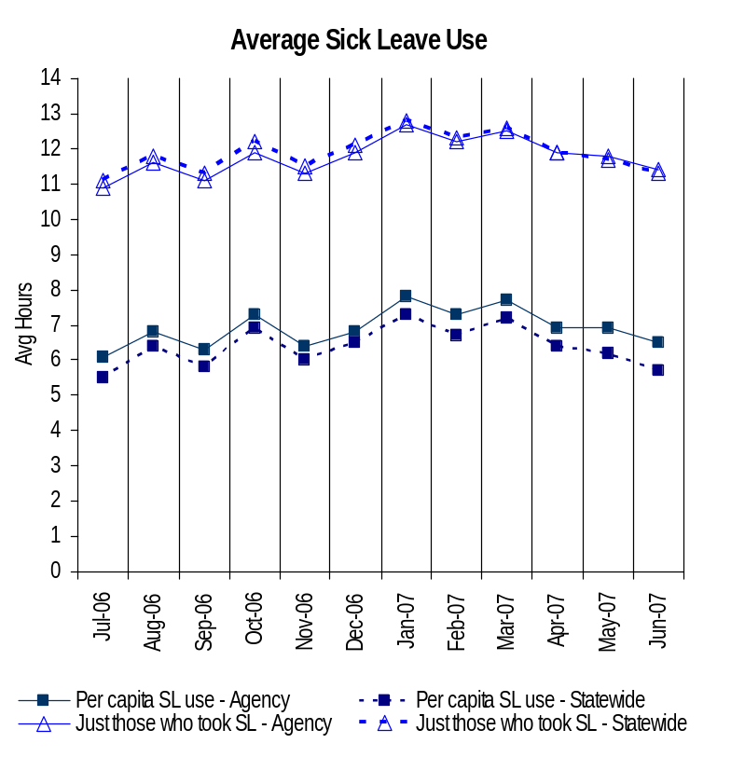
Deploy Workforce
Outcomes:
Staff know job expectations, how they’re doing, & are supported. Workplace is safe, gives capacity to perform, & fosters productive relations. Employee time and talent is used effectively. Employees are motivated.
Performance Measures
Percent employees with current performance expectations
Employee survey ratings on “productive workplace” questions
Overtime usage
Sick leave usage
Non-disciplinary grievances/appeals filed and disposition (outcomes)
Worker safety
Department of Social and Health Services
Sick Leave Usage
Analysis:
From July 1, 2004 through June 30, 2005, the average DSHS sick leave usage was 7.7 hours per month per capita. Between July 1, 2005 and June 30, 2006, the average per capita usage was 7.9 hours per month, representing a .2% of an hour increase. From July 1, 2006 through June 30, 2007, the per capita average dropped to 6.9 hours per month, representing a reduction of 1 hour per month per capita.
DSHS is committed to meeting the sick leave usage goal. However, DSHS has 22 institutions ( e.g. Western State Hospital, State Operated Living Alternative (SOLA), Group Homes) providing a wide variety of services. The majority of sick leave usage comes from shift employees providing direct care services. For this reason, we anticipate remaining slightly higher than the state average in both per capita and individual sick leave usage.
Action Steps:
In July 2007, the Secretary sent out a memo indicating DSHS would strive to meet the state-wide sick leave usage goal.
HRD sent a memo to time and attendance processors to ensure input of leave is consistent with the leave codes and types on October 2, 2007.
Sick Leave Hrs Used / Earned (per capita)
Avg Hrs SL Used (per capita) - Agency | % of SL Hrs Earned (per capita) - Agency
6.9 Hrs | 89.8%
Avg Hrs SL Used (per capita) – Statewide* | % of SL Hrs Earned (per capita) – Statewide*
6.4 Hrs | 82.6%
Sick Leave Hrs Used / Earned (those who took SL)
Avg Hrs SL Used (those who took SL) - Agency | % SL Hrs Earned (those who took SL) - Agency
11.8 Hrs | 147.1%
Avg Hrs SL Used (those who took SL) – Statewide* | % SL Hrs Earned (those who took SL) – Statewide*
11.9 Hrs | 148.4%
Sick Leave time period = 07/2006 through 06/2007
* Statewide data does not include DOL, DOR, L&I, and LCB
Source: DOP Provided numbers on Spreadsheet

Slide 17
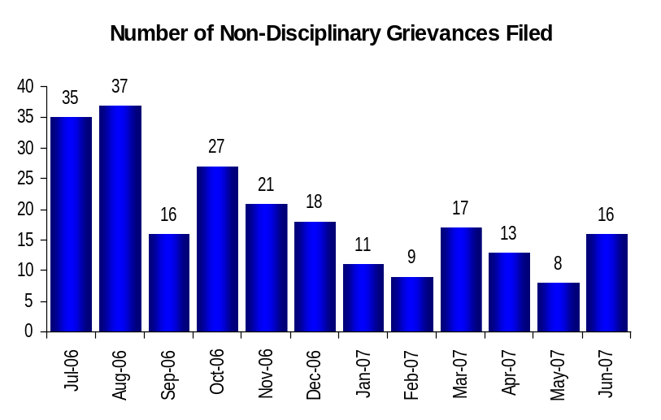
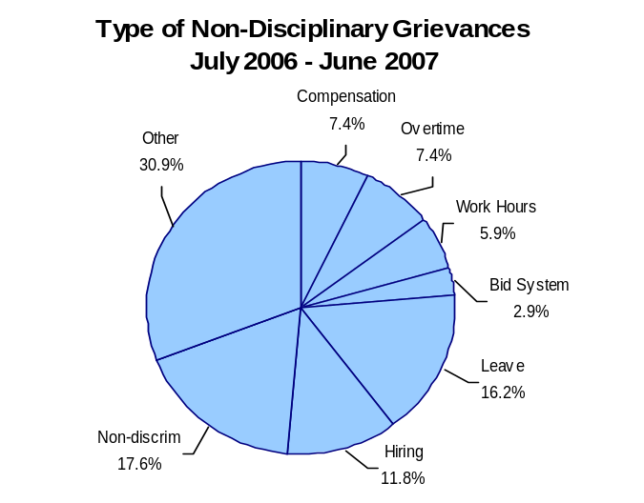
Deploy Workforce
Outcomes:
Staff know job expectations, how they’re doing, & are supported. Workplace is safe, gives capacity to perform, & fosters productive relations. Employee time and talent is used effectively. Employees are motivated.
Performance Measures
Percent employees with current performance expectations
Employee survey ratings on “productive workplace” questions
Overtime usage
Sick leave usage
Non-disciplinary grievances/appeals filed and disposition (outcomes)
Safety and Workers Compensation (TBD)
Department of Social and Health Services
[Enter Agency Name]
Non-Disciplinary Grievances (represented employees)
Analysis and Action Steps see next page
Total Non-Disciplinary Grievances = 228
* There is not a one-to-one correlation between the number of grievances filed (shown top of page) and the outcomes determined during this time period. The time lag between filing date and when a decision is rendered can cross the time periods indicated.
Non-Disciplinary Grievance Disposition*
(Outcomes determined during 07/2006 through 06/2007
46 Closed
48 Pending
97 Settled
61 Withdrawn
____________
252 Total
Data as of June 30, 2007
Source: Internal Reporting
Notes:
Closed – a decision has been made and the grievance is considered closed or completed.
Settled – Means the parties reached a settlement agreement
Withdrawn -The union withdrew the grievance

Slide 18
Deploy Workforce
Outcomes:
Staff know job expectations, how they’re doing, & are supported. Workplace is safe, gives capacity to perform, & fosters productive relations. Employee time and talent is used effectively. Employees are motivated.
Performance Measures
Percent employees with current performance expectations
Employee survey ratings on “productive workplace” questions
Overtime usage
Sick leave usage
Non-disciplinary grievances/appeals filed and disposition (outcomes)
Safety and Workers Compensation (TBD)
Department of Social and Health Services
[Enter Agency Name]
Non-Disciplinary Grievances (represented employees)
Analysis:
Compiling grievance disposition data is hampered by different definitions of outcomes between HRMS and GMAP. A possible GMAP disposition is “Closed,” which means “not advanced,” “arbitration decision,” “grievance resolution panel decision,” or “closed by OFM Labor Relations Office.” In HRMS, these outcomes are defined respectively as “withdrawn,” or “arbitration decision,” (recorded as its own category in HRMS).
From June 2006 – June 2007, 325 grievances were filed. 228 were non-disciplinary grievances and 97 disciplinary grievances.
As Management, employees, and the Union increase their understanding of contract language, and as a history of interpretative arbitration decisions occur, fewer non-disciplinary grievances are being filed. Half as many non-disciplinary grievances were filed between January – June 2007 than between July – December 2006 (154 to 74).
However, the number of disciplinary grievances filed between January – June 2007 was nearly triple the number filed between July – December 2006 (26 to 71). The disciplinary article is cited in grievances nearly as often as all other CBA articles combined. This is because a grievance is the only avenue of appeal for disciplinary actions. It also suggests that as management becomes more familiar with just cause provisions, more disciplines are occurring.
The definition of “Other” includes CBA articles that are not listed individually as percentages on the chart. It excludes the disciplinary article which has a separate page in this report.
Action Steps:
From January – June 2007, HRD staff trained 2,305 appointing authorities, direct reports and supervisors on the new 2007 – 2009 collective bargaining agreements that took effect July 1, 2007.
HRD will continue to meet regularly with Management and OFM Labor Relations staff to strategize and resolve administration of contract language and to support agency-wide and local union-management communication committee meetings. HRD will also continue to meet regularly with WFSE representatives regarding upcoming events and issues in order to avoid disputes and resolve differences in administration of contract language at the lowest possible level.
HRD will implement a companion grievance tracking system in order to more accurately record grievance data, so that in subsequent quarters GMAP data does not have to be compiled manually.
Notes:
Closed – a decision has been made and the grievance is considered closed or completed.
Settled – Means the parties reached a settlement agreement
Withdrawn -The union withdrew the grievance

Slide 19
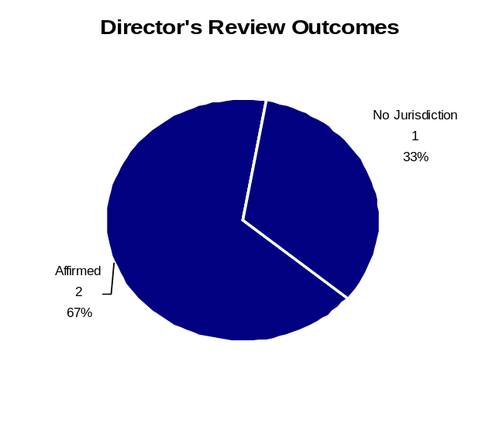
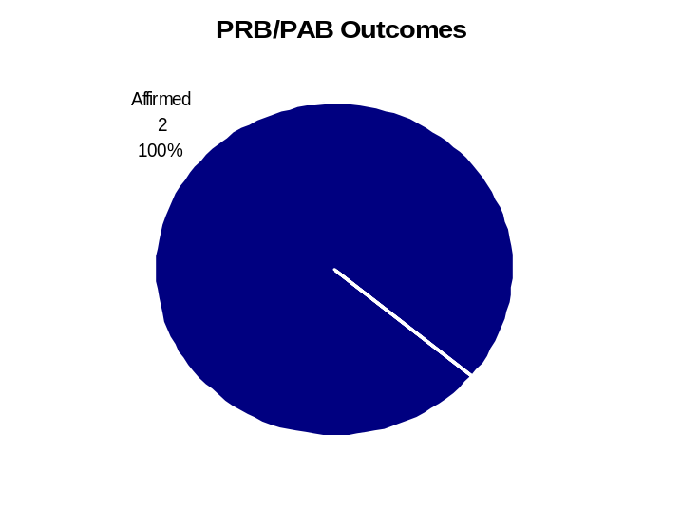
Deploy Workforce
Outcomes:
Staff know job expectations, how they’re doing, & are supported. Workplace is safe, gives capacity to perform, & fosters productive relations. Employee time and talent is used effectively. Employees are motivated.
Performance Measures
Percent employees with current performance expectations
Employee survey ratings on “productive workplace” questions
Overtime usage
Sick leave usage
Non-disciplinary grievances/appeals filed and disposition (outcomes)
Safety and Workers Compensation (TBD)
Department of Social and Health Services
[Enter Agency Name]
Non-Disciplinary Appeals (mostly non-represented employees)
Filings for DOP Director’s Review
Time Period = 07/2006 through 06/2007
20 Job classification
1 Rule violation
0 Name removal from register
0 Rejection of job application
0 Remedial action
21 Total filings
Filings with Personnel Resources Board
Time Period = 07/2006 through 06/2007
2 Job classification
1 Other exceptions to Director Review
0 Layoff
0 Disability separation
0 Non-disciplinary separation
3 Total filings
Non-Disciplinary appeals only are shown above.
There is not a one-to-one correlation between the filings shown above and the outcomes displayed in the charts below. The time lag between filing date and when a decision is rendered can cross the time periods indicated. Five appeals from previous time period have not been scheduled,
Total outcomes = 3
Time Period = 07/2006 through 06/2007
Total outcomes = 2
Time Period = 07/2006 through 06/2007
Source: Dept of Personnel

Slide 20
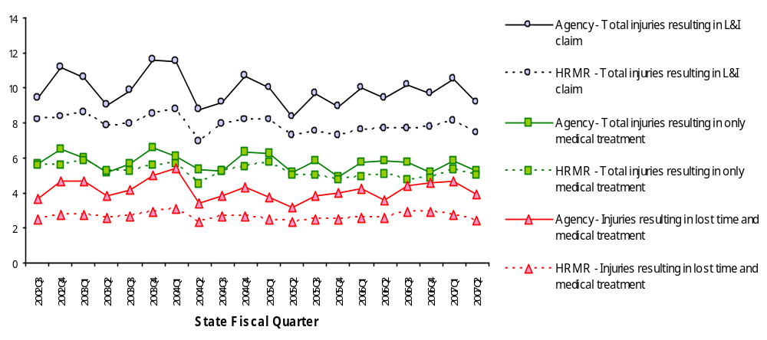
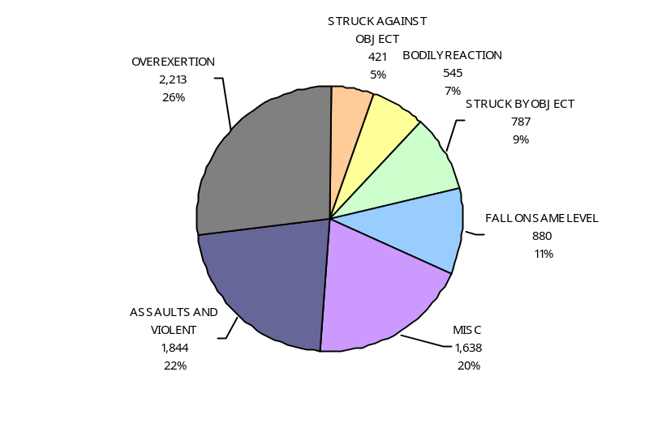
Deploy Workforce
Outcomes
Staff know job expectations, how they’re doing, & are supported. Workplace is safe, gives capacity to perform, & fosters productive relations. Employee time and talent is used effectively. Employees are motivated.
Performance Measures
Percent employees with current performance expectations
Employee survey ratings on 'productive workplace' questions
Overtime usage
Sick leave usage
Non-disciplinary grievances/appeals filed and disposition outcomes
Worker Safety
Department of Social and Health Services
Worker Safety
Allowed Annual
Claims Rate*^:
Agency vs. All HR
Management Report
(HRMR) agencies
*Annual claims rate
is # claims / 100 FTE
1 FTE = 2000 hours
^Due to natural lag
in claim filing, rates
are expected to
increase significantly
over time
Injuries by Occupational
Injury and Illness
Classification (OIICS)
event:
For fiscal period 2002Q3
through 2007Q2
(categories under 3% or not
adequately coded are grouped
into 'misc.')
Oiics Code | Oiics Description | Percent | Number
61 | Assaults And Violent | 22% | 1844
21 | Bodily Reaction | 7% | 545
13 | Fall On Same Level | 11% | 880
- | Misc | 20% | 1638
22 | Overexertion | 27% | 2213
01 | Struck Against Object | 5% | 421
02 | Struck By Object | 9% | 787
Source: Labor & Industries, Research and Data Services (data as of 09/03/2007 )
Notes:
HRMR Safety Report Overview
The HRMR Safety Reports are:
- PowerPoint slides created by the Department of Labor and Industries
- Created for each state agency that is reporting their employee safety program results bi-
annually as part of their Human Resources Management Report (HRMR).
- Snapshots of five years of worker’s compensation claim data specific to that agency, as
well as a comparison to the combined data for agencies completing HRMR reports.
- There is a two quarter lag at the end of the five years.
This allows each agency’s payroll data to be entered into L&I’s computer system. This
payroll data is used to compute the number of workers per agency and quarter.
Definitions
Claim – When a covered worker sustains an occupational injury or illness, that worker files a
'claim’ for benefits. A 'claim number' is assigned, and all wage replacement payments, medical
provider bills, etc, for that worker and injury, are associated with that claim number.
Report Detail
'Allowed Annual Claim Rate'
This chart shows your agency's rate of injuries resulting in allowed
claims, by injury quarter, for on-the-job injuries and occupational illnesses. The rate for all
reporting agencies is shown for comparison.
- The rate is the number accepted claims per 200,000 annual worker hours (100 workers)
Three rates are included in this chart:
A)The total rate for all injuries resulting in a claim; the two groups listed below are
exclusive of each other.
B)The rate of injuries which required medical care, but no compensation for lost
time.
C)The rate of injuries which resulted in compensation for lost time in addition to
medical care.
'Injuries by Occupational Injury and Illness Classification (OIICS) Event’
This section contains a pie chart which shows your agency's injuries by type* and a table which
shows the percent and number of accepted claims by OIICS Event description and code.
This information is useful in identifying what causes injuries so prevention can occur. Prevention
might include root cause analysis, education, and hazard mitigation.
* Injury Type is based on the 2 digit Major Group code of the Event or Exposure section of the Occupational
Injury and Illness Classification System (OIICS). Groups with less than 3% of the
total injuries are combined into the 'Misc' category.
How to get this report for your agency:
All worker compensation reports will be available on the L&I website by the 20th of September or
the 20th of March of each year. The data will be provided in a PowerPoint slide to which you will
add your own analyses and action plans.

Slide 21
Deploy Workforce
Outcomes
Staff know job expectations, how they’re doing, & are supported. Workplace is safe, gives capacity to perform, & fosters productive relations. Employee time and talent is used effectively. Employees are motivated.
Performance Measures
Percent employees with current performance expectations
Employee survey ratings on 'productive workplace' questions
Overtime usage
Sick leave usage
Non-disciplinary grievances/appeals filed and disposition outcomes
Worker Safety
Department of Social and Health Services
Analysis:
The chart reflects the total injuries by occupational injury and illnesses beginning October 2002 through September 30, 2007.
The Overexertion category includes Ergonomics related claims.
DSHS has a total of 13 residential facilities which account for approximately 95% of patient/staff assault claims. Western State Hospital and Rainier School have the highest number of patient/staff assault incidents.
Patient staff assaults accounts for 22% of worker’s compensation claims filed with the Department of Labor and Industries (L & I).
Action Steps:
Continue to provide L&I information to management and employees regarding safety and worker’s compensation through:
  Monthly reports
  Safety newsletter
  Responding to requests for information
Continue the recognition of safety performance as part of the annual agency employee recognition and awards activities.
Continue to provide guidance to all DSHS safety committees regarding effective workplace safety plans and activities.
Continue to provide worksite safety training and awareness to staff and management to include ergonomics.
Continue training supervisors and managers on the topics of:
  Conducting accident investigations
  Developing accident prevention strategies and measurements
Consult with residential facilities to reduce patient/staff assaults. Facilities provide training on appropriate treatment models and behavior management techniques to reduce patient/staff assaults.
Source: Labor & Industries, Research and Data Services (data as of 09/03/2007 )
Notes:
HRMR Safety Report Overview
The HRMR Safety Reports are:
- PowerPoint slides created by the Department of Labor and Industries
- Created for each state agency that is reporting their employee safety program results bi-
annually as part of their Human Resources Management Report (HRMR).
- Snapshots of five years of worker’s compensation claim data specific to that agency, as
well as a comparison to the combined data for agencies completing HRMR reports.
- There is a two quarter lag at the end of the five years.
This allows each agency’s payroll data to be entered into L&I’s computer system. This
payroll data is used to compute the number of workers per agency and quarter.
Definitions
Claim – When a covered worker sustains an occupational injury or illness, that worker files a
'claim’ for benefits. A 'claim number' is assigned, and all wage replacement payments, medical
provider bills, etc, for that worker and injury, are associated with that claim number.
Report Detail
'Allowed Annual Claim Rate'
This chart shows your agency's rate of injuries resulting in allowed
claims, by injury quarter, for on-the-job injuries and occupational illnesses. The rate for all
reporting agencies is shown for comparison.
- The rate is the number accepted claims per 200,000 annual worker hours (100 workers)
Three rates are included in this chart:
A)The total rate for all injuries resulting in a claim; the two groups listed below are
exclusive of each other.
B)The rate of injuries which required medical care, but no compensation for lost
time.
C)The rate of injuries which resulted in compensation for lost time in addition to
medical care.
'Injuries by Occupational Injury and Illness Classification (OIICS) Event’
This section contains a pie chart which shows your agency's injuries by type* and a table which
shows the percent and number of accepted claims by OIICS Event description and code.
This information is useful in identifying what causes injuries so prevention can occur. Prevention
might include root cause analysis, education, and hazard mitigation.
* Injury Type is based on the 2 digit Major Group code of the Event or Exposure section of the Occupational
Injury and Illness Classification System (OIICS). Groups with less than 3% of the
total injuries are combined into the 'Misc' category.
How to get this report for your agency:
All worker compensation reports will be available on the L&I website by the 20th of September or
the 20th of March of each year. The data will be provided in a PowerPoint slide to which you will
add your own analyses and action plans.

Slide 22
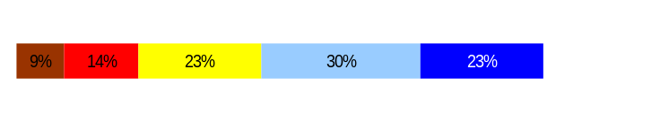
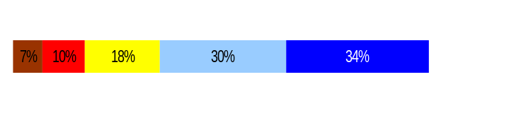
Develop Workforce
Outcomes:
A learning environment is created. Employees are engaged in professional development and seek to learn. Employees have competencies needed for present job and future advancement.
Performance Measures
Percent employees with current individual development plans
Employee survey ratings on “learning & development” questions
Competency gap analysis (TBD)
Department of Social and Health Services
[Enter Agency Name]
Individual Development Plans
Analysis:
This measure correlates to part 2 of the Performance Development Plan (PDP).
DSHS worked with each administration to manually verify the number of current individual development plans. The data is a reflection of the result of that collection.
Between the last reporting period and this period, there has been a significant increase, 11%, in completion of current individual development plans. This increase is due to the emphasis placed on supervisors/managers by the Secretary.
Only 53% of respondents feel they have opportunities to learn and grow at work.
Many employees appreciate the chance to take on challenging assignments.
Some employees want to have more opportunities to approach their work creatively.
Data gathered from all administrations revealed the following trends interfere with the timely completion of PDP’s:
  Vacations, extended sick leave, resignations, transfers, promotions of staff and supervisors
  Staff movement within institutions
  Lack of training by supervisors
Percent employees with current individual development plans = 90%
Total # of employees with current IDPs* = 14,874
Total # of employees* = 16,527
*Applies to employees in permanent positions, both WMS & GS
Employee Survey “Learning & Development” Ratings
Q5. I have opportunities at work to learn and grow.
Q8. My supervisor gives me ongoing feedback that helps me
improve my performance.
Avg
3.5
3.7
Never
Seldom
Occasionally
Usually
Always
Overall average score for Learning & Development Ratings: 3.6
Footnotes:
  DSHS Employee Survey: March – April 2006
  Number of Respondents: 13,311 – 77% Response Rate – based on FTEs
  All DSHS Employees – Unweighted
  In addition to multiple choice questions, DSHS also offered two open-ended questions for employees to answer. Some analyses were based on responses to these open-ended questions.
Data as of June 30, 2007
Source: Internal Procedures and Survey - DSHS Employee Survey: March – April 2006

Slide 23
Develop Workforce
Outcomes:
A learning environment is created. Employees are engaged in professional development and seek to learn. Employees have competencies needed for present job and future advancement.
Performance Measures
Percent employees with current individual development plans
Employee survey ratings on “learning & development” questions
Competency gap analysis (TBD)
Department of Social and Health Services
[Enter Agency Name]
Individual Development Plans
Action Steps:
The Secretary sent a memo to DSHS managers emphasizing the importance of workforce management and development.
DSHS PDP training for managers and supervisors will include a discussion on the importance of identifying individual development plans with employees to support the employee’s career growth, including:
  The importance of identifying performance expectations for new and current employees
  The purpose of expectations and how to write and communicate them
  Setting and adjusting timeframes to meet leave, turnover, and internal staff movement
Effective October 15, 2007, HRD will train Personnel Administrative Processors how to enter and track performance expectations, performance development plans and position description forms.
Data captured will be from July 1, 2007 forward.
Data as of June 30, 2007
Source: Internal Procedures and Survey - DSHS Employee Survey: March – April 2006

Slide 24
Reinforce Performance
Outcomes:
Employees know how their performance contributes to the goals of the organization. Strong performance is rewarded; poor performance is eliminated. Successful performance is differentiated and strengthened. Employees are held accountable.
Performance Measures
Percent employees with current performance evaluations
Employee survey ratings on “performance and accountability” questions
Disciplinary actions and reasons, disciplinary grievances/appeals filed and disposition (outcomes)
Reward and recognition practices (TBD)
Department of Social and Health Services
Current Performance Evaluations
Percent employees with current performance evaluations = 83.8*
*Based on 9,601 of 11,459 reported employees who had evaluations due, January 1 through June 30, 2007.
Applies to employees in permanent positions, both WMS & WGS
Analysis:
This measure correlates to part 5 of the Performance Development Plan (PDP).
DSHS is using the percent of completed PDP’s for this measure. Reporting this measure is a challenge, because PDP’s are completed throughout the year preventing a baseline measure from which to begin reporting for GMAP.
From July 2006 thru December 30, 2006, the percentage of current performance evaluations was an approximation based on total employee count; not the number of employees due evaluations.
From January 2007 thru June 2007 a manual count of evaluations due was used as the percentage base.
Data gathered from all administrations revealed the following trends interfere with completion of performance evaluations:
  Vacations, extended sick leave, resignations, transfers, promotions of staff and supervisors
  Staff movement within institutions
  Lack of training by supervisors
Action Steps:
DSHS PDP training for managers and supervisors will continue to address the importance of performance evaluations for employees, to include:
  The importance of identifying performance expectations for new and current employees
  The purpose of expectations and how to write and communicate them
  Setting and adjusting timeframes to meet leave, turnover, and internal staff movement
Effective October 15, 2007, HRD will train Personnel Administrative Processors how to enter and track performance expectations, performance development plans and position description forms.
Data captured will be from July 1, 2007 forward.
Data as of June 30, 2007
Source: Internal Procedure and Survey

Slide 25
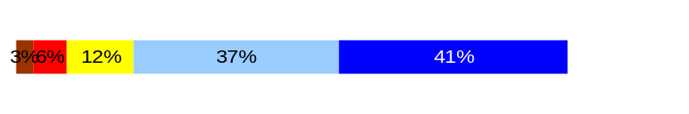
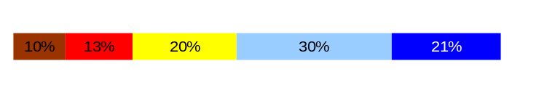
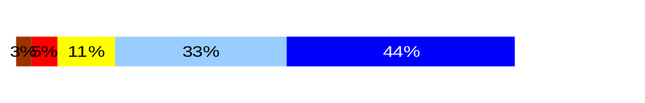
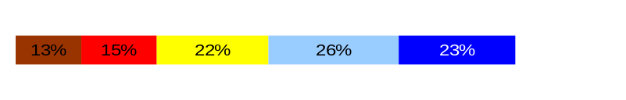
Reinforce Performance
Outcomes:
Employees know how their performance contributes to the goals of the organization. Strong performance is rewarded; poor performance is eliminated. Successful performance is differentiated and strengthened. Employees are held accountable.
Performance Measures
Percent employees with current performance evaluations
Employee survey ratings on “performance and accountability” questions
Disciplinary actions and reasons, disciplinary grievances/appeals filed and disposition (outcomes)
Reward and recognition practices (TBD)
[Enter Agency Name]
Department of Social and Health Services
Employee Survey “Performance & Accountability” Ratings
Analysis:
77% of respondents indicate their supervisors hold them accountable for performance.
Only 51% say their performance evaluation provides meaningful information about their performance.
Employee comments suggest that their evaluations should be timely, relevant, candid, and can help them do a better job.
Action Steps:
Administrations will develop communication tools to clarify for employees how success is measured and how the employee contributes to agency goals on an ongoing basis.
To improve delivery of employees Milestone Certificates for years of service, effective September 2007, personnel representatives in field offices are now completing them.
To maximize efficiency of creating Milestones certificates, the HRD website/employee recognition page now has monthly lists of DSHS staff earning milestones. Instructions, helpful tips and electronic certificate templates that are password protected for security are available on the web page.
Suggestions taken from the survey on the formal Employee Recognition Nomination form will be incorporated into the form by November 2007.
Avg
Q3. I know how my work contributes to the goals of my agency.
Q10. My performance evaluation provides me with meaningful information about my performance.
Q11. My supervisor holds me and my co-workers accountable for performance.
Q9. I receive recognition for a job well done.
4.1
3.4
4.1
3.3
Never
Seldom
Occasionally
Usually
Always
Overall average score for “Performance & Accountability” ratings: 3.7
Footnotes:
  DSHS Employee Survey: March – April 2006
  Number of Respondents: 13,311 – 77% Response Rate – based on FTEs
  All DSHS Employees – Unweighted
  In addition to multiple choice questions, DSHS also offered two open-ended questions for employees to answer. Some analyses were based on responses to these open-ended questions.
Data as of June 30, 2007
Source: DSHS Employee Survey: March – April 2006

Slide 26
Reinforce Performance
Outcomes:
Employees know how their performance contributes to the goals of the organization. Strong performance is rewarded; poor performance is eliminated. Successful performance is differentiated and strengthened. Employees are held accountable.
Performance Measures
Percent employees with current performance evaluations
Employee survey ratings on “performance and accountability” questions
Disciplinary actions and reasons, disciplinary grievances/appeals filed and disposition (outcomes)
Reward and recognition practices (TBD)
Department of Social and Health Services
Formal Disciplinary Actions
Disciplinary Action Taken
Time period = 07/2006 through 06/2007
Analysis:
15% of the 114 disciplinary actions during this time period were not disputed while the remaining 85% were appealed through a grievance process.
As DSHS managers and supervisors become familiar with the “just cause” process, employees’ accountability for workplace actions has increased.
Between January 1, 2007 and June 30, 2007, there has been an overall decline in disciplinary actions due to management’s more aggressive just-cause approach to administering progressive discipline.
Disciplinary actions taken during this time period are subject to change based on settlement agreements, grievance decisions and appeals.
Action Steps:
HRD staff will continue to train and educate staff on:
  Just Cause discipline
  Performance issues
  Attendance issues
  Arbitration decisions
Dismissals | 31
Demotions | 19
Suspensions | 26
Reduction in Pay* | 38
Total Disciplinary Actions* | 114
* Reduction in Pay is not currently available in HRMS/BW
Issues Leading to Disciplinary Action
11 Ethics
1 Harassment
35 Inappropriate Behavior
25 Insubordination
7 Inappropriate Use of State Resources
35 Work Performance
Data as of June 30, 2007
Source: HRMS Business Warehouse

Slide 27
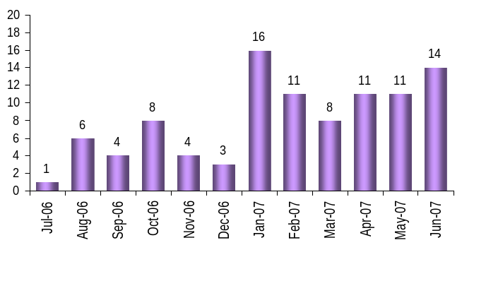
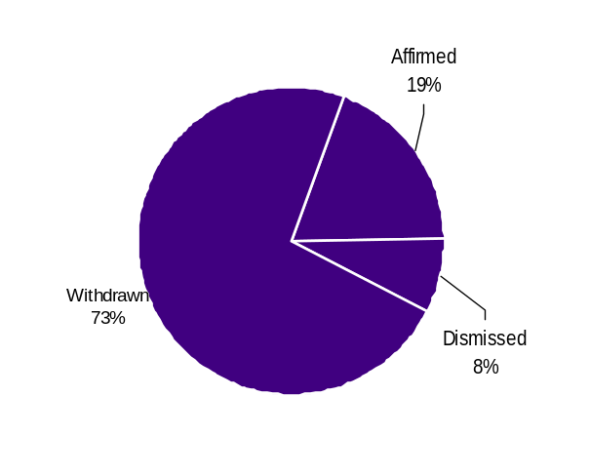
Reinforce Performance
Outcomes:
Employees know how their performance contributes to the goals of the organization. Strong performance is rewarded; poor performance is eliminated. Successful performance is differentiated and strengthened. Employees are held accountable.
Performance Measures
Percent employees with current performance evaluations
Employee survey ratings on “performance and accountability” questions
Disciplinary actions and reasons, disciplinary grievances/appeals filed and disposition (outcomes)
Reward and recognition practices (TBD)
Department of Social and Health Services
Disciplinary Grievances and Appeals
Disciplinary Grievances
(Represented Employees)
Disciplinary Appeals
(Non-Represented Employees
filed with Personnel Resources Board)
Time Period = 07/2006 through 06/2007
1 Dismissals
0 Demotions
0 Suspensions
0 Reduction in salary
1 Total Disciplinary Appeals Filed with PRB
Total # Disciplinary Grievances Filed: 97
DSHS Note: There is no one-to-one correlation between the filings shown above and the outcomes displayed in the charts below. The time lag between filing date and when a decision is rendered can cross the time periods indicated.
Disposition (Outcomes) of Disciplinary Grievances
Time period = 07/2006 through 06/2007
8 Closed
49 Pending
37 Settled
35 Withdrawn
Disposition (Outcomes) of Disciplinary Appeals*
Time period = 07/2006 through 06/2007
*Outcomes issued by Personnel Resources Board
Data as of June 30, 2007
Source: Internal Resources

Slide 28
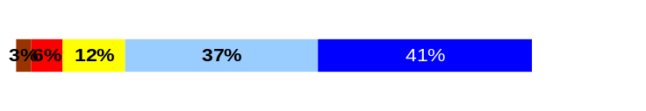
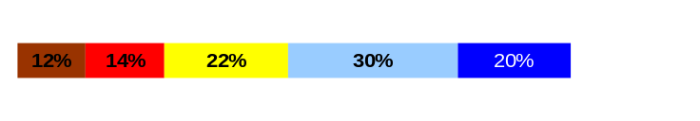
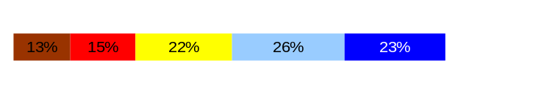
ULTIMATE OUTCOMES
Employees are committed to the work they do and the goals of the organization
Successful, productive employees are retained
The state has the workforce breadth and depth needed for present and future success
Performance Measures
Employee survey ratings on “commitment” questions
Turnover rates and types
Turnover rate: key occupational categories
Workforce diversity profile
Retention measure (TBD)
[Enter Agency Name]
Department of Social and Health Services
Employee Survey “Employee Commitment” Ratings
Analysis:
78% of respondents say they know how their work contributes to the agency goals.
Only 50% indicate that they know how the agency measures its success.
While some employees are proud of their contributions to agency goals, others feel their goals are hard to reach without sufficient resources.
Some employees feel the requirement for collecting and reporting data reduces their time to serve clients.
Action Steps:
Administrations within DSHS have developed specific action plans targeted at improving employee commitment ratings.
Examples include:
Executive managers have visited regional offices to talk with field employees and solicit their input.
Employees have been given the opportunity to provide input on new and revised policies and procedures, as appropriate, and on an ongoing basis.
Administrations will continue to gather input from staff for staff meetings.
Administrations will gather input on workflow and best practices.
Administrations will update the Intranet and Internet to make it a more user friendly and useful tool/resource for customers and staff.
The DSHS Chief Administrative Officer sent out an all state agency employee survey on October 1, 2007, to assess the satisfaction of our workforce.
Avg
Q3. I know how my work contributes to the goals of my agency.
Q12. I know how my agency measures its success.
Q9. I receive recognition for a job well done.
4.1
3.3
3.3
Never
Seldom
Occasionally
Usually
Always
Overall average score for Employee Commitment ratings: 3.6
Footnotes:
  DSHS Employee Survey: March – April 2006
  Number of Respondents: 13,311 – 77% Response Rate – based on FTEs
  All DSHS Employees – Unweighted
  In addition to multiple choice questions, DSHS also offered two open-ended questions for employees to answer. Some analyses were based on responses to these open-ended questions.
Data as of June 30, 2007
Source: DSHS Employee Survey: March – April 2006

Slide 29
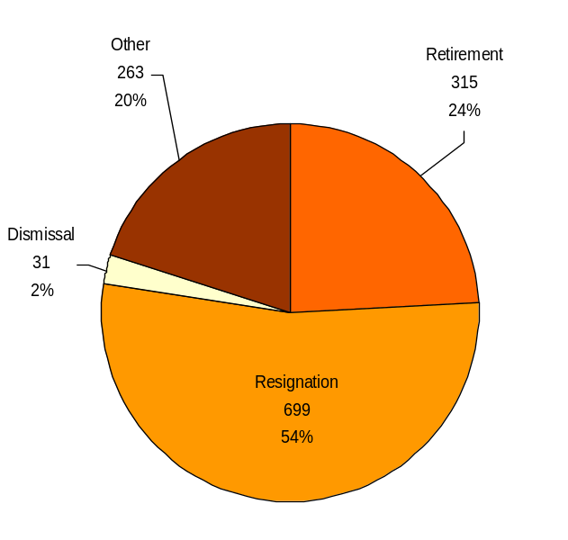
ULTIMATE OUTCOMES
Employees are committed to the work they do and the goals of the organization
Successful, productive employees are retained
The state has the workforce breadth and depth needed for present and future success
Performance Measures
Employee survey ratings on “commitment” questions
Turnover rates and types
Turnover rate: key occupational categories
Workforce diversity profile
Retention measure (TBD)
Department of Social and Health Services
Turnover Rates
Total % Turnover (leaving state)
Time Period: 07/2006 through 06/2007
Analysis:
Of the 1,308 employees who left DSHS between July 2006 through June 2007, 315 or 24% of the employee turnover resulted from retirement and 699 or 54% resigned.
Turnover statistics only include employees in permanent, probationary or trial service status.
The category “Other” includes disability separations, separations during the probationary period, death, layoff, failure to comply with union shop requirement, reversion out to register and abandonment of position.
Over the next two years, approximately 3,607 employees are eligible to retire. Even though 2,997 employees were eligible to retire during the period of July 1, 2006 to June 30, 2007, only 315 did so which is approximately 10.5%.
Of the 3,607 employees who are eligible to retire within the next two years, 1,146 are PERS Plan 1, 2,114 are PERS Plan 2 and 347 are PERS Plan 3.
Action Steps:
DSHS administrations are aware of the large number of employees eligible to retire in the next two years. Administrations will assess the likelihood of the number who will actually retire and develop strategies for their replacement as they develop and update Recruitment and Succession Plans by October 2007.
DSHS has revised the exit questionnaire to collect more detailed information on why employees leave. Administrations will begin collecting and analyzing the data in July 2007 and incorporate the early results of the data into strategies for Recruitment and Succession Plans due October 2007.
Total Turnover Actions: 1,308
Total % Turnover: 7.4%
Note: Movement to another agency is currently not available in HRMS/BW
Data as of June 30, 2007
Source: HRMS Business Warehouse

Slide 30
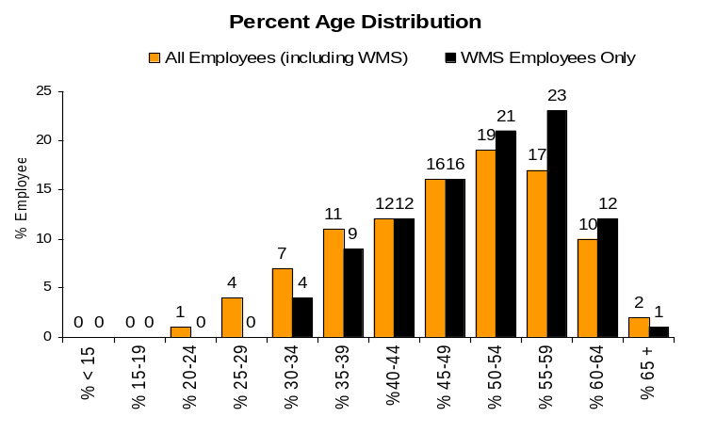
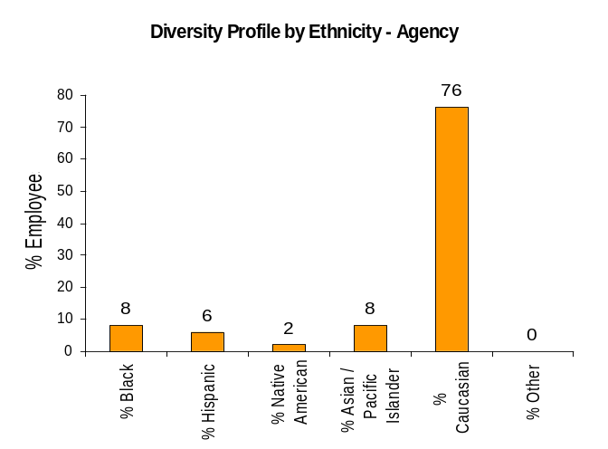
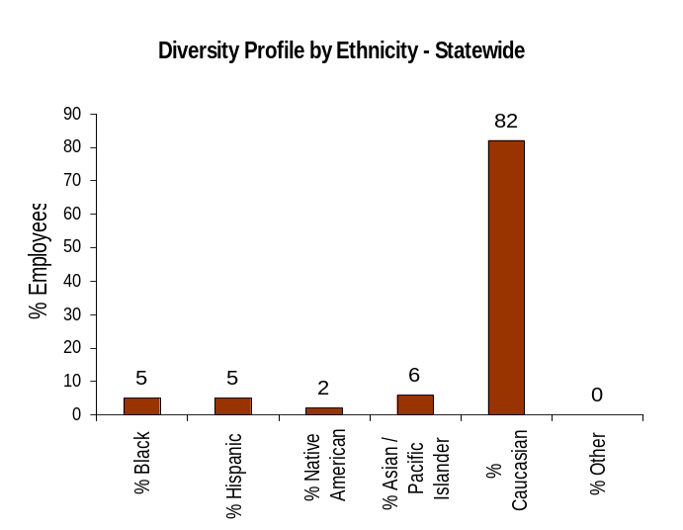
ULTIMATE OUTCOMES
Employees are committed to the work they do and the goals of the organization
Successful, productive employees are retained
The state has the workforce breadth and depth needed for present and future success
Performance Measures
Employee survey ratings on “commitment” questions
Turnover rates and types
Turnover rate: key occupational categories
Workforce diversity profile
Retention measure (TBD)
Department of Social and Health Services
Workforce Diversity Profile
Agency State
Female 65% 53%
Disabled 6% 5%
Vietnam Vet 6% 7%
Disabled Vet 1% 2%
People of color 24% 18%
Persons over 40 77% 75%
Analysis:
Diversity Affairs Office shows a slight variance in the percentage of Workforce Diversity Profile groups listed.
Agency roll-up does not provide enough detail to identify where under-representation exists within each Administration, Region and Job Group.
All Job Groups are combined and do not reflect a true picture of the gaps that exist between Skilled Craft workers and Executive Management.
Action Steps:
Diversity Affairs will work with administrations to review their monthly Affirmative Action Goals Reports to identify under-representation and assist in developing strategies for solutions.
Diversity Affairs will continue to identify and focus hiring and succession efforts on Regions and Job Groups where under-representation exists.
Affirmative Action Plan has been completed and submitted for approval to DOP. Issues identified in Analysis are being addressed through an Action Steps & Implementation Plan.
The agency-wide strategic plan will be implemented after July 2008 and will include an agency wide focus on diversity.
Effective July 15, 2007, all employment opportunities listed on the DSHS Employment website are also shared with diverse communities and populations throughout Washington State.
Data as of June 30, 2007
Source: HRMS Business Warehouse

