Slide 1
S1 Welcome and Introduction
S2 Deployment State CVISN System Design
S3 System Design Guidelines/ Pre-Work Review
S4 Panel Discussion
S5 Safety Information Exchange
S6 Credentials Administration
S7 Conformance Assurance Process/Questions
S8 Electronic Screening
S9 Scope Workshop Recap
S10 Work Session & Consultation
S11 State Presentations
S12 Feedback and Next Steps
Session 5
Safety Information Exchange
Notes:
PC
Projection

Slide 2
Session Plan
Day 1
Overview: Safety Information Exchange (12 min)
New Safety Systems (16 min)
Snapshots & Safety Reports (12 min)
Example Operational Scenario (20 min)
Breakout Plan (10 min)
Breakout: State CVISN system design (120 min)
Total Time = 190 min (3 hrs 10 min)
Day 2
State presentations & questions (30 min)
Notes:
Overhead
Viewgraph

Slide 3
Session Objectives
Understand CVISN operational concepts and architectural guidelines related to Safety Information Exchange:
  Exchanging safety information electronically
  New systems
    SAFER
    CVIEW
  Snapshots and reports
Walk through an inspection reporting example
Make preliminary design decisions about safety information exchange in your state
Scope Page 5 - <number>
Notes:
PC
Projection

Slide 4
Safety Information Exchange
The Safety Information Exchange capabilities
Automated collection of safety performance information
Automated collection of credentials information
Improved access to carrier and vehicle safety and credentials information *
Proactive updates of carrier and vehicle snapshots *
Support programs to identify unsafe operators and improve their performance
(* no consensus yet for including driver snapshots)
Expected benefits
Improved safety performance
Increased scrutiny of safety performance by the insurance industry
Focusing government resources on high risk operators
Providing carriers with better information to manage their safety programs
Overview
Notes:
PC
Projection

Slide 5
SAFER & CVIEW are needed to support increased demand for safety data.
As roadside functions become automated they need to receive more data electronically
Few legacy systems can handle the need
  High volume queries / responses from roadside and administrative offices
  Near real-time response
  High-priority updates
Overview
Notes:
PC
Projection

Slide 6
SAFER & CVIEW were created to
Minimize additional work load for legacy systems
Reduce the changes required in legacy systems by providing a single standard exchange format
- the snapshot
  Identifiers/Census Data
  Safety Data
  Credentials Data
Collect information from multiple sources so that data users go to a single place to get the data they need
Overview
Notes:
A snapshot is: A collection of carrier, vehicle, and driver (future) information assembled from authoritative or indirect sources.
Snapshots reflect the state of those data when the information was provided to SAFER/CVIEW.
PC
Projection

Slide 7
Safety Information Exchange: Standardized transactions and common identifiers enable roadside and deskside safety performance checking.
State Administrative Systems
Exchanging safety information is intended to improve safety performance.
Monitor safety performance in safety assurance programs;
Collect driver/vehicle inspection data, carrier compliance information, citation & accident data;
Provide safety & credentials snapshots to the roadside for screening & inspections;
Check safety history before granting credentials;
Share information with other states
Legacy Systems Associated with Safety
- SAFETYNET 2000
- Compliance (e.g., CAPRI)
1
Legacy Systems
Associated with Credentialing
2
Leg Sys Mods
1
4
LSIs
3
EDI
or
New
CVIEW
4
5
5
LSIs
or
EDI
AFF
Note: AFF - Application File Format
2
3
EDI
Leg Sys Mods
CVISN Core Infrastructure
State CV Roadside Check Stations (Fixed or Mobile)
- Roadside Operations
- Screening
- Inspection (e.g., ASPEN)
- Citation & Accident
SAFER
2
5
MCMIS
AFF
New
Overview
Scope Page 5 - <number>
Notes:
This slide shows the systems that are involved in safety information exchange.
REVIEW the numbered points one by one.
The slide builds, with numbers on left appearing sequentially.
Two New Systems – SAFER at the national level, CVIEW in each state – support the increased exchange of safety information
Remind them why they exchange safety information:
Identify carriers and drivers that operate unsafely
Support programs to encourage unsafe operators to improve their performance or to remove them from the highways
Identify carrier, driver, & vehicle factors that lead to unsafe commercial vehicle operations
Provide safety compliance statistics to support policy decisions, rule making, and program development
PC
Projection

Slide 8
SAFER/CVIEW System Descriptions
SAFER
Safety and Fitness Electronic Records (SAFER) System
SAFER is a data exchange system like CVIEW except:
  federally owned, single system
  primary focus is on exchanging interstate data among states
Why use SAFER?
  Facilitates national exchange of interstate safety & credential data
CVIEW
Commercial Vehicle Information Exchange Window (CVIEW)
CVIEW is a data exchange system like SAFER except:
  owned by and located in a state
  primary focus is on exchanging inter- and intrastate data within a state
Why use CVIEW?
  Facilitates state-level exchange of inter- and intrastate carrier, vehicle, and driver safety and credential data
  Allows states greater control and increased flexibility regarding interfaces with state legacy systems
New Safety Systems
Notes:
This slide builds, with first SAFER, then CVIEW appearing.
Who would use CVIEW?
A single state electing to use CVIEW as a data exchange method
A consortium of states, e.g., HELP, electing to use a single CVIEW as a data exchange method
More on why use CVIEW...
Keeps intrastate credentials data within the state
Improved performance for access to state-stored snapshots and reports
PC
Projection

Slide 9




SAFER/CVIEW Data Exchange
Maryland
State
Systems
SAFER
Inspection
Sites
CVIEW
Kentucky
State
Systems
SAFER/Carrier
SAFER/Driver-Vehicle
Inspection
Sites
CVIEW
Key
Interstate carrier, vehicle, & driver data
Other States
State
Systems
Inter- & intrastate carrier, vehicle, & driver data
Inter- & intrastate carrier, vehicle, & driver data based in that state
Inspection
Sites
CVIEW
New Safety Systems
Notes:
PC
Projection

Slide 10
The State CVIEW handles the exchange of safety and credentials information within the state, and the exchange of credentials snapshot data with other jurisdictions via SAFER.
CVIEW
Assembles and maintains intrastate snapshots. Manages state’s copies of interstate snapshots.
Provides interstate snapshot segment updates for credentials data to SAFER, and is pass-through for CV safety reports.
Distributes interstate and intrastate snapshots or reports to roadside sites and other state systems.
Responds to queries for snapshots and reports from state data users.
1
2
3
4
State Credentials
& Taxes Administration
SAFER
1
2
3
4
2
3
4
Commercial Vehicle
Information Exchange Window (CVIEW)
1
3
4
1
2
3
4
State Safety Administration
State Roadside CV Check
New Safety Systems

Slide 11
Why use CVIEW?
Facilitates access to intrastate carrier and vehicle information
Gives the state better control of its intrastate data with respect to privacy issues
Allows states greater control and increased flexibility regarding the interfaces with state legacy systems
Improved performance for access to state-stored snapshots and reports
Allows a state to more easily include state specific fields and functions
New Safety Systems
Scope Page 5 - <number>
Notes:
PC
Projection

Slide 12
What is a “CVIEW-equivalent system”?
The CVISN architecture calls for every state to have a CVIEW or an equivalent system
The simple answer is, a system that performs the CVIEW functions can be considered a “CVIEW equivalent”
  could be a combination of systems
Several options come to mind:
  Using an integrated CVO database where snapshots are a subset of the data (Indiana approach)
  Using a merged Credentialing Interface & CVIEW (not two systems hosted on the same machine, but actually merged)
  Several states using a common CVIEW
New Safety Systems
Notes:
PC
Projection

Slide 13
Can’t we just put all our data into SAFER?
This is a possible alternative solution being explored by some states . . .
Support for intrastate data is contingent on assigning USDOT numbers.
Safety ratings for intrastate operators are not planned before 2002. FMCSA is developing a prototype algorithm for use with intrastate carriers.
Support for state-specific fields (e.g., vehicle emissions data) needs to be worked out.
Note: You may still want to have a database at each roadside site for screening & safety enforcement (including PRISM). You may also find it convenient to populate those databases from a single state system.
New Safety Systems
Notes:
PC
Projection

Slide 14
What are the development options?
Use the APL CVIEW as-is with no modifications (using the existing EDI interfaces)
Start with the APL CVIEW as a baseline for custom development
Start with the Minnesota version (developed by Cambridge Systematics Incorporated) as a baseline
Start with the Washington State version as a baseline
Conduct an open procurement
Build it in-house from scratch
Join other states in developing a “regional CVIEW”
Use SAFER’s future capability to exchange intrastate data from MCMIS instead of CVIEW.
New Safety Systems
Notes:
PC
Projection

Slide 15
Snapshots and Reports
SAFER/CVIEW snapshots are retrieved & updated proactively via subscription and are stored in SAFER or CVIEW
Snapshot contents include
  Identifier/census data
  Safety information
  Credential information
SAFER generates reports for queries from the roadside
  More detailed safety history
SAFER/CVIEW Users can
  Subscribe to receive snapshot updates proactively upon change
  Request a new snapshot via a query that supplies enough identity information for SAFER/CVIEW to find the snapshot
  Request selected reports via SAFER/CVIEW
Snapshots & Safety Reports
Notes:
PC
Projection

Slide 16
SAFER & CVIEW exchange data using open standards and custom interface agreements
Snapshots
  usually transmitted electronically using EDI open standards (ASC X12 transaction set 285)
  We are starting to prototype XML interfaces
  normally used by systems
Safety Reports
(inspections, compliance reviews, crash data, enforcement data)
  usually transmitted using custom interface agreements
  normally used by people
Snapshots come in different types
  Carrier (available now)
  Vehicle (available now)
  Driver (future)
Snapshots & Safety Reports
Notes:
More on EDI in session 6, Credentials Administration
Motor Carrier Safety Profiles are also considered Safety Reports. From the FHWA Web site http://www.fhwa.dot.gov/omc/catalog/chap3.htm#page8
The Motor Carrier Safety Profile (CSP) is a composite summary of a specific carrier's national safety performance. Unlike the Carrier File Extract, which contains data from the MCMIS Carrier File only, the CSP blends selected information from the Carrier, Review, Accident, Inspection and Enforcement Files to present a detailed snapshot of the safety performance of a single carrier.
PC
Projection

Slide 17
SAFER & CVIEW exchanges occur proactively and via query/response
Different sources fill different snapshot types, and different segments of those snapshots:
  Interstate, Intrastate
  Census/ID, Safety, Credential
Snapshots views* are sent proactively via subscription, or in response to a query
Reports are sent only in response to a query
*Terminology: A view is a subset of the data elements in a snapshot
Snapshots & Safety Reports
Notes:
PC
Projection

Slide 18
Why use Snapshots & Reports?
Snapshots and reports provide the standard information that systems and people need from multiple authoritative sources
Snapshots support automated screening of commercial motor vehicles at main-line speeds
Snapshots provide cross reference information for use during vehicle and driver inspections
Snapshots can help in the evaluation of credentials applications
Reports can help to dig deeper into safety performance issues
Snapshots & Safety Reports
Notes:
PC
Projection

Slide 19
Recap on Snapshots: Fundamental Principles
Three types: carrier, vehicle & (future) driver
SAFER manages interstate snapshots
State CVIEW manages intrastate and interstate snapshots
Snapshots were designed for e-screening; other uses emerged
Routinely distributed according to subscription criteria
Also available for near-immediate response to a query
Authoritative sources contribute specific segments of data proactively to snapshots, sometimes via indirect source systems
Snapshots contain summary safety data and the electronic equivalent of decals and documents carried in vehicles today
Data are stored in SAFER and CVIEW
SAFER and CVIEW do not store copies of data that are readily available to SAFER/CVIEW users from other on-line systems.
Snapshots & Safety Reports
Notes:
Refer to the snapshot white paper for details.
PC
Projection

Slide 20
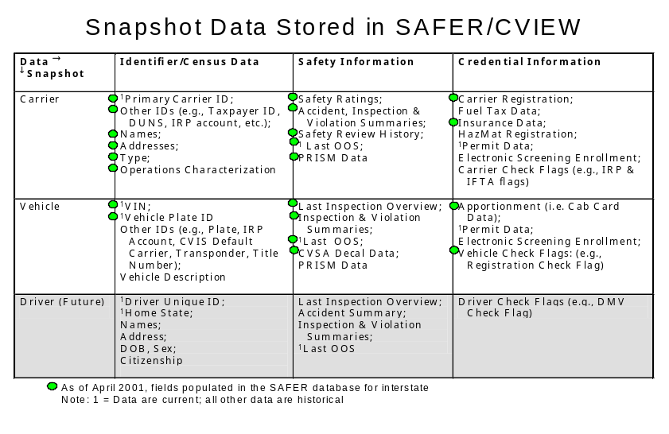
Snapshots & Safety Reports

Slide 21
Safety Information Exchange Design Decisions
What’s reflected in the sample operational scenario...
1. Will you implement a CVIEW (or equivalent) system?
  We are implementing a CVIEW.
2. Will you build it from scratch or start with one of the existing CVIEW systems as a baseline?
  We started with the APL CVIEW as a baseline.
Example scenario
Notes:
PC
Projection

Slide 22
Safety Information Exchange Design Decisions
What’s reflected in the sample operational scenario...
3. What functions will your CVIEW perform?
  Provide for the electronic exchange of:
    interstate carrier and vehicle safety and credential data between state source systems, users, and SAFER
    Intrastate carrier and vehicle safety and credential data between state source systems and users
  Serve as the repository for a state-selected subset of
    interstate carrier and vehicle safety and credential data
    intrastate carrier and vehicle safety and credential data
  Support safety inspection data reporting & retrieval by roadside enforcement personnel
  Provide inter- and intrastate carrier and vehicle safety and credential data to the roadside to support electronic screening and other roadside operations
  Perform electronic exchange using:
    Electronic Data Interchange (EDI) standards
    Non-EDI standards, the selection of which is system-dependent
    New open standard methods of information exchange (e.g., XML) as they become available and are requested by users
  Allow the general public to access data without the security risk of providing a direct connection to sensitive legacy systems
Example scenario
Notes:
PC
Projection

Slide 23
Safety Information Exchange Design Decisions
What’s reflected in the sample operational scenario...
4. Will CVIEW act as the single interface system for ASPEN units in the field?
  CVIEW will be the interface for all our state’s ASPEN units, once ASPEN Version 2 and CVIEW 3 are in place. For now, all ASPEN units interface directly with SAFER.
5. Will credentials snapshot inputs come directly from legacy systems, and snapshots go to legacy systems? Or from/to the legacy systems via the CI?
  CVIEW will interface directly with the legacy credentialing systems, not via the CI. Credentials inputs will be provided by the legacy credentialing systems.
Example scenario
Notes:
PC
Projection

Slide 24
Safety Information Exchange Design Decisions
What’s reflected in the sample operational scenario...
6. Will credentials snapshot segment updates use the EDI format or some other custom interface format?
  If we are modifying the legacy system to handle EDI inputs, we’ll use EDI for snapshot-related exchanges with CVIEW. If not, we’ll create a custom interface format. Or we may explore XML.
7. How will state systems be connected to CVIEW?
  It depends on the system. For the IRP and IFTA systems, for example, we have an SNA Ethernet backbone. They connect to the CVIEW TCP/IP LAN via an SNA-TCP gateway.
Example scenario
Notes:
PC
Projection

Slide 25
Operational Scenario
Record inspections electronically and report them to SAFER and MCMIS
  Retrieve past inspections
  Report inspection; update snapshots accordingly
  Review inspection using SAFETYNET, and submit to MCMIS; update snapshots accordingly
There are two versions of the scenario in this package. The first shows how inspections will be reported once ASPEN Version 2, SAFETYNET 2000, and SAFER/CVIEW Version 3 are ready. This is the version that is reflected on pages 26 through 29. The second reflects how things are today. This is reflected on pages 30 through 33.
Example scenario
Notes:
For inspection-related scenarios, it is often convenient to think of the steps in the operational scenario in three subgroups.
On this and subsequent pages, the groups are highlighted with the colors shown:
Yellow steps support the initial retrieval of past inspections (steps 1-4),
Lavender cross-hatched steps correspond to the reporting of the inspection and the initial update & distribution of snapshots (steps 5-10),
Blue steps involve the formal review of the inspection, and submission to MCMIS; snapshots are updated and distributed (steps A-D). These steps are labeled A-D instead of 11-14 since there is normally a break between the retrieval of the inspections using SAFETYNET 2000 and their review & submission to MCMIS.
The slide show will skip to the thread diagram. We will walk through the steps of the operational scenario [use overhead projector to show the list]. We’ll only walk through the first scenario.
In the breakout session, you’ll develop operational scenario steps and a thread diagram for how you intend to automate this same inspection reporting process. You’ll choose which scenario to work on, depending on when you expect to automate inspection reporting.
Keep the scenario steps at about the same level of detail as in this example. Each step should “name” the information being exchanged and what format (e.g., EDI TS 285) will be used for the exchange. Also describe, at a high level, the processing performed.
PC
Projection

Slide 26
Operational Scenario for SAFER/CVIEW Version 3:
Record inspections electronically, report them to SAFER & MCMIS via CVIEW
1. An enforcement officer, using the Past Inspection Query system (PIQ), issues a query to CVIEW’s input mailbox in the CVIEW Data Mailbox (CDM), for all inspection reports relating to a particular carrier. The PIQ is in Application File Format (AFF), a precursor to EDI translation.
2. CVIEW passes the query to the SAFER, via a Remote Procedure Call (RPC).
Note: All queries are passed to SAFER where Interstate and Intrastate Inspection Reports are stored for 60-day period.
3. SAFER receives the query, processes the request, and then retrieves the inspection report from data storage. SAFER sends all inspection reports matching the query to CVIEW, via RPC.
4. CVIEW passes the inspection reports to ASPEN via its query mailbox in the CDM, in AFF format. The PIQ detects and processes the report for display on ASPEN. The past inspections show that this carrier’s vehicles often have brake problems.
Example scenario
Notes:
Read through the steps, referring to the thread diagram.
As you read through step 1, explain what the CVIEW (and SAFER) Data Mailbox is: The CVIEW Data Mailbox (CDM) is a store-and-forward service used to exchange information between CVIEW and other external systems and users, referred to as clients. Clients utilize the Simple Mail Transfer Protocol (SMTP) to send information to the CDM and the Post Office Protocol, Version 3, (POP3) to retrieve information from the CDM. SAFER also has a mailbox service, called the SAFER Data Mailbox, or SDM.
Overhead
Viewgraph

Slide 27
Operational Scenario for SAFER/CVIEW Version 3, continued:
Record inspections electronically, report them to SAFER & MCMIS via CVIEW
5. The enforcement officer conducts the inspection and finds that the brakes are not functioning properly. He completes the inspection and places the vehicle Out-Of-Service (OOS). ASPEN sends the inspection report to CVIEW’s input mailbox in the CDM, in AFF.
6. CVIEW passes the inspection report to SAFER.
7. CVIEW sends the inspection report to SAFETYNET 2000’s mailbox in the CDM; SAFETYNET retrieves the inspection report from its CDM mailbox.
8. SAFER updates the vehicle snapshot segment with inspection information, e.g., OOS status, Inspection history. SAFER forwards snapshot views to subscribers via their subscription mailboxes in the SDM in EDI X12 TS 285 format.
Example scenario
Notes:
Overhead
Viewgraph

Slide 28
Operational Scenario for SAFER/CVIEW Version 3, continued:
Record inspections electronically, report them to SAFER & MCMIS via CVIEW
A. The SAFETYNET 2000 staff member reviews the inspection report and sends it to MCMIS, in AFF, via the SDM.
B. MCMIS receives the inspection report, updates carrier summary information, and computes carrier safety statistics, e.g., carrier safety ratings and history, inspection summaries. Weekly, MCMIS sends SAFER updated carrier snapshot segments via flat file.
C. SAFER updates its stored snapshots with carrier snapshot segments it receives from MCMIS. SAFER forwards snapshot views to subscribers via their subscription mailboxes in the SDM in EDI X12 TS 285 format.
D. CVIEW forwards carrier snapshot views to ASPEN units via their subscription mailboxes in the CDM in AFF.
NOTE: Functional acknowledgment for all EDI messages (except TS 997) is made by responding with a TS 997. The results of processing an incoming TS 285 are reported via TS 824.
Example scenario
Notes:
Overhead
Viewgraph

Slide 29
Functional Thread Diagram for SAFER/CVIEW Version 3 :
Record inspections electronically and report them
to SAFER and MCMIS via CVIEW
(ASPEN Version 2, SAFETYNET 2000, SAFER/CVIEW 3)
Generic State Commercial Vehicle Administration Systems
Web Site
CVISN
Core Infrastructure
Systems
(National/Regional)
Service Providers
L
S
I
L
M
IRP
L
S
I
L
M
IFTA Tax
Processing
Carrier Systems
Credentialing
Interface (CI)
Internet Tools
(e.g. Browser)
L
S
I
L
M
IFTA
Registration
E-Screening
Enrollment
CDLIS
L
S
I
L
M
SSRS
Credentialing
System
(e.g., CAT)
L
S
I
L
M
HazMat
L
S
I
L
M
Compliance
Review
(e.g., CAPRI)
IRP
Clearinghouse
L
S
I
L
M
Driver
Licensing
L
S
I
L
M
OS/OW
L
S
I
L
M
Treasury or
Revenue
IFTA
Clearinghouse
Other Carrier
Systems
L
S
I
L
M
Titling
A
NMVTIS
L
S
I
L
M
Intrastate Veh
Registration
L
S
I
L
M
SAFETYNET
2000
7
CV Info Exchange
Window (CVIEW)
3
MCMIS
8
C
A
B
2
1
6
SAFER
5
4
Licensing &
Insurance
Generic State Roadside Systems
L
M
Compliance
Review
(e.g., CAPRI)
Carrier Commercial
Vehicle
Screening
L
S
I
L
M
Roadside
Operations
D
Transponder
Sensor/
Driver Comm
L
S
I
L
M
Citation &
Accident
L
M
Inspections
(ASPEN V2,
ISS-2, PIQ)
8
Other Jurisdictions
C
Example scenario
Notes:
PC
Projection

Slide 30
Operational Scenario for today:
Record inspections electronically and report them to SAFER and MCMIS
1. An enforcement officer, using the Past Inspection Query system (PIQ), issues a query to SAFER’s input mailbox in the SAFER Data Mailbox (SDM), for all inspection reports relating to a particular carrier, in ASPEN-Unique, non-EDI file format.
Note: Intrastate and Interstate Inspection reports are stored in SAFER for 60 days.
2. SAFER receives, processes, and sends all inspection reports matching the query to ASPEN, in ASPEN-Unique, non-EDI file format. The past inspections show that this carrier’s vehicles often have brake problems
Note: The SAFER system retrieves the query from its input mailbox in the Safer Data Mailbox (SDM), processes the request, and then retrieves the inspection report from data storage. The report is placed in the requester’s query mailbox in the SDM. The PIQ detects and processes the report for display on ASPEN.
Example scenario

Slide 31
Operational Scenario for today, continued
Record inspections electronically and report them to SAFER and MCMIS
3. The enforcement officer conducts the inspection and finds that the brakes are not functioning properly. He completes the inspection and places the vehicle Out-Of-Service (OOS). ASPEN sends the inspection report to SAFER’s input mailbox and SAFETYNET’s input mailbox in the SDM, in ASPEN-Unique, non-EDI file format.
4. SAFER updates the vehicle snapshot segment with inspection information e.g., OOS status, Inspection history. SAFER forwards snapshot views to subscribers via their subscription mailboxes in the SDM in EDI X12 TS 285 format.
5. SAFETYNET 9 or 10 retrieves the inspection report from its input mailbox on the SDM, still in ASPEN-Unique non-EDI file format.
Example scenario

Slide 32
Operational Scenario for today, continued:
Record inspections electronically and report them to SAFER and MCMIS
A. The SAFETYNET 9 or 10 staff member reviews the inspection report and sends it to MCMIS using existing methods.
B. MCMIS receives the inspection report and updates carrier summary information and computes carrier safety statistics, e.g., carrier safety ratings, history and inspection summaries. Weekly, MCMIS sends SAFER updated carrier snapshot segments in flat file format.
C. SAFER updates its stored snapshots with carrier snapshot segments it receives from MCMIS. SAFER forwards snapshot views to subscribers via their subscription mailboxes in the SDM in EDI X12 TS 285 format.
D. SAFER then forwards carrier snapshot views to ASPEN subscribers in AFF.
NOTE: Functional acknowledgment for all EDI messages (except TS 997) is made by responding with a TS 997. The results of processing an incoming TS 285 are reported via TS 824.
Example scenario

Slide 33
Functional Thread Diagram for today:
Record inspections electronically and report them to SAFER and MCMIS
Generic State Commercial Vehicle Administration Systems
Web Site
Service Providers
CVISN
Core Infrastructure
Systems
(National/Regional)
L
S
I
L
M
IRP
L
S
I
L
M
IFTA Tax
Processing
Carrier Systems
Credentialing
Interface (CI)
Internet Tools
(e.g. Browser)
L
S
I
L
M
IFTA
Registration
E-Screening
Enrollment
CDLIS
L
S
I
L
M
SSRS
Credentialing
System
(e.g., CAT)
L
S
I
L
M
HazMat
L
S
I
L
M
Compliance
Review
(e.g., CAPRI)
IRP
Clearinghouse
L
S
I
L
M
Driver
Licensing
L
S
I
L
M
OS/OW
L
S
I
L
M
Treasury or
Revenue
IFTA
Clearinghouse
Other Carrier
Systems
L
S
I
L
M
Titling
A
NMVTIS
L
S
I
L
M
SAFETYNET
C
L
S
I
L
M
Intrastate Veh
Registration
CV Info Exchange
Window (CVIEW)
4
MCMIS
B
5
SAFER
1
Licensing &
Insurance
Generic State Roadside Systems
L
M
Compliance
Review
(e.g., CAPRI)
Carrier Commercial
Vehicle
Screening
L
S
I
L
M
Roadside
Operations
D
2
3
Transponder
4
Sensor/
Driver Comm
L
S
I
L
M
Citation &
Accident
L
M
Inspections
(ASPEN,
ISS, PIQ)
Other Jurisdictions
C
Example scenario

Slide 34
Breakout Goals
Set goals and objectives for safety information exchange in your state
Make initial design decisions about your safety information exchange
Illustrate inspection reporting in your state using the technique shown in this session (operational scenario list of steps and functional thread diagram)
Make initial allocation of new functions to existing or new computers and networks
Breakout
Notes:
PC
Projection

Slide 35
What inputs are needed?
What outputs are created?
Input/Pre-work needed:
  COACH Part 1 checklists in 4.1, 4.2
  System Inventory (optional)
    ASPEN
    SAFETYNET
    etc.
  Keys & IDs
Outputs:
  Revised COACH checklists
  Goals & objectives
  Answers to some key design decisions
  Completed thread diagram
  Updated top-level physical design
  Updated action plan, decision list, issue list
Breakout
Notes:
PC
Projection

Slide 36
Breakout Plan
120 minutes
Using your state’s CVISN system design template and network template, and following the example just presented, do the following:
Step 1. ~10 min. Assign roles. Review & update COACH Part 1 checklists 4.1, 4.2.
Step 2. ~20 min. Briefly discuss how you exchange safety information today. Set the near-term goals and objectives for safety information exchange in your state. Record the goals & objectives so that the team can see them.
Step 3. ~30 min. Discuss the Safety Information Exchange Design Decisions (please see pages 43-46) . Reach preliminary conclusions for as many questions as possible. Record actions as needed to answer the questions.
Step 4. ~30 min. So that the team can see them, tailor the list of scenario steps presented in this session for inspection reporting in your state. Select the model operational scenario based on when you think you might be ready to start reporting inspections to MCMIS & SAFER as illustrated.
Breakout
Notes:
The Breakout Plan slides build by bringing up each paragraph separately.
There are several pages in this section that will be shown as overhead transparencies, instead of using computer projection.
For step 1, show the Team Roles (page 41).
For step 2, show the blank page for recording goals and objectives (page 42).
For step 3, show the list of Safety Information Design Decisions and the blank page for recording answers (page 43-46)
Explain step 4
PC
Projection
Overhead
Viewgraph
Overhead
Viewgraph
Overhead
Viewgraph

Slide 37
Breakout Plan
120 minutes
Step 5. ~10 min. Start with a copy of your system design template. Label it to match the inspection reporting scenario you are illustrating. Connect the boxes with directional lines to illustrate the information flow for the scenario. Label the lines with the step numbers from the scenario.
Step 6. ~10 min. Start with a copy of your network template. Label it to match the scenario it will support. Review the network template to see what new or enhanced processing power or connectivity is needed to support the interactions for your inspection reporting scenario. As needed, add computers or connections to the diagram. If a new process is being added to an existing computer, list the software application in that computer’s box. If you can, identify the communications protocol you will you use for each new connection.
Step 7. ~ 5 min. Make sure you’ve noted all the open actions on your action plan and preliminary decisions on your decision table. List the three most important safety-related issues or questions that your state needs assistance with.
Breakout
Notes:
For step 5, show the Generic State Design Template (page 47)
For step 6, show the Generic Network Template (page 48)
For step 7, remind them to continue building on the lists they’ve already started. Show them the blank issues chart on page 49.
PC
Projection
Overhead
Viewgraph
Overhead
Viewgraph
Overhead
Viewgraph

Slide 38
Breakout Plan
120 minutes
Step 8. ~ 5 min. Get ready to present your results to the main group. A sample outline includes:
  Goals and objectives for Safety Information Exchange (step 2)
  Preliminary design decisions for Safety Information Exchange (step 3)
  Inspection Reporting operational scenario and functional thread diagram (steps 4 and 5)
  Network diagram for inspection reporting scenario (step 6)
  Actions, decisions, issues (step 7)
Assemble the material for the presentation:
  If you do it electronically, copy the file onto a floppy disk and take it with you to the main meeting room.
  Otherwise, make transparencies.
  If necessary, carry flip chart pages with you to the main meeting room for reference.
  If you have time, make a copy for each member of your team and for the master book.
Breakout
Notes:
Explain step 8.
Tell them what to do when they have finished their breakout work. Nominally, if we are on schedule, they should come back to the main meeting room.
PC
Projection

Slide 39
As time permits, or after the workshop, finish the top-level design steps associated with Level 1 functionality
Review the slide labeled Snapshot Data Stored in SAFER/CVIEW
Review the Snapshot White Paper
Complete the Snapshot Data Sources tables for carrier and vehicle snapshots by identifying which source systems will provide each type of snapshot data
Verify that sources provide appropriate data formats and types as specified in the Snapshot White Paper
Note any discrepancies and consult your CSA or the ACCB
Breakout
Notes:
In addition to the snapshot data sources, it will be very helpful to identify potential problems with data compatibility across different systems. Any effort you put into gathering information about the lengths and formats of data items, and other such technical details, will pay off in the long run.
PC
Projection

Slide 40
As time permits, or after the workshop, finish the top-level design steps associated with Level 1 functionality
If you are implementing the complete set of CVISN Level 1 safety information exchange capabilities, then you should define each of these operational scenarios:
  Record inspections electronically and report them to SAFER and MCMIS
  Query for a past inspection report
  Maintain carrier and vehicle snapshots for intrastate operators (may require multiple scenarios)
  Query for a snapshot
Breakout
Notes:
PC
Projection

Slide 41
Team Roles
Facilitator _________________________
Presenter _________________________
Scribe _________________________
Time Keeper _________________________
CSA _________________________
Change the roles for each breakout session
(except facilitator and CSA)
Breakout
Notes:
Overhead
Viewgraph

Slide 42
State Safety Information Exchange Goals & Objectives
Breakout
Notes:
Overhead
Viewgraph

Slide 43
Safety Information Exchange Design Decisions
1. Will you implement a CVIEW (or equivalent) system?
2. Will you build it from scratch or start with one of the existing models?
Breakout
Notes:
Overhead
Viewgraph

Slide 44
Safety Information Exchange Design Decisions
3. What functions will your CVIEW perform?
  Provide for the electronic exchange of:
    interstate carrier and vehicle safety and credential data between state source systems, users, and SAFER
    intrastate carrier and vehicle safety and credential data between state source systems and users
  Serve as the repository for a state-selected subset of
    interstate carrier and vehicle safety and credential data
    intrastate carrier and vehicle safety and credential data
    Note: in the APL version of CVIEW, inspection data are not stored.
  Support safety inspection data reporting & retrieval by roadside enforcement personnel
  Provide inter- and intrastate carrier and vehicle safety and credential data to the roadside to support electronic screening and other roadside operations
  Perform electronic exchange using:
    Electronic Data Interchange (EDI) standards
    Non-EDI standards, the selection of which is system-dependent
    New open standard methods of information exchange (e.g., XML) as they become available and are requested by users
  Allow the general public to access data without the security risk of providing a direct connection to sensitive legacy systems
Breakout
Notes:
Overhead
Viewgraph

Slide 45
Safety Information Exchange Design Decisions
4. Will CVIEW act as the single interface system for ASPEN units in the field?
5. Will credentials inputs come from legacy systems? From the CI?
6. In EDI format? In some custom interface format?
7. How will state systems be connected to CVIEW?
Breakout
Notes:
Overhead
Viewgraph

Slide 46
Safety Information Exchange Design Decisions
Breakout
Notes:
Overhead
Viewgraph

Slide 47
Generic State System Design Template
Use Your State’s Template
Generic State Commercial Vehicle Administration Systems
Web Site
Service Providers
CVISN
Core Infrastructure
Systems
(National/Regional)
L
S
I
L
M
IRP
L
S
I
L
M
IFTA Tax
Processing
Carrier Systems
Credentialing
Interface (CI)
Internet Tools
(e.g. Browser)
L
S
I
L
M
IFTA
Registration
E-Screening
Enrollment
CDLIS
L
S
I
L
M
SSRS
Credentialing
System
(e.g., CAT)
L
S
I
L
M
HazMat
L
S
I
L
M
Compliance
Review
(e.g., CAPRI)
IRP
Clearinghouse
L
S
I
L
M
Driver
Licensing
L
S
I
L
M
OS/OW
L
S
I
L
M
Treasury or
Revenue
IFTA
Clearinghouse
Other Carrier
Systems
L
S
I
L
M
Titling
L
S
I
L
M
SAFETYNET
NMVTIS
L
S
I
L
M
Intrastate Veh
Registration
CV Info Exchange
Window (CVIEW)
MCMIS
SAFER
Licensing &
Insurance
Generic State Roadside Systems
L
M
Compliance
Review
(e.g., CAPRI)
Carrier Commercial
Vehicle
Screening
L
S
I
L
M
Roadside
Operations
Transponder
Sensor/
Driver Comm
L
S
I
L
M
Citation &
Accident
L
M
Inspections
(e.g., ASPEN,
ISS-2, PIQ)
Breakout
Scope Page 5 - <number>
Notes:
Overhead
Viewgraph

Slide 48
Generic Network Template
Use Your State’s Template
Motor Vehicle Administration
State Police (MCSAP Agency)
Web Site
Credentialing Interface,
All MVA LSIs,
E-Screening Enrollment
Inspections
(ASPEN)
Carrier
Registration &
Permitting
CAPRI
Intrastate
Registration
Licensing
& Titling
IRP
CVIEW
dial-up
SAFETYNET
Gateway
Dedicated dial-up
Firewall
Dial-up
SNA
Ethernet Backbone
TCP/IP
CVISN Core
Infrastructure Systems
Firewall
AAMVAnet
Frame Relay
(TCP/IP)
SAFER
Carrier Systems
Internet Tools
Firewalls
Licensing &
Insurance
Internet
Repeater
Credentialing
System
dial-up
CDLIS
Gateway
(token
ring)
AAMVAnet
CSN
(TCP/IP)
AAMVAnet
SNA
MCMIS
sensors
Firewall
IRP
Clearinghouse
RF
Link
Ethernet Backbone
IFTA
Clearinghouse
State Highway Administration
Motor Fuel Tax Agency
Sensor/
Driver Comm
Screening
Roadside
Operations
Treasury:
Mainframe DB
IFTA Registration
& IFTA Tax
Processing
Existing
Proposed
SNA
Ethernet Backbone
Breakout
Notes:
Overhead
Viewgraph

Slide 49
Safety Issues/Questions
Breakout
Notes:
Overhead
Viewgraph

Slide 50
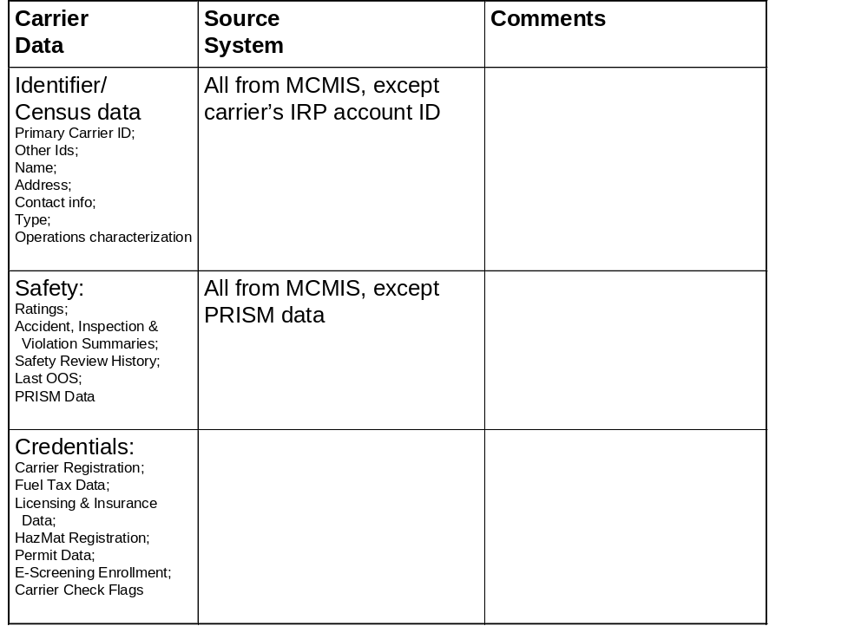
SAFER/CVIEW Snapshot Data Sources
Interstate Carrier
Breakout

Slide 51
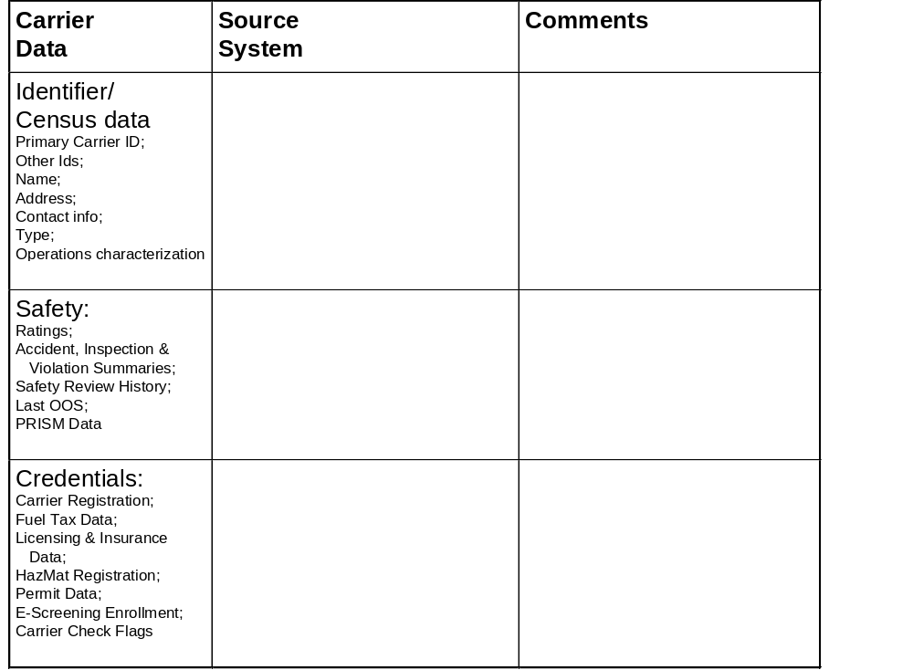
SAFER/CVIEW Snapshot Data Sources
Intrastate Carrier
Breakout

Slide 52
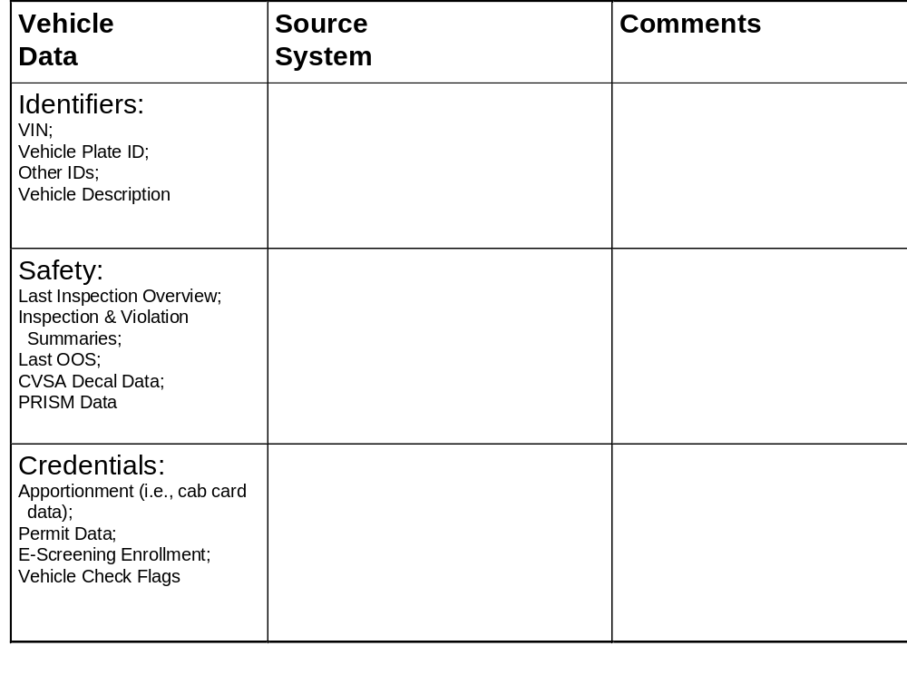
SAFER/CVIEW Snapshot Data Sources
Interstate Vehicle
Breakout

Slide 53
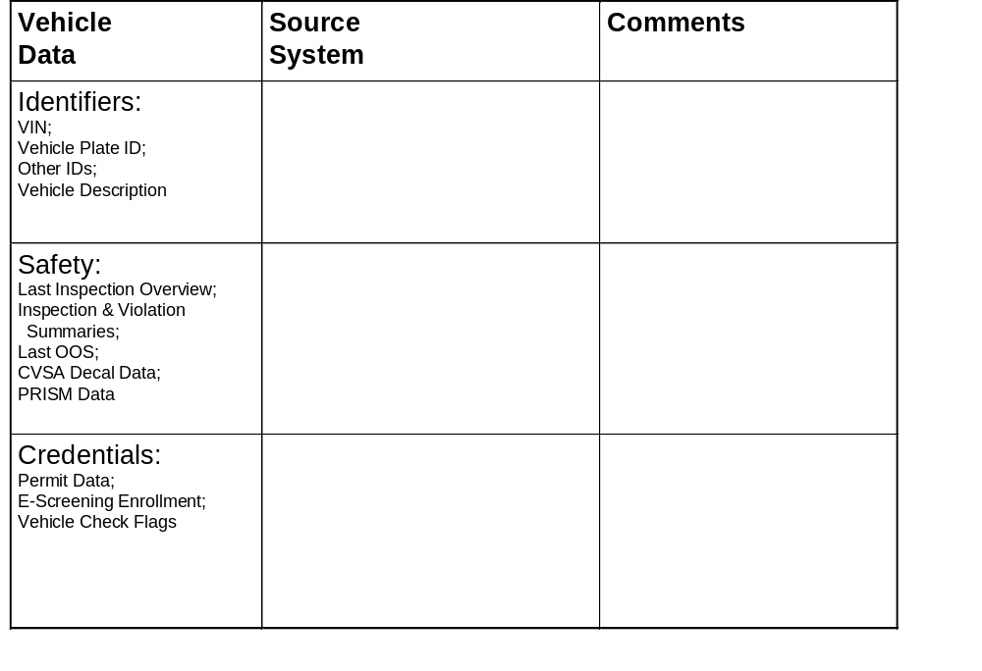
SAFER/CVIEW Snapshot Data Sources
Intrastate Vehicle
Breakout

Slide 54
Background Material

Slide 55
SAFER assembles interstate snapshots from authoritative & indirect sources, and responds to queries for snapshots & safety reports. SAFER stores and makes available inspection reports.
Authoritative
Sources
Federal Systems
Inspection Systems
Information
Users
CVIEW
Mobile Unit
SAFETYNET
HELP PrePass™
NorPass
Carrier
Insurer
Shipper
Clearinghouse
Others...
SAFER
Carrier Snapshots
Vehicle Snapshots
Indirect
Sources
CVIEW
Multi-State Systems
Clearinghouses
Driver Snapshots
(proposed)
Inspection Reports
Key
Commercial / Government
Query/response interaction
Inspection report
Snapshot segment update
Subscription fulfillment
Other interaction
Wireline / Wireless Services
(e. g.,Internet, AAMVAnet, NLETS, FTS 2000)
Scope Page 5 - <number>
Notes:
The Safety & Fitness Electronic Record (SAFER) system facilitates safety & credentials data exchange among multiple systems:
Assembles and stores interstate carrier, vehicle, and driver (future) snapshots; sends updates to subscribers proactively or upon request
Systems establish “subscriptions” with SAFER. A subscription is equivalent to a standing request for SAFER to send snapshot data. A subscription is defined based on the information contained within a carrier, vehicle, or driver snapshot, and the types of changes to that data that are used to trigger a subscription update. By specifying which carriers and vehicles are of interest and which changes are significant, the client only receives updates that are relevant to its operations.
Sending the information “proactively” means that the data are sent without a new request for them. The subscription acts like a standing request. Whenever the subscription criteria are met, SAFER automatically send the subscriber the updated data.
Stores inspections for 60 days. Normally, past inspections are sent in response to a query.
Supports queries for reports by requesting from authoritative sources and returning results to user
Federal “authoritative source” systems include MCMIS and Licensing & Insurance.

Slide 56
SAFER (Safety and Fitness Electronic Records)
SAFER is a multi-state system that provides standardized carrier, vehicle, and driver datasets (snapshots and reports) containing safety and credentials information to authorized users within a few seconds. (system under development by FMCSA). The SAFER Data Mailbox component facilitates the exchange of information between roadside sites and administrative centers by acting as a temporary repository for data files and messages
The primary function of SAFER is to provide users timely, electronic access to safety and credential data via one or more wide area network (WAN) communication links. This information includes identity data about carriers, vehicles, and drivers, summaries of past safety performance histories (inspections, accidents, and other data) and credential information.
SAFER provides users with either a summary safety record (“snapshot”), or a more detailed report. Two such reports are the carrier profile and vehicle/driver inspection reports. SAFER supports on-line query and response for snapshot and report information.
One of SAFER’s primary objectives is to increase the efficiency and effectiveness of the inspection process at the roadside. The SAFER System currently provides carrier, vehicle, and driver safety and credentials information to fixed and mobile roadside inspection stations. This allows roadside inspectors and other potential government and private users to focus their efforts on high-risk areas; i.e., selecting vehicles and/or drivers for inspection based on the number of prior carrier inspections and its safety and credential history.
SAFER allows users to request, via subscriptions, that specific snapshots are sent to them automatically when substantial change in the data occurs. Users can also specify the types of change that triggers transmission of subscription requests.
To utilize these system functions, users will require, at a minimum, a computer system, a user account, and the ability to connect to the one or more WANs supported by SAFER.

Slide 57
CVIEW assembles and maintains the credentials portions of interstate snapshots, and assembles intrastate snapshots. It also stores snapshots.
Authoritative
Sources
State Systems
Inspection Systems
Information
Users
SAFER
Roadside Enforcement
Mobile Unit
HELP PrePass™
NorPass
Carrier
Insurer
Shipper
Clearinghouse
Others...
CVIEW
Carrier Snapshots
Vehicle Snapshots
Indirect
Sources
SAFER
Driver Snapshots
(proposed)
Key
Commercial / Government
Query/response interaction
Inspection report
Snapshot segment update
Subscription fulfillment
Other interaction
Wireline / Wireless Services
(e. g.,Internet, AAMVAnet, NLETS, FTS 2000)
Scope Page 5 - <number>
Notes:
Contrast with the figure of SAFER you just showed .

Slide 58
CVIEW
(Commercial Vehicle Information Exchange Window)
CVIEW (CV Information Exchange Window) is a system in each state that collects information from the CV credentialing and tax systems to formulate segments of the interstate carrier, vehicle, and (future) driver snapshots and reports for exchange within the state (e.g., to roadside sites) and with the SAFER system. Each state is responsible for maintaining the credential segments of the snapshots for interstate carriers and vehicles based there.
The state CVIEW provides whole snapshots for intrastate carriers and vehicles. The state CVIEW passes to SAFER the safety reports generated for interstate carriers based in the state.
In addition to snapshot-related functions, CVIEW or its equivalent is also expected to serve as the single interface system for ASPEN units in the field. ASPEN will retrieve inspections through CVIEW, and report inspections through CVIEW.
CVIEW has similar Data Mailbox facilities as SAFER to facilitate the exchange of information among state users within the state agencies.
In CVISN Level 1, there is a requirement to implement a system called CVIEW or its equivalent
for snapshot exchange within the state.
CVIEW is a distributed version of the FMCSA-developed SAFER system. It is owned by and located in a state. The CVIEW (or equivalent) functions are listed below:
Provide for the electronic exchange of state-based interstate carrier and vehicle credential data between state source/legacy systems, users, and SAFER
Provide for the electronic exchange of intrastate carrier and vehicle snapshot data between state source systems and users
Serve as the repository for a state-selected subset of interstate carrier and vehicle safety and credential data
Serve as the repository for a state-selected subset of intrastate carrier and vehicle safety and credential data
Provide inter- and intrastate carrier and vehicle safety and credential data to the roadside to support electronic screening and other roadside operations

