Slide 1
MAXIM Periscope Module
Instrument Systems Engineering
Deborah Amato
25 April 2003

Slide 2
A Pair of MAXIM Periscopes
3
2
Detector
4
1
X
Periscope Module
Z

Slide 3
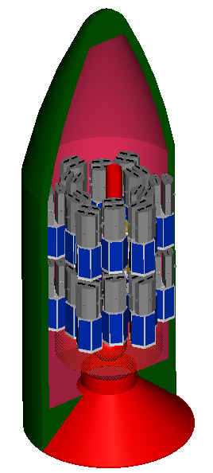
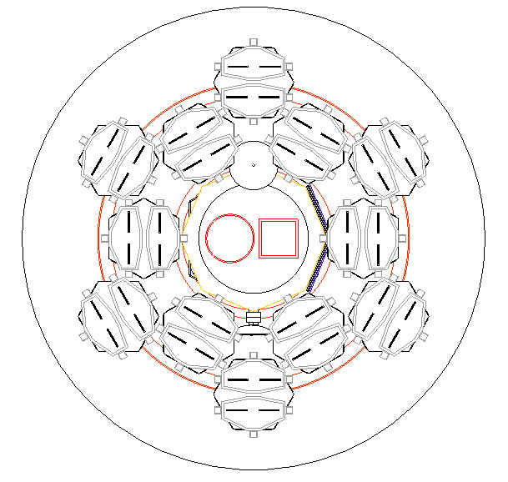
Launch Configuration
1 Detector spacecraft
26 Periscope spacecraft for 1000 cm² of collecting area:
  25 free-flyers with 4 periscopes each
  1 hub with 12 periscopes
Hub and Detector spacecraft stacked
Free-flyer
Launch fairing envelope

Slide 4
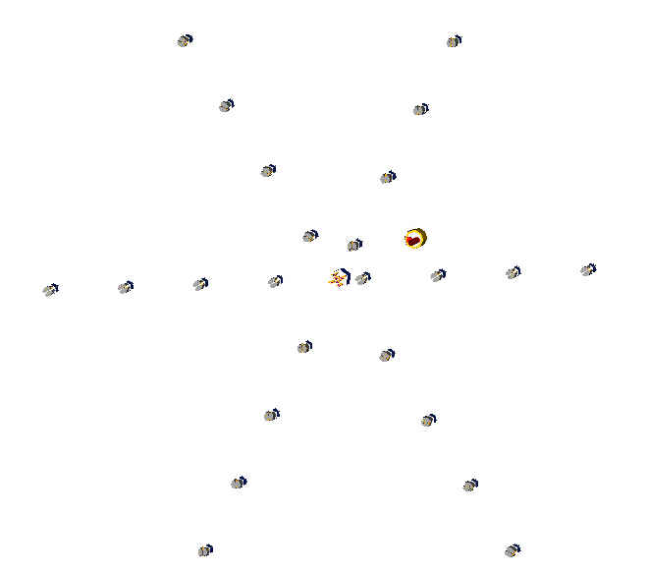
Operational Configuration at L2
S/C | Dist from hub (m)
1 | 10
2 | 11.8
3 | 13.9
4 | 16.4
5 | 19.4
6 | 22.9
7 | 27.0
8 | 31.9
9 | 37.6
10 | 44.4
11 | 52.3
12 | 61.8
13 | 72.9
14 | 86.0
15 | 101.5
16 | 120.0
17 | 141.3
18 | 166.7
19 | 196.7
20 | 232.1
21 | 274.9
22 | 323.2
23 | 381.4
24 | 450.1
25 | 531.1

Slide 5
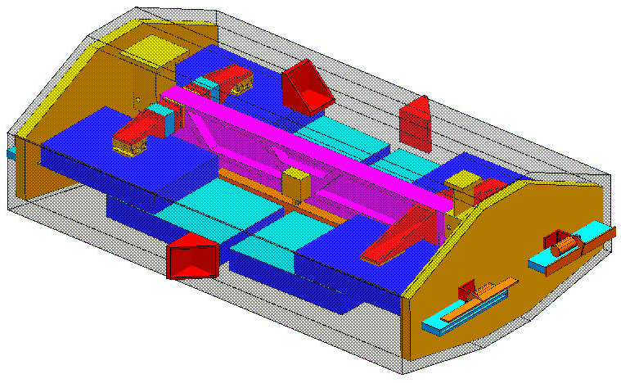
Periscope Coordinate System
X
Yaw
Pitch
Roll
Y
Z=LOS

Slide 6
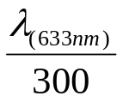

MAXIM Periscope Requirements
Low mass and power
Mounted mirror surface quality = rms for θ = 1°
Difference in entrance and exit mirror-pair spacing, Δh
Optical Path Difference between periscopes, OPD < λ_{x-ray}/10 = 1Å
Relative Strehl ratio > 80%
Position Tolerances – next slide
Must be able to open and close periscope aperture
Must be able to align images on the detector plane
MAXIM Mission Periscope Parameters for this study
  Periscope spacecraft swarm diameter, D = 1 km*
  Focal length, F = 20,000 km*
  Mirror length, m = 30 cm
  Mirror width = 20 cm
  Graze angle, θ = 1°
  Wavelength, λ = 10Å
  * different values used in optical analysis

Slide 7
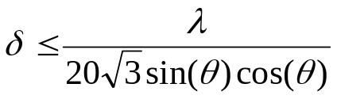
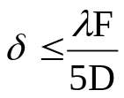
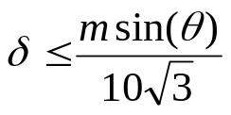
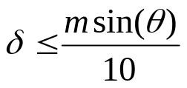
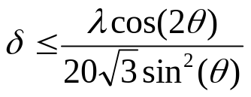
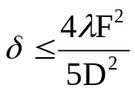
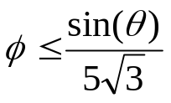
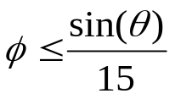
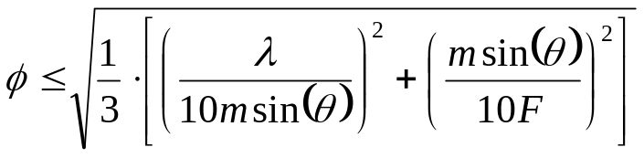
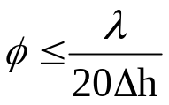
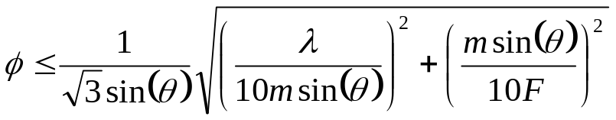
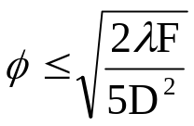
MAXIM Position Tolerances λ=1nm, F=20,000km, D=1km, m=30cm, θ=1deg, Δh=1μm
DOF | Mirror Equation | Periscope Equation | Mirror Tolerance | Periscope Tolerance
X |  |  | ±1.7nm | ±4μm
Y |  |  | ±0.3mm | ± 0.5mm
Z |  |  | ±94.7nm | ±0.32m
X-rot (yaw) |  |  | ±6.9 arcmin | ± 7.8 arcmin
Y-rot (pitch) |  |  | ±2.3 marcsec | ± 10 arcsec
Z-rot (roll) |  |  | ±0.13 arcsec | ±18.5 arcsec

Slide 8


Δh and OPD – Key Requirements
3
2
θ = 1°
h2
h1
1
4
OPD < λ_{x-ray}/10

Slide 9
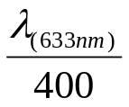
Trade Studies
Mirror width: 2 cm, 10 cm, 20 cm, 30 cm
  Need to quantify the flux requirement for initial calibration
  Baseline design: 20 cm wide mirrors
  Trade mirror size versus number of spacecraft – discussed in Optical Analysis section
  Consider 20 cm versus 30 cm wide mirrors in future studies
Mounted mirror surface quality is dependent on graze angle:
rms for θ = 1°
rms for θ = 2°
  Chose θ = 1° for this baseline design
Internal metrology
  Baseline design uses absolute position encoders calibrated with lasers in ground testing.

Slide 10
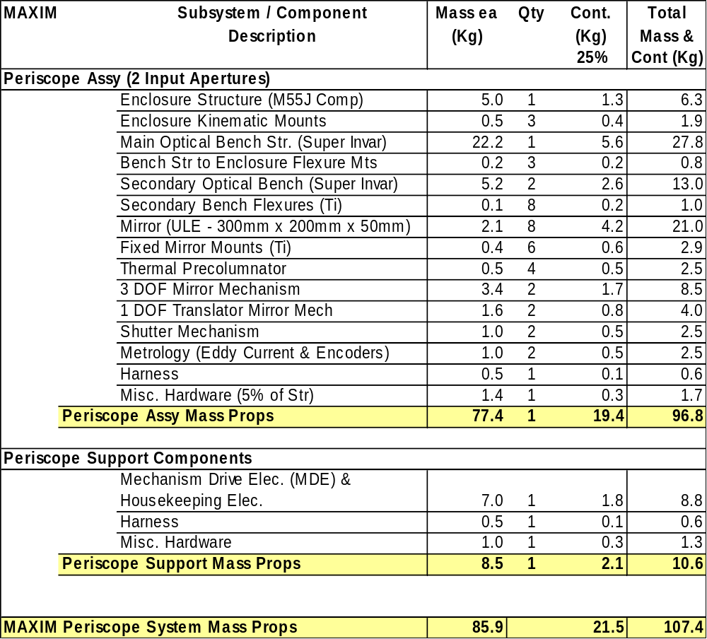
Periscope Mass Summary

Slide 11
Periscope Power Summary
Spacecraft Power Bus Requirement
End Items | Avg. Power
1 Main Electronics Box | 26.6 Watts
Actuators @ 1 Watt each | 1 Watts
Drive Motors @ 1 Watt each | 1 Watt
Heaters | 25 Watts
Instrument Total: | 53.6 Watts

Slide 12
Future Studies
This study looked at internal periscope issues – periscope to periscope tolerancing issues still need to be addressed.
  Look at operational control and/or mechanical options
Mirror width
  2 cm width feasible?
  30 cm width versus fewer spacecraft
  Mirror material is a factor in this trade (silicon vs. ULE)
Further thermal and mechanical design optimization should be done.
See other subsystem presentations for other potential issues.

Slide 13
Up Next
Dennis Evans will discuss the optical analysis next.

Slide 14
Backup

Slide 15
OPD
The Optical Path Difference (OPD) between any two periscopes must be within 1Å. The OPD must be changeable with a larger (TBD) range.
Ways to introduce Optical Path Differences:
  Move mirrors 2 and 3 together (or 1 and 4 together) to get an OPD of 2δsin(θ); 3 nm of motion ⇒ 1Å OPD
  Move 1 mirror, range is less than ~1 micron to preserve Δh; 1.5 nm of mirror motion ⇒ 1Å OPD
  Rotate a mirror pair by 1 milliarcsecond for 1Å of OPD
  Move the entire periscope; Δz of 30 cm ⇒ 1Å OPD (remember periscopes are tied together in each spacecraft)
  Move a mirror pair (1 and 2 or 3 and 4) in the X direction

