Slide 1
RCF Status
Smooth operation over the course of last week
  No reportable outages of the Mass Storage System (HPSS), the Tape Libraries and the Network
  Data received from PHENIX & STAR Counting Houses was safely migrated to Tape

Slide 2
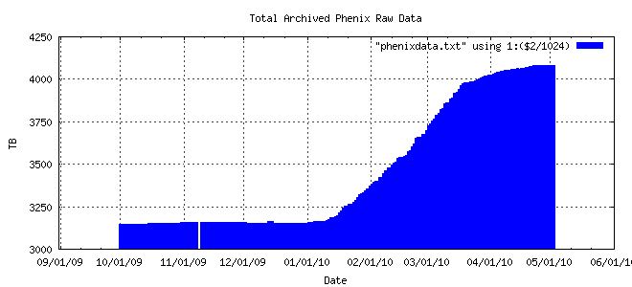
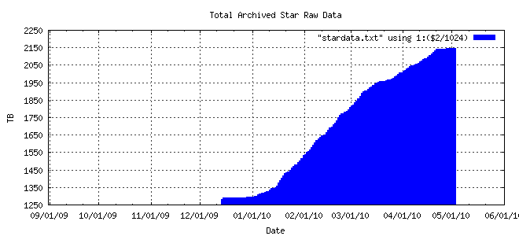
Raw Data Volume collected & archived – 1780 TB to date
100 TB
PHENIX Raw Data
Physics
950 TB
3150 TB
180 TB
STAR Raw Data
830 TB
1300 TB
03/23/10

Slide 3
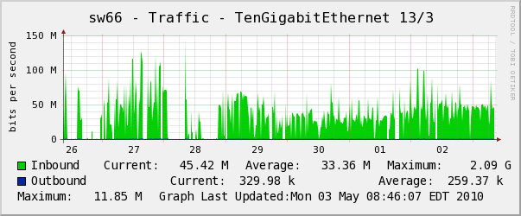
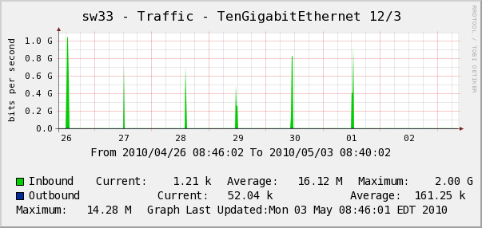
STAR & PHENIX Counting House ⬄ RCF Network
Transfer rates
observed last
week
100 Mbps
1 Gbps

