Slide 1
Integrating a Safety Culture into a
Radiation Dose ALARA Program
Leonard Sygitowicz, CHP
ESS&H Manager
Bechtel BWXT Idaho, LLC

Slide 2
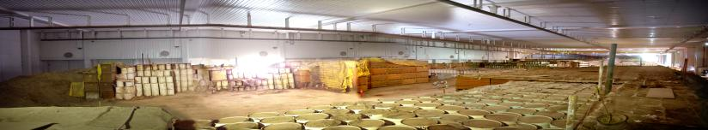
BBWI AMWTP Overview
Large volume of waste (65,000 m³ of stored transuranic mixed waste)
Average ~800 drum movements per day
Dose rates typically <1 mrem/hr (gamma and neutron)
Small population of waste containers with higher dose rates (up to 200 mrem/hr)

Slide 3
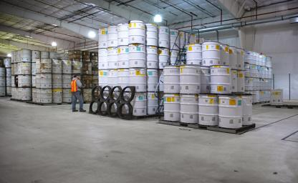
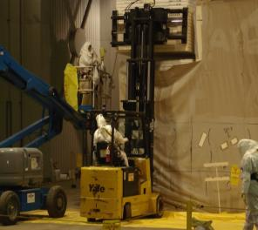
Obstacles
Large volumetric source of low-level radiation exposure
Worker awareness of low dose rate fields contributing to their dose
  Misconceived ideas that AMWTP is an “alpha only” facility and that alpha contamination is the only radiological concern
Worker awareness of waste containers emitting more substantial radiation dose rates
Unique opportunities for unexpected exposure rate situations during retrieval

Slide 4
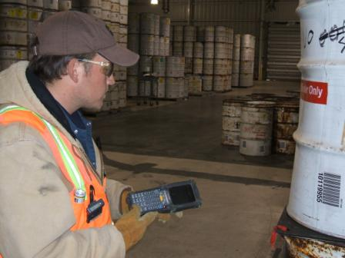
Dose Reduction Methods
Electronic Dosimeters (EDs) have been used as an effective ALARA tool by:
  Producing audible chirps to create worker awareness
    Set to user preference for a single ionizing event or desired increments of 0.1 mrem
    AMWTP’s General Use EDs set to alarm:
      15 mrem (dose)
      50 mrem (dose rate)

Slide 5
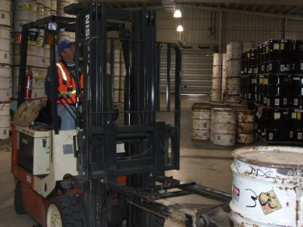
Dose Reduction Methods (Cont’d)
  Estimating/tracking dose during special work evolutions
    Telemetry allows for remote real-time monitoring
      Extremely useful for new or first time work evolutions or when processing results in removal of shielding (drum and liner lids) from waste materials

Slide 6
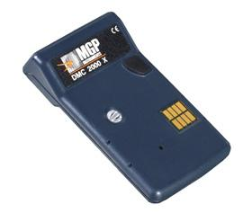
Dose Reduction Methods (Cont’d)
MGP DMC 2000x
Wide response range (X-ray and gamma >20 KeV)
  Sensitive to low E photons (Am-241) which are major radiological component of our waste
Dose tracking software available
Telemetry available for special projects with higher expected dose rates
~$300 each
Lightweight, rugged, use standard calculator batteries

Slide 7
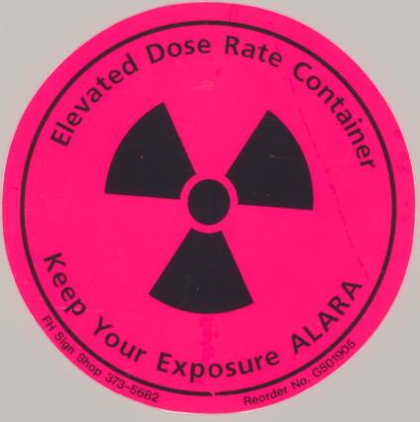
Dose Reduction Methods (Cont’d)
Increased Visibility
  Highly visible labels have been placed on drums with dose rates >40 mrem/hr @ 30 cm
  Segregation or isolation of higher dose rate drums
Increased communications
  Discussing dose reduction techniques during pre-job briefings
  ALARA project indicator (stoplight)
  ALARA webpage

Slide 8
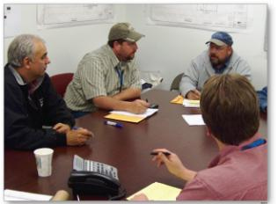
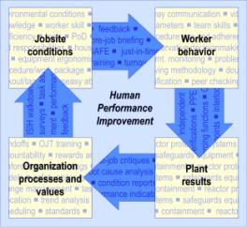
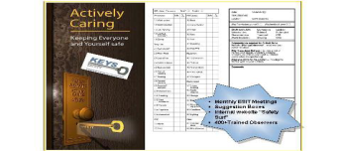
Worker Safety Culture
AMWTP has cultivated a strong safety culture as demonstrated by the success of our other safety programs
  Like many other programs ALARA programs are designed to increase worker safety
  The ALARA program is able to tap into the existing desire the workers possess to keep themselves and everyone around them safe

Slide 9
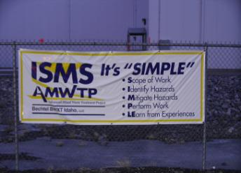
Worker Safety Culture (Cont’d)
Worker involvement at all levels is solicited and expected at quarterly ALARA committee meetings
  This allows for the workforce to be invested in ALARA developments and provide ALARA suggestions
ALARA suggestion box

Slide 10
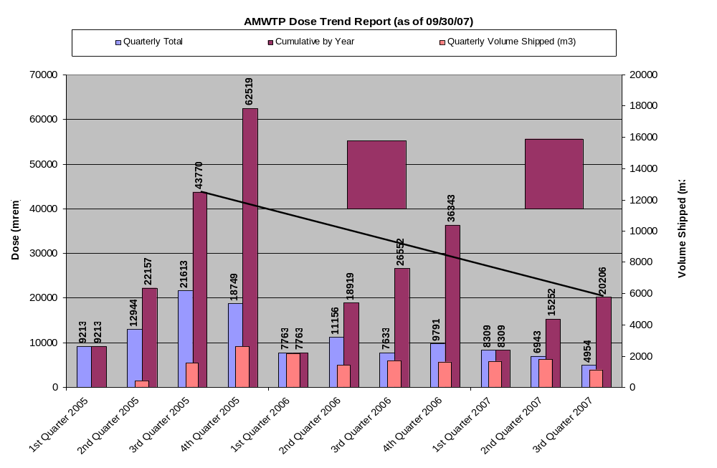
Results

Slide 11
Results (Cont’d)
Quarter | Average Dose per Quarter | Dose Reduction
2nd-4th 2005 | 17.8 REM | Baseline
1st-4th 2006 | 9.1 REM | ~49% from 2005
1st-3rd 2007 | 6.7 REM | ~26% from 2006 and ~62% from 2005

Slide 12
Conclusion
Simple tools such as EDs and special labels provide instant feedback to workers, allowing for an immediate behavior modification.
Providing the right tools, knowledge base, and encouragement for worker involvement are effective dose reduction methods.
ALARA programs integrated into ISMS benefit from and contribute to a healthy safety culture.

