Slide 1
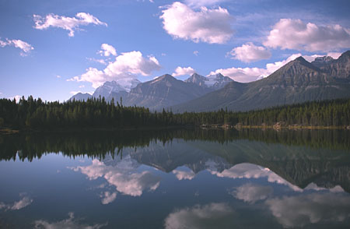
2003 MT Governor's
Conference on Tourism
Norma Nickerson, Ph.D.
Outlook
Lewis & Clark
Vacation Experiences

Slide 2
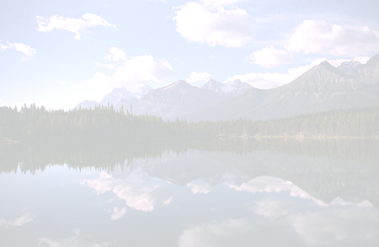
WHAT YOU WILL WALK AWAY WITH TODAY!
Travel outlook for 2003
Updates on Lewis & Clark national awareness of bicentennial
The Montana Vacation Experience

Slide 3
The National Perspective
2002p
+2% domestic leisure travel
-4% domestic business travel
-17% international
2003f
+3% U.S. domestic travel
+.5% U.S. business travel

Slide 4
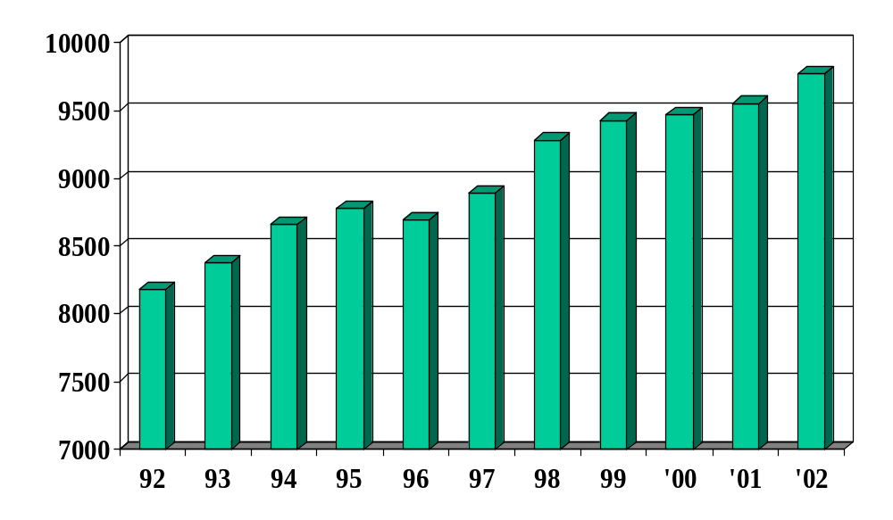

Nonresident Visitation
millions
2002 shows a preliminary increase of 2%

Slide 5
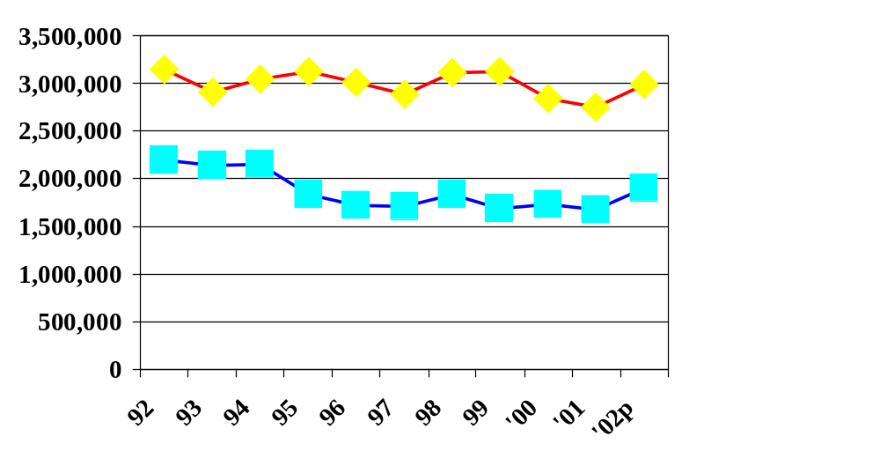
National Park Visitation
1992-2002
Yellowstone
+ 8%
Glacier:
+13%

Slide 6
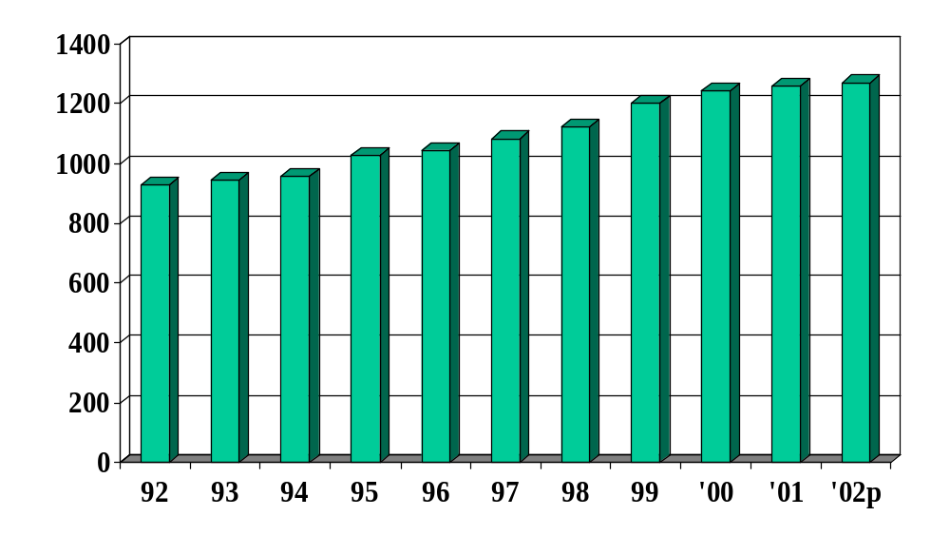

Montana Airport Deboardings
Less than 1% increase for 2002

Slide 7
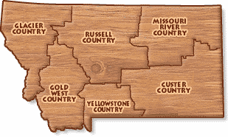
Airport Percent Change “02 vs “01
Kalispell: +2.4%
Missoula:
-3.3%
Great Falls: -1.9%
Bozeman: +5.2%
Helena: +3.0%
Butte:
-5.8%
Billings: +6.9%

Slide 8
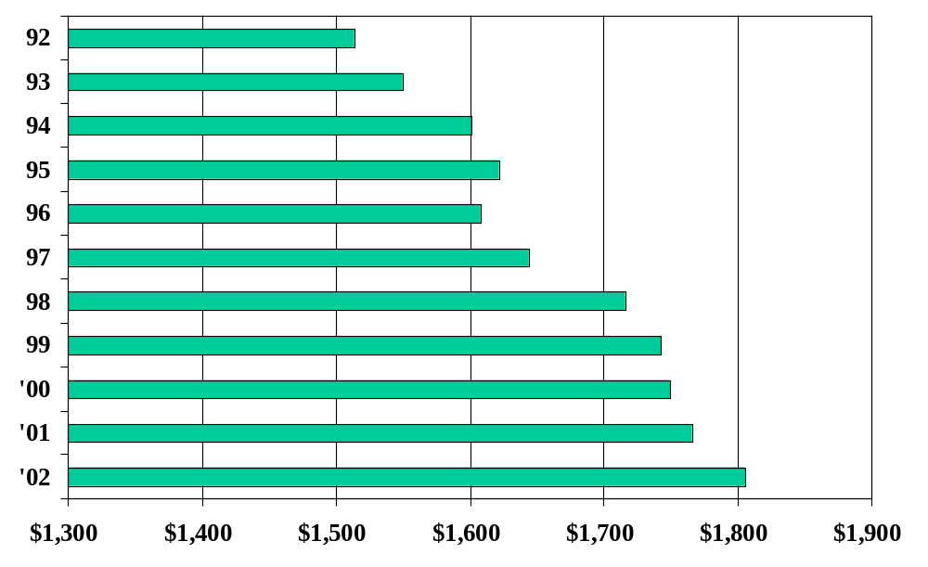
Nonresident Travel Expenditures
$1.8 billion of direct expenditures in 2002
$million

Slide 9
Summer Visitor Expenditure Profile
TOP 5 Expenditures | Vacation (52%) | VFR (15%) | Pass-Thru (21%)
Retail | $29.16 | 25.02 | 8.86
Gas | $25.80 | 23.91 | 28.28
Restaurant | $22.91 | 19.02 | 16.03
Hotel | $16.07 | 9.99 | 14.79
Grocery | $12.25 | 8.56 | 4.25
TOTAL | $130.58/day | 100.79/day | 79.01/day

Slide 10
% Summer Non-Res. Overnights
33%
2%
9%
30%
14%
11%

Slide 11
Region Attraction Study: Average nights in MT and Region
MT: 7.5
Region: 5.3
MT: 7.2
Region: 4.1
MT: 7.5
Region: 4.0
MT: 6.5
Region: 4.5
MT: 5.3
Region: 2.8
MT: 6.9
Region: 4.0

Slide 12
Region Attraction Study: % Resident/Nonresident who visited Nat’l Parks
Glacier: 71%
Yellowst.
24%
Glacier: 30%
Yellowst.
13%
Glacier: 45%
Yellowst.
30%
Glacier: 24%
Yellowst.
43%
Glacier: 16%
Yellowst.
74%
Glacier: 15%
Yellowst.
46%

Slide 13

Montana Travel Industry Business Owner Survey (N=191)
2002 showed:
52% had increases
18% stayed same
30% had decrease
2003 Outlook
70% expect an increase
22% expect same
8% expect decrease

Slide 14

2003 Travel Industry Outlook 2-5% increase
Based on:
national and local business projections
No terrorist attacks on U.S. soil
No further economic downturns
No gasoline shortage

Slide 15
Questions on MONTANA OUTLOOK?

Slide 16
Lewis & Clark
Interest and
Awareness Study

Slide 17
Background
Initial study conducted nationally in the spring of 2000
Partners desired more information regarding the level of interest in the Bicentennial in order to better plan and prepare for potential visitation

Slide 18
States Involved
Along with funding from ITRR the following states were part of the project:
Idaho North Dakota
Illinois Oregon
Iowa South Dakota
Missouri Virginia
Nebraska Washington
Federal agency Lewis & Clark MOU Group

Slide 19
L&C Methodology
Study conducted by NFO Plog Research, who administered the first study
Nationally represented sample of 2500 persons was randomly selected from NFO Panel
Data were collected via a 4-page mail questionnaire
Data collection period October 14--Nov 18, 2002
67% response rate

Slide 20
Markets Most Interested in Bicentennial
History Buffs 74%
Venturers 70%
55+ 63% (41% of sample)
$75K HHI 61% (36% of sample)
History Buffs were those who said “gaining knowledge of history or other cultures was important in the survey (35% of sample).
Venturers seek new experiences, are achievement oriented, and search for undiscovered destinations (11% of sample).

Slide 21
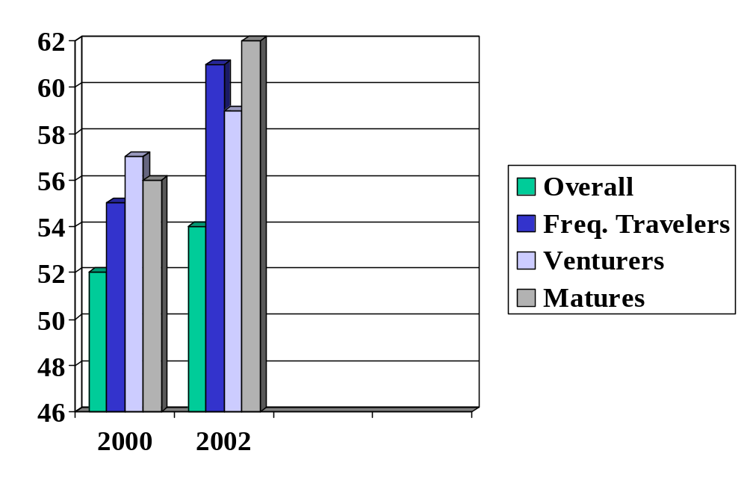
Expedition Awareness - Growing

Slide 22
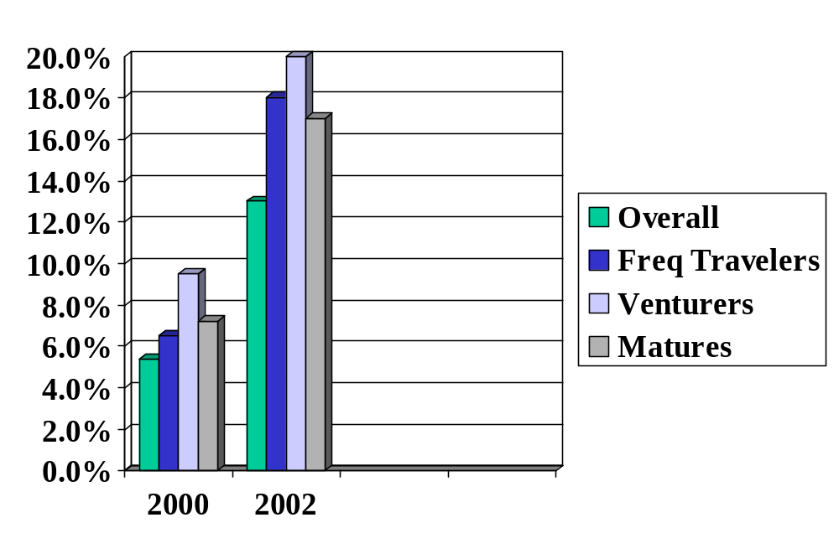
Bicentennial Awareness- Growing but still Small

Slide 23
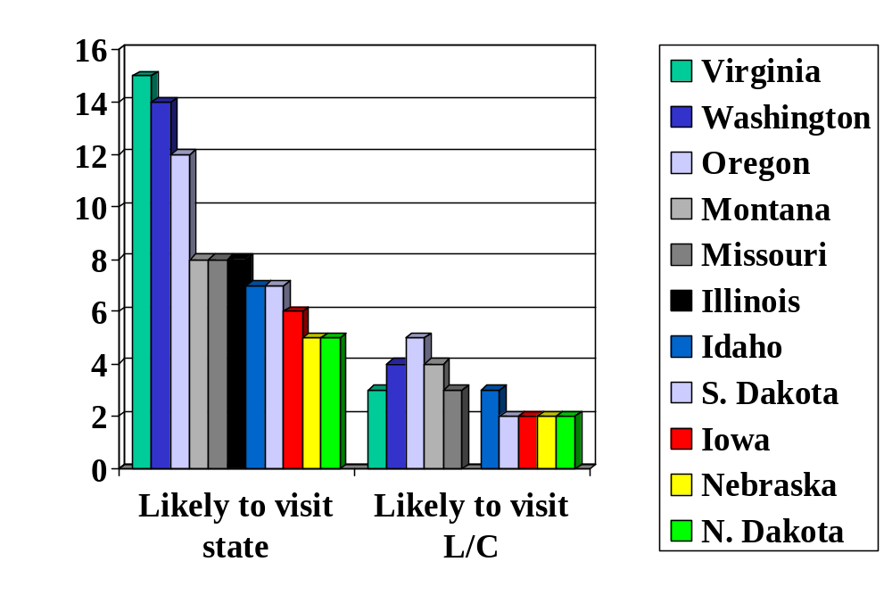
Likelihood of Visiting States/Attractions
Montana
7.5 Million/yr.
3.8 Million/yr.

Slide 24
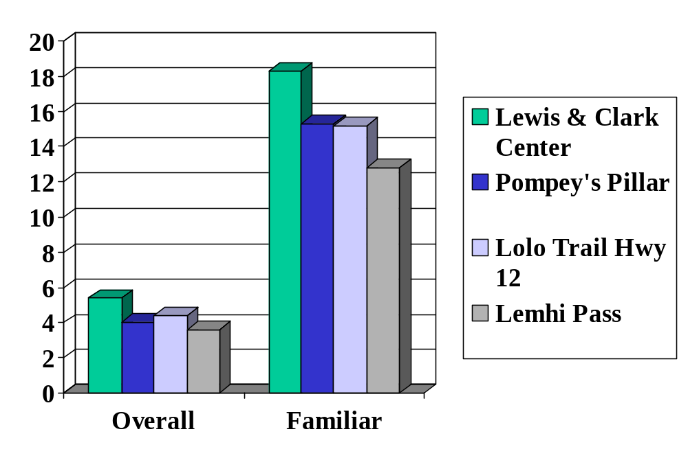
Very/Somewhat Likely to Visit
15.5 million visitors in 3 years?

Slide 25
L&C Media
11% had seen media coverage of the bicentennial
Of those who saw related media, the proportion interested in visiting a site is 3x greater then those who are not interested.
When asked to recall the state to which the media referred, Missouri (28%), Oregon (27%), & Montana (17%) were the top three.

Slide 26
Summary
“Evidence exists that coverage of the upcoming commemoration boosts interest--of those who saw related media, the proportion interested in visiting a Bicentennial site/event (20%) is 3 times greater than those not interested (7%)”
However, awareness is still very low with only 13% of U.S. population aware of the commemoration.

Slide 27
Questions on Lewis & Clark Awareness study?

Slide 28
THE MONTANA VACATION EXPERIENCE
Methods:
Vacationers in Montana (summer 2002) were interviewed about what a Montana vacation meant to them. Interviews were taped, transcribed, and analyzed.
In this presentation, quantitative results from the 2001 nonresident survey are presented along with the Vacation Experience results for comparability.
Results of the Vacation Experience showed five themes emerging from the vacation.

Slide 29
Theme “Trip Planning” –
Quantitative Results
Sources used before trip
Internet 53%
Auto Club 30%
National Park brochure 26%
Guide book 17%
Chamber/CVB 14%
MT Travel Planner 13%
Private Businesses 10%
Sources used during trip
Info center person 36%
Brochure rack 36%
Highway signs 36%
Service person 34%
Billboards 11%

Slide 30
What the
Montana
Vacationer
Said

Slide 31
THEME: “Trip Planning”-
Qualitative Results Summary
While the amount and type of planning conducted by vacationers varied drastically, one constant was the use of the Internet. The Internet was used for ideas, to answer questions, and to reserve accommodations. Additionally, all other promotional mediums (e.g. guide books, brochures, maps, AAA, books about Montana, magazine articles) were used by some vacationers. This suggests a need to continue the diversity of promotional mediums to assure reaching the diverse audience of vacationers.

Slide 32
Themes “Activities” –
Quantitative Results
Wildlife viewing 50%
Hiking 46%
Shopping 45%
Picnicking 36%
Visiting history sites 35%
Camping (dvlp.) 31%
Visiting museums 25%
Fishing 22%
Visit Native American sites 20%
Visit Lewis & Clark sites 20%

Slide 33
What the
Montana
Vacationer
Said

Slide 34
THEME: “Experiences & Activities”
Qualitative Results Summary
Experiences and Activities: Fishing was the activity mentioned most often by visitors. Other activities included rafting/floating, hiking, camping, biking, birding, motorcycling, photography, horseback riding, and simply being in the outdoors. Visitors predominantly discussed activities as a mechanism to be in nature. This suggests that Montana’s natural environment was the draw for the activity rather than the activity as the main focus.

Slide 35
Theme “Attractions” –
Quantitative Results
Mountains/forests 60%
Yellowstone National Park 56%
Open space/uncrowded areas 47%
Rivers/lakes 44%
Glacier National Park 42%
Wildlife 38%
Camping 27%
Hiking 25%
Fishing 21%

Slide 36
What the
Montana
Vacationer
Said

Slide 37
THEME: “Attractions and Motivations”
Qualitative Results Summary
Motivations for visiting Montana spanned the horizon from visiting friends to fishing to just being outdoors. Those elements that attracted visitors were Glacier and Yellowstone National Parks, followed by Native American culture, Montana history, and Lewis & Clark. Visitors viewed these destinations as a “must see.” Glacier was generally described as awesome and spiritual while Yellowstone was described as commercialized and too crowded. Most visitors, while bothered by the crowds in Yellowstone, still enjoyed their experience. This suggests that Montana provides a “visual” to the vacation planner (e.g. parks, culture or history) that lures them to the state.

Slide 38
Theme: “Relationship to the Environment”- Quantitative Results
88% said they were satisfied with the condition of the natural environment.
68% say the condition of the natural environment has stayed the same , 21% better, 11% worse.
69% say the amount of wildlife viewing opportunities have improved, 20% say better, 11% say worse.
69% say the amount of open space has stayed the same overtime, 9% say it has improved, 22% say it has worsened.

Slide 39
What the
Montana
Vacationer
Said

Slide 40
THEME: “Relationship to the Environment”
Qualitative Results Summary
Vacationers expounded on Montana’s natural environment more than any other aspect of their experience. Mountains and forests, open space and uncrowded areas, wildlife, lakes and rivers, and badlands and plains, were highlights of their trip. In most cases, visitors were pleasantly surprised by the beauty and tranquility Montana offered. The naturalness and de-commercialized aspect of [most of] Montana provided the get-away they were seeking. This suggests that Montana, by virtue of the natural environment, succeeds in providing an experience that is rejuvenating to the visitor.

Slide 41
What the
Montana
Vacationer
Said

Slide 42
THEME: “Impressions of Montana”
Qualitative Results Summary
This emerging theme suggested that what visitors came here for was different than what they left with. They came here for the “attraction” of a park or mountains but left with an experience and “feeling” of spirituality and connection to nature, history, and people. On the positive side they had heard of the “big sky” and now understood what it meant. The western atmosphere was seen and felt especially through the expansive valleys running up against green lush mountains. Montana people were perceived as friendly, hospitable and easy going. Vacationers discussed the connection with a spiritual side or simply with nature that they had not experienced elsewhere. On the negative side, some visitors questioned a culture with so many casinos and others were disappointed in a lack of signage. Some repeat visitors were alarmed at the “urban sprawl” in the west and the resulting “sameness” as California. This suggests that Montana provides a unique connection to the environment, history, and self but is perceived by some as on the verge of losing this connection in portions of the state.

Slide 43
SUMMARY
Trip Planning – Internet most used but all sources are used to some extent.
Experiences & Activities – all outdoor activities (fishing mentioned most) but the activity is used as “an excuse” to be in the landscape.
Attractions & Motivations – provide the “icons” of parks, Native Americans, history etc…to lure them.
Relationship to Environment – visitors leave refreshed after a Montana visit.
Impressions – MT provides history and connection to self via environment, but some think this may be a disappearing piece that Montana offers.

Slide 44
Questions on the Montana Vacation Experience?

Slide 45
Thank You
For more information
www.forestry.umt.edu/itrr

