Slide 1
U.S. Saudi Arabian Business Council
Edward Burton
President and Managing Director

Slide 2

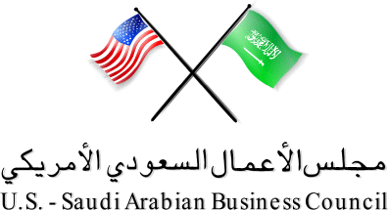

The Saudi Market
Key Elements:
High disposable income
Prefer American products
Large expatriate population
Regional integration
WTO accession
Fast growing population: 60% under age 29
Notes:
The Central Department of Statistics and Information (CDSI) has estimated the Kingdom's population for 2008 at 24.81 million. Of this, Saudis constituted 73.0 percent (18.12 million), and non-Saudis 27.0 percent (6.69 million). Source: SAMA, 45th report published in Aug 2009.
Growth rate: 2.1 percent ( 2005-2015)
A demographic study indicates that the Saudi society is among the fastest growing young societies of the world.

Slide 3
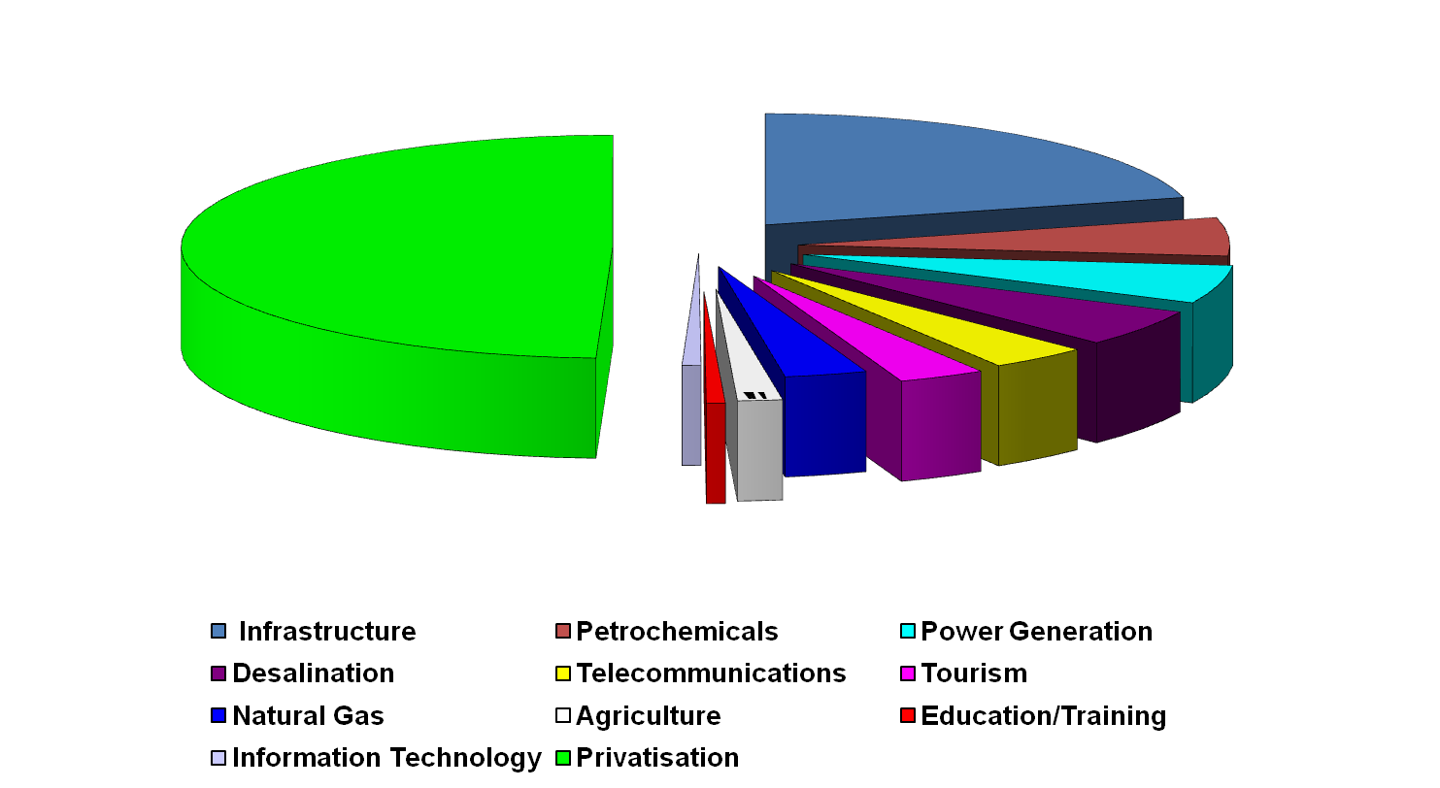
Market Opportunity
Saudi Economic Boom
Saudi Arabia: $1.4 Trillion Investment Market
$149 B
$800 B
$92 B
$50 B
$88 B
$60 B
$50 B
$53 B
$11 B
$53.5 B
$28 B
$11 B
Source: Saudi Committee for Development of International Trade, others

Slide 4
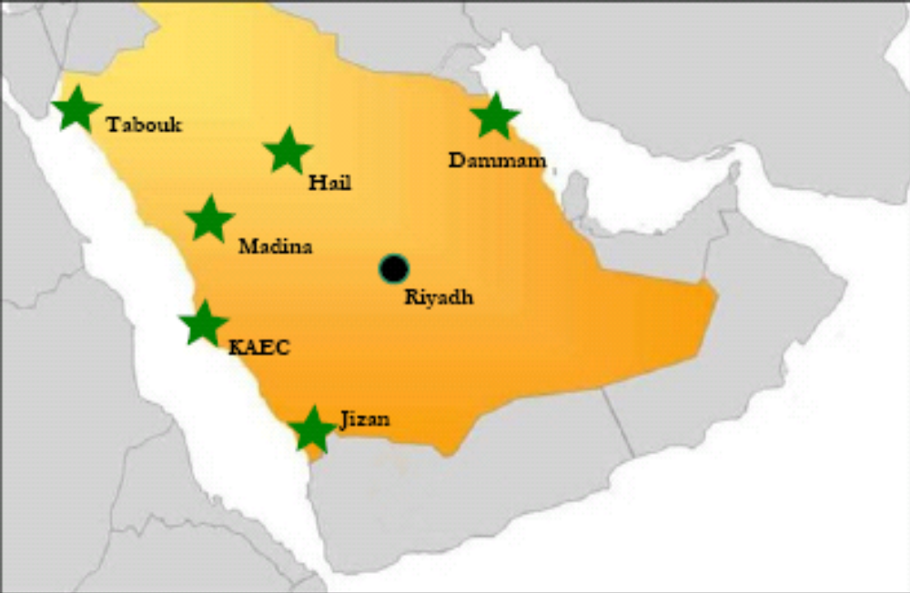
Six New Economic Cities
Tabouk Economic City
Energy Economic City
Prince Abdulaziz Bin Musaed Economic City
Knowledge Economic City
King Abdullah Economic City
Jizan Economic City
$100 Billion Worth of Investment Projects
Notes:
For example the King Abdullah Economic City is the largest investment opportunity project of the seven planned. It is estimated at $53 Billion
Six Distinct Components: 2.6 million sq. meter new Millennium Seaport
Industrial District: 8 million sq. meters to accommodate 1,500 tenants
Educational Zone: universities, schools, research & development centers
Financial Island: 48,000 offices, exhibition halls & conference rooms - covering 500,000 square meters of space
Resorts: water sport facilities, 18-hole golf course, 3,500 hotel
Residential Area: town center, marina, restaurants, 25,000 waterfront -- villas, berth for private boats, 250,000 apartments
Retail Space: 3.3 million sq. meters with capacity for 22,000 shops

Slide 5
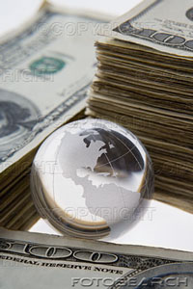
U.S.-Saudi Arabian
Business Relationship
Trade
Bilateral Trade: $67.3 Billion in 2008
U.S. is KSA’s Largest Trading Partner
KSA is U.S.14th Largest Trading Partner
Saudi Export to US:$54.8 Billion in 2008
U.S. Export to KSA:$12.5 Billion in 2008
Notes:
-46% Growth over 2007

Slide 6
Power Generation
Investment Opportunities through 2020:
  $179 billion in power generation and desalination
Projects in Development:
  -10 Independent Water & Power Projects
  13 Desalination Plants
  5 Independent Power Projects
  Expansion and upgrade of pipelines

Slide 7

Construction Sector
Year | Construction contracts ($bn)
2005 | 2.4
2006 | 6.4
2007 | 13
2008 | 11.5
2009 to date | 15.7
The total value of contracts awarded in Q1 2009:
Already exceeds the total awarded in 2008
MEED Projects
Investment Opportunities Over the Next 5 Years
  $120 Billion in general infrastructure development:
    Water, sewage, electricity, cement, steel, HVAC plants & equipment
    Schools, hospitals , hotels, roads, railways, bridges, airports
Notes:
CONSTRUCTION
According to Gulf projects tracker MEED Projects, the total value of construction contracts awarded in the country in the first two and a half months of this year already exceeds the total awarded during the whole of 2008 (see table)
Business opportunities: Public sector awards are replacing the private sector work being cancelled or postponed. Government-funded infrastructure projects, such as power, water and waste water plants, schools, universities, hospitals, railways, roads and bridges, airports, and real estate are expected to provide the bulk of opportunities. Significantly, infrastructure and building projects are set to provide the best opportunities.
Examples of Sectors of Opportunities:
REAL ESTATE: Real estate activity varies by select regions. Of the total $129 billion that will be invested in new real estate development through 2010, $40 billion will be invested in Riyadh alone.
TOURISM/ ENTERTAINMENT INFRASTRUCTURE: many of the economic cities include a tourist/resort area. KAEC's resort zone are a championship-standard 18-hole golf course with training facilities and driving range, an equestrian club, a yacht club, and a range of water sports that will take advantage of the Red Sea's coastline.
-Makkah will soon be home to the largest luxury hotel in the Middle East, the Zam Zam Sofitel Grand Suites, which will include 1,250 suites and cost $600 million.
Eastern Province: City Fanar, a 3.3-million square meter complex located on the coastline between Dammam and Al-Khobar, comprising condominiums, hotels, water-front houses, and leisure facilities.

Slide 8
Transportation
Investment Opportunities through 2020
  - $100 billion in general infrastructure development
Projects in Development:
  - Expansion of international and regional air & sea ports
  - Privatization of national air carrier, Saudi Arabian Airlines
  - Licensing of two low cost carriers
  - Major Railway Expansion:
    Landbridge Project (Jeddah, Riyadh, Dammam, Jubail)
    North-South Railway Project (Riyadh, Hail, Ras Al-Azour)
    Makkah-Madinah Rail Link (Jeddah, Makkah, Yanbu, Madinah)
Notes:
New airports to be built in Madinah and Rabigh
Expansion of major ports: Jeddah and Dammam
Railway development totaling $20 billion

Slide 9
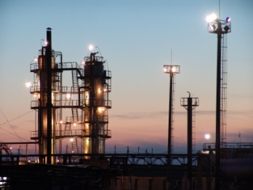
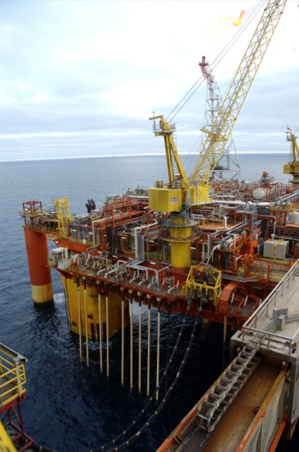
Oil and Gas
  Investment Opportunities through 2020
    - $137 billion in oil development
    - $50 billion in natural gas expansion
  Projects in Development:
        - Discovery of new oil & gas fields
        - Expansion of refineries and pipeline system
        - Construction of new export refineries
        - Expansion of the national Master Gas System
The greatest oil energy program in history
Notes:
Investment Opportunities: - $137 billion in oil development $50 billion in natural gas expansion (by 2020) of which $80 billion is for rigs, refineries, wells, processing plants (by 2011)
To maintain the Kingdom’s 25% share of world energy reserves, Saudi Arabia has launched the largest oil energy program in history with a combined investment of $187 Billion by 2020.
Saudi Aram co has approx. 150 active projects ranging in cost from $ 2 to $ 10 million of which five are mega projects to develop or discover oilfields.
In terms of oilfield developments, this could translate into lucrative opportunities for small-medium size businesses that produce that produce truck-lines, flow lines, eclectic pimp and cables, and a variety of drilling equipment would.
Another example is The Dow Chemical – one of our members – was selected by Saudi Aramco to partner in a $22/16 billion expansion of a refinery this could open up possible sub-contacting opportunities for SME engaged in offsite and utilities work

Slide 10
Petrochemicals
  Investment Opportunities through 2020:
    - $90 billion in petrochemicals expansion
  Projects in Development:
    - Vertical Integration (refinery + petrochemicals complex)
      Ras Tanura ( $16B/$22 B Saudi Aramco -Dow Chemical JV)-2006
      Petro-Rabigh ($4.3B/$9 B Saudi Aramco-Sumitomo JV)–2005
    - Downstream:
      SABIC: petrochemicals based on natural gas, NGLs
      Saudi Aramco: petrochemicals based on naphtha
      Private sector: aromatics, eylene glycol, ethylene, propylene

Slide 11


Healthcare
Largest market for medical equipment & services in the region
Public Sector:
-218 hospitals; 1,905 healthcare centers
  - 41 hospitals run by governmental agencies
Private sector : 123 hospitals; 1,055 clinics
Total Healthcare Expenditures:
    2008: $44.5 Billion (80% government, 20 % private sector)
    2009: $52.3 Billion (est.)
Budget Allocations:
    2008: $11.9 Billion
    2009: $13.9 Billion
Notes:
In 2009, the Saudi Government allocated $13.94 billion for health and social services, up from $11.87 billion the previous year. Currently, the majority of healthcare services in the Kingdom are funded by the Saudi Government.

Slide 12

Thank You
Edward Burton
President
The U.S.-Saudi Arabian Business Council
Office Telephone: 703-962-9300
Our Website: www.us-sabc.org
Notes:
Ask the audience if you can take Questions at this time….

Slide 13
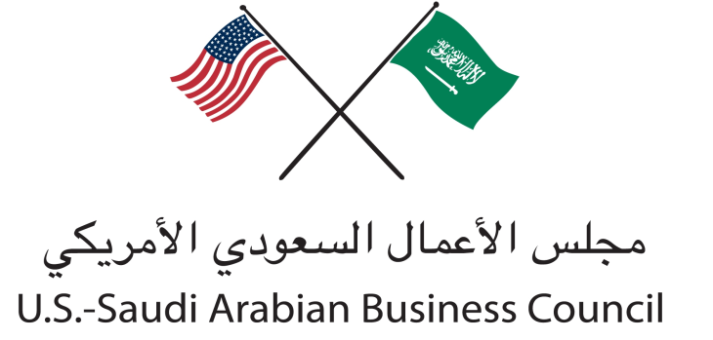
Conclusion

Slide 14
Contacts
Amer M. Kayani Edward Burton
Counselor for Commercial Affairs President
Embassy of the United States Telephone: 703-962-9300
Riyadh, Kingdom of Saudi Arabia www.us-sabc.org
Phone: +966-1-488-3800
Shawn D. Saathoff
President & Managing Director
Acoustiblok Mideast
C/O Arabian Plastic Compounds
Second Industrial Area
P.O. Box 27507 Riyadh 11427
Kingdom of Saudi Arabia
E-Mail - saatsound@aol.com
Factory + 966 1 265 0088
Local Cell + 059 944-9015
U.S. Cell + 00 1 813 -760-3622
U.S. Office + 001 813-991-1152

