Slide 1
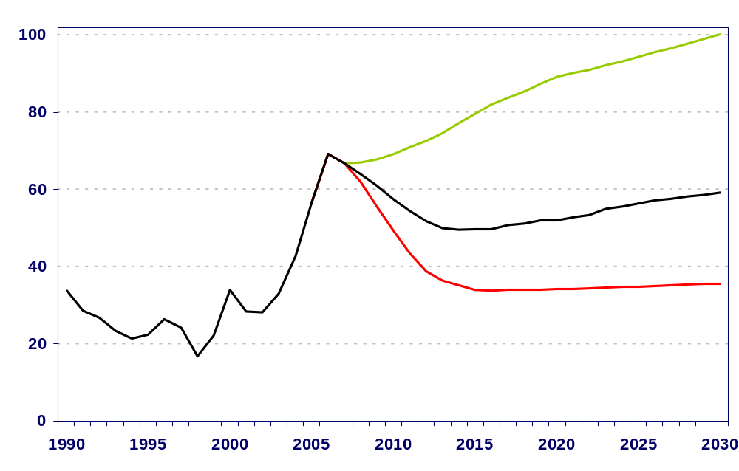
World Oil Prices in Three Cases, 1990-2030
2005 dollars per barrel
High Price
Reference
Low Price
History
Projections

