Slide 1

State of Washington
Military Department
Human Resource
Management Report
Plan & Align Workforce
Hire Workforce
Deploy Workforce
Reinforce Performance
Develop Workforce
October 2007

Slide 2
Managers’ Logic Model for Workforce Management
Washington Military Department
Outputs
Initial Outcomes
Intermediate Outcomes
Plan & Align Workforce
Articulation of managers HRM accountabilities. HR policies. Workforce planning. Job classes & salaries assigned.
Managers understand HRM accountabilities. Jobs, staffing levels, & competencies aligned with agency priorities.
Foundation is in place to build and sustain a productive, high performing workforce.
Hire
Workforce
Qualified candidate pools, interviews & reference checks. Job offers. Appts & per-
formance monitoring.
Best candidate hired & reviewed during appointment period. Successful performers retained.
The right people are in the right job at the right time.
Ultimate Outcomes
Employees are committed to the work they do & the goals of the organization
Productive, successful employees are retained
State has workforce depth & breadth needed for present and future success
Deploy
Workforce
Work assignments& requirements defined. Positive workplace environment created. Coaching, feedback, corrections.
Workplace is safe, gives capacity to perform, & fosters productive relations. Staff know job rqmts, how they’re doing, & are supported.
Time & talent is used effectively. Employees are motivated & productive.
Develop Workforce
Individual development plans. Time/ resources for training. Continuous learning environment created.
Learning environment created. Employees are engaged in develop-
ment opportunities & seek to learn.
Employees have competencies for present job & career advancement
Agencies are better enabled to successfully carry out their mission. The citizens receive efficient government services.
Reinforce Performance
Clear performance expectations linked to orgn’al goals & measures. Regular performance appraisals. Recognition. Discipline.
Employees know how performance contributes to success of orgn. Strong performance rewarded; poor performance eliminated
Successful perf is differentiated & strengthened. Employees are held accountable.

Slide 3
Standard Performance Measures
Washington Military Department
Plan & Align Workforce
Percent supervisors with current performance expectations for workforce management
Management profile
Workforce planning measure (TBD)
Percent employees with current position/competencies descriptions
Time-to-fill funded vacancies
Candidate quality
Hiring Balance (Proportion of appointment types)
Separation during review period
Percent employees with current performance expectations
Employee survey ratings on “productive workplace” questions
Overtime usage
Sick leave usage
Non-disciplinary grievances/appeals filed and disposition (outcomes)
Worker safety
Percent employees with current individual development plans
Employee survey ratings on “learning & development” questions
Competency gap analysis (TBD)
Percent employees with current performance evaluations
Employee survey ratings on “performance & accountability” questions
Disciplinary actions and reasons, disciplinary grievances/appeals filed and disposition (outcomes)
Reward and recognition practices (TBD)
Ultimate Outcomes
Hire
Workforce
Employee survey ratings on “commitment” questions
Turnover rates and types
Turnover rate: key occupational categories
Workforce diversity profile
Retention measure (TBD)
Deploy
Workforce
Develop Workforce
Reinforce Performance

Slide 4
Plan & Align Workforce
Outcomes:
Managers understand workforce management accountabilities. Jobs and competencies are defined and aligned with business priorities. Overall foundation is in place to build & sustain a high performing workforce.
Performance Measures:
Percent supervisors with current performance expectations for workforce management
Management profile
Workforce Planning measure (TBD)
Percent employees with current position/ competency descriptions
Washington Military Department
Workforce Management Expectations
Percent supervisors with current performance expectations for workforce management = 63%
Analysis:
Due to the nature of the Military Department’s mission, some State employees are supervised by Federal employees. Federal supervisors and EMT members were not included in our count.
Current performance expectations include all expectations in probationary, and trial service review period, and annual evaluations, received either on time or late, as indicated by the tracking database snapshot for the October 2007 report.
Action Steps:
Continue tracking and analyzing PDP submission to determine which Divisions/Units are not completing PDP’s in a timely manner. Continue to provide this information at agency quarterly GMAP sessions.
Continue to consult with supervisors in the identified areas and develop strategies for completing meaningful performance expectations.
Begin tracking PDP’s in HRMS
Continue to provide EMT monthly progress reports on timeliness of PDP.
Review and analyze reports to identify issues / areas for improvement.
Total # of supervisors with current performance expectations for workforce management = 24
Total # of supervisors = 38
Data as of October 17, 2007
Source: PDP Tracking Log

Slide 5
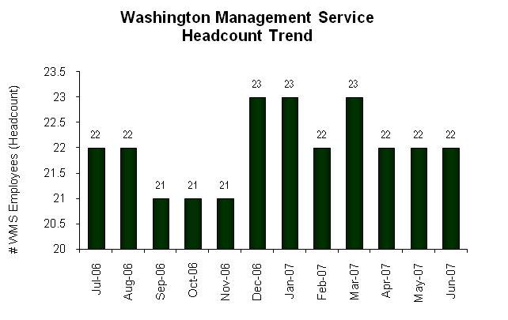
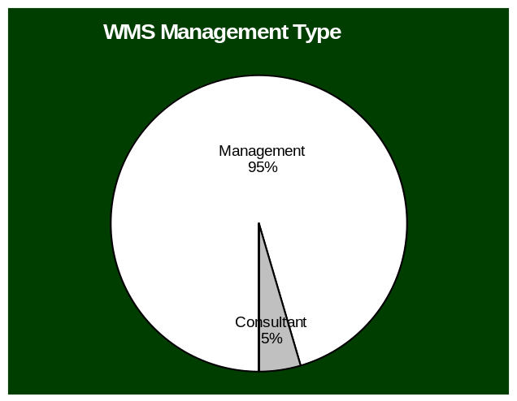
Plan & Align Workforce
Outcomes:
Managers understand workforce management accountabilities. Jobs and competencies are defined and aligned with business priorities. Overall foundation is in place to build & sustain a high performing workforce.
Performance Measures:
Percent supervisors with current performance expectations for workforce management
Management profile
Workforce Planning measure (TBD)
Percent employees with current position/ competency descriptions
Washington Military Department
Management Profile
WMS Employees Headcount = 22
Percent of agency workforce that is WMS = 5.8%
Managers* Headcount = 34
Percent of agency workforce that is Managers* = 8.9%
* In positions coded as “Manager” (includes EMS, WMS, and GS)
Analysis:
The number of WMS employees increased in December due to Presidential Disaster Declarations related to the November Flooding and December Windstorm. The incumbents of these positions are in acting positions. They will resume their general service positions upon completion of the higher level responsibilities.
Action Steps:
Continue to monitor our WMS staffing to ensure it stays below 5.9%.
Management 21
Consultant 1
Policy 0
Not Assigned 0
Data as of June 30, 2007
Source: Business Warehouse

Slide 6
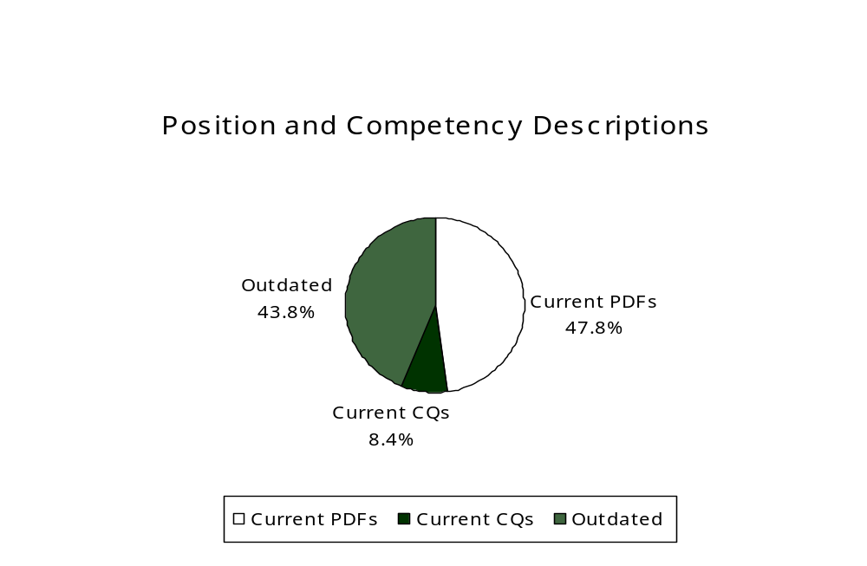
Plan & Align Workforce
Outcomes:
Managers understand workforce management accountabilities. Jobs and competencies are defined and aligned with business priorities. Overall foundation is in place to build & sustain a high performing workforce.
Performance Measures:
Percent supervisors with current performance expectations for workforce management
Management profile
Workforce Planning measure (TBD)
Percent employees with current position/ competency descriptions
Washington Military Department
Current Position/Competency Descriptions
Percent of employees with current position/competency descriptions = 56.2%
Analysis:
Data reflects occupied permanent positions with updated position/ competency descriptions. It does not differentiate between appointment types.
The data does not include the department’s three Title 38 exempt positions.
Current position/competency descriptions include all Position Description Forms and/or Classification Questionnaires that have been updated and signed within the last three years.
Action Steps:
Managers and human resource staff coach and mentor supervisors regarding the completion of PDFs.
Managers are required to review/update position/competency descriptions, both as needed and during the performance evaluation process.
Updated position/competency descriptions are required prior to the initiation of the recruitment and/or hiring process.
The Department will update PDF training and make it available during the next reporting period.
HRO is implementing an aggressive program to assist managers in updating all PDF by January 2008.
Total # of employees with current position/competency descriptions* = 159
Total # of employees = 283
*Applies to permanent positions, including GS, WMS and non-Title 38 EMS
Data as of October 10, 2007
Source: PDF Tracking Log

Slide 7
Hire Workforce
Outcomes:
Best candidates are hired and reviewed during appointment period. The right people are in the right job at the right time.
Performance Measures
Time-to-fill vacancies
Candidate quality
Hiring Balance (proportion of appointment types)
Separation during review period
Washington Military Department
Time-to-fill / Candidate Quality
Time-to-fill Funded Vacancies
Average number of days to fill*: 79.8
Number of vacancies filled: 23
*Equals # of days from creation of the requisition to job offer acceptance
Time Period: January 26, 2007 – June 30, 2007
Analysis:
Department began using E-Recruiting in January of 2007
The Department had three hard to fill positions that went over 100 days. Additionally, we hired armed security guards which require extensive background checks including a polygraph and psychological evaluation. When these four recruitments were removed, the Department’s average number of days to fill was 67 days.
Since the candidate quality process was recently implemented we are evaluating methods to increase manager participation.
Action Steps:
Develop committee / charter to streamline appointment approval process.
Implement monthly recruitment/vacancies meetings with Division Directors.
Reorganize Human Resource Office to provide better customer service and increase efficiencies.
Candidate Quality
Of the candidates interviewed for vacancies, how many had the competencies (knowledge, skills & abilities) needed to perform the job?
  Number = 53 Percentage = 81%
Of the candidates interviewed, were hiring managers able to hire the best candidate for the job?
  Hiring managers indicating “yes”:
  Number = 11 Percentage = 85%
  Hiring managers indicating “no”:
  Number = 2 Percentage = 15%
Time Period: April 15, 2007 to June 30, 2007
Data as of June 30, 2007
Source: E-Recruiting and Manager Survey

Slide 8
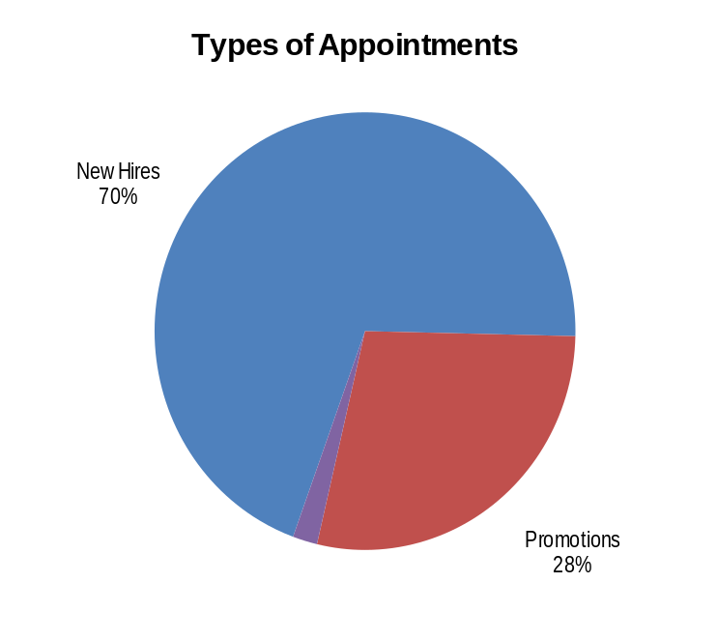
Hire Workforce
Outcomes:
Best candidates are hired and reviewed during appointment period. The right people are in the right job at the right time.
Performance Measures
Time-to-fill vacancies
Candidate quality
Hiring Balance (proportion of appointment types)
Separation during review period
Washington Military Department
Hiring Balance / Separations During Review Period
Analysis:
Due to the Department’s coding practices in HRMS, the BW does not reflect the correct number of appointments. From July 1, 2006 to June 30, 2007, the Department made 53 new permanent appointments (37 new hires, 15 promotions, and 1 exempt.
Action Steps:
Provide recruitment training to hiring managers and supervisors in the winter of 2007.
Continue to require reference checks and background checks on all potential hires permanent and/or nonpermanent. This includes verification of education and personnel file reviews for all current/previous state employees.
Review HRMS coding practices.
Total number of appointments = 53*
Time period = July 1, 2007 through June 30, 2007
Includes appointments to permanent vacant positions only; excludes reassignments
“Other” = Demotions, re-employment, reversion & RIF appointments
Separation During Review Period
Probationary separations – Voluntary 0
Probationary separations – Involuntary 0
  Total Probationary Separations 0
Trial Service separations – Voluntary 0
Trial Service separations – Involuntary 0
  Total Trial Service Separations 0
Total Separations During Review Period 0
Time period = July 1, 2007 through June 30, 2007
Data as of 06/07
Source: Business Warehouse / Recruitment Log

Slide 9
Deploy Workforce
Outcomes:
Staff know job expectations, how they’re doing, & are supported. Workplace is safe, gives capacity to perform, & fosters productive relations. Employee time and talent is used effectively. Employees are motivated.
Performance Measures
Percent employees with current performance expectations
Employee survey ratings on “productive workplace” questions
Overtime usage
Sick leave usage
Non-disciplinary grievances/appeals filed and disposition (outcomes)
Safety and Workers Compensation (TBD)
Washington Military Department
Current Performance Expectations
Percent employees with current performance expectations = 65.7%
Analysis:
Report reflects evaluations due
April 1, 2007 through October 17, 2007.
Nonpermanent employees, probationary/trial service/review period employees whose evaluations were not due, EMT, and employees on leave without pay were not included.
Current performance expectations include all expectations in probationary, trial service, review period, and annual evaluations, received either on time or late, as indicated by the tracking data base snapshot for the October 2007 report.
Action Steps:
Continue tracking and analyzing PDP submission to determine which Divisions/Units are not completing PDP’s in a timely manner.
Continue to consult with supervisors in the identified areas and develop strategies for completing meaningful performance expectations.
Begin tracking PDP in HRMS.
EMT members are provided monthly progress reports on timeliness of PDP submission and it is reported quarterly at the agency GMAP session.
Total # of employees with current performance expectations* = 167
Total # of employees* = 254
*Applies to employees in permanent positions, both WMS & General Service
Data as of October 17, 2007
Source: PDP Tracking Log

Slide 10
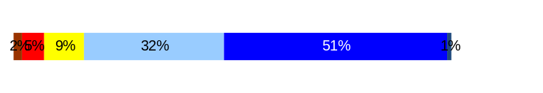
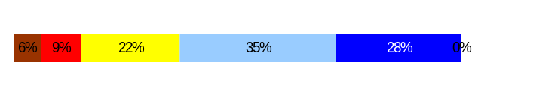
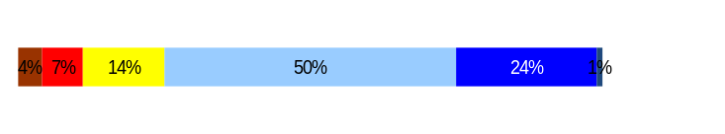
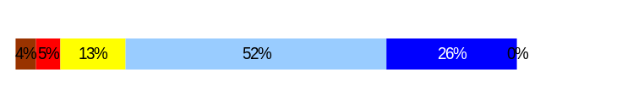
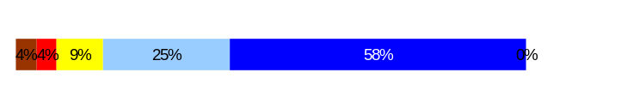
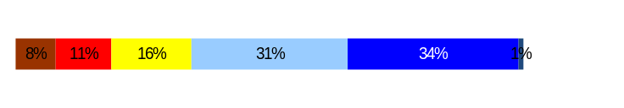
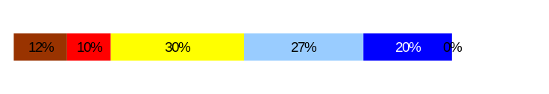
Deploy Workforce
Outcomes:
Staff know job expectations, how they’re doing, & are supported. Workplace is safe, gives capacity to perform, & fosters productive relations. Employee time and talent is used effectively. Employees are motivated.
Performance Measures
Percent employees with current performance expectations
Employee survey ratings on “productive workplace” questions
Overtime usage
Sick leave usage
Non-disciplinary grievances/appeals filed and disposition (outcomes)
Safety and Workers Compensation (TBD)
Washington Military Department
Employee Survey “Productive Workplace” Ratings
Avg
Q4. I know what is expected of me at work.
Q1. I have opportunity to give input on decisions affecting my work.
Q2. I receive the information I need to do my job effectively.
Q6. I have the tools and resources I need to do my job effectively.
Q7. My supervisor treats me with dignity and respect.
Q8. My supervisor gives me ongoing feedback that helps me
improve my performance.
Q9. I receive recognition for a job well done.
Analysis:
EMT will review Q1, 2 and 6 to determine if there are opportunities to determine more clearly what line staff need in the way of information, tools, resources and input to do their job more effectively.
Action Steps:
Continue to monitor employee perception of day-to-day support through review of Part 3 of Performance Development Plan.
Develop action plans if needed after analysis of questions.
Administering Employee Survey November 1, 2007 and will analyze to current history.
4.26
3.68
3.85
3.9
4.31
3.43
3.32
Never
Seldom
Occasionally
Usually
Always
Overall average score for Productive Workplace Ratings: 3.9%
Data as of 12/31/2006
Source: Employee Survey Results

Slide 11
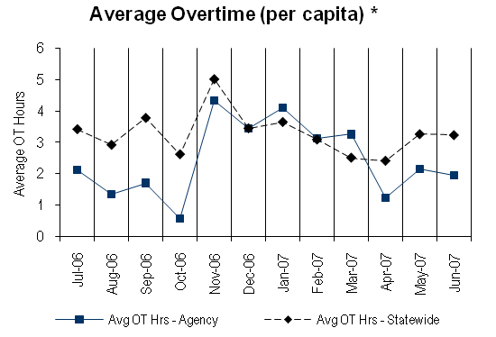
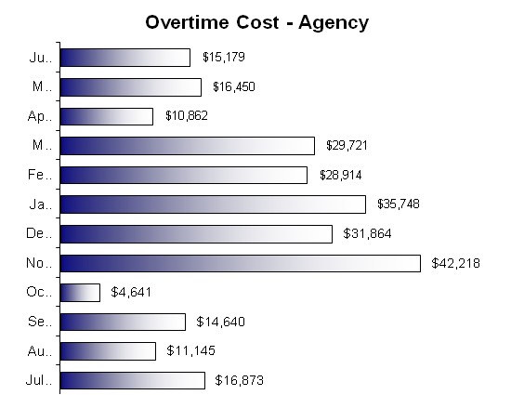
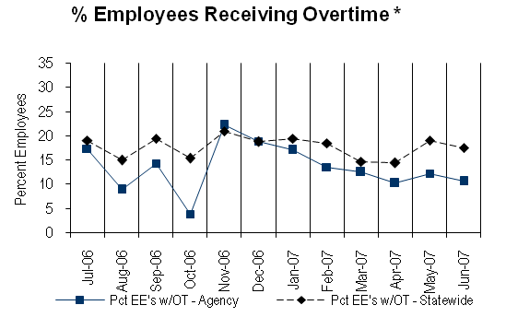
Deploy Workforce
Outcomes:
Staff know job expectations, how they’re doing, & are supported. Workplace is safe, gives capacity to perform, & fosters productive relations. Employee time and talent is used effectively. Employees are motivated.
Performance Measures
Percent employees with current performance expectations
Employee survey ratings on “productive workplace” questions
Overtime usage
Sick leave usage
Non-disciplinary grievances/appeals filed and disposition (outcomes)
Worker safety
Washington Military Department
Overtime Usage
Overall agency avg overtime usage – per capita, per month: 2.43**
*Statewide overtime values do not include DNR
**Overall agency avg overtime usage – per capita, per month = sum of monthly OT averages divided by number of months
Analysis:
The Department’s overtime cost increased significantly in November through January due to Presidential Disaster Declarations resulting from the November flooding and the December windstorm.
We have not set a numerical goal for overtime as it is driven by events beyond the control of the agency (natural disasters). Overall the Department's overtime rate is lower than the state average.
Action Steps:
Monitor utilization of overtime and report out to EMT as appropriate.
Overall agency avg employees receiving overtime per month: 13.46%**
*Statewide overtime values do not include DNR
**Overall agency avg employees receiving overtime per month = sum of monthly OT percentages divided by number of months
Data as of June 30, 2007
Source: Business Warehouse

Slide 12
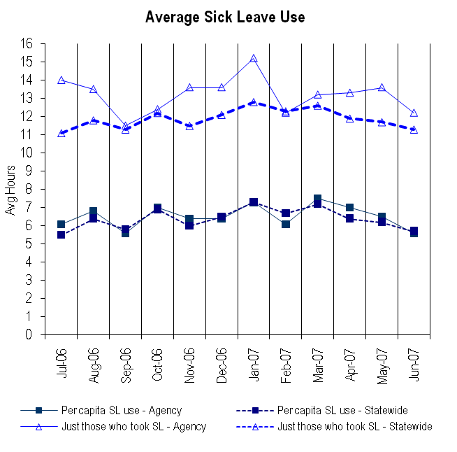
Deploy Workforce
Outcomes:
Staff know job expectations, how they’re doing, & are supported. Workplace is safe, gives capacity to perform, & fosters productive relations. Employee time and talent is used effectively. Employees are motivated.
Performance Measures
Percent employees with current performance expectations
Employee survey ratings on “productive workplace” questions
Overtime usage
Sick leave usage
Non-disciplinary grievances/appeals filed and disposition (outcomes)
Worker safety
Washington Military Department
Sick Leave Usage
Analysis:
The Department’s sick leave usage is higher than the statewide average.
Action Steps:
Conduct more in-depth data analysis to review leave usage for patterns or leave abuse regarding unplanned leave by
October 31, 2007
Continue to provide case-by-case assistance to manager regarding leave abuse issues.
Sick Leave Hrs Used / Earned (per capita)
Avg Hrs SL Used (per capita) - Agency | % of SL Hrs Earned (per capita) - Agency
6.5 Hrs | 82.9%
Avg Hrs SL Used (per capita) – Statewide* | % of SL Hrs Earned (per capita) – Statewide*
6.4 Hrs | 82.5%
Sick Leave Hrs Used / Earned (those who took SL)
Avg Hrs SL Used (those who took SL) - Agency | % SL Hrs Earned (those who took SL) - Agency
13.2 Hrs | 164.7%
Avg Hrs SL Used (those who took SL) – Statewide* | % SL Hrs Earned (those who took SL) – Statewide*
11.9 Hrs | 148.4%
Sick Leave time period = July 1, 2006 through June 30, 2007
* Statewide data does not include DOL, DOR, L&I, and LCB
Source: Business Warehouse

Slide 13
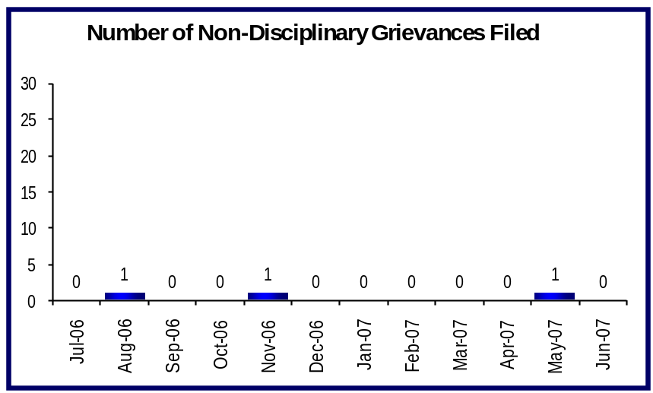
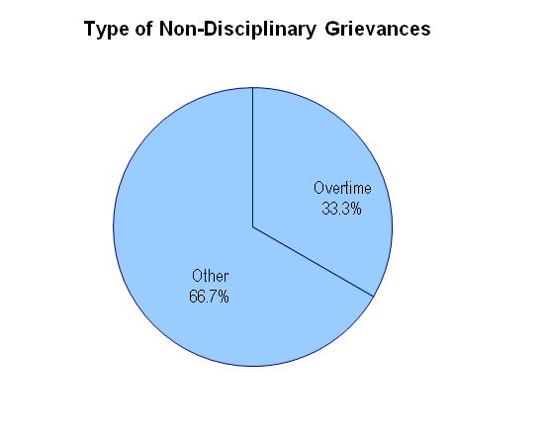
Deploy Workforce
Outcomes:
Staff know job expectations, how they’re doing, & are supported. Workplace is safe, gives capacity to perform, & fosters productive relations. Employee time and talent is used effectively. Employees are motivated.
Performance Measures
Percent employees with current performance expectations
Employee survey ratings on “productive workplace” questions
Overtime usage
Sick leave usage
Non-disciplinary grievances/appeals filed and disposition (outcomes)
Safety and Workers Compensation (TBD)
Washington Military Department
Non-Disciplinary Grievances (represented employees)
Total Non-Disciplinary Grievances = 2
Non-Disciplinary Grievance Disposition*
(Outcomes determined during 07/01/2006 through 6/30/07)
One was withdrawn by the WFSE
One was withdrawn by the WPEA
One was settled.
Analysis:
The Washington Military Department has an effective working relationship with both the WPEA and the WFSE. This has facilitated information sharing and resolution of issues at the lowest possible level.
Action Steps:
Continue to maintain strong working relationships with union personnel.
* There may not be a one-to-one correlation between the number of grievances filed (shown top of page) and the outcomes determined during this time period. The time lag between filing date and when a decision is rendered can cross the time periods indicated.
Data as of 6/30/2007
Source: Grievance Records

Slide 14
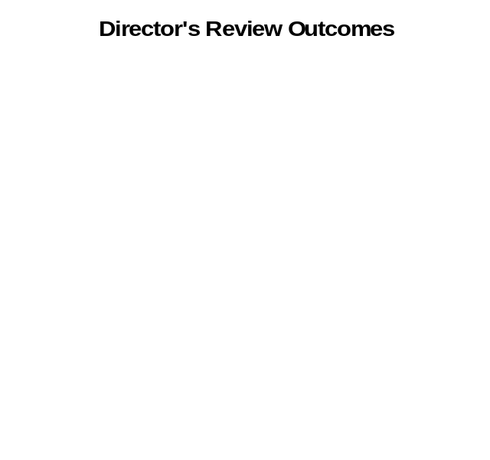
Deploy Workforce
Outcomes:
Staff know job expectations, how they’re doing, & are supported. Workplace is safe, gives capacity to perform, & fosters productive relations. Employee time and talent is used effectively. Employees are motivated.
Performance Measures
Percent employees with current performance expectations
Employee survey ratings on “productive workplace” questions
Overtime usage
Sick leave usage
Non-disciplinary grievances/appeals filed and disposition (outcomes)
Safety and Workers Compensation (TBD)
Washington Military Department
Non-Disciplinary Appeals (mostly non-represented employees)
Filings for DOP Director’s Review
Time Period = 7/06 through 6/07
0 Job classification
0 Rule violation
0 Name removal from register
0 Rejection of job application
0 Remedial action
0 Total filings
Filings with Personnel Resources Board
Time Period = 7/06 through 6/07
0 Job classification
0 Other exceptions to Director Review
0 Layoff
0 Disability separation
0 Non-disciplinary separation
0 Total filings
Non-Disciplinary appeals only are shown above.
There is no one-to-one correlation between the filings shown above and the outcomes displayed in the charts below. The time lag between filing date and when a decision is rendered can cross the time periods indicated.
Total outcomes = 0
Time Period = 7/06 through 6/07
Total outcomes = 0
Time Period = 7/06 through 6/07
Source: Dept of Personnel

Slide 15
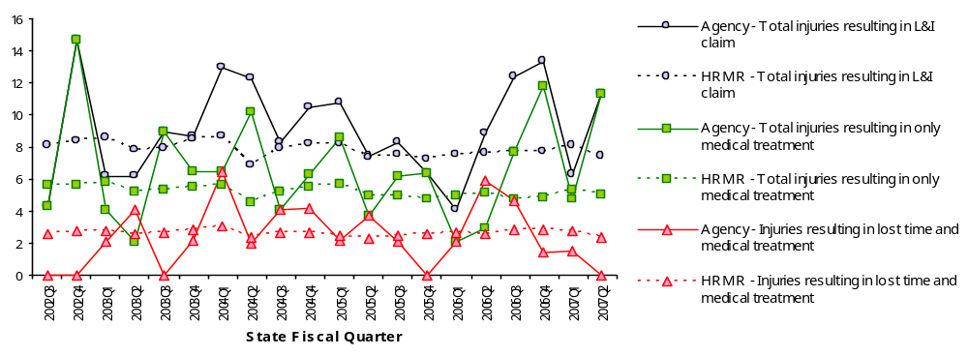
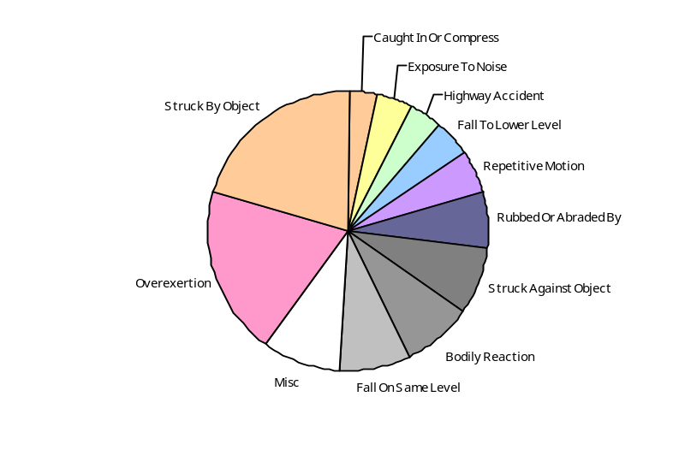
Deploy Workforce
Outcomes
Staff know job expectations, how they’re doing, & are supported. Workplace is safe, gives capacity to perform, & fosters productive relations. Employee time and talent is used effectively. Employees are motivated.
Performance Measures
Percent employees with current performance expectations
Employee survey ratings on 'productive workplace' questions
Overtime usage
Sick leave usage
Non-disciplinary grievances/appeals filed and disposition outcomes
Worker Safety
Worker Safety: Military Department
Analysis:
Department is above the HRM1R Total Injuries in all three areas identified.
Department conducted a GAP Analysis and identified four key areas for improvement. These areas are identified in the action plan.
Established and recruited new Safety Program Manager position. The new Safety Program Manager starts 10/16/2007.
Action Plan:
Ensure staff assigned safety duties have the work time allocated to perform those duties.
Develop and implement a process for all employees will have their workstations / activities reviewed to identify hazards.
Conduct emergency drills with employees twice a year.
Train managers to include safety as a component of the Performance Development Plan (PDP)
Allowed Annual
Claims Rate*^:
Agency vs. All HR
Management Report
(HRMR) agencies
*Annual claims rate
is # claims / 100 FTE
1 FTE = 2000 hours
^Due to natural lag
in claim filing, rates
are expected to
increase significantly
over time
Injuries by Occupational
Injury and Illness
Classification (OIICS)
event:
For fiscal period 2002Q3
through 2007Q2
(categories under 3% or not
adequately coded are grouped
into 'misc.')
Oiics Code | Oiics Description | Percent | Number
21 | Bodily Reaction | 8% | 8
03 | Caught In Or Compress | 3% | 3
35 | Exposure To Noise | 4% | 4
13 | Fall On Same Level | 8% | 8
11 | Fall To Lower Level | 4% | 4
41 | Highway Accident | 4% | 4
- | Misc | 9% | 9
22 | Overexertion | 19% | 19
23 | Repetitive Motion | 5% | 5
05 | Rubbed Or Abraded By | 6% | 6
01 | Struck Against Object | 8% | 8
02 | Struck By Object | 20% | 20
Source: Labor & Industries, Research and Data Services (data as of 09/03/2007 )
Notes:
HRMR Safety Report Overview
The HRMR Safety Reports are:
- PowerPoint slides created by the Department of Labor and Industries
- Created for each state agency that is reporting their employee safety program results bi-
annually as part of their Human Resources Management Report (HRMR).
- Snapshots of five years of worker’s compensation claim data specific to that agency, as
well as a comparison to the combined data for agencies completing HRMR reports.
- There is a two quarter lag at the end of the five years.
This allows each agency’s payroll data to be entered into L&I’s computer system. This
payroll data is used to compute the number of workers per agency and quarter.
Definitions
Claim – When a covered worker sustains an occupational injury or illness, that worker files a
'claim’ for benefits. A 'claim number' is assigned, and all wage replacement payments, medical
provider bills, etc, for that worker and injury, are associated with that claim number.
Report Detail
'Allowed Annual Claim Rate'
This chart shows your agency's rate of injuries resulting in allowed
claims, by injury quarter, for on-the-job injuries and occupational illnesses. The rate for all
reporting agencies is shown for comparison.
- The rate is the number accepted claims per 200,000 annual worker hours (100 workers)
Three rates are included in this chart:
A)The total rate for all injuries resulting in a claim; the two groups listed below are
exclusive of each other.
B)The rate of injuries which required medical care, but no compensation for lost
time.
C)The rate of injuries which resulted in compensation for lost time in addition to
medical care.
'Injuries by Occupational Injury and Illness Classification (OIICS) Event’
This section contains a pie chart which shows your agency's injuries by type* and a table which
shows the percent and number of accepted claims by OIICS Event description and code.
This information is useful in identifying what causes injuries so prevention can occur. Prevention
might include root cause analysis, education, and hazard mitigation.
* Injury Type is based on the 2 digit Major Group code of the Event or Exposure section of the Occupational
Injury and Illness Classification System (OIICS). Groups with less than 3% of the
total injuries are combined into the 'Misc' category.
How to get this report for your agency:
All worker compensation reports will be available on the L&I website by the 20th of September or
the 20th of March of each year. The data will be provided in a PowerPoint slide to which you will
add your own analyses and action plans.

Slide 16
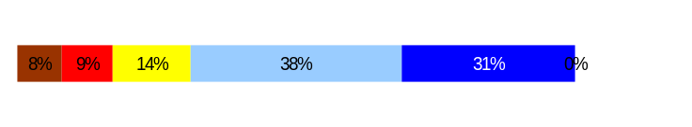
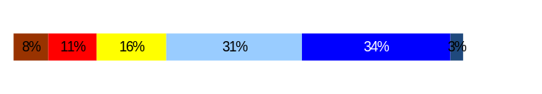
Develop Workforce
Outcomes:
A learning environment is created. Employees are engaged in professional development and seek to learn. Employees have competencies needed for present job and future advancement.
Performance Measures
Percent employees with current individual development plans
Employee survey ratings on “learning & development” questions
Competency gap analysis (TBD)
Washington Military Department
Individual Development Plans
Percent employees with current individual development plans = 65.7%
Analysis:
Nonpermanent employees, probationary/trial service/review period employees whose evaluations were not due, EMT, and employees on leave without pay were not included.
Current Individual Development Plans (IDP) include all plans provided as probationary, trial service, review period, and annual evaluations, received either on time or late, as indicated by the tracking data base snapshot for the 2007 report.
Action Steps:
Continue analyzing PDP submission to determine if viable IDP’s are being developed and outlined by supervisors.
Continue to consult with supervisors in the identified areas and develop strategies for assuring the various components of the IDP’s are completed.
Total # of employees with current IDPs* = 167
Total # of employees* = 254
*Applies to employees in permanent positions, both WMS & GS
Employee Survey “Learning & Development” Ratings
Q5. I have opportunities at work to learn and grow.
Q8. My supervisor gives me ongoing feedback that helps me
improve my performance.
Avg
3.74
3.74
Overall average score for Learning & Development Ratings: 3.7
Data as of October 17, 2007
Source: PDP Tracking Log

Slide 17
Reinforce Performance
Outcomes:
Employees know how their performance contributes to the goals of the organization. Strong performance is rewarded; poor performance is eliminated. Successful performance is differentiated and strengthened. Employees are held accountable.
Performance Measures
Percent employees with current performance evaluations
Employee survey ratings on “performance and accountability” questions
Disciplinary actions and reasons, disciplinary grievances/appeals filed and disposition (outcomes)
Reward and recognition practices (TBD)
Washington Military Department
Current Performance Evaluations
Percent employees* with current performance evaluations = 75.6%
Analysis:
Non-permanent employees, probationary/trial service/review period employees whose evaluations were not due, EMT, and employees on leave without pay were not included.
Current performance feedback for all employees including those in probationary and trial service review periods, and annual evaluations, received either on time or late, as indicated by the tracking data base snapshot for the October 2007 report.
Action Steps:
Continue tracking and analyzing PDP submission to determine which Divisions/Units are not completing PDP’s in a timely manner.
Continue to consult with supervisors in the identified areas and develop strategies for completing meaningful performance expectations.
Begin tracking PDPs in HRMS.
We have an Access database and manually track PDP submission. EMT members are provided monthly progress reports on timeliness of PDP submission and it is reported out quarterly at the agency GMAP
Total # of employees with current performance evaluations* = 192
Total # of employees* = 254
*Applies to employees in permanent positions, both WMS & GS
Data as of October 17, 2007
Source: PDP Tracking Log

Slide 18
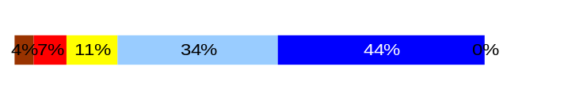
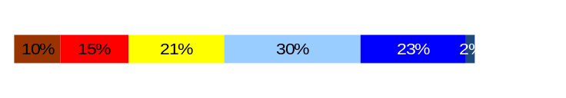
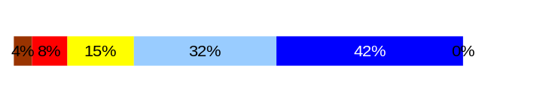
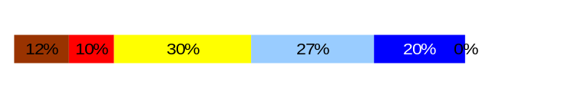
Reinforce Performance
Outcomes:
Employees know how their performance contributes to the goals of the organization. Strong performance is rewarded; poor performance is eliminated. Successful performance is differentiated and strengthened. Employees are held accountable.
Performance Measures
Percent employees with current performance evaluations
Employee survey ratings on “performance and accountability” questions
Disciplinary actions and reasons, disciplinary grievances/appeals filed and disposition (outcomes)
Reward and recognition practices (TBD)
Washington Military Department
Employee Survey “Performance & Accountability” Ratings
Avg
Analysis:
WMD is currently moving towards 100% current evaluations on staff. Attainment of this goal will mean feedback is timely, next steps will be to make it meaningful to the employee. It appears from our ratings that we may not be giving individual recognition from the supervisor level.
Action Steps:
Determine what would be meaningful in the way of recognition. We currently have quarterly recognition in each division and an agency wide event during PSRW.
Q3. I know how my work contributes to the goals of my agency.
Q10. My performance evaluation provides me with meaningful information about my performance.
Q11. My supervisor holds me and my co-workers accountable for performance.
Q9. I receive recognition for a job well done.
4.1
3.4
4.0
3.3
Never
Seldom
Occasionally
Usually
Always
Overall average score for “Performance & Accountability” ratings: 3.7
Data as of 12/31/2006
Source: Employee Survey Results & Military Department HRO PDP Database

Slide 19
Reinforce Performance
Outcomes:
Employees know how their performance contributes to the goals of the organization. Strong performance is rewarded; poor performance is eliminated. Successful performance is differentiated and strengthened. Employees are held accountable.
Performance Measures
Percent employees with current performance evaluations
Employee survey ratings on “performance and accountability” questions
Disciplinary actions and reasons, disciplinary grievances/appeals filed and disposition (outcomes)
Reward and recognition practices (TBD)
Washington Military Department
Formal Disciplinary Actions
Disciplinary Action Taken
Time period = July 2006 through June 30, 2007
Analysis:
The Department had two dismissals during the reporting period. Additionally there were two instances where the pre-determination process was initiated and the employee chose to resign prior to formal disciplinary action being taken.
Action Steps:
Continue to investigate allegations of misconduct and take the appropriate level of discipline where warranted.
Dismissals | 2
Demotions | 0
Suspensions | 0
Reduction in Pay (tracked by agency)* | 0
Total Disciplinary Actions* | 2
* Reduction in Pay is not currently available in HRMS/BW.
Issues Leading to Disciplinary Action
Misuse of state resources.
Inappropriate use of the computer
Data as of June 30, 2007
Source: HRMS BW

Slide 20
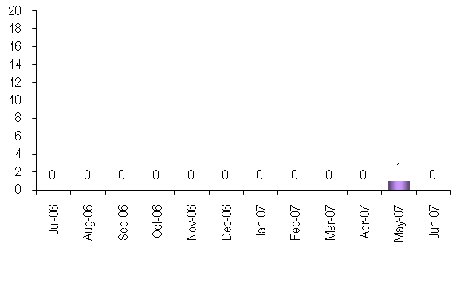
Reinforce Performance
Outcomes:
Employees know how their performance contributes to the goals of the organization. Strong performance is rewarded; poor performance is eliminated. Successful performance is differentiated and strengthened. Employees are held accountable.
Performance Measures
Percent employees with current performance evaluations
Employee survey ratings on “performance and accountability” questions
Disciplinary actions and reasons, disciplinary grievances/appeals filed and disposition (outcomes)
Reward and recognition practices (TBD)
Washington Military Department
Disciplinary Grievances and Appeals
Disciplinary Grievances
(Represented Employees)
Disciplinary Appeals
(Non-Represented Employees
filed with Personnel Resources Board)
Time Period = 7/06 through 6/07
0 Dismissal
0 Demotion
0 Suspension
0 Reduction in salary
0 Total Disciplinary Appeals Filed with PRB
Total # Disciplinary Grievances Filed: 0
There is no one-to-one correlation between the filings shown above and the outcomes displayed in the charts below. The time lag between filing date and when a decision is rendered can cross the time periods indicated.
Disposition (Outcomes) of Disciplinary Grievances
Time period = 07/06 through 6/07
Grievance was settled.
Disposition (Outcomes) of Disciplinary Appeals*
Time period = 07/06 through 6/07
There were no disciplinary appeals filed during
this reporting period.
*Outcomes issues by Personnel Resources Board
Data as of June 30, 2007
Source: Appeals and Director’s Review Data on hr.dop.wa.gov

Slide 21
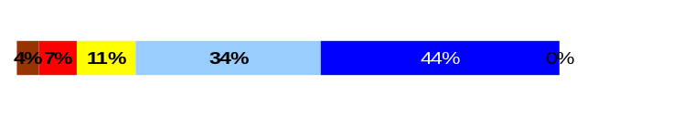
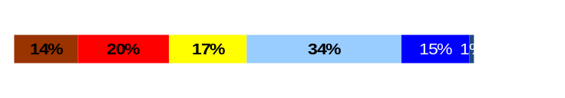
ULTIMATE OUTCOMES
Employees are committed to the work they do and the goals of the organization
Successful, productive employees are retained
The state has the workforce breadth and depth needed for present and future success
Performance Measures
Employee survey ratings on “commitment” questions
Turnover rates and types
Turnover rate: key occupational categories
Workforce diversity profile
Retention measure (TBD)
Washington Military Department
Employee Survey “Employee Commitment” Ratings
Avg
Analysis:
Overall employees are committed to the mission of the agency and understand how their work contributes.
Action Steps:
We will continue to develop more effective ways of informing line staff of our strategic plan and GMAP measurements and their impact on those.
Q3. I know how my work contributes to the goals of my agency.
Q12. I know how my agency measures its success.
Q9. I receive recognition for a job well done.
4.1
3.2
3.3
Never
Seldom
Occasionally
Usually
Always
Overall average score for Employee Commitment ratings: 3.5%
Data as of 12/ 31/2006
Source: Employee Survey Results

Slide 22
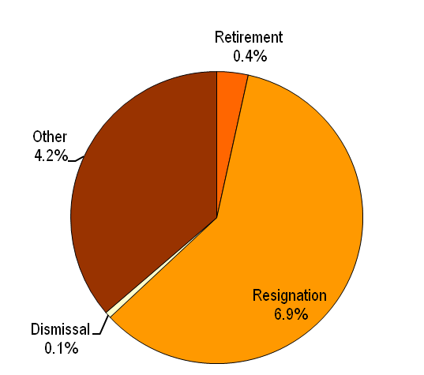
ULTIMATE OUTCOMES
Employees are committed to the work they do and the goals of the organization
Successful, productive employees are retained
The state has the workforce breadth and depth needed for present and future success
Performance Measures
Employee survey ratings on “commitment” questions
Turnover rates and types
Turnover rate: key occupational categories
Workforce diversity profile
Retention measure (TBD)
Washington Military Department
Turnover Rates
Total % Turnover (leaving state)
Time Period: 07/2006 through 06/2007
Analysis:
The graph does not represent movement to another agency as this information is currently not available in HRMS/BW.
The Department monitors the number of permanent state employees leaving on a quarterly basis through our agency GMAP presentations. We have set a goal to maintain a 6% or less turnover rate. The turnover rate reported at GMAP sessions for the last year were:
  QTR 1 = 3%
  QTR 2 = 4%
  QTR 3 = 3%
  QTR 4 = 4%
Department began conducting exit interviews in September 2007
Action Steps:
Continue to monitor turnover data at a division level on a quarterly basis to identify trends and develop action plans if necessary.
Analyze exit interview data.
Total Turnover Actions: 32
Total % Turnover: 12.1%
Note: Movement to another agency is currently not available in HRMS/BW
Data as of June 30, 2007
Source: Business Warehouse

Slide 23
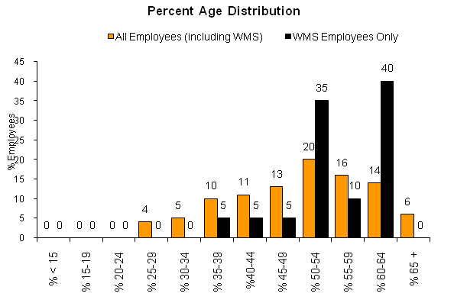
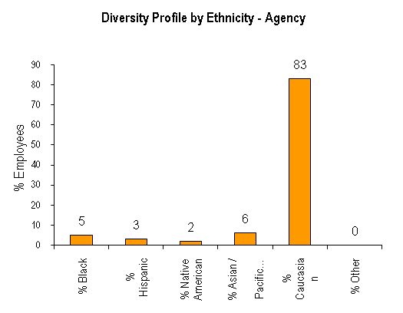
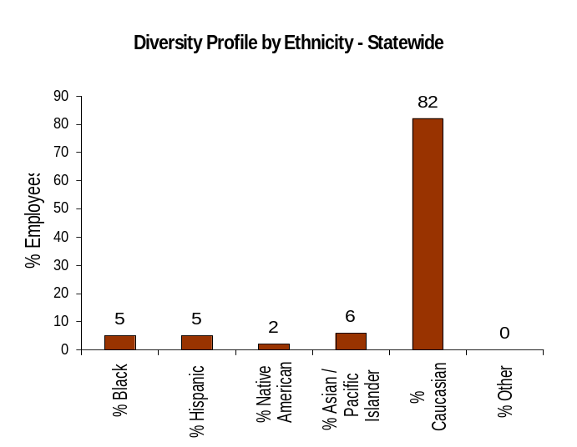
ULTIMATE OUTCOMES
Employees are committed to the work they do and the goals of the organization
Successful, productive employees are retained
The state has the workforce breadth and depth needed for present and future success
Performance Measures
Employee survey ratings on “commitment” questions
Turnover rates and types
Turnover rate: key occupational categories
Workforce diversity profile
Retention measure (TBD)
Washington Military Department
Workforce Diversity Profile
Agency State
Female 31% 52%
Disabled 6% 5%
Vietnam Vet 16% 7%
Disabled Vet 6% 2%
People of color 16% 18%
Persons over 40 80% 75%
Analysis:
The Department is making progress towards meeting our diversity goals. We have made significant gains in recruiting and retaining females into our professional job group. We need to continue to focus our efforts on recruiting women and minorities.
Action Steps:
Continue the Department’s progress towards meeting our Affirmative Action goals. Continue to provide quarterly updates at agency GMAP
Continue to attend diversity and recruitment roundtable meetings.
Data as of 06/30/07. Source: HRMS BW

